Slide 1

A proof of concept for Model completion based on Source code.
Software Requirements analysis and CD validity checking.

Slide 2
objectif
An approach based on Model driven engineering principles to mine code repositories and extract knowledge in order to provide ready to use data that will serve as input for ML algorithms.
The user starts his diagram partially and enters class names.
The system returns a proposition
Compare it to existing design
User choose convenient concepts
Incremental process

Slide 3

Research Question
Is the source code sufficient ?
By only using the code are we able to learn?
The improvement is in the data source and not the algorithm used.

Slide 4


Approach
Reverse Engineering:
Eclipse plugin
Model to Text transformation
preprocessing
Learning phase
Text generation model
Association Type prediction
Implementing the Incremental process

Slide 5
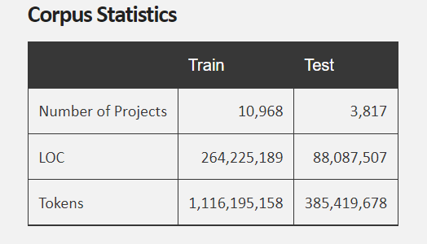
Implementation
Starting point : Java code repository.
Data: https://groups.inf.ed.ac.uk/cup/javaGithub/

Slide 6

Implementation
Reverse Engineering: extracting ecore files. Using eclipse (a plugin)
Challenge:
Doing the reverse engineering of a number of projects in one click.
Manage the huge number of these projects across the different resources.

Slide 7
Implementation
Preprocessing :
Gather obtained data into a csv file.
For each project, consider each package seperately :
A package corresponds to a new class diagram.
Data cleaning:
Consider only package that are not related to java code
Remove entries with code related concepts/ Digits ….
Prepare entries into the appropriate input : (className1, className2)…

Slide 8

Implementation
Learning phase:
Concepts generation :
GPT2. => pretrained on english dictionary.
Concepts relation prediction:
Word2vec Embedding => pretarined on wikipedia pages.
Validity checking

Slide 9
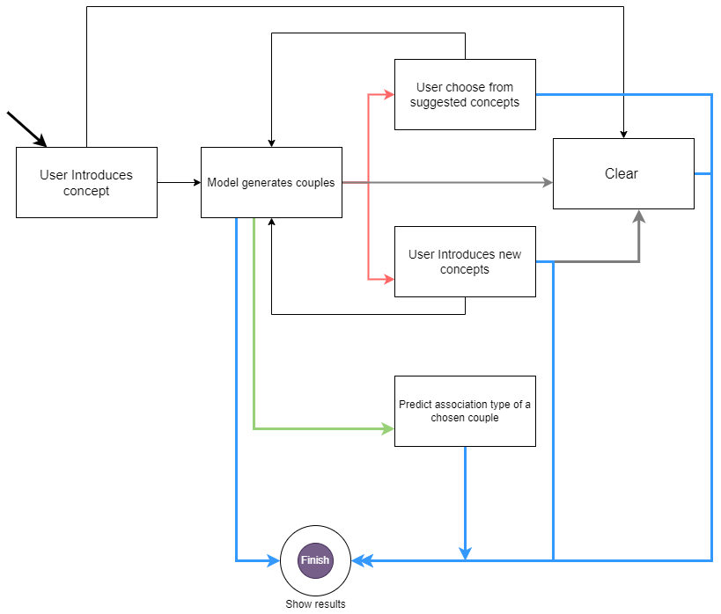
Implementation
Implementing the incremental process.

Slide 10
Improvements done after analysis
1) The system is not learning from related concepts. The data is huge, but the model is not able to learn some patterns.
A data expansion by duplicating the couples of concepts but not in the same combinations. (different sequences are obtained as entry for the models.
Duplication is done randomly (not all combinations are considered)

Slide 11
Improvements done after analysis
2) the data extracted from code lines present too much noise. (concepts related to code)
use a pretrained model on English language
Define a list of words that we judge are code related and remove the entries that contain these words.
Deleting the entries is done randomly.

Slide 12
Improvements done after analysis
3) the learned format is not exactly what we are looking for (className1, association, className2)
Perform a Constrained decoding

Slide 13
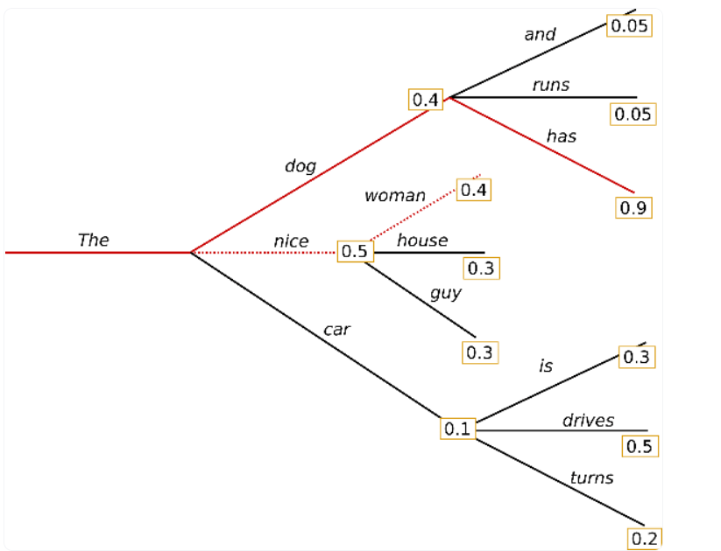
Constrained decoding: Conditional Transformer Language Model
Code: Use generate method in Model and play with the arguments.
min_length: the number of generated tokens can help stick to the pattern.
make sure the model never outputs the class as target and source.
=> Validation part
=>Code: no_repeat_ngram_size= 5
Should we add randomness ? creativity/sensibility tradeoff of the model
temperature=0.7
The use of Beam search :
=> not interesting in my case.

Slide 14
Improvements done after analysis
4) Good user experience
Python and flask to implement the features discussed previously.

Slide 15


Demo

Slide 16
To do
Retrain the models on other epochs to enhance the accuracy of the work.
Considering attributes and multipplicity.
Improove the user experience (consider diagrams )

