Slide 1
COSMOS/ORBIT Tutorials (Introduction)

Slide 2
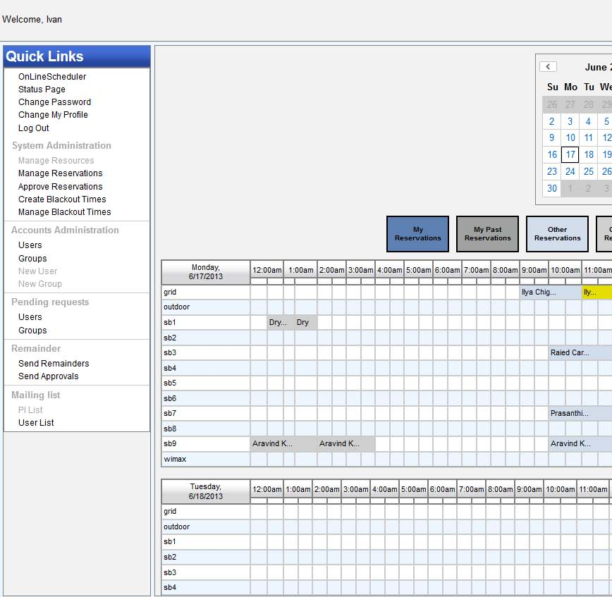
Control Panel

Slide 3
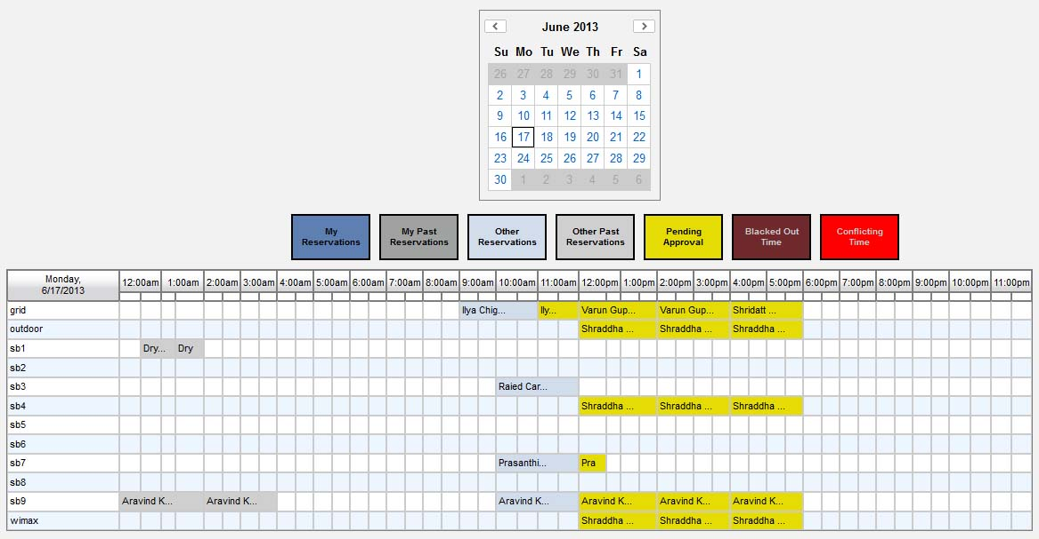
Reservation System

Slide 4
Auto-approval
Two stage algorithm:
“Early bird” – runs once a day (at 2 PM) and resolves conflicts and approves first two hours for all users for the next day
(e.g if you ask for your first slot daily slot from 10-12 the next day , at 2 PM a day earlier you will know wheather you got it).
“Just in time” – for reservations made after 2 PM or for more than 2 hours per day per domain, the slots will be automatically approved at the beginning of the slot.
Conflicts are resolved based on usage in the last three weeks
(the less you (ab)use it the more likely you are to get it ☺).
Be aware of major (conference) deadlines

Slide 5
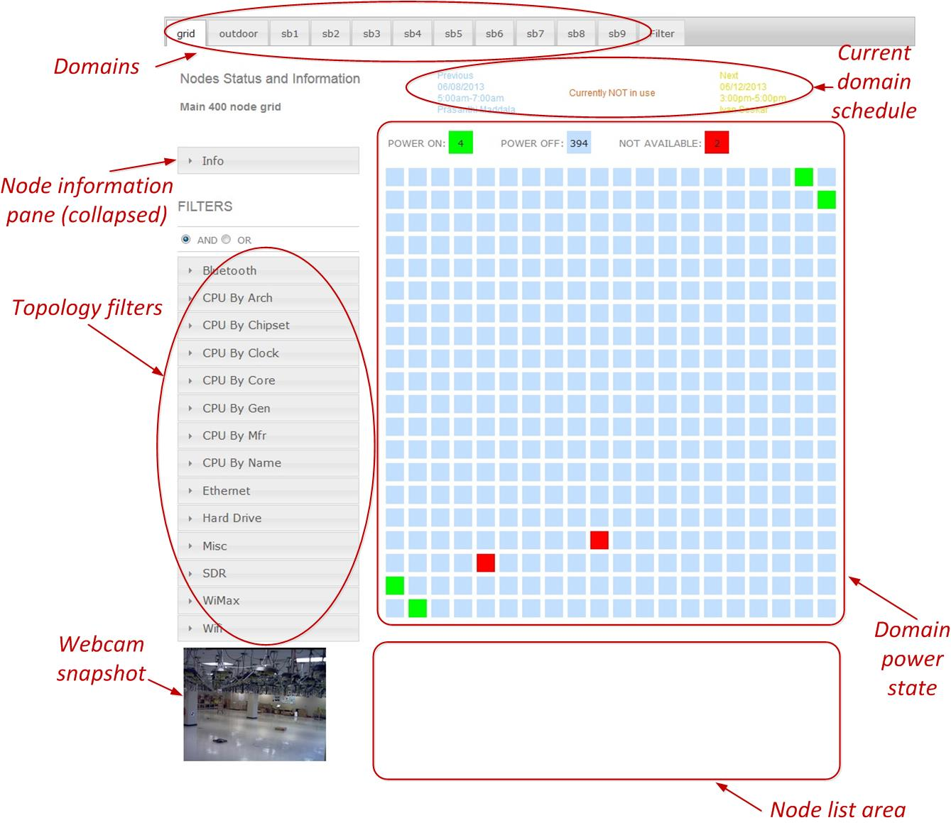
Status Page

Slide 6
First Exercise: Account Creation, Scheduler, Login (ssh) and Status Page

Slide 7
ORBIT Management Framework
OMF is a framework to use and manage experimental platforms (testbeds)
Use
support “experiment cycles” & scientific rigor
validation, accuracy & reproducibility
Manage
ease operation and maintenance tasks
optimize resource utilization inside / across testbeds
Written mostly in Ruby
Notes:
7

Slide 8
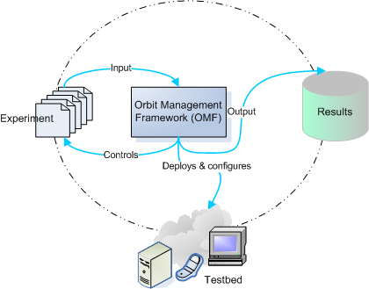
OMF Workflow
OMF Tasks:
Controlling experiments
Managing the testbed
Measuring and collecting results
Notes:
8

Slide 9
OMF - Experimenter View
Testbed(s)
Experiment
Description
Node 1
Apps A
Apps A
Apps A
OML Client
Experiment Controller
(Node Handler)
Aggregate Managers
(Grid Services)
Resource Controller
(Node Agent)
Experimental Network(s)
DB
….
Console
Server(s)
Node K
Apps A
Apps A
Apps A
Control & Management
Network
OML Client
Resource Controller
(Node Agent)
Notes:
9

Slide 10
OMF Command (aka “NodeHandler”)
omf [SUBCOMMAND] [ARGUMENT]...
Subcommand | Description
omf help | Display the help for using omf commands.
omf exec | Execute an experiment script.
omf load | Load a disk image on a given set of nodes.
omf save | Save a disk image from a given node into a file.
omf tell | Switch a given set of nodes ON/OFF.
omf stat | Returns the status of a given set of nodes

Slide 11
Second Exercise: Basic OMF commands omf {tell, stat, load, save}

Slide 12
OMF Experiment Description Language (OEDL)
Domain-specific Language based on Ruby
Two parts of experiment description (ED):
Resource requirements and configuration: specifies experimental resources
Task description: state-machine that enumerates tasks to perform

Slide 13
OEDL Commands
8 groups:
Top-level commands
Topology-specific commands
Group-specific commands
Prototype-specific commands
Application-specific commands
Execution-specific commands
Resource Paths
Testbed-specific commands

Slide 14
OEDL Top-level Commands: defProperty
defProperty(name, initialValue, description)
name: name of the property. This name will be used to refer to this property in any consecutive OEDL commands.
initialValue: the initial value of the property. This also determines the type of the property.
description: Textual description. Used in Experiment Controller's help message, as well as for the default web interface.
Usage:
defProperty('rate', 300, 'Bits per second sent from sender')
defProperty('packetSize', 1024, 'Size of packets sent from sender')

Slide 15
OEDL Top-level Commands: prop
prop.propName
prop.propName = newValue
propName: Name of experiment property.
newValue: New value to assign to the property.
Usage:
defProperty('rate', 300, 'Bits per second sent from sender') …
'rate' => prop.rate
…
[500, 1000, 2000].each { |newRate|
prop.rate = newRate 14
}

Slide 16
OEDL Top-level Commands: logging
debug(arg1, ...)
info(arg1, ...)
warn(arg1, ...)
error(arg1, ...)
arg1: None or more strings to be logged
Usage:
info("Starting")
debug(i, " resource(s) are up")
Note: DEBUG and INFO log normal progress and can be ignored, while WARNING and ERROR report on abnormal behavior.

Slide 17
OEDL Top-level Commands: wait
wait(time)
time: pause experiment execution for time seconds
Usage:
whenAllInstalled {
...
[500, 1000, 2000].each { |newRate|
prop.rate = newRate
wait 30
}
}

Slide 18
OEDL Topology Commands: defTopology
Used to specify topology consisting of a set of nodes and links each with certain characteristics
defTopology( name , arrayOfNodes = nil , &block = nil )
name: Name of the defined topology.
arrayOfNodes: (optional) array of resources (e.g. nodes) to include in this topology.
the list of valid definition patterns are:
[x,y]: Describes a single node at location x@y
[x1..x2, y]: Describes a set of nodes along a line starting at x1@y and ending at x2@y. For instance, [2..4, 5] defines the nodes [2,5], [3,5], [4,5].
[x, y1..y2]: Same as previous, but for the y coordinate.
[x1..x2, y1..y2]: This defines a rectangle area of nodes within the grid.
[[x1,y1], [x2,y2], [x3,y3]]: An arbitrary long list of single nodes.
block: (optional) a block of commands that can be used to build/configure this topology.

Slide 19
OEDL Topology Commands: defTopology (cont’d)
Topology Sub-Commands | Description
addNode(x,y) | Add node at location x@y to the topology.
removeNode(x,y) | Remove node at location x@y from the topology.
addLink (x, y, spec) | Adds a link between nodes x and y and configures it with the characteristics defined in the 'spec'.'spec' is a hash with the following valid keys {:rate , :per, :delay, :asymmetric}
RemoveLink (x, y) | Severs the link between nodes x and y.
size() | Return the number of nodes in this topology.
getNode(index) | Return the node at the position index in this topology. Return nil if index is greater than the number of nodes in the topology.
getFirstNode() | Return the node at the 1st position in this topology.
getLastNode() | Return the node at the last position in this topology.
getRandomNode() | Return a random node from this topology.
getUniqueRandomNode() | Return a unique random node from this topology. When all the available nodes in this topology have been drawn, this method will return nil and output a warning message to the console.
eachNode(&block) | Execute the commands in block on each node within this topology.
setStrict() | Set the strict flag for this topology. By default, the strict flag is NOT set for a topology.
unsetStrict() | Clear the "strict" flag. By default, the strict flag is NOT set for a topology.
hasNode(x, y) | Return true if the node at location x@y is part of this topology, return false otherwise.

Slide 20
OEDL Topology Commands: defTopology (cont’d)
defTopology('test:topo:circle') { |t|
nodeNum = 8
xCenter = 10
yCenter = 10
radius = nodeNum
# use simple 4-way algorithm to pick the nodes
r2 = radius * radius
t.addNode(xCenter, yCenter + radius)
t.addNode(xCenter, yCenter - radius)
(1..radius).each { |x|
y = (Math.sqrt(r2 - x*x) + 0.5).to_i
t.addNode(xCenter + x, yCenter + y)
t.addNode(xCenter + x, yCenter - y)
t.addNode(xCenter - x, yCenter + y)
t.addNode(xCenter - x, yCenter - y)
}
}

Slide 21
OEDL Group Commands: defGroup
defGroup( groupName, selector, &block = nil )
groupName: name of the defined set of resources
selector: selects the resources to be contained in this set. Group selector can be also defined with topology URI (i.e. set of nodes that form the topology)
block: instructions for all resources in the group
Usage:
defGroup('sender1', [1, 1]) # set contains 1 resource
defGroup('sender2', [2, 1..8]) # set contains 8 resources [2,1], [2,2], ... [2,8]
defGroup('sender', ['sender1', 'sender2', [3, 1..8]]) {|node|
node.prototype("test:proto:sender", {
'destinationHost' => '192.168.1.1',
…
}
node.net.w0.mode = "master" #802.11 Master Mode
}

Slide 22
OEDL Group Commands: defGroup (cont’d)
addApplication | Install an application on a node
exec | Execute a command on all nodes in this group.
image | Check whether a node boots in the required image. (not available in version 4.4 of the NH)
netmask | This is the network mask resource path.
onNodeUp | Execute a block of commands when a node is up.
pxeImage(...) | Instructs a resource to boot from a network PXE image (recommended for expert users only).

Slide 23
OEDL Group Commands: group and allGroups
group(groupSelector).command() group(groupSelector).resource_path = value group(groupSelector).resource_path {...}
groupSelector: set of resources to use.
command: command to run for that set.
resource_path: is the parameter to be set
value: is the value to assign to the resource path parameter
Usage:
group('sender1').startApplications
group(['s1', 'r1']).net.w0.essid = "orbit"
allGroups.net.w0 { |w|
w.essid = "orbit“
}

Slide 24
Resource Paths
A resource path allows the access and the value assignment of a specific configuration parameter of a resource
Can be used in any section of the ED.
Follow a hierarchical organization:
<resource_selector>.<hierarchical_path>
allGroups.net.w0.type = g
Set it to 802.11g
Network
parameter
Type attribute
Set of all nodes defined
in the ED are the resource
Of the first
wireless device

Slide 25
net - network resource path
{e0, e1} Ethernet interface
arp = true|false En/disable ARP
forward = true|false Enable forwarding
ip = address/netmask IP address of interface
up = true|false En/disable interface
{w0, w1} Wireless interface
All the above
channel (intel only) = 1..11; 36, 40, 44, 48, 52, 56, 60, 64, 149, 153, 157, 161
frequency (intel only) = 2.412..2.462GHz (5 Mhz steps); 5.18GHz (20Mhz steps)
essid = arbitrary string
mode = master|managed|monitor, ad-hoc (intel only)
rts (atheros only) = packetSizeThreshold [bytes]
rate (intel only) = 1, 5, 11; 6, 9, 12, 18, 24, 36, 48, 54
tx_power = -12..15 dBm (intel), 0..20 dBm (atheros)
type = a/b/g

Slide 26
hello-world-wireless.rb
defProperty('res1', 'node1-1.grid.orbit-lab.org', "ID of sender node")
defProperty('res2', 'node1-2.grid.orbit-lab.org', "ID of receiver node")
defProperty('duration', 60, "Duration of the experiment")
defGroup('Sender', property.res1) do |node|
node.addApplication("test:app:otg2") do |app|
app.setProperty('udp:local_host', '192.168.0.2')
app.setProperty('udp:dst_host', '192.168.0.3')
app.setProperty('udp:dst_port', 3000)
app.measure('udp_out', :samples => 1)
end
node.net.w0.mode = "adhoc"
node.net.w0.type = 'g'
node.net.w0.channel = "6"
node.net.w0.essid = "helloworld"
node.net.w0.ip = "192.168.0.2"
end
defGroup('Receiver', property.res2) do |node|
node.addApplication("test:app:otr2") do |app|
app.setProperty('udp:local_host', '192.168.0.3')
app.setProperty('udp:local_port', 3000)
app.measure('udp_in', :samples => 1)
end
node.net.w0.mode = "adhoc"
node.net.w0.type = 'g'
node.net.w0.channel = "6"
node.net.w0.essid = "helloworld"
node.net.w0.ip = "192.168.0.3"
end
onEvent(:ALL_UP_AND_INSTALLED) do |event|
info "This is my first OMF experiment"
wait 10
allGroups.startApplications
info "All my Applications are started now..."
wait property.duration
allGroups.stopApplications
info "All my Applications are stopped now."
Experiment.done
end

Slide 27
COSMOS Summary
Focus on ultra high bandwidth, low latency, edge cloud
Open platform (building on ORBIT) integrating mmWave, SDR, and optical x-haul
1 sq mile densely populated area in West Harlem
Local community outreach
Research community:
Develop future experiments, provide input
(short term) get involved in the educational outreach
More information: http://advancedwireless.org http://www.orbit-lab.org http://www.cosmos-lab.org
http://omf.orbit-lab.org http://oml-doc.orbit-lab.org

