Slide 1
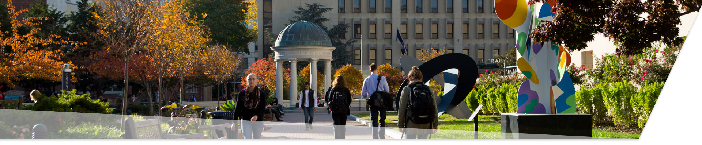

Welcome to the NSF MERIF Education Workshop
George Washington University
May 29-30, 2019

Slide 2




MERIF Education Workshop Organizers
Larry Landweber,
Ibrahim Matta,
Violet Syrotiuk,
Tim Wood,
We are here to help.

Slide 3





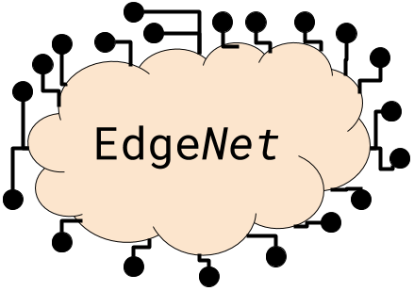
What is MERIF?
MERIF is the Midscale Experimental Research Infrastructure Forum
The NSF research infrastructure projects include:
And also:

Slide 4

Goal of the MERIF Education Workshop
The goal of this workshop is to give you tools to use these infrastructure projects in courses that you develop!
We hope to follow up with you in a year to understand what you have done.
We have to write a report to NSF, right!?

Slide 5
Overview of the Workshop: Day 1 Morning
08:15-08:30, Welcome from NSF, Deep Medhi
08:30-09:00, GENI: A Networked Infrastructure for At-Scale Experiments
Zongming Fei, University of Kentucky
09:00-09:30, CloudLab: Flexible, Scientific Infrastructure for Research on the Future of Cloud Computing
Dmitry Duplyakin, University of Utah
09:30-10:00, COSMOS: An Open Programmable City Scale Testbed for Evaluation of Edge-Cloud Enhanced Future Wireless Systems,
Michael Sherman, Rutgers University
10:00-10:30, Coffee Break

Slide 6
Overview of the Workshop: Day 1 Morning
10:30-11:00, Edge-Net.org,
Rick McGeer, US-Ignite
11:00-11:30, Chameleon: Cloud on Cloud
Kate Keahey, University of Chicago and Argonne National Lab
11:30-12:00, POWDER and Wireless Networking Experimentation
Gary Wong, University of Utah
12:00-13:30, Lunch

Slide 7
Overview of the Workshop: Day 1 Afternoon
Parallel tutorial sessions (upstairs):
13:30-15:00
15:00-15:30, Coffee break
15:30-17:00
Session #1: CloudLab in SEH 1300
Session #2: GENI in SEH 1400
Session #3: COSMOS in SEH 1450
Dinner on your own

Slide 8
Overview of the Workshop: Day 2 Morning
Parallel tutorial sessions:
08:30-10:00
10:00-10:30, Coffee break
10:30-12:00
Session #1: Chameleon in SEH 1300
Session #2: POWDER-RENEW in SEH 1400
Session #3: Edge-Net in SEH 1450
Boxed lunch

Slide 9
GWU Facilities and Wireless Info
Wi-Fi network: GWConnect or Eduroam
Account should have been created, or you can set up a new guest account
B1 lower level: Coffee breaks, lunches
Main level: Tutorial classrooms
Restrooms: Around the corner to the right when facing elevators

Slide 10
Thank you, and enjoy the workshop!
And in case we didn’t mention it, many THANKS to our sponsor!

