Slide 1
Introduction to the
Enterprise Library

Slide 2
Sounds familiar?
Writing a component to encapsulate data access
Building a component that allows you to log errors to different sources
Building framework/infrastructure components to generally simplify app development
Searching on the internet thinking
  Most applications need something like this
  People must have written hundreds of things like this
  I wish I could find a solution for this that I could reuse
…wishing Microsoft had done some of this for you?

Slide 3
Agenda
In this session I will
  Introduce Enterprise Library
  Examine each of the “blocks” in Enterprise Library
So that you will
  Understand what Enterprise Library offers
  Understand what problems each block solves
  Know when to use Enterprise Library

Slide 4


Application Blocks
“Helpers”
Classes which “help” you to do something but don’t impose an architecture
Examples
  Data Access
  Exception Management
  Configuration
“Mini Frameworks”
Classes which help implement a design for a specific area of an application
Examples
  User Interface Process
  Async Invocation Block
  Offline Application Block

Slide 5
Application Block Feedback
Make blocks consistent
Make blocks work well together
Minimize dependencies
  On other blocks
  On infrastructure
Make it easier to configure blocks
Make evaluation and understanding of blocks easier
Make using blocks easier

Slide 6
Enterprise Library Philosophy
Consistency
  Application blocks should feature consistent design patterns and implementation approaches.
Extensibility
  Application blocks must include defined extensibility points that allow developers to customize the behavior of the application blocks by adding in their own code.
Ease of Use
  Application blocks must be easy to use and should
  Leverage a graphical configuration tool
  Provide a simple installation procedure
  Include clear complete documentation and samples
Integration
  Application blocks should be designed to work well together and tested to make sure that they do. But it should also be possible to use the application blocks individually

Slide 7
Enterprise Library
Enterprise Library is…
A library of application blocks which solve common challenges
A set of helper classes which work in any architectural style
Architectural guidance embodied in code which ships with full source allowing you to modify and extend
Available as a free download
Enterprise Library is not…
A part of the .NET Framework
An application framework that imposes an architectural style
A Microsoft product with support, compatibility and localization
For sale

Slide 8
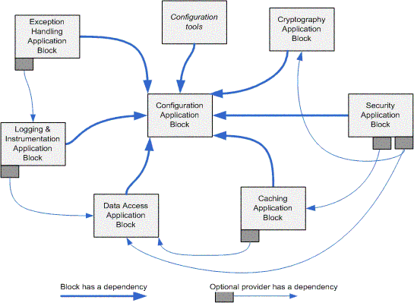
Enterprise Library 1.0

Slide 9
Data Access Application Block (DAAB)
Data Access Application Block provides access to the most often used features of ADO.NET in simple-to-use classes, boosting developer productivity.

Slide 10
Data Access Block
Provides the logic to perform the most common data access tasks.
Developers only need to do the following:
1. Create the database object.
2. Supply the parameters for the command, if they are needed.
3. Call the appropriate method.
These methods are optimized for performance.
They are also portable. The DAAB works transparently with SQL Server, DB2, and Oracle databases.

Slide 11
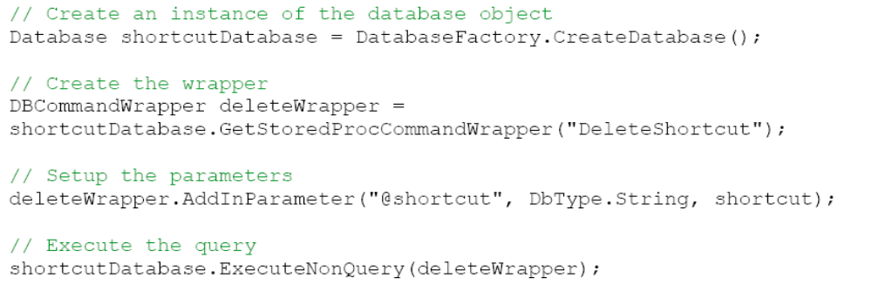
Using a DataReader to Retrieve Multiple Rows
Database db = DatabaseFactory.CreateDatabase();
using (IDataReader dataReader = db.ExecuteReader(CommandType.Text,
"Select Name, Address, City From Customers" ))
{
customerGrid.DataSource = dataReader;
customerGrid.DataBind();
}

Slide 12
Design Goals
Encapsulate the logic used to perform the most common data access tasks.
Relieve developers of the need to write duplicate code for common data access tasks.
Minimize the need for custom code.
Incorporate best practices for data access, as described in the .NET Data Access Architecture Guide.
Perform within 5 percent of ADO.NET's efficiency.
Have a small number of objects and classes.
Ensure that all the application block's functions work identically for different types of databases.
Ensure that applications written for one type of database are, in terms of data access, the same as applications written for another type of database.

Slide 13
Limited set of interfaces
ExecuteDataSet
LoadDataSet
ExecuteReader
ExecuteScalar
ExecuteNonQuery
UpdateDataSet

Slide 14
Logging & Instrumentation Block
Provides
  A way to log information about application execution
  A way to abstract generation of log content from destination
  An easy configuration interface to change what is logged where at runtime

Slide 15
Supported sinks
The event log
E-mail messages
A database
A message queue
A file
WMI
Custom – Write your own

Slide 16
Client-Distributor Architecture
Composed of two components
Client creates messages that are written out by the distributor.
Typically both client and distributor are on the same machine.
Allows for separating these two components to run on separate machines.

Slide 17
Distribution Strategies
Client sends messages to the distributor using a distribution strategy.
Two distribution strategies provided in the Logging block
  In Process
  MSMQ.
The In Process strategy is the default.
With the MSMQ strategy, the client will create a log message and send it to MSMQ. Another process waits for the message to arrive then writes it out to the appropriate sinks.

Slide 18
Exception Handling Block
Provides
A way to standardize exception handling throughout your application
A simple way to add boilerplate exception code
A way to log exception information
An easy way to adjust what is logged
A way to wrap and replace exceptions before they are propagated up the call stack

Slide 19
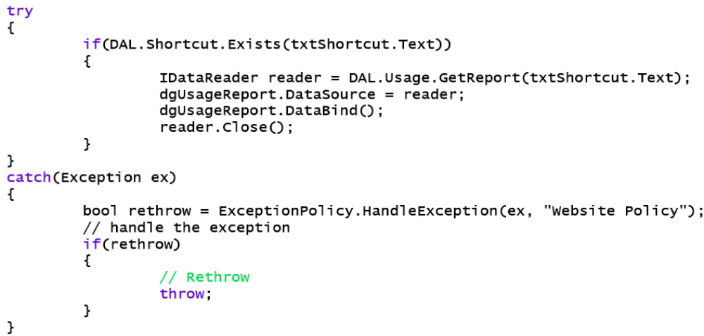
Documented Usage

Slide 20
Exception Handlers
Wrap handler. This exception handler wraps one exception around another.
Replace handler. This exception handler replaces one exception with another.
Logging handler. This exception handler formats exception information such as the message and the stack trace.
Then the logging handler gives this information to the Enterprise Library Logging and Instrumentation Application Block so that it can be published.

Slide 21
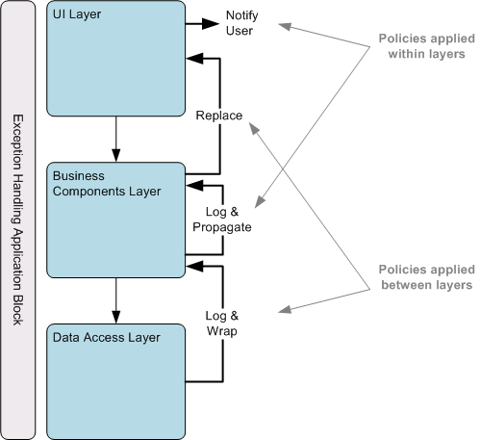
When to use the Exception Handling Block

Slide 22
Configuration Block
Provides:
A way to read AND write complex configuration data
A way to be notified of configuration data changes
A way to secure sensitive configuration information
An interface for administrators to change and validate configuration

Slide 23
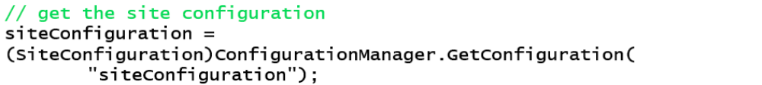
Typical Examples
Reading
Writing

