Slide 1
COMP2015
INTRODUCTION TO JAVASCRIPT AND JQUERY:
DAY 2

Slide 2
Learning Outcomes – Day 2
isNaN
if statements
Math operators
Dates and times
Arrays
while loop
for loop
Objects and methods
parseInt
indexOf
Events and handling
window.onload
COMP2015 - Intro to JS and JQuery - Lesson 2

Slide 3
isNaN: is NOT a number
var a = 5;
alert(isNaN(a)); // false
var a = “”;
alert(isNaN(a)); // false; “” is like 0
COMP2015 - Intro to JS and JQuery - Lesson 2

Slide 4
variables
<style type="text/css">
.red{ color: red }
</style>
<script type="text/javascript">
var firstName = "jason";
var lastName = 'harrison';
alert("full name is " + firstName + " " + lastName);
var currentYear = 2010;
var birthYear = 1990;
var ageInYears = currentYear - birthYear;
alert("you are " + ageInYears + " years old");
var browserType = navigator.appName;
alert(browserType);
document.write('<span class="red">\'hi!\'</span>');
</script>
COMP2015 - Intro to JS and JQuery - Lesson 2

Slide 5
Control Statement: if
Very often, a programmer writes pieces of code which should only be executed if some certain conditions apply. Real-life examples could include:
if the distance to the store is two miles or less, I will walk
if it is not snowing, I will walk to the store
if the car is broken down and I have no bus fare, I will walk to the store
if it is sunny or cloudy, I will walk to the store
if (distance <= 2.0){
walk_to_store = true;
}
if (!snowing){
walk_to_store = true;
}
if (snowing == false){
walk_to_store = true;
}
if ((car_is_broken == true) && (have_bus-fare == false)){
walk_to_store = true;
}
if ((sunny == true) || (cloudy == true)){
walk_to_store = true;
}
COMP2015 - Intro to JS and JQuery - Lesson 2

Slide 6
Logical and Relational Operators
! not
|| or
&& and
== equal
=== identical
!= not equal
!== not identical
> greater than
>= greater than/equal
< less than
<= less than/equal
COMP2015 - Intro to JS and JQuery - Lesson 2

Slide 7
If statement, logical operators
/* at the time of writing the code, we don’t know the value. Maybe the value comes from user input, or from ajax, or from a math calculation */
var salary;
if (salary > 50000.00)
{
document.write(“You make a good salary”);
}
else if (salary == 50000.00)
{
document.write(“You make 50 grand”);
}
else // it must be under 50 000
{
document.write(“You need a raise”);
}
COMP2015 - Intro to JS and JQuery - Lesson 2

Slide 8
Objects
JavaScript is an object-based language.
The interactions that JavaScript makes with the Web page are done through objects.
JavaScript has access to many built-in objects on a Web page, depending upon the browser type and version.
Each object has different properties and behaviours.
http://devguru.com is a good resource.
https://developer.mozilla.org/en/JavaScript is the official JavaScript site
COMP2015 - Intro to JS and JQuery - Lesson 2

Slide 9
Objects
Four of the most useful objects we use with JavaScript:
  navigator (browser)
  window (often implied; current window is default)
  document (the HTML page and all its contents)
  style (CSS properties)
COMP2015 - Intro to JS and JQuery - Lesson 2

Slide 10
Homework
Lab 1 is due to BCIT’s SHARE/IN server before the start of next class
Please check your @my.bcit.ca email periodically
The next lesson begins with a quiz worth 10% of your overall grade.
COMP2015 - Intro to JS and JQuery - Lesson 2

Slide 11
Quiz Topics
invented js:
netscape (and has NOTHING to do with java)
infinity browsers
standards for js:
ecma
standards for dom:
w3c
COMP2015 - Intro to JS and JQuery - Lesson 2

Slide 12
Quiz Topics
dom:
code that lets js interact with browser
Popular dom objects:
- navigator // browser
- window // often implied; current window default
- document // the html document
- style // CSS properties
COMP2015 - Intro to JS and JQuery - Lesson 2

Slide 13
Quiz Topics
history of js:
- no js
- dom 0 (document.images)
- no common standards
- simple
- awkward but widely understood by virtually all browsers
- browser wars
- netscape (document.layers)
- ie (document.all)
- w3c dom 1 (document.getElementById)
dom 2, dom 3
a single dom standard
- jQuery (toolkits / frameworks)
- DART / HTML5
COMP2015 - Intro to JS and JQuery - Lesson 2

Slide 14
Quiz Topics
<html>
<head>
<script type="text/javascript">
<!--
document.write("bad");
window.document.write("bad");
var schoolName = ‘BCIT’;
alert(schoolName); // alerts BCIT in a dialog box
alert("ok");
window.alert("ok");
COMP2015 - Intro to JS and JQuery - Lesson 2

Slide 15
Quiz Topics
var name = navigator.appName;
if(name == 'Microsoft Internet Explorer')
{
alert("you need a new browser");
}
// -->
</script>
COMP2015 - Intro to JS and JQuery - Lesson 2

Slide 16
Quiz Topics
<script type="text/javascript" src='x.js'></script>
</head>
<body>
<noscript><p>enable js!</p></noscript>
</body>
</html>
COMP2015 - Intro to JS and JQuery - Lesson 2

Slide 17
Quiz Topics
things js cannot do:
- close windows it didn't open
- execute programs on browser's machine
- connect your machine to another
- READ the history
- open invisible windows
- fill in file-upload contents
- invisibly send emails
COMP2015 - Intro to JS and JQuery - Lesson 2

Slide 18
Mathematical Operators
Mathematical operators available in JavaScript:
var x = 20;
var y = 7;
* multiplication e.g. x * y = 140
/ division e.g. x / y = 2.85714...
% modulus e.g. x % y = 6 (x and y must be integers)
+ addition e.g. x + y = 27
- subtraction e.g. x - y = 13
++ increment e.g. x++ (x equals 21 now)
-- decrement e.g. y-- (y equals 6 now)
COMP2015 - Intro to JS and JQuery - Lesson 2

Slide 19
Dates and Times
javascript can determine the date and time on the client’s (browser’s) computer
Javascript can also create dates and times
This can be used for display purposes, or to calculate spans of time
e.g.:
  “5 more days until January 1”,
  “you are 777600000 seconds old”
COMP2015 - Intro to JS and JQuery - Lesson 2

Slide 20
Dates and Times
JavaScript’s Date object and its methods are very useful for working with dates and times.
This is the technique to get the current date stored into a Date variable:
var today = new Date( );
You can reference all of the Date object methods available for the today variable. On the next slide is a list of the most common Date object methods. Here is a simple example of how to use the Date object and its methods:
  function writeDate()
  {
  var today = new Date();
  document.write(today);
  }
COMP2015 - Intro to JS and JQuery - Lesson 2

Slide 21
Date Methods
var today = new Date();
document.write("<br />DAY = " + today.getDay());
document.write("<br />MONTH = " + today.getMonth());
document.write("<br />DATE = " + today.getDate());
document.write("<br />YEAR = " + today.getFullYear());
document.write("<br />HOURS = " + today.getHours());
document.write("<br />MINUTES = " + today.getMinutes());
document.write("<br />SECONDS = " + today.getSeconds());
A full listing of Date methods can be found here
http://devguru.com/technologies/javascript/10585.asp
COMP2015 - Intro to JS and JQuery - Lesson 2

Slide 22
Date Methods
You can create your own Date objects, not dependent on the current date
var newYearsEve = new Date();
//e.g. set to December 31, 2010
newYearsEve.setFullYear(2010,11,31);
//note month count begins at 0 for January
COMP2015 - Intro to JS and JQuery - Lesson 2

Slide 23
Date Methods
The getTime() method returns an integer representing the number of milliseconds since midnight, January 1, 1970
Use this to determine the number of days between two dates…
COMP2015 - Intro to JS and JQuery - Lesson 2

Slide 24
Date Methods
Create a Date variable for the July 5, 1990. Use the getTime( ) method to determine the number of milliseconds from midnight January 01, 1970 to July 5, 1990.
Create a Date variable for the July 5, 1991. Use the getTime( ) method to determine the number of milliseconds from midnight January 01, 1970 to July 5, 1991.
Subtract the 1990 getTime( ) value from the 1991 getTime( ) value to get the number of milliseconds between the two dates.
Convert this milliseconds value to a days value.
COMP2015 - Intro to JS and JQuery - Lesson 2

Slide 25
Date Methods
var newYearsEve = new Date();
newYearsEve.setFullYear(2010,11,31);
var today = new Date();
var difference = newYearsEve.getTime() - today.getTime();
var minutes = 1000*60; //1000 millisec per sec; 60 sec/hr
var hours = minutes*60; //60 minutes per hour
var days = hours*24; //24 hours per day
document.write(difference/days+" days until new years eve!");
COMP2015 - Intro to JS and JQuery - Lesson 2

Slide 26
Self test
The 2012 Chinese new year will be on January 23rd
Write a script which calculates and displays the number of weeks we have to prepare for it.
Investigate the toFixed() function of numeric variables if you want to format the number of decimal places displayed.
COMP2015 - Intro to JS and JQuery - Lesson 2

Slide 27
var today = new Date();
var christmas = new Date();
christmas.setFullYear(2010, 11, 25);
var milliseconds = christmas - today;
var seconds = milliseconds / 1000;
var minutes = seconds / 60;
var hours = minutes / 60;
var days = Math.round(hours / 24);
document.write(days + " days until christmas");
var dayOfTheWeek = christmas.getDay();
if(dayOfTheWeek == 0){
document.write("*****Sunday");
}else if(dayOfTheWeek == 1){
document.write("*****Monday");
}else if(dayOfTheWeek == 2){
document.write("*****Tuesday");
}else if(dayOfTheWeek == 3){
document.write("*****Wednesday");
}else if(dayOfTheWeek == 4){
document.write("*****Thursday");
}else if(dayOfTheWeek == 5){
document.write("*****Friday");
}else if(dayOfTheWeek == 6){
document.write("*****Saturday");
}else{ // error. should be a number 0 – 6}
COMP2015 - Intro to JS and JQuery - Lesson 2

Slide 28
More Objects, Methods, Properties
When you create new objects such as new Date() or new Array(), that object will have properties and methods available for us to use
window.alert()
document.write()
navigator.appName
style.backgroundColor
Date.setFullYear()
Math.round()
COMP2015 - Intro to JS and JQuery - Lesson 2

Slide 29
Arrays
Arrays are special data types. They are a single variable which can contain multiple values
Use arrays to store information about a collection of related data
Eg: a list of products
Eg: a series of images for an animation
COMP2015 - Intro to JS and JQuery - Lesson 2

Slide 30
Arrays
var days = new Array();
days[0] = "sunday";
days[1] = "monday";
days[2] = "tuesday";
days[3] = "wednesday";
days[4] = "thursday";
days[5] = "friday";
days[6] = "saturday";
alert(days.length); // 7
COMP2015 - Intro to JS and JQuery - Lesson 2

Slide 31
Arrays
index value
0 | “Sonny”
1 | “Billie”
2 | “Thelonius”
3 | “Miles”
Arrays use an integer index (starting with 0 ‘zero’) to keep track of where particular values are stored
COMP2015 - Intro to JS and JQuery - Lesson 2

Slide 32
Arrays
An array is an Object.
Use the ‘new’ keyword to create an array
Use [ num ] to describe the index you wish to access
var myArray = new Array();//create array
myArray[1] = “Holiday”; //change a value
var name = myArray[2];//access a value
COMP2015 - Intro to JS and JQuery - Lesson 2

Slide 33
JSON Array Notation
days = ['sun', 'mon', 'tue', 'wed'];
alert(days.length);
alert(days[1]); // mon
COMP2015 - Intro to JS and JQuery - Lesson 2

Slide 34
Arrays, CSS properties, HTML attributes
<html><head>
<script>
books=['eloquent javascript', 'don\'t make me think']
alert(books[1])
</script>
</head>
<body>
<img src="dog.jpg">
<img src="cat.jpg">
<img src="fish.jpg">
<img src="turtle.jpg">
<img src="bird.jpg">
<script>
document.images[0].style.borderStyle='dashed'
document.images[0].style.width="50px"
document.images[1].width=50
</script>
</body>
</html>
COMP2015 - Intro to JS and JQuery - Lesson 2

Slide 35
Control structures: Loops
Loops are used to repeat sections of code. Any section of code in a script can be executed zero times (for example, skip the code because it fails an “if” condition), one time, or many times (using a loop). To repeat one or more statements 100 times, a web author could simply write out the statement(s) 100 times in a row, like this:
document.write(“Hi, my name is Jason<br>”);
document.write(“Hi, my name is Jason<br>”);
document.write(“Hi, my name is Jason<br>”);
document.write(“Hi, my name is Jason<br>”);
etc…
COMP2015 - Intro to JS and JQuery - Lesson 2

Slide 36
while
var counter = 1;
while(counter <= 1000)
{
if(counter == 300)
{
break; // kills the loop
}
document.write(counter + "<br />");
counter = counter + 1;
if(counter == 100)
{
continue;
}
document.write("this is the end of the loop<br>");
}
document.write("the <hr />end");
COMP2015 - Intro to JS and JQuery - Lesson 2

Slide 37
Arrays
var provinces = new Array();
provinces[0] = "bc";
provinces[1] = "ab";
provinces[2] = "sk";
// provinces[3]=“mb”;
provinces[4] = "on";
provinces[5] = "qc";
provinces[6] = "newfoundland";
var index = 0;
while(index < provinces.length){
if(typeof(provinces[index]) != 'undefined'){
document.write(provinces[index] + "<br />");
}
index++;
}
COMP2015 - Intro to JS and JQuery - Lesson 2

Slide 38
Control Structures: For Loop
The “for” loop repeats a section of code a number of times. The number of times to repeat is specified like this:
for ( var counter = 0;
counter < num_repetitions; counter++)
  {
  all of this code
  is repeated
  }
COMP2015 - Intro to JS and JQuery - Lesson 2

Slide 39
Control Structures: For Loop
for (var counter = 0; counter < 100; counter++)
{
document.write(“Hi, my name is Jason<br>”);
}
COMP2015 - Intro to JS and JQuery - Lesson 2

Slide 40
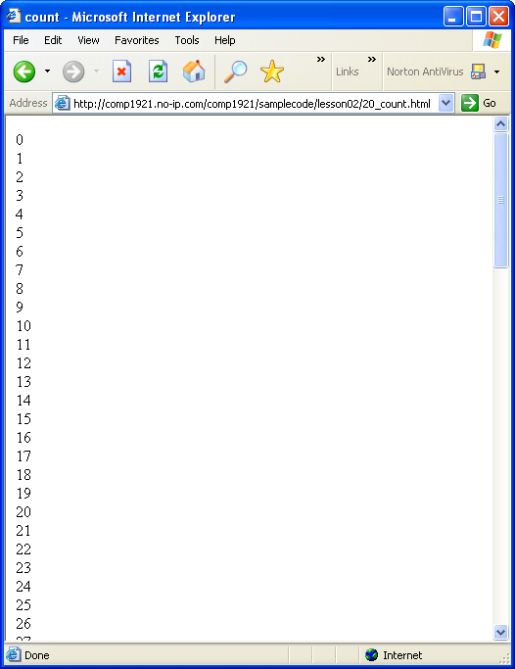
Control Structures: For Loop
We can use the same loop to print out 100 numbers:
for ( var counter = 0;
counter < 100;
counter++)
{
document.write(counter + “<br>\n”);
}
COMP2015 - Intro to JS and JQuery - Lesson 2

Slide 41
Break
At any time inside a loop, you can stop the loop and continue with the instructions after the end of the loop by using the break instruction, like this:
  for (var counter = 0; counter < 100; counter++)
  {
  document.write(counter + “<br>”);
  if (counter == 30)
  {
  break;
  }
  }
document.write("end of loop");
This example would print the numbers from 0 to 30, then STOP the loop and continue with the document.write("end of loop"); instruction
COMP2015 - Intro to JS and JQuery - Lesson 2

Slide 42
Self test
Write and test a script that has the following behaviour:
  Contains a variable named numberToBeginCountingFrom
  Assigns a large positive integer value to it.
  Prints the value of the variable, and counts down from that value by 2s, printing each time.
  If the number 13 is ever about to be printed, instead of printing 13 print ‘BOOM!’ and stop the countdown
  Stops counting down when the value reaches zero or less
  Prints ‘finished counting down’ when finished
COMP2015 - Intro to JS and JQuery - Lesson 2

Slide 43
“while” versus “for”
//these next two loops (while and for) are essentially identical
var i = 1;
while(i < 10)
{
alert(i);
i++;
}
for(var i = 1; i < 10; i++)
{
alert(i);
}
COMP2015 - Intro to JS and JQuery - Lesson 2

Slide 44
Arrays
The for loop is useful for iterating over an array
Use the length property to determine how many elements are in an array:
for(var index = 0; index < myArray.length; index++){
document.write(myArray[index]);
}
COMP2015 - Intro to JS and JQuery - Lesson 2

Slide 45
Arrays
You can put any datatype into an array:
  numbers
  booleans
  Strings
  Objects
  other arrays (multi-dimensional array)
Usually best to use the same data type for all elements of a particular array
COMP2015 - Intro to JS and JQuery - Lesson 2

Slide 46
Self test
Create an array with the names of at least five Canadian provinces.
Write a for loop that iterates through the entire array and prints both the contents and their associated index number to the screen.
COMP2015 - Intro to JS and JQuery - Lesson 2

Slide 47
Loop through Images
<html><head></head><body>
<img src="dog.jpg"/> <br/>
<img src="cat.jpg"/> <br/>
<img src="bird.jpg"/> <br/>
<img src="fish.jpg"/> <br/>
<script type="text/javascript">
for(var i = 0; i < document.images.length; i++){ // DOM 0
alert(document.images[i].src);
document.images[i].width=100;
}
</script>
</body></html>
COMP2015 - Intro to JS and JQuery - Lesson 2

Slide 48
Objects
JavaScript is an object-based language.
The interactions that JavaScript makes with the Web page are done through objects.
JavaScript has access to many built-in objects on a Web page, depending upon the browser type and version.
Each object has different properties and behaviours.
http://devguru.com is a good resource.
https://developer.mozilla.org/en/JavaScript is the official JavaScript site
COMP2015 - Intro to JS and JQuery - Lesson 2

Slide 49
OOP
Objects have properties and behaviours.
  Properties define the state of an object. accessed via the . operator
    document.bgColor = ‘blue’;
  Behaviors are the things an object can do, accessed via the . operator and () parenthesis
    document.write(‘Write this!’);
COMP2015 - Intro to JS and JQuery - Lesson 2

Slide 50
OOP
For example, the “document” is a built-in object, which can be accessed and modified like this:
<script type = "text/javascript">
<!--
alert(document.bgColor);
document.bgColor = "#00ff00";
// -->
</script>
COMP2015 - Intro to JS and JQuery - Lesson 2

Slide 51
OOP – Document properties
property description
alinkColor color of active links.
bgColor background color of the web page, set in the HTML <body> tag
cookie value of a cookie.
defaultCharset default character set
domain domain name of the document server (e.g. “http://signalflare.ca”
embeds array of document plugins
fgColor text color of the web page, set in the HTML <body> tag
fileCreatedDate date when the loaded HTML file was created
fileModifiedDate date of the most recent change to the loaded HTML file
fileSize size of the file, in bytes
fileUpdatedDate date of the most recent update to the loaded HTML file
lastModified date the file was last modified
linkColor color of links in the document, specified in the HTML <body> tag
COMP2015 - Intro to JS and JQuery - Lesson 2

Slide 52
OOP – Document properties
location full web address of the loaded HTML file
mimeType array of mime types
protocol HTTP, FTP, etc....
readyState state of the document: loaded, loading...
security security certificate status
title from the head section’s <title> tag
URL location of the current document.
vlinkColor color of visited links, as specified in the HTML <body> tag
COMP2015 - Intro to JS and JQuery - Lesson 2

Slide 53
OOP - Methods
Methods allow us to interact with objects.
Methods are used to change objects.
With this example...
document.write(“hello”);
...write is a method of the document object. It is used to write content to a new document. (However, once a page has been written, there are other ways to add content to it.)
COMP2015 - Intro to JS and JQuery - Lesson 2

Slide 54
OOP - Methods
Each type of object has a different set of methods available to it, just like each type of object has a different set of properties available to it.
For instance, a “title” has no “src”, but an image does. To use a method to change an object, specify the method like this:
document.method( )
...sometimes there are contents inside the parentheses, (brackets) and sometimes the parentheses are empty.
COMP2015 - Intro to JS and JQuery - Lesson 2

Slide 55
Self test
Write a script that uses the write() method of the document to print out the following information:
  When the document was last modified
  The title of the document
Alter the color of the text on the page using the DOM
Use the following list or find another resource
http://devguru.com/technologies/javascript
COMP2015 - Intro to JS and JQuery - Lesson 2

Slide 56
OOP
So far we have only been concentrating on the document object.
There are many other useful objects that can be referenced by JavaScript.
Anchor | Checkbox | Frame | Link | Option | Select
Applet | Date | Function | Location | Password | String
Area | Document | Hidden | Math | Radio | Submit
Array | Event | History | Navigator | RegExp | Text
Boolean | FileUpload | Image | Number | Reset | Textarea
Button | Form | Layer | Object | Screen | Window
COMP2015 - Intro to JS and JQuery - Lesson 2

Slide 57
Objects, properties, methods, events
Objects: document, window, navigator, Date, Array, Math, style, Image
Properties: src, width, length, color, backgroundColor, all the CSS properties, all the HTML attributes
Methods: document.write(), window.alert(), date.setFullYear(), etc…
Event handlers: onclick, ondblclick, onload, onmouseover, onmouseout…
COMP2015 - Intro to JS and JQuery - Lesson 2

Slide 58
Window Methods
Some javascript functions are built in, meaning you don’t need an object to use them. e.g dialog boxes
alert()
confirm()
prompt()
Actually, these are methods of the window object, but very often the “window” is assumed and not written. For instance, we could write window.alert() instead of simply alert()
COMP2015 - Intro to JS and JQuery - Lesson 2

Slide 59
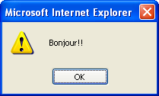
alert
<script type = "text/javascript">
<!--
alert("Bonjour!!");
// -->
</script>
Until the user presses the OK button, the script is “frozen”...when the OK button is pressed, the box disappears and the rest of the code can be run.
COMP2015 - Intro to JS and JQuery - Lesson 2

Slide 60
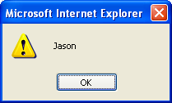
alert
You can use variables with alert dialogs:
<script type = "text/javascript">
<!--
var firstname = “Jason”;
alert(firstname); // no quotes
// -->
</script>
COMP2015 - Intro to JS and JQuery - Lesson 2

Slide 61
confirm
var userInput = confirm("Are you sure you want to learn js?");
if (userInput){
document.write(“You clicked OK”);
}
else{
document.write(“You clicked Cancel”);
}
COMP2015 - Intro to JS and JQuery - Lesson 2

Slide 62
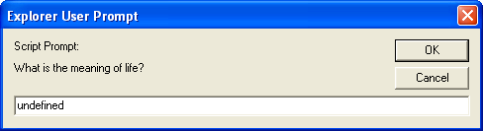
prompt
The prompt dialog allows you to get text input from your visitors
<script type = "text/javascript">
<!--
prompt("What is the meaning of life?");
// -->
</script>
COMP2015 - Intro to JS and JQuery - Lesson 2

Slide 63

prompt
You can also specify a default “answer” in the textbox.
Change the instruction from this:
prompt("What is the meaning of life?");
to this
prompt("What is the meaning of life?", “to be happy”);
COMP2015 - Intro to JS and JQuery - Lesson 2

Slide 64
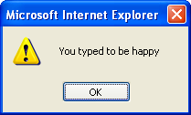
prompt
You can store the user’s prompt text in a variable like we did with the confirm dialog.
var userInput = prompt("What is the meaning of life?", “to be happy”);
alert(“You typed “ + userInput);
COMP2015 - Intro to JS and JQuery - Lesson 2

Slide 65
What did the user do?
var userInput = prompt("What is the meaning of life?", "to be happy");
if (userInput == null)
{
alert("You pressed Cancel");
}
else if(userInput == "")
{
alert("You didn’t type anything!");
}
else
{
alert("You typed " + userInput);
}
COMP2015 - Intro to JS and JQuery - Lesson 2

Slide 66
DOM
The DOM is a model that allows scripting languages to handle browser input and output and manipulate information on web pages.
Use the DOM to
  determine the state of page elements
  change particular elements on a web page
  react to events, such as mouse clicks
COMP2015 - Intro to JS and JQuery - Lesson 2

Slide 67
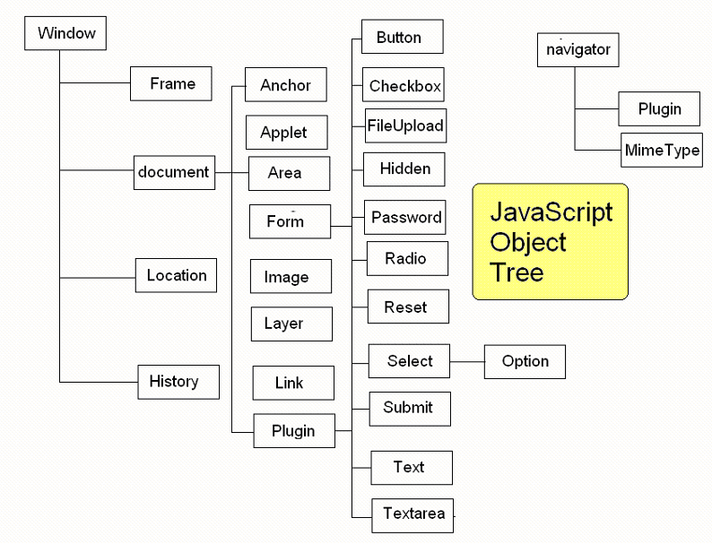
COMP2015 - Intro to JS and JQuery - Lesson 2

Slide 68
DOM support
The DOM has gone through many versions. The latest is DOM level 3.
Older browsers may not support the latest version. DOM level 0 is supported by virtually all browsers, but is not as powerful as level 3.
http://www.webdevout.net/browser-support-dom
COMP2015 - Intro to JS and JQuery - Lesson 2

Slide 69
DOM 1: document.getElementById()
getElementById() is used to query or manipulate a page element.
First set both the name and id attributes of an HTML tag, like this:
<img name="boy" id="boy" src="jaden.jpg“ />
Use getElementById() to query or manipulate a page element.
var myImage = document.getElementById(“boy”);
document.write(“The filename for this image is “ + myImage.src);
myImage.src=“joey.jpg”;
COMP2015 - Intro to JS and JQuery - Lesson 2

Slide 70
Events
JavaScript can detect and react to events.
We can use event handlers to tell the browser what should be done when an event occurs.
For instance, when the mouse rolls over an image, javascript can react (e.g. by changing the image, or the cursor).
COMP2015 - Intro to JS and JQuery - Lesson 2

Slide 71
Event Handlers
onabort
onblur
onchange
onclick
ondblclick
ondragdrop
onerror
onfocus
onkeydown
onkeypress
onkeyup
onload
onmousedown
onmousemove
onmouseout
onmouseover
onmouseup
onmove
onreset
onresize
onselect
onsubmit
onunload
COMP2015 - Intro to JS and JQuery - Lesson 2

Slide 72
Events
To respond to a document event, write an event handler.
<head><title>The main event</title></head>
<body bgcolor = “beige” onclick = “alert(‘clicked’);”>
Click me.
</body>
COMP2015 - Intro to JS and JQuery - Lesson 2

Slide 73
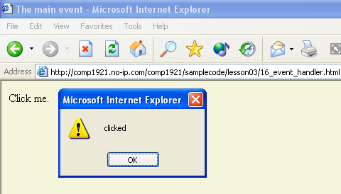
COMP2015 - Intro to JS and JQuery - Lesson 2

Slide 74
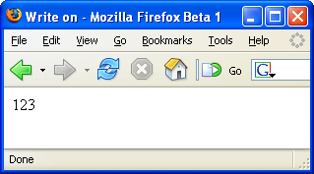
parseInt( )
To get the integer portion of a string which begins with a number, use the parseInt( ) function (instruction). There is also a parseFloat( ) function which works similarly, but with decimal numbers.
var address = “123 west 56th avenue”;
var avenue = parseInt(address);
document.write(avenue); // no quotation marks
Useful for CSS properties such as “100px”, “20%”, “3em”
COMP2015 - Intro to JS and JQuery - Lesson 2

Slide 75
parseInt( )
var cssProperty = "14px";
var numberAtFront = parseInt(cssProperty);
alert(cssProperty); // 14px
numberAtFront++; // 15
cssProperty = numberAtFront + "px";
alert(cssProperty); // 15px
COMP2015 - Intro to JS and JQuery - Lesson 2

Slide 76
indexOf( )
This is a very useful function which determines if a certain character or string exists inside another string. For example, if you ask the user for a URL, you can use indexOf to determine if “http://” or “www” or “.com” are inside the string.
The first character of a string is position zero. So a string with 8 characters such as “Harrison” is built like this:
var name = “Harrison”;
H a r r i s o n
0 1 2 3 4 5 6 7
Here is how indexOf works:
  name.indexOf(“H”) equals 0
  name.indexOf(“a”) equals 1
  name.indexOf(“r”) equals 2, the first instance of r occurs at position 2
  name.indexOf(“u”) equals -1, which means the search text is not found
  name.indexOf(“son”) equals 5, the starting position of the search text
COMP2015 - Intro to JS and JQuery - Lesson 2

Slide 77
indexOf
var browserInfo = navigator.userAgent;
document.write(browserInfo);
var index = browserInfo.indexOf("MSIE");
if(index == -1)
{
alert("This is not MSIE");
}else{
alert("This is MSIE");
}
COMP2015 - Intro to JS and JQuery - Lesson 2

Slide 78
indexOf
var string = "british columbia institute of technology";
alert(string.indexOf("col")); // 8
alert(string.indexOf("xyz")); // -1
alert(string.indexOf("briti")); // 0
alert(string.indexOf("BRITI")); // -1
// -1 means "not found"
if(navigator.appName.indexOf("Internet Explorer") != -1){
alert("you are using internet explorer");
}
COMP2015 - Intro to JS and JQuery - Lesson 2

Slide 79
window.onload
After the window finishes loading, we can set up JavaScript behaviors
window.onload=function(){}
This is an anonymous (unnamed) function.
Very common.
COMP2015 - Intro to JS and JQuery - Lesson 2

Slide 80
<html>
<head>
<script type="text/javascript">
for(var i = 0; i < document.images.length; i++)
{
document.images[i].width = 100;
}
</script>
</head>
<body>
<img src="dog.jpg"/> <br/>
<img src="cat.jpg"/> <br/>
<img src="bird.jpg"/> <br/>
<img src="fish.jpg"/> <br/>
</body>
</html>
COMP2015 - Intro to JS and JQuery - Lesson 2

Slide 81
Good Quiz Question
<html><head>
<script type="text/javascript">
window.onload=function() {
for(var i = 0; i < document.images.length; i++)
{
document.images[i].width = 100;
}
}
</script>
</head>
<body>
<img src="dog.jpg"/> <br/>
<img src="cat.jpg"/> <br/>
<img src="bird.jpg"/> <br/>
<img src="fish.jpg"/> <br/>
</body>
</html>
COMP2015 - Intro to JS and JQuery - Lesson 2

Slide 82
Last Quizzable Material
window.onload = function(){
// DOM 1
// could also getElementsByTagName("p"), etc...
var allImages = document.getElementsByTagName("img");
for(var i = 0; i < allImages.length; i++) {
allImages[i].width = 400;
}
}
COMP2015 - Intro to JS and JQuery - Lesson 2

Slide 83
Due Next Week
Lab 2
Quiz at the start of next lesson
COMP2015 - Intro to JS and JQuery - Lesson 2

