Slide 1
MINI PROJECT
MEDINEX
AI-Based Digital Health Record & Prescription Verification System
Presented by:
Aiebel Mariyam Roy ,
Merin Geo,
Noah Emmanuel Thomas.
Department of Computer Applications
SAINTGITS College of Engineering (Autonomous)

Slide 2
OVERVIEW
Abstract
MEDINEX is a role-based digital health platform with five portals. The admin approves hospitals onto the platform; hospitals add or remove their doctors and manage complaints raised against them; doctors view and edit prescriptions and view patient reports; patients view their reports, chat with an AI assistant, upload reports, and raise complaints about doctors; pharmacists dispense medicines against verified prescriptions and mark them as dispensed.
In the manual system, a single paper prescription can be reused at multiple pharmacies, leading to unwanted or unsupervised use of drugs. MEDINEX locks each prescription after it is dispensed so it cannot be reused, backed by AI-assisted verification that flags dosage or interaction issues before medicines reach the patient.
5
User roles
21
Database tables
AI
Prescription check
MEDINEX — Mini Project 2 — Review 1
2

Slide 3
SYSTEM STUDY
Existing System vs. Proposed System
Existing (Manual) System
Proposed System — MEDINEX
Paper prescriptions, easily lost or misread
No shared history between hospitals/pharmacies
Manual dosage cross-checking, error-prone
Patient complaints handled informally
Lab reports exchanged as physical printouts
Same prescription reused multiple times — unwanted, unsupervised drug use
Centralized digital health record per patient
Role-based portals: Admin, Hospital, Doctor, Patient, Pharmacist
AI-assisted prescription verification before dispensing
Structured complaint tracking with status history
Secure lab report upload & retrieval
Prescription locked after dispensing — prevents reuse & misuse of drugs
MEDINEX — Mini Project 2 — Review 1
3

Slide 4
SYSTEM STUDY
Identified Modules
A
H
D
P
P
Admin
Hospital
Doctor
Patient
Pharmacist
Approve hospitals onto the platform; overall platform oversight
Add / remove doctors, manage complaints raised against doctors
View & edit prescriptions, view patient reports
View reports, chat with AI assistant, upload reports, raise complaints about doctors
Dispense medicines against verified prescriptions & mark as dispensed
MEDINEX — Mini Project 2 — Review 1
4

Slide 5
UML DIAGRAM · 1 OF 2
Use Case Diagram
A
MEDINEX
Admin
Approve
Hospitals
View & Edit
Prescriptions
Add / Remove
Doctors
H
Hospital
D
View Health
Reports
Chat with AI
Assistant
Manage Doctor
Complaints
Doctor
P
Patient
Raise Complaint
on Doctor
Upload Lab
Report
Dispense &
Mark Medicines
P
Pharmacist
MEDINEX — Mini Project 2 — Review 1
5

Slide 6
UML DIAGRAM · 2 OF 2
System Architecture
Frontend
React + Vite + Bootstrap
Login · Register · Role Dashboards
Backend API
Node.js + Express
Auth · Admin · Hospital · Doctor · Patient · Pharmacist routes
Data & AI Layer
MySQL (medinex_db, 21 tables) · Gemini AI — prescription verification
Security: helmet, CORS, rate limiting, JWT (role-based, 15-min access token), bcrypt password hashing, OTP-based reset
MEDINEX — Mini Project 2 — Review 1
6

Slide 7
DESIGN
Database Design (medinex_db)
users
id, name, email, role, hospital_id, license_number, approval_status ...
prescriptions
id, patient_id, doctor_id, medicine_name, dosage, status ...
pharmacy_records
id, prescription_id, pharmacist_id, medicines_given, days_supplied
lab_reports
id, patient_id, file_name, file_path, uploaded_at
complaints
id, hospital_id, patient_id, doctor_name, complaint_text, status
21 tables in total, normalised to 3NF, with foreign-key relationships linking users → hospitals → prescriptions → pharmacy dispensing.
MEDINEX — Mini Project 2 — Review 1
7

Slide 8
DESIGN
UI Design
Auth
Patient Dashboard
Doctor Dashboard
Login, Register, Forgot / Reset Password
View reports, chat with AI assistant, upload reports, raise complaints
View & edit prescriptions, view patient reports
Pharmacist Dashboard
Hospital Dashboard
Admin Dashboard
Verify & dispense prescription, mark as dispensed
Add / remove doctors, manage doctor complaints
Approve hospitals, platform oversight
Wireframes designed in Figma; implemented with React components and Bootstrap 5 styling.
MEDINEX — Mini Project 2 — Review 1
8

Slide 9
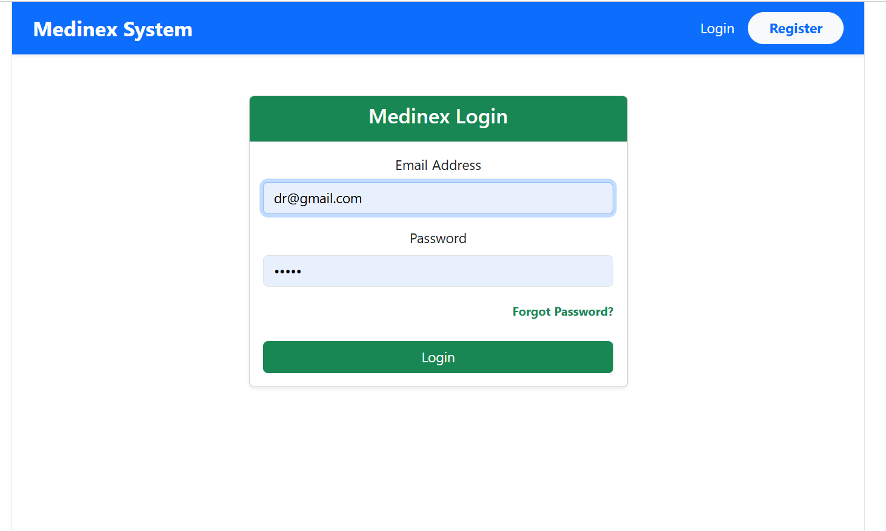
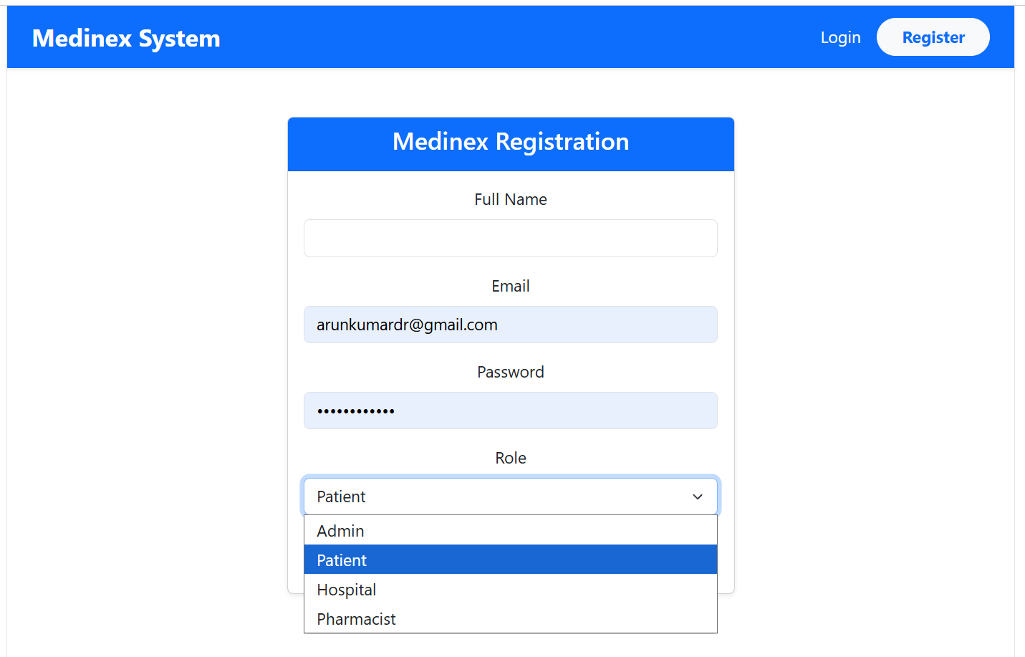
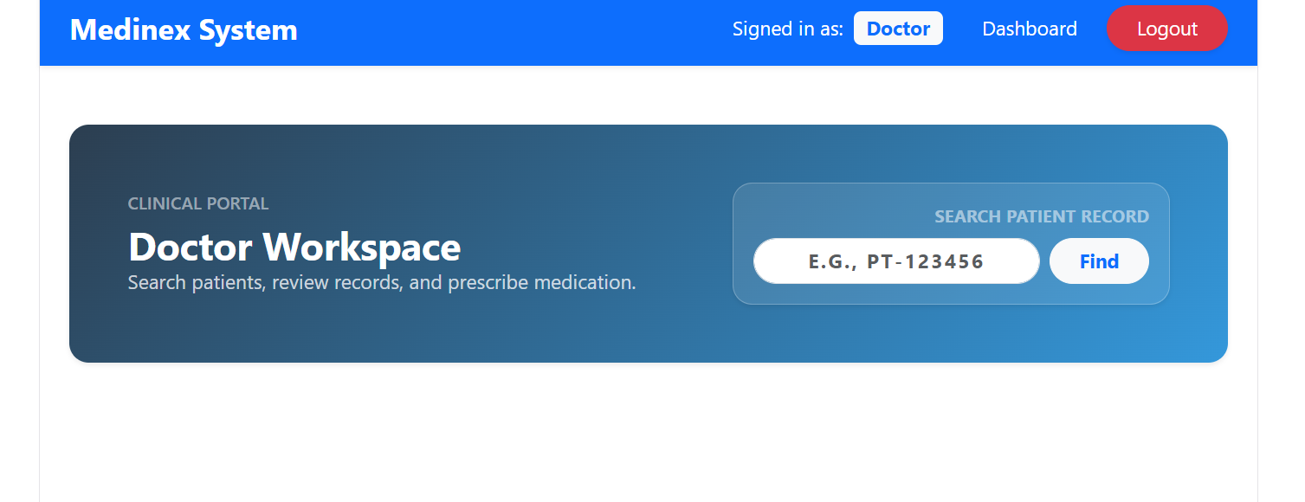
DESIGN
Live Application Screens · 1 of 2
Login
Registration
Doctor Workspace
Screens captured from the running MEDINEX application (React + Bootstrap 5).
MEDINEX — Mini Project 2 — Review 1
9

Slide 10
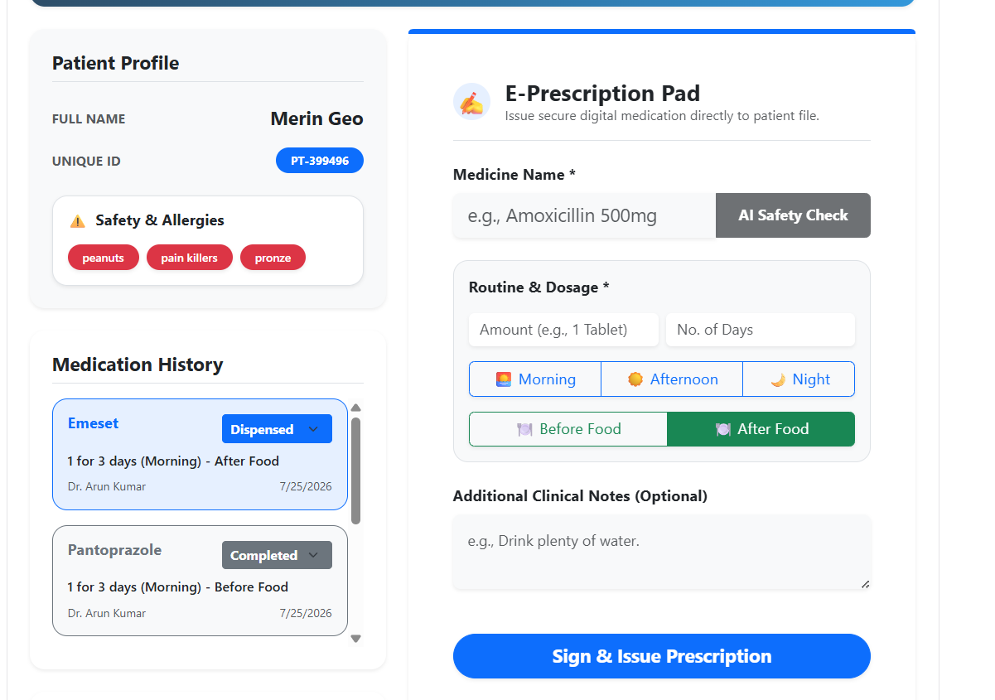
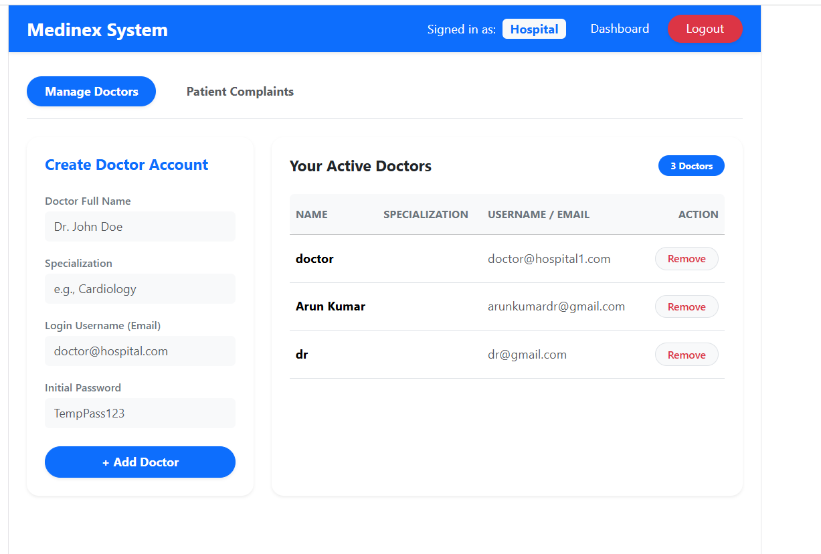
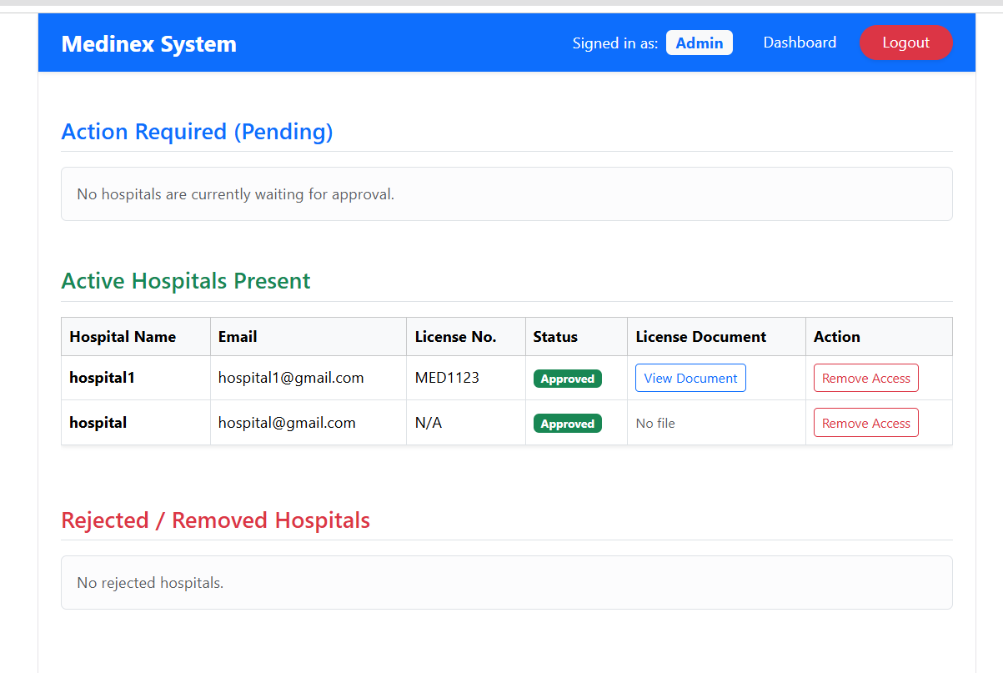
DESIGN
Live Application Screens · 2 of 2
E-Prescription Pad (AI Safety Check)
Hospital — Manage Doctors
Admin — Hospital Approvals
Screens captured from the running MEDINEX application (React + Bootstrap 5).
MEDINEX — Mini Project 2 — Review 1
10

Slide 11
IMPLEMENTATION
Technology Stack
Frontend
Backend
React (Vite), Bootstrap 5
Used for: All role dashboards, login & registration UI
Node.js, Express.js
Used for: REST APIs for all five role modules
Database
Auth & Security
MySQL (via WAMP / phpMyAdmin)
Used for: Storing users, prescriptions, reports & complaints (21 tables)
JWT, bcrypt, OTP reset, helmet, CORS, rate limiting
Used for: Securing login & protecting role-based routes
AI Integration
Tooling
Google Generative AI (Gemini) — prescription verification
Used for: Flagging dosage / interaction issues before dispensing
VS Code, Git/GitHub, REST Client for API testing
Used for: Development, version control & API testing
MEDINEX — Mini Project 2 — Review 1
11

Slide 12
PROJECT STATUS
Completion Status
~35–40% complete
Completed
Next Steps
21-table schema designed & implemented
Authentication: JWT, bcrypt, OTP reset
Admin, Hospital, Doctor, Patient, Pharmacist backend modules & routes
Prescription create → dispense workflow
Complaint tracking, lab report upload
AI (Gemini) integration started for prescription verification
UI polish across all dashboards
Complete AI verification logic & testing
Selenium test cases
Deployment / hosting
Automate the AI prescription interaction check (currently manual step)
Streamline lab report upload flow
Build a public landing page for MEDINEX
MEDINEX — Mini Project 2 — Review 1
12

