Slide 1
Bio334 – Building Maximum Likelihood Trees
Solutions to the exercises
Janko Tackmann and Lukas Malfertheiner
For remaining doubts feel free to contact us on Slack or at:
Janko.tackmann@uzh.ch or Lukas.malfertheiner@uzh.ch

Slide 2
Exercise 1 – Part 1: The grammar
Is the tree specified as rooted or unrooted?
((A,(B,(C,D))),(E,F));

Slide 3
Exercise 1 – Part 1: The grammar
Is the tree specified as rooted or unrooted?
((A,(B,(C,D))),(E,F));
-> The tree is rooted

Slide 4
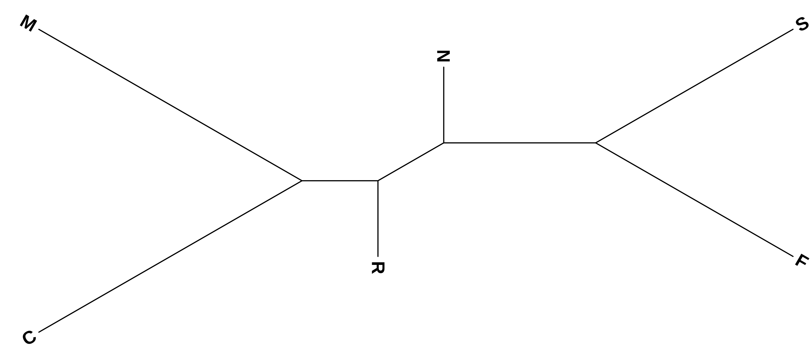
Exercise 1 – Part 2: Specifying branch length

Slide 5
Exercise 1 – Part 2: Specifying branch length
(N,(R,(C,M)),(S,F));

Slide 6
Exercise 1 – Part 2: Specifying branch length
(N:0.5,(R:0.5,(C:2,M:2):0.5):0.5,(S:1.5,F:1.5):1);

Slide 7
Exercise 1 – Part 3: Common errors in Newick representations

Slide 8
Exercise 1 – Part 3.a
(A,(E,D)),(C,(B,F));

Slide 9
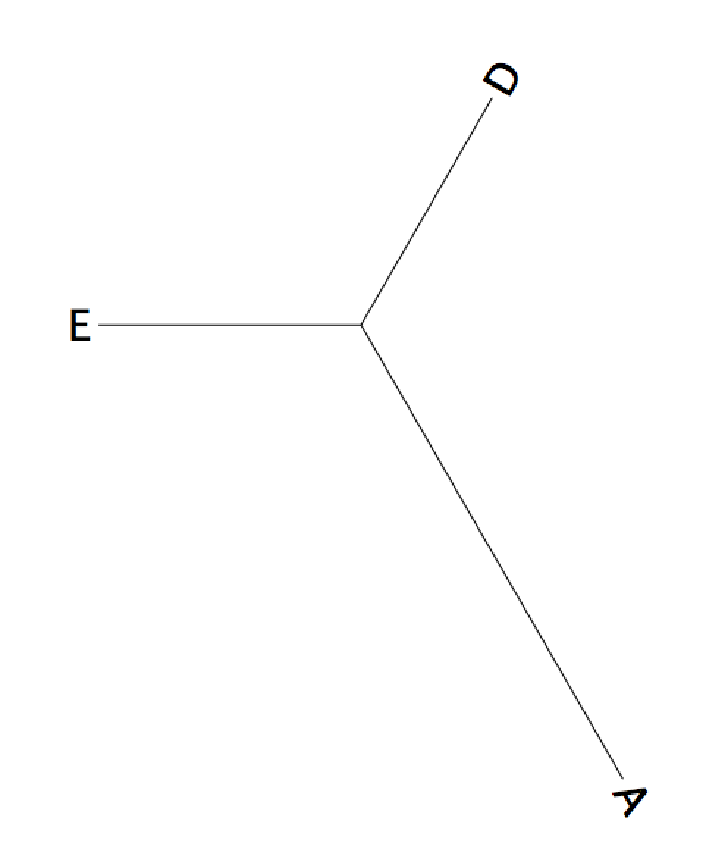
Exercise 1 – Part 3.a
(A,(E,D)),(C,(B,F));

Slide 10
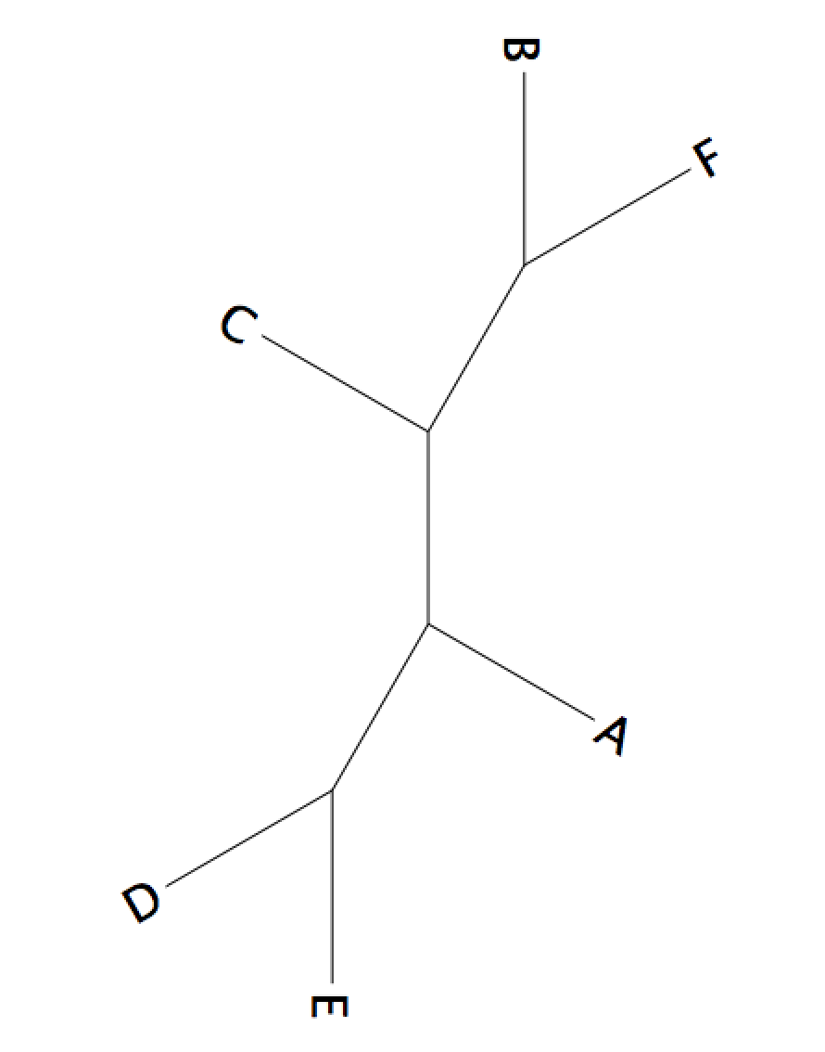
Exercise 1 – Part 3.a
(A,(E,D)),(C,(B,F));
(A,(E,D),(C,(B,F)));

Slide 11
Exercise 1 – Part 3.b
(A:1,D:6,([E:1.01,F:1.2]:1,B:2):0.21,(C:4,G:2.2):2):1);

Slide 12
Exercise 1 – Part 3.b
(A:1,D:6,([E:1.01,F:1.2]:1,B:2):0.21,(C:4,G:2.2):2):1);
Use correct parentheses
(A:1,(D:6,((E:1.01,F:1.2):1,B:2):0.21),(C:4,G:2.2):2):1);

Slide 13
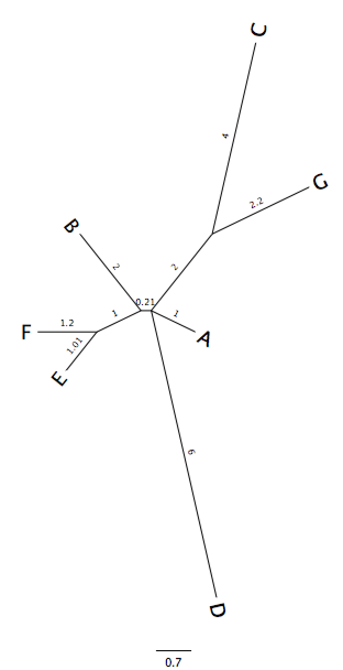
Exercise 1 – Part 3.b
(A:1,D:6,((E:1.01,F:1.2):1,B:2):0.21,(C:4,G:2.2):2):1);
Remove incorrect
branch length
(A:1,(D:6,((E:1.01,F:1.2):1,B:2):0.21),(C:4,G:2.2):2);

Slide 14
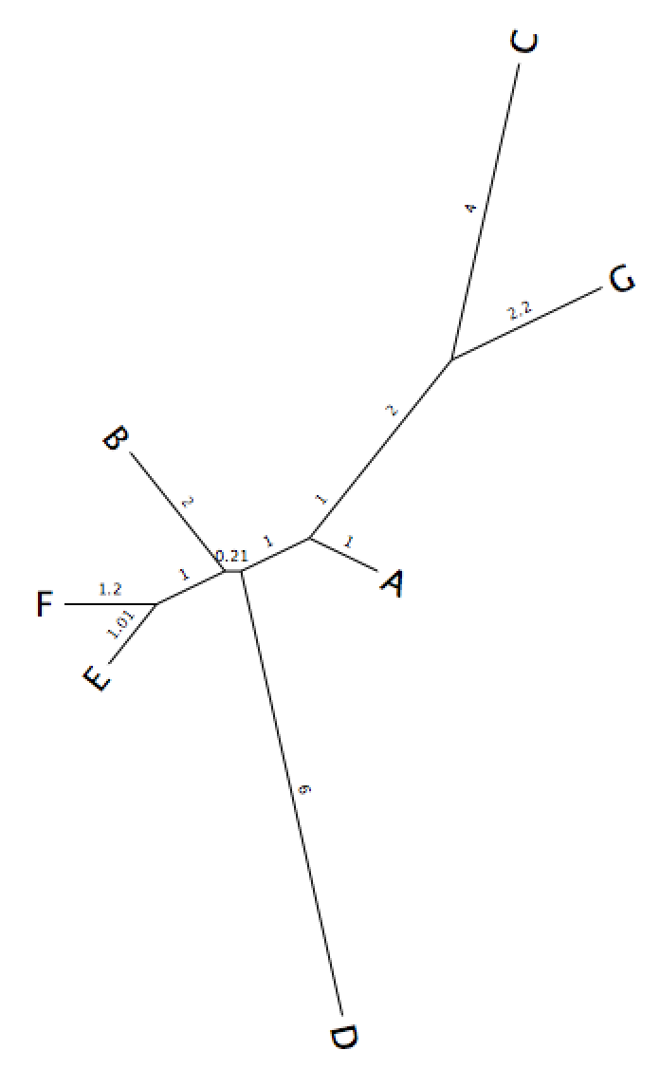
Exercise 1 – Part 3.b
(A:1,D:6,((E:1.01,F:1.2):1,B:2):0.21,(C:4,G:2.2):2);
Resolve multi-branching point
(A:1,(D:6,((E:1.01,F:1.2):1,B:2):0.21):1,(C:4,G:2.2):2);
Note: There are many ways to solve the multifurcation, this
is just one of the many.

Slide 15
Exercise 2 – Overview

Slide 16
Exercise 2 – Part 1.d
Can you identify which command line arguments are required (not-optional) for RAxML to be executed?
-s alignment_file_name
-n output_file_name_extension
-m model_of_amino_acid_substitution
-p random_seed

Slide 17
Exercise 2 – Part 2
Using RAxML on the MFS-1 dataset
raxmlHPC
-s mfs_domain_proteins_aligned_taxnames.fa
-n msf.auto.txt
-m PROTGAMMAAUTO
-p 123

Slide 18
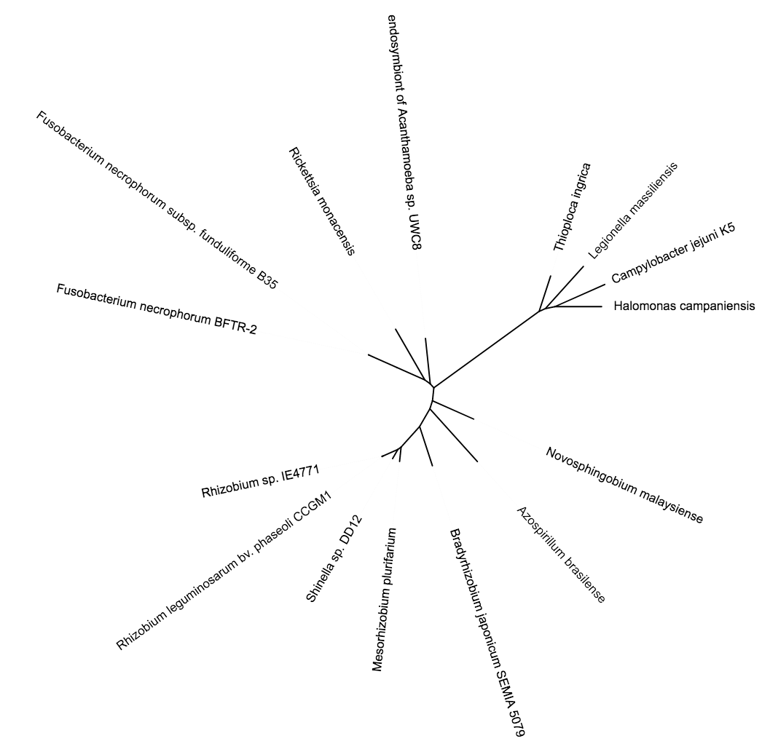
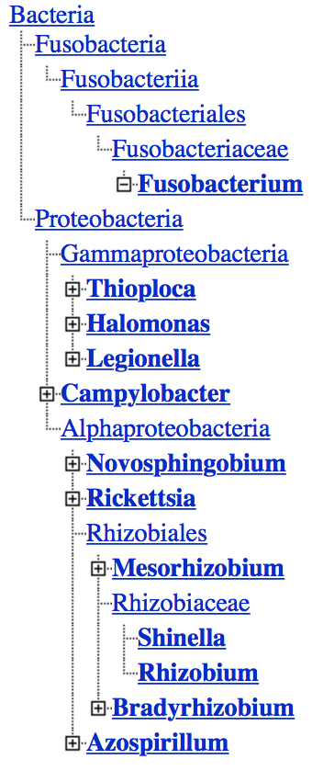
Maximum Likelihood (RAxML)
- unrooted

Slide 19
Maximum Likelihood (RAxML)
- unrooted

Slide 20
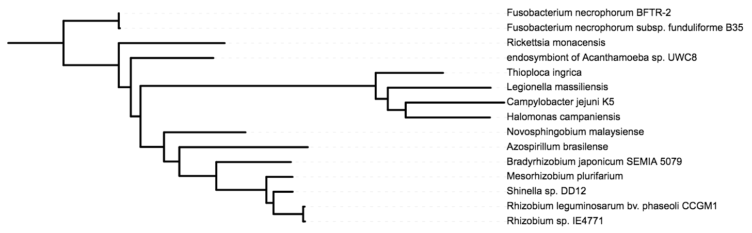
Maximum Likelihood (RAxML, rooted on Fusobacteria)

Slide 21
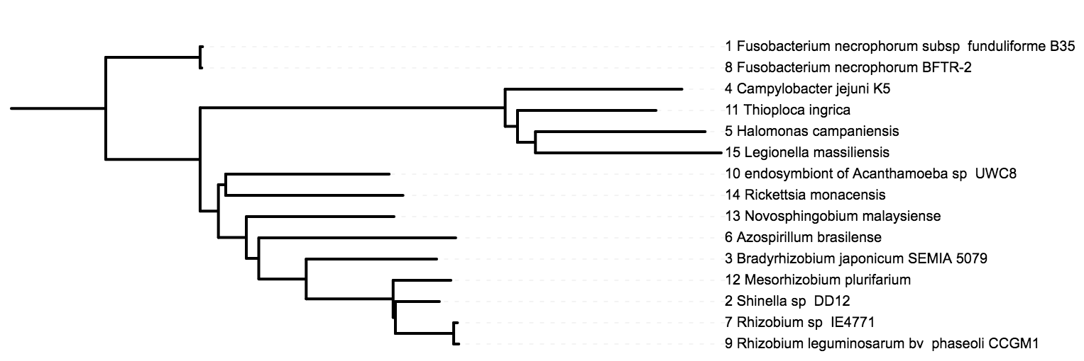
Neighbor joining (rooted on Fusobacteria)
Maximum Likelihood (RAxML, rooted on Fusobacteria)

Slide 22
Neighbor joining (rooted on Fusobacteria)
Maximum Likelihood (RAxML, rooted on Fusobacteria)

Slide 23
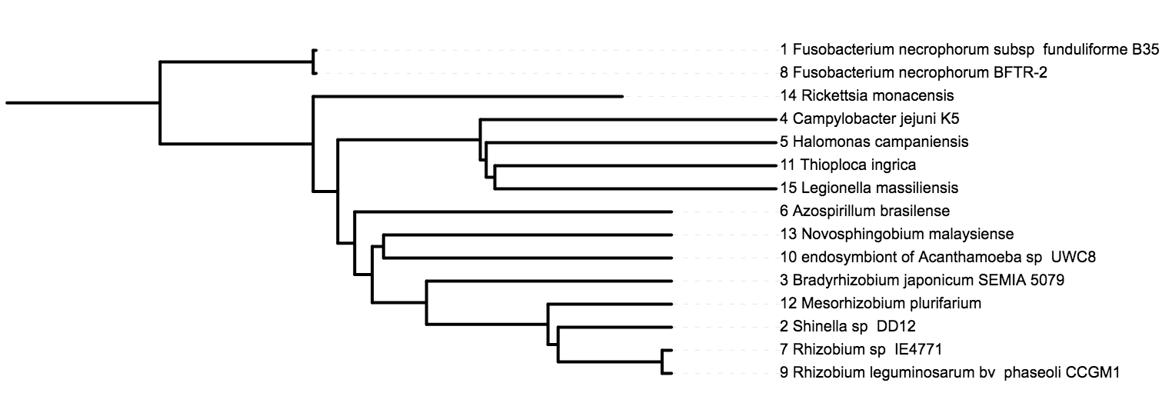
UPGMA (rooted on Fusobacteria)
Maximum Likelihood (RAxML, rooted on Fusobacteria)

Slide 24
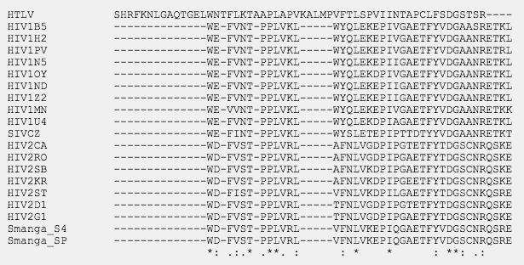
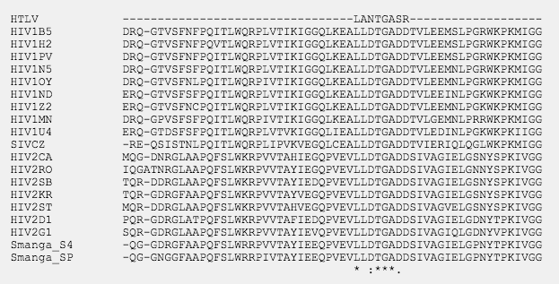
Exercise 3 – Part 1
Sequence alignment

Slide 25
Exercise 3 – Part 2
Tree reconstruction with RAxML
While the program is running, can you identify what parameters we are using?
-s
-n
-m
-f
-N
-x
-p

Slide 26
Exercise 3 – Part 2
While the program is running, can you identify what parameters we are using?
-s name of the alignment data file
-n name of the output file
-m Model of Binary (Morphological), Nucleotide, Multi-State, or Amino Acid Substitution
-f select algorithm
-N number of alternative runs on distinct starting trees
-x random seed for rapid bootstrapping
-p random number seed for the parsimony inferences

Slide 27
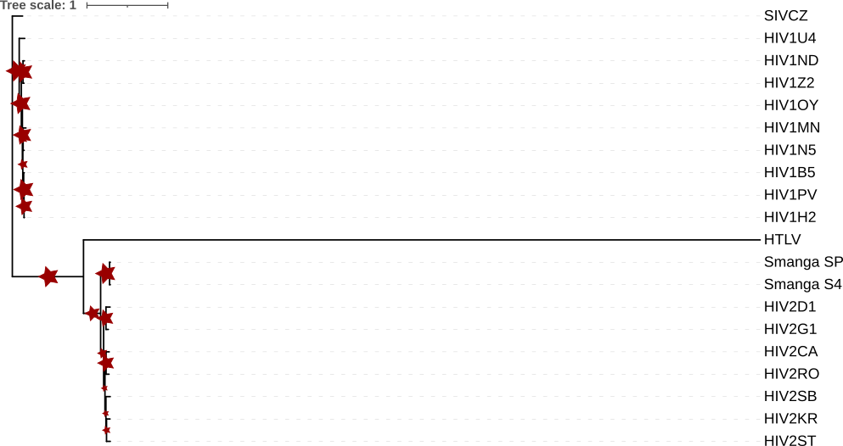
Exercise 3 – Part 3

Slide 28
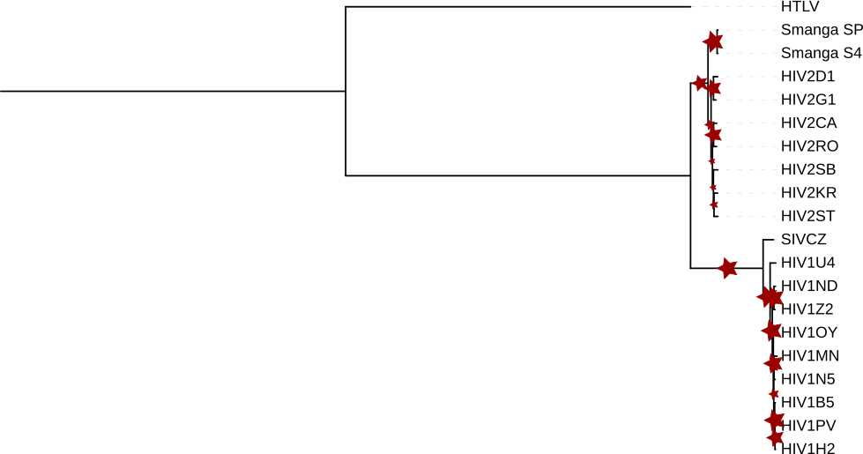
Exercise 3 – Part 4

Slide 29
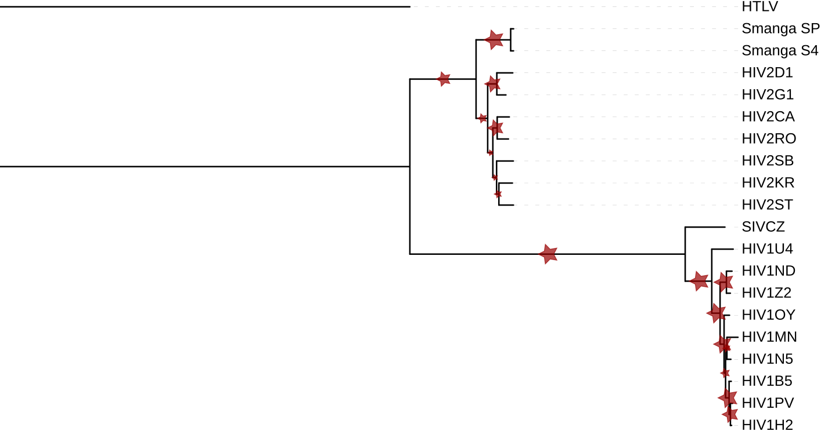
Exercise 3 – Part 4

Slide 30
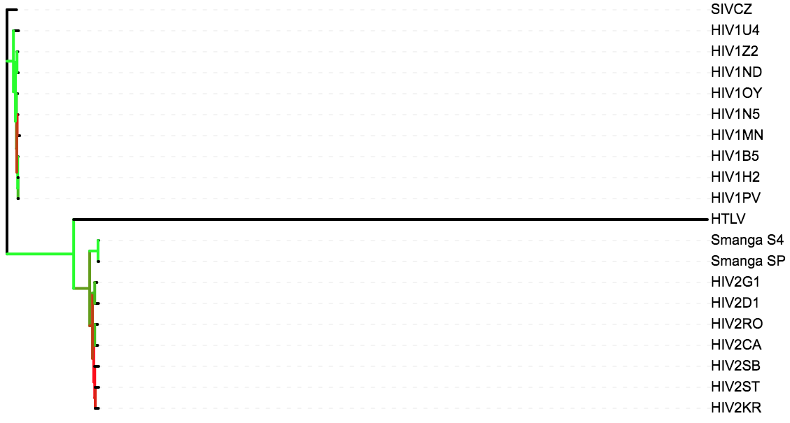
Exercise 3 – Part 3

Slide 31
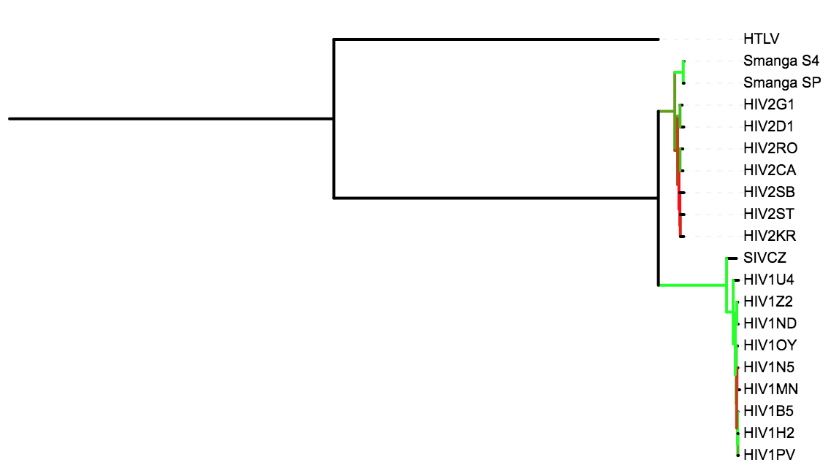
Exercise 3 – Part 4

Slide 32
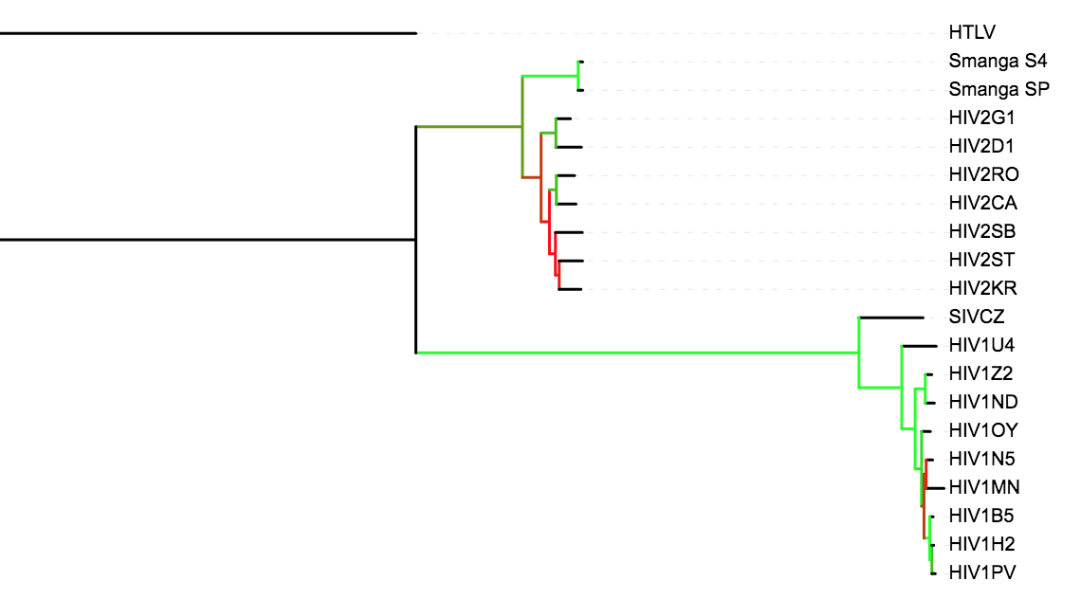
Exercise 3 – Part 4

