Slide 1
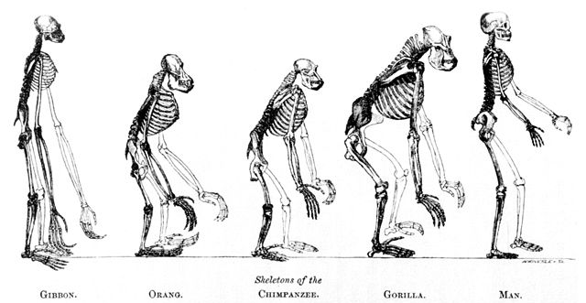
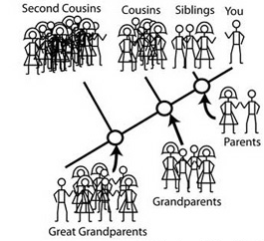
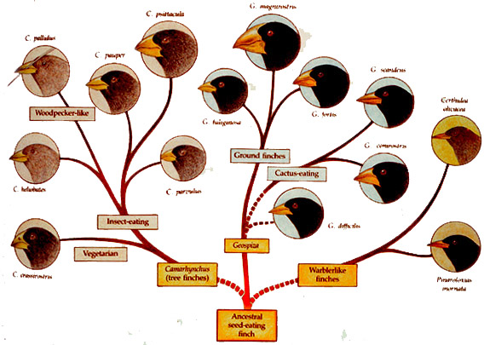
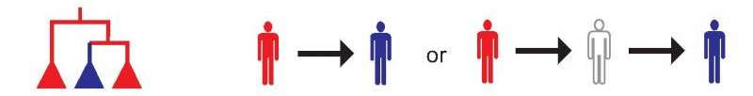
Why study Phylogenetics?
Study evolution of species
Individual relatedness
Geographic variation
Infection transmission

Slide 2
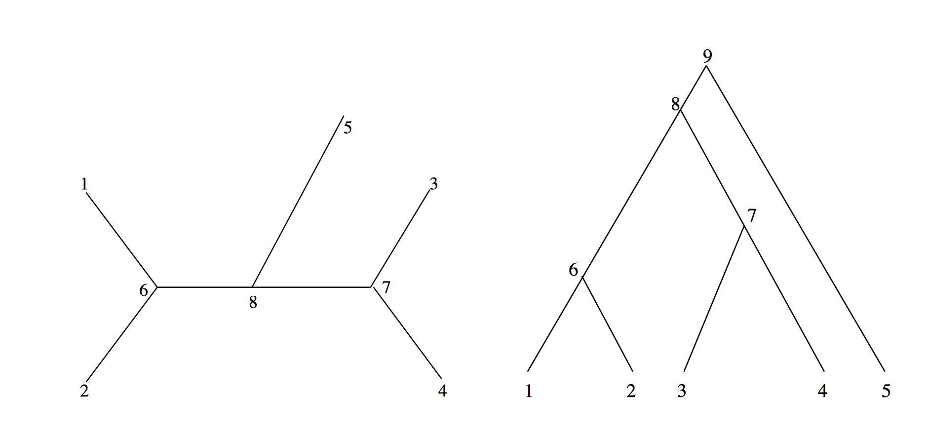
Phylogenetic Tree
Internal node
External node
Unrooted tree
Rooted tree

Slide 3
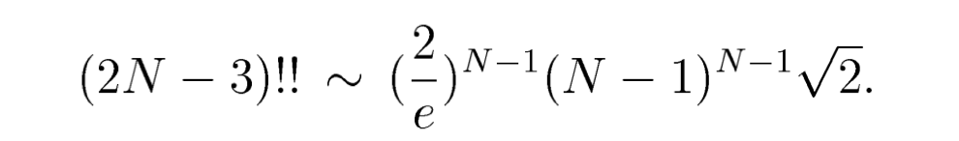
Phylogenetic Tree Topologies
N=10, roughly 2 million unrooted tree topology
N=20, 2.2 x 10²⁰ unrooted tree topology

Slide 4
Phylogenetic Reconstruction
Distance based methods – Neighbor Joining (NJ method), UPGMA …
Maximum parsimony – minimizing total number of evolutionary steps
Maximum Likelihood – based on evolutionary model, statistical models

Slide 5
Maximum Likelihood Summary
Data: alignment of sequences
Calculation: likelihood of each site in the data (alignment)
- varies with choice of the model and the initial tree
Optimization: total likelihood (product of the site likelihoods)
Result: ML tree is the tree topology that gives the highest likelihood under the given model

Slide 6
unobserved data
observed data
Pr (observed data| Tree, evolutionary model)

Slide 7
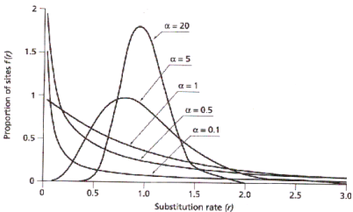
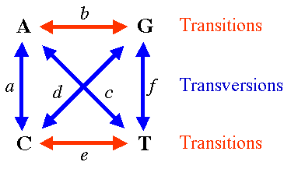
Parameterization of ML
Select an evolutionary model, describing mutation probabilities
Specify the ratio of variable to invariable sites in the sequence alignment
Estimate the heterogeneity in mutation rates across sites
0.04

Slide 8
Parameterization of ML
Choose a tree topology search algorithm
Specify a starting tree, evidence based or choose an algorithm
Select whether to optimize branch lengths, computationally expensive
Repeat this process, with different starting tress to estimate the reproducibility

