Slide 1
Practical Bioinformatics
Basic Unix
Lukas Malfertheiner lukas.malfertheiner@uzh.ch
Daniela Gaio daniela.gaio@mls.uzh.ch

Slide 2
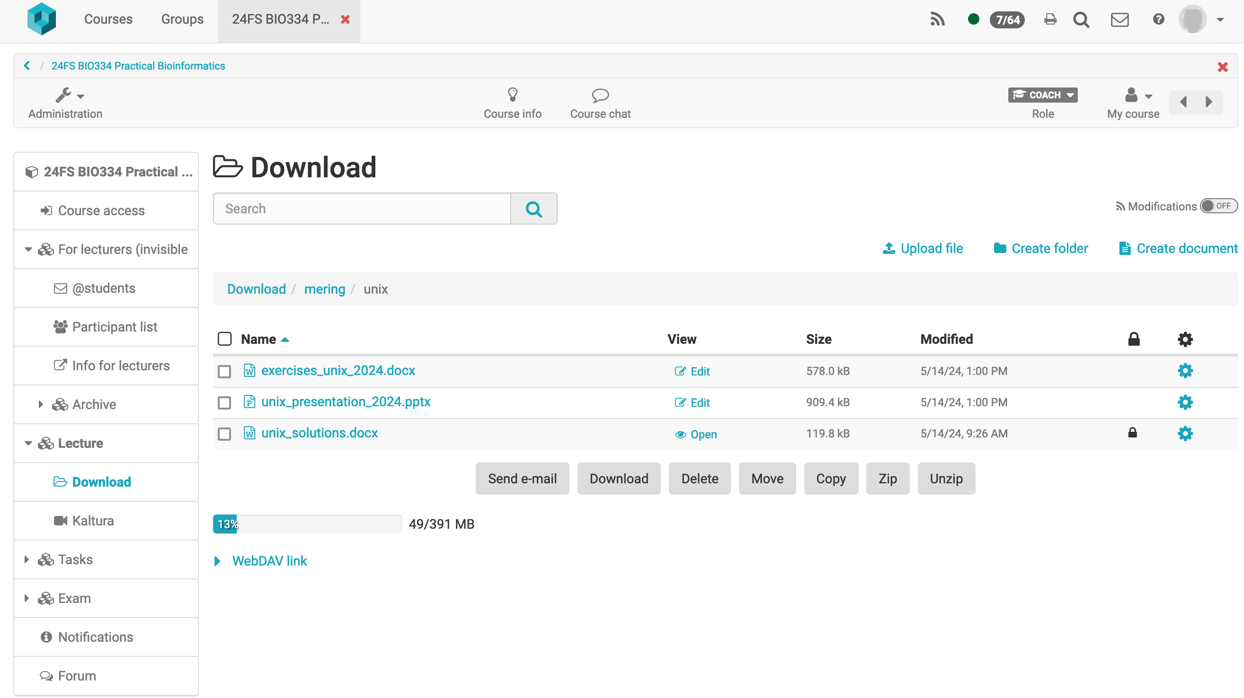
Get the presentation and exercises on OLAT

Slide 3
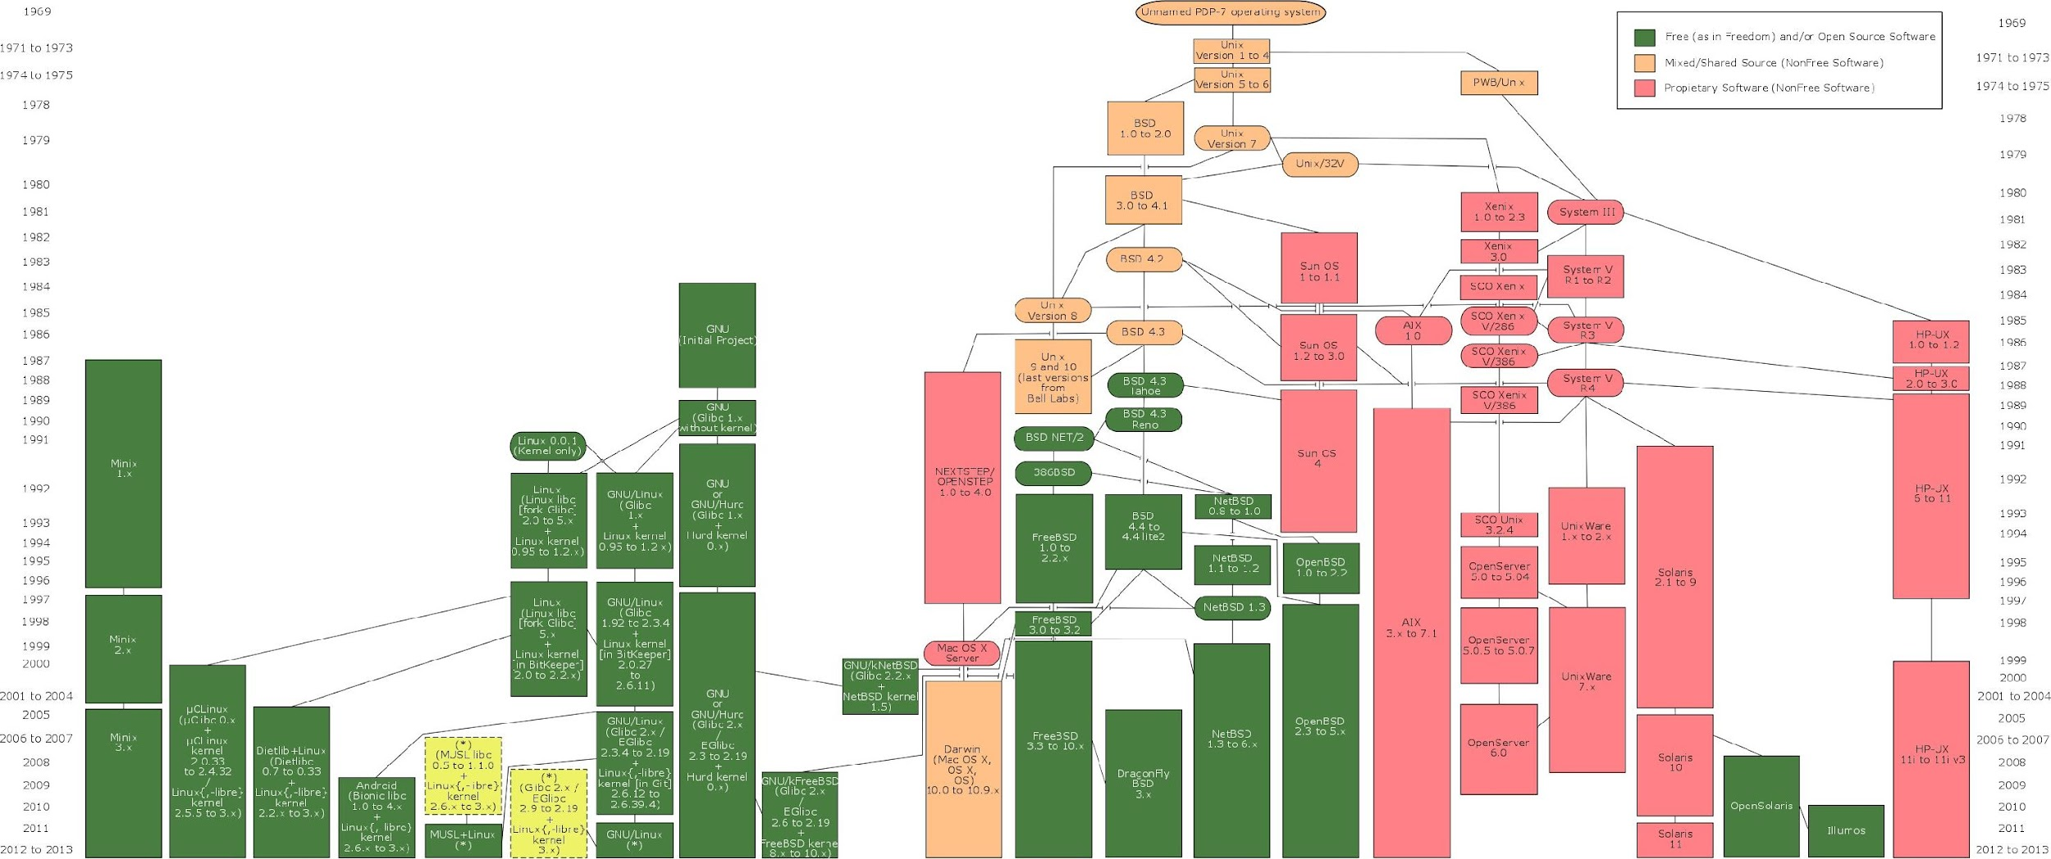
http://en.wikipedia.org/wiki/Unix
Notes:
a family of multitasking, multiuser computer operating systems
started 1969
based on a model of free and open-source software
different versions of unix are called distributions
Famous unix distribution: all linux systems like ubuntu Debian, etc macOS, Andoid

Slide 4
HARDWARE
(CPU, MEMORY, DEVICES)
KERNEL
(operating system)
PROGRAMS
Notes:
- kernel is a computer program at the core of a computer's operating system
- generally has complete control over system
- always resident in memory
- facilitates interactions between hardware and software components.

Slide 5

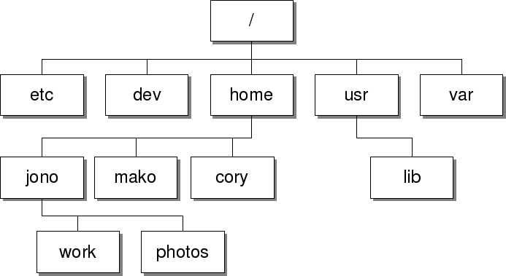







Filesystem structure
cd /
root
cd ..
cd home
cd ~
cd
cd ..
cd work
cd | ..
Notes:
One of the main things to know is the filesystem structure in unix
and how to navigate around it
This structure controls how data is stored and retrieved
etc - system configuration files
home - user directories and files
usr - contains executable commands

Slide 6
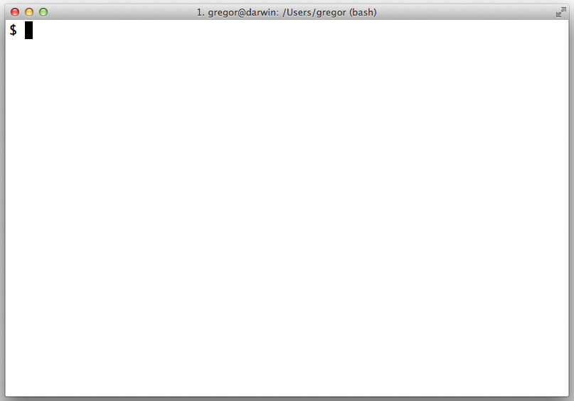
Shell
The most generic sense of the term shell means any program that users employ to type commands.
A shell is software that provides an interface for users of an operating system to access the services of a kernel.
CLI: command line (once the only way to control the computer)
GUI: graphical user interface

Slide 7
Shell basics
$ whoami $ uname -a $ df -h | # what is my # show basic |  |  | username on this info of the host |  | host OS
Filesystem | Size | Used | Avail | Use% | Mounted on
overlay | 282G | 102G | 169G | 38% | /
tmpfs | 64M | 0 | 64M | 0% | /dev
tmpfs | 16G | 0 | 16G | 0% | /sys/fs/cgroup
/dev/vda1 | 282G | 102G | 169G | 38% | /etc/hosts
shm | 64M | 0 | 64M | 0% | /dev/shm
tmpfs | 16G | 0 | 16G | 0% | /proc/acpi
tmpfs | 16G | 0 | 16G | 0% | /proc/scsi
tmpfs | 16G | 0 | 16G | 0% | /sys/firmware
Notes:
df : the amount of disk space available on the filesystem with each file name's argument

Slide 8
Home directory (~)
$ | pwd | # | where are we?
$ | cd ~ | # | change directory to /home/user
$ | pwd
$ | cd .. | # | go one level up (/Users)
$ | pwd
$ | cd | # | same as cd ~
$ | pwd | # | we are home
~ = /home/username
Download exercise files
$ cd ~
$ curl -OL http://expressrna.org/bioinfo.tar.gz
$ tar zxvf bioinfo.tar.gz
$ ls -l bioinfo
$ cd bioinfo
~/bioinfo = /home/username/bioinfo
Notes:
Pwd:

Slide 9
List directory content
$ ls -l
drwxr-xr-x | 2 rstudio | users | 4096 | May | 2 | 17:15 | dd
-rw-r--r-- | 1 rstudio | users | 24 | May | 8 | 2013 | file1.txt
-rw-r--r-- | 1 rstudio | users | 23 | May | 8 | 2013 | file2.txt
-rw-r--r-- | 1 rstudio | users | 941506 | Jan | 28 | 2013 | protein_abundance.txt
-rw-r--r-- | 1 rstudio | users | 885 | May | 12 | 2016 | proteins.fasta
-rw-r--r-- | 1 rstudio | users | 328 | May | 8 | 2013 | proteins.fasta.gz
-rwxr-xr-x | 1 rstudio | users | 60 | Apr | 29 | 2015 | script1.py
Use special characters (?, *)
$ ls -l file?.txt
-rw-r--r-- 1 rstudio users | 24 May | 8 | 2013 file1.txt
-rw-r--r-- 1 rstudio users | 23 May | 8 | 2013 file2.txt
$ ls -l protein*
-rw-r--r-- 1 rstudio users | 941506 | Jan | 28 | 2013 protein_abundance.txt
-rw-r--r-- 1 rstudio users | 885 | May | 12 | 2016 proteins.fasta
-rw-r--r-- 1 rstudio users | 328 | May | 8 | 2013 proteins.fasta.gz
Notes:
* file or directory
-rw-rw-r- permissions: user, group, other
1 : number of linked hard-links
lilo: owner of the file
lilo: to which group this file belongs to
0: size
Feb 26 07:08 modification/creation date and time
file1: file/directory name
has a link to itself and its parent

Slide 10
Copying files
$ cp proteins.fasta pcopy.fasta
$ mkdir temp
$ cp pcopy.fasta temp
$ cp –a temp temp1
Moving / renaming files
$ mv pcopy.fasta temp
$ mv temp temp2
Deleting files
$ rm –r temp*
Notes:
Without -R, the cp command skips directories.
-r is identical with -R on Linux, it differs in some edge cases on some other unix variants.
The -a option means -R and some other preservation options.
It attempts to make a copy that's as close to the original as possible:
- same directory tree,
- same file types,
- same contents,
- same metadata (times, permissions, extended attributes, etc.).

Slide 11
Displaying file content
$ less proteins.fasta
Outputs file content in a paginated fashion
Use arrows [up, down], [enter] and [space] to navigate, press [q] to quit; use /<pattern> for search
$ zless proteins.fasta.gz
Can also show gzip compressed files
$ cat proteins.fasta
Outputs the complete file
$ head proteins.fasta
Outputs the first 10 lines of the file
$ tail proteins.fasta
Outputs the last 10 lines of the file

Slide 12
Difference between two files
file1.txt
file2.txt
one two three four five
one two
four five six
$ diff file1.txt file2.txt
3c3
< three
---
>
5a6
> six
3c3: change line 3 of second file to line 3 of first file
5a6: add line 6 of second file after line 5 of first file

Slide 13
Finding (searching) files
$ find . -name "*.txt"
./file1.txt
./protein_abundance.txt
./file2.txt
Searching files for content
$ grep five *.txt
file1.txt:five file2.txt:five
Counting lines in files
$ wc -l *.txt
file1.txt
file2.txt
20489 protein_abundance.txt
20500 total

Slide 14
Redirections to files (<, >, >>)
$ echo "Hello world" > poem.txt
$ echo "Hello universe" >> poem.txt
Redirections between commands (|, pipe)
$ echo "Hello world" | wc -w
$ cat protein_abundance.txt | wc -l
$ grep ">" proteins.fasta | wc -l
$ grep -c ">" proteins.fasta
$ grep -v ">" proteins.fasta
man grep
Notes:
-v, --invert-match
-c, --count instead print a count of matching lines for each input file. With the -v, --invert-match option (see below), count non-matching lines.

Slide 15
Editing files with "vi"
$ vi first_script.sh
vi is in command mode press i (enters insert mode)
#!/bin/bash
echo "My first script :)"
press ESC (enters command mode) type :wq
$ chmod +x first_script.sh
$ ./first_script.sh
set executable flat to first_script.sh and run the script
bash script :)

Slide 16
Where to get help?
$ man ls
$ command -h
$ info ls
And after you are done?
$ exit
Notes:
--help

