Slide 1
Bio334 – Building Maximum Likelihood Trees
Solutions to the exercises
Janko Tackmann and Eugenio Perez-Molphe-Montoya
For remaining doubts feel free to contact us on slack or at:
janko.tackmann@uzh.ch / eugenio.perez@mls.uzh.ch

Slide 2
Location of today’s exercises
Within the cloned github repository:
Bio334/05_maximum_likelihood_phylogenies/exercises

Slide 3
Exercise 1 – Part 1: The grammar
Is the tree specified as rooted or unrooted?
((A,(B,(C,D))),(E,F));

Slide 4
Exercise 1 – Part 1: The grammar
Is the tree specified as rooted or unrooted?
((A,(B,(C,D))),(E,F));
-> The tree is rooted

Slide 5
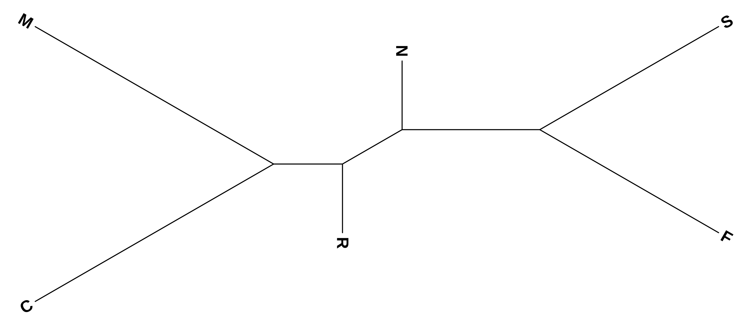
Exercise 1 – Part 2: Specifying branch length

Slide 6
Exercise 1 – Part 2: Specifying branch length
(N,(R,(C,M)),(S,F));

Slide 7
Exercise 1 – Part 2: Specifying branch length
(N:0.5,(R:0.5,(C:2,M:2):0.5):0.5,(S:1.5,F:1.5):1);

Slide 8
Exercise 1 – Part 3: Common errors in Newick representations

Slide 9
Exercise 1 – Part 3.a
(A,(E,D)),(C,(B,F));

Slide 10
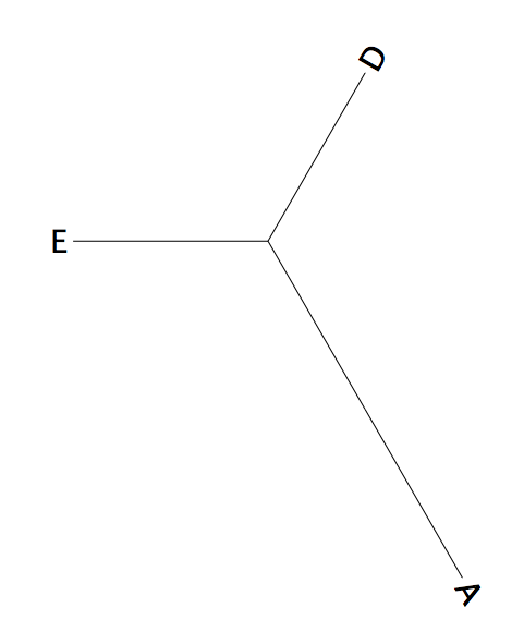
Exercise 1 – Part 3.a
(A,(E,D)),(C,(B,F));

Slide 11
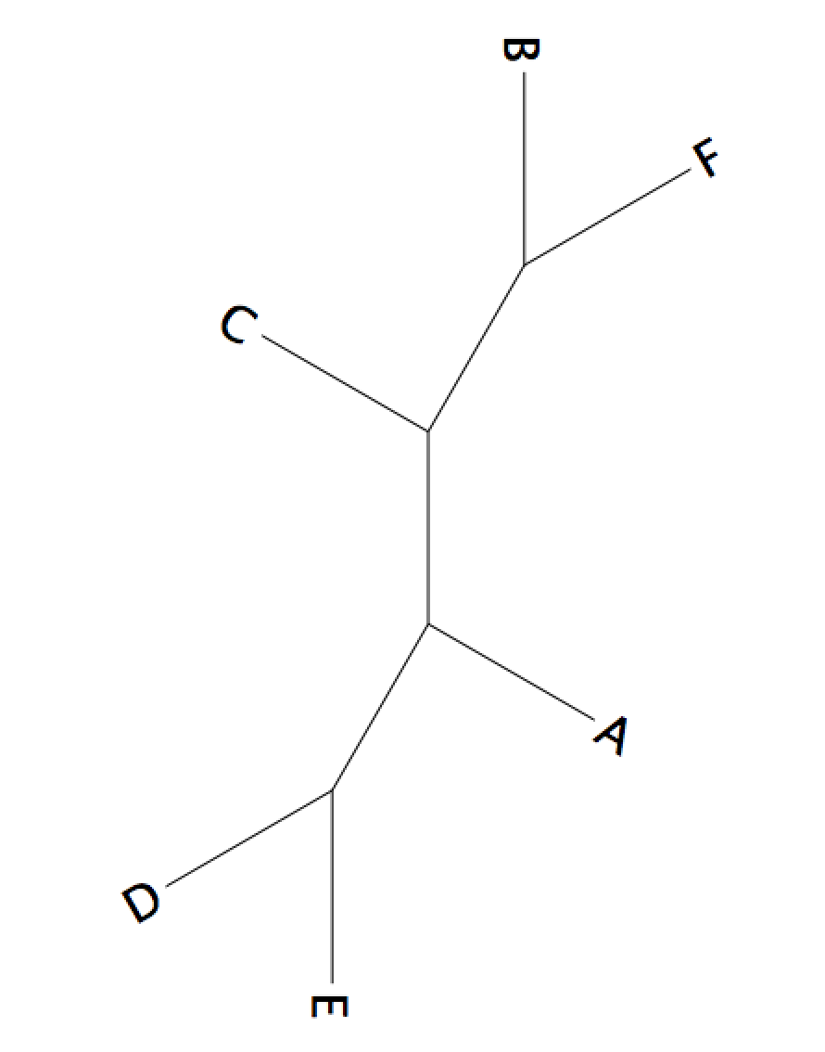
Exercise 1 – Part 3.a
(A,(E,D)),(C,(B,F));
(A,(E,D),(C,(B,F)));

Slide 12
Exercise 1 – Part 3.b
(A:1,D:6,([E:1.01,F:1.2]:1,B:2):0.21,(C:4,G:2.2):2):1);

Slide 13
Exercise 1 – Part 3.b
(A:1,D:6,([E:1.01,F:1.2]:1,B:2):0.21,(C:4,G:2.2):2):1);
Use correct parentheses
(A:1,(D:6,((E:1.01,F:1.2):1,B:2):0.21),(C:4,G:2.2):2):1);

Slide 14
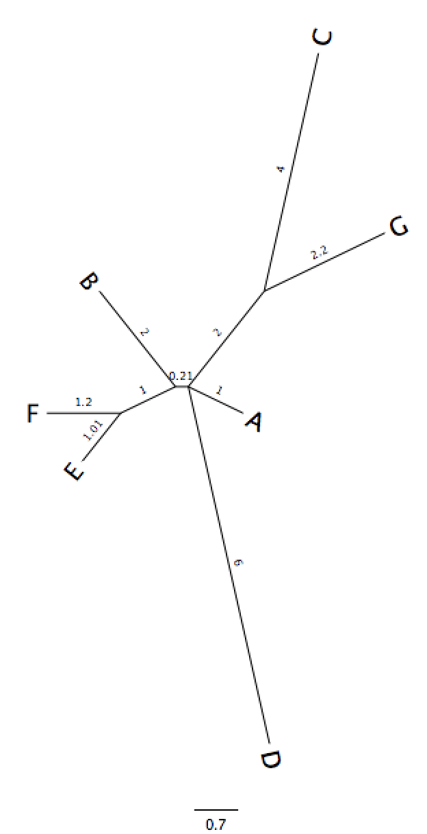
Exercise 1 – Part 3.b
(A:1,D:6,((E:1.01,F:1.2):1,B:2):0.21,(C:4,G:2.2):2):1);
Remove incorrect
branch length
(A:1,D:6,((E:1.01,F:1.2):1,B:2):0.21),(C:4,G:2.2):2);

Slide 15
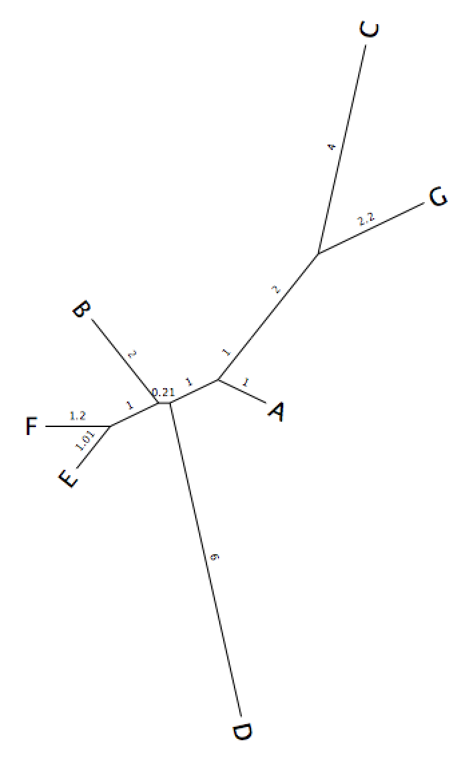
Exercise 1 – Part 3.b
(A:1,D:6,((E:1.01,F:1.2):1,B:2):0.21,(C:4,G:2.2):2);
Resolve multi-branching point
(A:1,(D:6,((E:1.01,F:1.2):1,B:2):0.21):1,(C:4,G:2.2):2);
Note: There are many ways to solve the multifurcation, this
is just one of the many.

Slide 16
Exercise 2 – Overview

Slide 17
Exercise 2 – Part 1.d
Can you identify which command line arguments are required (non-optional) for IQ-TREE to be executed?

Slide 18
Exercise 2 – Part 1.d
Can you identify which command line arguments are required (non-optional) for IQ-TREE to be executed?
-s name of the alignment file

Slide 19
Exercise 2 – Part 1.d
What are other basic parameters that are optional, but quite useful?

Slide 20
Exercise 2 – Part 1.d
What are other basic parameters that are optional, but quite useful?
-m model of binary (morphological), nucleotide, multi-state, or amino acid substitution
--prefix prefix used to name output files
--seed random seed for all stochastic steps

Slide 21
Exercise 2 – Part 2
Running IQ-TREE on the MFS-1 dataset
iqtree
-s mfs_domain_proteins_aligned_taxnames.fa
-m MFP
--prefix mfs.auto
--seed 123

Slide 22
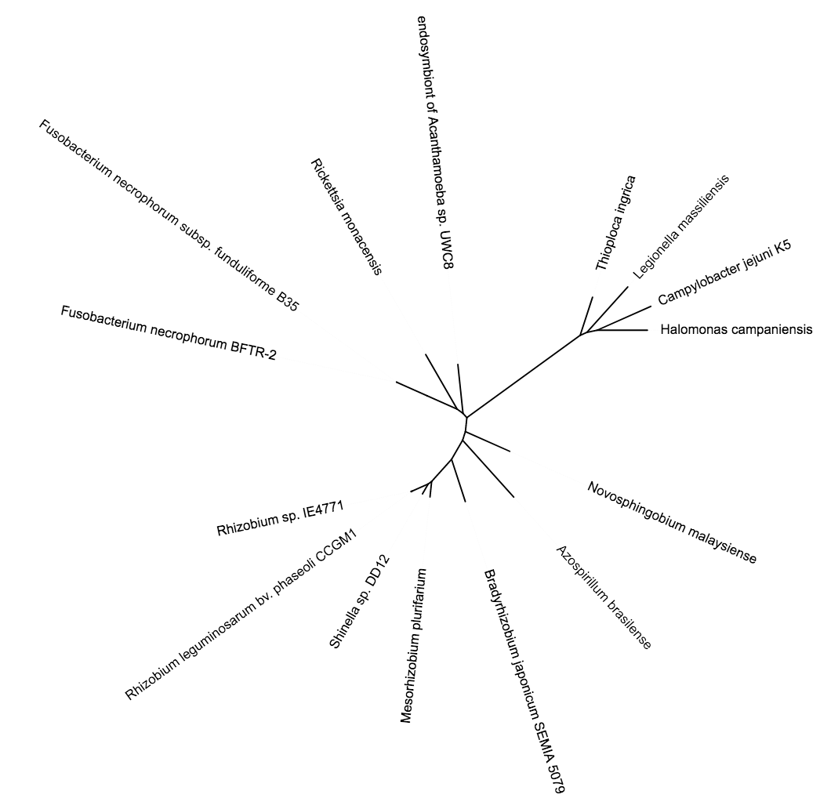
Maximum Likelihood (IQ-TREE)
- unrooted

Slide 23
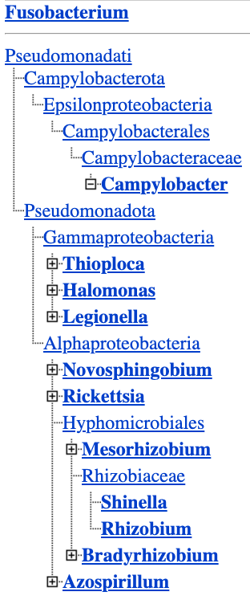

Slide 24
Kingdom:
Fusobacteriati
Kingdom:
Pseudomonadati

Slide 25
Maximum Likelihood (IQ-TREE)
- unrooted

Slide 26
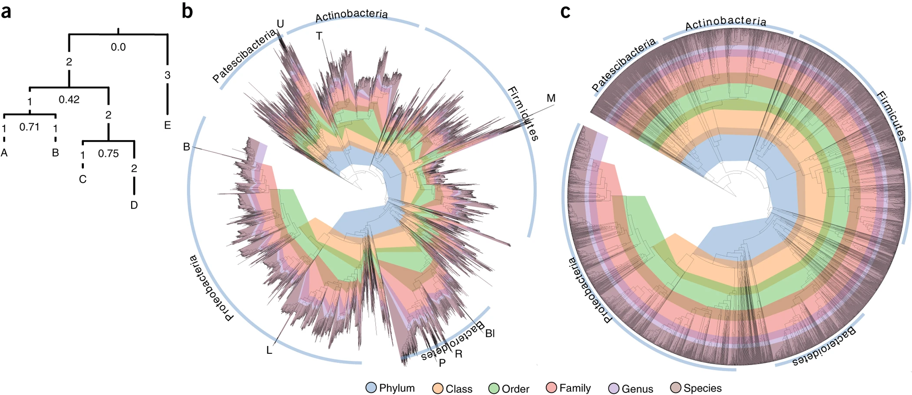
Revising bacterial taxonomy
Image from: Parks DH et al., Nat Biotechnol 36, 996–1004 (2018). https://doi.org/10.1038/nbt.4229

Slide 27
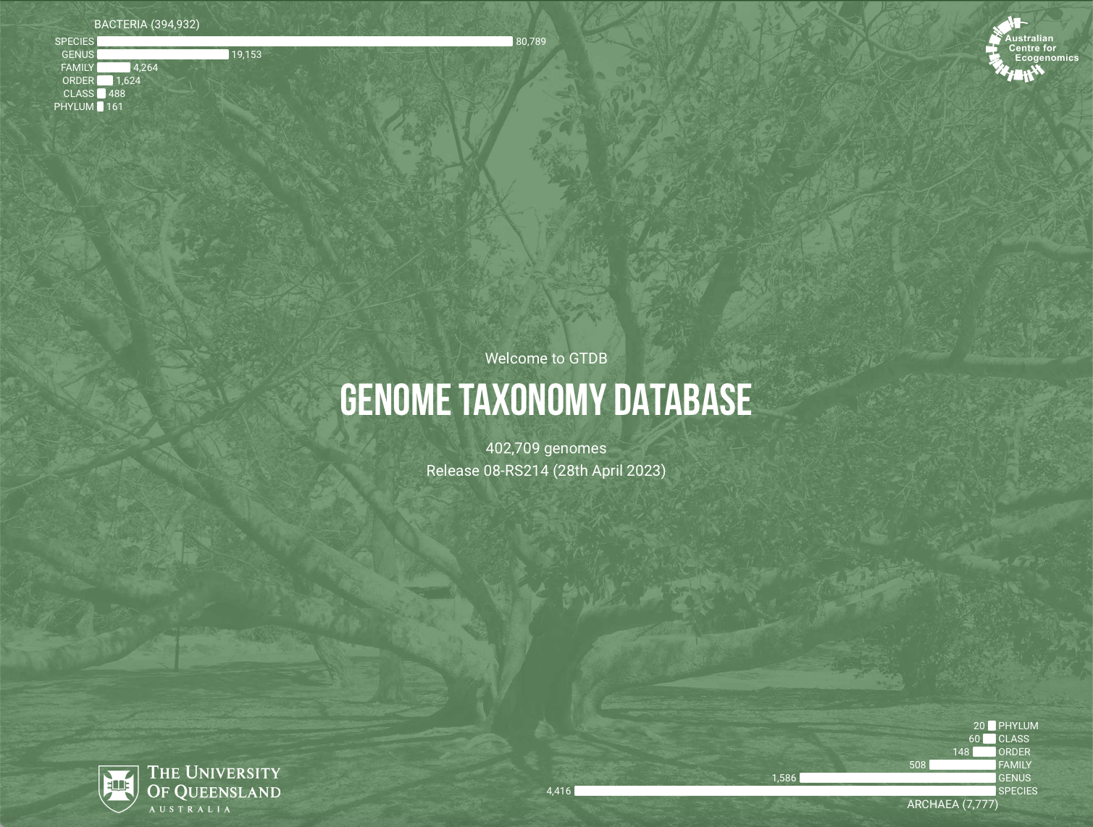

Slide 28
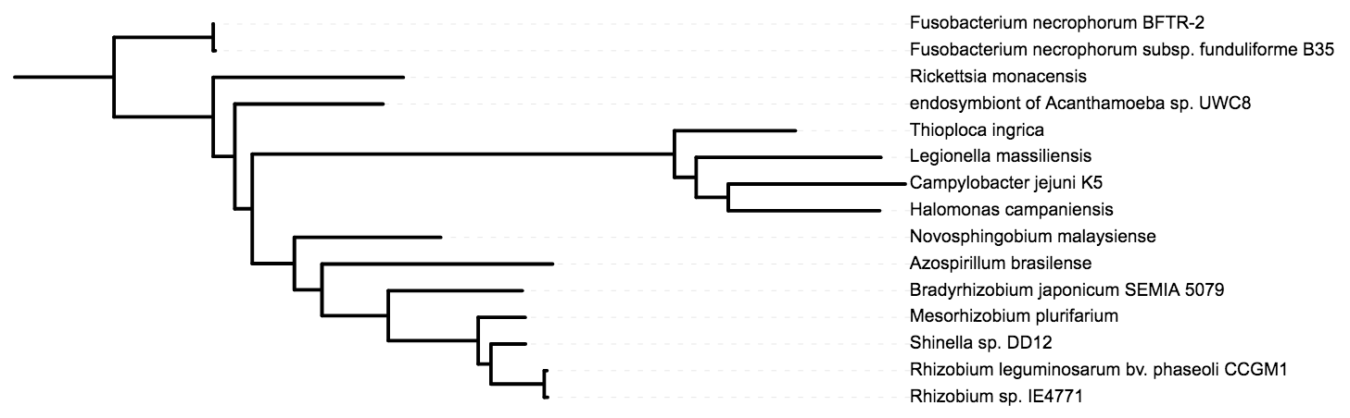
Maximum Likelihood (IQ-TREE, rooted on Fusobacteria)

Slide 29
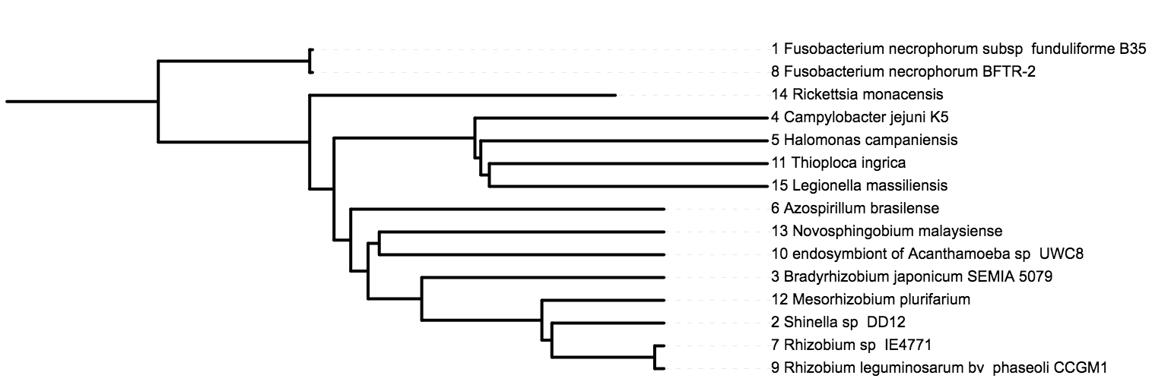
UPGMA (rooted on Fusobacteria)
Maximum Likelihood (IQ-TREE, rooted on Fusobacteria)

Slide 30
UPGMA (rooted on Fusobacteria)
Maximum Likelihood (IQ-TREE, rooted on Fusobacteria)

Slide 31
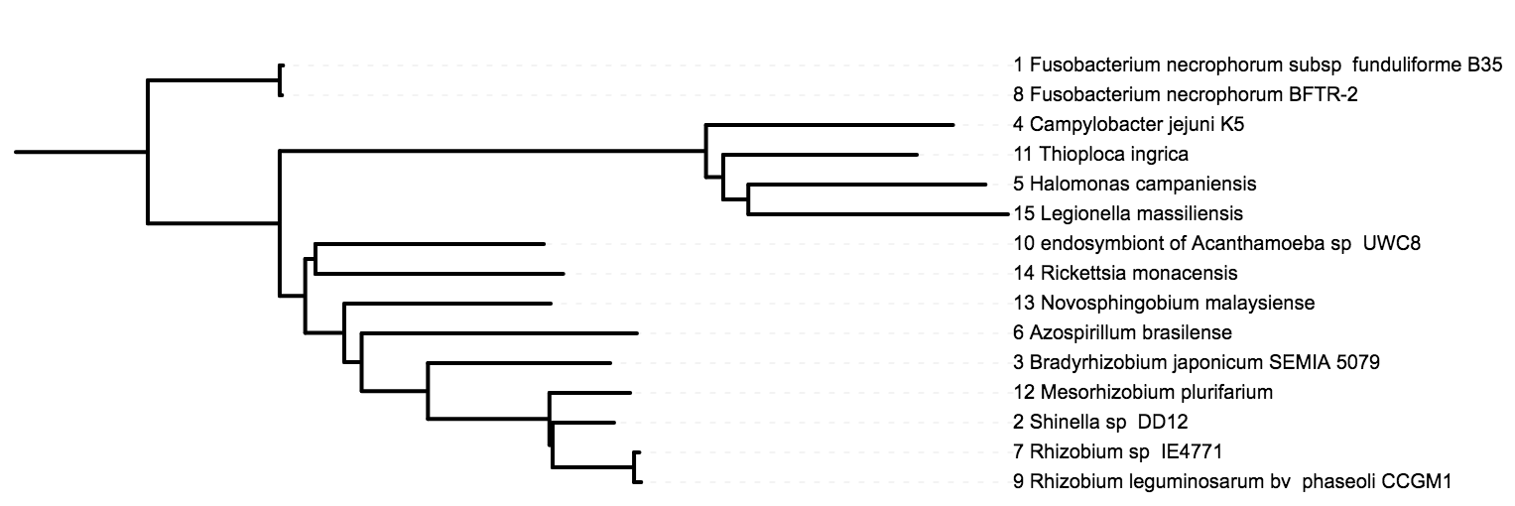
Neighbor joining (rooted on Fusobacteria)
Maximum Likelihood (IQ-TREE, rooted on Fusobacteria)

Slide 32
Neighbor joining (rooted on Fusobacteria)
Maximum Likelihood (IQ-TREE, rooted on Fusobacteria)

Slide 33
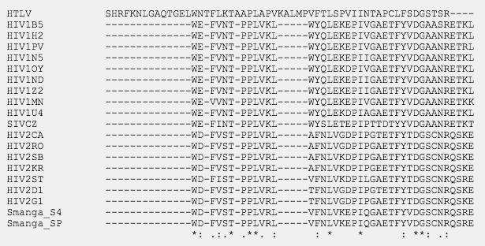
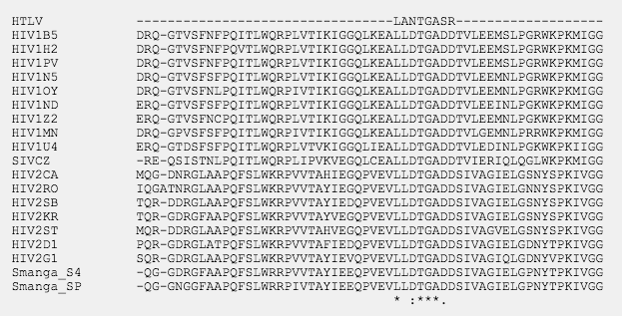
Exercise 3 – Part 1
Sequence alignment

Slide 34
Exercise 3 – Part 2
What is bootstrapping?

Slide 35
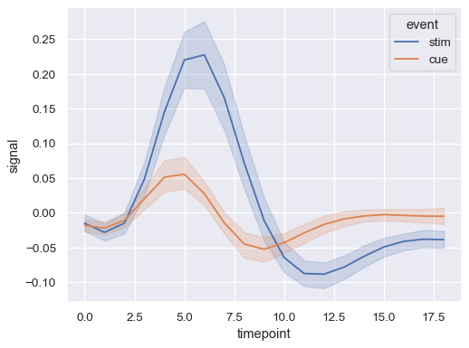
Exercise 3 – Part 2
What is bootstrapping?
General statistical technique that repeatedly resamples observed data to estimate the variability or confidence of a statistic (e.g. the mean or median)

Slide 36
Exercise 3 – Part 2
What is bootstrapping?
General statistical technique that repeatedly resamples observed data to estimate the variability or confidence of a statistic (e.g. the mean or median)
For phylogenetics, the bootstrapped statistic is tree topology (or clade support).

Slide 37
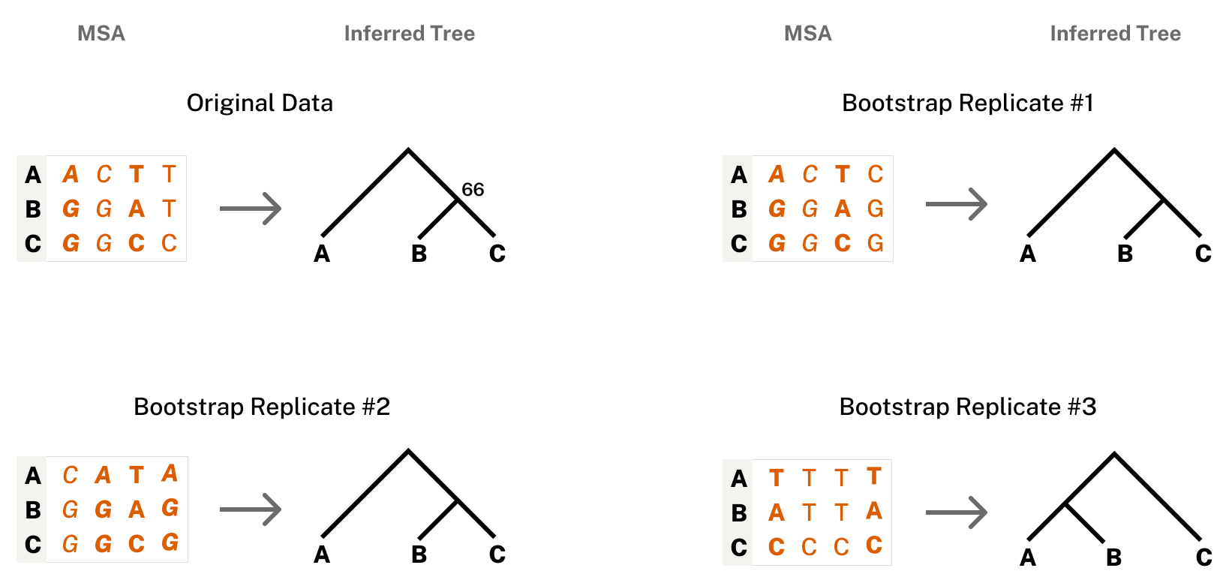
Exercise 3 – Part 2
What is bootstrapping?
Image from: https://www.geneious.com/guides/understanding-phylogenetics

Slide 38
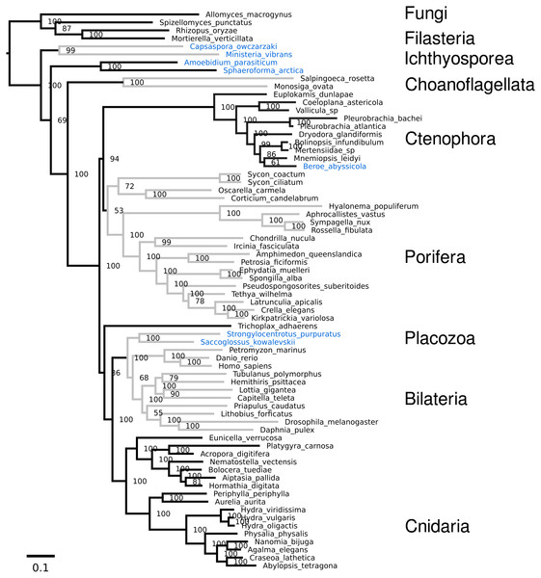
Image from: Warren R et al., PeerJ, 8 (2020)

Slide 39
Exercise 3 – Part 2
What are limitations of bootstrapping?

Slide 40
Exercise 3 – Part 2
What are limitations of bootstrapping?
Bootstrap values are not probabilities of a clade (or tree) being correct – they measure consistency, not truth.
They only quantify stability with respect to the dataset - high support suggests robustness (not necessarily correctness), low support suggest instability (not necessarily incorrectness).
However: given good data (!) and appropriate methods, they can provide reasonable support for evolutionary hypotheses.

Slide 41
Exercise 3 – Part 2
What do the following more advanced parameters do?
-b / -B

Slide 42
Exercise 3 – Part 2
What do the following, slightly more advanced parameters do?
-b standard bootstrap procedure
-B ultra-fast approximate bootstrap procedure (UFBoot)
- orders of magnitude faster
- non-standard interpretation: UFBoot FAQ
- can be further supported with approx. likelihood-ratio tests (-alrt)

Slide 43
Exercise 3 – Part 2
Why did you get a smaller number of bootstraps than specified?

Slide 44
Exercise 3 – Part 2
Why did you get a smaller number of bootstraps than specified?
UFBoot uses a “stopping rule” heuristic to avoid generation of unnecessary bootstrap trees
- when split frequencies have converged (do not “substantially” change anymore), stop the algorithm

Slide 45
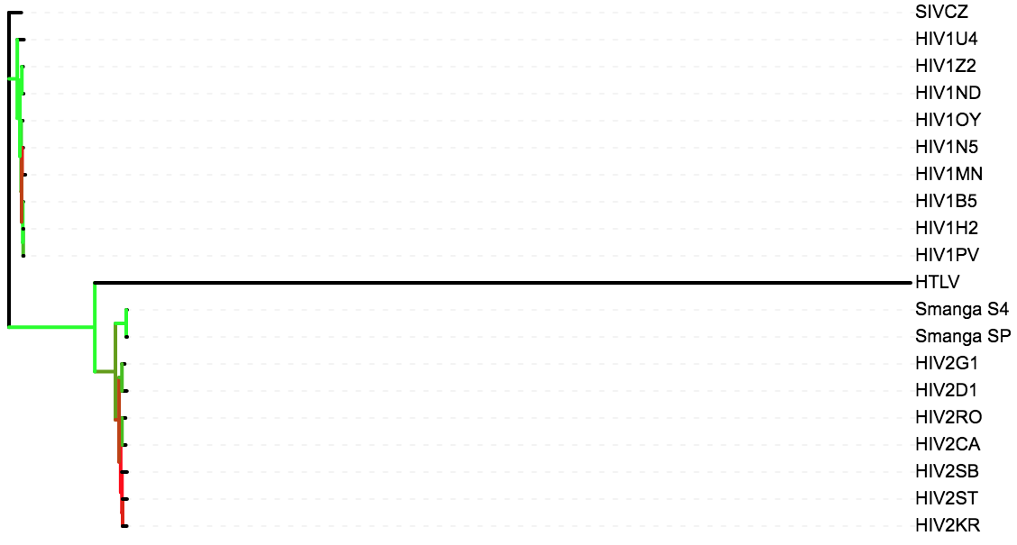
Exercise 3 – Part 3

Slide 46
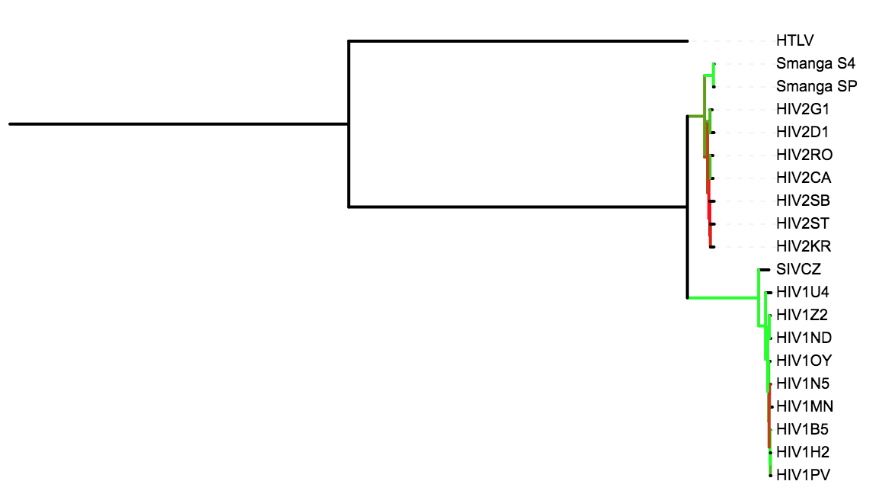
Exercise 3 – Part 4

Slide 47
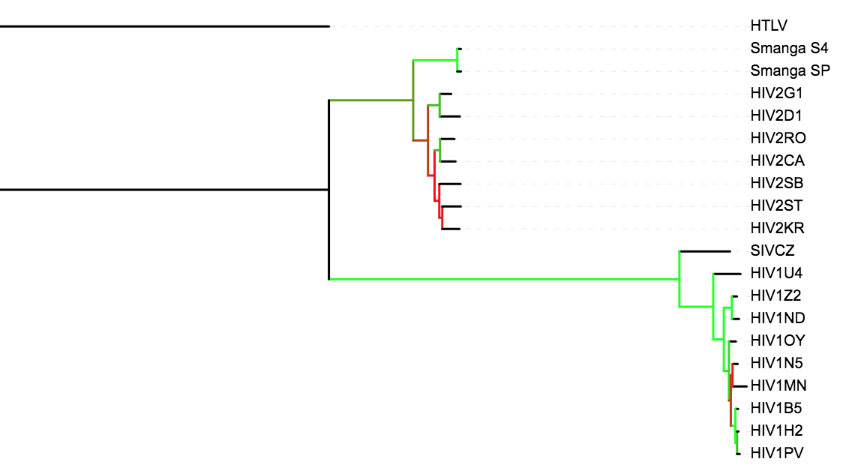
Exercise 3 – Part 4

Slide 48
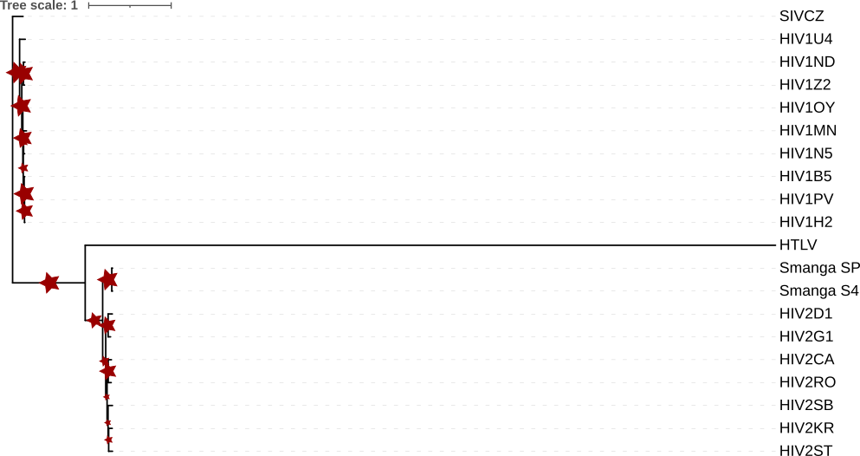
Exercise 3 – Part 3

Slide 49
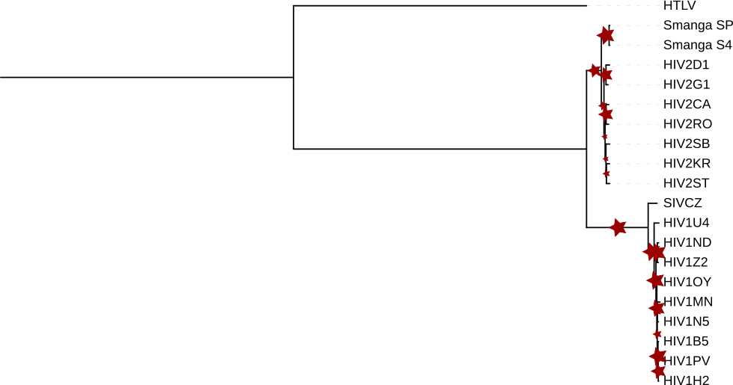
Exercise 3 – Part 4

Slide 50
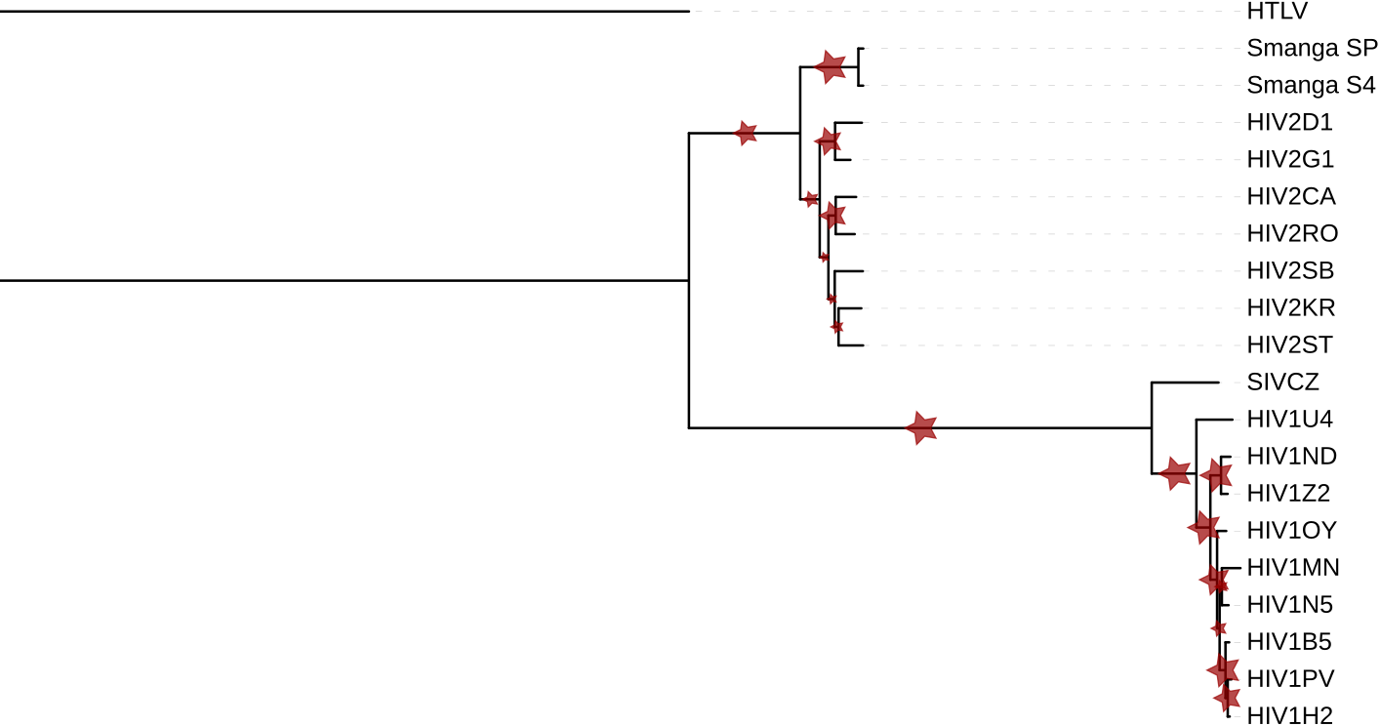
Exercise 3 – Part 4

