Slide 1
ILAHIA EXAM CELL AUTOMATION
Submitted by
Merin Varghese

Slide 2
ABSTRACT
Currently exam cell activity mostly includes a lot of manual calculations and is mostly paper based.
The project aims to bring in a centralized system that will ensure the activities in the context of an examination that can be effectively managed.
There will be total four semesters where each semester contains maximum of seven subjects.

Slide 3
Cont…
First, admin login into the system. Semester number and batch entry is done. Then student details is added .
Exam time table is obtained from the ktu website and the admin enter the timetable. Staff details is entered by the admin.
Duty list is assigned by the admin according to the exam time table.
Then the room arrangement is done and admin can select the arrangement pattern. In each room only 30 students are allocated.

Slide 4
Cont…
For each room, one staff is assigned. The seat arrangement is done according to the register number and it can be changed daily by admin.
Student attendence and staff attendence is calculated and absent report is generated.
Remuneration is calculated according to the staff attendence.

Slide 5
Module
Admin
Admin has the full control over the system.
First, admin login into the system. Then student details is added .semester number and batch entry is done.
Exam time table is obtained from the ktu website and the admin is added it.
Staff details is entered by the admin.
Duty list is assigned by the admin according to the exam time table.

Slide 6
Cont…
Room arrangement is done and admin can select the seat arrangement pattern.
Admin assigns staffs for each room.
The seat arrangement is done according to the register number and it can be changed daily by admin.
Student attendence and staff attendence is calculated and absent report is generated.
Remuneration is calculated according to the staff attendence.

Slide 7
About
My topic is “Ilahia Exam Cell Automation”.
The project aims to bring in a centralized system that will ensure the activities in the context of an examination that can be effectively managed.
Project is doing in JSP. Building tools are :
Glass fish
Netbeans
GITHub

Slide 8
JSP
JavaServer Pages (JSP) is a technology that helps software developers create dynamically generated web pages based on HTML, XML, or other document types. Released in 1999 by Sun Microsystems.
JSP is similar to PHP and ASP, but it uses the Java programming language.
To deploy and run JavaServer Pages, a compatible web server with a servlet container is require.

Slide 9
Glass Fish
GlassFish is an open-source application server project started by Sun Microsystems for the Java EE platform and now sponsored by Oracle Corporation.
The supported version is called Oracle GlassFish Server. GlassFish is free software, dual-licensed under two free software licences the Common Development and Distribution License (CDDL) and the GNU General Public License (GPL).
GlassFish is the reference implementation of Java EE .

Slide 10
Cont…
This allows developers to create enterprise applications that are portable and scalable.
Optional components can also be installed for additional services.
It uses a derivative of Apache Tomcat as the servlet container for serving Web content.
which uses Java New I/O (NIO) for scalability and speed.

Slide 11
Netbeans
NetBeans IDE is a free, open source, integrated development environment (IDE) that enables you to develop desktop, mobile and web applications.
The IDE supports application development in various languages, including Java, HTML5, PHP and C++. The IDE provides integrated support for the complete development cycle, from project creation through debugging, profiling and deployment.
The IDE runs on Windows, Linux, Mac OS X, and other UNIX-based systems.

Slide 12
Cont…
The IDE provides comprehensive support for JDK 7 technologies and the most recent Java enhancements.
It is the first IDE that provides support for JDK 7, Java EE 7, and JavaFX 2.
The IDE fully supports Java EE using the latest standards for Java, XML, Web services, and SQL and fully supports the GlassFish Server, the reference implementation of Java EE.

Slide 13
GitHub
It is a free open source, distributed version control system used to handle everything from small to very large projects with speed and efficiency.
GIT is easy to learn and fast performance.

Slide 14
Cont…
Version control is a system that manages changes to a file or files.
These changes are kept as logs in a history, with detailed information on what file(s) was changed, what was changed within the file, who changed it, and a message on why the change was made.
This is extremely useful, especially when working in teams .

Slide 15
BUGZILLA
Bugzilla is an open-source bug tracking system that allows developers effectively to keep track of outstanding problems with their product. It is written in perl and uses MYSQL database.
Bugzilla is a defect tracking tool, however it can be used as a test management tool as such it can be easily linked with other test case management tools like Quality Center, Testlink etc.
This open bug-tracker enables users to stay connected with their clients or employees, to communicate about problems effectively throughout the data-management chain.

Slide 16
Cont…
Key features of Bugzilla includes
Advanced search capabilities
E-mail Notifications
Modify file Bugs by e-mail
Time tracking
Strong security
Customization
Localization

Slide 17
Existing System
Currently exam cell activity mostly includes a lot of manual calculations and is mostly paper based.
It is a time consuming process.

Slide 18
Proposed System
The project aims to bring in a centralized system that will ensure the activities in the context of an examination that can be effectively managed.
Admin has the full control over the system.

Slide 19
TABLES
1. Tbl_teacher
Primary key:id
FIELD | TYPE | DESCRIPTION
id | Int(11)
facultyid | Varchar(50) | Faculty id
name | Varchar(50) | Name of faculty
username | Varchar(50) | Username of admin
password | Varchar(50) | Password of admin

Slide 20
2. Tbl_subject
Primary key:id
FIELD | TYPE | DESCRIPTION
id | Int(11) | Subject id
subjectname | Varchar(50) | Subject name
semester | Int(11) | Semester number

Slide 21
3. Tbl_semester
Primary key:id
FIELD | TYPE | DESCRIPTION
id | Int(11) | Semester id
sem | Varchar(10) | Semester number

Slide 22
4. Tbl_examtimetable
Primary key:id
FIELD | TYPE | DESCRIPTION
id | Int(11)
dd | Int(11) | Day
mm | Int(11) | Month
yy | Int(11) | Year
languageid | Int(11) | Subject id
timing | Varchar(50) | Time
examid | Int(11) | Exam id

Slide 23
5. Tbl_dutyassign
Primary key:id
FIELD | TYPE | DESCRIPTION
fid | Varchar(50) | Faculty id
id | Int(11)
noofday | Int(11) | Number of days
examid | Int(11) | Exam id

Slide 24
6. Tbl_student
Primary key:id
FIELD | TYPE | DESCRIPTION
id | Int(11)
studid | Varchar(50) | Student id
rollno | Varchar(50) | Rollnumber
ktuid | Varchar(50) | Ktu id
name | Varchar(50) | Student name
classid | Varchar(50) | Class id
batchid | Varchar(50) | Batch id

Slide 25
7. Tbl_batch
Primary key:id
FIELD | TYPE | DESCRIPTION
id | Int(11)
batchname | Varchar(50) | Batch name
duration | Varchar(50) | Duration of course

Slide 26
8. Tbl_examduty
Primary key:id
FIELD | TYPE | DESCRIPTION
id | Int(11)
dateof | Date | Date
class | Int(11) | Class
fid | Varchar(50) | Faculty id
batchid | Varchar(50) | Batch id
examid | Varchar(50) | Exam id

Slide 27
9. Tbl_exam
Primary key:id
FIELD | TYPE | DESCRIPTION
id | Int(11)
examname | Varchar(50) | Exam name
batchid | Int(11) | Batch id
semid | Int(11) | Sem id

Slide 28
10. Tbl_studentattendence
Primary key:id
FIELD | TYPE | DESCRIPTION
id | Int(11)
studid | Varchar(50) | Student id
examid | Varchar(50) | Exam id
edate | Varchar(50) | Exam date
present | ENUM(‘Y’,’N’) | Attendence
languageid | Int(11) | Language id

Slide 29
11. Tbl_teacherattendence
Primary key:id
FIELD | TYPE | DESCRIPTION
id | Int(11)
attdate | Varbinary(50) | Attendence date
fid | Varchar(50) | Faculty id
sfid | Varchar(50) | Substitution faculty id
eid | Varchar(50) | Exam id

Slide 30
UML DIAGRAMS

Slide 31
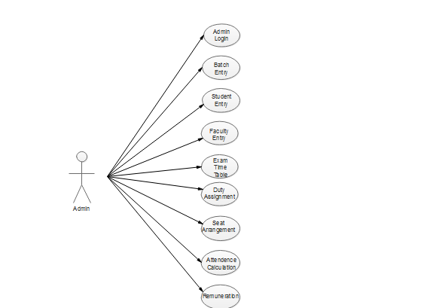
Use Case Diagram

Slide 32
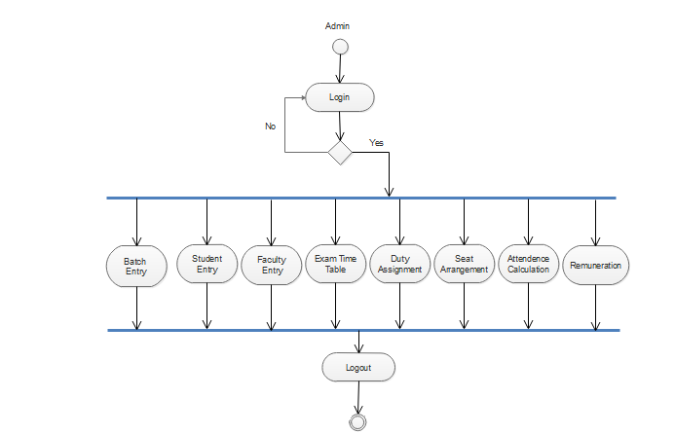
Activity Diagram

Slide 33
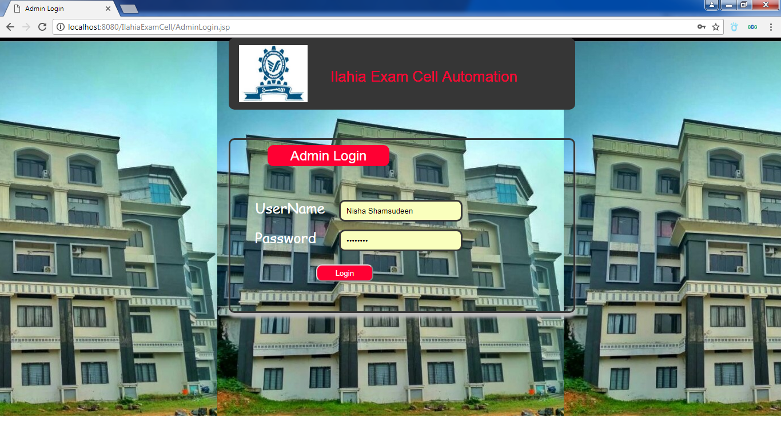
FORMS

Slide 34

Home page

Slide 35
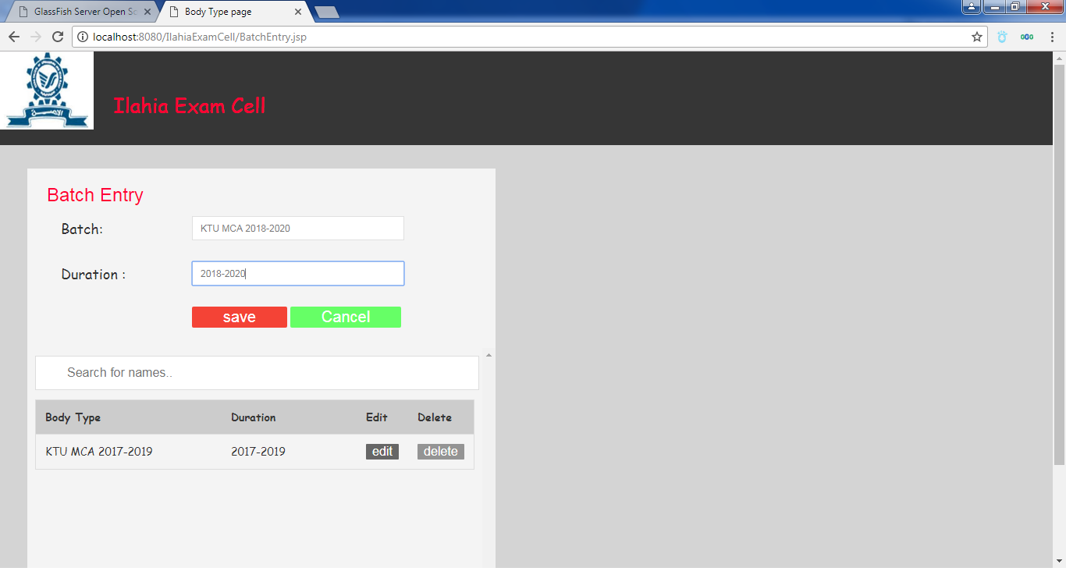
Batch Entry

Slide 36
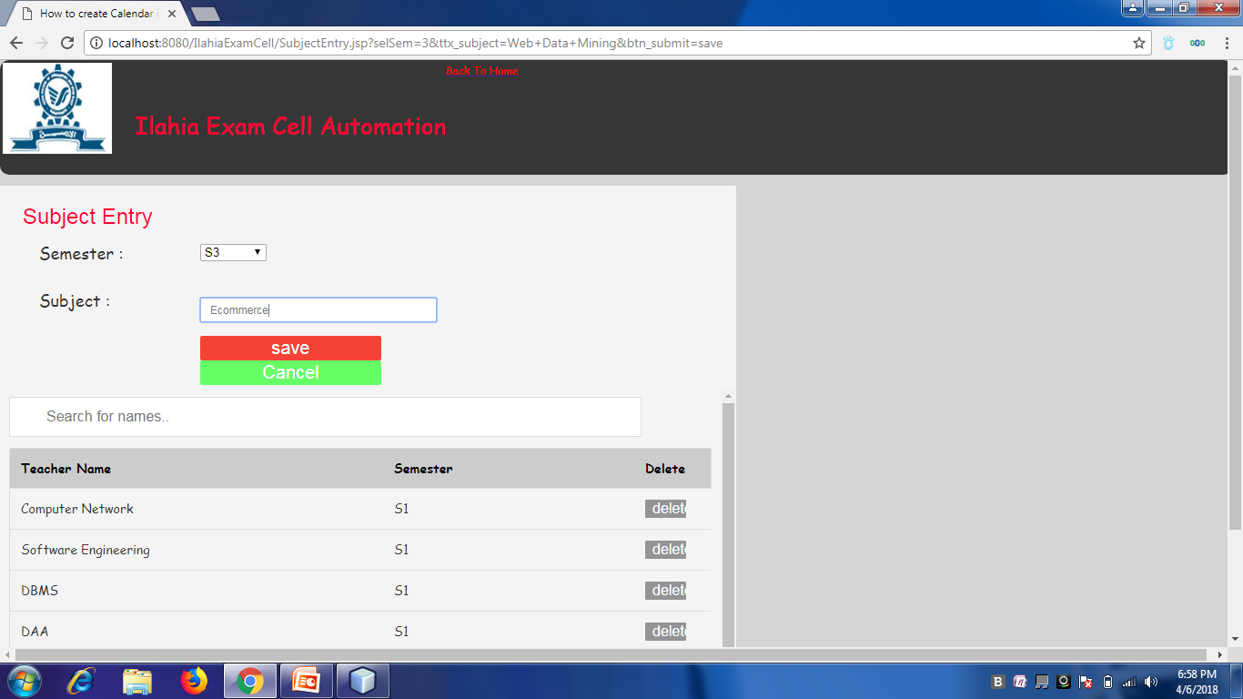
Subject Entry

Slide 37
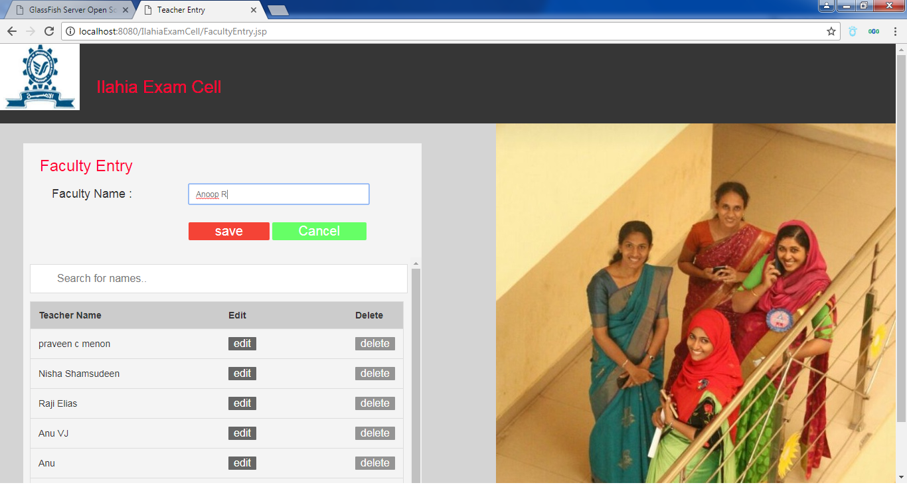
Faculty Entry

Slide 38
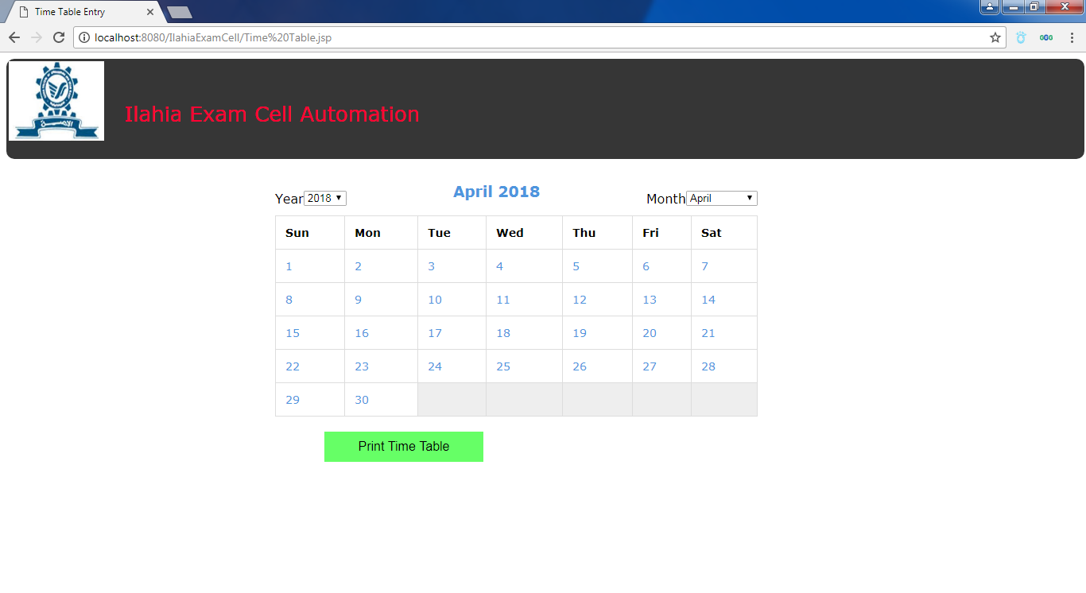
Exam Timetable

Slide 39
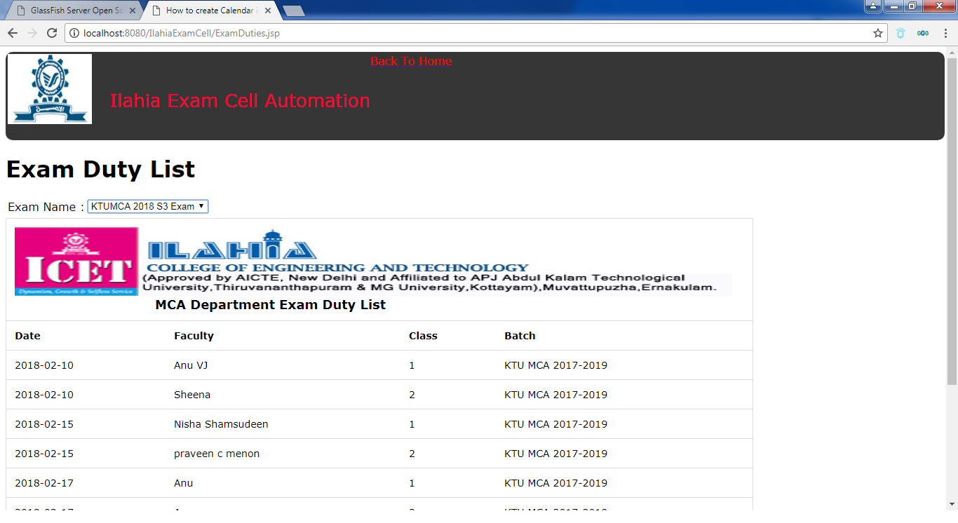
Duty List

Slide 40
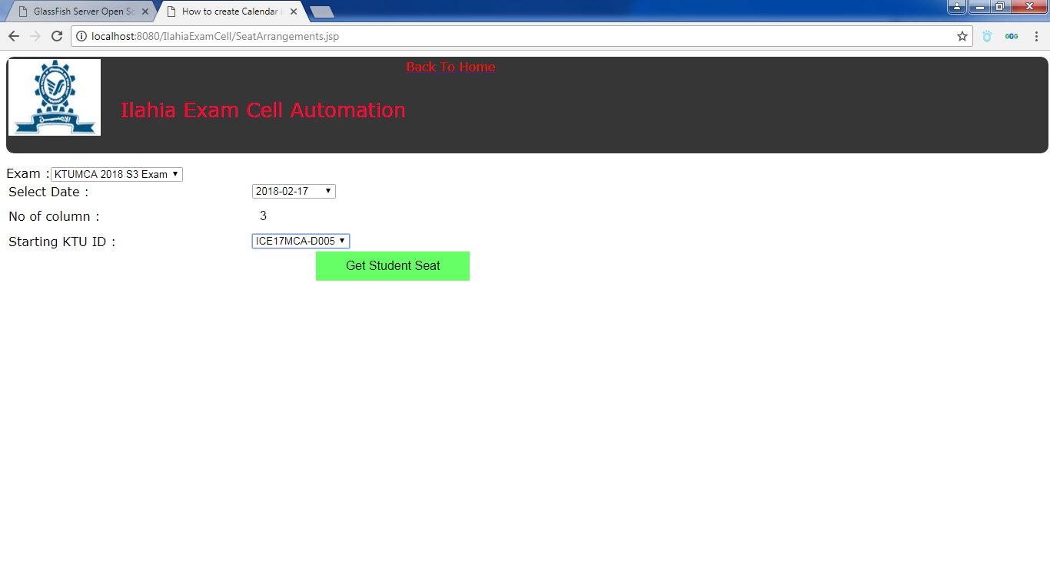
Seat Arrangement

Slide 41
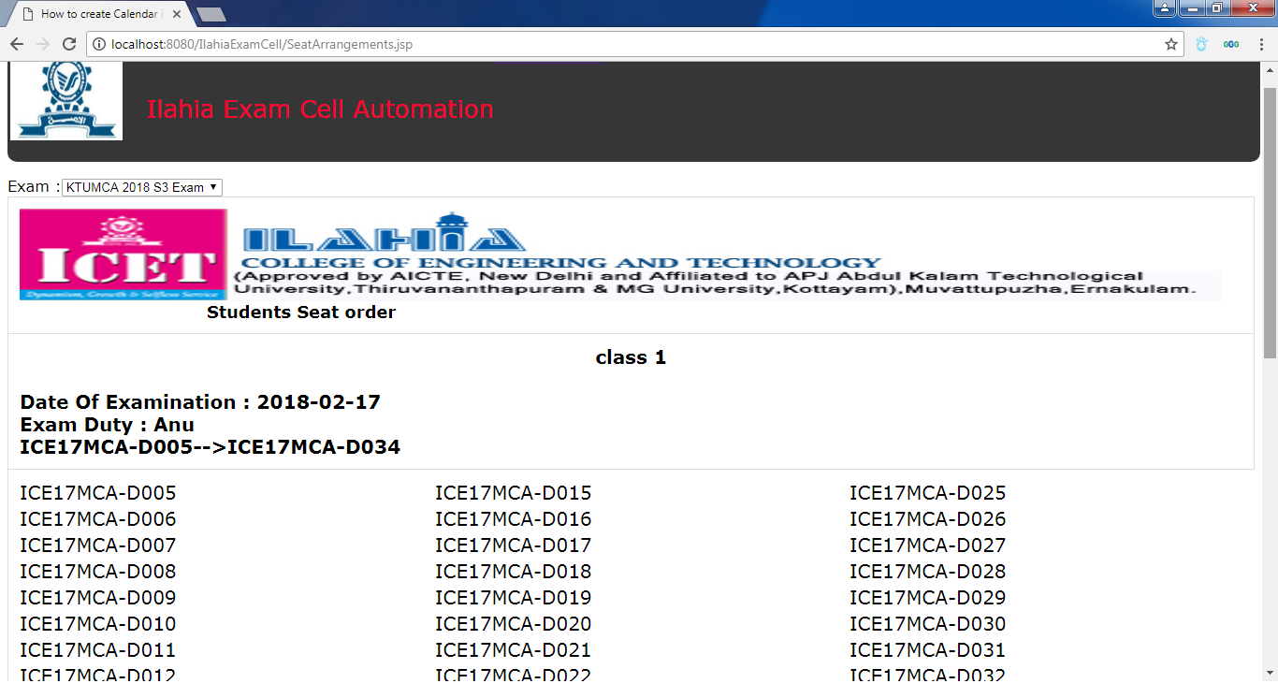
Seat Arrangement View

Slide 42
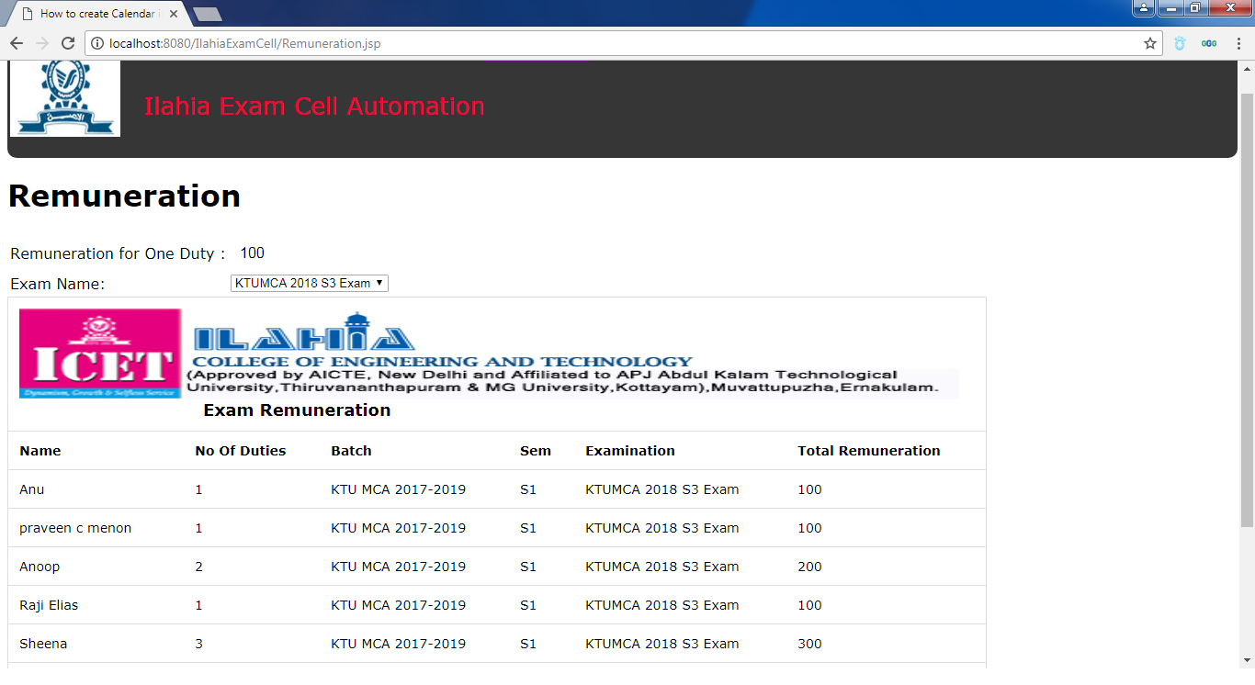
Remuneration

Slide 43
THANK U

