Slide 1

PowerEnjoy
Maria Chiara Zaccardi
Nicola Sosio
Riccardo Redaelli

Slide 2
Actor
Visitor
User
Operator

Slide 3
Our key points of interpretation
Operators must stay logged during their working hours
User for unlock a reserved car has to insert through the app, the car's code (unique, in the front of the car)
An operator take care of cars with no more than 20%, so no one user can pick a car with more than 80% of empty battery
If a user couldn't pay last ride the payment society notify the system who block the user's account
If a car is left by some user at more than 3 km from the nearest power grid station, an operator will move it to a power grid station

Slide 4
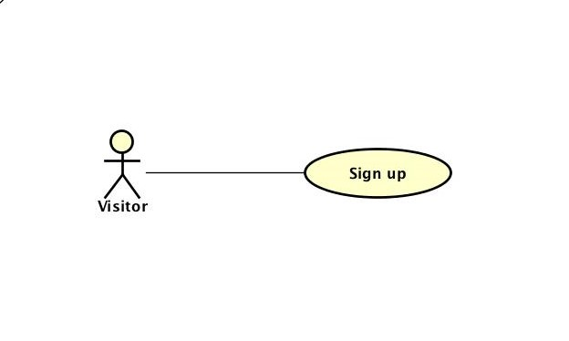
Use case diagram

Slide 5
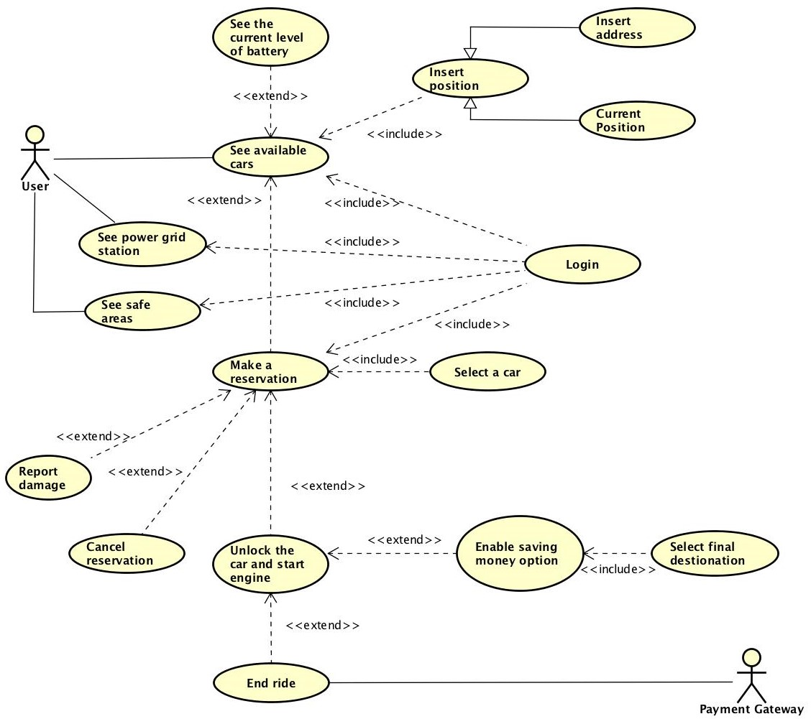

Slide 6
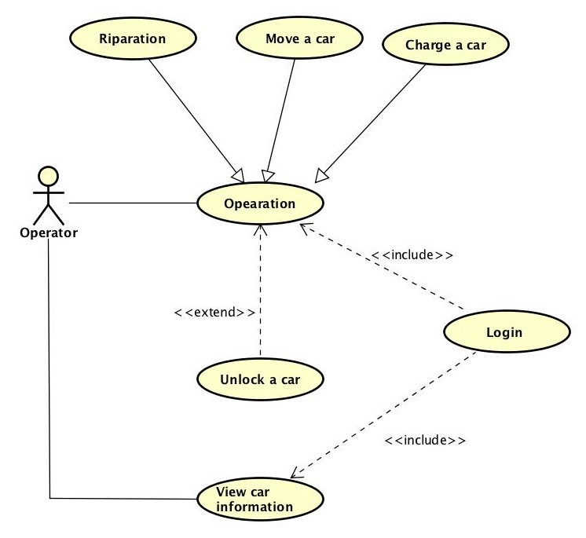

Slide 7
Class diagram

Slide 8
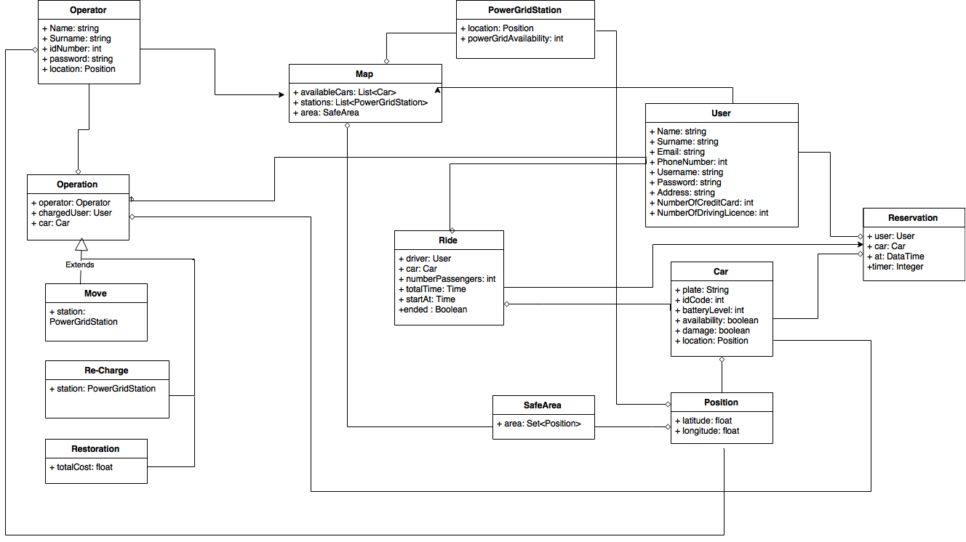

Slide 9
State chart diagram

Slide 10
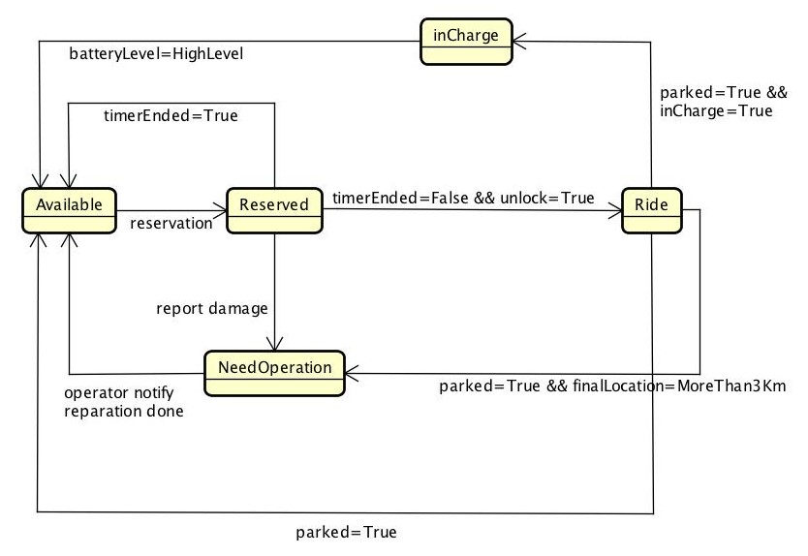

Slide 11
Alloy

Slide 12
