Slide 1
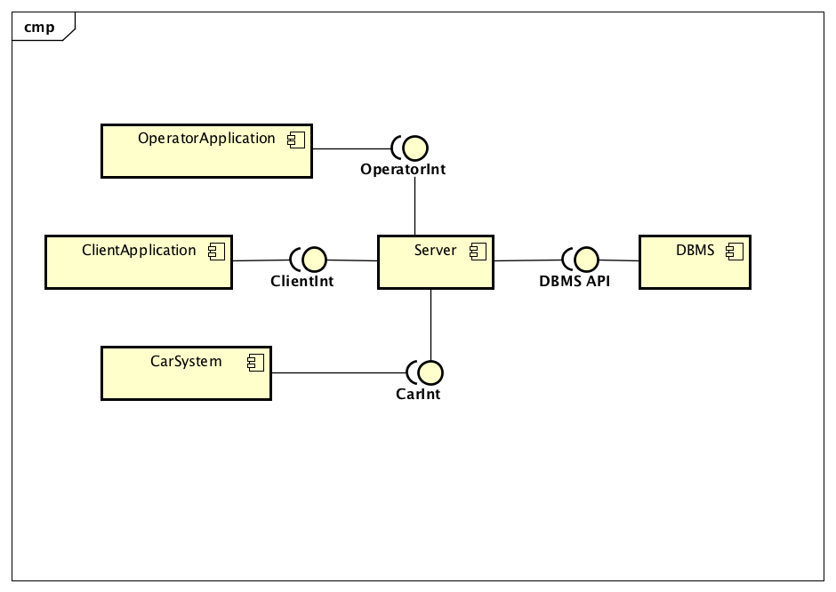
High level components and their interaction

Slide 2
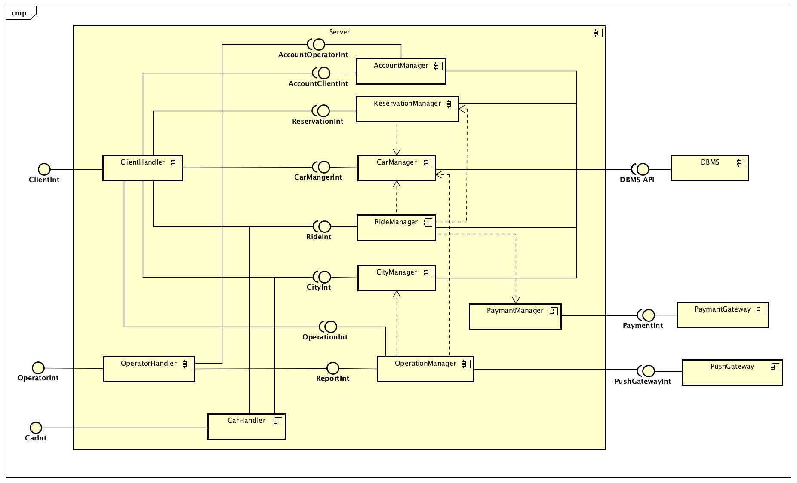
High level components and their interaction

Slide 3
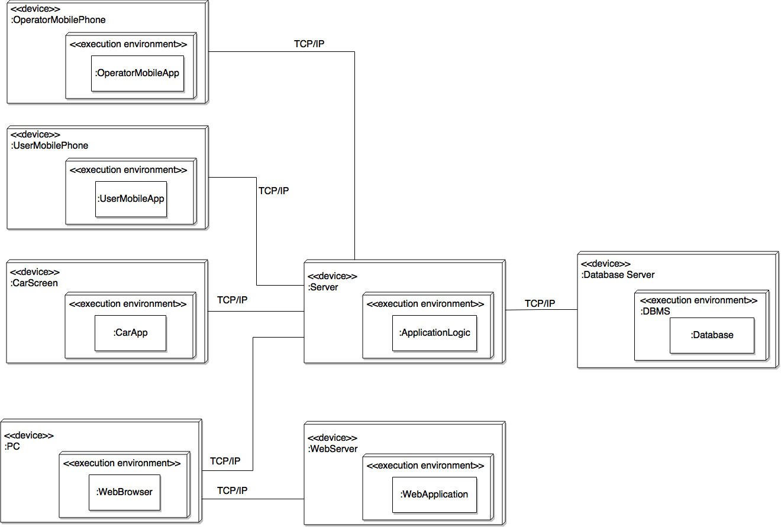
Deployment

Slide 4
Runtime view

Slide 5
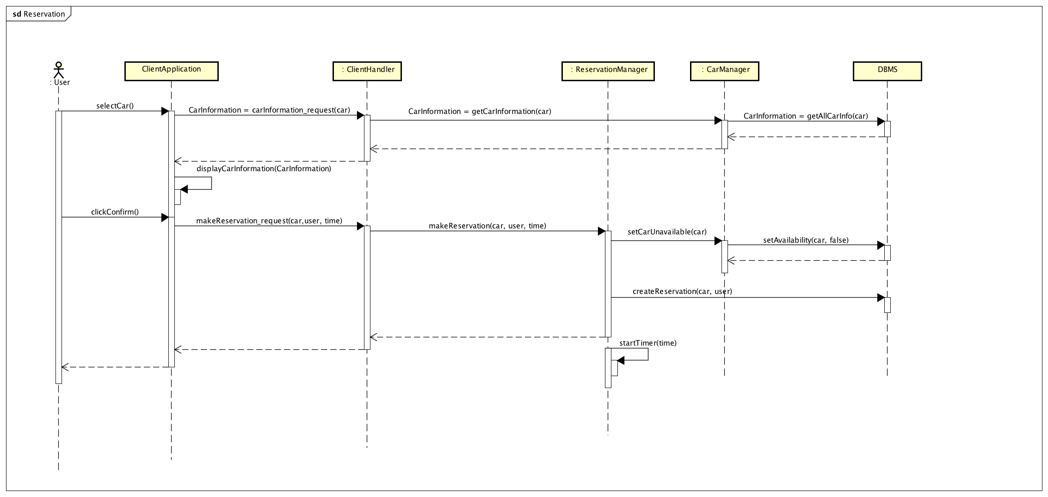

Slide 6
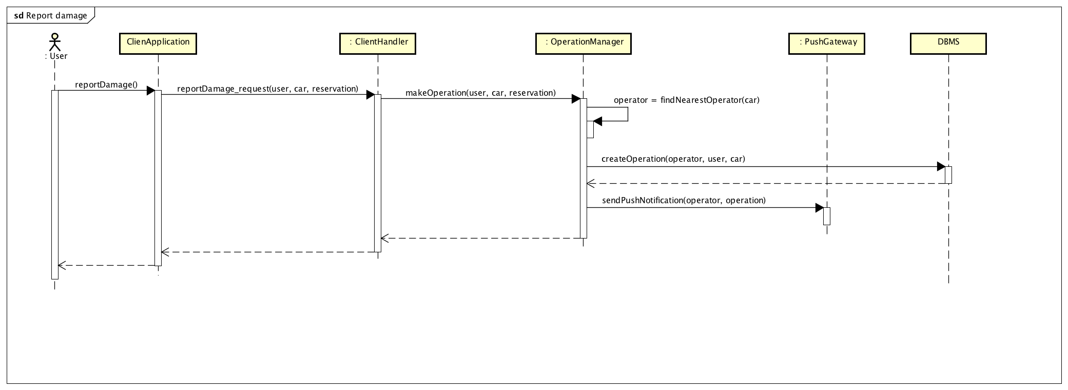

Slide 7
Component interfaces

Slide 8
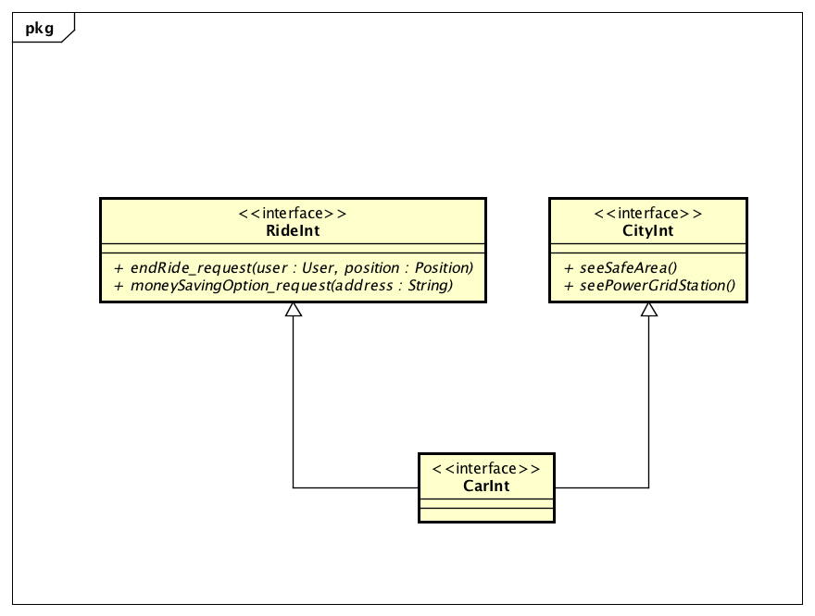
Car Interface

Slide 9
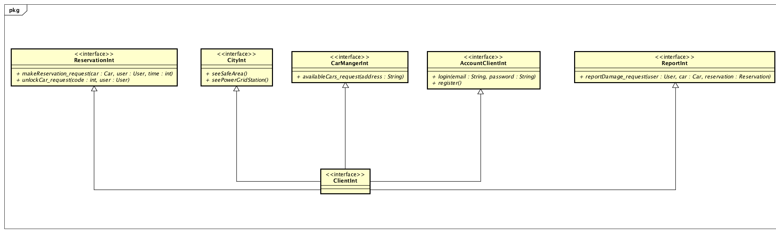
Client Interface

Slide 10
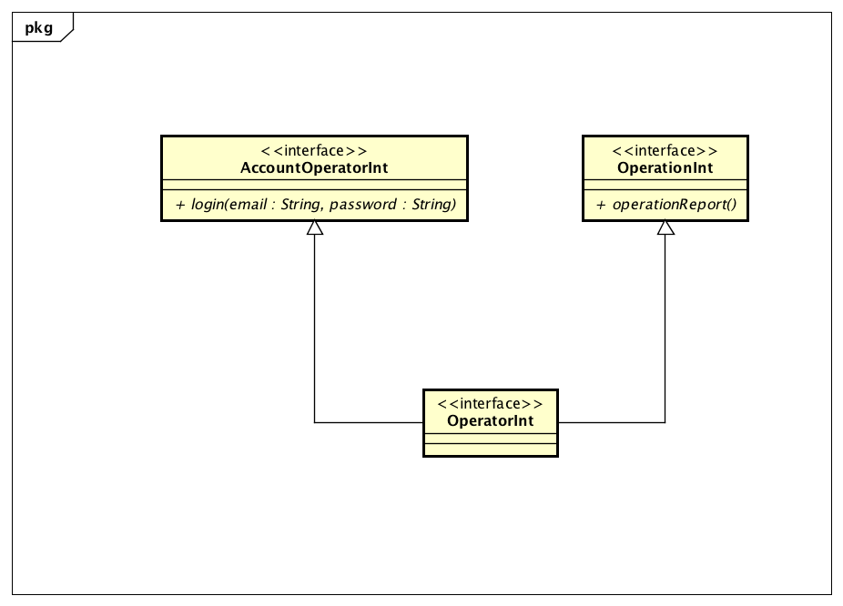
Operator Interface

Slide 11
UX

Slide 12
Ux Car

Slide 13
Ux Operator

Slide 14
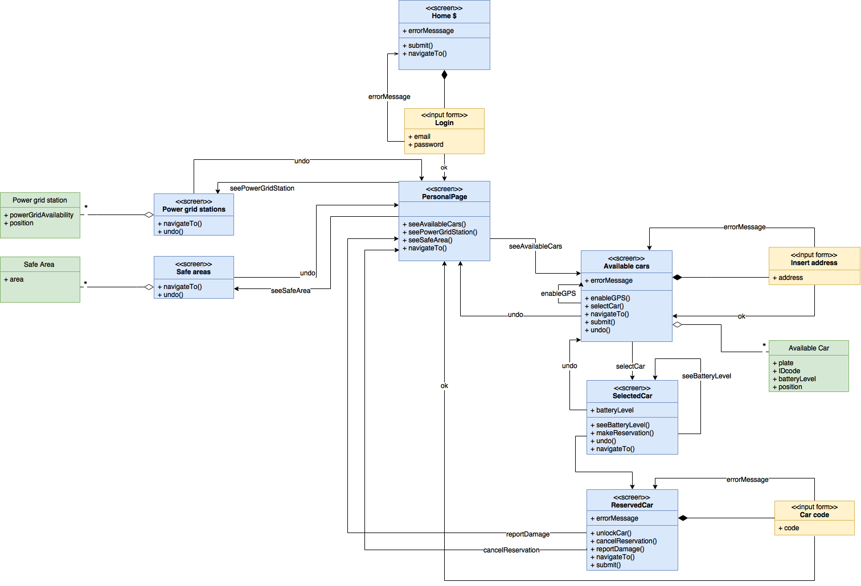
Ux User

Slide 15
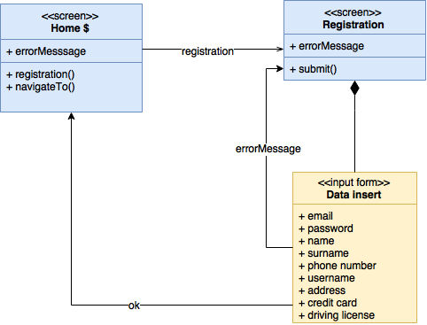
Ux Visitor

Slide 16
BCE

Slide 17
