Slide 1
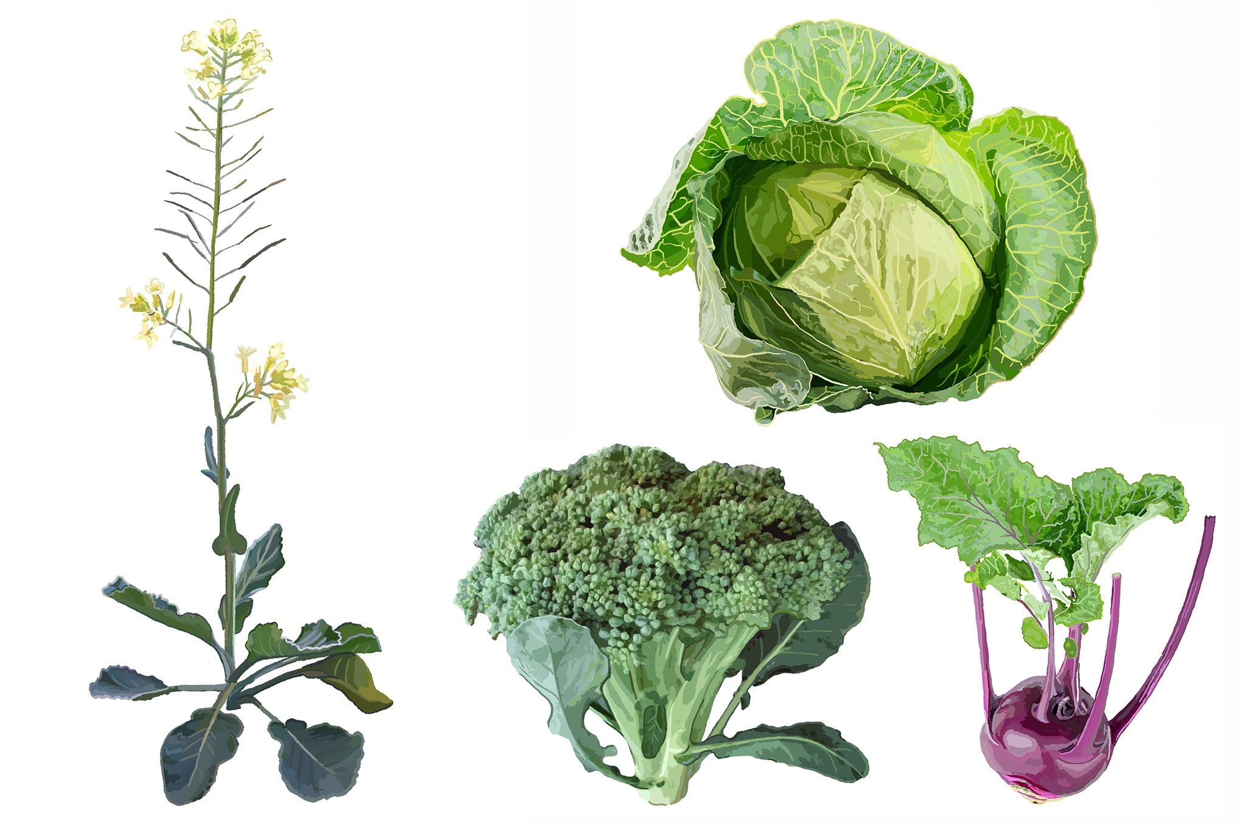
Name:
Selection on:
Flowers (terminal buds)
Seeds
Flowers (lateral buds)
Artificial selection
Stem
Leaves
Roots
Wild cabbage
(Brassica oleracea)
Super cabbage
(Brassica super)

