Slide 1
A text model
Use your favourite M2M for M2T
Edward Willink
Willink Transformations Ltd
Eclipse Foundation
MMT Component co-Lead
OCL Project Lead
QVTd Project Lead
QVTo Committer
OMG (Model Driven Solutions)
OCL 2.3, 2.4, 2.5 RTF Chair
QVT 1.2, 1.3, 1.4 RTF Chair
OCL 2018 @ MODELS 2018
14th October 2018

Slide 2


Overview
Model-to-Text (M2T) utility
M2T / Model-to-Model (M2M) distinction
Tx
  M2M
  XML 2 XML
  M2T using M2M
Example
Enhanced OCL text support

Slide 3
Model-to-Text utility
Models good
Model-to-Model transformation better
Models not always acceptable
  many users cannot understand models
  many tools cannot understand models
Model-to-Text makes model accessible
  user-friendly text rendering
  tool-compliant input text

Slide 4
Why can't QVTo be used for M2T?
persistent question from Toni Siljamaki
orthodoxy / prejudice
  OMG provide two specifications MOFM2T and QVT
  M2M uses rules, M2T uses string templates
  M2M preserves, M2T destroys models

Slide 5
Why is M2T different to M2M?
Common M2T / M2M functionality (M2...)
  metamodels, loading
  OCL expressions, navigation, queries
  rules, matching, hierarchy, modules
  tracing, incremental execution, ...
Distinct M2T / M2M functionality (...2T)
  text output
  powerful text synthesis - string templates
Hardly enough to justify independent tools

Slide 6
Basic M2T
Target text
The name is "computedName"
Forward escape: expression within text
The name is "[self.name/]". -- MOFM2T/Acceleo with escaped OCL
The name is "«this.name»". -- Xtend with escaped Java
Backward escape: text within expression
'The name is "[self.name/]".' -- MOFM2T
'''The name is "«this.name»".''' -- Xtend
Standard OCL can concatenate String values
'The name is "'+ self.name +'".' -- OCL

Slide 7
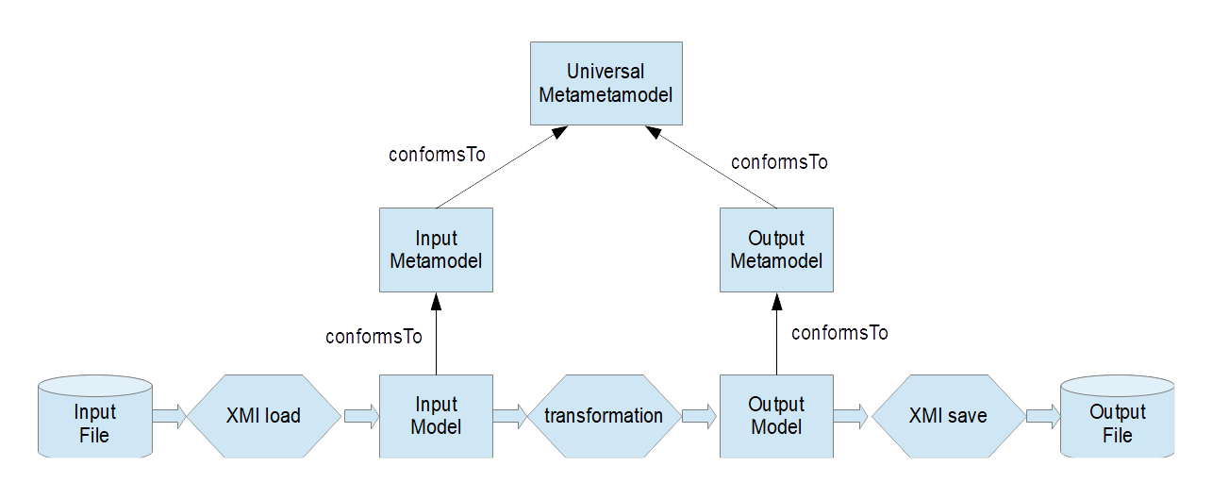

Traditional M2M models/processing
  file - load - input - tx - output - save - file
  all models have metamodels / universal metamodel
    Ecore / UML / ...

Slide 8
How can M2M do XML2XML?
Similar problem - inspires M2T solution
FAQ
  users want tweaked XMI
    usually preserved/special xmi:ids
  naive unhelpful answer
    xmi:id is a hidden serialization artefact
    don't use it in the modeling world
  realistic helpful answer
    xmi:id is an XMI /XML model element
    use an XML2XML model transformation
    but how?

Slide 9
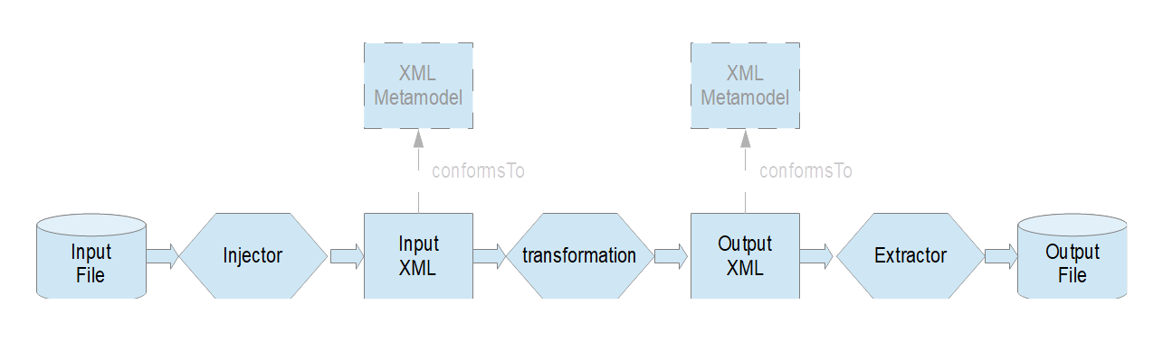
Old ATL XML2XML models/processing
  file - inject - input - tx - output - extract - file
    Custom loader / saver - injector / extractor
  weak / no metamodel conformance
    vague XML
  bit rot - not available in newer ATL implementations

Slide 10
Flexible modeled XML2XML
Custom injector / extractor
  inconvenient to maintain
    no longer available
EMF Resource
  abstract, flexible
  separate concerns

Slide 11
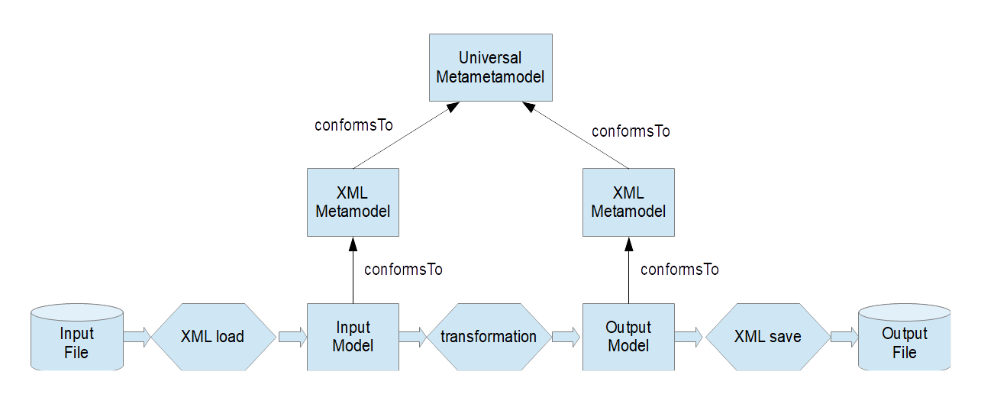
Modeled XML2XML models/processing
  file - XML-load - input - tx - output - XML-save - file
  all models have metamodels / universal metamodel
    'standard' XML metamodel

Slide 12
EMF Resource approach
EMF Resource
- an abstract model representation
    uniform EObject model elements internally
    appropriate persistence externally
  XMIResource - default XMI serialization
  UMLResource - specialized XMI serialization
  CDOResource - database persistence
  MyDslResource - custom specialized serialization
    may use Xtext to serialize as readable text
XMLModelResource
    'standard' XML metamodel EObjects internally
    XML serialization externally

Slide 13
'standard' XML metamodel
XML - unmodeled anarchic mess
XSD - unmodeled attempt to control the mess
No standard metamodels
  pragmatic - horrible
SAX parser - de facto standard
  use SAX parser events as basis for metamodel
    familiar vocabulary

Slide 14
What is needed to use M2M for M2T?
text output - mandatory
  use a text metamodel
powerful text synthesis - desirable
  OCL provides a modest String library

Slide 15

Modeled M2M/M2T models/processing
  file - load - input - tx - output - text-save - file
  all models have metamodels / universal metamodel
    'standard' text metamodel

Slide 16
What is a text metamodel?
Various text representations in T2M parsers
  8 bit bytes in a file
  multi-byte Unicode characters - 'letters'
  multi-character tokens - 'words'
  multi-word rules/productions - 'clauses'/'sentences'
M2T needs to be 'pretty'
  predictable flexible whitespace
  parsing tokens discard whitespace

Slide 17
Character-level text model too painful
Target text
The name is "computedName"
QVTo ststements
... -- 'The name is'
characters += object text::Character { value := ' '; };
characters += object text::Character { value := '"'; };
forEach (c : self.name.characters()) {
characters += object text::Character { value := c; };
}
characters += object text::Character { value := '"'; };
  potentially an object construction per character

Slide 18
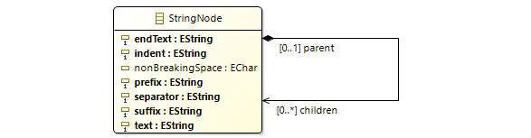

Hierarchical text tree
Depth first traversal yields simple text
  tree structured by parent/children
  optional text precedes children's serialization
  optional prefix/separator/suffix wrap children
  optional endText follows children's serialization
  ancestrally cumulative indent prefixes each new line
  ( nonBreakingSpace influences long line wrapping )

Slide 19
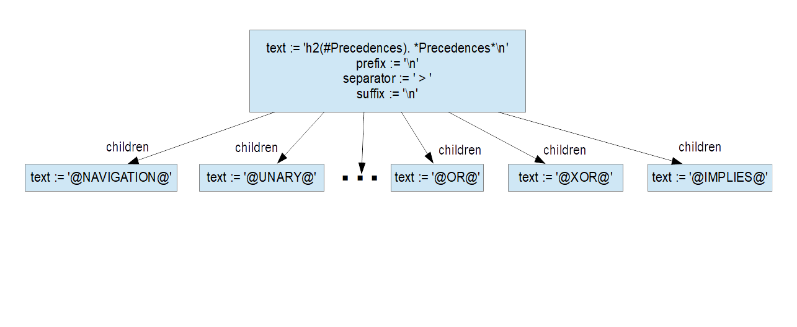
StringNode instances
Target text
Intermediate text output model

Slide 20
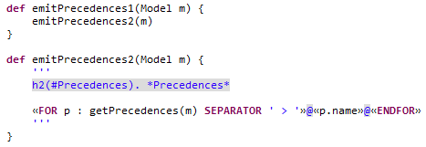
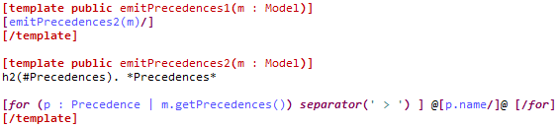
Example 1
Target text - textile documentation
Xtend solution
Acceleo solution

Slide 21
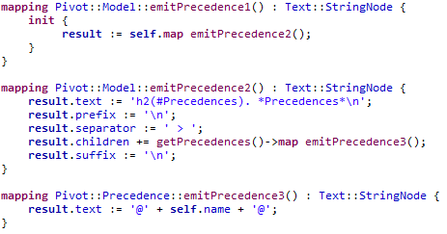
Example 2
Target text - textile documentation
QVTo solution

Slide 22
Eclipse Implementation Detail
No changes to QVTo (or ATL or ...) needed
EMF Resource typically chosen by file extension
  transform to *.xmi etc uses XMIResource
    conventional XMI output (M2M)
  transform to *.textmodel uses TextModelResource
    text output (M2T)
Desirable to-do for each M2M tool
  launch pull down menu to select resource explicitly
    transform to *.c can use TextModelResource

Slide 23
M2T-friendly OCL Strings
M2T-friendly OCL could have escapes
«ocl-expression» forwards escape within literal text
«'string-template'» backwards escape - an ocl-expression
Standard OCL text expression
'The name is "'+ self.name +'".'
M2T-friendly OCL string template expression
«'The name is "«this.name»".'»
?? Limited benefit
  small example, better readability, better in loops

Slide 24
M2T-friendly OCL Standard Library
splice iteration to format prefix/separator/suffix
more readable example
map Pivot::Model emitPrecedences2() : Text::StringNode {
«'
h2(#Precedences). *Precedences*
«getPrecedences(m)->splice(separator = ', ' | «'@«name»@'»)»
'»
}
- expression within text within expression within text within mapping
OCL evaluation
  splice evaluates as an iteration
QVTo compilation
  splice maps to StringNode instances

Slide 25
Separation of Concerns
model-to-text-model
  generate content
  specify structure, indentation/separation/...
text-model-to-text
  reify structure
  pretty print
  line wrap
  extensible

Slide 26
Performance
fast
  just a QVTo M2M - 2000 lines per second
  can be faster
declarative too
  text is serial, but trees are parallel
  tree branches can be computed in parallel
  final collation should respect 'ordered' properties
  tess is a model, traceable, incremental

Slide 27

OMG MOFM2T RFP revisited
MOFM2T Request For Proposal
"This RFP calls for a language and semantics for transforming models into text. The goal is not to create yet another language, but to use or extend existing OMG language(s). Justification must be provided for creating yet another language."
MOFM2T reuses
MOF metamodel, OCL expressions, QVT query syntax
  No justification for yet another language provided
Text model approach reuses QVT / ATL / ...
  optionally extends OCL

Slide 28
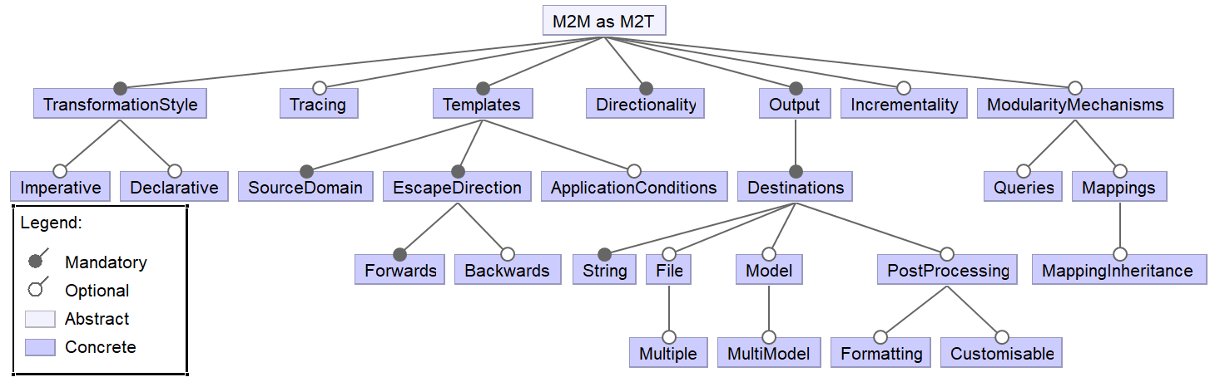
QVTo for M2T Feature Model
A feature model for model-to-text transformation languages.
Rose, Matragkas, Kolovos, Paige. ICSE 2012
Better/novel QVTo model capabilities
Need 'optional' String backward/forward escapes

Slide 29
Status
http://www.eclipse.org/qvt/2018/TextModel
    available in org.eclipse.qvtd.text since June 2018
http://www.eclipse.org/qvt/2018/XML
    available in org.eclipse.qvtd.xml since June 2018
useable
to do
  OCL forward/backward escapes
  OCL splice iteration
  QVTo launch menus
  QVTo splice optimization

Slide 30
Summary
now: M2M can be used unchanged for M2T
  exploit EMF resource flexibility
    new Text and XML 'standard' metamodels
OMG MOFM2T should have exploited M2M
future: OCL enhancements may be helpful
  backwards/forwards escapes
  splice() iteration

