Slide 1
The Micromapping Model of Computation
The Foundation for Optimized Execution of Eclipse QVTc/QVTr/UMLX.
Edward D. Willink
Willink Transformations Ltd
Eclipse Foundation
MMT Component co-Lead
OCL Project Lead
QVTd Project Lead
QVTo Committer
OMG (Model Driven Solutions)
OCL 2.3, 2.4, 2.5 RTF Chair
QVT 1.2, 1.3, 1.4 RTF Chair
ICMT2017 @ STAF2017
17th July 2017

Slide 2

Overview
Background => QVT, UMLX, The Problem
Procedural/Declarative Exposition
Connections and Micromappings
Mapping => Local Analysis
Global Analysis => Schedule
Results
Eclipse QVTc/QVTr/UMLX status
Conclusion

Slide 3



QVT Background
Query/View/Transformation
2002: standard transformation language RFP
    OMG specification - slow to mature
    ATL took a pragmatic short cut
    UMLX independent but rather similar
2005: Three language compromise
    QVTo (Operational Mappings) - Imperative
      2 1 good implementations : SmartQVT, Eclipse QVTo
    QVTr (Relational) - Declarative, rich
      2 0 poor implementations : ModelMorf, Medini QVT
    QVTc (Core) - Declarative, simple
      notional common core, no implementations
  Eclipse QVTd: QVTc/QVTr/UMLX editors
    limited utility in another very late M2M language
    must be better - optimized to Java

Slide 4
QVT Background
Query/View/Transformation
2002: standard transformation language RFP
    OMG specification - slow to mature
    ATL (textual) took a pragmatic short cut
    UMLX (graphical) independent but rather similar
2005: Three language compromise
    QVTo (Operational Mappings) - Imperative
    QVTr (Relational) - Declarative, rich
    QVTc (Core) - Declarative, simple
Eclipse QVTd: QVTc/QVTr/UMLX editors
    limited utility in another very late M2M language
    must be better - optimized to Java

Slide 5

Background - Procedural
Procedural model transformation
  programmer-specified execution schedule
    'good things' happen to the data

Slide 6
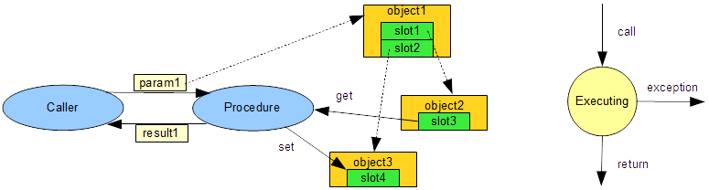
Procedural 'step'
Caller invokes procedure
  passes parameters
  receives results
Procedure accesses slots of objects

Slide 7
Procedural 'program'
'main'
param1
Procedure1
object1
slot1
Procedure3
slot2
result1
param2
object2
Procedure2
slot3
get
Procedure4
object3
slot4
param3
Procedure5
set
Control Flow: Procedure calls Procedure ...
  Well-defined procedure call-tree (maybe cyclic)
Data Flow: Accidental hidden object side effects

Slide 8
The Declarative Problem
Programmer-specified model truth
  no schedule, implied data dependencies
  tooling must discover execution schedule
Execute a declarative model transformation
  UMLX / QVTr / QVTc
  efficient run-time
  efficient schedule
Naive execution
  pool of all objects, set of mappings
  try all permutations of objects for all mappings
    very very inefficient
    may deadlock
M1
objects
M2
M3

Slide 9
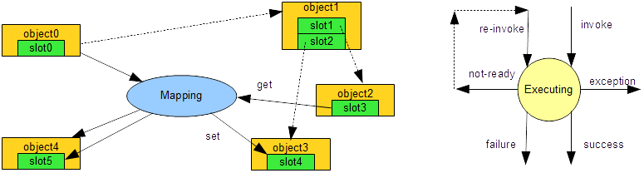
Declarative 'step'
Suitable input objects invokes mapping
  no parameters, no results
  may create more objects
Waits till accessed slots of objects are ready

Slide 10
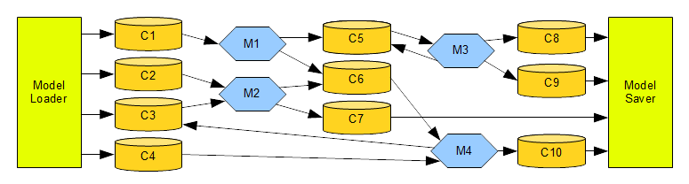
Declarative 'program' direct inputs
Connection manages similar (same-typed) objects
  queue of pending inputs
input Connections, Mapping, output Connections
  well-defined Connection/Mapping graph (mostly acyclic)
Metamodel types impose sensible structure

Slide 11
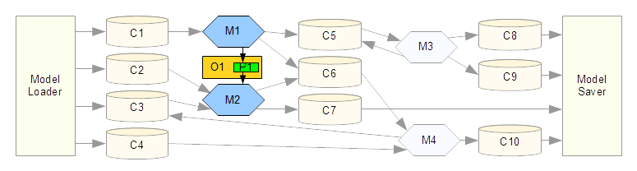
Declarative 'program' indirect inputs
Internal property accesses
  known producer(s), known consumer(s)
  additional producer-consumer data dependencies
Smart scheduling - M1 before M2
  guarantees that M2 access to O1::P1 is ready
Control derived from Data Flow: No accidents

Slide 12
Declarative Run-time
Many Connections
  each managing the pending Mapping inputs
Many Mappings
  each performing a step of execution
  may need to re-execute once inputs ready
Many Slot states
  tracks readiness of a Class instance slot
  blocks if premature, unblocks once ready

Slide 13
Static / Dynamic Schedule
Static (compile-time) schedule
  guarantees that all Mapping inputs are ready
    avoids need for associated Slot states
    avoids need for ready testing, not-ready re-execution
  typically over 90% of execution
Dynamic (run-time) schedule
  incurs extra overheads
    but only for a small proportion of Mapping invocations

Slide 14
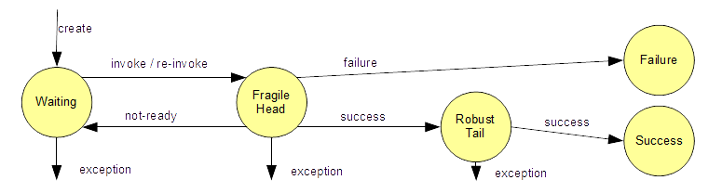
Mapping Lifecycle
Fragile Head
  evaluates guards/predicates, may fail
  checks sources, may be not-ready
  executes as often as necessary, no changes
Robust Tail
  executes exactly once, makes changes, never fails
Assumption
  a Mapping either executes or blocks

Slide 15
Mapping content
Mapping (Rule or Relation)
  friendly module of declarative execution
Multiple mappings may contradict
  M1: a = b + 1; ║ M2: b = a + 1;
  idiot program
Multiple mappings may conflict
  M3: a = b + 1; ║ M4: b = c + 1; d = a + 1;
  deadlock on computation of b
Partition into Micromappings to break deadlock
  M4A: b = c + 1; ║ M3: a = b + 1; ║ M4B: d = a + 1;

Slide 16
Model Truth, Speculation
MA: if B exists then A exists
MB: if A exists then B exists
Sequential/procedural conflict
  starting with an output comprising no A and no B
    cannot execute MA till MB executes and vice-versa
Declarative rules define the final truth
  checking the final output comprising an A and a B
    both MA and MB are satisfied
Consistent declarative execution
    both MA and MB must execute
Speculate
  B exists => A exists => B exists => OK

Slide 17
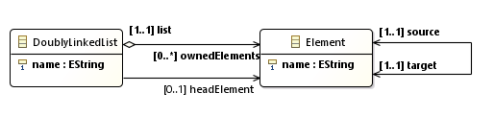
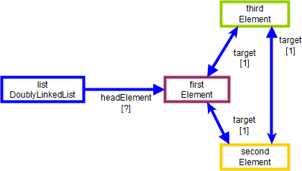
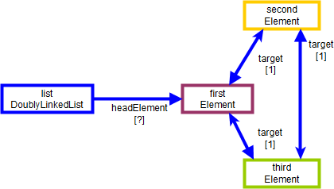
Doubly Linked List Reversal Example

Slide 18
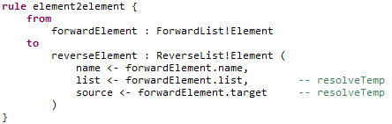
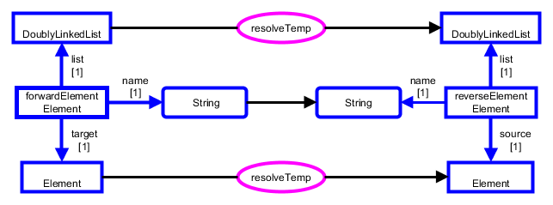
ATL rule

Slide 19
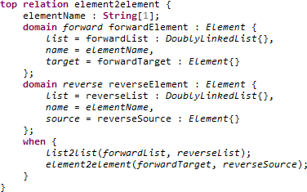
ATL rule / QVTr relation
unidirectional
ATL
(manual)
bidirectional
QVTr
(manual)

Slide 20
Patterns
Textual Mappings/Relations/Rules
  set of input recognition constraints
  set of output generation queries
Graphical Mappings/Relations/Rules
  use patterns for navigation constraints / queries
  use OCL for residual constraints / queries
  Henshin - endogeneous graphical syntax
  UMLX - exogeneous graphical syntax

Slide 21
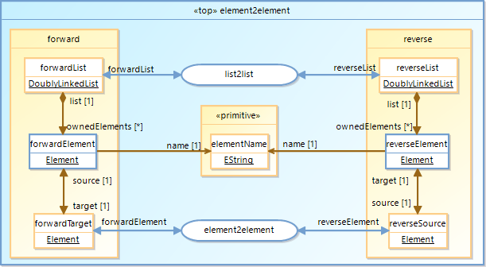
UMLX Relation Diagram
Derived
automatically
from QVTr

Slide 22
Eclipse QVTd Tx Chain Architecture
QVT Declarative
New Intermediate Languages
VM
QVTr
QVTc
OCL
UML
QVTc
QVTu
QVTm
QVTs
QVTs
QVTi
QVTi
+
Henshin
UMLX
ATL
ETL
ALF
QVTo
program-to-program
transformation
Java
composition
XYZ
language representation
Progressive transformation
  UMLX / QVTr / QVTc
  intermediates - QVTs
  interpreted execution - QVTi
  code generated execution - Java

Slide 23
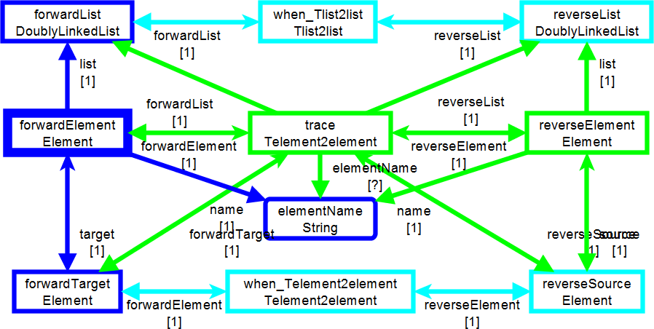
QVTs Mapping
Derived automatically:
UMLX<=>QVTr=>QVTc=>QVTu=>QVTm=>QVTs

Slide 24
QVTs Analysis - Arrows
Navigation
  metamodel defines forward/reverse navigation
    everything has an opposite in OCL
  metamodel defines forward/reverse multiplicity
    [1..1], [0..1] define to-one navigation
    QVTs arrows show to-one paths
to-one analysis => one/multiple head nodes
Head nodes
  minimum set of nodes to reach all nodes reachable
    strong calling clue, searching clue
  QVTs shows heads with thick border

Slide 25
QVTs Analysis - Colors
Phasing
  transformation defines input / output metamodels
    input metamodel elements are LOADED
    output metamodel elements are REALIZED
  rule/relation has intermediate elements
    intermediate input elements are PREDICATED
    intermediate output elements are REALIZED

Slide 26
UMLX / QVTs patterns
Same 'UML' pattern
  UMLX has pale blue inter-relation dependencies
  QVTs has reified trace object dependencies
    trace is this invocation
    when_Tlist2list, when_Telement2element are used
  LOADED, PREDICATED before REALIZED

Slide 27
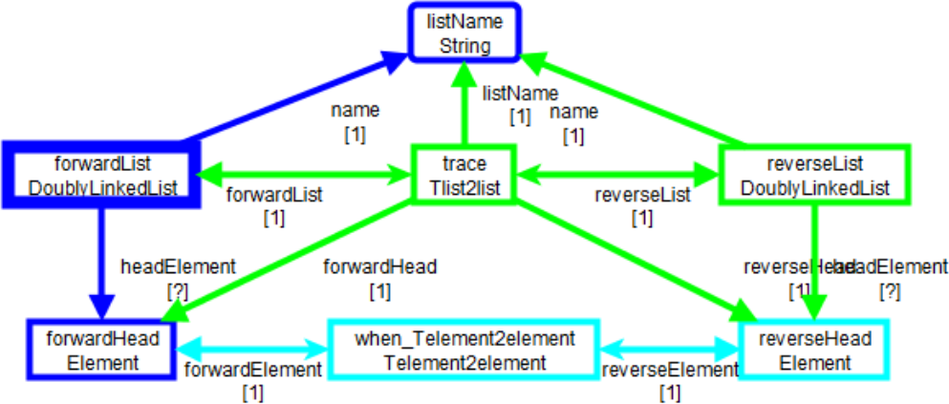
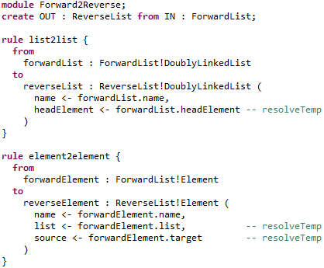
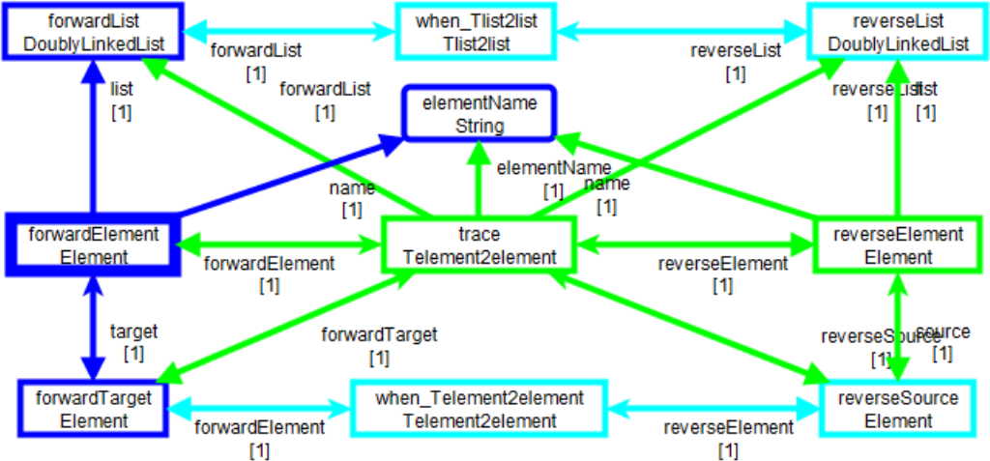
Dependency Conflicts
oops
REALIZE
before
PREDICATE

Slide 28
Partitioning
Split Mappings into Micromappings
  conflicts in distinct micromappings
  speculation before realization
    early micromapping speculates
      only the trace model changes
    intermediate micromapping mediates
      all speculations consistent
    late micromapping realizes
      output model changes

Slide 29
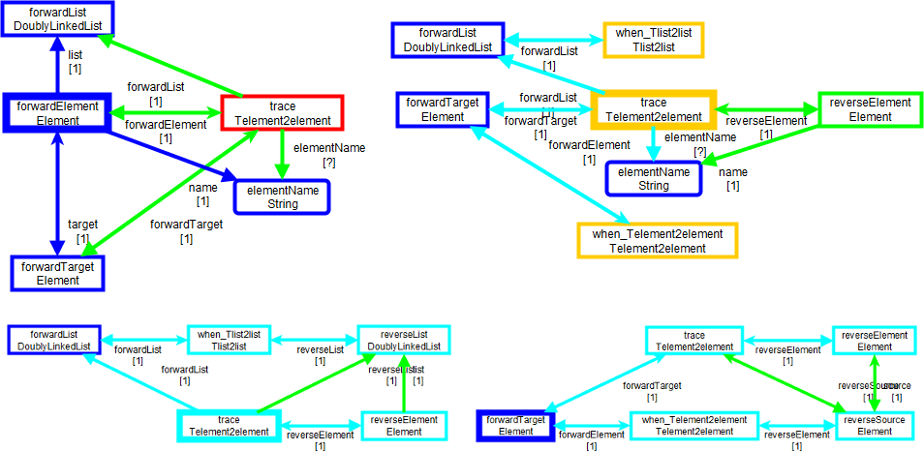
Partitioned
SPECULATION trace ignores some predicates
SPECULATED skipped predicates checked

Slide 30
Total Global Schedule
Partioned
  atomic micromappings
    class consumers / producers => types
    property gets / sets => types
  types => connections
    producers, consumers, gets, sets
  inheritance
    multi-production/consumption

Slide 31
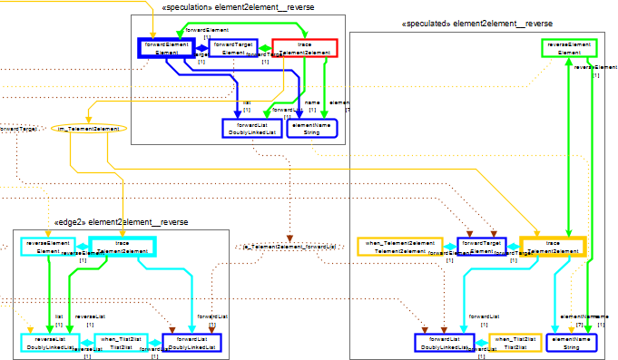
Full Global Schedule

Slide 32
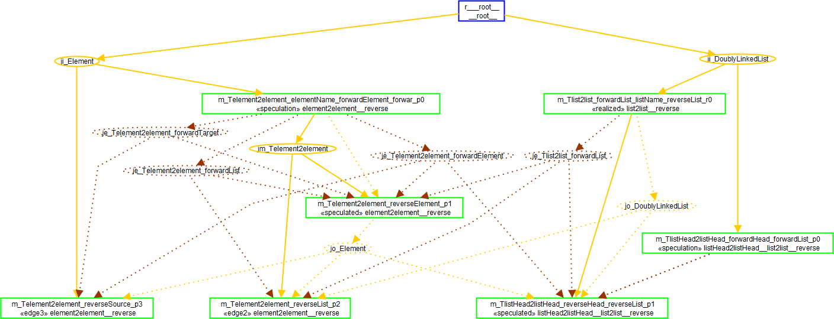
Simplified Global Declarative Schedule
Micromapping
Implemented Connection - passed
Required Nodes / Objects - recomputed
Required Edges / Properties - recomputed

Slide 33
Global Declarative Call Tree
Micromappings - 'hyperedges' in a call 'tree'
  mostly single input
    potentially inlined wrt caller
  multiple inputs
    permuted
Connections - nodes in a call 'tree'
  mostly acyclic
    static scheduled
    static buffering policy
  cyclic
    dynamic / run-time
  local sub-scheduler - incremental

Slide 34
Global Imperative Call Tree
Allocate a first index to each micromapping
  respecting call tree sequencing
Allocate a last index to each micromapping
  respecting call 'tree' cycles
first...last defines active range
  prune dependencies for non-overlapping ranges
optimization goals
  maximize pruning
  maximize micromapping merging
    adjacent indexes, same dependencies can be merged

Slide 35
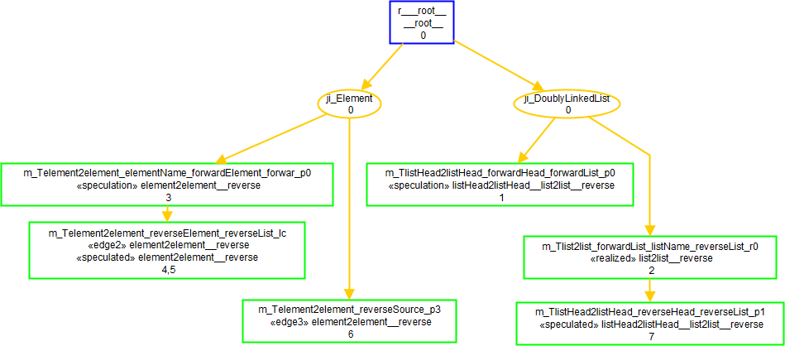
Global Imperative Merged Schedule

Slide 36
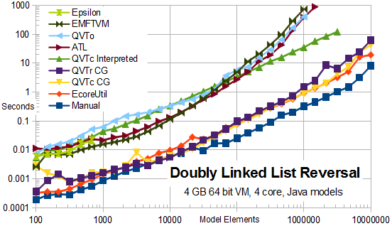
Doubly Linked List Reversal Results

Slide 37
Eclipse QVTd Status
0.12.0 (Mars - June 2015)
  QVTi execution (code generated or interpreted)
0.13.0 (Neon - June 2016)
  preliminary QVTc / QVTr execution
    low quality - research only
0.14.0 (Oxygen - June 2017)
  preliminary UMLX
  better but no override, no in-place
  no debugger, minimal documentation / examples
1.0.0 (Photon - June 2018)
  first release functionality

Slide 38
Conclusion
Micromappings + Connections
  Useful efficient run-time
  Mostly dictated by metamodel/transformation
First
  implementation of the QVTc specification
  optimized implementation of QVTr
  direct code generator for model transformations.
Thirty fold speed-up.
Many more optimizations to do.

