Slide 1
QVT Traceability
What does it really mean?
Edward Willink
Willink Transformations Ltd
Eclipse Foundation
MMT Component co-Lead
OCL Project Lead
QVTd Project Lead
QVTo Committer
OMG (Model Driven Solutions)
OCL 2.3, 2.4, 2.5 RTF Chair
QVT 1.2, 1.3 RTF Chair
AMT 2015 @ MODELS 2015
28th September 2015

Slide 2


Overview
Traceability
  alternate meanings
  vague QVT specification
Traceability details
Traceability consequences
  declarative
  imperative

Slide 3

QVT
Query / View / Transformation
  OMG specification - slow to mature
  ATL took a pragmatic short cut
Three languages
  QVTo (Operational Mappings) - Imperative
  QVTr (Relational) - Declarative, rich
  QVTc (Core) - Declarative, simple
    notional common core
Eclipse QVTd
  QVTr->QVTc->QVTu->QVTm->QVTp->QVTi->Java

Slide 4


Background
QVT ...
  Aspires to be bigger, better, specified
  QVT 1.2 - resolved 95 issues
  QVT 1.2 - left 29 issues deferred
    'for lack of time'
      need to prototype solution
      need inspiration
QVT Traceability specification is a mess
  discussion document
  invited paper for AMT 2015

Slide 5
Traceability use cases
requirements traceability
'printf' traceability
debugger traceability
internal traceability
incremental traceability

Slide 6
Requirements Traceability
How does X relate to the specification?
correlate rules/mappings to specification
  vague 'requirements'
not M2M traceability

Slide 7
'printf' Traceability
What happened?
voluminous output
  facilitate debugging
  facilitate performance analysis
model rather than informal text
informal pragmatic content

Slide 8
Debugger Traceability
What is happening?
source level debugging
  correlated source view
  stepping
  inspection
  breakpoints

Slide 9
Internal Traceability 1
Has X been executed?
General transformation policy
  do not repeat computations
Internal mechanism
  hidden from users

Slide 10
Not so Simple Transformation
Primary S1 to T1 rule
Secondary S1,S2 to T1,T2 rule
  re-use T1 created by R1 from S1
S1
R1
T1
S1
R1
T1
S2
R2
T2

Slide 11
Internal Traceability 2
What was the result of X?
Trivial transformation
    tree-structured output - can use parameters
Complex transformation
    graph-structured output - too complex for parameters
Overlap resolution - internal mechanism
    ATL : resolveTemp
    Epsilon : equivalent
    QVTo : resolve
    QVTr : when
Overlap resolution - explicit mechanism
    QVTc : middle model

Slide 12
Incremental Traceability
What do I need to re-execute?
support incremental update
  at another time
    persisted state
  at another place
    interchangeable/loadable

Slide 13
Traceability use cases
    requirements traceability
    'printf' traceability
    debugger traceability
    internal traceability
    incremental traceability
QVT - bigger and better
  incremental traceability
    internal/debug traceability re-use the solution
  declarative
    imperative

Slide 14
Tentative QVT specification
QVT 1.2 (aspirationally) specifies
  interchangeable QVTc/QVTo/QVTr traceability
  incremental re-execution
    persistent traceability model
?? QVT 1.3 ??
An incremental transformation execution may exploit the saved traceability from a previous execution.
Simple principle
  corrolaries?
  declarative then imperative

Slide 15
What do I need to re-execute?
s1 : S1
R1
t1 : T1
s2 : S2
R2
t2 : T2
R1, R2 represent some computation
  (expression, statement,) rule/mapping
s1,s2 represent input state/objects of type S1,S2
t1,t2 represent output state/objects of type T1,T2
If s1 or s2 changes, R2 must re-compute

Slide 16
How do I know what has changed?
Original execution
Possible re-execution
Compare s1' and s1
  s1 may no longer exist, must use a 'recording'
    trace representation
Compare trace representation of s1
and trace representation of s1'
s1 : S1
R1
t1 : T1
s1' : S1
R1
t1' : T1

Slide 17
What is a trace representation ? 1
all the state needed to support comparison
in practice
  save old trace representations
  reload old trace representations
  decide whether re-execute transformation
    compare old with new
    some inputs may have changed e.g. time

Slide 18

What is a trace representation ? 2
Immutable DataType 'instances' - values
  Integer, String, Set(String), Tuple ...
  not unique
    many objects may have a zero-valued Integer property
  require full state as trace representation
    simple/small for values such Integer - 4
    complex/large for e.g. Collection of Tuple of ...
      ?? share repeated usages from a 'pool'
4
4
ref
ref
Set{1,2,3}

Slide 19
What is a trace representation ? 3
Class instances - objects
  'unique'
    in memory, location/address can represent full state
    full state must be persisted/reloaded
  almost unique
    declarative transformation
      distinct reloaded / prevailing states - old time / new time
    declarative in-place transformation
      distinct before / after states
    only one state needs to be saved

Slide 20
Has X been executed?
s1 : S1
R1
t1 : T1
What is executed?
  a computation R1
  one or more inputs, e.g. s1 conforming to S1
  one or more outputs, e.g. t1 conforming to T1
The trace record: {{R1, {s1}}, {t1}}
  The trace identity: {R1, {s1}}
    computation identity: R1
    input trace representations: s1
  output trace representations: t1

Slide 21

What was the result of X?
s1 : S1
R1
t1 : T1
s2 : S2
R2
t2 : T2
Trace Data = all Trace Records
Trace Records: {{R1, {s1}}, {t1}}, {{R2, {s1,s2}}, {t1,t2}}
Trace Identities: {R1, {s1}} , {R2, {s1,s2}}
Has (trace identity) X been executed?
  does trace data contain a trace record for X?
What was the result of (trace identity) X?
  extract outputs from trace record for the X

Slide 22
(Mapping/Rule) Refinement
OO supports operation overloading
    invariant / contra-variant arguments
    covariant results
    'simple' dynamic dispatch of type match
M2M permits mapping/rule refinement
    mappings have predicates
      non-execution is permissible
    predicate arbitration amongst candidates
    refined mappings may have covariant inputs
    refined mappings may have additional/redundant inputs
    multi-refinement is feasible

Slide 23
Independent Mappings and Refinements
s1 : S1
R1
t1a : T1
s1 : S1
R2
t1b : T1
Independent mappings
  each matching mapping is executed
  {{R1, {s1}}, t1a} and {{R2, {s1}}, t1b}

Slide 24
Dependent Mappings and Refinements
s1 : S1
R1
t1 : T1
s2 : S2
R2
t2 : T2
Dependent mappings
  refinements, inheritances, (disjuncts in QVTo)
    each refines one or more base mappings
  best match for each base mapping executed once
    multi-refinements execution may be 'shared'
  {{R1, {s1}}, t1} or {{R2, {s2}}, t2}

Slide 25
Refinement Tracing 1
s1 : S1
R1
T1
s1 : S1
R2
T2
s2 : S2
what do we need to re-execute?
  re-assess predicates wrt the base
    trace record must have {R1,{s1}} as trace identity
  re-assess change wrt previous execution
    trace record must have {R2,{s1,s2}} as trace identity

Slide 26
Refinement Tracing 2
s1 : S1
R1
T1
s1 : S1
R2
T2
s2 : S2
what is the result of R1?
  user may not know about R2
    trace record must have {R1,{s1}} as trace identity
what is happening ?
  referenced trace identity must be actual refinement
    trace record must have {R2,{s1,s2}} as trace identity

Slide 27
Refinement Tracing 3
One trace identity is not enough
  need apparent/base trace identity
  need actual trace identity
Better trace record
  One or more trace identities
    computation identity
    input trace representations
  output trace representations
Multi-refinement
    one or more apparent/base trace identities
    one actual trace identity

Slide 28
QVTr Impact
No fundamental change
Clarify (define) Refinement Semantics
  and corresponding QVTr2QVTc mappings
Eliminate spurious single mapping input limit
  and corresponding QVTr2QVTc mappings
Clarify (rewrite) Middle Metamodel synthesis
  and corresponding QVTr2QVTc mappings

Slide 29
QVTc Impact
No fundamental change
Custom Middle metamodel
  structural recommendations
  re-use exploits OCL unnavigable opposites
    no resolveTemp/resolve/equivalent/when
Clarify (define) Refinement Semantics

Slide 30
Imperative, QVTo
Objects are mutable
List / Dict are mutable Sequence / Map
Mapping parameters may be inout
Global / transformation context is mutable
Trace representation is not stable

Slide 31
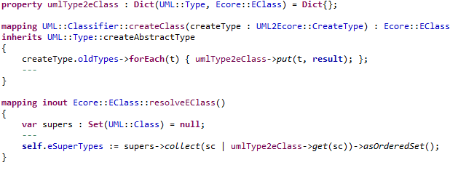
Dict example 1
1
2
3
1) Declare a global source-to-target Dict
2) Populate it many times in many places
3) Use it many times in many places

Slide 32
Dict example 2
Surely that's what "resolve" does?
Yes, but:
  "resolve" is built-in, invisible, undebuggable
    underspecified, poorly worded
    suspect implementation (Eclipse QVTo has improved)
    complex problem leads to distrust
  Dict is mine, visible, debuggable
Dict is a traceability nightmare
    global variable
    multiple write sites, multiple read sites
    correct usage is disciplined, usage to be debugged is not

Slide 33
What is a trace representation ? 4
Mutable DataType 'instances' - values
  imperative transformations only
  in QVTo List(String), Dict(String, Set(Real))
  not unique, not stable
    imperative transformation may make many changes
  require full prevailing state as trace representation
    naive - use per-usage deep clones
    better - share a deep clone of each distinct state
    more compact - share similar deep clones
      use a differential description of similar states
ref1
ref2
Set{1,2,4}
s/3/4
Set{1,2,3}

Slide 34
What is a trace representation ? 5
Class instances - objects
  not unique for imperative transformation
    numerous intermediate states
  re-execution must use the corresponding state
  multiple states can not co-exist in memory

Slide 35
What is a trace representation ? 6
s1 (old)
s1' (new)
s1 (old)
s1' (new)
BAD
s2 (old, new)
s2 (old, new)
s2 (old, new)
UML / MOF / Ecore single containment
  old state can use a coherent set of objects
  new / another state can use another coherent set
  cannot share contained/container objects
  completely independent objects for new / old / ...
    co-ordinating equivalence map
  differential representation for similar objects

Slide 36
Practical trace representation
Declarative - Problems can be bypassed
  single coherent set of object states
  correlation of old / new input
Imperative - problems are real
  multiple object states
Disciplined Imperative - single states
  is'nt declarative easier?

Slide 37
Declarative
Transformation execution
  forest of data/actions
  inputs - actions - intermediates - actions - outputs
Transformation re-execution
  only those actions whose inputs have changed
  for each action
    record all old inputs
    compare new inputs

Slide 38

Mutable Traceability 1
R1
Objects are mutable
  execute R1 for s1
  modify object s1 to s1'
  execute R2 for {s1',s2}
does {{R1,{s1}},t1} provide t1 for R2?
  Yes. Otherwise unuseable. Need Object-to-Object.
s1 : S1
t1 : T1
s1' : S1
R1
t1 : T1
s2 : S2
R2
t2 : T2

Slide 39
Mutable Traceability 2
DataTypes (List, Dict) are mutable
  execute R2 for {s1,s2}
  modify DataType s2
  execute R2 for {s1,s2'}
does {R2,{s1,s2}} re-use {R2,{s1,s2'}} ?
  No. Need multiple Object-to-Object.
s1 : S1
R1
t1 : T1
s2 : S2
R2
t2 : T2
s1 : S1
R1
t1 : T1
s2' : S2
R2
t2 : T2

Slide 40
Mutable Traceability 3
Class instances can be changed
  {{R1,{s1}},t1} is also {{R1,{s1'}},t1}
  order dependent
  {{R1,{s1'}},t1'} is also {{R1,{s1}},t1'}
DataType values cannot be changed
  {{R2,{s1,s2}},{t1,t2}} is not {{R2,{s1,s2'}},{t1,t2'}}
Asymmetric mess

Slide 41
Traceability specification conclusion
An incremental transformation execution may exploit the saved traceability from a previous execution.
Declarative - QVTc, QVTr
  practical, minor clarification of refinement tracing
Imperative - QVTo
  impractical for arbitrary transformations
    too much state to clone, differential state too hard
  practical for well-behaved transformations
    candidates for auto-conversion to QVTr

Slide 42
Imperative Trace Data
Trace representation is not stable
  create copy
    when tracing or when modifying
Clones
  selective deep clone with powerful analysis
  widespread deep clones with simple analysis
  potentially too large
Object versions
  many clones rather similar
  persist relative rather than absolute values

Slide 43
QVTo Options
Trace representation is not stable
  selective deep clone with powerful analysis
    may not be possible, certainly hard, ? too hard
  widespread deep clones with simple analysis
    unacceptable performance impact
Compromises
  leave unspecified, proprietary implementation
  reduce aspiration, just debug functionality
  restricted specification, no mutation, ...

Slide 44
QVTo Conclusion
Full traceability for QVTo impractical
  need deep semantic understanding
'Much easier' to transform to declarative

Slide 45
Trace Metamodel 1
There is a shared Trace Metamodel
QVT has distinct views
  per-mapping classes for QVTc (and QVTr)
    simple object re-use by reference
  per-semantic classes for QVTo
    pragmatic
      object re-use
    'rigorous'
      multi-state objects / values

Slide 46
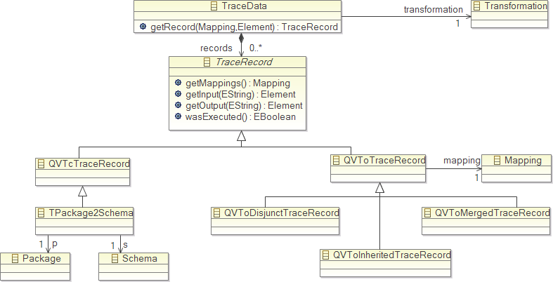
Trace Metamodel 2
Share between M2M tools
Can Mapping / Transformation be shared?

Slide 47
Conclusion
Various traceability use cases
  incremental traceability most stringent
QVT underspecified
Declarative tracing
  relatively straightforward
Imperative tracing
  too hard to fix
  heavy cloning cost unless relative objects used

