Slide 1
Optimized declarative transformation
First Eclipse QVTc results
Edward D. Willink
Willink Transformations Ltd
Eclipse Foundation
MMT Component co-Lead
OCL Project Lead
QVTd Project Lead
QVTo Committer
OMG (Model Driven Solutions)
OCL 2.3, 2.4, 2.5 RTF Chair
QVT 1.2, 1.3, 1.4 RTF Chair
BigMDE @ STAF 2016
8th July 2016

Slide 2


Overview
QVT Background
Eclipse QVTd architecture
Execution time
  imperative/declarative
Intra-mapping optimization
Inter-mapping optimization
Eclipse QVTc results
Eclipse QVTc/QVTr status
Conclusion

Slide 3


QVT Background
Query/View/Transformation
2002: standard transformation language RFP
    OMG specification - slow to mature
    ATL took a pragmatic short cut
2005: Three language compromise
    QVTo (Operational Mappings) - Imperative
      2 1 good implementations : SmartQVT, Eclipse QVTo
    QVTr (Relational) - Declarative, rich
      2 0 poor implementations : ModelMorf, Medini QVT
    QVTc (Core) - Declarative, simple
      notional common core, no implementations
  Eclipse QVTd: QVTc/QVTr editors

Slide 4

Eclipse QVTd Tx Chain Architecture
QVT Declarative
New Intermediate Languages
VM
QVTr
QVTc
OCL
UML
QVTc
QVTu
QVTm
QVTp
QVTs
QVTi
QVTi
+
program-to-program
transformation
ATL
ETL
ALF
QVTo
Java
XYZ
language representation
composition
QVTr2QVTc - nominally as in QVT specification
QVTc2QVTu ⇒ Unidirectional (remove reverse bloat)
QVTu2QVTm ⇒ Minimal (remove refinement etc)
QVTm2QVTp ⇒ Partitioned to avoid deadlocks
QVTp2QVTs ⇒ Schedulable graphical form
QVTs2QVTi ⇒ Imperative executable form

Slide 5
Execution time considerations
Approximate execution time: (W.N.R.L.C)^{A}
  W - the Workload - the number of data elements to be processed
  N - the Necessary computations per data element
  R - the memory Representation access overhead
  L - the programming Language overhead
  C - the Control overhead
  A - the Algorithmic overhead

Slide 6
Imperative Transformations
Explicit control statements
Manual programming
  hopefully good
  may be bad
Tooling
  hopefully good
  may be bad

Slide 7
Declarative Transformations
No control statements
Manual programming
  different approach, may be good/bad
Tooling
  must discover a control strategy
  hopefully good
  may be VERY BAD

Slide 8
Naive Polling Schedule
Retry loop - loop until all work done
Mapping loop - loop over all possible mappings
Object loops - multi-dimensional loop for all object/argument pairings
Compatibility guard - if object/argument pairings are type compatible
Repetition guard - if this is not a repeated execution
Validity guard - if all input objects are ready
Execute mapping for given object/argument pairings
Create a memento of the successful execution
Works for any declarative transformation
Hideously inefficient - VERY VERY BAD
Optimization goal - a statically ordered schedule

Slide 9
Declarative Optimization
Micro-mapping primitive
  partial mapping that avoids dependency deadlocks
Intra-micro-mapping
  reduce dimensionality of matching input object search
    3-dimensional search awkward, cubic performance
    1-dimensional search is simple loop
Inter-micro-mapping
  invoke micro-mappings in sensible order
    mostly static schedule
    efficient dynamic fall-back schedule for residue

Slide 10
QVTc Mapping Areas and Patterns
Left Guard
Middle Guard
Right Guard
Left Guard
Left Guard
Middle Bottom
Right Bottom
Left Bottom
Left/Middle/Right Input/Trace/Output domains
Guard/Bottom predicate/action patterns
Just like a triple graph, but Middle is reified

Slide 11
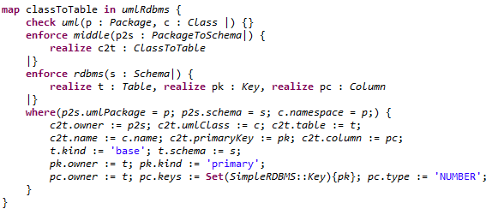
Intra-mapping Example - QVTp
Left(uml)/Right(rdbms) Hand Patterns
  variables, (predicates, assignments)
Middle Pattern
  variables, predicates, assignments

Slide 12
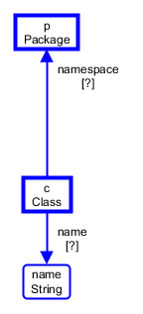
Example - LHS
Left Hand 'Object' Pattern
For each p that is-a Package
For each c that is-a Class
For each name that is-a String
  provided c.namespace = p
    Class objects must be non-null
  (provided c.name = name)
    DataType objects may be null

Slide 13
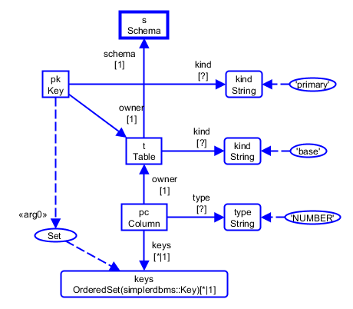
Example - RHS
Right Hand 'Object' Pattern
Create objects
  s, pk, t, pc
Assign relationships
  owner, owner, schema
Dashed: Compute set
  keys
Assign attributes
  kind, kind, type, keys

Slide 14
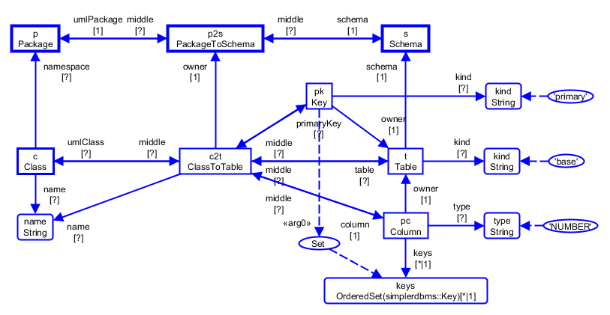
Example - Middle Elements
QVTc: Explicit Trace Objects - c2t, p2s
  OCL: all object navigations are bidirectional

Slide 15
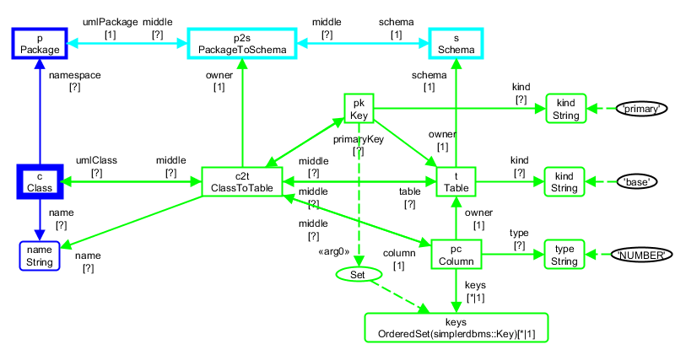
Example - Dependency Analysis
BLACK - constant
BLUE - loaded from input
CYAN - created/assigned elsewhere
GREEN - created/assigned here

Slide 16
Example - Multiplicity Analysis
Pattern defines the result truth
to-1 multiplicities the same truth
Ignore non-to-1 relationships
everything navigable by to-1 from c:Class

Slide 17
Intra-Mapping Optimization
Example
  naively 3-dimensional {Package, Class, String}
  optimized 1-dimensional {Class} and 2 navigations
Empirical observation
  about 90% of mappings can be single input
  multi-input mappings have quadratic/worse execution
Work in progress
  nearly all multi-input mappings can be reduced to
  single input and local loops
  only Cartesian problems need Cartesian execution

Slide 18
Inter-Mapping optimizations
Inter-mappings have simple dependency rule
  CYAN elements must be produced elsewhere
  elements are produced as GREEN elements
Global analysis: GREEN before CYAN
Complications
  multiple GREEN producers
  multiple CYAN consumers
  consumption of derived types

Slide 19
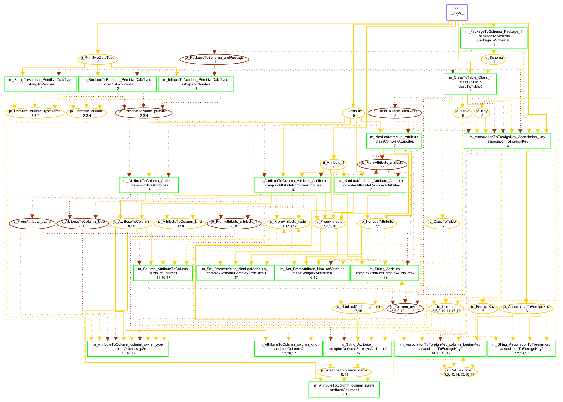
Full UML2RDBMS schedule

Slide 20
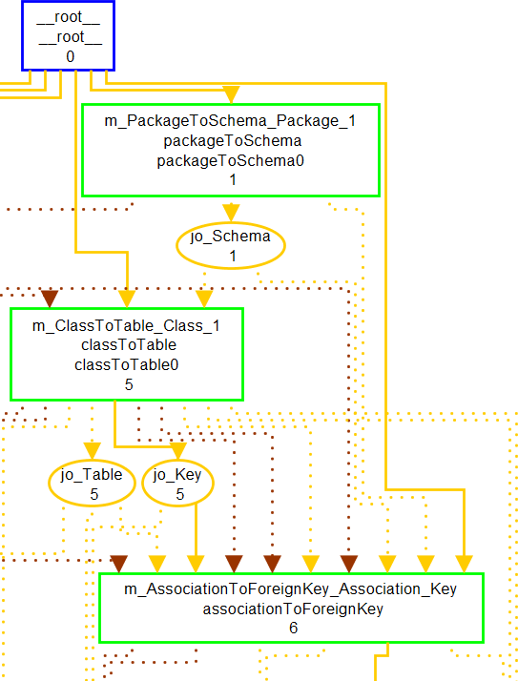
Top of UML2RDBMS schedule
Solid edges
  passed inputs
Dashed edges
  dependencies
  required inputs
  locally renavigated
Ellipses
  communication buffers

Slide 21
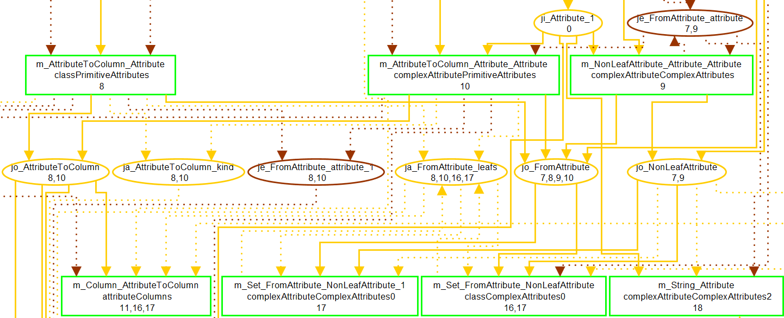
Recursion in UML2RDBMS schedule
Static integer schedule slots
Up arrows recurse - multiple schedule slots
  run-time speculative / retry execution

Slide 22
UML2RDBMS overall
Results
20 micro-mappings
  15 reduced to single input - linear performance
  5 with two inputs - quadratic performance
    when associations in use
    work in progress use local loops - linear wrt output
No point showing fixable quadratic performance
  use Families2Persons - linear performance

Slide 23
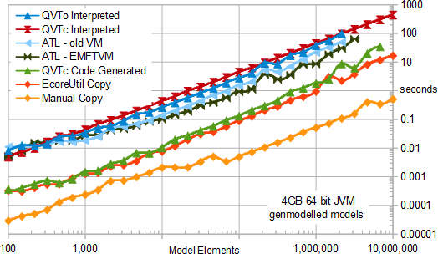
Families2Persons Results

Slide 24
Families2Persons Size Results
Failing at/below 10,000,000 elements in 4 GB.
  400 Bytes per element!
  50 'things' 8 bytes per thing with 64 bit CPU
Input/trace/output objects, String names
44 bytes per HashMap$Entry node

Slide 25
Eclipse QVTd Status
0.12.0 (Mars - June 2015)
  QVTi execution (code generated or interpreted)
0.13.0 (Neon - June 2016)
  preliminary QVTc / QVTr execution
    low quality - research only
  no incremental / check / in-place facilities
  no debugger
  minimal documentation / examples
1.0.0 (Oxygen - June 2017)
  first release functionality (? with UMLX ?)

Slide 26
Conclusion
First implementation of the QVTc specification.
First direct code generator for model transformations.
Thirty fold speed-up.
Graph presentation of metamodel and dependency analyses tames the naive inefficiencies of a declarative schedule.
Many more optimizations to do, and ... QVTr.

