Slide 1
Local Optimizations in
Eclipse QVTc and QVTr using the
Micro-Mapping Model of Computation
Edward D. Willink
Willink Transformations Ltd
Eclipse Foundation
MMT Component co-Lead
OCL Project Lead
QVTd Project Lead
QVTo Committer
OMG (Model Driven Solutions)
OCL 2.3, 2.4, 2.5 RTF Chair
QVT 1.2, 1.3, 1.4 RTF Chair
EXE 2016 @ MODELS 2016
3rd October 2016

Slide 2


Overview
QVT Background
Eclipse QVTd architecture
Do things in the right order
  imperative/declarative
Intra-mapping scheduling
Example results
Eclipse QVTc/QVTr status
Conclusion

Slide 3


QVT Background
Query/View/Transformation
2002: standard transformation language RFP
    OMG specification - slow to mature
    ATL took a pragmatic short cut
2005: Three language compromise
    QVTo (Operational Mappings) - Imperative
      2 1 good implementations : SmartQVT, Eclipse QVTo
    QVTr (Relational) - Declarative, rich
      2 0 poor implementations : ModelMorf, Medini QVT
    QVTc (Core) - Declarative, simple
      notional common core, no implementations
  Eclipse QVTd: QVTc/QVTr editors

Slide 4

Eclipse QVTd Tx Chain Architecture
QVT Declarative
New Intermediate Languages
VM
QVTr
QVTc
OCL
UML
QVTc
QVTu
QVTm
QVTs
QVTs
QVTi
QVTi
+
Henshin
UMLX
ATL
ETL
ALF
QVTo
program-to-program
transformation
Java
composition
XYZ
language representation
QVTr2QVTc - nominally as in QVT specification
QVTc2QVTu ⇒ Unidirectional (remove reverse bloat)
QVTu2QVTm ⇒ Minimal (remove refinement etc)
QVTm2QVTs ⇒ Create graphical form
QVTs2QVTs ⇒ Optimize/schedule graphical form
QVTs2QVTi ⇒ Imperative executable form

Slide 5
Correct Execution 1
No global state => Object Orientation
No naughty writes => Static Single Assignment
  impractical in the large
No naughty writes => Functional Programming
  new system, inefficient in the large
But
  multiple threads
  complex object state
  evolving object state

Slide 6
Correct Execution 2
No naughty reads
  every property read occurs after its property write
Functions - f(a,b,c) { return a.x + g(b.y.z, c); }
  parameters easy to analyze - a, b, c
  references hard to analyze - g(b.y.z, c)
  => secret undeclared inputs, manual discipline
Declarative Mappings/Relations/Rules
  same problem; global analysis necessary/possible

Slide 7
Imperative Transformations
Explicit control statements
Manual programming
  hopefully good
  may be bad
Tooling
  hopefully good
  may be bad

Slide 8
Declarative Transformations
No control statements
Manual programming
  different approach, may be good/bad
Tooling
  must discover a control strategy
  hopefully good
  may be VERY BAD

Slide 9
Naive Polling Schedule
Retry loop - loop until all work done
Mapping loop - loop over all possible mappings
Object loops - multi-dimensional loop for all object/argument pairings
Compatibility guard - if object/argument pairings are type compatible
Repetition guard - if this is not a repeated execution
Validity guard - if all input objects are ready
Execute mapping for given object/argument pairings
Create a memento of the successful execution
Works for any declarative transformation
Hideously inefficient - VERY VERY BAD
Optimization goal - a statically ordered schedule

Slide 10
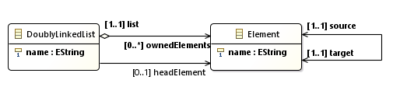
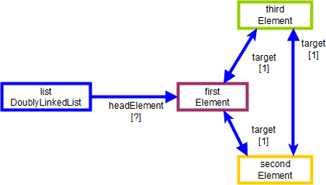
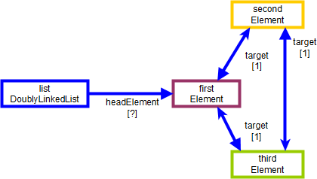
Doubly Linked List Reversal Example

Slide 11
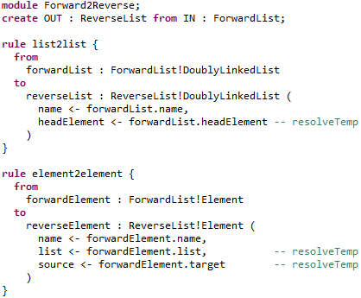
ATL solution

Slide 12
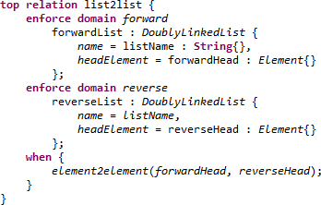
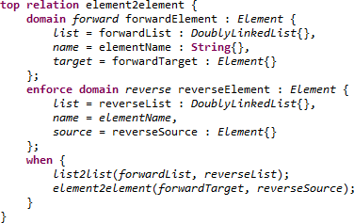
QVTr solution

Slide 13
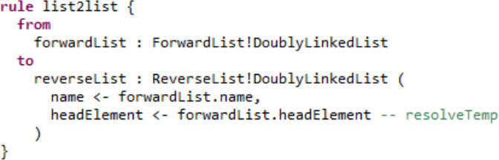
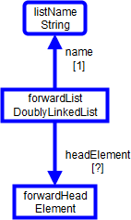
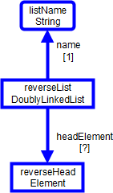
Underlying (ATL) functionality
resolveTemp

Slide 14
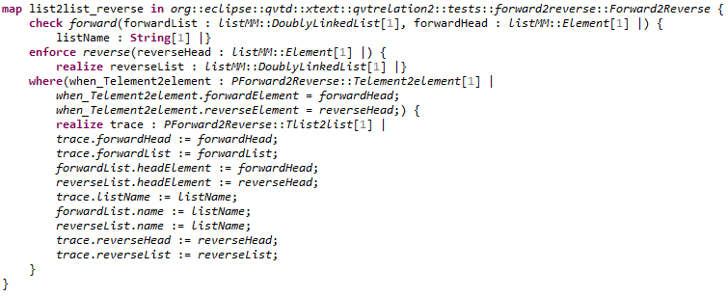
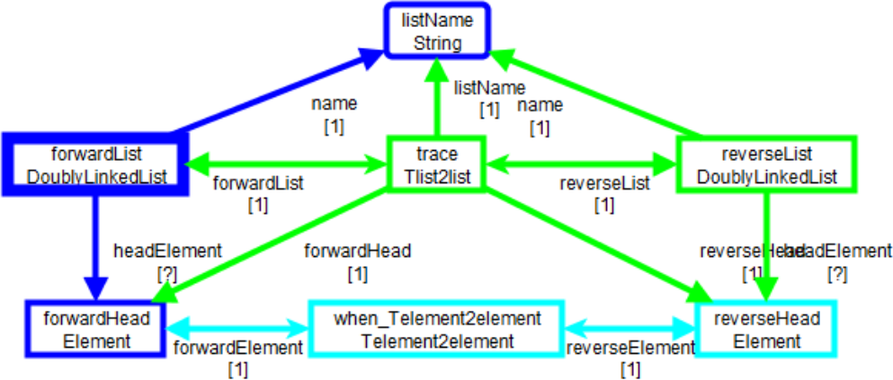
Underlying
QVTr in QVTc functionality

Slide 15
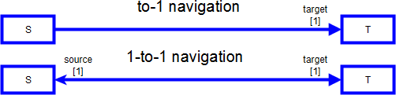
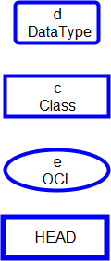
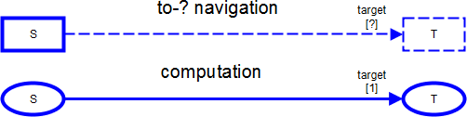
Mapping Diagram Artefacts

Slide 16
Mapping MoC
Truth - after execution
  to-1 relationships
    => 1:1 group of objects
    => HEAD from which all 1:1 objects can be reached

Slide 17
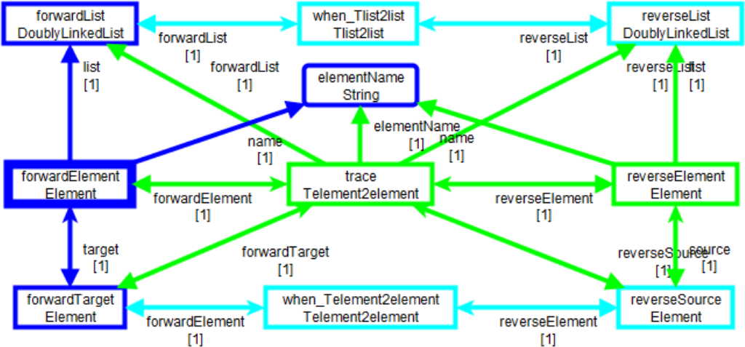
Dependency Conflicts
REALIZE
before
PREDICATE

Slide 18
Declarative Optimization
Micro-mapping primitive
  partial mapping that avoids dependency deadlocks
Intra-micro-mapping
  reduce dimensionality of matching input object search
    3-dimensional search awkward, cubic performance
    1-dimensional search is simple loop
Inter-micro-mapping
  invoke micro-mappings in sensible order
    mostly static schedule
    efficient dynamic fall-back schedule for residue

Slide 19
Intra-Mapping Optimization
Example
  naively 3-dimensional {Package, Class, String}
  optimized 1-dimensional {Class} and 2 navigations
Empirical observation
  about 90% of mappings can be single input
  multi-input mappings have quadratic/worse execution
Work in progress
  nearly all multi-input mappings can be reduced to
  single input and local loops
  only Cartesian problems need Cartesian execution

Slide 20
Inter-Mapping optimizations
Inter-mappings have simple dependency rule
  CYAN elements must be produced elsewhere
  elements are produced as GREEN elements
Global analysis: GREEN before CYAN
Complications
  multiple GREEN producers
  multiple CYAN consumers
  consumption of derived types

Slide 21
Declarative Transformation Execution
Transformation specifies numerous 'final' truths
  relationships between output and input model elements
Execution must proceed step by step
  permutations of input objects that match mappings
  compute step sequence at compile time
Mapping
  good / useful unit of programming
    relevant relationships for a few types
  bad execution step
    deadlocks between relationships

Slide 22
Micro-Mapping
Executable step in a declarative execution
  no deadlocks between steps
Primitive Micro-Mapping
  many dependencies to be satisfied
  single action - object creation / property assignment
Composite Micro-Mapping
  merge primitives with identical dependencies
  multiple actions

Slide 23
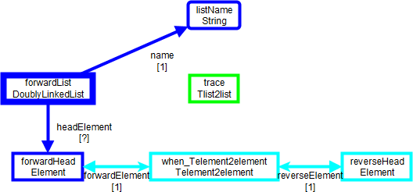
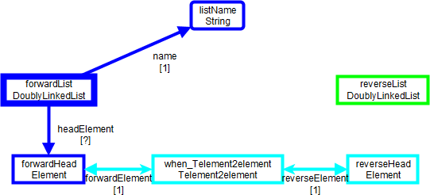
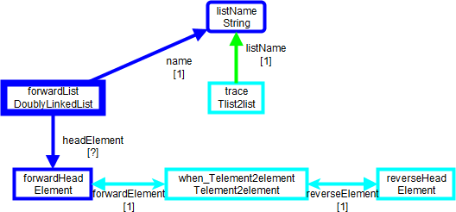
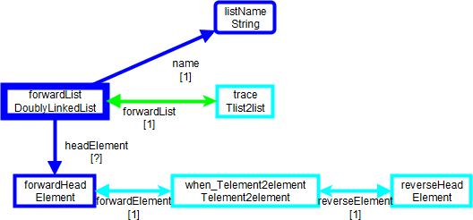
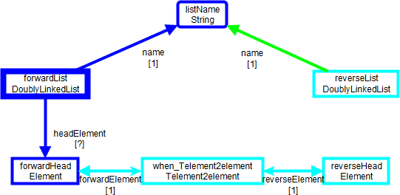
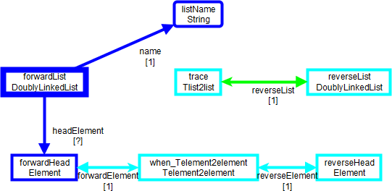
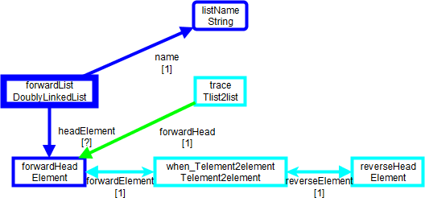
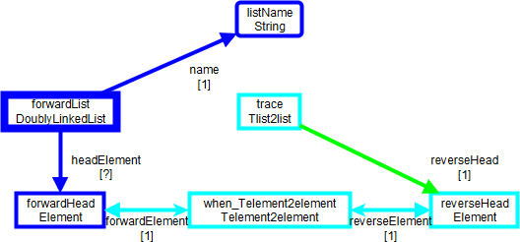
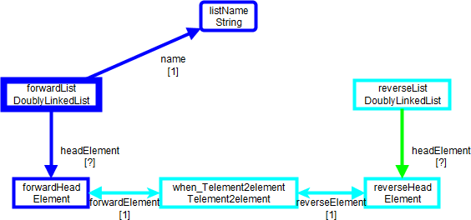
Primitive Micro-Mappings
One GREEN action at a time
  once CYAN predicates satisfied

Slide 24
Speculation
All Primitive Micro-Mappings share predicate
Acyclic dependency resolveable at run-time
Cyclic dependency insoluble
  need to speculate
defer predicates
  ATL ignores inter-mapping predicates
    works for typical transformations
  Eclipse QVTd ignores predicates wrt trace creation
    checks predicates wrt output objects/properties

Slide 25
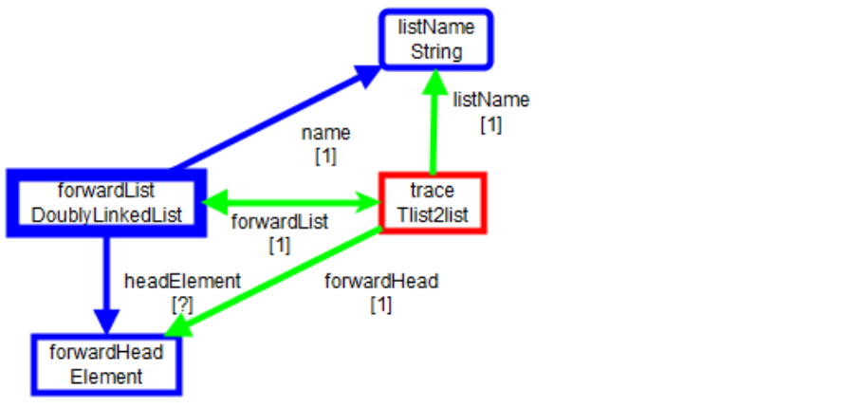
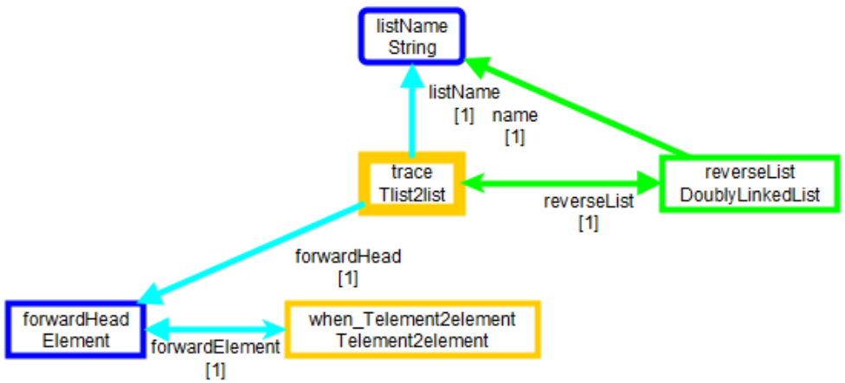
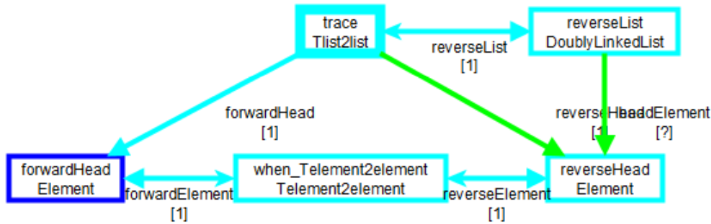
Speculation Partitioning
Overall 1: Speculating
2: Speculated 3: Residue

Slide 26
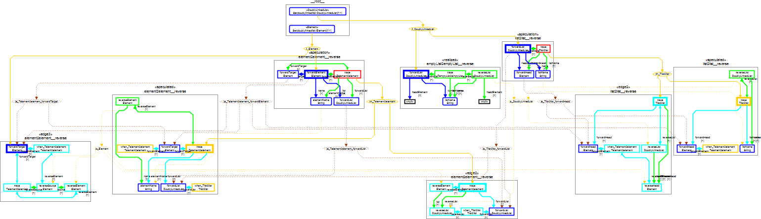
Mapping with all dependencies

Slide 27
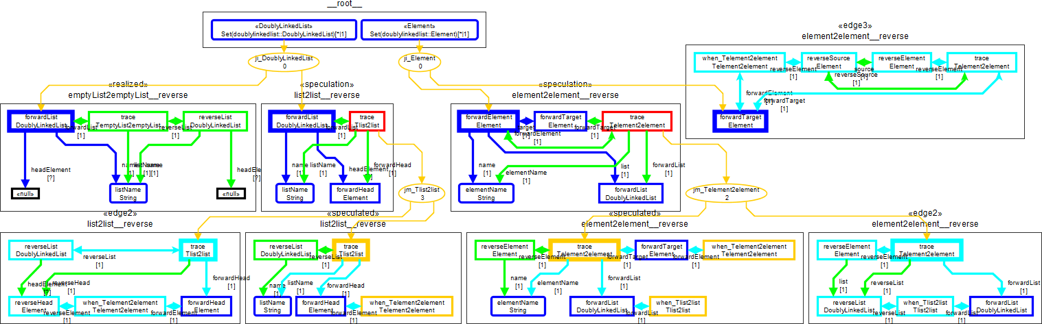
Scheduled Mapping, pruned dependencies

Slide 28
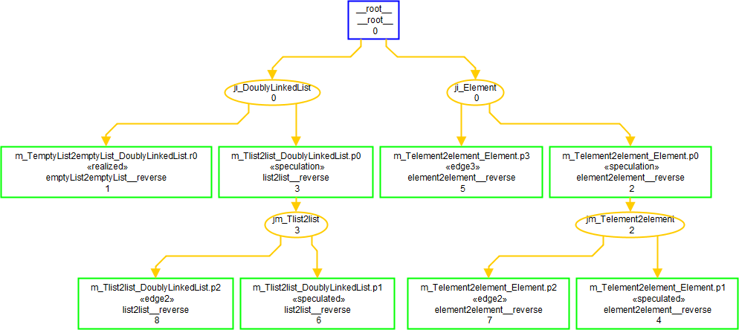

Overview static schedule
2 Mappings
  => 1 Root, 4 communication buffers, 8 Micro-Mappings,
    TODO post-scheduling merge

Slide 29
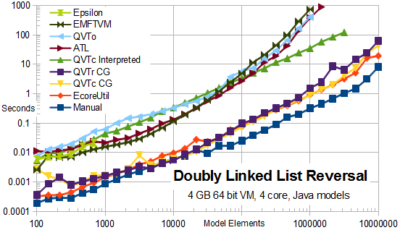
Doubly Linked List Reversal Results

Slide 30
Eclipse QVTd Status
0.12.0 (Mars - June 2015)
  QVTi execution (code generated or interpreted)
0.13.0 (Neon - June 2016)
  preliminary QVTc / QVTr execution
    low quality - research only
  no incremental / check / in-place facilities
  no debugger
  minimal documentation / examples
1.0.0 (Oxygen - June 2017)
  first release functionality (? with UMLX ?)

Slide 31
Conclusion
Do things in the right order
  Mappings declare the order
  Micro-Mappings can be ordered (graphically)
First implementation of the QVTc specification.
First optimized implementation of QVTr.
First direct code generator for model transformations.
Thirty fold speed-up.
Many more optimizations to do.

