Slide 1
QVT State of the Art
Edward Willink
Willink Transformations Ltd,
Nomos Software / Model Driven Solutions
OMG OCL 2.4 RTF chair
Eclipse OCL Project Lead
OMG QVT 1.2.RTF chair
Eclipse QVT Declarative Project Lead
Eclipse QVT Operational Project Committer
OMG Quarterly meeting
Reston
26th March 2014

Slide 2



Overview
Past
  why QVT
Present
  QVT 1.2
Future
  Eclipse QVTd
    declarative scheduling
  OCL 2.5 / QVT
    auto-generation
Summary

Slide 3
QVT Specification Background
UML 2.0 FAS September 2003
Models good, model transformations better
QVT 1.0 RFP April 2002
  8/7/1 submissions, January 2003 to April 2004
OCL 2.0 FAS May 2006
QVT 1.0 FAS July 2007
QVT 1.1 FAS January 2011
QVT 1.2 RTF March 2014

Slide 4
QVT
Query
  reuses OCL which can do queries
View
  a read-only transformation
Transformation
  OCL cannot change anything
  a disciplined model mutation capability

Slide 5
QVT Components
QVTo - Operational Mappings
  familiar imperative style, OCL model navigation
  limited integrity/analyzability
QVTr - Relational
  high level declarative style, OCL model navigation
  powerful
QVTc - Core
  low level declarative style, OCL model navigation
  common foundation

Slide 6
QVTo status
Open Source implementations
  SmartQVT (France Telecom) unmaintained
  Eclipse QVTo (Borland) actively maintained again
    good but not perfect
    editor, compiler, executor, debugger - no optimizer
Small enthusiastic user base
  not as widely used as e.g. ATL
Not a failure, but not a success either

Slide 7
QVTc Status
No implementation
Eclipse QVTd
  editors 2010
  Java code generator/debugger 2013
  compiler/scheduler 2014
Only really useful as an intermediate

Slide 8
QVTr Status
Semi-Open Source
  ModelMorf - never progressed beyond Beta
  Medini QVT - disappointing, limited maintenance
Eclipse QVTd
  editors 2010
  Java code generator/debugger 2013
  basic compiler/scheduler 2014/2015
  optimizer 2015
Very late

Slide 9
Specification Status
QVT 1.2 RTF reports this meeting
  7 voting, 6 non-voting representatives
  71 issues resolved
    9 critical/urgent, 22 significant, 15 minor, 22 text
  9 duplicate, 14 no change
  1 transferred, 29 deferred
Deferred
  awaiting sound OCL 2.5 models
  awaiting specification auto-generation from models
  awaiting research

Slide 10
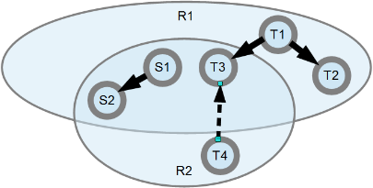
Traceability
Tree transformation
  easy inputs in context yield outputs in context
Graph transformation
  cross-references
  new output reference and reuse outputs
e.g.
  R1: (S1,S2) => (T1,T2,T3)
  R2: (S1,S2) => (T3,T4) reusing the T3 from R1

Slide 11
Traceability Utility
Transient
  Internal
    support cross-references and so graph transformation
Persistent
  Diagnostic
    support analysis of the transformation execution
  Incremental Update
    support selective re-execution for changed inputs

Slide 12
Traceability Principles
http://www.eclipse.org/mmt/qvt/docs/ICMT2014/QVTtraceability.pdf
identifies some basic principles
  trace representation
  trace record
  trace identity
No two trace records share the same trace identity

Slide 13
Traceability Corrolaries
No two trace records share the same trace identity
corrolaries for QVTo
  mutable collections inhibit incremental update
    persisting every state unreasonable/unnecessary
  limitations/compromises must be explained
    user must understand what is not traced
corrolaries for QVTc/QVTr
  define transformation extension semantics
  define relation/mapping refinement semantics

Slide 14
QVTc/QVTr Progress
Horacio Hoyos Rodriguez
  University of York, Eng D student
    Sponsored by Willink Transformations and UK Govt.
Advanced Optimisations for Declarative Transformations

Slide 15
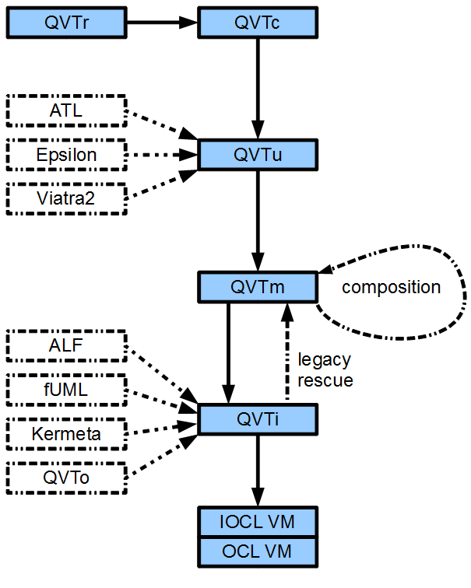
(Imperative) OCL VM for QVT
Simple OCL VM
  AST walker
  QVT richer AST
Code generated VM
  dispatch tables
  flattened code
  inlined operations
Debugging tools

Slide 16
QVTr to QVTc to QVTu to QVTm to QVTi to Java
Convert multi-directional to uni-directional
  keep what the user wants to do
  throw away the rest
Simple program to program transformation
  prototype working (using Epsilon)

Slide 17
QVTr to QVTc to QVTu to QVTm to QVTi to Java
Convert rich to minimal syntax
  flatten extension/refinements
  normalize construct placement
Simple program to program transformation
  prototype working (using Epsilon)

Slide 18
QVTr to QVTc to QVTu to QVTm to QVTi to Java
Originally QVTi to OCL VM
  interpreted execution
OCL VM evolving to support OCL to Java
  code generated imperative schedule
Small extension of OCL to Java generator
  working in bespoke Java
  25 times faster than interpreted QVTi
  25 times faster than Eclipse QVTo

Slide 19
QVTr to QVTc to QVTu to QVTm to QVTi to Java
Need an imperative schedule
QVTo - imperative
  programmer defines schedule
  resolution can be confusing/mis-timed
QVTc/QVTr - declarative
  programmer defines truths
  nothing is timed/nothing can be mis-timed
  how?

Slide 20

Really Naive Declarative Scheduling
do
for each of M mappings
for each permutation of I mapping inputs and O input objects
if mapping can execute
execute mapping
while more to execute - P passes
very inefficient: complexity: P∙M∙O^{I}

Slide 21
Smart Scheduling
execute mappings in sensible order
  respect creation/usage dependencies
  traverse model composition trees
execute mappings on sensible objects
  respect metamodel type constraints
  share known context
very efficient: much closer to optimal

Slide 22
Micro-mappings
QVTc low level mappings
  separate left-middle and middle-right parts
  cannot be executed in one go
Micro-mappings
  can be executed in one go
    once guard condition satisfied

Slide 23
QVTm to Declarative MicroMappings
Split L-M-R multi-part mapping
  separate L-M, M-R micro-mappings
Build Declarative Micro-Mapping Graph
  prune derived inputs
Merge Micro-Mappings
Overlap Input/Output Composition Trees

Slide 24
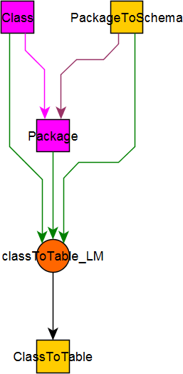
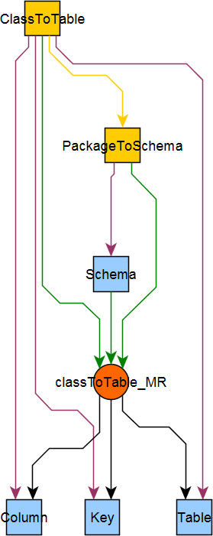
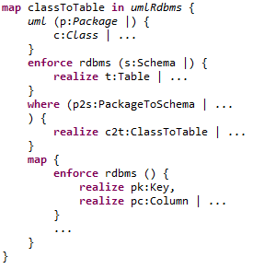
Micro Mapping
Textual mapping =>
..._LM, ..._MR micromappings
Micromapping fully executable
  once guards satisfied

Slide 25
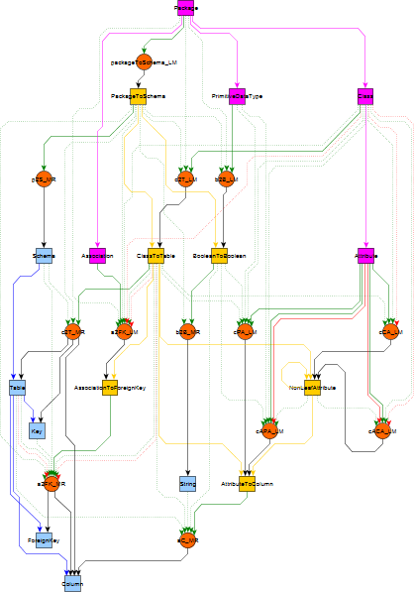
MicroMapping Graph
In Type
In Composition
Middle Type
Middle Composition
Out Type
Out Composition
Micro Mapping
Creates
Needs
Uses
Needs too

Slide 26
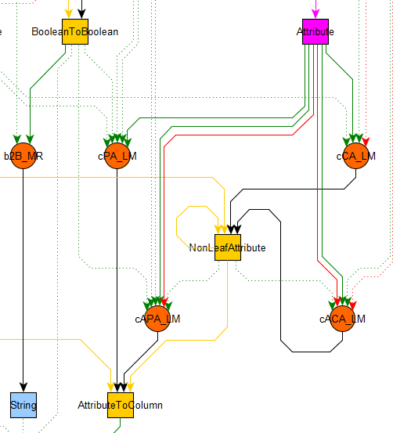
Partial Graph
In Type
In Composition
Middle Type
Middle Composition
Out Type
Out Composition
Micro Mapping
Creates
Needs
Uses
Needs too

Slide 27
Read off Imperative Schedule
Most of schedule compile time determinate
  metamodel type relationships
Localized run-time scheduling
  loops using compile-time strategies
  worst case seach over very limited extents
Compiler has a flexible problem specification
  free to find an efficient, accurate schedule
  multiprocessor schedules

Slide 28
Realized Vision
QVTr
QVTc
ATL
QVTu
QVTm
QVTo
QVTm
QVTμ
QVTμ Declarative
Declarative Graph
QVTμ Imperative
Imperative Graph
QVTi
QVTi / OCL
Java
Java

Slide 29
QVTc
QVTc to QVTu to QVTm
  working in Epsilon
QVTm to MicroMappings to QVTi
  close to working in Epsilon
QVTi to Java
  working
Migrate Epsilon to QVTc
  autogenerate Java tooling implementations

Slide 30
QVTr to QVTc to QVTu to QVTm to QVTi to Java
QVTr to QVTc
  not sensible - no one executes multidirectional
QVTr to QVTu
  more useful
  program to program transformation
  much simpler than QVTr to QVTc

Slide 31
OCL/QVT Progress
Adolfo Sanchez-Barbudo Herrera
  University of York, Eng D student
    Sponsored by Willink Transformations and UK Govt.
Auto-generation of transformation tooling

Slide 32

OCL Specification/Implementation
OCL specification is incomplete
  EBNF grammars
  UML models
  OCL rules
  semi-OCL mappings - perhaps QVTr

Slide 33
The Old Eclipse OCL (RSA)
Most of tool is manually coded
  distinct Ecore, UML code, ~OCL 2.3
Significant difficulties enhancing code
  many bugs categorized as too difficult
Significant difficulties exploiting OMG models

Slide 34
The New Eclipse OCL using Xtext
Xtext covers large parts of an implementation
  Xtext uses an EBNF with meta-model annotations
IfExpCS returns IfExpCS:
'if' condition=ExpCS
'then' thenExpression=ExpCS
'else' elseExpression=ExpCS
'endif';
Modest gaps between specification and tooling

Slide 35
OCL Specification work
Define consumable EBNF grammars
Define consumable CST/ASG mapping
Define complete (UML+OCL) Pivot ASG model
Define accurate (UML+OCL) WFRs
Define extensible OCL Standard Library
Autogenerate specification from models

Slide 36
QVT Specification work
No CS model for QVTo/QVTc
No CS2AS Analysis rules for QVTo/QVTc
No AS WGRs
(No modeled execution semantics).

Slide 37
Eclipse OCL Tooling Work
OCL to Java automation of WFRs
    OCL-friendly Transformation Virtual Machine
Automation of Pivot ASG creation/mapping
Automation of CST to Pivot ASG mappings
Re-useable for QVT

Slide 38
Summary
QVTo status adequate
QVT specification incomplete
Good progress on QVTc/QVTr compiler tooling
  ? better than hand coded ?
Good progress on OCL/QVT parser tooling
  inherently good models
  autogenerated specification

