Slide 1
Yet Another Three QVT Languages
Edward Willink, Willink Transformations Ltd
Horacio Hoyos, The University of York
Dimitris Kolovos, The University of York
ICMT 2013, Budapest
18th June 2013

Slide 2


QVT History
Models are good
Model Transformation must be good
OMG: Need a standard
    2002 RFP: Request for Proposal
QVT: Query/View/Transformation standard
    2003 Competing Proposals - 8 then 7
    2004,5 Merged Proposal => 3 languages
    2007 QVT 1.0 Standard
    2011 QVT 1.1 Standard - minor fixes

Slide 3



QVTo - QVT Operational Mappings
Operational/Imperative paradigm
SmartQVT from France Telecom
  mature since 2008
Eclipse QVT Operation Project (from Borland)
  stagnated in 2009
  moving again since 2012
    48 fixes in Kepler (June 26 2013)

Slide 4
QVTr - QVT Relational
Powerful, multi-directional Declarative paradigm
Medini QVT (from ikv++ technologies)
  mature since 2011
  disappointing performance
ModelMorf (from Tata)
  only Beta releases in public domain
Eclipse QVT Declarative Project
  models, parsers, editors
  no execution

Slide 5
QVTc - QVT Core
Simpler, multi-directional Declarative paradigm
Eclipse QVT Declarative Project
  models, parsers, editors
  no execution

Slide 6
Three more QVTs
QVT Declarative
New Intermediate Languages
VM
QVTr
QVTc
OCL
UML
QVTc
QVTu
QVTm
QVTi
QVTi
+
Java
Direct QVTr implementation too hard
Break problem into smaller parts
Progressive program-to-program transformation
Exploit Eclipse OCL VM and Java code generator

Slide 7
QVTr to QVTc
QVT Declarative
New Intermediate Languages
VM
QVTr
QVTc
OCL
UML
QVTc
QVTu
QVTm
QVTi
QVTi
+
Java
'Provided' by the QVT specification
single pass, hard to read
many syntax errors, never exercised
requires a working QVTr tool to convert QVTr
re-implement in QVTc

Slide 8
QVTc to QVTu
QVT Declarative
New Intermediate Languages
VM
QVTr
QVTc
OCL
UML
QVTc
QVTu
QVTm
QVTi
QVTi
+
Java
Multi-directional powerful for specification
powerful specification capability
unhelpful implementation of actual user requirement
QVTu - Unidirectional subset of QVTc
QVTc to QVTu - discard multi-directional bloat

Slide 9
QVTu to QVTm
QVT Declarative
New Intermediate Languages
VM
QVTr
QVTc
OCL
UML
QVTc
QVTu
QVTm
QVTi
QVTi
+
Java
Normal forms more powerful for optimization
powerful specification capability
unhelpful implementation of actual user requirement
QVTm - Minimal declarative subset of QVTc
QVTu to QVTm - discard syntax sugar (eg refinement)

Slide 10
QVTm to QVTi
QVT Declarative
New Intermediate Languages
VM
QVTr
QVTc
OCL
UML
QVTc
QVTu
QVTm
QVTi
QVTi
+
Java
Declarative semantics inappropriate for implementation
introduce imperative search schedule
exploit metamodel
QVTi - Imperative variant subset of QVTc
QVTm to QVTi - synthesize an execution schedule

Slide 11
QVTi + OCL to Java
QVT Declarative
New Intermediate Languages
VM
QVTr
QVTc
OCL
UML
QVTc
QVTu
QVTm
QVTi
QVTi
+
Java
OCL
powerful side-effect free model evaluation
QVTi
disciplined model mutation, schedule
reuse OCL interpreter (and debugger)
reuse OCL to Java code generator

Slide 12
QVTi enhancements
QVT Declarative (Core/Relational)
Declarative rule matching
QVT Imperative
Explicit Mapping Call with bindings
map NestedMapping {
guardPatternVariable1 <= collectionOfBindings;
guardPatternVariable2 := explicitBinding;
}

Slide 13
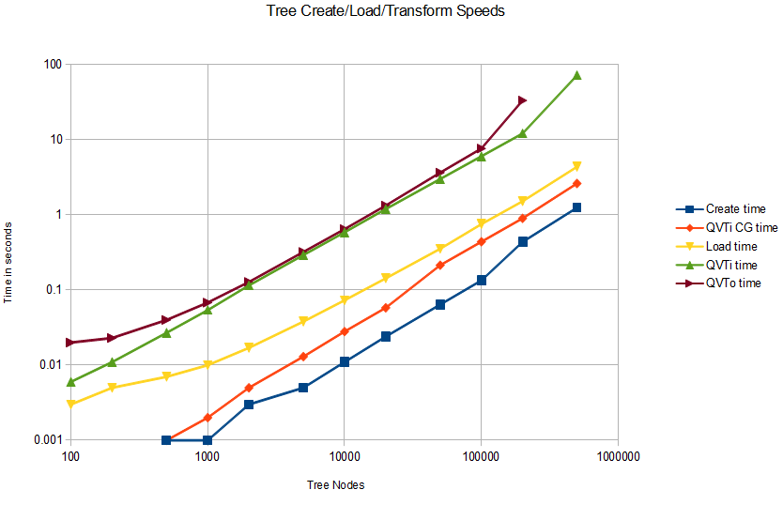
QVTi Preliminary Performance
20x

Slide 14
Demonstration / Poster
Eclipse QVT Declarative Project
  Kepler release (June 26 2013)
QVTr Xtext editor/parser
QVTc Xtext editor/parser
QVTi Xtext editor/parser
QVTr -> QVTc -> QVTm -> QVTi (Luna)
QVTi interpreter
QVTi to Java code generator
QVTi debugger (Luna)

Slide 15
QVTu Opportunities
QVT Declarative
New Intermediate Languages
VM
QVTr
QVTc
OCL
UML
QVTc
QVTu
QVTm
QVTi
QVTi
+
Java
ATL
ETL
Interchange point for alternative declarative syntaxes

Slide 16
QVTm Opportunities
QVT Declarative
New Intermediate Languages
VM
QVTr
QVTc
OCL
UML
QVTc
QVTu
QVTm
QVTi
QVTi
+
Java
composition
Normalized form
composition of multiple transformations
  variety of declarative languages
optimization of the composition

Slide 17
QVTi Opportunities
QVT Declarative
New Intermediate Languages
VM
QVTr
QVTc
OCL
UML
QVTc
QVTu
QVTm
QVTi
QVTi
+
Java
legacy rescue
QVTo
Interchange point for alterative imperative syntaxes
Legacy rescue of imperative transformations
exploit composition of declarative transformations

Slide 18
Shared tool chain
QVT Declarative
New Intermediate Languages
VM
QVTr
QVTc
OCL
UML
QVTc
QVTu
QVTm
QVTi
QVTi
+
Java
Editors
Optimizers/Composers/Rescuers
Interpreters/Debuggers
New transformation language
leverage interpreter/debugger/optimizers/composers
Better debugger
reuseable by many languages

Slide 19

Summary
Eclipse QVT Declarative moving at last
  QVTc/QVTr editors in Helios (2010)
  QVTi execution in Kepler (2013)
  QVTi code generation in Kepler (2013)
    20 times speed up
  QVTr execution targeted for Luna (2014)
  QVTi/c/r debugger targeted for Luna (2014)
Eclipse QVT Operational moving again
  Xtext editor targeted for Luna (2014)
  alignment with QVTd and OCL projects

