Slide 1
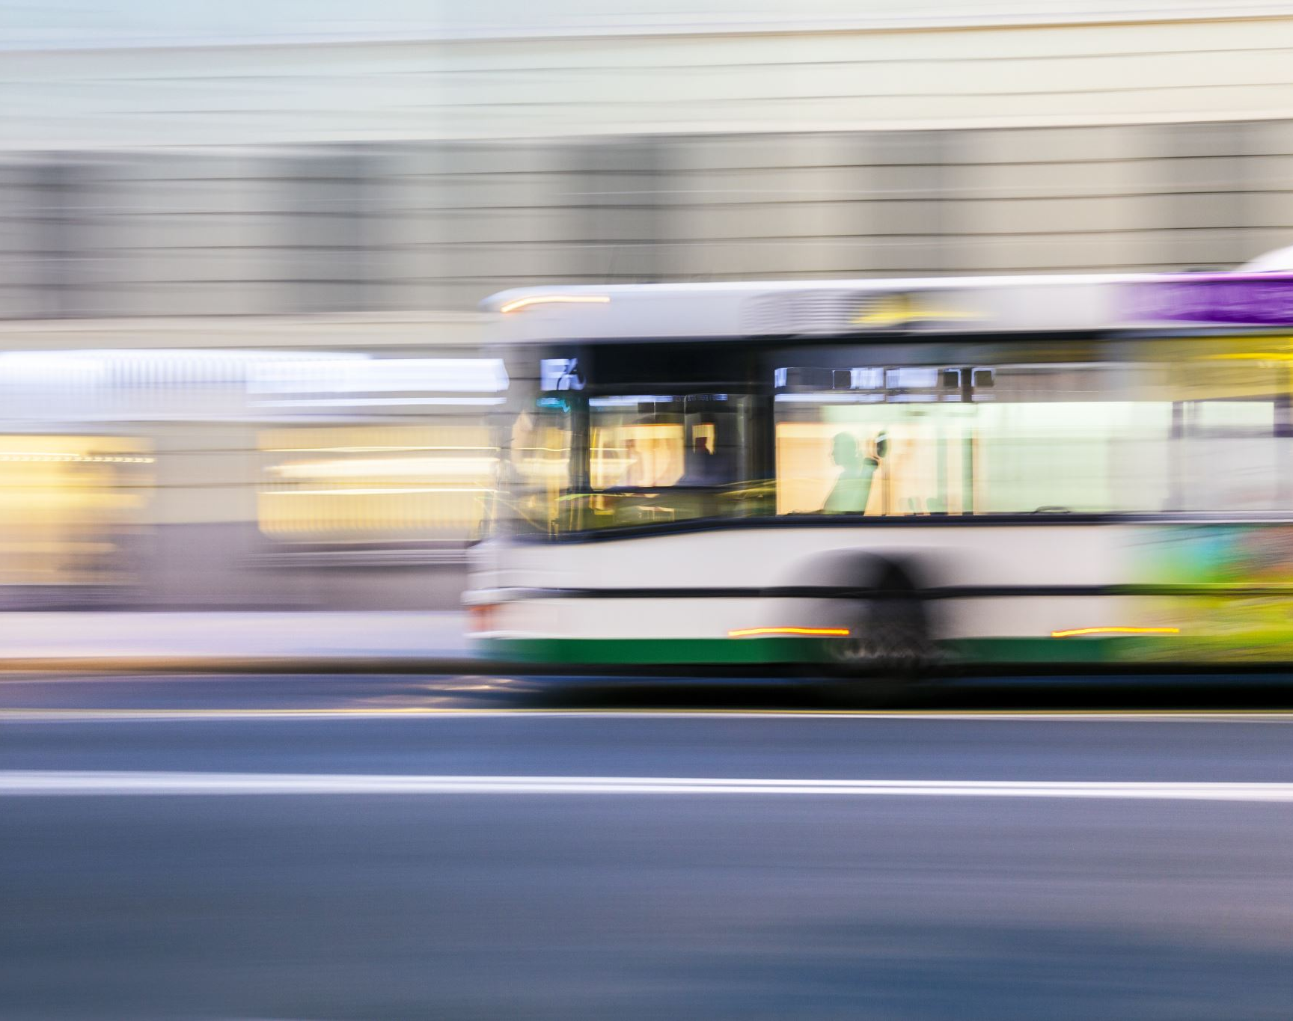
Implementing real-data in a drone and bus delivery system simulation

Slide 2
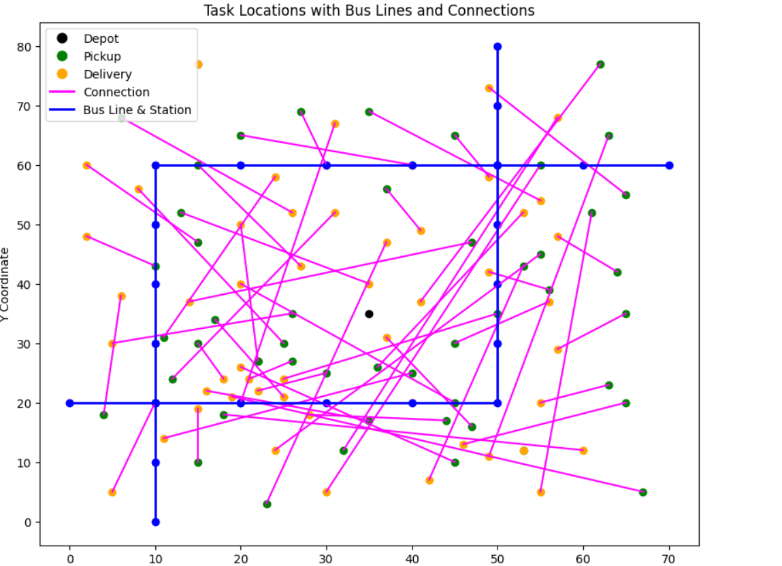
The base simulation we want to challenge

Slide 3
Assumptions that could be released
Bus system :
Bus lines are geometric → Bus stops data coordinates
Bus lines have constant speed over space → Travelling and stop time averages from real data
Bus lines have constant headway → Real headways at terminus
Each bus has constant speed between two given stops, throughout the day → Simulate every time a “real” bus, with the exact time it reached each station
Bus timetable is known in advance → Have a simulation which hides the real bus delay until it is delayed

Slide 4
Assumptions to release
Demand is random and independent from bus lines
Use real data (population density and shops data) to generate synthetic demand.

