Slide 1
Introduction to Physical Design / APR
Workshop Session 1
Presented by
Hafiz Wajeh ul Hasan

Slide 2
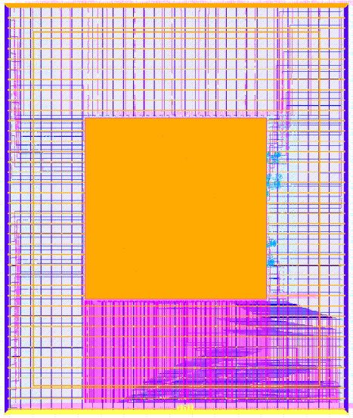
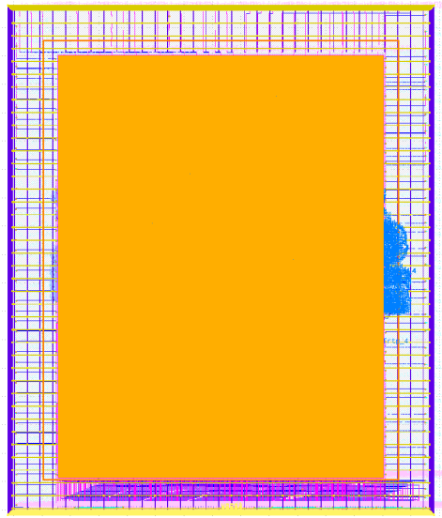
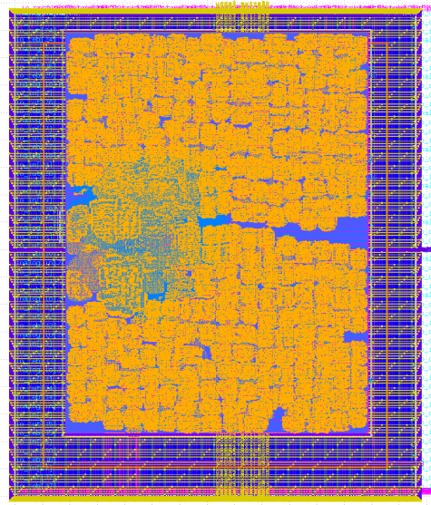
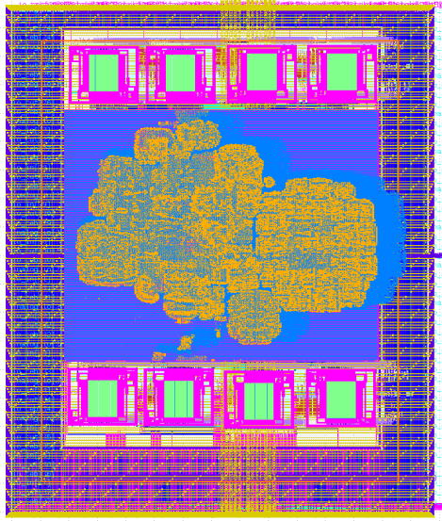
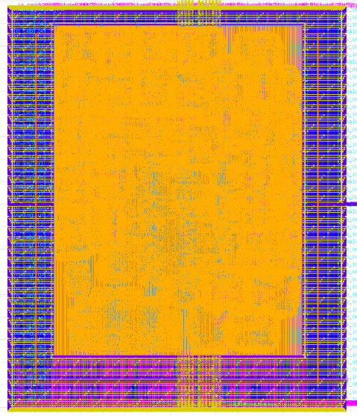
Our Tape-outs
We have taped-out 5 designs on Google shuttle program
Ibtida SoC
Ghazi SoC
Azadi SoC
Lexicon SoC
BrqRV SoC
MPW-1 | Nov 2020
MPW-2 | June 2021
STATUS: In the midst of fabrication
STATUS: In the midst of verification before fabrication

Slide 3
GitHub Links
https://github.com/hadirkhan10/caravel_ibtida_soc
https://github.com/merledu/caravel_Ghazi_soc
hhtps://github.com/merledu/caravel_azadi_soc
hhtps://guthub.com/wajehulhasan/caravel_Lexicon
https://github.com/HamzaShabbir517/caravel_BrqRV_EB1

Slide 4
Instructions
Post the questions in the comment box
You can post the questions on slack workspace as well, the link is provided in the description
You should also install VM in your PCs/laptops with the Sky130 PDK installed using the links provided on the slack
In case you are encountering any problems during installation, post them on the slack workspace

Slide 5
Contents
Design Flow
Physical Design
Standard Cells
Stick Diagrams
Inverter
NAND
NOR
APR
APR Flow

Slide 6
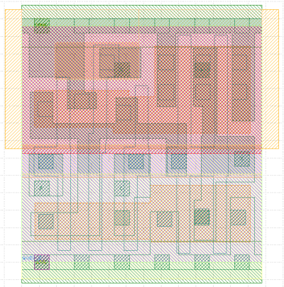
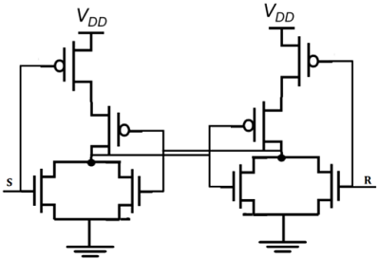
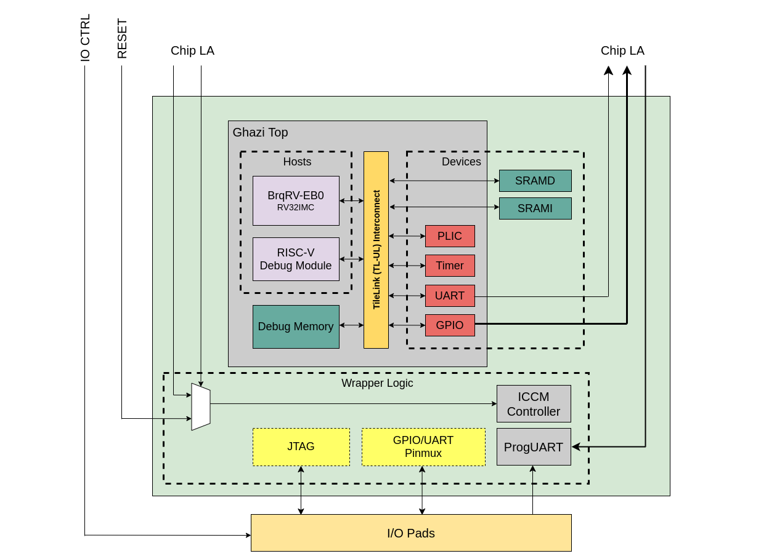
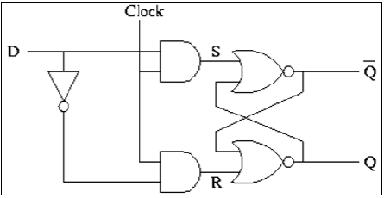
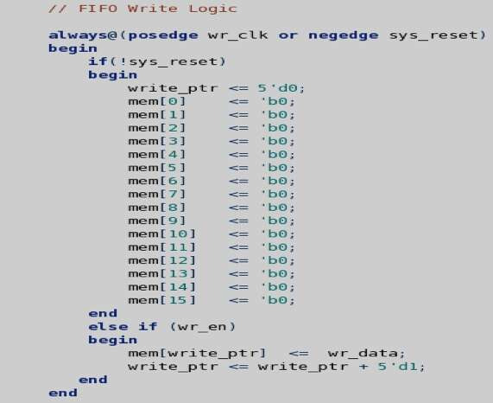
Design Flow
An overview of the design flow
Step 1: Defining the architecture of your design
Step 2: Writing the design abstraction for the architecture
This could be done using VHDL, Verilog or System Verilog
Step 3: This code is then synthesized to Gate Level Circuit Design/Netlist
The circuit design level can also be referred to transistor level, inside every Gate/Standard Cell we have some transistors
Step 4: Physical Design, this is the process of transforming a circuit description into the physical layout.
Architectural Design
RTL Design
Synthesized Design
Physical Design [APR]

Slide 7
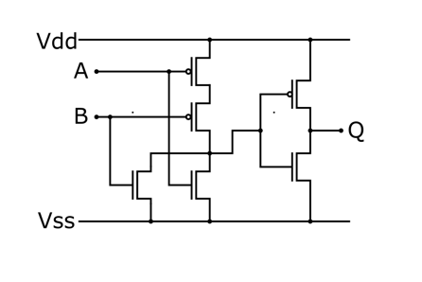
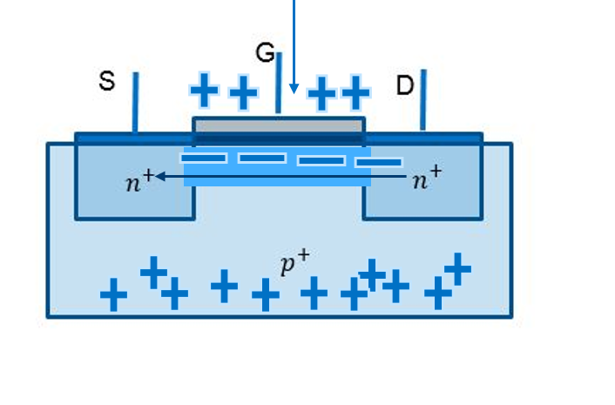
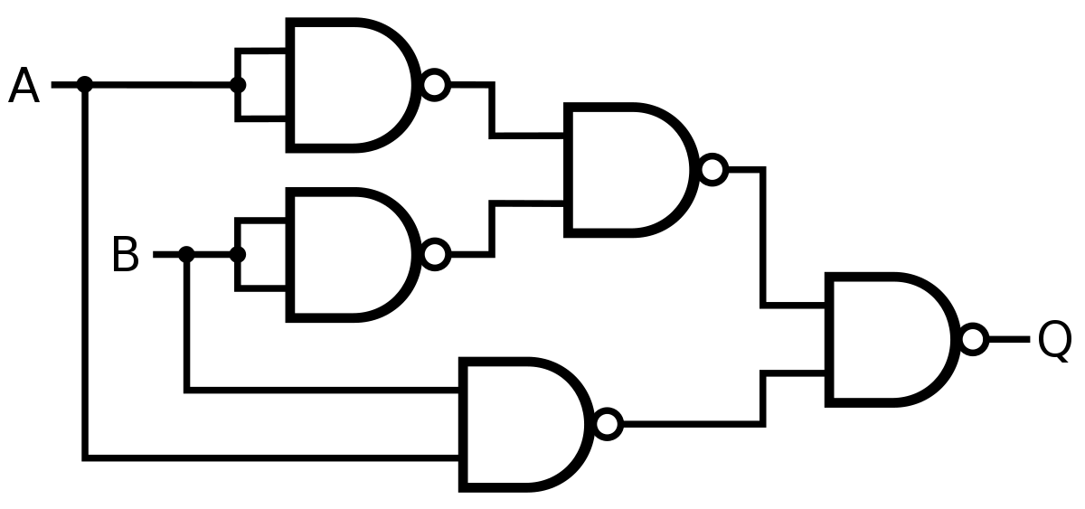
Physical Design
The physical design is where the circuit level is converted to a complete physical geometric representation. This geometric representation is called integrated circuit layout
During the Physical Design, we place and route Logic Gates[Standard Cells]. So the basic building block for the complete design are the Standard Cells
Standard Cells comprises of Transistors[CMOS]
Device Level
Transistor Level
Gate Level
Physical view of a simple planar transistor

Slide 8
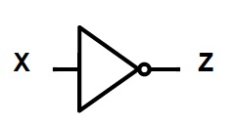
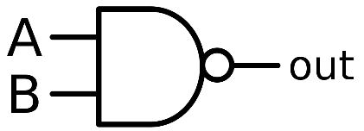
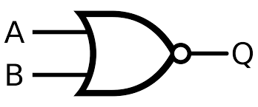
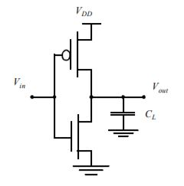
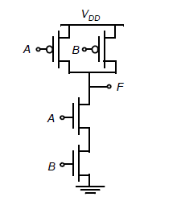
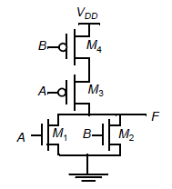
Standard Cells
The basic Standard Cells are:
Inverter
NAND
NOR
Symbolic View
Symbolic View
Symbolic View
Schematic View
Schematic View
Schematic View

Slide 9
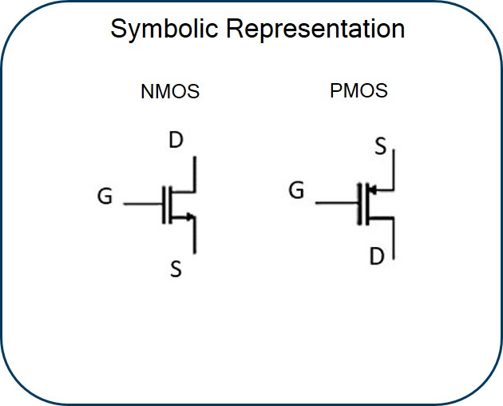
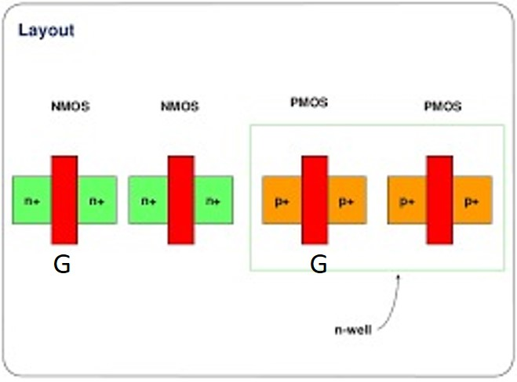
Stick Diagram
It is basically an interface between symbolic circuit and the actual layout.
Stick diagrams convey layer information through color codes (or monochrome encoding).
RTL Design
MANUAL
APR
Circuit Design
Synthesized Design
Stick Diagram
Physical Design
Physical Design[APR]

Slide 10
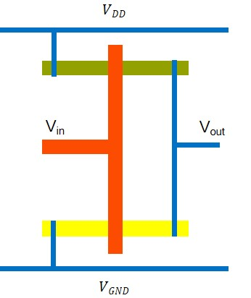
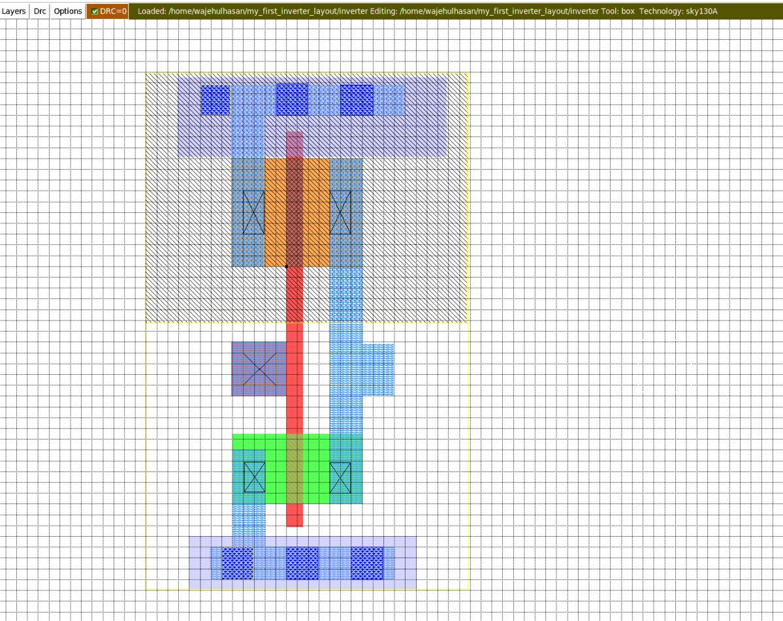
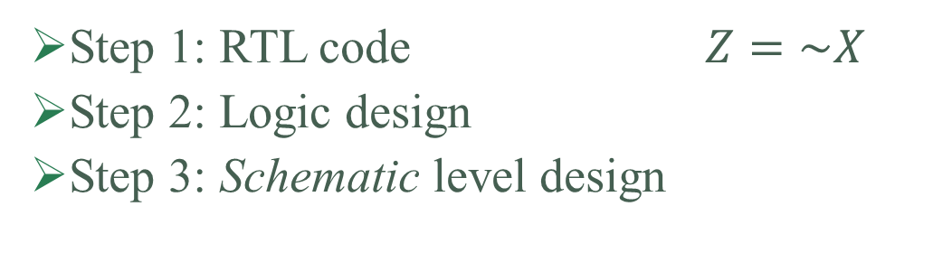


Inverter
METAL
Step 1: RTL code $Z=\sim X$
Step 2: Logic design
Step 3: Schematic level design
POLY
P Diff
N Diff
$$VDD$$
Stick Diagram
Actual Layout
V_{in}
V_{out}
Now making the connection of Power and Ground to the transistors
Next we would draw the transistors, NMOS at the bottom and PMOS at the top
Drawing the input and the output
We start by drawing the power and ground
$$VGND$$

Slide 11
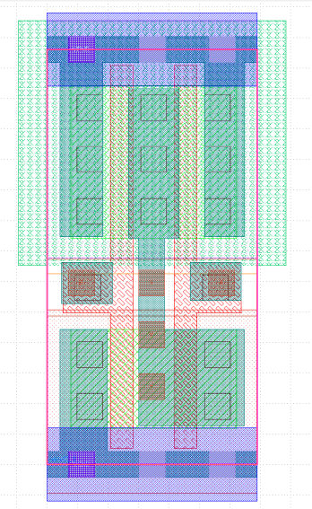
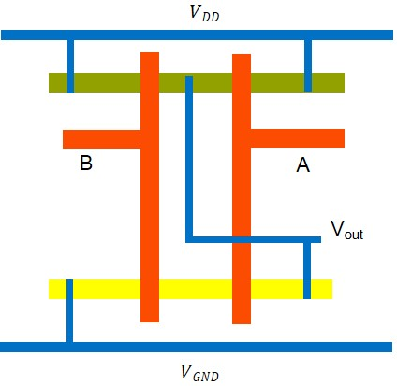
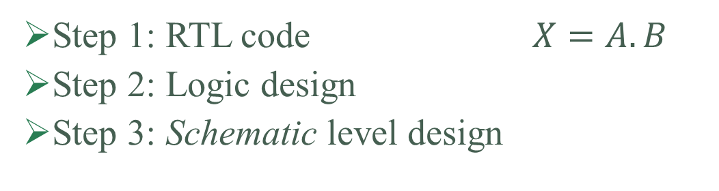
NAND
METAL
Step 1: RTL code $X=A.B$
Step 2: Logic design
Step 3: Schematic level design
POLY
P Diff
N Diff
$$VDD$$
Stick Diagram
Actual Layout
B
A
V_{out}
Drawing the input and the output
Now making the connection of Power and Ground to the transistors
This time we have 3 connections to Power and Ground
Next we would draw the transistors, NMOS at the bottom and PMOS at the top.
This time we would have 2 NMOSs and 2 PMOSs
We start by drawing the power and ground
$$VGND$$

Slide 12
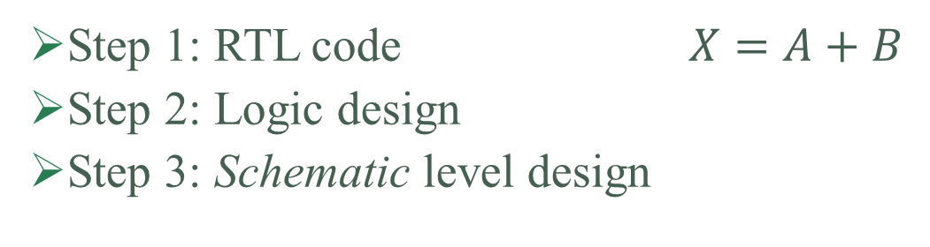
NOR
Step 1: RTL code $X=A+B$
Step 2: Logic design
Step 3: Schematic level design
?
Stick Diagram

Slide 13
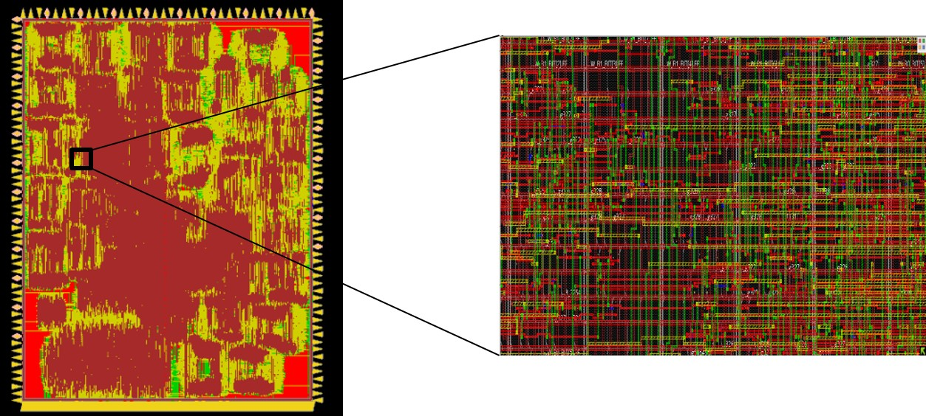

APR
What is APR
APR is Auto Place and Route
Place the standard cells
Route the standard cells together
Why APR?
Lets have a look at the following design
When the designs are too big, it is tedious to draw the layout manually
Note: The last design we did had 279995 Gates
Imagine yourself placing and routing near 300,000 Gates
Now let’s have an overview of the APR flow

Slide 14


APR Flow
Routing
Placement
LIBRARY CONTAINING STANDARD CELLS
Floorplan
CTS
Architectural Design
XNOR
NOR3
AND4
AND
INV
FF
Floorplan
OR3
NAND2
XOR2
RTL Design
FF
NAND
XOR
AND
OR
NOR
Placement
FF
NOR
Synthesis
INV
FF
XOR
NAND
INV
FF
AND
NAND
Physical Design/APR
STANDARD CELLS USED IN THE NETLIST
Clock Tree Synthesis [CTS]
NAND
FF
NOR
OR
OR
DRC LVS Checks
NOR
FF
Routing
Fabrication
AND
OR
FF
INV
INV
FF
XOR
CLK

Slide 15
Design.v, Design.sdc, Std_cells.lef, Std_cells.lib
Input
Synthesis
Yosys, OpenSTA
Design_gate_level_netlist.v
Output
Design_gate_level_netlist.v, macro.lef, macro.cfg
Input
Floorplan/Power Network
init_fp, ioplacer, pdn
Floorplan.def
Output
Floorplan.def
Input
Placement
RePLace,OpenDP
Placement.def
Output
Open-source EDA Tools
Design_gate_level_netlist.v, Placement.def
Input
CTS
TritonCTS
CTS.def, CTS_netlist.v
Output
Input
Routing
FastRoute, TritonRoute
CTS.def
Routing.def
Output
Input
RC Extraction
SPEF-Extractor
Routing.def
Design.spef
Output
Input
GDS Generation
Magic
Input
Routing.def
Output
Output
Design.gds, Design.lef
Input
Physical Verification
APR Step
Design.gds
Magic
EDA Tool

Slide 16
Thank you

