Slide 1
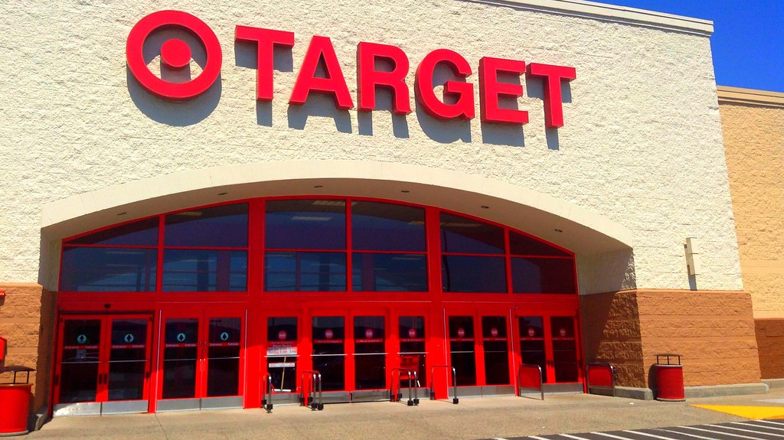
Target Brazil Business Case Study
by Asha Rajan

Slide 2


Objective
To analyze the given data from Target Store and to derive insights and present recommendations
Inputs
This business case has information of 100k orders from 2016 to 2018 made at Target in Brazil
Data is available in 8 csv files about customers, geolocation, order, items, payments, reviews, orders, products, and sellers
Dataset
Link

Slide 3

Target is one of the world’s most recognized brands and one of America’s leading retailers.
Target makes itself a preferred shopping destination by offering outstanding value, inspiration, innovation and an exceptional guest experience that no other retailer can deliver.
By analyzing the extensive data, it becomes possible to gain valuable insights into Target's operations in Brazil.
The information can shed light on various aspects of the business, such as order processing, pricing strategies, payment and shipping efficiency, customer demographics, product characteristics, and customer satisfaction levels.

Slide 4


Slide 5

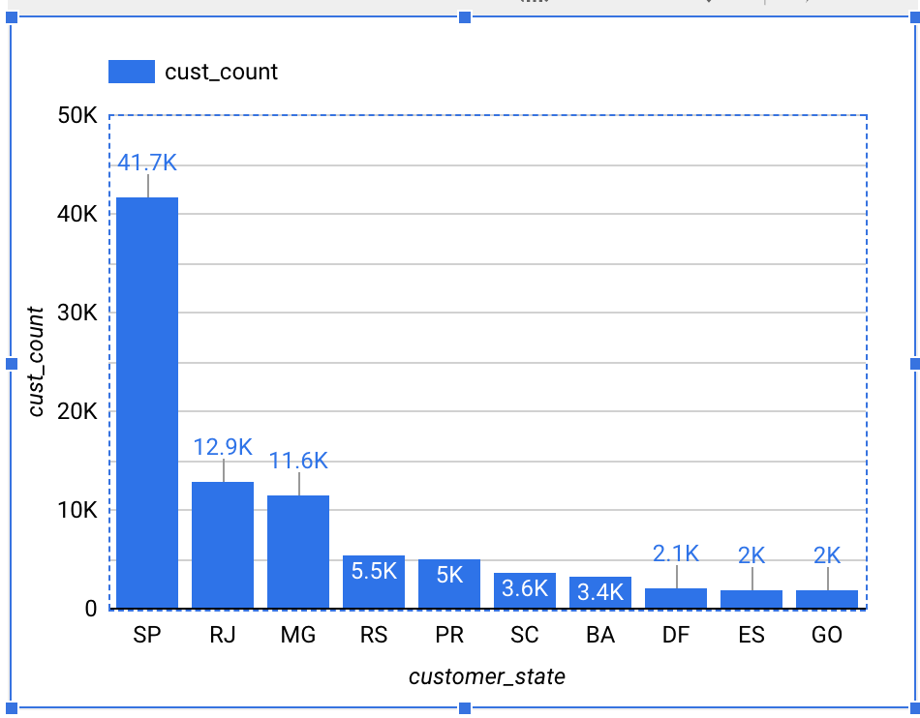
Customers Table
Top 10 States by Customers count
SELECT customer_state, COUNT(customer_id) AS cust_count
FROM `target-sql-361009.TargetDS.customers`
GROUP BY customer_state
ORDER BY cust_count DESC LIMIT 10
The states of San Paulo and Rio de janeiro have more Customers

Slide 6
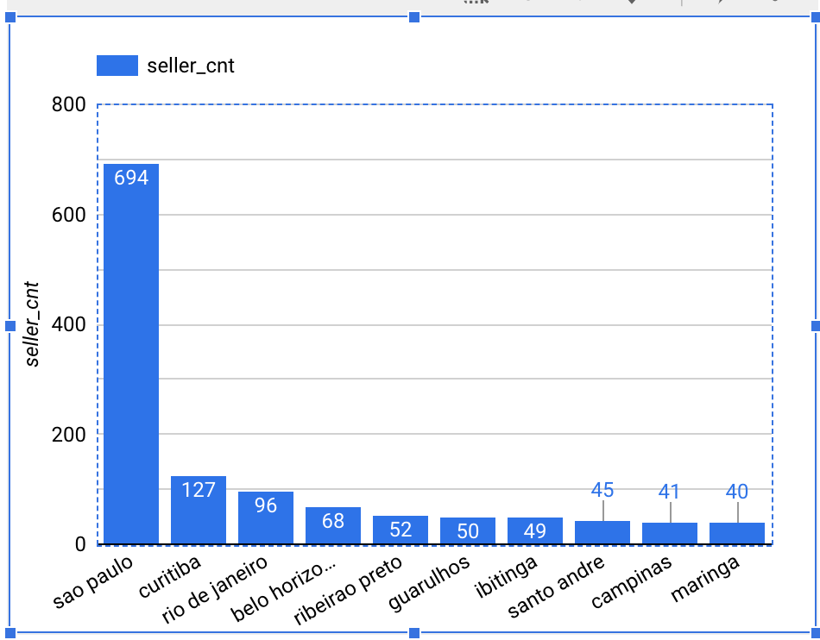
Sellers Table
Top 10 Cities with high number of Sellers
SELECT seller_city, count(seller_id) AS seller_cnt
FROM `target-sql-361009.TargetDS.sellers`
GROUP BY seller_city
ORDER BY seller_cnt DESC LIMIT 10
States of San Paulo, Curitiba and Rio continue to be on top even in terms of Sellers count.

Slide 7
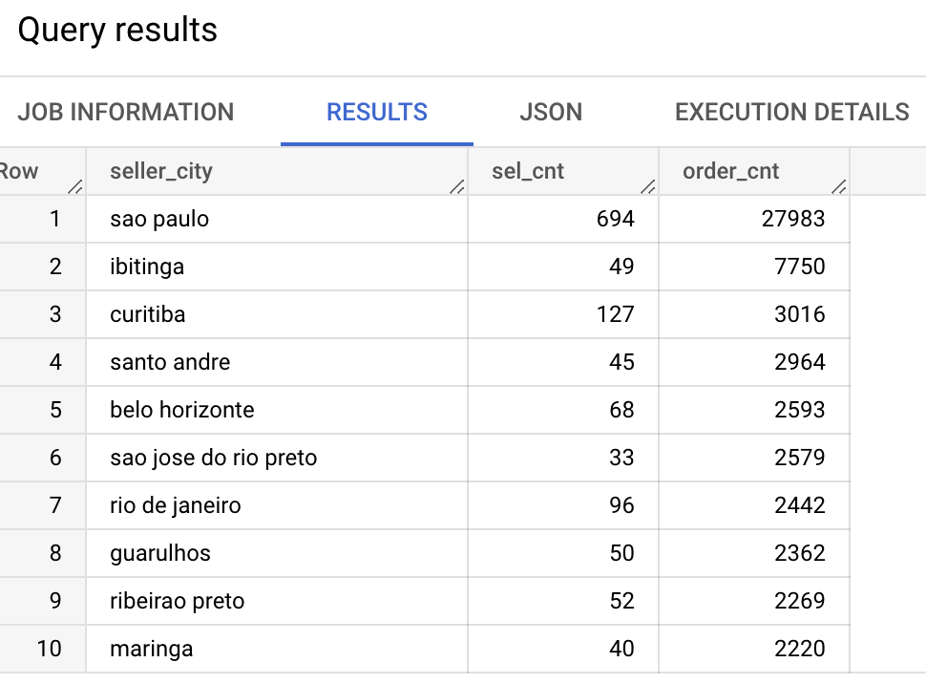
Top 10 Cities of Sellers with high number of Orders
SELECT seller_city, count(distinct(sel.seller_id)) sel_cnt, count(order_item_id) order_cnt
FROM `target-sql-361009.TargetDS.sellers` sel
JOIN `target-sql-361009.TargetDS.order_items` order_item
ON sel.seller_id = order_item.seller_id
GROUP BY seller_city
ORDER BY order_cnt DESC LIMIT 10
Though Rio has more number of Sellers, but recorded less number of Orders as compared to other cities.

Slide 8
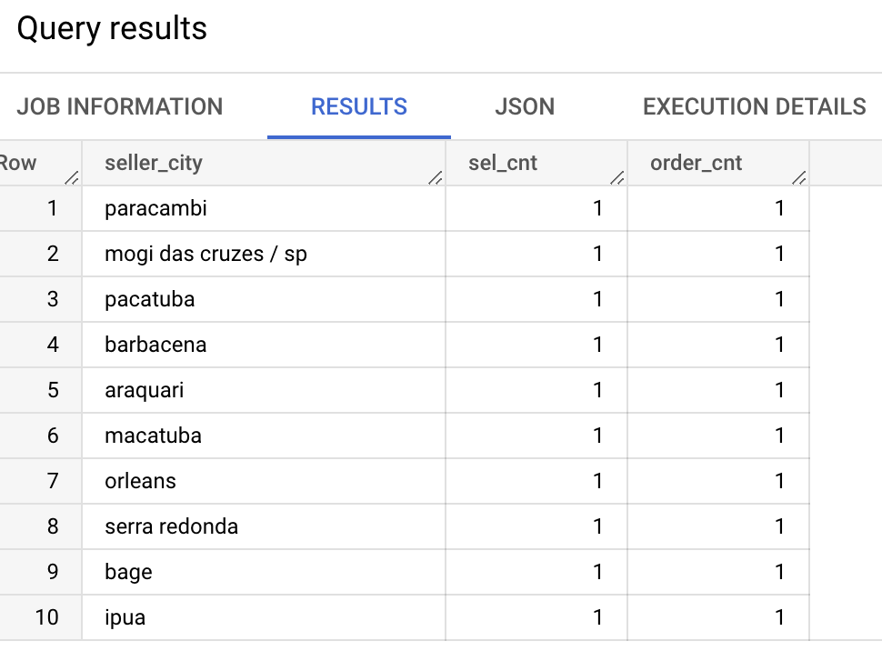
Top 10 Cities with low number of Sellers their respective count of Orders
SELECT seller_city, count(distinct(sel.seller_id)) sel_cnt, count(order_item_id) order_cnt
FROM `target-sql-361009.TargetDS.sellers` sel
ON sel.seller_id = order_item.seller_id
GROUP BY seller_city
The cities with low count of Sellers have also resulted in low number of Orders

Slide 9
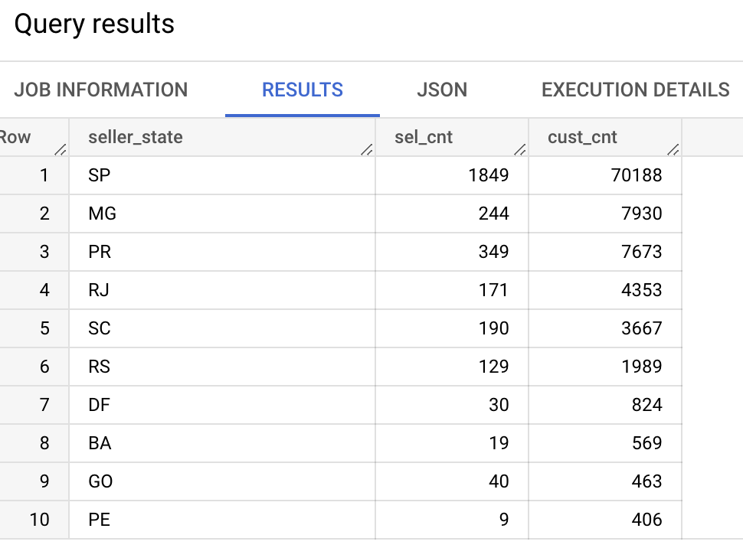
Top 10 States of Sellers with high number of Customers
SELECT seller_state, count(distinct(sel.seller_id)) sel_cnt, count(distinct(customer_id)) cust_cnt
FROM `target-sql-361009.TargetDS.sellers` sel
JOIN `target-sql-361009.TargetDS.order_items` order_item
ON sel.seller_id = order_item.seller_id
JOIN `target-sql-361009.TargetDS.orders` ord
ON order_item.order_id=ord.order_id
GROUP BY seller_state
ORDER BY cust_cnt DESC LIMIT 10
The states with high number of Sellers also seem to have high number of Customers.

Slide 10
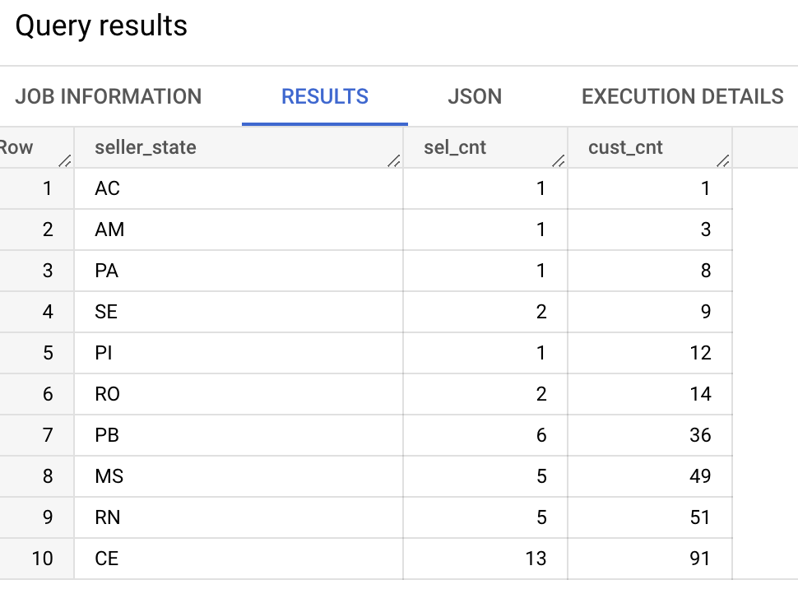
States with smaller number of Sellers and their respective number of Orders
SELECT seller_state, count(distinct(sel.seller_id)) sel_cnt, count(distinct(customer_id)) cust_cnt
FROM `target-sql-361009.TargetDS.sellers` sel
JOIN `target-sql-361009.TargetDS.order_items` order_item
ON sel.seller_id = order_item.seller_id
JOIN `target-sql-361009.TargetDS.orders` ord
ON order_item.order_id=ord.order_id
GROUP BY seller_state
ORDER BY cust_cnt ASC LIMIT 10
The state of ‘AC’ seem to have only 1 Seller and 1 Customer.

Slide 11
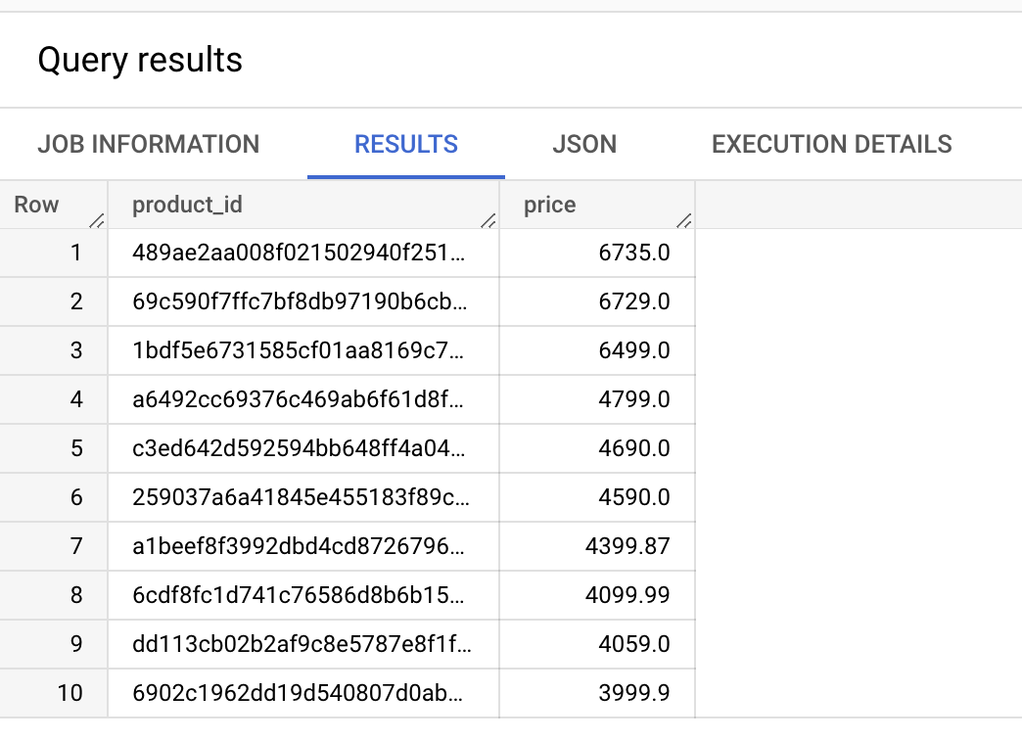
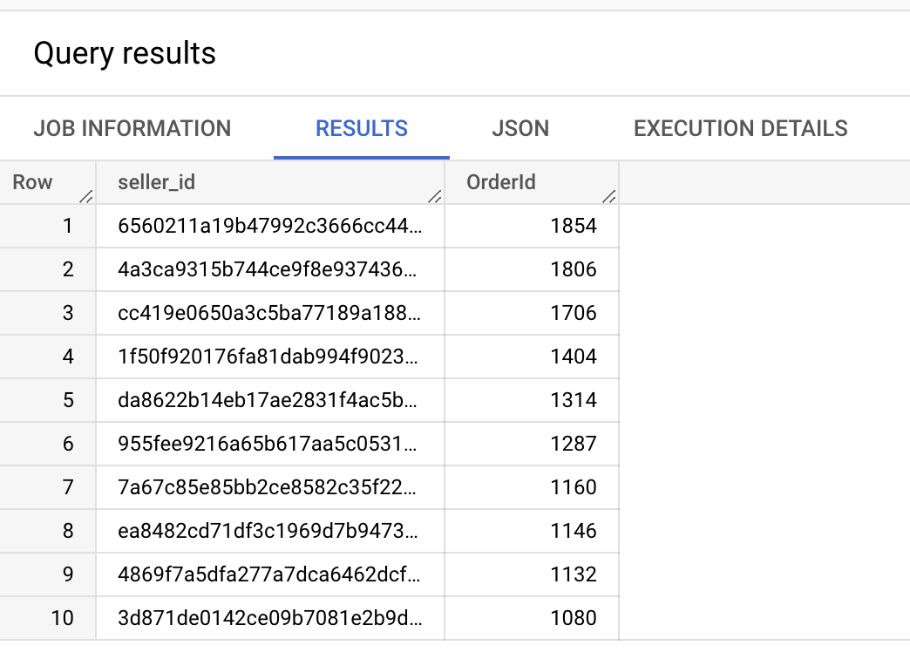
Top 10 Products in terms of Price
SELECT product_id, price
FROM `target-sql-361009.TargetDS.order_items`
ORDER BY price DESC LIMIT 10
Top 10 Sellers
SELECT seller_id, count(distinct(order_id)) AS OrderId
FROM `target-sql-361009.TargetDS.order_items`
GROUP BY seller_id
ORDER BY OrderId DESC LIMIT 10

Slide 12
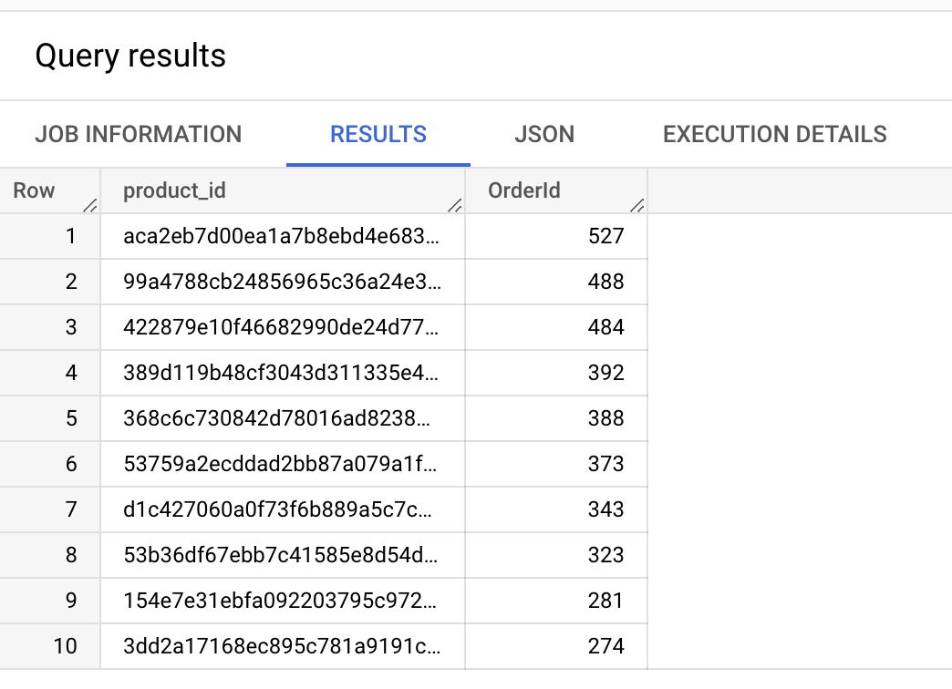
Products that are sold more
SELECT product_id, count(order_id) AS OrderId
FROM `target-sql-361009.TargetDS.order_items`
GROUP BY product_id
ORDER BY OrderId DESC LIMIT 10
Are there any Sellers who didn’t have any sales? – No
SELECT seller_id
FROM `target-sql-361009.TargetDS.order_items`
WHERE order_id is null
The above query returned zero results, which means all the registered sellers at Target are active and they have sales.

Slide 13
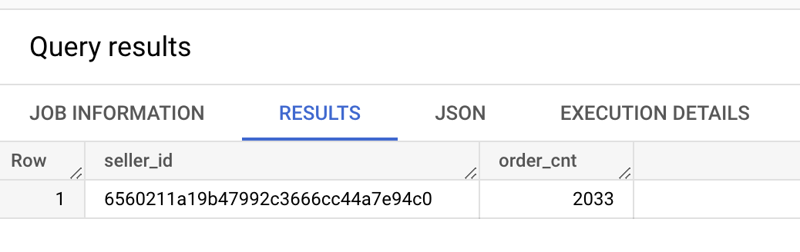
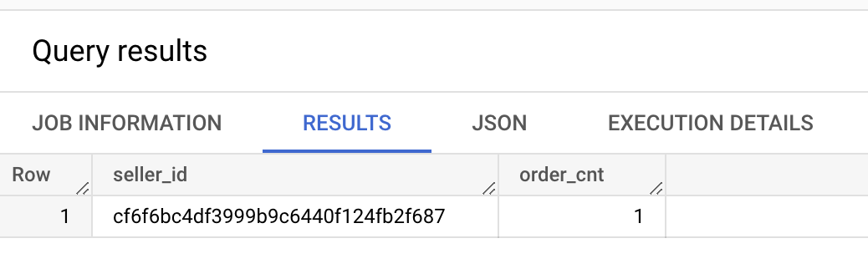
Seller who has maximum number of orders
SELECT seller_id, count(order_id) AS order_cnt
FROM `target-sql-361009.TargetDS.order_items`
GROUP BY seller_id
ORDER BY order_cnt DESC LIMIT 1
Seller with minimum number of orders
SELECT seller_id, count(order_id) AS order_cnt
FROM `target-sql-361009.TargetDS.order_items`
GROUP BY seller_id
ORDER BY order_cnt ASC LIMIT 1

Slide 14
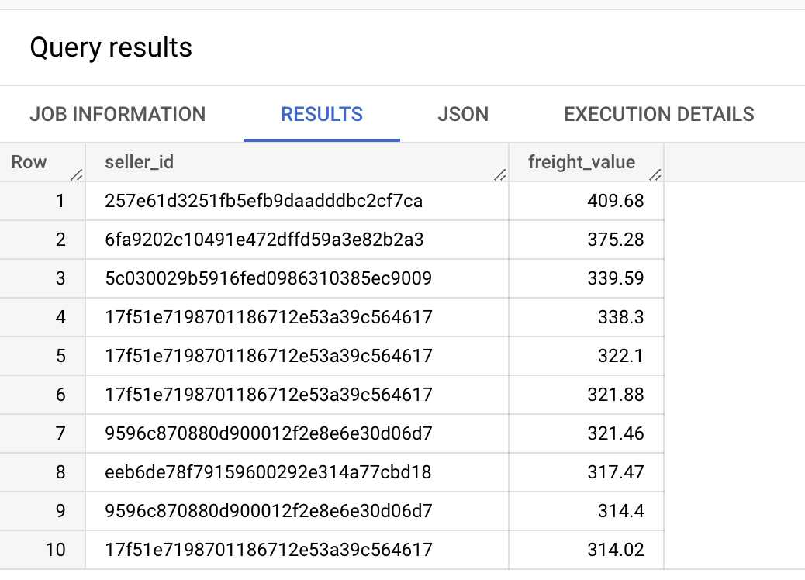
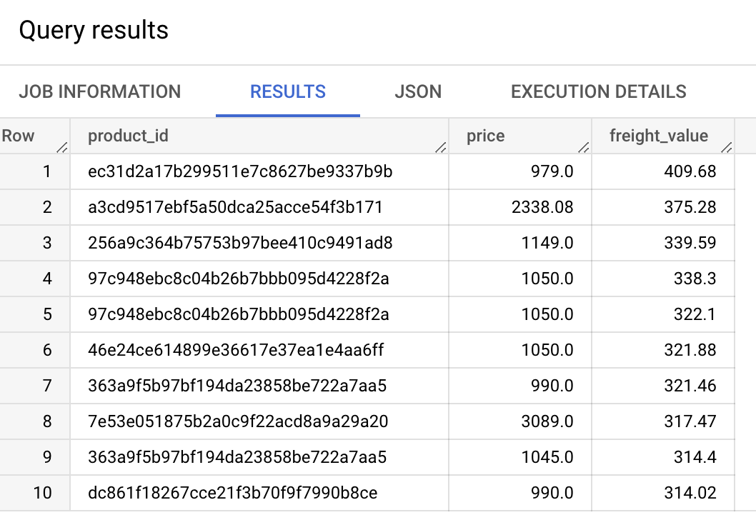
Seller with maximum freight value
SELECT seller_id, freight_value
FROM `target-sql-361009.TargetDS.order_items`
GROUP BY seller_id, freight_value
ORDER BY freight_value DESC LIMIT 10
Correlation b/w product price and freight value
SELECT product_id, price, freight_value
FROM `target-sql-361009.TargetDS.order_items`
GROUP BY product_id, price, freight_value
ORDER BY freight_value DESC LIMIT 10
There is no correlation b/w the product price and high freight value

Slide 15
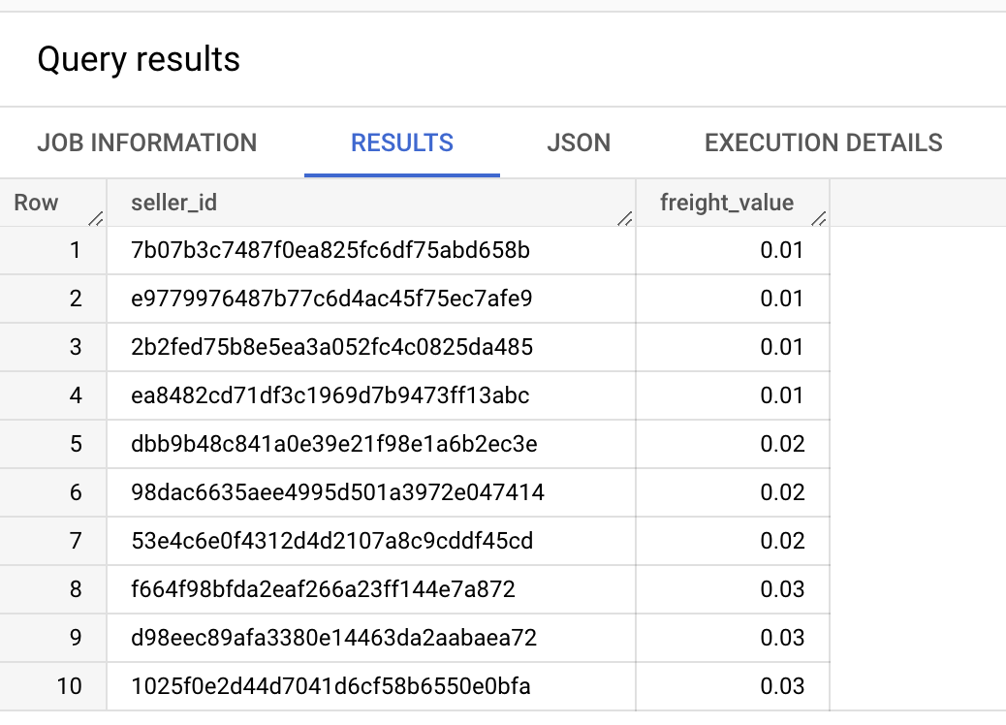
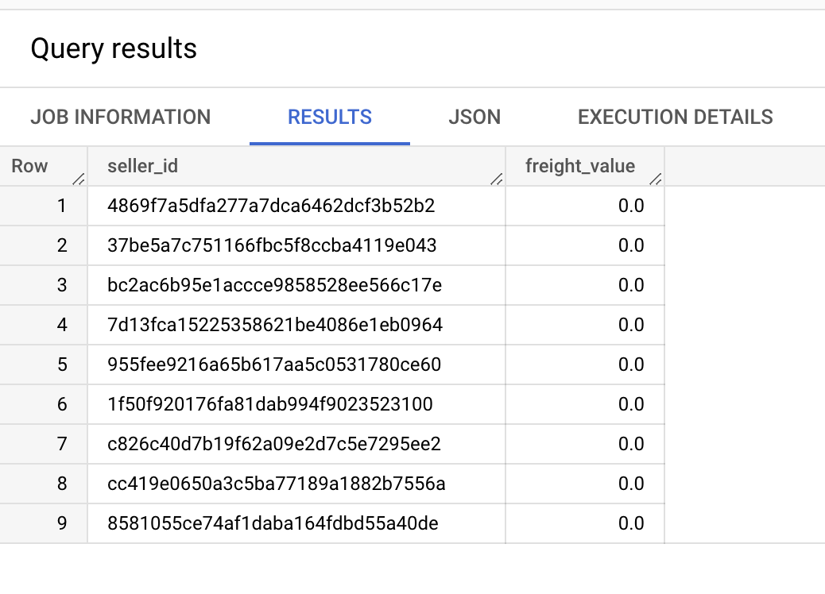
Seller who charges minimum freight value
SELECT seller_id, freight_value
FROM `target-sql-361009.TargetDS.order_items`
WHERE freight_value>0
GROUP BY seller_id, freight_value
ORDER BY freight_value ASC LIMIT 10
Sellers with zero freight value
SELECT seller_id, freight_value
FROM `target-sql-361009.TargetDS.order_items`
WHERE freight_value=0
GROUP BY seller_id, freight_value
ORDER BY freight_value

Slide 16
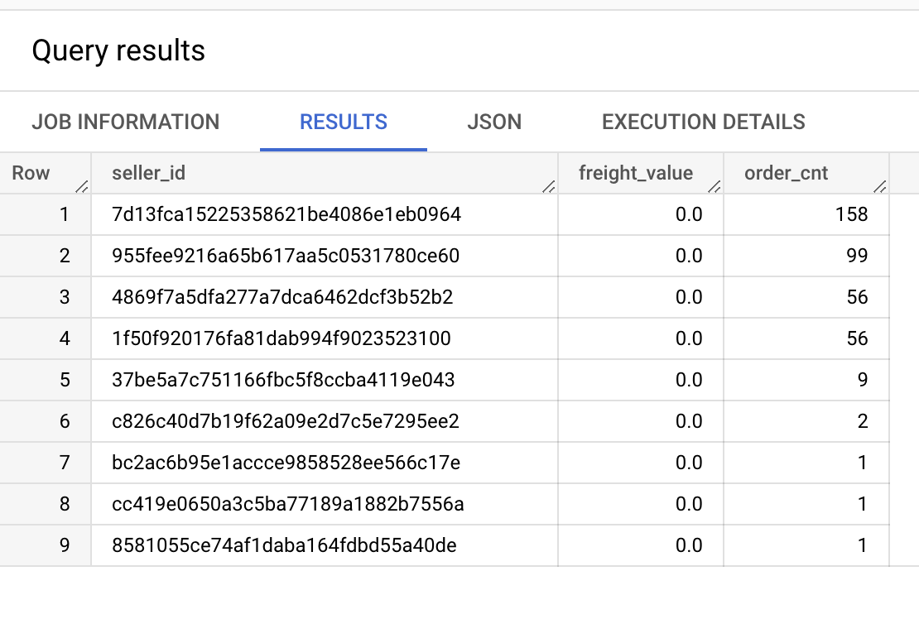
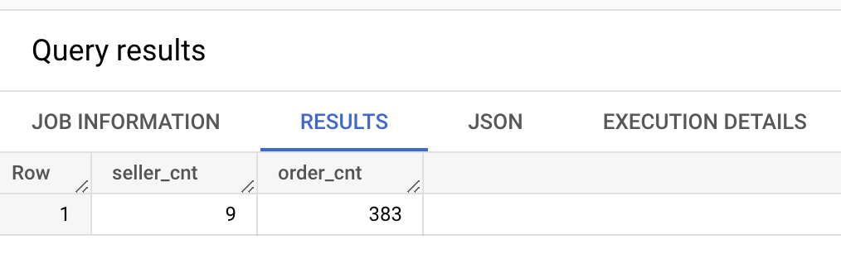
Sellers with zero freight value and their order count
SELECT seller_id, freight_value, count(order_id) AS order_cnt
FROM `target-sql-361009.TargetDS.order_items`
WHERE freight_value=0
GROUP BY seller_id, freight_value
ORDER BY order_cnt DESC
Sellers with zero freight value and their order count
SELECT count(distinct(seller_id)) AS seller_cnt, count(order_id) AS order_cnt
FROM `target-sql-361009.TargetDS.order_items`
WHERE freight_value=0
There are 9 sellers who have zero freight charges, their respective order counts.

Slide 17
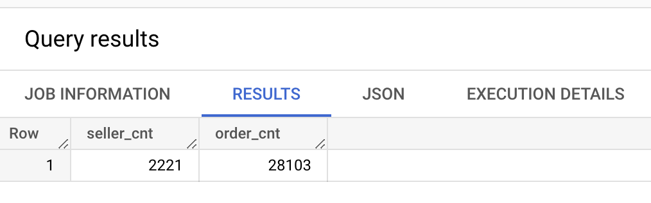
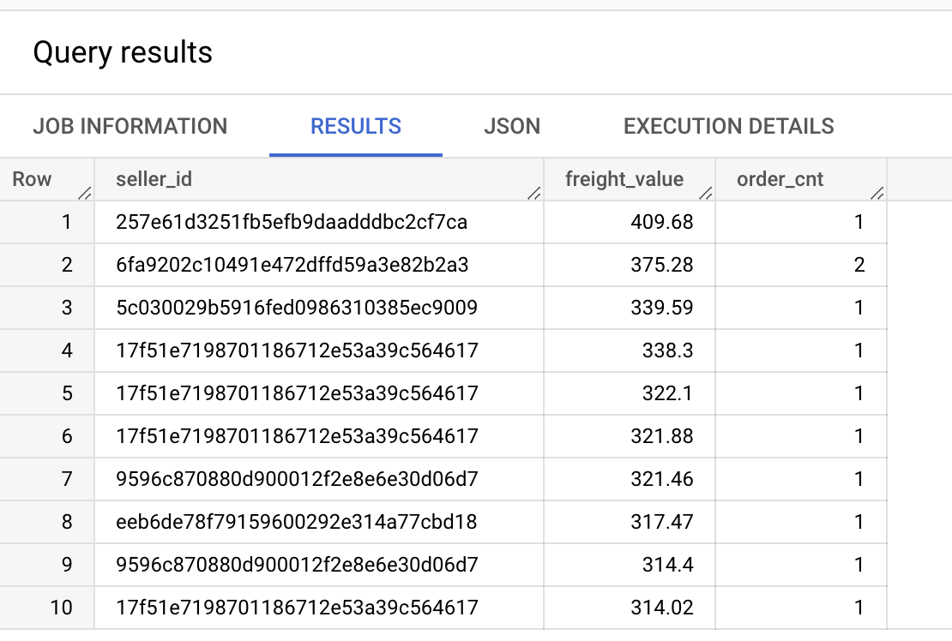
Sellers with high freight value and their order count
SELECT seller_id, freight_value, count(order_id) AS order_cnt
FROM `target-sql-361009.TargetDS.order_items`
GROUP BY seller_id, freight_value
ORDER BY freight_value DESC LIMIT 10
The sellers with high freight value have less number of orders
Number of orders by Sellers whose freight value is above 20
SELECT count(distinct(seller_id)) AS seller_cnt, count(distinct(order_id)) AS order_cnt
FROM `target-sql-361009.TargetDS.order_items`
WHERE freight_value>20
30% of orders have freight value $20 and above

Slide 18
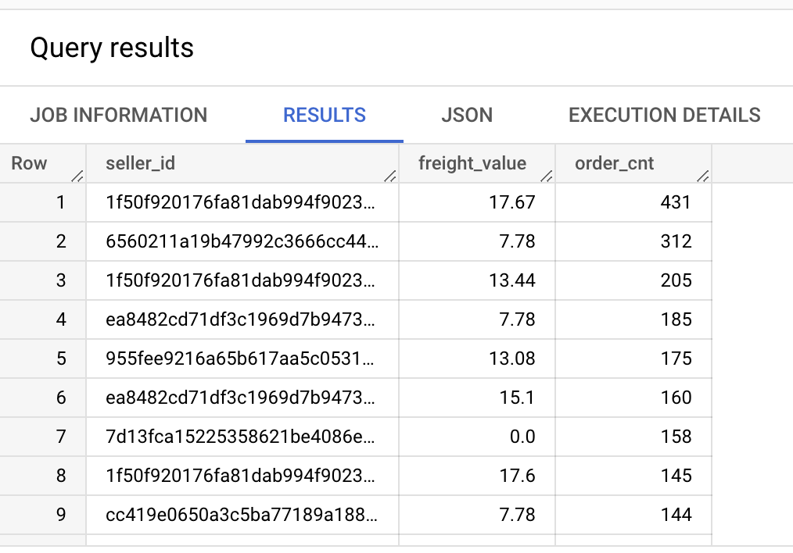
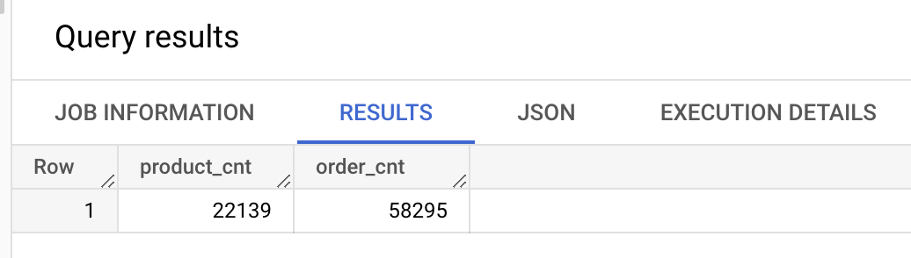
Sellers with high number of orders and their freight value
SELECT seller_id, freight_value, count(order_id) AS order_cnt
FROM `target-sql-361009.TargetDS.order_items`
GROUP BY seller_id, freight_value
ORDER BY order_cnt DESC
This indicates that the sellers with relative lower freight value have higher number of orders
No of products whose freight value is between 10 and 20 and their order counts
SELECT count(distinct(product_id)) AS product_cnt, count(distinct(order_id)) AS order_cnt
FROM `target-sql-361009.TargetDS.order_items`
WHERE freight_value BETWEEN 10 AND 20
This indicates that 80% of orders are from products who have freight value b/w 10 and 20

Slide 19
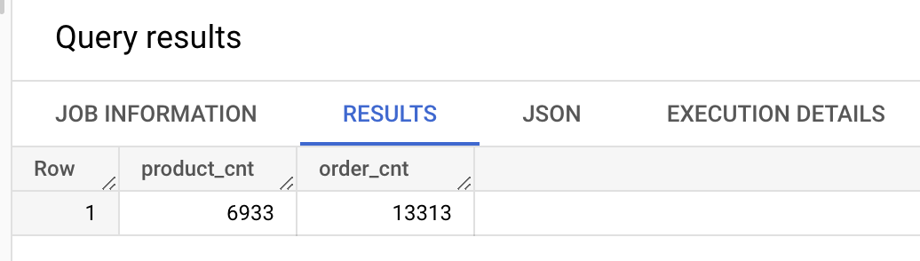
Of products whose freight value is between 1 and 10 and their order counts
SELECT count(distinct(product_id)) AS product_cnt, count(distinct(order_id)) AS order_cnt
FROM `target-sql-361009.TargetDS.order_items`
WHERE freight_value>0 AND freight_value<=10
This indicates that 13% of orders are from products who have freight value less than 10.

Slide 20
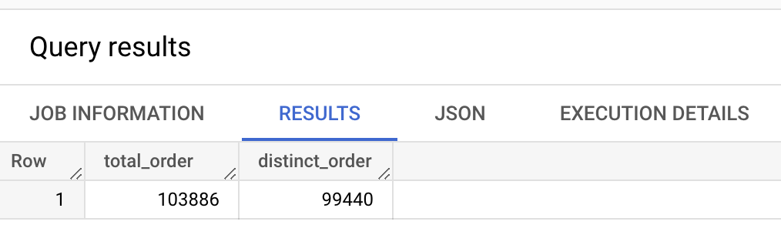
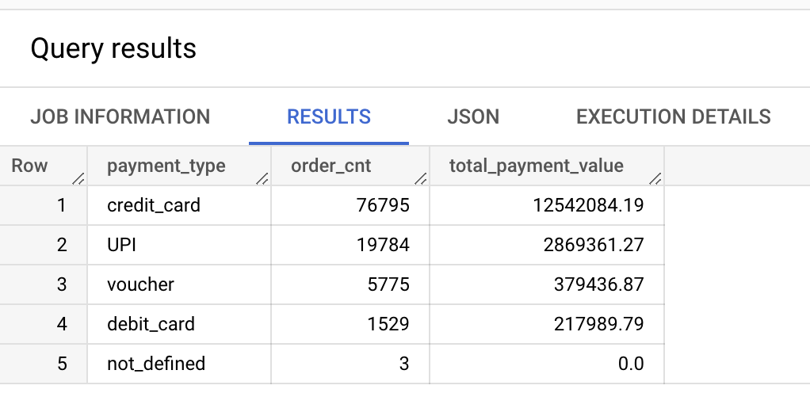
Payments Table
Total count of orders from Payments table
SELECT count(order_id) AS total_order, count(distinct(order_id)) AS distinct_order FROM `target-sql-361009.TargetDS.payments`
List of Payment Types, respective order counts and their total payment value
SELECT distinct(payment_type), count(order_id) AS order_cnt,
round(sum(payment_value),2) AS total_payment_value
FROM `target-sql-361009.TargetDS.payments`
GROUP BY payment_type
ORDER BY order_cnt DESC
Clearly credit card seems to be the most preferred payment type, followed by UPI.

Slide 21
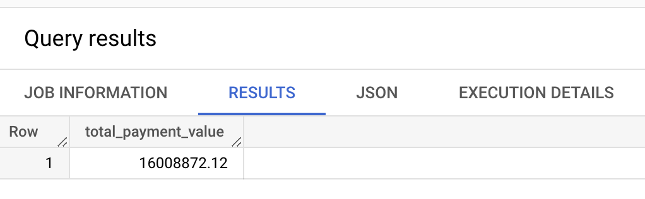
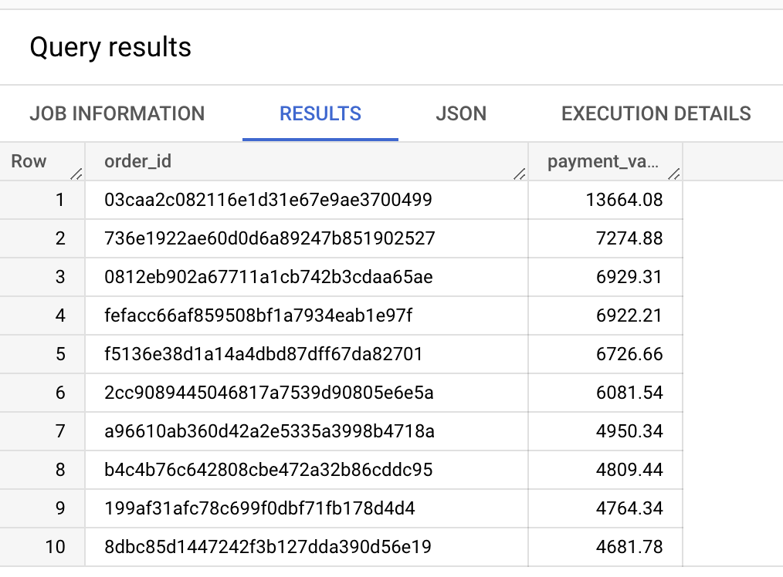
Total Payment value by all orders
SELECT round(sum(payment_value), 2) AS total_payment_value
FROM `target-sql-361009.TargetDS.paymen
Top 10 orders with high payment value
SELECT order_id, payment_value
FROM `target-sql-361009.TargetDS.payments`
ORDER BY payment_value DESC LIMIT 10

Slide 22
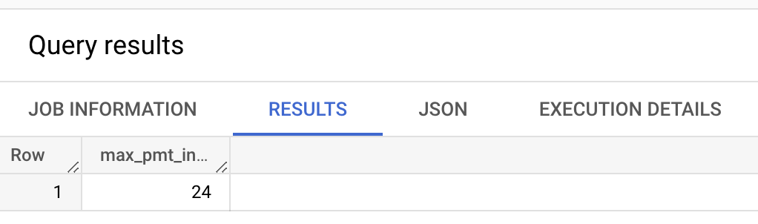
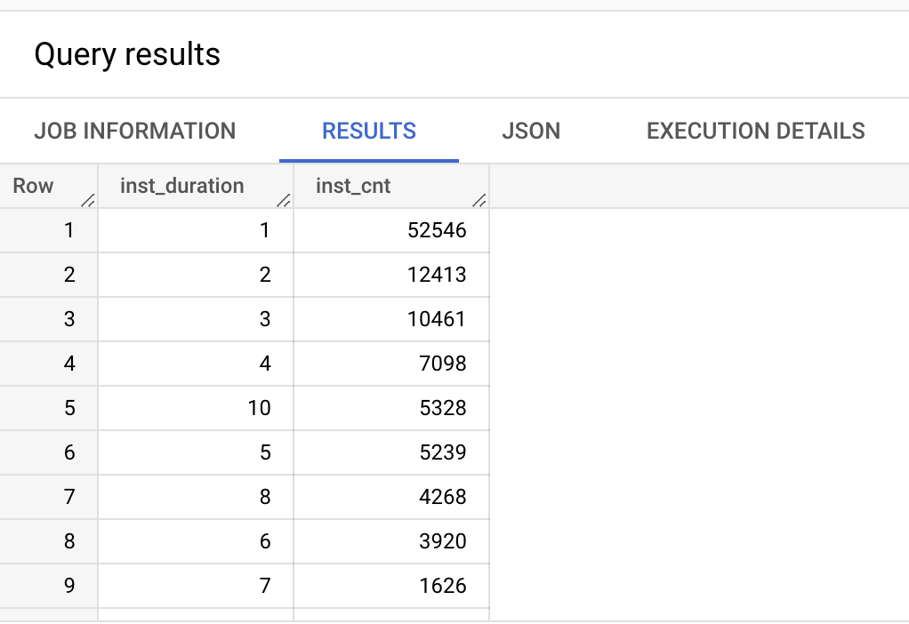
Maximum possible payment instalment
SELECT max(payment_installments) as max_pmt_installment FROM `target-sql-361009.TargetDS.payments`
This indicates maximum possible instalment duration is Two years.
Top 10 orders by payment instalment and their respective count (Number of instalments pattern)
SELECT payment_installments AS inst_duration, count(payment_installments) AS inst_cnt FROM `target-sql-361009.TargetDS.payments`
GROUP BY payment_installments
ORDER BY inst_cnt DESC

Slide 23
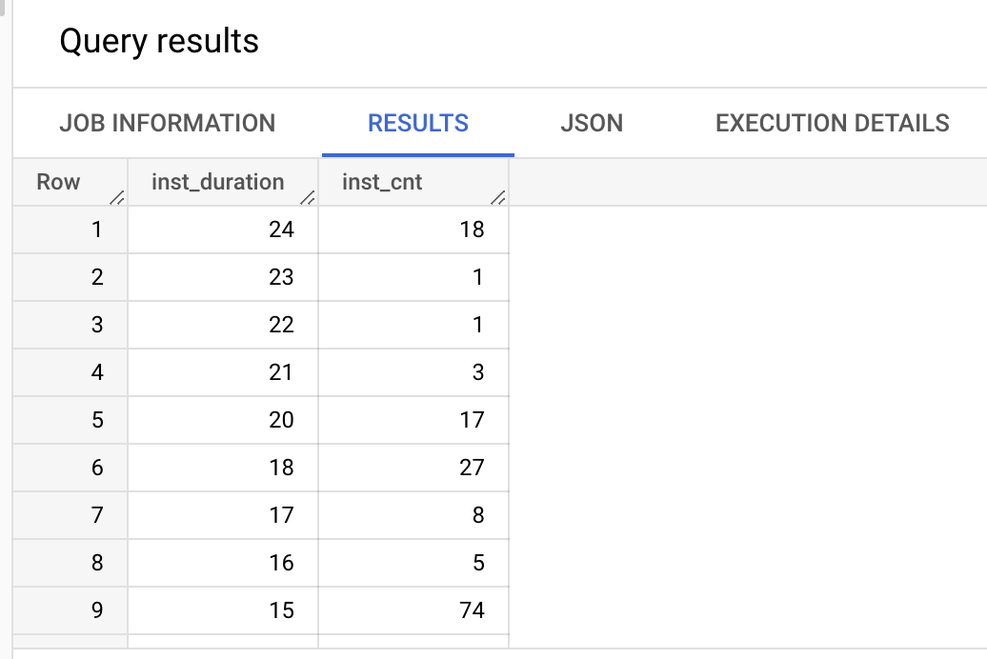
Top 10 orders by payment instalment and their respective count (Number of instalments pattern)
SELECT payment_installments AS inst_duration, count(payment_installments) AS inst_cnt FROM `target-sql-361009.TargetDS.payments`
GROUP BY payment_installments
ORDER BY inst_duration DESC
Based on above two data points, interestingly Customers seem to prefer/paid lower instalment than dragging it too long.

Slide 24

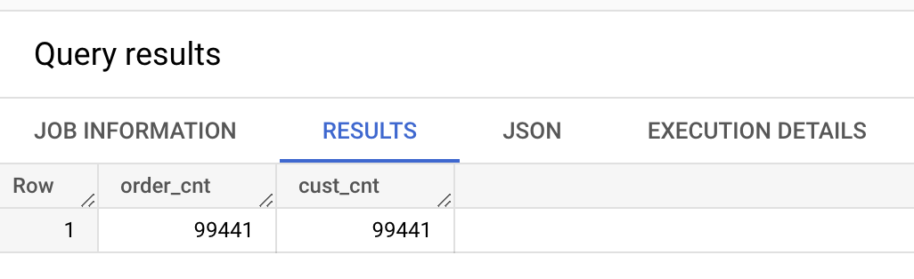
Orders Table
Number of orders from Orders table
SELECT count(order_id) AS order_cnt, count(distinct(order_id)) AS ord_distinct_cnt FROM `target-sql-361009.TargetDS.orders`
Number of orders and customers
SELECT count(order_id) AS order_cnt, count(distinct(customer_id)) AS cust_cnt
FROM `target-sql-361009.TargetDS.orders`

Slide 25
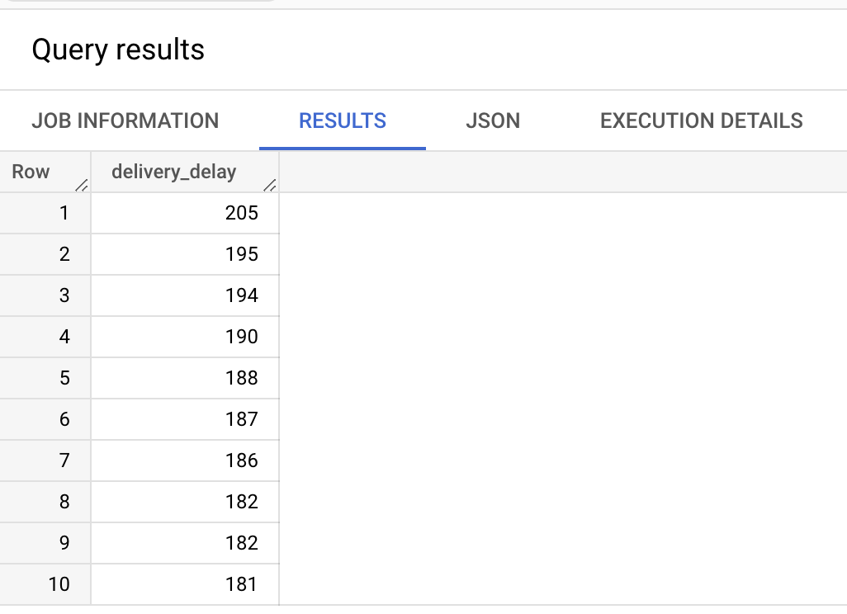
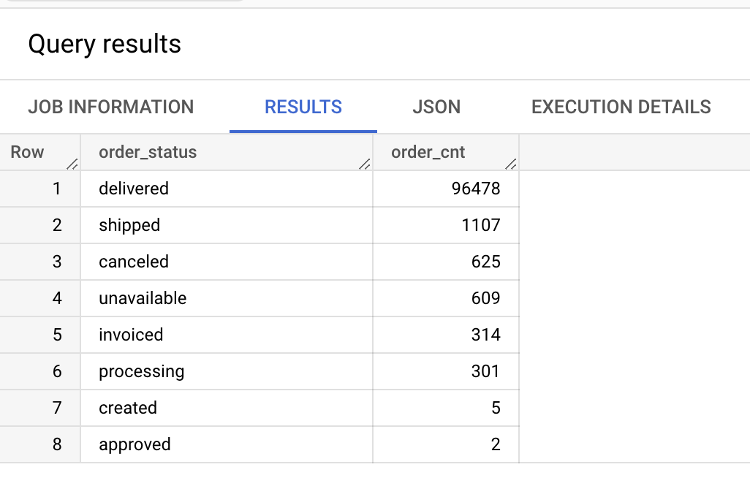
List of Order status and corresponding number of Orders
SELECT distinct(order_status), count(order_id) AS order_cnt
FROM `target-sql-361009.TargetDS.orders`
GROUP BY order_status
ORDER BY order_cnt DESC
This indicates 97% of the orders are delivered & completed.
Delay b/w order delivery dates by customer & carrier
SELECT date_diff(order_delivered_customer_date, order_delivered_carrier_date, DAY) as delivery_delay,
FROM `target-sql-361009.TargetDS.orders`
ORDER BY delivery_delay DESC LIMIT 10

Slide 26
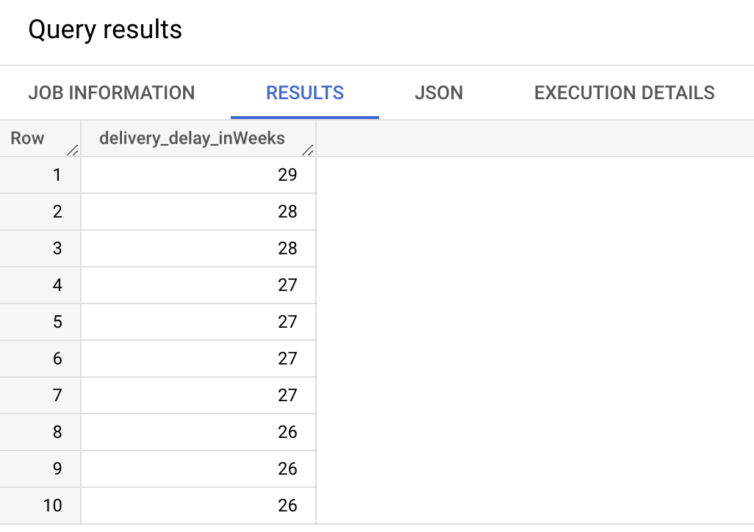
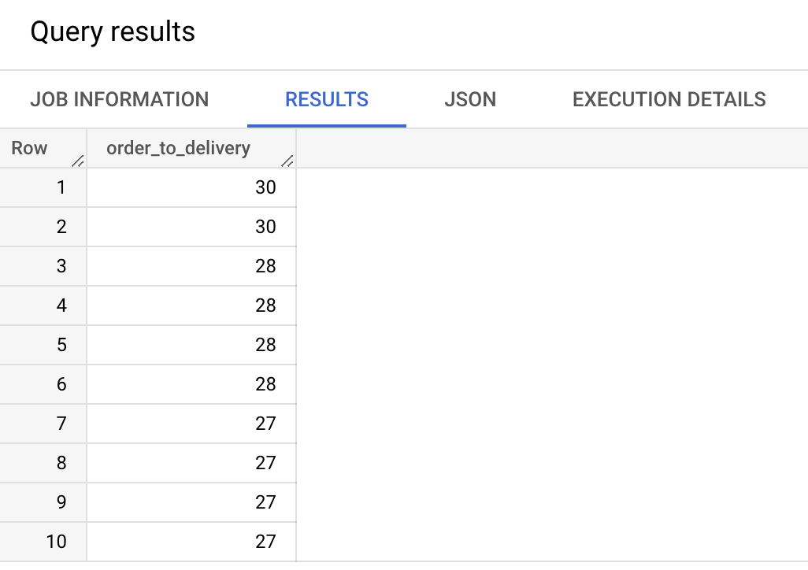
Delay b/w order delivery dates by customer & carrier
SELECT date_diff(CAST(order_delivered_customer_date AS DATE), CAST(order_delivered_carrier_date AS DATE), WEEK) as delivery_delay_inWeeks,
FROM `target-sql-361009.TargetDS.orders`
ORDER BY delivery_delay_inWeeks DESC LIMIT 10
Time duration from Order to Delivery dates
SELECT date_diff(CAST(order_delivered_customer_date AS DATE), CAST(order_purchase_timestamp AS DATE), WEEK) as order_to_delivery,
FROM `target-sql-361009.TargetDS.orders`
ORDER BY order_to_delivery DESC LIMIT 10
Based on the above queries, it’s heartening to see the ‘Order to delivery’ is 30 weeks and there around % of orders with more than 20 weeks delivery duration, which is not good.

Slide 27
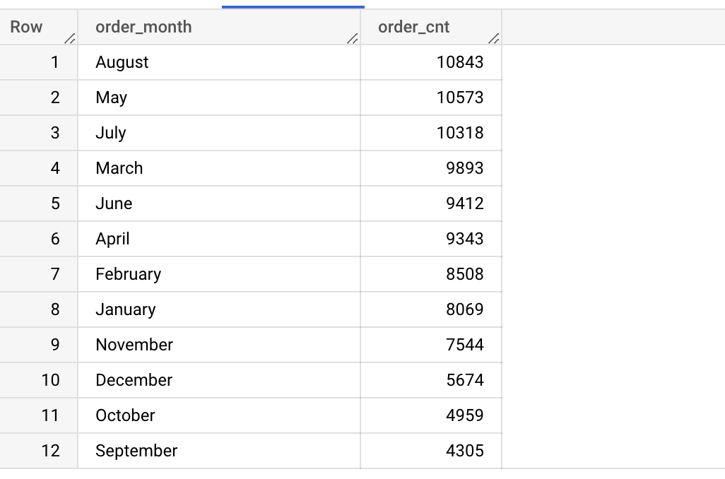
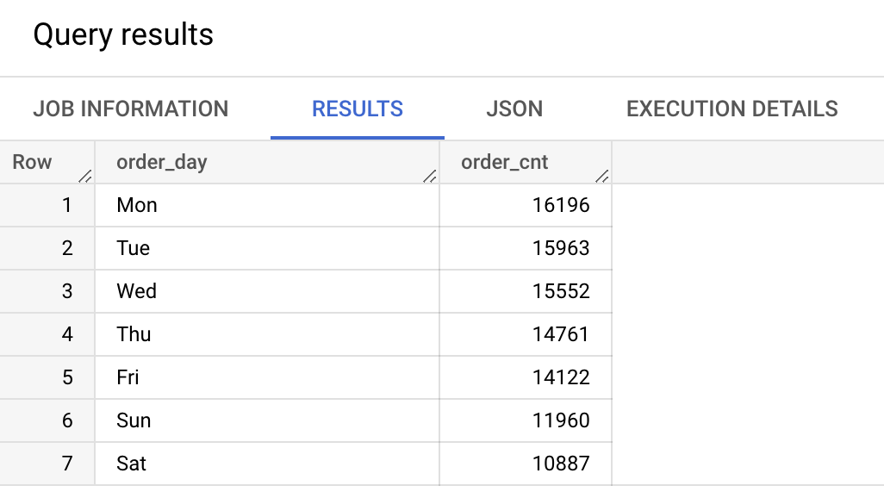
Month-wise Order count
SELECT FORMAT_DATETIME("%B", DATETIME(order_purchase_timestamp)) as order_month, count(order_id) order_cnt
FROM `target-sql-361009.TargetDS.orders`
GROUP BY order_month
ORDER BY order_cnt DESC
August is the top order month. August, May and July have more number of Orders. September is the lowest number of Orders.
Day-wise Order count
SELECT FORMAT_DATETIME("%a", DATETIME(order_purchase_timestamp)) as order_day, count(order_id) order_cnt
FROM `target-sql-361009.TargetDS.orders`
GROUP BY order_day
ORDER BY order_cnt DESC
Surprisingly, the number of orders relatively seem to be less on week-ends compared to week-days, and Monday being the top order day.

Slide 28
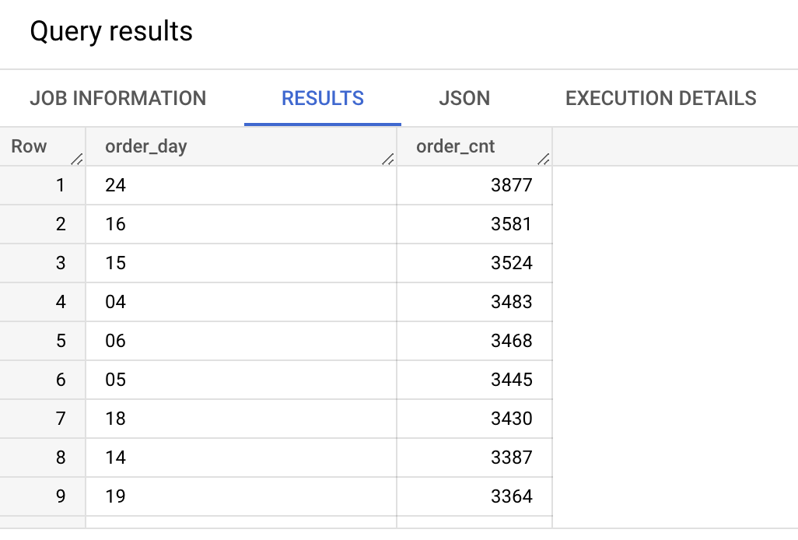
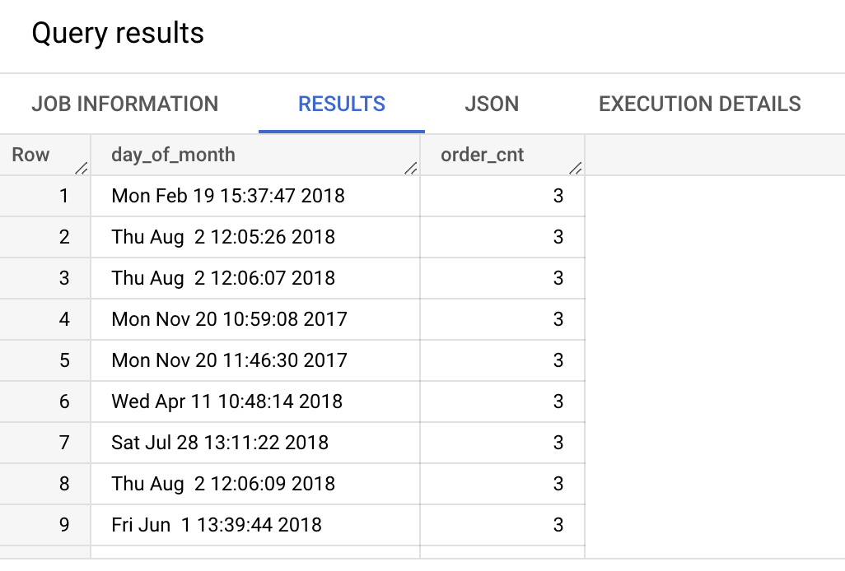
Day of month with high number of Orders
SELECT FORMAT_DATETIME("%d", DATETIME(order_purchase_timestamp)) as day_of_month, count(order_id) order_cnt
FROM `target-sql-361009.TargetDS.orders`
GROUP BY day_of_month
ORDER BY order_cnt DESC
There doesn’t seem to be any pattern in terms of which date of a month more orders are placed, like salary week or mid week or anything like that.
The days which recorded highest number of orders
SELECT FORMAT_DATETIME("%c", DATETIME(order_purchase_timestamp)) as day_of_month, count(order_id) order_cnt
FROM `target-sql-361009.TargetDS.orders`
GROUP BY day_of_month
ORDER BY order_cnt DESC
The day of the year with highest number of orders in a single day seems to be Aug 2nd.

Slide 29
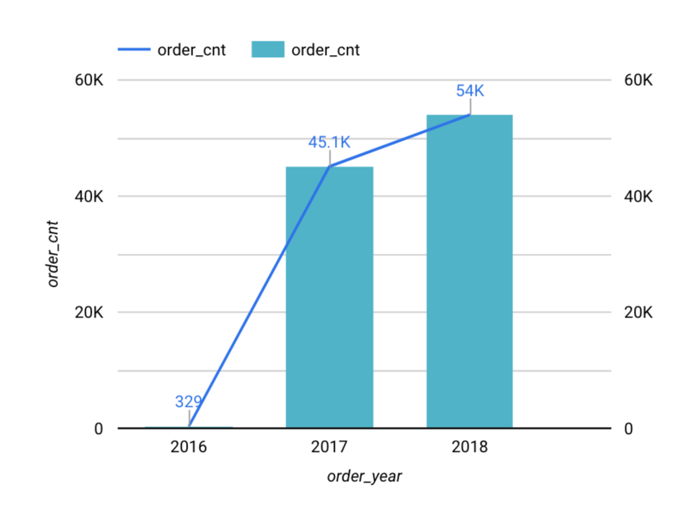
Year-wise count of Orders
SELECT EXTRACT(YEAR FROM DATE (order_purchase_timestamp)) as order_year, count(order_id) order_cnt
FROM `target-sql-361009.TargetDS.orders`
GROUP BY order_year
ORDER BY order_cnt DESC
This is clear indication of how sales/e-commerce has increased over the years in Brazil.

Slide 30
Reviews Table
The days which recorded highest number of orders
SELECT FORMAT_DATETIME("%c", DATETIME(order_purchase_timestamp)) as day_of_month, count(order_id) order_cnt
FROM `target-sql-361009.TargetDS.orders`
GROUP BY day_of_month
ORDER BY order_cnt DESC
The day of the year with highest number of orders in a single day seems to be Aug 2nd.

Slide 31
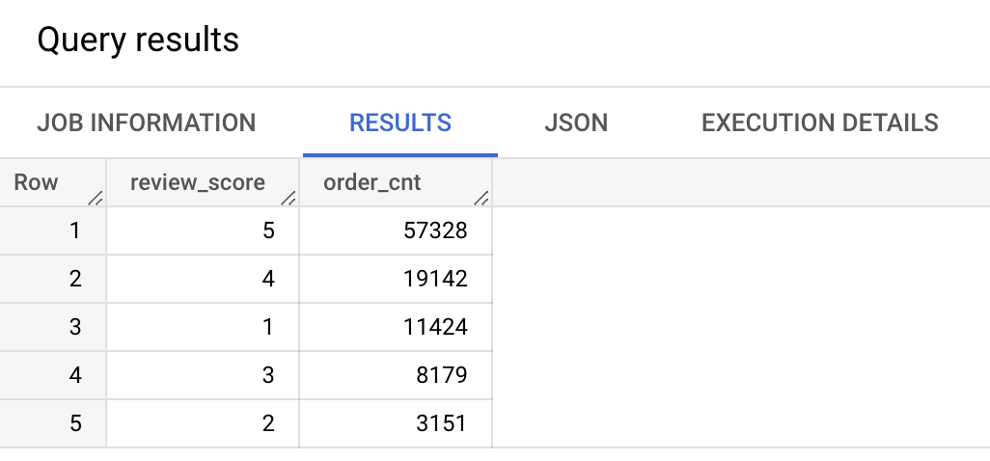
Reviews Table
Orders with top review scores
SELECT review_score, count(order_id) as order_cnt FROM `target-sql-361009.TargetDS.order_reviews` GROUP BY review_score
ORDER BY order_cnt DESC
57% of the total orders have got top review score and 11% has got low review score.

Slide 32
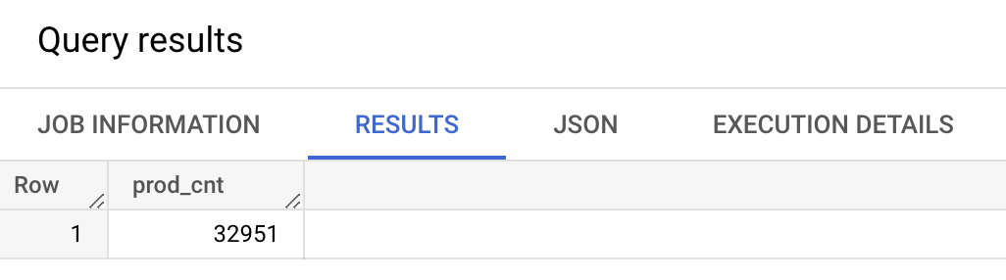
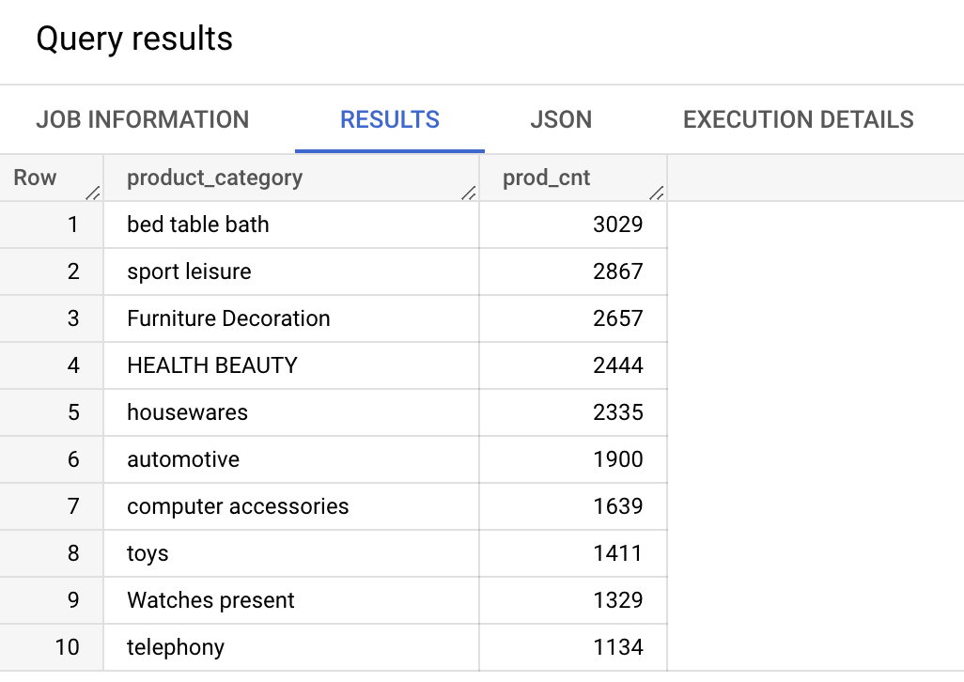
Products Table
Total number of Products
SELECT count(product_id) prod_cnt
FROM `target-sql-361009.TargetDS.products`
Top 10 Product Categories in terms of count
SELECT product_category, count(product_id) prod_cnt
FROM `target-sql-361009.TargetDS.products`
GROUP BY product_category
ORDER BY prod_cnt DESC LIMIT 10
The top 3 product categories with more number of products are ‘bed table bath’, ‘sports’, and ‘furniture’

Slide 33
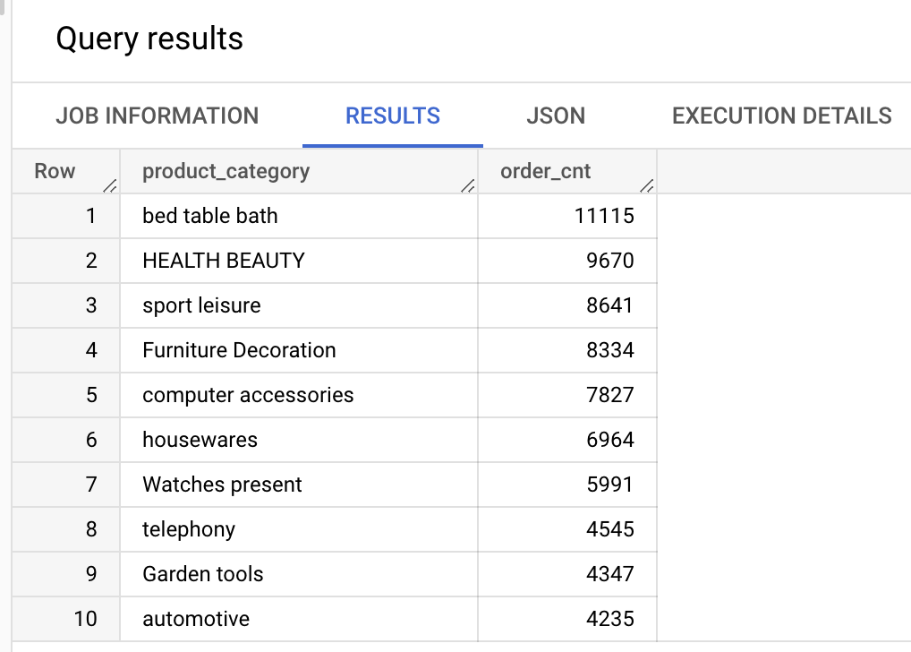
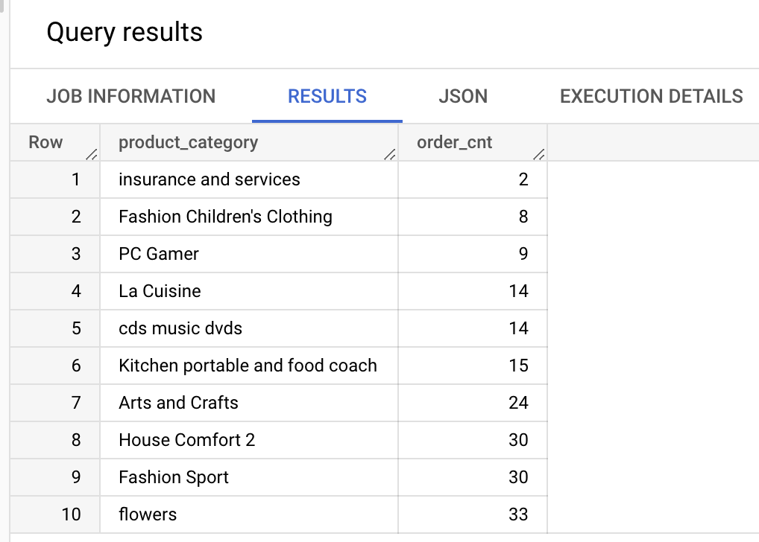
The product categories with less number of orders
SELECT product_category, count(order_item_id) order_cnt
FROM `target-sql-361009.TargetDS.products` prod
LEFT JOIN `target-sql-361009.TargetDS.order_items` order_item
ON prod.product_id = order_item.product_id
GROUP BY product_category
Insurance and Services and Children’s Fashion Clothing are the product categories with less number of orders.
The product categories with more number of orders
SELECT product_category, count(order_item_id) order_cnt
FROM `target-sql-361009.TargetDS.products` prod
LEFT JOIN `target-sql-361009.TargetDS.order_items` order_item
ON prod.product_id = order_item.product_id
GROUP BY product_category
ORDER BY order_cnt DESC LIMIT 10
The top 3 product categories with more number of orders are ‘bed table bath’, ‘health beauty’ and ‘sports’.

Slide 34
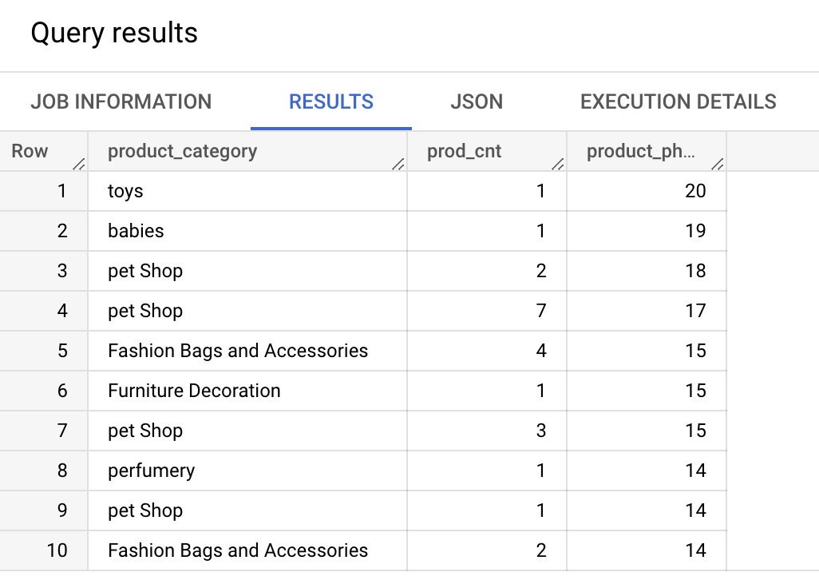
Top 10 Product Categories with high number of Photos
SELECT product_category, count(product_id) prod_cnt, product_photos_qty
FROM `target-sql-361009.TargetDS.products`
GROUP BY product_category, product_photos_qty
ORDER BY product_photos_qty DESC LIMIT 10
Though ‘Toys’ has only one product, the number of product images are high. Similarly we can see babies and pet products have more photos.
Product categories that don’t have photo images
SELECT product_category, count(product_id) prod_cnt, product_photos_qty
FROM `target-sql-361009.TargetDS.products`
WHERE product_photos_qty=0
GROUP BY product_category, product_photos_qty
LIMIT 10
This query has returned with zero which indicates all the products have atleast one product image.

Slide 35
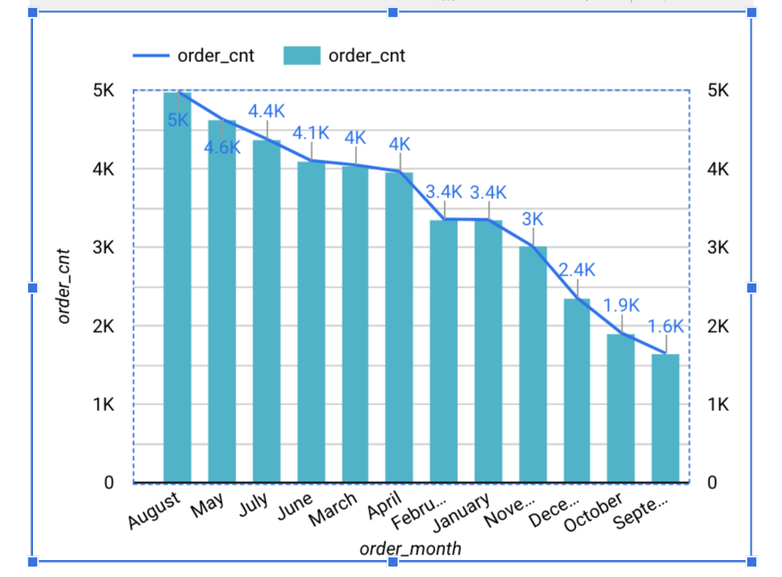
Orders trend by month
SELECT FORMAT_DATETIME("%B", DATETIME(order_purchase_timestamp)) as order_month, count(order_id) order_cnt, customer_state
FROM `target-sql-361009.TargetDS.orders` ord
INNER JOIN `target-sql-361009.TargetDS.customers` cust
ON ord.customer_id = cust.customer_id
GROUP BY order_month, customer_state
ORDER BY order_cnt DESC LIMIT 12

Slide 36

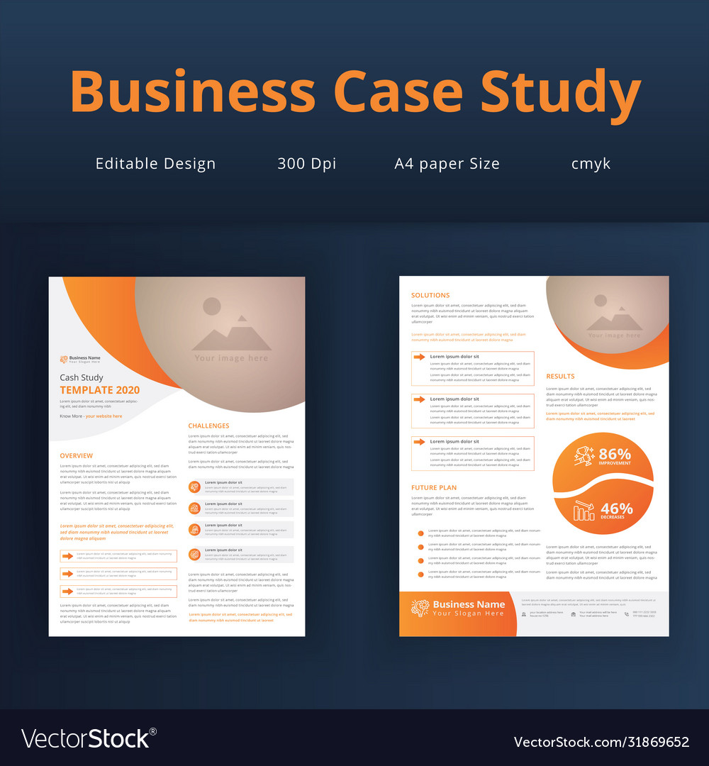
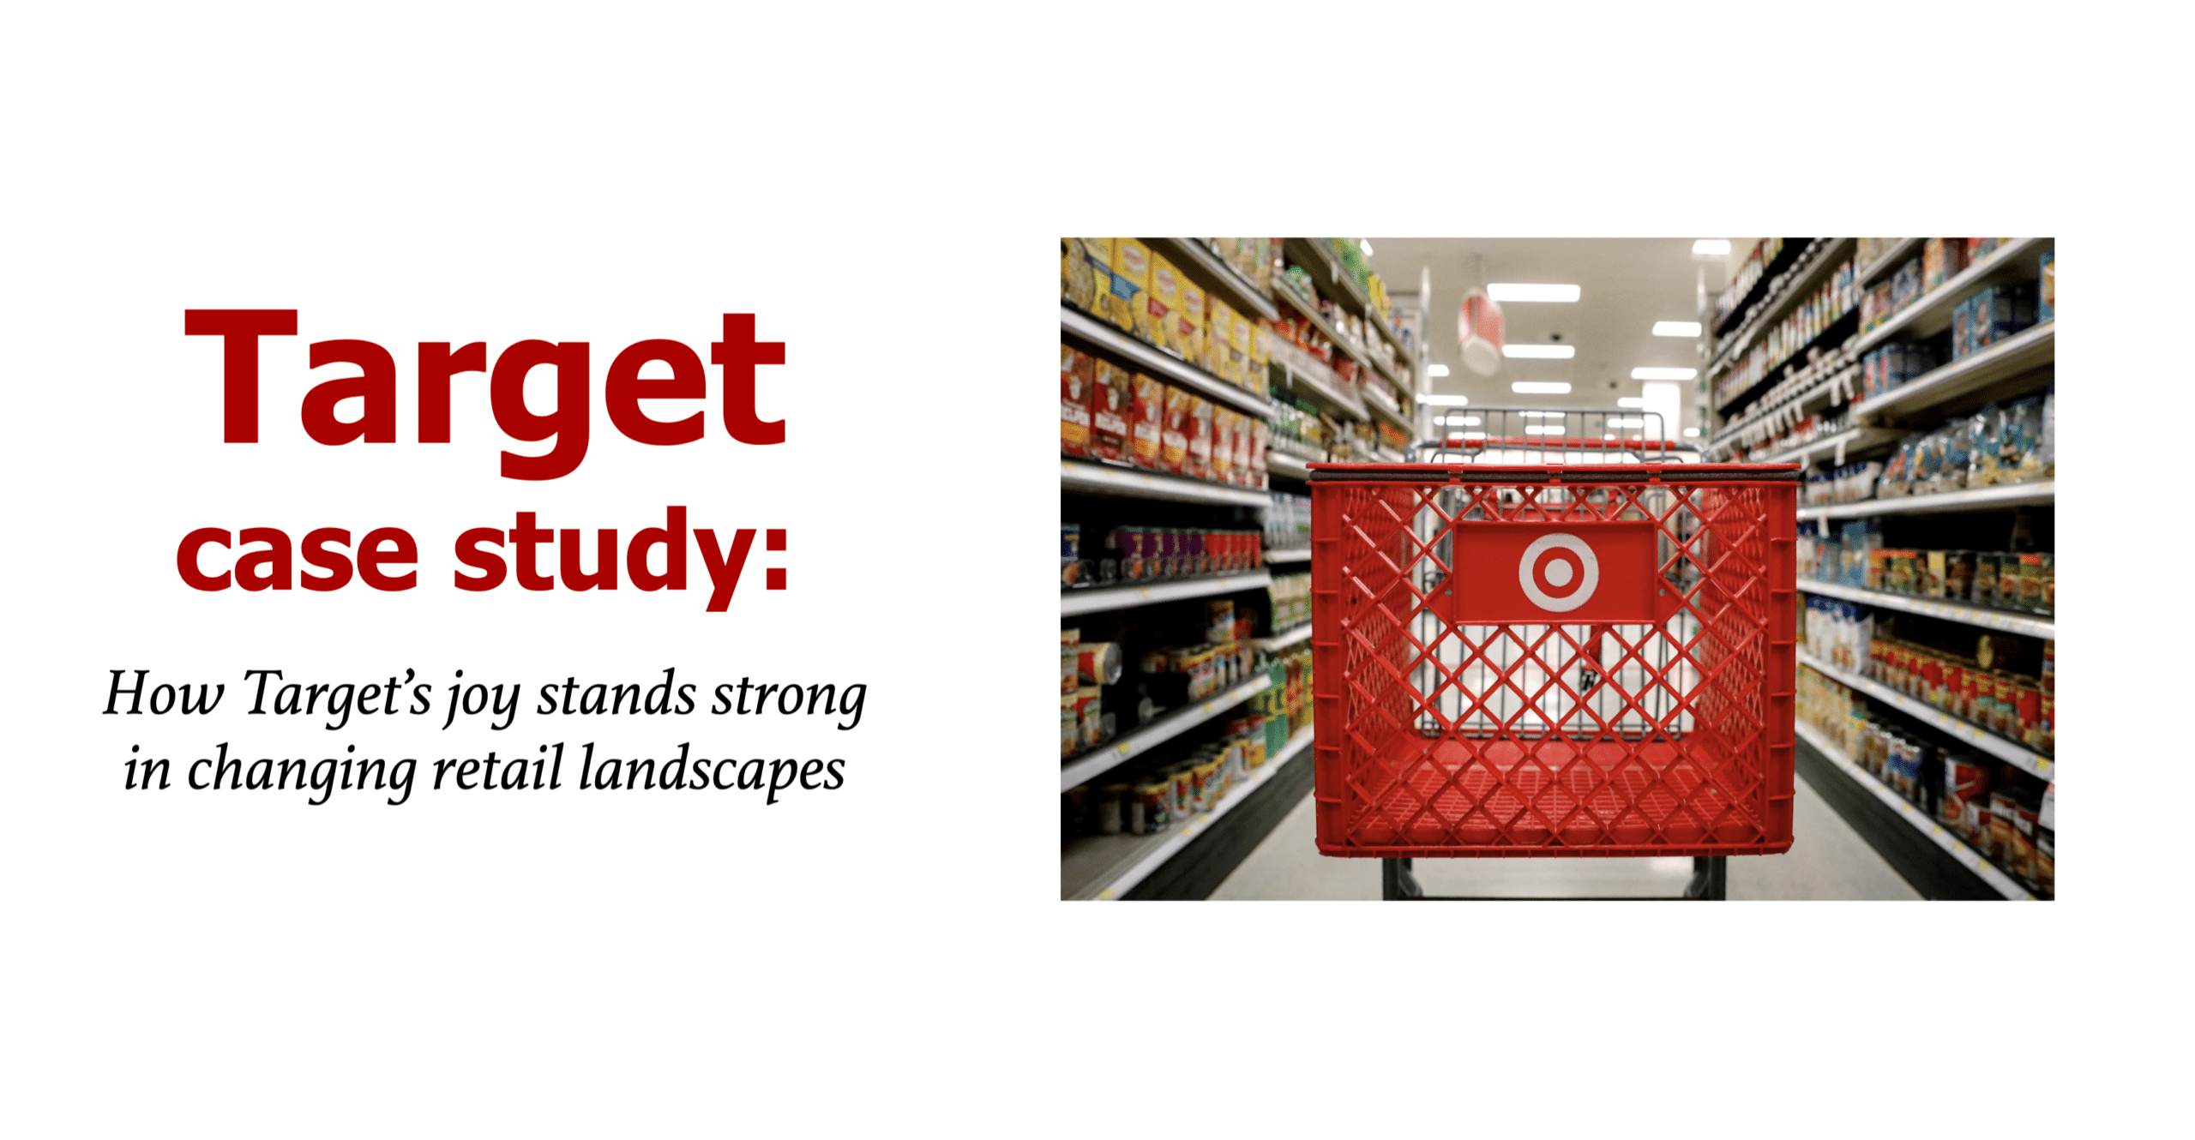

Slide 37

Target Business Case Study
Cities, States, Customers & Sellers:
Top states with more Customers - San Paulo, Rio de Janeiro
Top states with more Sellers - San Paulo, Curitiba and Rio continue
All the registered sellers at Target are active and they have sales
Cities and States with more number of Sellers have recorded high number of Orders
There is no correlation b/w the product price and high freight value
Orders:
August is the top order month.
August, May and July have more number of Orders.
September has the lowest number of Orders
Surprisingly the number of orders relatively seem to be less on week-ends compared to week-days, and Monday being the top order day.
There doesn’t seem to be any pattern in terms of which date of a month more orders are placed, like salary week or mid week or anything like that.

Slide 38
Freight Value:
High freight value have less number of orders
Lower freight value have higher number of orders
There are 9 orders with zero freight charges, and their total order count is 383
30% of orders have freight value $20 and above
80% of orders are from products who have freight value between 10 and 20
13% of orders are from products who have freight value less than 10
Payment Options:
Preferred payment option is Credit Card with 78%
UPI mode of payment is 17%
Voucher holds 2% of overall payment value
Instalments:
Maximum instalment duration is Two years
Customers seem to prefer/ paid lower instalment than dragging it too long.
80% of the instalments are within first 4 months

Slide 39
Delivery:
Delivery status indicates 97% of the orders are delivered & completed
Only 0.6% of total orders either cancelled or unavailable which is a good sign
It’s heartening to see the ‘Order to delivery’ is 30 weeks and there around good number of orders with more than 20 weeks delivery duration, which is not good.
Reviews:
57% of the total orders have got top review score
11% of the orders have got low review score
Products:
The top 3 product categories with more number of orders are ‘bed table bath’, ‘health beauty’ and ‘sports’.
‘Insurance and Services’ and ‘Children’s Fashion Clothing’ are the product categories with less number of orders
Though ‘Toys’ has only one product, the number of product images are high. Similarly we can see babies and pet products have more photos.
All the products have atleast one product image.

Slide 40

Recommendations
States like Acre (AC), Amazonas (AM), Bahia (BA) are with less number of Customers. Target can increase the number of Sellers to attract more customers and more orders.
In such above States & Cities, Target can come up with seasonal promotions and increase Customer count.
The location/ region where UPI payment is not used, Target can check and provide the options appropriately.
The location where voucher payment type is not/less used, probably Target can give voucher promotions.
If a particular state/city is not/less using the instalment type means, probably the given duration of 2 years may not be suffice. Target can try to increase the instalment duration and see if it attracts more customers.

Slide 41
Recommendations
Customers who make frequent purchases – recognize them with rewards and privileges.
Target can come up with promotions for the months like September, where Sales is low.
Freight charges are really high for few orders which certainly need to be looked at and can be reduced.
Order to delivery duration is seemingly high for few orders which certainly must be sorted out.
‘Insurance and Services’, ‘Children’s Fashion Clothing’, ‘PC Gamer’ are the product categories with less sales, which is an area of opportunity to improve
There are 11% or Orders with low review scores. Target must review these scores and improve based on user comments.

Slide 42


