Slide 1

CORPORATE CAPABILITY
Strategic Maritime Competence & Engineering
Steel Engineering, Advanced Fiberglass, and Integrated Water Transport Solutions for Regional Excellence.
© 2024 KHA Marine. Proprietary and Confidential.
Corporate Capability | 01

Slide 2
OPERATIONAL FRAMEWORK
Strategic Core Expertise
Leveraging three specialized divisions to provide end-to-end maritime infrastructure and tactical offshore services.
KHA Marine Strategic Framework
02

Slide 3






Integrated divisions provide mission-critical offshore and transit infrastructure
Division I: Advanced Fiberglass
Division II: Steel Engineering
Division III: Water Transport
Elite composite technology utilizing vacuum-infusion for high-performance leisure and specialized rescue assets.
Heavy-duty maritime assets engineered for offshore personnel transport and heavy industrial logistics support.
High-capacity transit networks including ferries, urban water taxis, and rapid marine medical services.
Source: KHA Marine Divisional Analysis 2024
Portfolio Overview | 03

Slide 4




Division I: Advanced Fiberglass engineering delivers superior performance via composite tech
Technical Framework
Value Proposition
Vacuum-infusion technology ensures optimal resin-to-glass ratios, resulting in unmatched structural integrity and significant weight reduction compared to traditional methods.
Superior power-to-weight ratios deliver higher fuel efficiency and increased top speeds while maintaining exceptional durability in harsh maritime environments.
Division I: Technical Specs
04

Slide 5



Division I Products: Specialized vessels optimized for leisure and rapid intervention
Sport Fishing Boats
Search & Rescue
Bespoke deep-sea platforms merging naval architecture with tactical sonar suites and modular deck layouts for professional profiles.
Mission-critical assets featuring self-righting hull capabilities and reinforced composite impact zones for severe conditions.
KEY FEATURE
KEY FEATURE
Elite naval architecture with modular customization.
High-speed intervention with FLIR thermal imaging.
Source: KHA Marine Product Roadmap
Division I Portfolio | 05

Slide 6
DIVISION II
Steel Vessel Engineering
Engineered for heavy-duty industrial and mission-critical tactical offshore deployments in demanding environments.
Division II Overview
06

Slide 7


Division II Products: Uncompromising reliability for industrial offshore logistics
Crew Boats
Landing Crafts
Grade-A marine steel hulls with triple/quad inboard propulsion systems ensuring safe, rapid personnel rotations for O&G operations.
Heavy-duty hydraulic RoRo ramps engineered for 40T trucks and heavy machinery in undeveloped coastal zones.
30+ knot cruise speeds
Shallow draft capability
Reinforced cargo decks
40-60 personnel capacity
Industrial Logistics Capabilities
07

Slide 8
DIVISION III
Integrated Water Transport
Optimizing urban connectivity through high-capacity ferry networks and emergency medical logistics.
Division III Overview
08

Slide 9






Modular ferry networks and medical shuttles drive regional urban mobility
Mass Transit
Urban Water Taxis
Marine Ambulance
Scalable ferries for 50-250+ passengers with IMO-certified safety and fuel-optimized hull profiles.
RTA-compliant shuttles for narrow canals, serving VIP hospitality and urban public transit standards.
Rapid aquatic ICU units with shock-mitigated bays for life-saving transit in riverine zones.
Urban Mobility Solutions
09

Slide 10
Operational readiness is sustained through 360° technical support
Predictive Maintenance: Condition-based monitoring systems and scheduled servicing to maximize vessel uptime.
Spare Parts Logistics: Global inventory of OEM components with 24-hour dispatch to minimize operational downtime.
Dry-Docking & Refits: Full shipyard services for structural repairs, engine overhauls, and hull maintenance.
24/7 Rapid Response: Mobile technical teams ready for immediate dispatch for troubleshooting and urgent interventions.
Operational Assurance Strategy
10

Slide 11
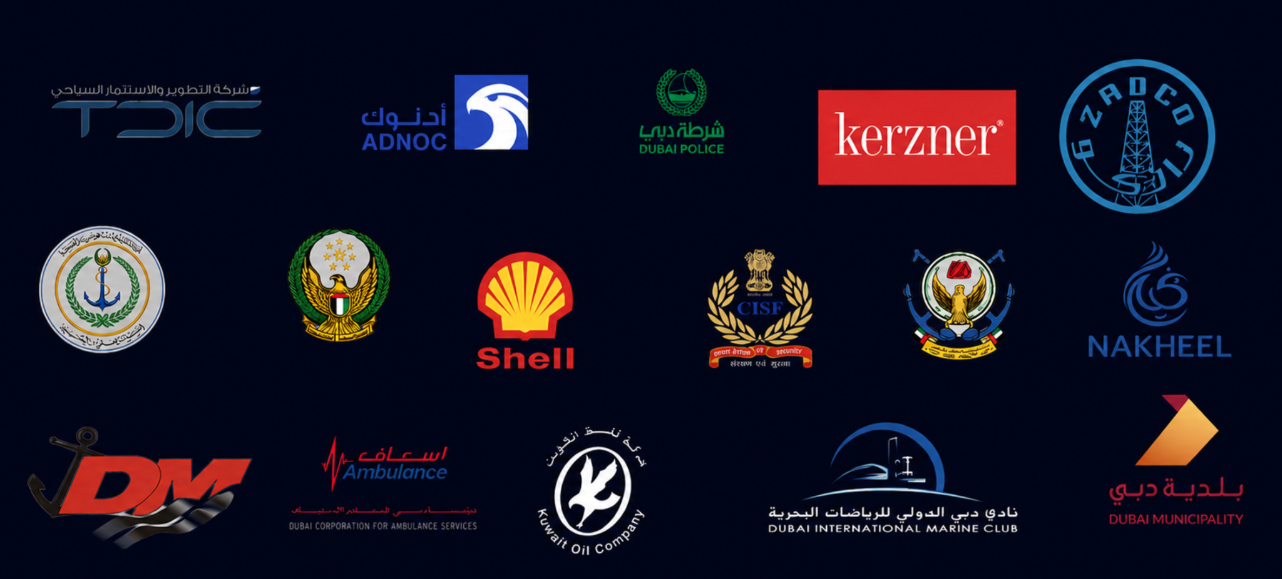
Strategic Partners
Our Clients

Slide 12

Partnering for Excellence
Mission-critical maritime assets. Decades of engineering expertise.
Global HQ
Connect
Dubai Maritime City Head Office, 4th Floor
@khamarine.com
KHA Marine Corporate Engagement
12

