Slide 1
Product Management System

Slide 2
Contents
Overview
Technology Used
Modules
Future Aspects
Conclusion

Slide 3
Overview
Product Management System is designed to store and manage product records in an array as objects.
It allows us to manipulate product records by providing us various operations:
Display all product records
Display product details
Delete product records
Add products
Edit product data
Filter product data
Sort product data

Slide 4
Technology Used
Front-End
create-react-app
Redux thunk middleware
Material UI
Porgressive Web App (PWA)
Yup
Formik
React-router-dom
Typescript
Back-End
MongoDB
Mongoose
NodeJS
Express
Logging with winston

Slide 5
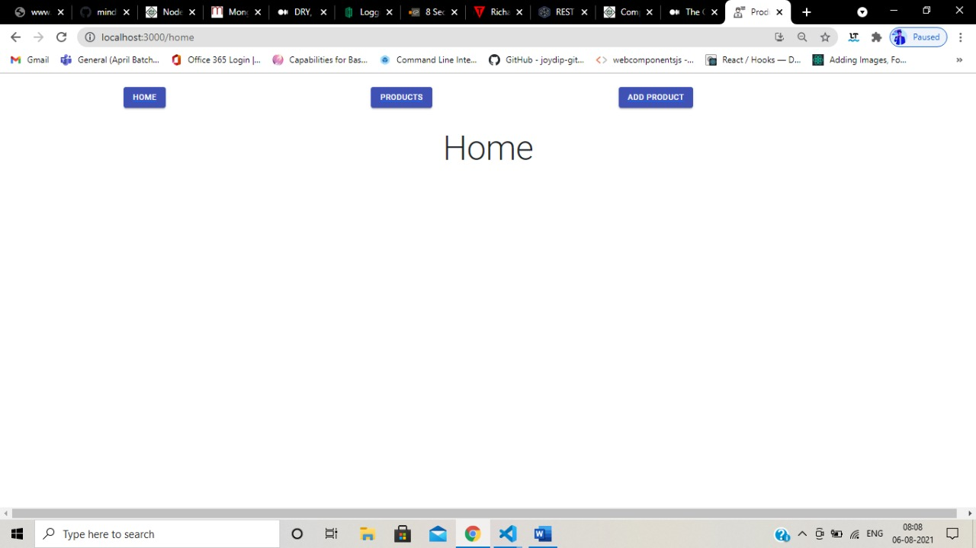
Modules
Home Page

Slide 6
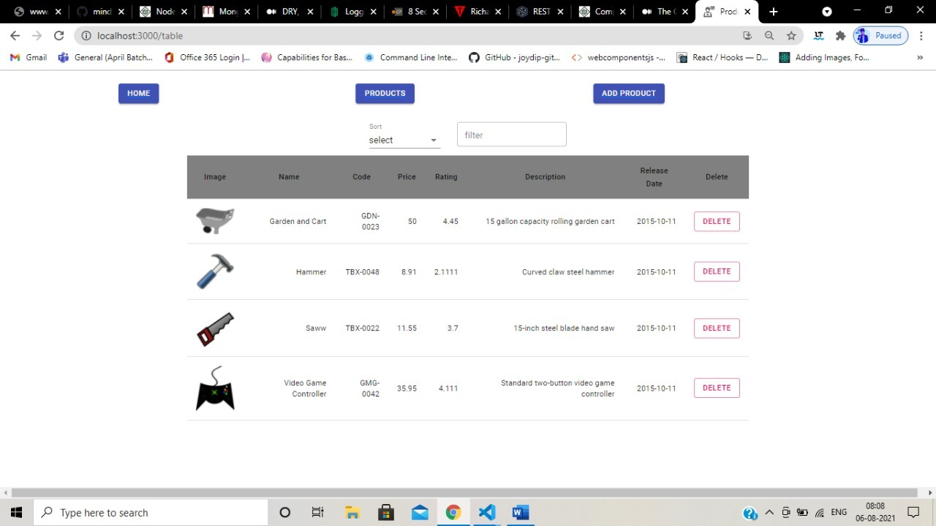
Modules
Display All Products / Allows us to delete product

Slide 7
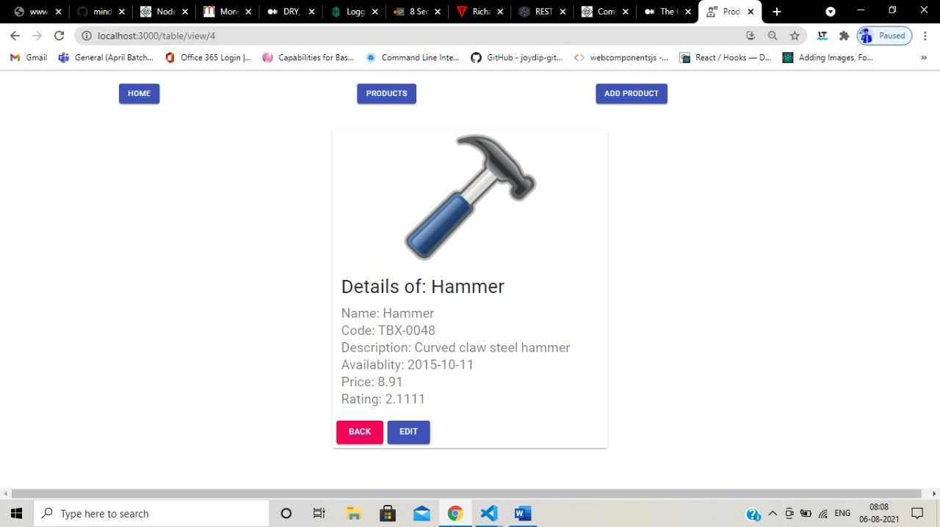
Modules
Display product details

Slide 8
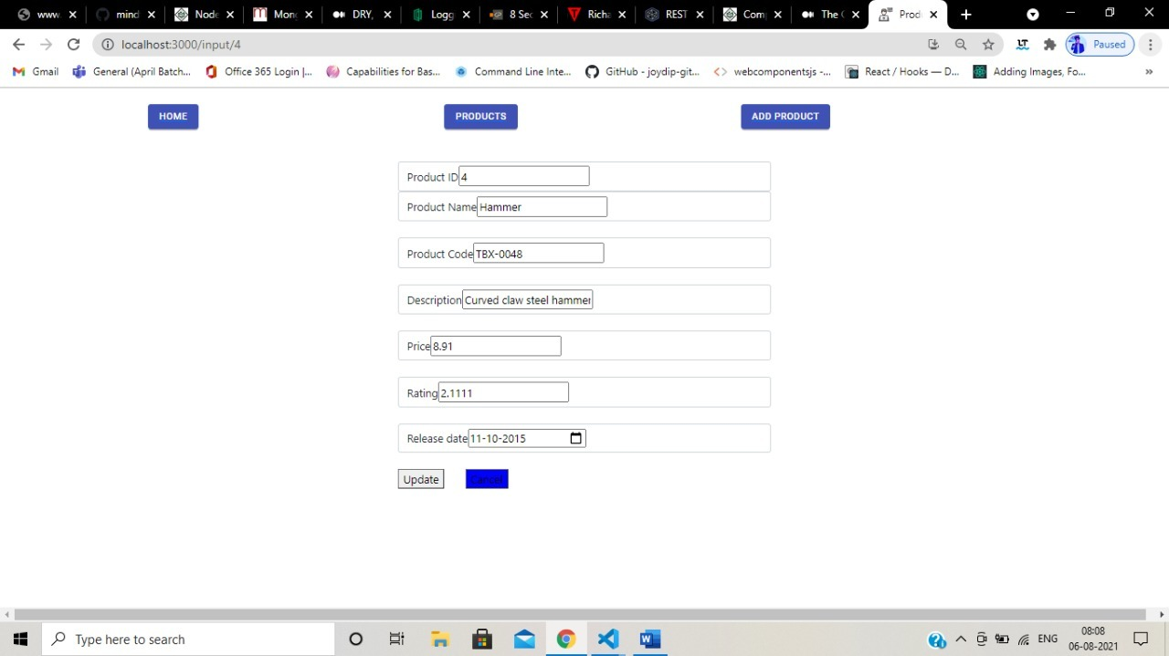
Modules
Edit/Update Product

Slide 9
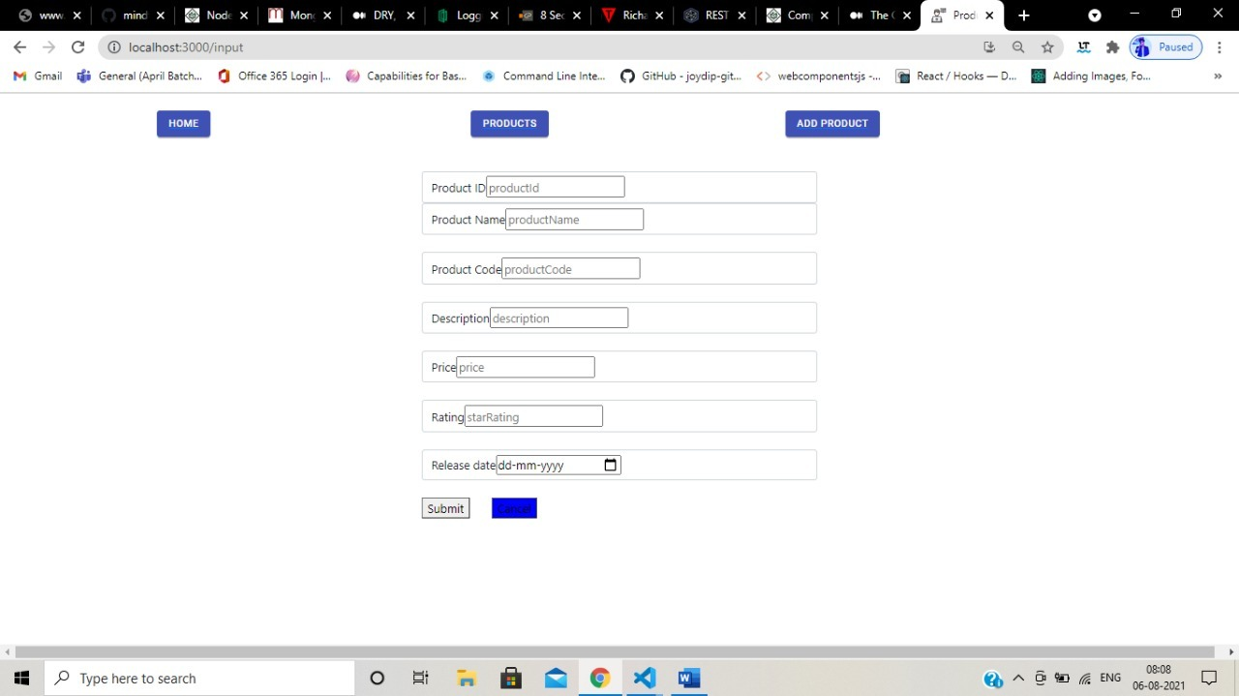
Modules
Add Product

Slide 10
Future Aspects
To create a login page for different users like admin, customer to enhance security to access the data.
We are hoping to create a clone/ E-commerce application like swiggy, zomato etc. to allow the user to purchase products.
Maintain and secure database more efficiently.
To make the application more reliable and user-friendly.

Slide 11
Conclusion
Product Management System has to store and maintain product records and allows to manipulate data.
We are expecting to make this case study to go to another level and increase its scope.

Slide 12
Thank You

