Slide 1
Learnly ? OS2 (????? ????? 5 ?????)
Flutter ? Android

Slide 2
???? ???????
???? ??????? ????? ????? ???????
????? ????? ????? ????????
??????? ??????: ??? 5 ????? ???

Slide 3
??????? ???????? (5 ???)
1) Splash | ???? ??????? + ???? ???
2) Login | ????? ???? ????????
3) Register | ????? ???? ????
4) Home | ??? ???????? ???????
5) Course Detail | ?????? ?????? + ?? ????????/????????

Slide 4
??? ???? ???????
Splash: ??? ?????? ?? ???????? ???????
Login: ????? ?????? ?????? ?????
Register: ????? ???? ????
Home: ????? ?????? ?????
Course Detail: ??????? ?????? ?????

Slide 5
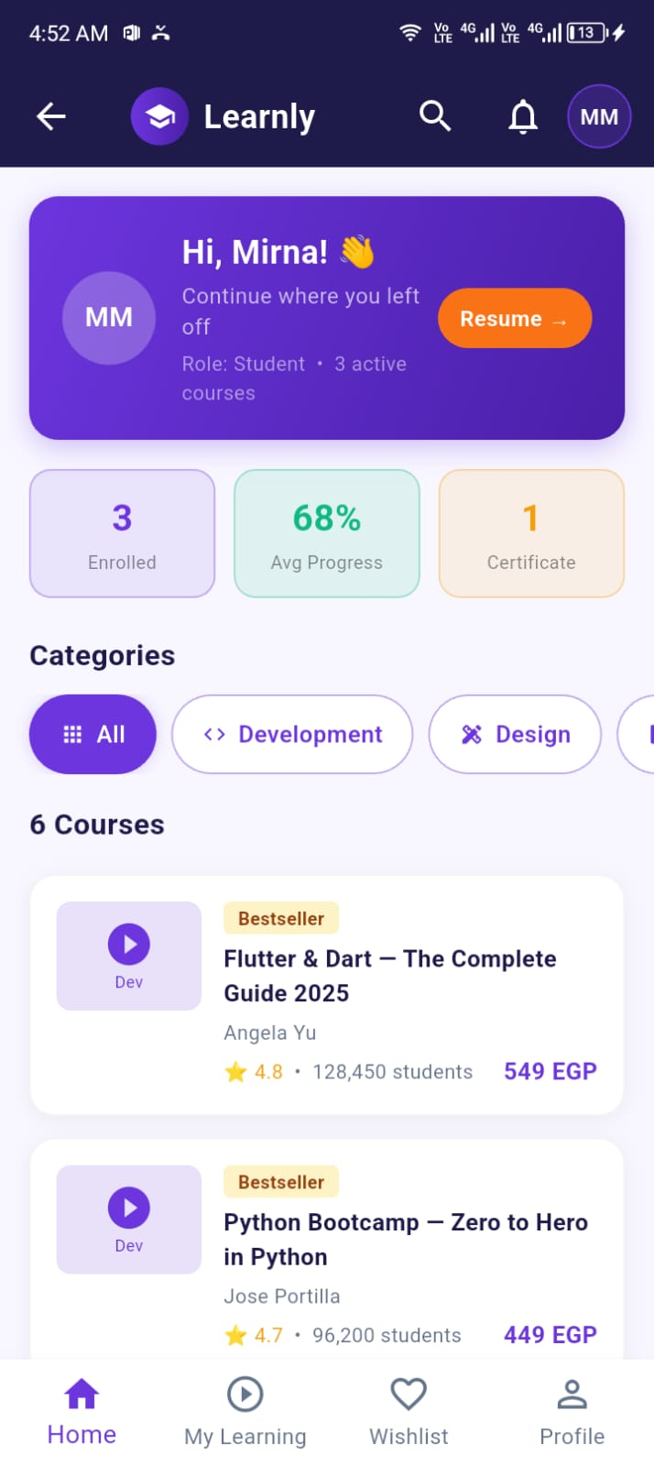
???? ?? ???????
????? Home

Slide 6
??????? ?????
????? ????? ???? 5 ????? ???
????? ??????? ??? ???? ?? Emulator
???????? ??? ??????? ?????

