Slide 1
Learnly ? OS2 Course Project
Mobile Learning App ? Flutter ? Mansoura University

Slide 2
Idea & Goal
Provide a clear, friendly mobile learning experience
Show OS2 security & protection concepts inside UI
Meet project requirements exactly (Android + 10+ screens + API)

Slide 3
Main Functions
User registration & login
Browse courses with categories
Course details + enroll / continue
My Learning progress tracking
Wishlist + Checkout + Certificate

Slide 4
Tech Stack
Flutter (Android)
REST API integration (DummyJSON)
Local session storage (SharedPreferences)
CachedNetworkImage for real images

Slide 5
User Journey (Simple)
Splash ? Login/Register
Home ? Browse courses
Course Detail ? Enroll
My Learning ? Resume lessons
Profile ? View account info

Slide 6
Screens (13+)
Splash | Brand & secure boot concept
Login | Authentication + MFA concept
Register | RBAC role assignment
Home | Browse courses + API list
Course Detail | ACL for enrolled vs not enrolled
My Learning | Progress + capability tokens
Video Player | Session control
Instructor | Least privilege
Search | Audit log & IDS notes
Wishlist | Access revocation
Checkout | Payment integrity
Certificate | PKI & digital signature
Profile | Domain of protection

Slide 7
OS2 Concepts Shown
Ch05: RBAC, ACL, DAC, Capabilities, Least Privilege
Ch06: Authentication, MFA, Encryption, PKI, Audit Logs
Each screen contains a concept box or note

Slide 8
REST API Integration
Courses fetched from public REST API (DummyJSON)
Displayed in a dedicated ?API Courses? section
Satisfies requirement: Web service API integration

Slide 9
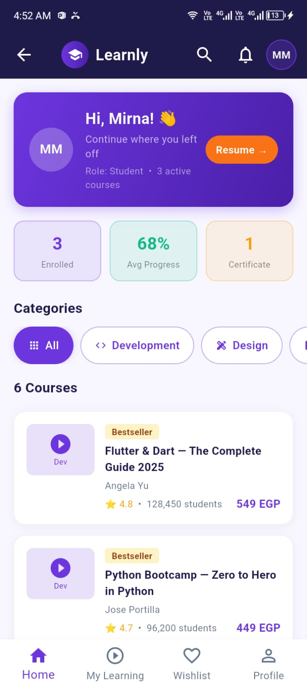
App UI (Home Screen)
Screenshot from device

Slide 10
Compliance Checklist
Android app built with Flutter
10+ screens implemented
API integration included
Works on real device / emulator

Slide 11
What Each Function Does
Login/Register: creates and saves user session
Home: shows categories, featured, API courses
Course Detail: enroll or continue
My Learning: progress + resume
Profile: user data + OS2 material map

Slide 12
Future Enhancements
Connect Firebase Auth & Firestore
Admin panel for course creation
Offline caching for lessons

