Slide 1
Learnly ? ????? OS2
????? ?????? ???????? ? Flutter

Slide 2
???? ???????
????? ?????? ??????? ??????? ?????????
????? ?????? ???? OS2 ???? ???????
????? ????????? (Android + 10 ????? + API)

Slide 3
??????? ????????
????? ???? ?????? ????
???? ??????? ??? ?????
???? ?????? ?????? + ??????/??????
?????? ?????? ?? ??????
Wishlist + Checkout + Certificate

Slide 4
???????? ?????????
Flutter (Android)
REST API ???? ?????? ??????
??? ?????? ???????? ?????? (SharedPreferences)
??? ?????? ???????? (CachedNetworkImage)

Slide 5
???? ????????
Splash ? Login/Register
Home ? ?????? ????
Course Detail ? ??????
My Learning ? ?????? ??????
Profile ? ?????? ??????

Slide 6
??????? (13+)
Splash | ???? ??????? + ????? ????
Login | Authentication + MFA
Register | RBAC + ????? ???? ??????
Home | ???? + ?????? ?? API
Course Detail | ACL ?????????
My Learning | Progress + Capabilities
Video Player | Session Control
Instructor | Least Privilege
Search | Audit Log / IDS
Wishlist | Revocation of Access
Checkout | Integrity / Encryption
Certificate | PKI + Digital Signature
Profile | Domain of Protection

Slide 7
??? ?????? OS2
Ch05: RBAC, ACL, DAC, Capabilities, Least Privilege
Ch06: Authentication, MFA, Encryption, PKI, Audit Logs
?? ???? ???? ??? ?? ?????? ???????

Slide 8
????? REST API
??? ?????? ?????? ?? ???? REST
??? ???? ?? Home ??????? ??? API
???????? ?? ????? ??? ??? API

Slide 9
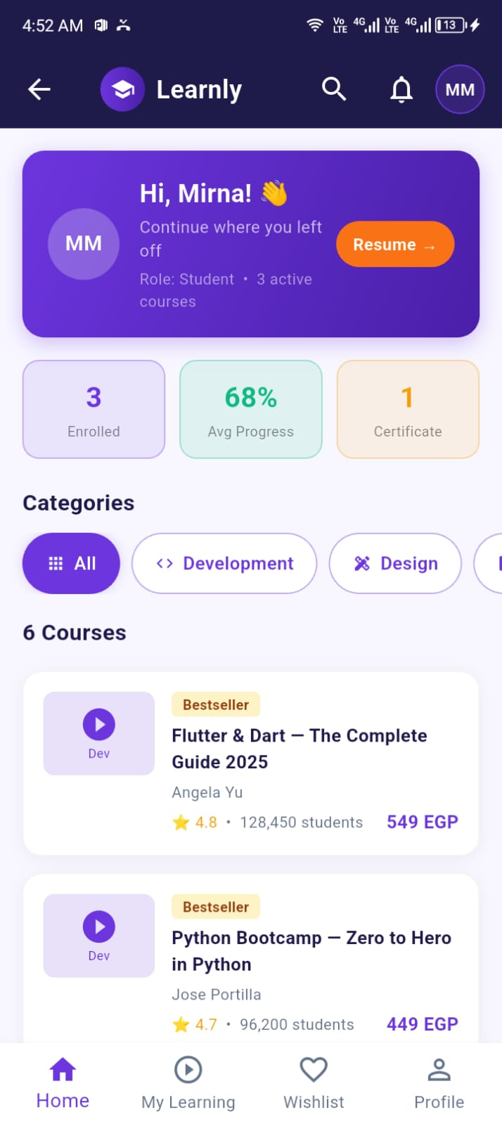
????? ??????? (Home)
???? ?? ??????

Slide 10
?????? ?????????
Flutter + Android ?
???? ?? 10 ????? ?
????? API ?
??? ??????? ??? ???? ????? ?

Slide 11
??? ???? ??? ?????
Login/Register: ????? Session ???? ????????
Home: ??? ?????? ????????? ???? ??????
Course Detail: ?????? ?? ??????
My Learning: ?????? ??????
Profile: ?????? ?????? + Material Map

