Slide 1
Emacs
A Text Editor and More
Tools Talk
Michael Ernst & Greg J. Badros
University of Washington
Computer Science & Engineering
5 October 1998
http://www.cs.washington.edu/uns/ToolsTalks

Slide 2
Outline
Basic concepts
How to get more help
Customizing Emacs
Emacs usage tips
Packages (extensions)
Stump the experts

Slide 3
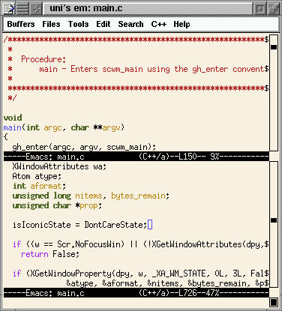
Files, Buffers,
Windows, and Frames
frame
file
main.c
window
Emacs
Process Image
window
main.c
buffer

Slide 4
Keystroke handling
kernel
keytables
Keypress
keycode
keycode
xmodmap
Console
X Server
character
or escape
sequence
keysym
Window Manager
keysym
keysym
xterm
emacs in X
character
or escape
sequence
XTerm*VT100*\
Translations
emacs
translation tables,
keymaps
What Emacs saw:
C-h l
Notes:
Two important things:
Keys can be interpreted before Emacs ever sees them --
(Stolen by X Server and/or Window manager)
Emacs key bindings have three cases
1) Keysyms from X Server
2) Escape sequences from XTerm
3) Escape sequences from console
Note the multiple layers of translation!

Slide 5
Getting help
M-x help or C-h
Emacs tutorial: C-h t
Online manuals: C-h i or
M-x info
  Emacs, extension packages
  Emacs Lisp, E-Lisp intro
  Info, much more
FAQ: /uns/share/doc/emacs-faq
Package source
/uns/share/emacs/19.34/lisp/
/uns/share/emacs/20.3/lisp/
/uns/share/xemacs/20.4/lisp/
/uns/share/emacs/site-lisp/

Slide 6
Getting more help
M-x describe-mode (C-h m)
Commands relating to a task
  all packages by keyword: C-h p
  M-x apropos or C-h a
  M-x lisp-dir-apropos
C-h: help
  bindings (for keys)
  functions
  variables
  after some other keys

Slide 7
Emacs versions
Emacs 19: emacs (default version)
Emacs 20: emacs-20 (Mike recommends)
XEmacs 20: xemacs (Greg recommends)
For casual users, any /uns version
Emacs: more stable and consistent
XEmacs: more features
  Windows: widgets, fonts, toolbar, graphics, embedding; non-X faces
  gnuattach: connect to server from a terminal
  More bundled packages, APIs, ToolTalk (compiler integration, Emacs Lisp, customization)

Slide 8
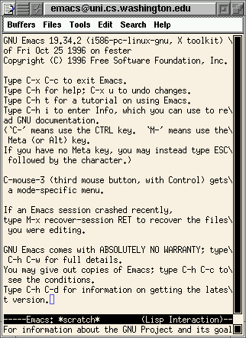
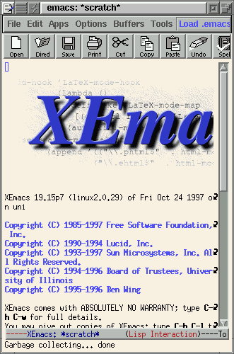
Emacs and XEmacs

Slide 9
Comon Startup Options
-q Do not load ~/.emacs
--debug-init Enable debugger during initializ-
ation (useful to debug ~/.emacs)
-u user Load ~user/.emacs instead of yours
--no-site-file Do not load
/uns/share/emacs/site-start.el
-nw Ignore DISPLAY and use tty
-display Choose X server for display
-l file Load file after startup
-f func Run func after startup
--batch Do not run interactively
(useful for just byte-compiling)

Slide 10
Customization
M-x customize ([X]Emacs 20)
Setting variables
  (setq mail-yank-prefix “> “)
  (setq require-final-newline t)
  (setq auto-mode-alist
  (cons '("\\.lsp" . common-lisp-mode)
  auto-mode-alist))
  (setq load-path
  (cons (expand-file-name "~/emacs")
  load-path))
  (setq font-lock-string-face 'midnightblue)
Using packages
  (autoload 'mc-install-read-mode "mailcrypt" nil t)
  (require 'uniquify)
  (load "mode-hooks-mde")
  See the instructions at the top of the source file

Slide 11
More customization
Binding keys
(global-set-key “\C-l” ‘smart-recenter)
(define-key lisp-mode-map “\C-cl” ‘run-lisp)
Mode hooks
(add-hook 'text-mode-hook
'auto-fill-mode)
(add-hook 'LaTeX-mode-hook
'auto-fill-mode)
(add-hook 'emacs-lisp-mode-hook 'turn-on-font-lock)
(global-font-lock-mode t)
Emacs Lisp in ~/.emacs:
powerful, may be complex;
cut and paste from other users

Slide 12
Emacs techniques
Undo: C-/ or C-_ or C-x u
buffer modification mark
ESC and M- prefixes
X cut and paste
Buffer list
Completion
Minibuffer history: M-n and M-p
Syntax-based editing:
character, word, sentence, paragraph, line, s-expression, function
c-beginning-of-statement
transpose-words

Slide 13
More tricks
Regular expression search, replace
metacharacers: \(, \), \|
Narrow to region
Repetition: C-u or C-7
Keyboard (editor) macros
C-x( to start, C-x) to end
{call,edit,name}-last-kbd-macro
C-u 0 to repeat until error
abbrev mode; dynamic abbreviations (M-/; “dabbrev”)
Set auto-save-directory to /tmp (especially for Linux)

Slide 14
Extension packages
Text: mail, news, ispell
Programming: language modes, compilation, tags, debuggers, interaction
OS: dired, ftp, crypt, shell
Version control, diff
Server
Amusements
Use familiar editing commands, fully customizable
May be slower in in machine time

Slide 15
Mail and news
Rmail (Emacs only)
VM (XEmacs only)
MH-E
Gnus
sorting, scoring, folders

Slide 16
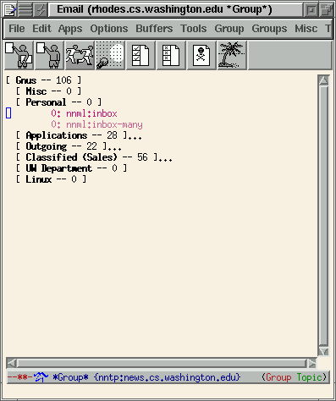
Gnus (netnews and mail)

Slide 17
Spellchecking with ispell
M-x spell-buffer
(add-hook 'mail-send-hook
'ispell-message)
M-$ or M-x spell-word
Per-file local-words annotation

Slide 18
Language major modes
Most languages, including
  cc-mode: C, C++, Objective C, Java
  cperl-mode: Perl
  AUC Tex: LaTeX, TeX, BibTeX, ...
Features
  indentation
  syntax-related movement
  colorization
  documentation links
  execution

Slide 19
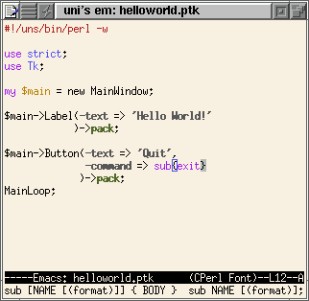
Cperl mode

Slide 20
Compilation
C-c C-c or M-x compile
C-x ` or M-x next-error to iterate through errors
Errors in *compilation*
buffer are clickable
M-x grep is similar

Slide 21
Debugging
M-x gdb
Usual gdb commands
In source file, set breakpoints and more
Supported debuggers:
  gdb, sdb, dbx, xdb, perldb, pdb, jdb
Interpreter interaction:
M-x run-lisp, M-x py-shell

Slide 22
Tags
Prepare TAGS file with (one of):
etags *.[ch]
etags *.el
M-. or M-x find-tag
Primed with identifier near point
Completes
M-x tags-search
M-x tags-query-replace
M-x tags-apropos
M-x visit-tags-table
Switch currently used TAGS file

Slide 23
Dired (directory editor)
M-x dired or C-x d
or find-file on a directory
Omit uninteresting files
Sort
Operate on files
  copy, rename, delete
  print, chmod, (un)compress
  ! = shell command (with DWIM)
  mark multiple files (with regexp)
g: refresh

Slide 24
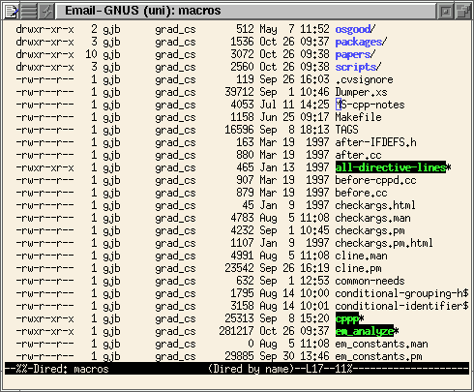
Dired screen shot
Omitting, sorting, DWIM with !

Slide 25
Ange-ftp, EFS
Filenames in a special form:
/mernst@cf-web.mit.edu:/www/index.html
Edit from home, edit non-NFS-accessible files
Use as a general ftp client
/anonymous@prep.ai.mit.edu:/pub
(works with Dired)

Slide 26
Version control
RCS:
C-x C-q vc-toggle-read-only C-x v v vc-next-action
CVS:
Above keystrokes, but also
pcl-cvs mode for updating and managing module
M-x cvs-update

Slide 27
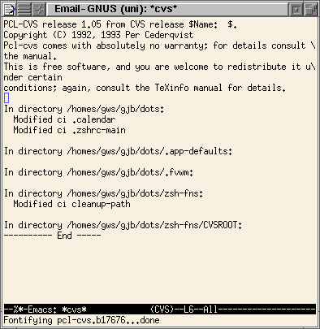
pcl-cvs mode

Slide 28
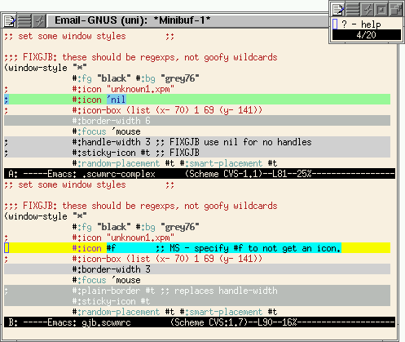
Ediff mode

Slide 29
Crypt++
(require ‘crypt++)
Transparently handle:
  compressed
  archives (via tar-mode)
  encrypted
  newline variants (Unix vs DOS)
  combinations of these
Other options:
jka-compr, dos-mode

Slide 30
Emacs server
Reuse existing Emacs process
(faster, less memory)
Emacs: (server-start)
To edit files: emacsclient
XEmacs: (gnuserv-start)
gnuclient, gnuattach, gnudoit
To finish editing: C-x #
Use VISUAL, EDITOR and EDIT environment variables

Slide 31
More about the server
Emacs on other machine?
Use gnuserv (even for Emacs)
gnuclient -h EMACS_HOST -r \
/$USER\@$HOSTNAME:
-r option gives prefix to tell Emacs where how to get to the root filesystem of the machine you invoke gnuclient from
Use a fallback:
setenv EDITOR gnuclient-or-other
#!/bin/sh - # gnuclient-or-other
if [ "$DISPLAY" = "" ]; then jed "$@” else
gnuclient "$@" || pico "$@"
fi

Slide 32
Amusements
hanoi, life
madlib, cryparithmetic puzzles adventure games
tetris
yow

Slide 33
Doctor
My advisor hates me.
Why do you say advisor hates you?
He criticizes my research, and his mother wears combat boots.
Tell me something about his family.
She's a bearded lady. Should I drop out of school to join the circus?
Tell me about your school.
My office is in a beautiful building.
What makes you think your office is in a beautiful building?
I think very little.
Possibly problems at school are caused by this.

Slide 34
Other packages
calendar
desktop
complete library
M-X -rectangle<TAB>
two-column library

