Slide 1
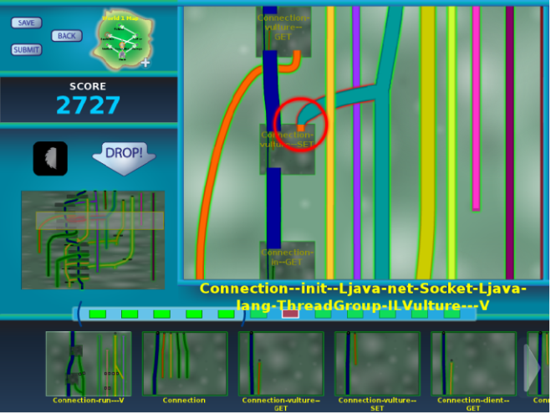
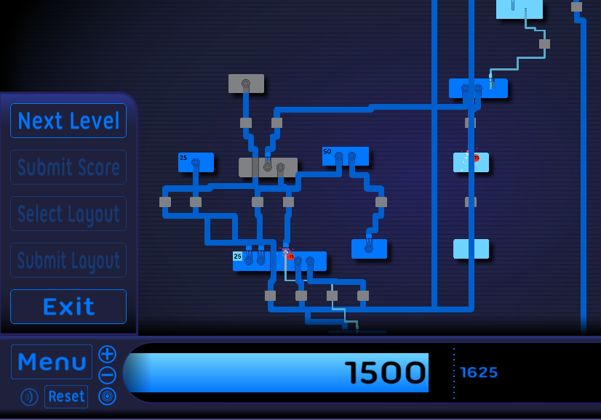
Verification games: Making verification fun
University of Washington
http://cs.washington.edu/verigames/
Francois Boucher-Genesse, Dan Brown, Jonathan Burke, Matthew Burns, Seth Cooper, Craig Conner, Werner Dietl, Stephanie Dietzel, Michael Ernst, Nat Mote, Tim Pavlik, Zoran Popović, Tyler Rigsby, Eric Spishak, Brian Walker
CSFV PI Meeting, July 23, 2013

Slide 2
Review

Slide 3
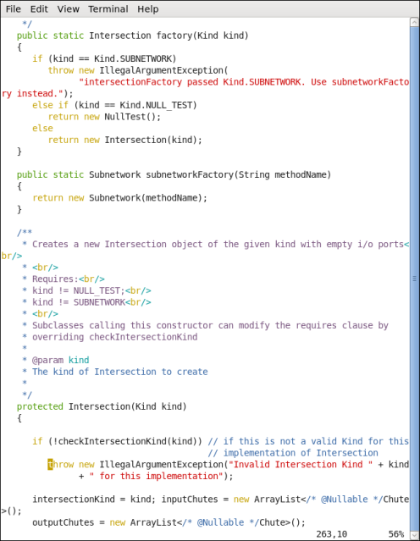
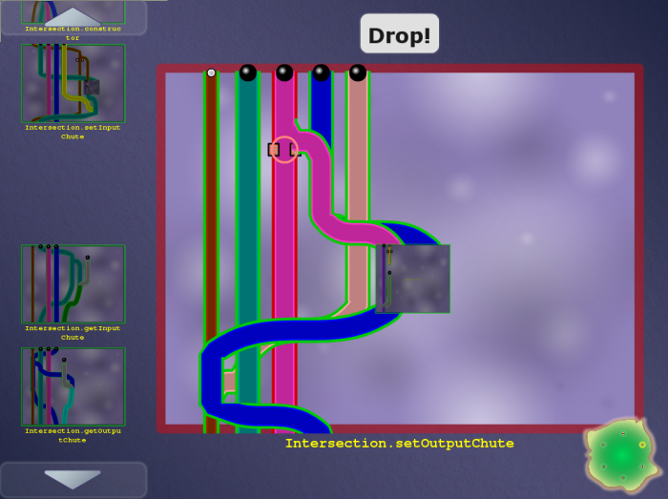
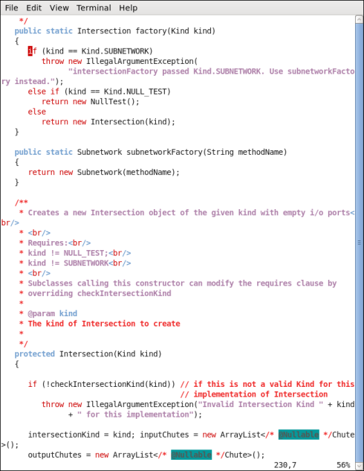


Code
Game
Automatic translation
Encodes a constraint system
Encodes a constraint system
Free labor
Highly-skilled, expensive labor
Verified software
(with proof/ annotations)
Completed game
Automatic translation

Slide 4
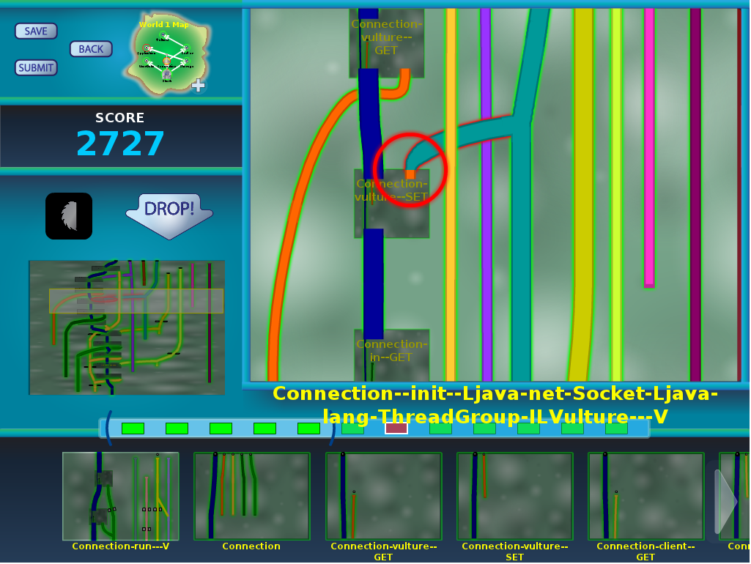
Pipe Jam game demo
Notes:
In the order: wind, earth, crash.

Slide 5


Code
Game
Automatic translation
Free labor
Highly-skilled, expensive labor
Bug detected, notify programmer
Completed game
with buzzsaws
Automatic translation

Slide 6



Example: encryption
Goal: no cleartext is sent over the network
Pipe ↔ a variable
Pipe width ↔ narrow: encrypted, wide: cleartext
Ball ↔ a value
Ball size ↔ small: encrypted, large: cleartext
Pinch point ↔ network communication
Unmodifiable pipe/ball ↔ cleartext from user

Slide 7
Example: null pointer errors
Goal: no dereference of null
Pipe ↔ a variable
Pipe width ↔ narrow: non-null, wide: maybe null
Ball ↔ a value
Ball size ↔ small: non-null, large: null
Pinch point ↔ dereference
Unmodifiable pipe/ball ↔ literal null

Slide 8
Program ↔ game correspondence
Intuition: dataflow
Pipe ↔ a variable
Pipe width ↔ a property of the variable (type)
Ball ↔ a value
Ball size ↔ a property of the value
Pinch point ↔ requirement
Unmodifiable pipe/ball ↔ requirement

Slide 9
Type flow vs. dataflow
Multiple flows per variable
A variable’s type may have multiple qualifiers
@Immutable Map<@English String, @NonNegative Integer>
Some variables are not represented at all
primitives (int, …) when analyzing null pointer errors
No loops
If program is verifiable, solvable in polynomial time
Human leverage: high-level pattern matching
More accurate intuition: type constraints
Building a new type inference framework

Slide 10
Other examples
SQL injection
unintended side effects
format string and regexp validation
incorrect equality checks
race conditions and deadlocks
units of measurement
aliasing
CWE/SANS Top 25 Most Dangerous Software Errors
…

Slide 11
Accomplishments since March
Program analysis
Game
Other

Slide 12
Program analysis accomplishments
Type inference and game solver
Type systems
Dataflow framework
Automated inference
Insertion into source code
Infrastructure improvements

Slide 13
Type inference and game solver
Better type constraints
type parameters (generics)
overriding
Representing library methods (no source)
Programs >30K lines

Slide 14
Type systems
Over a dozen type inference problems turned into games
OSTrusted
Hardcoded
Random
Encrypted
SafeFileType
OneWayHashWithSalt
Lock
...
Most challenging: locking
Key idea: don’t simultaneously infer guarded variables and lock acquisition (rely on partial specification)

Slide 15
Dataflow framework
Flow-sensitive analysis & local type inference
Test status:
Almost every unit & regression test passes
29K carefully crafted lines of code
First system test passed
Release when second system test passes
Users have already migrated to this unreleased version
Building from version control repository
They are happy with the results
Deprioritized since last meeting (not a blocker)

Slide 16

Automated inference
Pre-pass: solve easy parts of problem before presenting to players
Interprocedural abstract interpretation
Sometimes more powerful than our type-checkers
Analyses for about a dozen type systems
All analyses run on hadoop-common and hadoop-auth
Improvements to scalability and efficiency
Ability to provide manual security annotations
fields, method/constructor parameters, returns
Insertion into source code is underway

Slide 17
Insertion into source code
Game produces annotated XML files
Convert XML files into Java type annotations
Insert annotations into source code
Package-qualified types, compound types, varargs
Inserted receivers and casts
Cross-check with type-checker
Present to verification expert

Slide 18
Infrastructure improvements
Checker Framework (pluggable type-checking)
Stub file generation and parsing improvements
Maven plugin (Hadoop uses Maven)
Eclipse plugin
Framework generalizations
Efficiency
Unsound checking modes (per user request)
Java Type Annotations
In Oracle javac (in OpenJDK)

Slide 19
Gaming accomplishments
New game representation / skin: “Grid World”
Scoring:
Different costs for different conflicts
Position in the board / impact on the program
Creating heuristics for program analysis
Eliminate the concept of buzzsaws
Can move on at any time; conflicts cost points
Integration with TopCoder and verigames.com

Slide 20
Grid World game representation

Slide 21
Grid World: The same game
Same verification problem
Same type constraints
Same XML input and output files
Has its own skins: pipes, electrical plugs, audio plugs, etc.
New game representation
Pipes ⇒ boxes
One box for arbitrarily many pipes of the same color
Pipe connections ⇒ lines
Explicitly represented, not by color

Slide 22
Grid World: A different game
Problem with Pipe Jam Classic: action at a distance
Colored pipes are linked & have the same width
Represent different uses of the same variable
Game abstractions are same as the program’s
Goal: bring information together
Two game-playing modalities: conflicts, layout

Slide 23
Implications of Grid World
Fewer boards, but bigger ones
Layout is more challenging
More compact representation
No traveling balls/cars
See more on the screen

Slide 24
Grid World status
Two implementations: testbed and deployment.
Automation of common operations: push conflicts up or down
A few features remain to be implemented (maps, generics).
Will Grid World be successful?
No free lunch
Didn’t eliminate action at a distance, but made it explicit in the form of lines
A/B testing is planned

Slide 25
Hard problems in software verification
Choosing modularity and abstractions
Task breakdown
Dividing tasks between people and tools
Transparent vs. powerful tools
Optimizing intractable problems
Cooperation, competition, and specialization
The role of training
Information overload
Making verification fun
Games↔verification: A useful, if imperfect, analogy
Science benefits from:
A games perspective on verification
A verification perspective on games
May apply elsewhere

Slide 26
Other accomplishments
Hiring
Doug Hoeger
Dan Brown
David McArthur
Collaborations
IBM/Toronto
NYU/Google
Publications
JavaUI: Effects for Controlling UI Object Access by Colin S. Gordon, Werner Dietl, Michael D. Ernst, and Dan Grossman. In ECOOP 2013 - Object-Oriented Programming, 27th European Conference, (Montpellier, France), July 3-5, 2013.
Rely-Guarantee References for Refinement Types Over Aliased Mutable Data by Colin S. Gordon, Michael D. Ernst, and Dan Grossman. In PLDI 2013, Proceedings of the ACM SIGPLAN 2013 Conference on Programming Language Design and Implementation, (Seattle, WA, USA), June 17-19, 2013.

Slide 27


Verification Games
Gamification of program verification
Game corresponds to correctness condition
Game utilizes physical intuition
Game is playable by anyone
Game allows application of human insight
Goal: cheaper verification ⇒ more verification
http://cs.washington.edu/verigames

