Slide 1
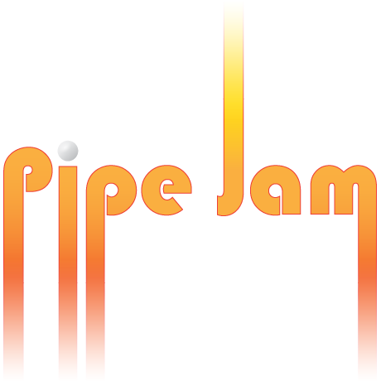
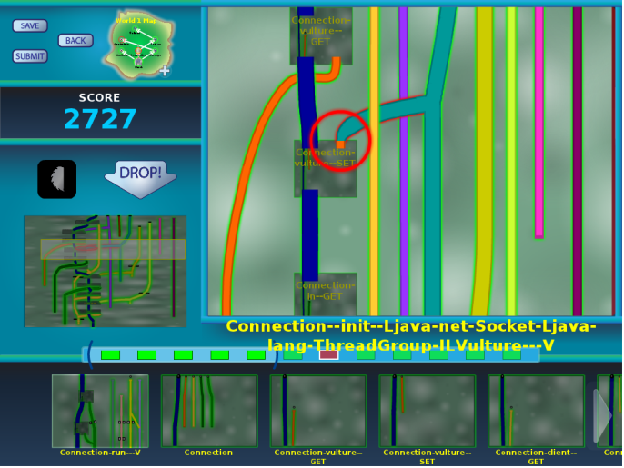
Verification games: Making verification fun
University of Washington
http://cs.washington.edu/verigames/
Francois Boucher-Genesse, Jonathan Burke, Matthew Burns, Seth Cooper, Craig Conner, Werner Dietl, Stephanie Dietzel, Michael Ernst, Nat Mote, Tim Pavlik, Zoran Popović, Tyler Rigsby, Eric Spishak, Brian Walker

Slide 2
Review from last time

Slide 3
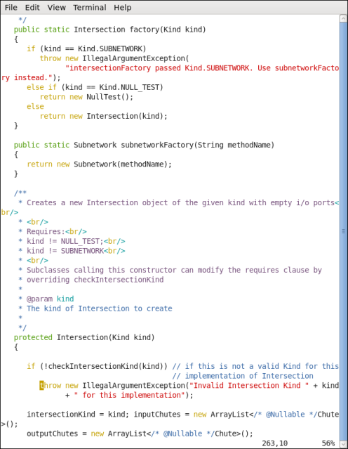
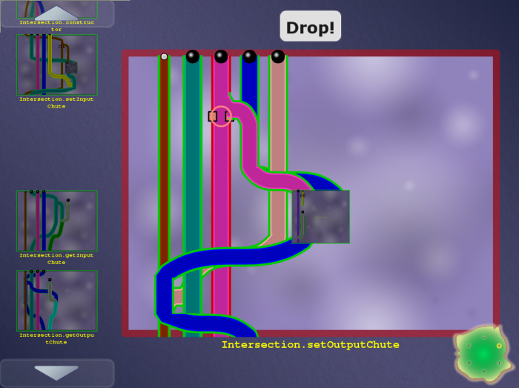
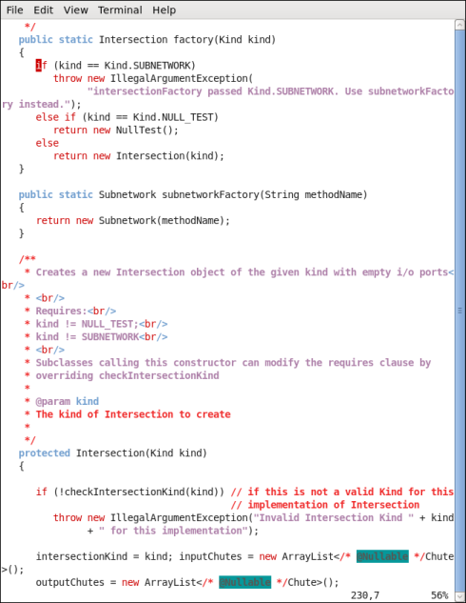
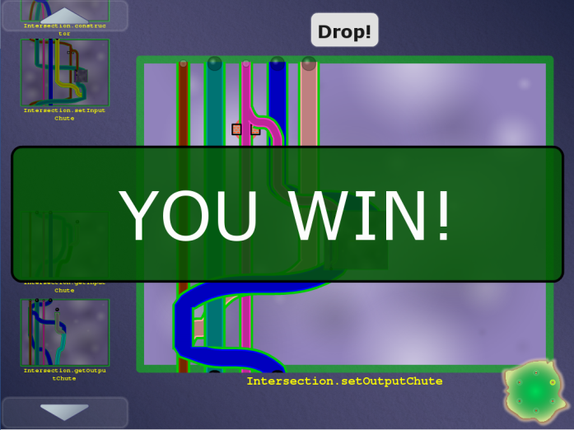

Code
Game
Automatic translation
Encodes a constraint system
Encodes a constraint system
Free labor
Highly-skilled, expensive labor
Verified software
(with proof/ annotations)
Completed game
Automatic translation

Slide 4
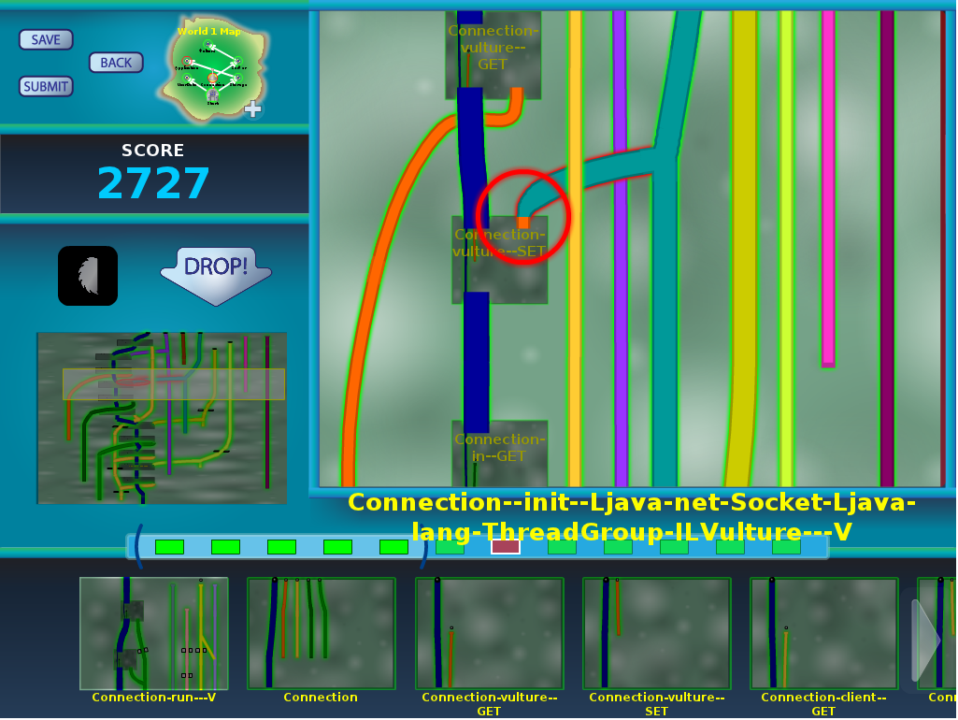
Pipe Jam game demo
Notes:
In the order: wind, earth, crash.

Slide 5
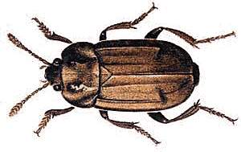

Code
Game
Automatic translation
Free labor
Highly-skilled, expensive labor
Bug detected, notify programmer
Completed game
with buzzsaws
Automatic translation

Slide 6



Program ↔ game correspondence
Intuition: dataflow
Pipe ↔ a variable
Pipe width ↔ a property of the variable (type)
Ball ↔ a value
Ball size ↔ a property of the value
Pinch point ↔ requirement
Unmodifiable pipe/ball ↔ requirement

Slide 7
Example: encryption
Goal: no cleartext is sent over the network
Pipe ↔ a variable
Pipe width ↔ narrow: encrypted, wide: cleartext
Ball ↔ a value
Ball size ↔ small: encrypted, large: cleartext
Pinch point ↔ network communication
Unmodifiable pipe/ball ↔ cleartext from user

Slide 8
Example: null pointer errors
Goal: no dereference of null
Pipe ↔ a variable
Pipe width ↔ narrow: non-null, wide: maybe null
Ball ↔ a value
Ball size ↔ small: non-null, large: null
Pinch point ↔ dereference
Unmodifiable pipe/ball ↔ literal null

Slide 9
Type flow vs. dataflow
Multiple flows per variable
A variable’s type may have multiple qualifiers
@Immutable Map<@English String, @NonNegative Integer>
Some variables are not represented at all
primitives (int, …) when analyzing null pointer errors
No loops
If program is verifiable, solvable in polynomial time
Human leverage: high-level pattern matching
More accurate intuition: type constraints
Building a new type inference framework

Slide 10
Other examples
SQL injection
unintended side effects
format string and regexp validation
incorrect equality checks
race conditions and deadlocks
units of measurement
aliasing
CWE/SANS Top 25 Most Dangerous Software Errors
…

Slide 11
New material

Slide 12

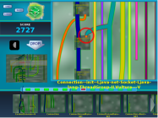
Architecture of Verification Games
Program
Constraint generator
Constraints
Game
generator
Game XML
.java
α <: β
<xml>
<game>
*Jam
implementation
Verified program
Annotation
inserter
Types for vars
Video game
.java
@Encrypted
.jaif

Slide 13

Reducing problem/game size
Program
Constraint generator
Constraints
.java
α <: β
External tool: Julia analyzer
Subcontractor: Julia srl
Abstract interpetation over bytecode
Creates verified type annotations
Ran over Hadoop, found real (minor) bugs
Adding ability to handle new properties

Slide 14
Example bug fixes
Prevented cyclic game boards from being generated
Fixed layout of Java’s Map.get() method

Slide 15
Testing framework: TestSolver
Program
Constraint generator
Constraints
Game
generator
Game XML
.java
α <: β
<xml>
<game>
Constraint Tests
Verify that Visitor and Checker create the correct constraints
Syntax-directed constraint generation
XML Tests
Verify that constraints are correctly converted into an XML representation of a game
Layout information is removed from the XML files before the comparison

Slide 16
Game translation issues
Should parameters bypass or pass through subboards?

Slide 17
Type systems
@Hardcoded
@OStrusted
Aiming to generalize from these
Units of measure
multiple annotations per qualifier
qualifier polymorphism
framework operates over qualifiers, not annotations
Division by zero: challenges were not relevant
Selected 25-27 Java vulnerabilities from CWE/SANS Top 25 and On the Cusp (out of 41 total)
Contains common themes

Slide 18
Annotation insertion
Program
.java
Verified program
Annotation
inserter
Types for vars
.java
@Encrypted
.jaif
Annotations are easy to insert on existing types
Buzzsaws: add casts in arbitrary places
File format for arbitrary locations in source
Insert more than annotations: Convert x+y to ((@A C) (x+y))
Support new Java 8 class file format
Insertion, extraction
To do: support new compound type representation

Slide 19
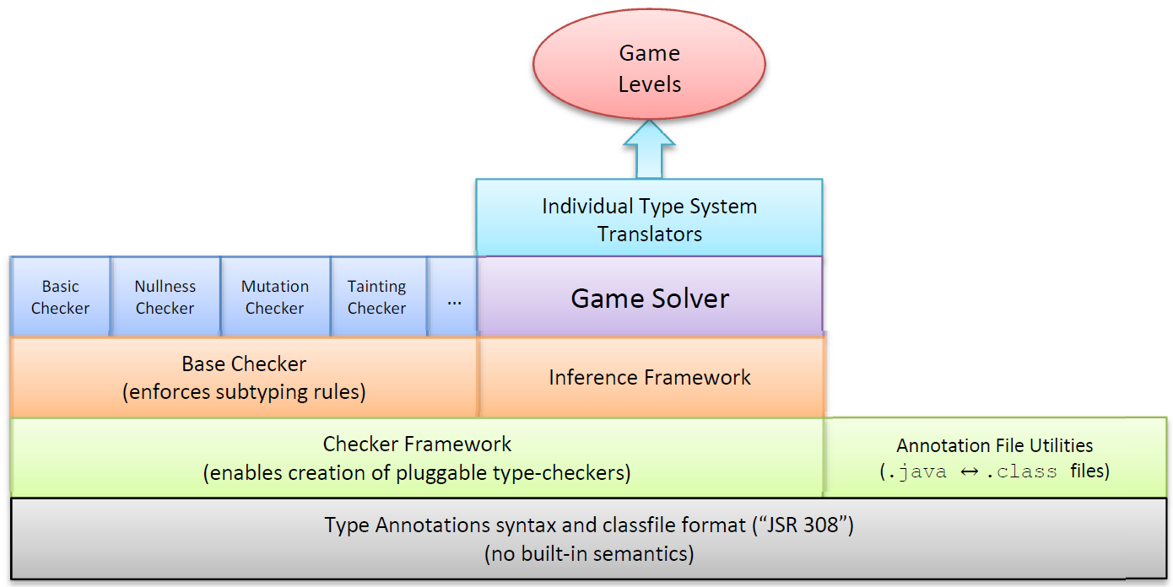
System architecture

Slide 20
Type annotations in Java
Our implementation appears in Oracle JDK 8 release M6 (January 31, 2013)
Source code annotations
Class file format
Our tool will be practical and relevant to real-world developers

Slide 21
Checker Framework
Monthly releases
Eclipse and Maven integration
Gradle build scripts for test automation
Fix classpath issues
New tutorial

Slide 22
Defining a type checker Defining a type inference
September: major improvements (simplifications) for writing a type-checker
More coming in February
Goal: Enable a single definition to suffice for creating a type checker and inference

Slide 23
Dataflow framework
Standard type system
Flow-sensitive type system
A variable has the same type throughout its lifetime
int x;
x = …
… x …
x = …
… x …
A variable’s type change as it is assigned or its value is modified
@Nullable Object x;
x = new Gadget();
… x …
x = mightReturnNull();
… x …
x is non-null
x is an int
x is nullable

Slide 24
Dataflow framework status
Dramatic improvement over previous version
Thousands of tests pass
Fewer than 10 tests fail
Far fewer failures than previous version
Almost done
We mean it this time!
Culmination of years of work

Slide 25
Publications
“Reducing the barriers to writing verified specifications”
by Todd W. Schiller and Michael D. Ernst.
In OOPSLA 2012
“ReIm & ReImInfer: Checking and inference of reference immutability and method purity”
by Wei Huang, Ana Milanova, Werner Dietl, and Michael D. Ernst.
In OOPSLA 2012

Slide 26
Non-technical accomplishments
Hiring:
Jonathan Burke
Suzanne Millstein
Mark Roberts
Craig Conner

Slide 27

Verification Games
Gamification of program verification
Game corresponds to correctness condition
Game utilizes physical intuition
Game is playable by anyone
Game allows application of human insight
Goal: cheaper verification ⇒ more verification
http://cs.washington.edu/verigames

