Slide 1


CHEOPS: CCSDS PARSING MODULE
PROJECT PRESENTATION
JULIEN GRAISSE

Slide 2
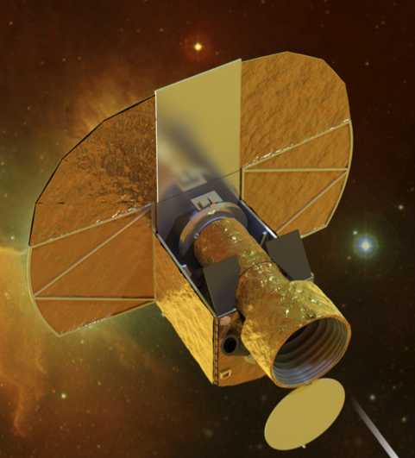
1. The CHEOPS mission

Slide 3
2. Objectives of this project

Slide 4
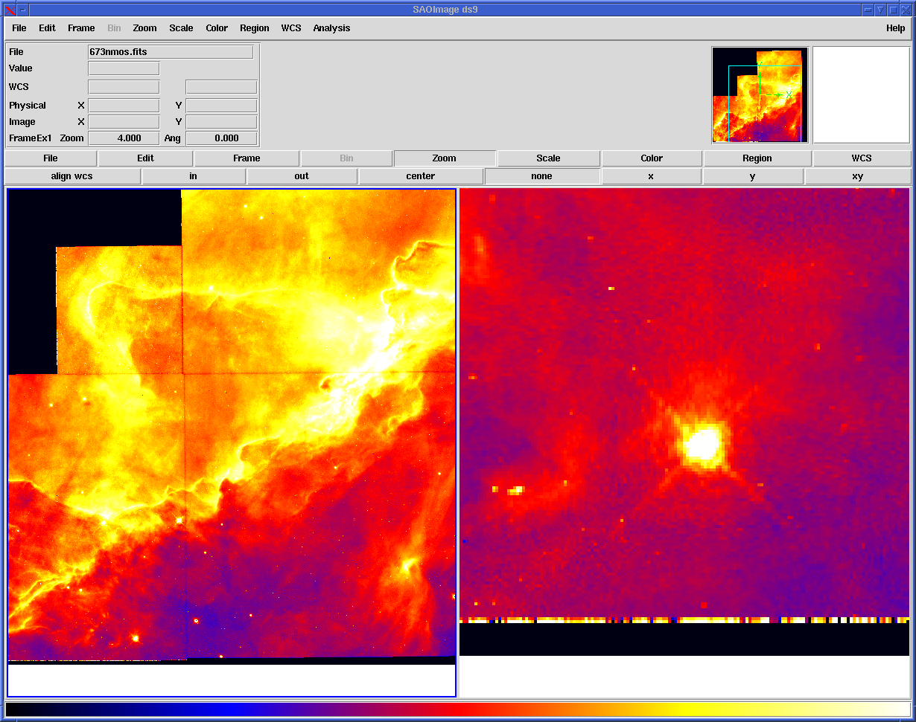
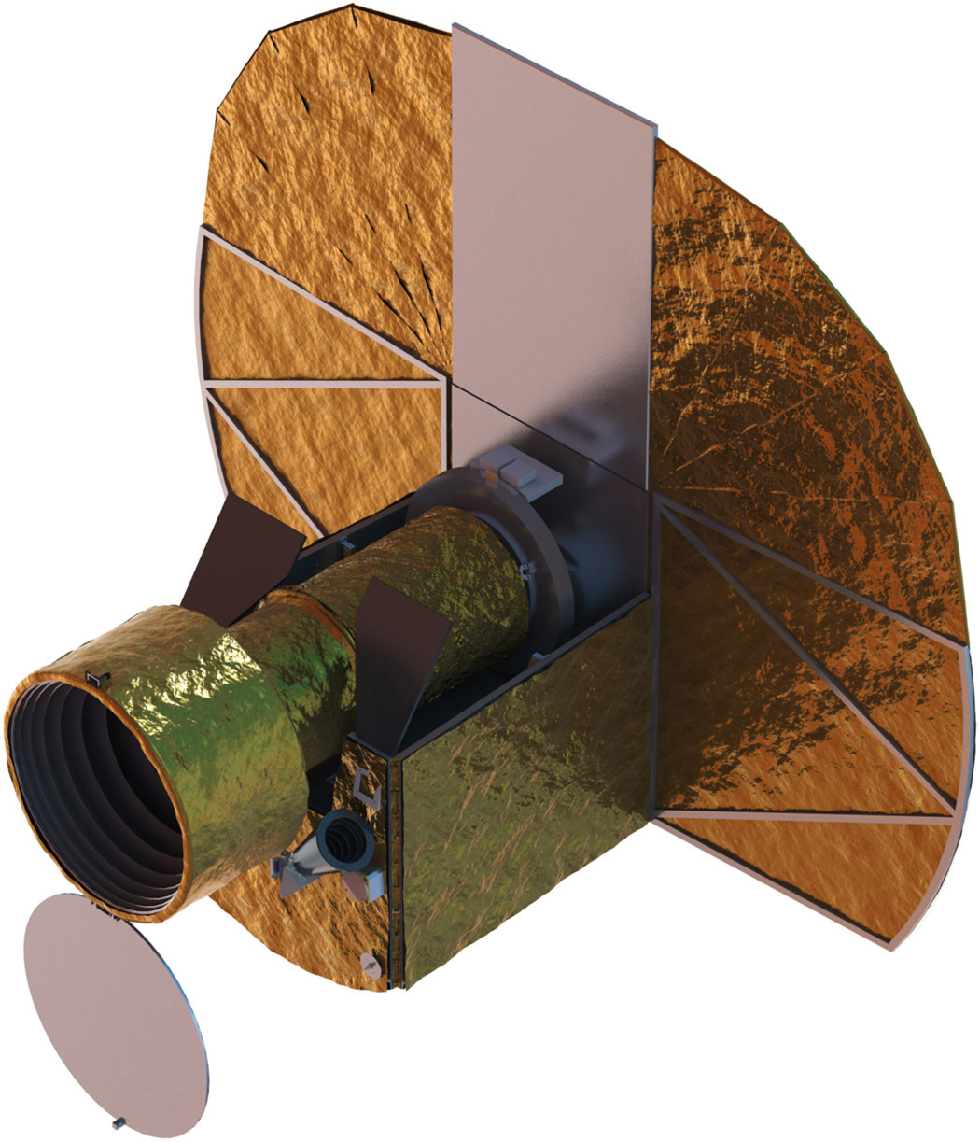

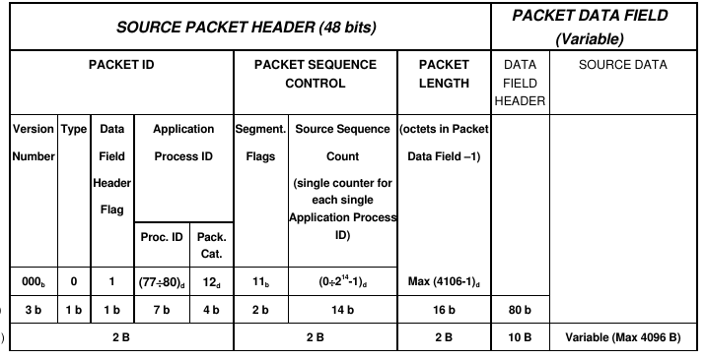

2. Objectives of this project
Implement those modules:
Packet Parser module
Packet Handler module
Error Handler
module

Slide 5
3. Design guideline

Slide 6
3. Design guideline
Requirements:

Slide 7
3. Design guideline
Requirements:
  Weak on the performances

Slide 8
3. Design guideline
Requirements:
  Weak on the performances
  Emphasis on the detection of errors:

Slide 9
3. Design guideline
Requirements:
  Weak on the performances
  Emphasis on the detection of errors:
Requirements defined
In the report:

Slide 10
3. Design guideline
Requirements:
  Weak on the performances
  Emphasis on the detection of errors:
Requirements defined
In the report:

Slide 11
3. Design guideline
Development tools:

Slide 12

3. Design guideline
Development tools:

Slide 13

3. Design guideline
Development tools:

Slide 14

3. Design guideline
Development tools:

Slide 15
3. Design guideline
Development tools:
The sources can be found on github:
  github.com/merodrem/CHEOPS

Slide 16
4. Software implementation

Slide 17

4. Software implementation
The packet parser:
Class PacketParser(const char* filepath)

Slide 18
4. Software implementation
The Error Handler:
See picture...

Slide 19
4. Software implementation
The Packet Handler:

Slide 20
4. Software implementation
The Packet Handler:
Quite empty at the moment. Many features can be added at the module at any time.
For now, only reading and printing the data file.

Slide 21
4. Software implementation
The Packet Handler:
Quite empty at the moment. Many features can be added at the module at any time.
For now, only reading and printing the data file.
Example of execution...

Slide 22
5. Discussion

Slide 23
5. Discussion
Improvements:

Slide 24
5. Discussion
Improvements:
The documentation

Slide 25
5. Discussion
Improvements:
The documentation
Less hard-coding

Slide 26
5. Discussion
Improvements:
The documentation
Less hard-coding
Exhaustive implementation of errors

Slide 27

6. Questions

