Slide 1


Slide 2

What is Shell Scripting ?
A shell script is a computer program designed to be run by the Unix/Linux shell.
which could be one of the following:
The Bourne Shell
The C Shell
The Korn Shell
The GNU Bourne-Again Shell

Slide 3
A shell is a command-line interpreter and typical operations performed by shell scripts include
file manipulation, program execution and printing text
Shell provides you with an interface to the Unix system. It gathers input from you and executes programs based on that input. When a program finishes executing, it displays that program's output.

Slide 4
Shell Prompt
The prompt $, which is called command prompt is issued by the shell. While the prompt is displayed, you can type a command.
Example
Shell command, which displays the current date and time is
$date

Slide 5
#!/bin/sh
This tells the system that the commands that follow are to be executed by the Bourne Shell.
It is called shebang because the # symbol is called a hash and the ! Symbol is called a bang
Save the script using .sh extension
Make the script executale y
$chmod +x filename.sh
Execution - $./programname.sh

Slide 6
Variable Name
The name of a variable can contain only letters (a to z or A to Z), numbers(0 t0 9) or underscore character(_).
Valid variable names _ALI, TOKEN_A, VAR_1
Invalid varibale names _var, -var, var-var

Slide 7
Accessing Values
To access the values stored in a variable, prefix its name with the dollar sign ($)
Example:
#!bin/sh
NAME = “Anu”
echo $NAME

Slide 8
User Input
To read a variable
read var_name
You can print the variable using echo.
echo $var_name
Let us write a small script.
#! / b i n / sh
read -p " enter your name : " first last
echo " F i r s t name : $ f i r s t "
echo " La s t name : $ l a s t "

Slide 9
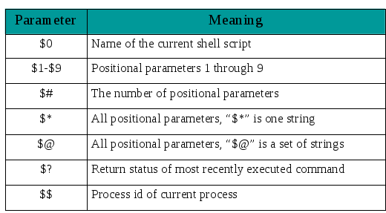
Special Shell Variables

Slide 10
Experimenting with special shell variables
#! / b i n / bash
echo " Name o f your s c r i p t i s $0"
echo " arguement s entered on command line $ *"
echo " first arguement $1"
echo " Second arguement $2“
echo " You entered $# argument s "
echo " process id is $$"

Slide 11
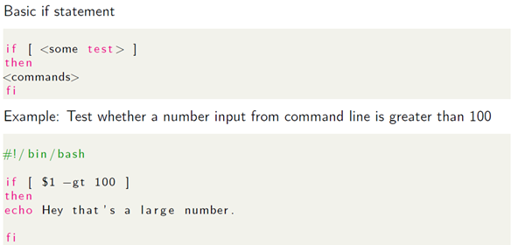
Control structures

Slide 12
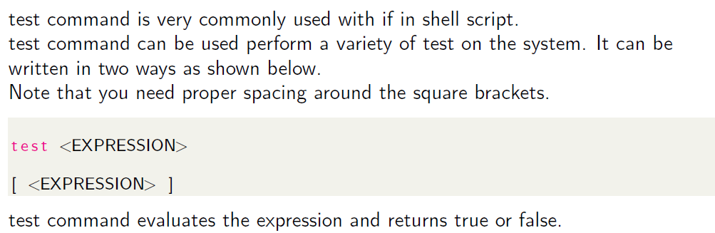
test Command

Slide 13
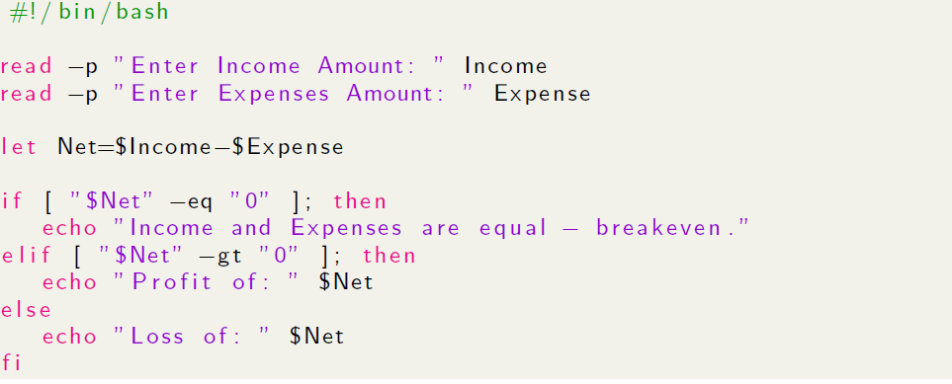
If elif

Slide 14
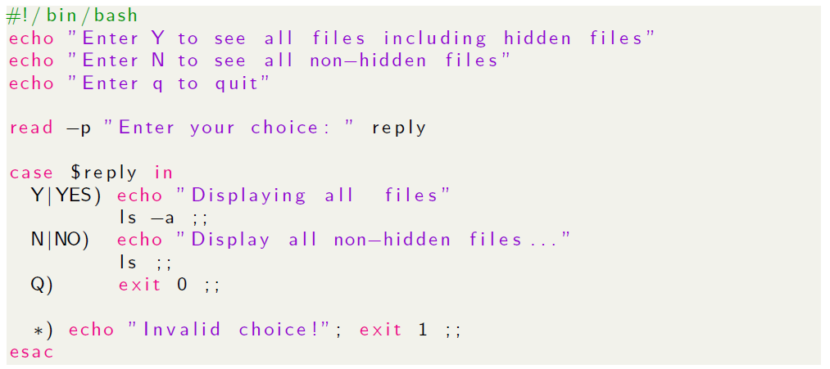
Case statement

Slide 15
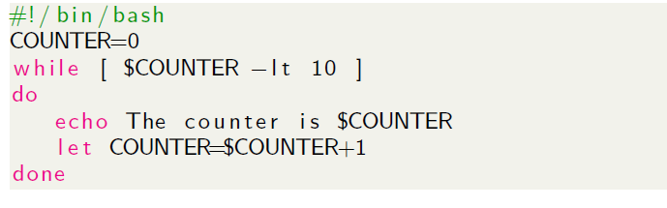
While Loop

Slide 16
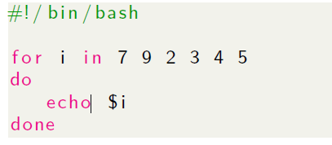
for Loop

