Slide 1



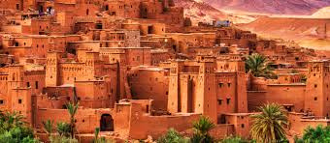
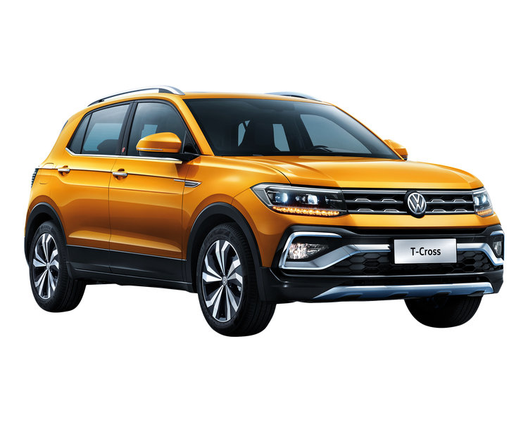


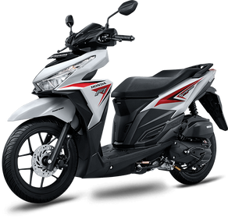
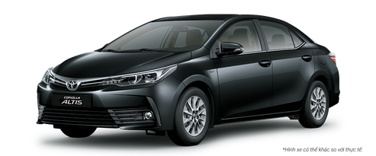




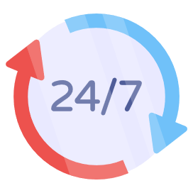


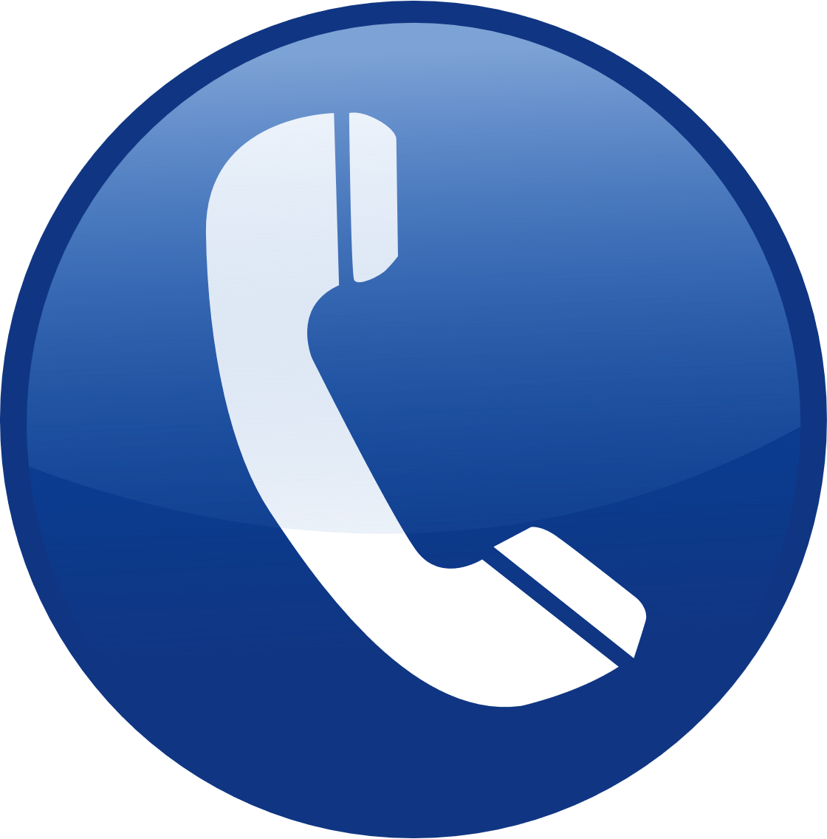


uto insurance
Ouarzazate
AUTOMOBILE INSURANCE
IN MOROCCO
Third-Party Insurance
Third-Party Plus Insurance
Comprehensive Insurance (All Risks)
Our advantages
Cars
Motorcycles
Trucks
Competitive prices
National coverage
24/7 assistance
Fast subscription
Call us
0688888888
email: contact@ouarzazate.com
adresse: avenue mohamed V,ouarzazate

