Slide 1
MICROSOFT BUILD 2026 — CONFERENCE Summary
From AI Assistants to Agentic Systems
Add a cover photo here
Key themes and opportunities in enterprise AI
A short Summary of what was presented at this year's conference, and what it could mean for the work we do.
Merra Kokebie | 20-minute Summary | June 2026
Notes:
This is a roughly 20-minute Summary of Microsoft Build 2026. The central theme to anchor on is the shift from chat-based AI assistants toward agentic AI — systems that reason, coordinate tasks, and act across enterprise data rather than only responding to prompts. I'll cover the major themes and close with what they mean for our systems, including App Development. I'll take questions at the end.

Slide 2
ROADMAP
What we'll cover
1
The central shift
2
The platform
Agentic AI and autonomous systems
AI Foundry for building AI apps
3
Where it runs
4
Building software
Hybrid: cloud and on-device AI
AI-assisted development and new models
5
Data and access
6
People and planet
Enterprise data, Fabric and MCP
Human-centered AI and what it means for us
Microsoft Build 2026 · Summary
2
Notes:
Six areas. We begin with the central shift toward agentic AI, then the platform Microsoft is positioning for building AI apps, where the AI runs, how it supports software development, the data and connector story including MCP, and finally the human-centered and sustainability themes plus concrete opportunities for us.

Slide 3
THE CENTRAL SHIFT
From assistants you prompt to systems that act
THE TRADITIONAL ASSISTANT
THE AGENTIC SYSTEM
Responds to a prompt, then waits for the next instruction.
Pursues a goal — planning, taking actions, and coordinating across systems.
What this means. Agentic AI doesn't only answer — it plans, uses the tools available to it, checks the result, and keeps going until the goal is met. It's the same underlying technology, now applied to completing tasks rather than only holding a conversation.
Microsoft Build 2026 · Summary
3
Notes:
If there is one idea to take away, it is this shift. A traditional assistant responds to a prompt and waits. An agentic system pursues a goal: it plans, takes actions, uses tools, evaluates the result, and keeps going until the goal is met. The capability is built on the same models — the difference is that AI is now being applied to complete tasks end to end, not only to hold a conversation.

Slide 4
AGENTIC AI
From fixed steps to goal-driven loops
A traditional workflow
An agentic workflow
Step A
→
Step B
→
Step C
Goal → Reason → Choose actions → Use tools → Evaluate ↻
The same path runs every time, regardless of context.
The loop repeats until the goal is met; the path is decided as it runs.
The key difference. The sequence is no longer fully predefined — the system chooses the next step based on what it has learned along the way.
Microsoft Build 2026 · Summary
4
Notes:
A traditional workflow is hard-wired: A, then B, then C. An agentic workflow is a loop. You set a goal; the model reasons, chooses an action, uses a tool, evaluates the result, and decides whether to continue. The important point is that the sequence is no longer fully predefined — which is also why governance and oversight come up later in the deck.

Slide 5
AGENTIC AI
What an agent can do
Plan a task by breaking a goal into steps
Carry out several steps in sequence
Use the tools available to it — scripts, services, APIs
Retrieve information from connected sources
Make decisions within defined boundaries
Work alongside other agents on a larger task
Taken together, this is what lets AI handle things like routine reporting, monitoring, and investigations with limited hand-holding — coordinating across applications instead of waiting for each instruction.
Microsoft Build 2026 · Summary
5
Notes:
Six capabilities appeared consistently across the sessions: planning, executing steps, using tools, retrieving information, making decisions within defined boundaries, and collaborating with other agents. For engineering teams the useful framing is intelligent workflow engines: analyzing data, generating reports, monitoring systems, running investigations, and handling exceptions across applications without driving each step manually.

Slide 6
EXAMPLES — AS OF JUNE 2026
What this looks like in real tools
General-purpose desktop agents
Coding-focused agents
Claude Cowork (Anthropic)
New GitHub Copilot app
Controls your desktop and files to run multi-step tasks. (This deck was built in it.)
Launched at Build 2026 — supervise several coding agents tied to issues and PRs.
Gemini Spark (Google)
OpenAI Codex
An always-on cloud agent you email; works across Gmail and the web. Uses MCP.
Cloud coding agent that runs tests and opens pull requests via parallel sub-agents.
OpenClaw (open-source)
These move quickly — treat the specifics as a June 2026 snapshot.
Runs locally — shell, files and browser — with 100+ built-in skills.
The common thread. Each one acts — it plans, uses tools and does the work — and several connect through MCP.
Microsoft Build 2026 · Summary
6
Notes:
To make agentic AI concrete, here are real tools as of mid-2026. General-purpose: Claude Cowork is a desktop agent for non-developers — in fact this deck was built in it; Gemini Spark is Google's always-on cloud agent you can email, which works across Gmail and Docs and connects through MCP; and OpenClaw is a popular open-source agent that runs locally with broad system access. Coding-focused: the new GitHub Copilot desktop app, announced at this very Build conference, lets you supervise several coding agents tied to issues and pull requests, and OpenAI Codex is a cloud coding agent that runs tests and opens pull requests. The takeaway is the common thread: each one acts rather than just answering, and several speak MCP, which connects back to earlier slides. Worth saying aloud: this area changes quickly, so treat the details as a snapshot.

Slide 7
THE PLATFORM
AI Foundry: a place to build AI applications
Microsoft presented AI Foundry as a central place to build and manage AI work, rather than assembling a series of separate, one-off tools. The idea is to create capabilities that can be reused, with consistent security and oversight across them.
AI FOUNDRY PLATFORM
Agents
Build, run and orchestrate
Models
Managed in one place
Tools & connectors
via MCP
Data & knowledge
Security, identity & governance
Microsoft Build 2026 · Summary
7
Notes:
Microsoft positioned AI Foundry as the central platform to build and manage AI: model management, agent development, tool integration, security controls, and evaluation and monitoring in one place. The message to engineering teams is reuse and governance — rather than building many isolated chatbots, build shared capabilities with consistent controls.

Slide 8
WHERE IT RUNS
Hybrid AI: cloud and on-device
The previous model
User
Cloud AI
Response
The emerging model
Device AI
Enterprise AI
Cloud AI
Cloud reserved for the harder requests
Work increasingly runs on the device and within the enterprise first, with the cloud reserved for the harder reasoning. The benefits are practical: lower cost, better privacy for sensitive data, faster responses, and some capability even when offline.
Microsoft Build 2026 · Summary
8
Notes:
A major theme was reducing reliance on cloud-only processing. The previous pattern was user to cloud to response. The emerging pattern routes through on-device and enterprise models first, reserving the cloud for more complex reasoning. The benefits are lower cost from fewer tokens, better privacy because sensitive data can remain local, lower latency, and some offline capability. This aligns with advances in local models and AI-enabled PCs.

Slide 9
PERSONAL AI
Bringing AI closer to the desktop
Better hardware and more efficient models make it practical to run capable AI on a user's own machine — so a portion of what used to need the datacenter now happens locally.
Add a photo (e.g. a laptop / workplace)
Lower cost, since less work goes to the cloud
Better privacy, with data kept on the device
Faster responses for everyday tasks
Closer integration with local files and data
Microsoft Build 2026 · Summary
9
Notes:
Closely related to the hybrid theme is the idea of personal AI — bringing AI closer to the user, sometimes described as a datacenter on the desktop. As hardware and model efficiency improve, more can run locally, which lowers cost and latency and improves privacy and local-data integration. Likely uses include document analysis, report generation, code assistance, and data exploration, with the cloud reserved for harder reasoning.

Slide 10
NEW MODELS
Microsoft's own AI (MAI) models
Microsoft introduced more of its own models. The strategic point matters more than any single release: Microsoft is positioning itself as both the platform you build on and a provider of the underlying models.
Where the focus is
Reasoning — stronger multi-step problem solving
Efficiency — more output for the compute used
Cost — lower to run at scale
Enterprise fit — designed to work with business data
Microsoft Build 2026 · Summary
10
Notes:
Microsoft introduced additional MAI models focused on reasoning, efficiency, cost optimization, and enterprise integration. The strategic point matters more than any single model: Microsoft is positioning itself as both the platform you build on and a provider of the underlying models, owning more of the stack.

Slide 11
BUILDING SOFTWARE
From code completion to task completion
Previously
Increasingly
The assistant completed the current line or block as you typed.
You describe the outcome you want, and the assistant helps carry it out across files.
Seen across the tooling: GitHub Copilot, agent modes in the editor, code and documentation generation, and help with refactoring.
A recurring idea was reusable “skills” — capabilities built once and reused across projects, rather than rebuilt each time.
Microsoft Build 2026 · Summary
11
Notes:
The development theme is a shift from code completion to task completion. Rather than finishing the current line, tools such as GitHub Copilot and agent modes take a described outcome and help implement it — generating code, documentation, and refactors. A recurring concept was skills: reusable agent capabilities that are built once and reused across projects.

Slide 12
DATA AND ACCESS
Only as useful as the data it can reach
Microsoft Fabric was presented as a key part of putting AI to work in an organization. The point is simple: AI becomes valuable when it can draw on your own data, not just public information — so answers are grounded in the business.
What Fabric helps with
Bringing data sources together
Analytics that turn data into insight
Governance over access and lineage
Giving AI controlled access to enterprise data
Microsoft Build 2026 · Summary
12
Notes:
A straightforward but important point: AI is only as useful as the data it can reach. Microsoft Fabric was presented as the backbone for connecting it — data integration, analytics, governance, and giving AI controlled access to enterprise information. That is what allows AI to answer business questions from organizational data rather than public sources. This sets up the MCP discussion that follows.

Slide 13
THE KEY TECHNICAL DEVELOPMENT
MCP: a common way for AI to reach your systems
The Model Context Protocol (MCP) is an open standard that lets AI securely connect to tools and data — much as APIs created a common way for applications to talk to one another.
One agent, many systems — connected through MCP
SQL Server & databases
MCP
open standard
Document stores
AI agent
Internal APIs & tools
Email & files
Microsoft Build 2026 · Summary
13
Notes:
This is the development I would emphasize most. MCP — the Model Context Protocol — is an open standard that lets AI securely interact with tools and data, comparable to how APIs standardized communication between applications. Today each integration is custom-built; with MCP, an agent uses one standard connector to reach SQL databases, document repositories, ticketing systems, and internal apps, while preserving governance and security. This is the direction Microsoft, GitHub, and others are converging on.

Slide 14
MCP IN PRACTICE
An example: a reporting assistant
1
Connect to the database through MCP — no custom code
2
Read the schema to learn the tables and relationships
3
Turn a plain-language request into a query
6
Draft a report that's ready for review
5
Produce charts and a short summary of results
4
Run the query within its granted permissions
Each step is achievable on its own; MCP is what lets a single assistant carry them out in sequence. This is the direction the major providers are moving toward.
Microsoft Build 2026 · Summary
14
Notes:
To make MCP concrete: a reporting assistant could connect to SQL through MCP, read the schema, translate a plain-language request into SQL, run it within defined permissions, produce charts and summaries, and draft a report ready for review. Each step is achievable on its own; MCP is what allows a single agent to chain them together securely. This reflects the shared direction across major providers.

Slide 15
PEOPLE
Keeping people at the center
A consistent message from leadership was a human-first approach: the aim is to support people's work, not replace their judgment. In practice that means responsible use, real human oversight, transparency about what the system is doing, and earning trust over time.
Add a photo (e.g. people / team)
The vision they returned to: AI as a collaborator that augments people, with a person kept in the loop on decisions.
Microsoft Build 2026 · Summary
15
Notes:
A consistent theme from leadership was a human-first approach: responsible AI, human oversight, transparency, trust, and productivity. The stated goal is not to replace people but to augment human capability, with AI acting as a collaborator and a person remaining in the loop for decisions. This is a useful point to make for anyone concerned about the move toward agents.

Slide 16
PLANET
The infrastructure behind it
Microsoft also spoke about sustainability — reducing water and energy use and environmental impact, including new approaches to cooling and datacenter design.
A worthwhile takeaway is that building AI at this scale now draws on many fields working together, not software alone:
Add a photo (e.g. datacenter / nature)
Software, hardware and electrical engineering
Mechanical engineering and materials science
Chemistry and environmental specialists
Microsoft Build 2026 · Summary
16
Notes:
A less obvious theme was sustainability. Microsoft is working to reduce water and energy use and environmental impact through new cooling and infrastructure technologies. The notable engineering takeaway is that AI infrastructure now requires far more than software expertise — hardware, electrical, mechanical, materials, chemistry, and environmental disciplines — making it a genuinely interdisciplinary challenge.

Slide 17
WHAT THIS MEANS FOR US
Opportunities for App Development
Reporting in plain language
Help with SQL and analysis
Someone could ask, “Show loans funded this month by originator,” and get a report back without writing a query.
Explaining queries, suggesting improvements, drafting report logic, and looking into performance issues.
Finding information
Assisting routine work
Locating answers across our databases, documentation, policies, and procedures.
Looking into reconciliation differences, drafting operational summaries, watching data quality, and helping prepare for audits.
Microsoft Build 2026 · Summary
17
Notes:
This is the most relevant section for us. Four practical directions for App Development: reporting in plain language so users can ask for information rather than writing SQL; help with SQL and analysis, including explaining and improving queries; finding information across our databases, documentation, and policies; and assisting routine work such as reconciliation investigations, operational summaries, data-quality monitoring, and audit preparation. These align with the conference themes of agentic AI, enterprise data, and hybrid deployment.

Slide 18
A BALANCED VIEW
Opportunities and things to weigh
Opportunities
Things to weigh
Meaningful gains in productivity
Routine work that can be automated
Enterprise data that's easier to reach
Faster reporting and analysis
Keeping costs in check at scale
Keeping people reviewing the output
Keeping important knowledge in-house
Not leaning on AI for code and decisions uncritically
Clear approval and governance for agents
Microsoft Build 2026 · Summary
18
Notes:
A balanced view before the close. The opportunities are real: productivity, automation, and more accessible data. So are the considerations: managing costs at scale, maintaining human oversight, keeping institutional knowledge in-house, avoiding overreliance, and establishing governance and approval for agentic systems. Microsoft's suggested approaches map to earlier themes — hybrid architectures, local execution, human approval workflows, and human-centered design.

Slide 19
THE TAKEAWAY
Things to remember
1
The shift is to agentic AI
AI is moving from assistants you prompt toward systems that pursue a goal and act.
2
It's practical for us
Our own data, reached through standards like MCP, makes plain-language reporting and helpful assistants realistic for App Development.
3
Adopt it deliberately
Start small, keep people in the loop, and stay mindful of cost and governance.
Microsoft Build 2026 · Summary
19
Notes:
To close, three points. First, the central shift is from assistants you prompt toward agentic systems that act. Second, it is practical for us: our own data, reached through standards like MCP, makes plain-language reporting and helpful assistants realistic for App Development. Third, adopt deliberately — start small, keep people in the loop, and stay mindful of cost and governance. I'm happy to take questions.

Slide 20
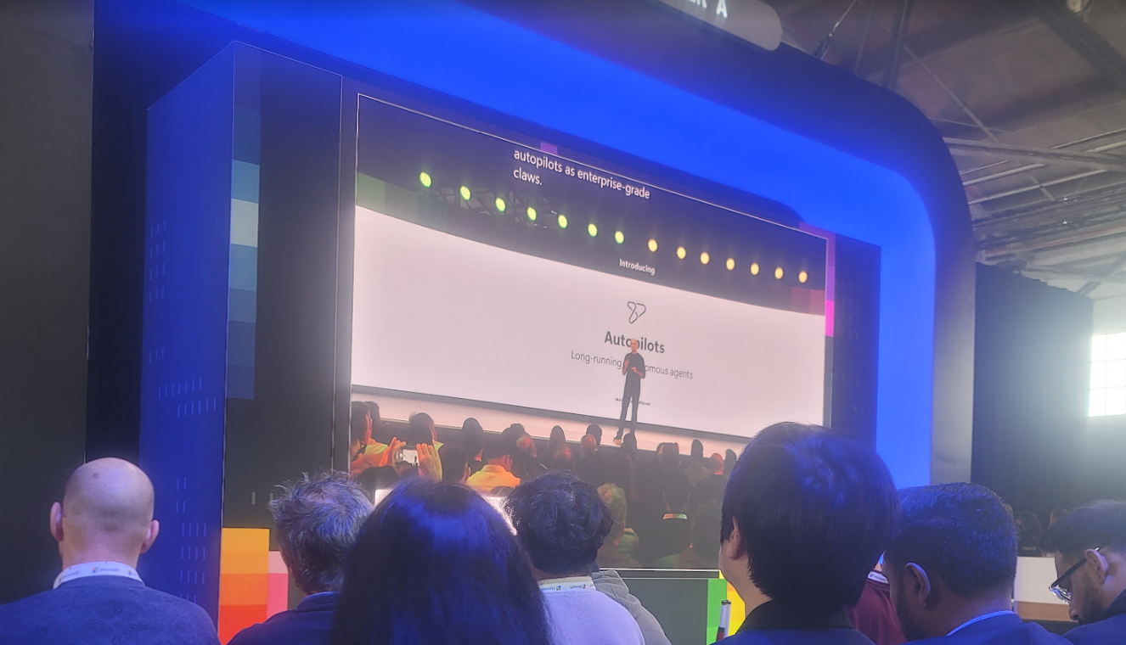

Slide 21


Waymo

Slide 22
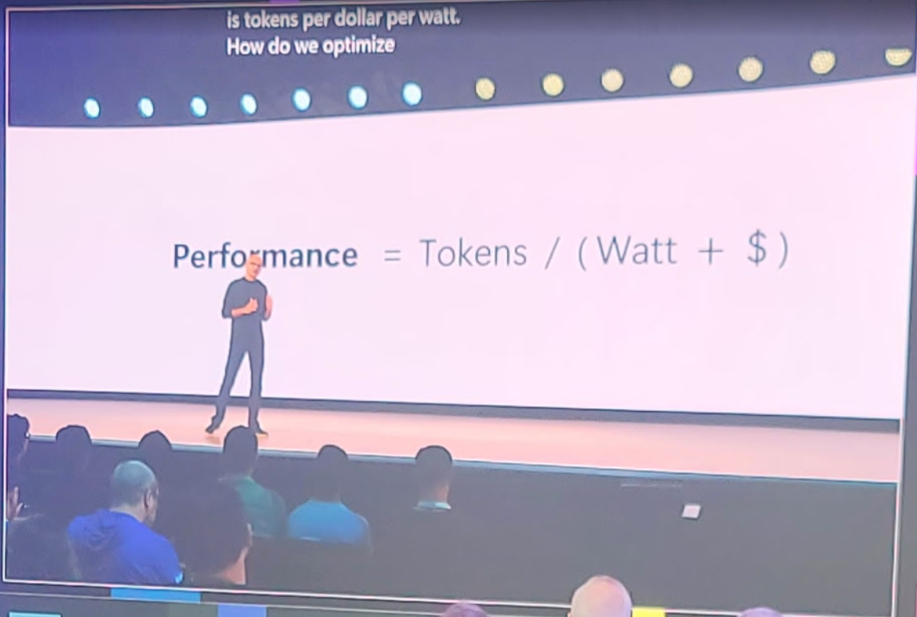

Slide 23
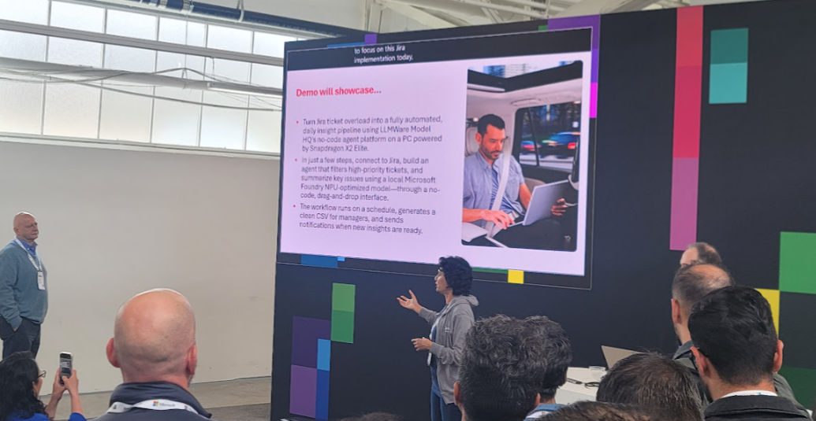

Slide 24
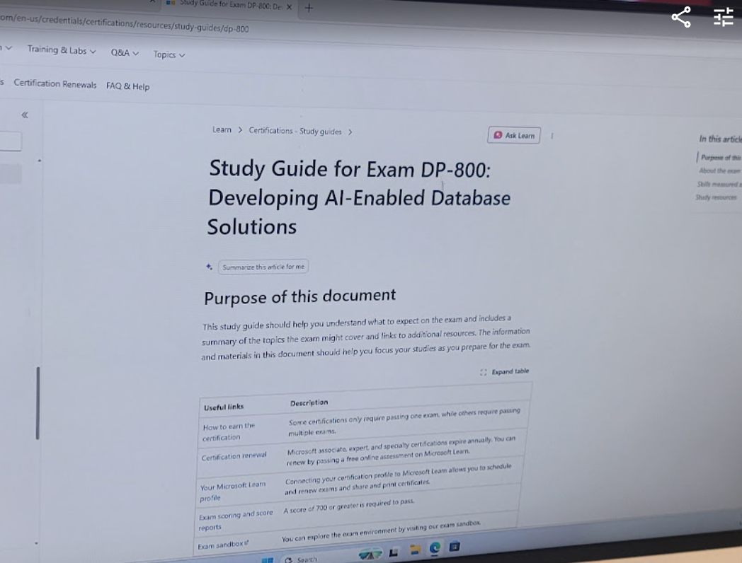

Slide 25
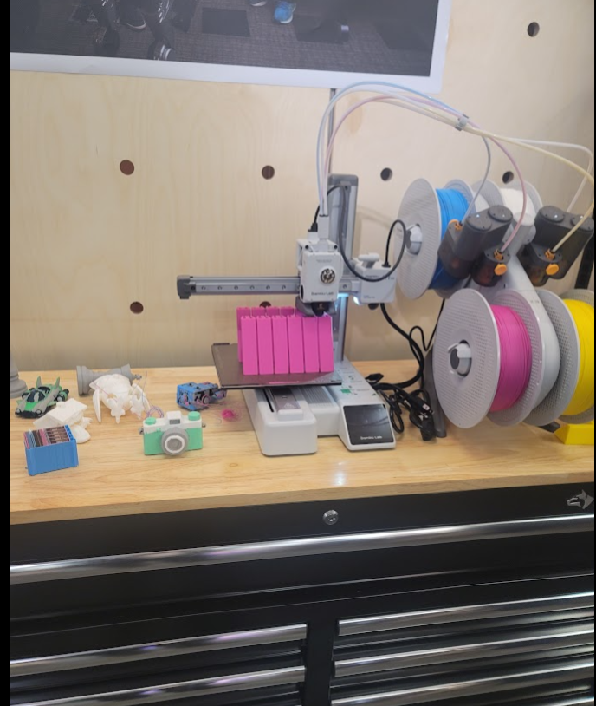

Slide 26
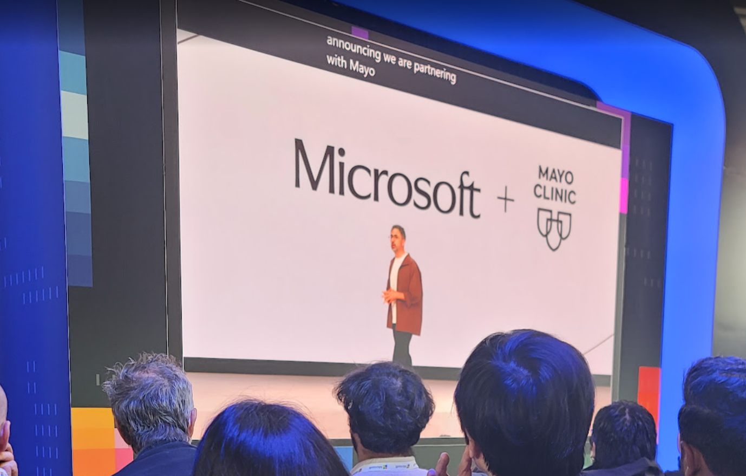

Slide 27
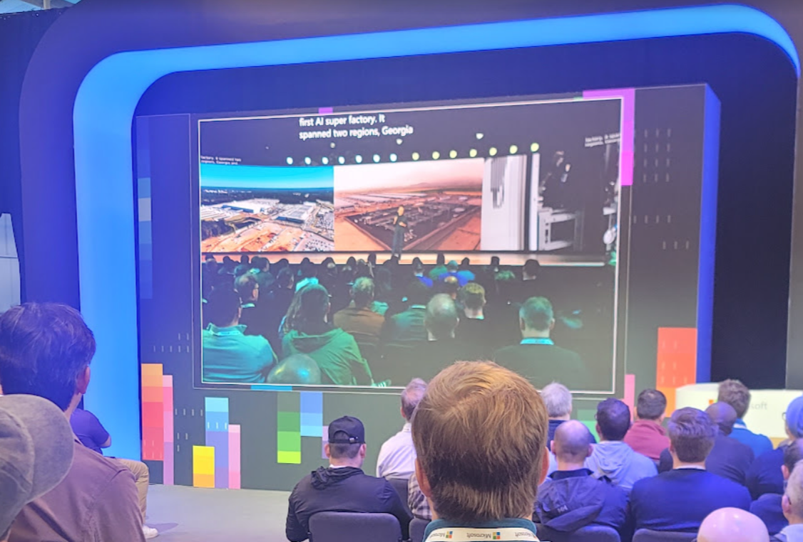

Slide 28
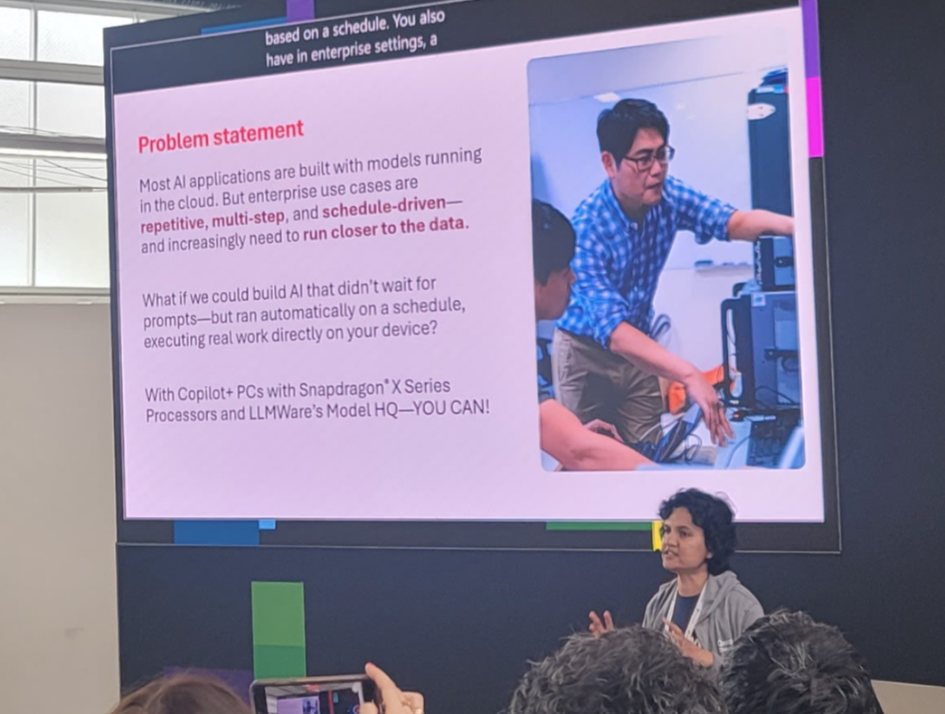

Slide 29
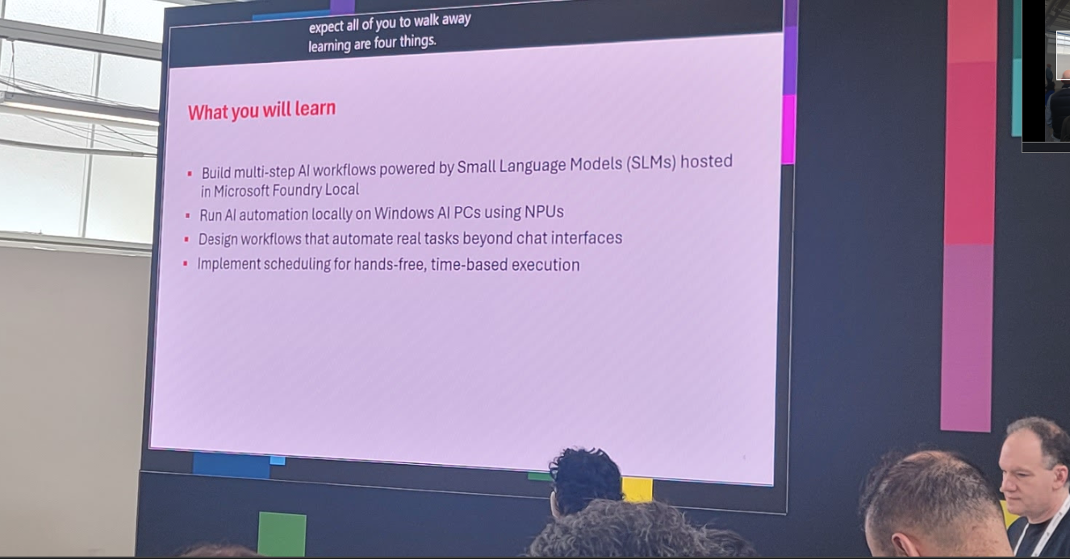

Slide 30
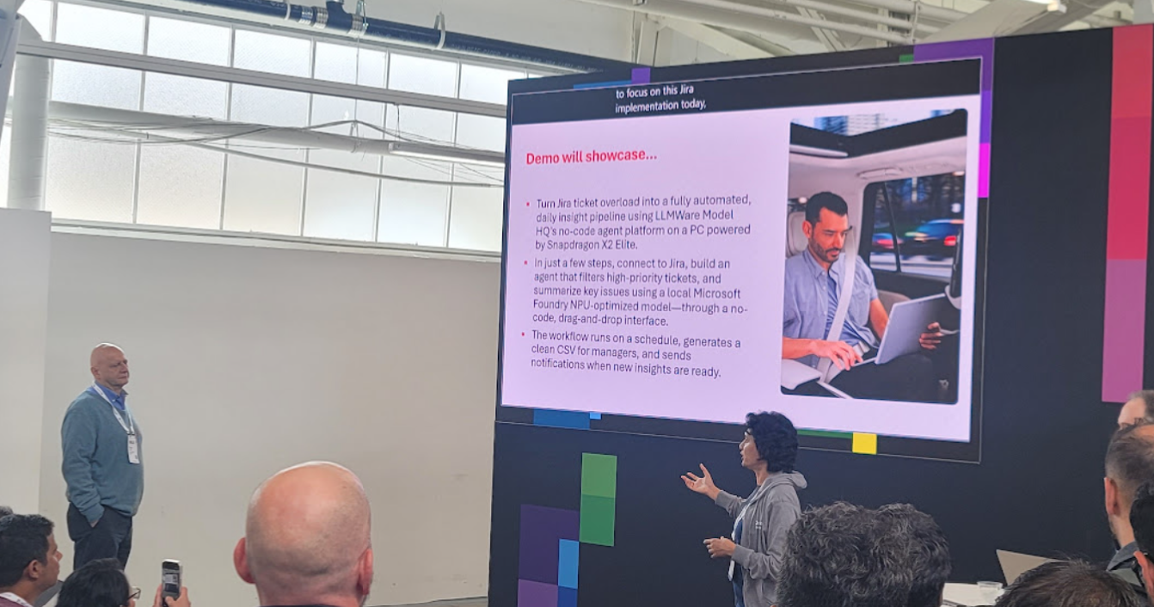

Slide 31
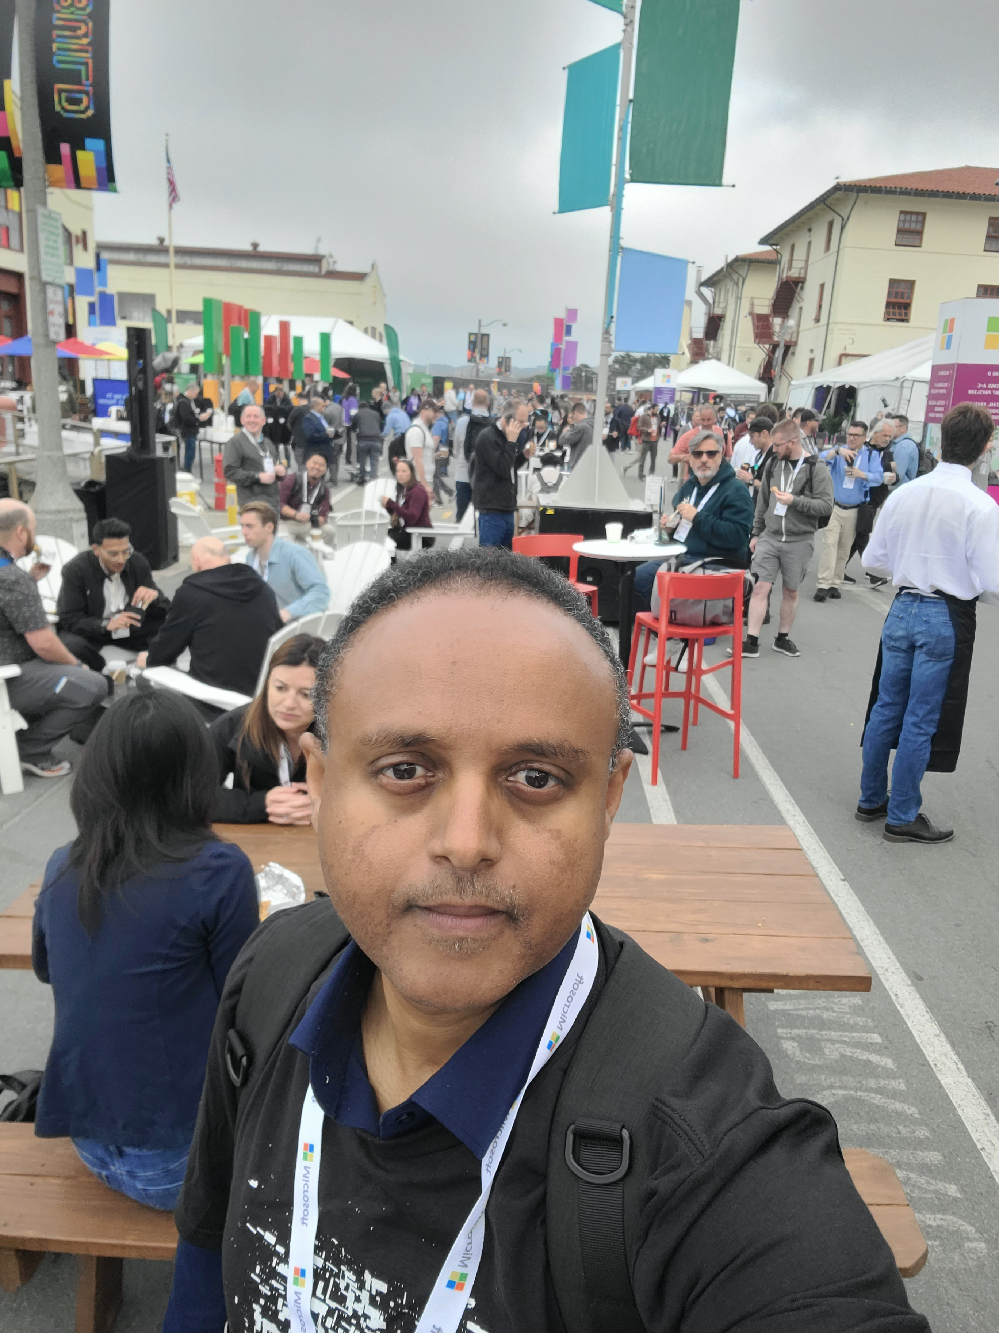

Slide 32
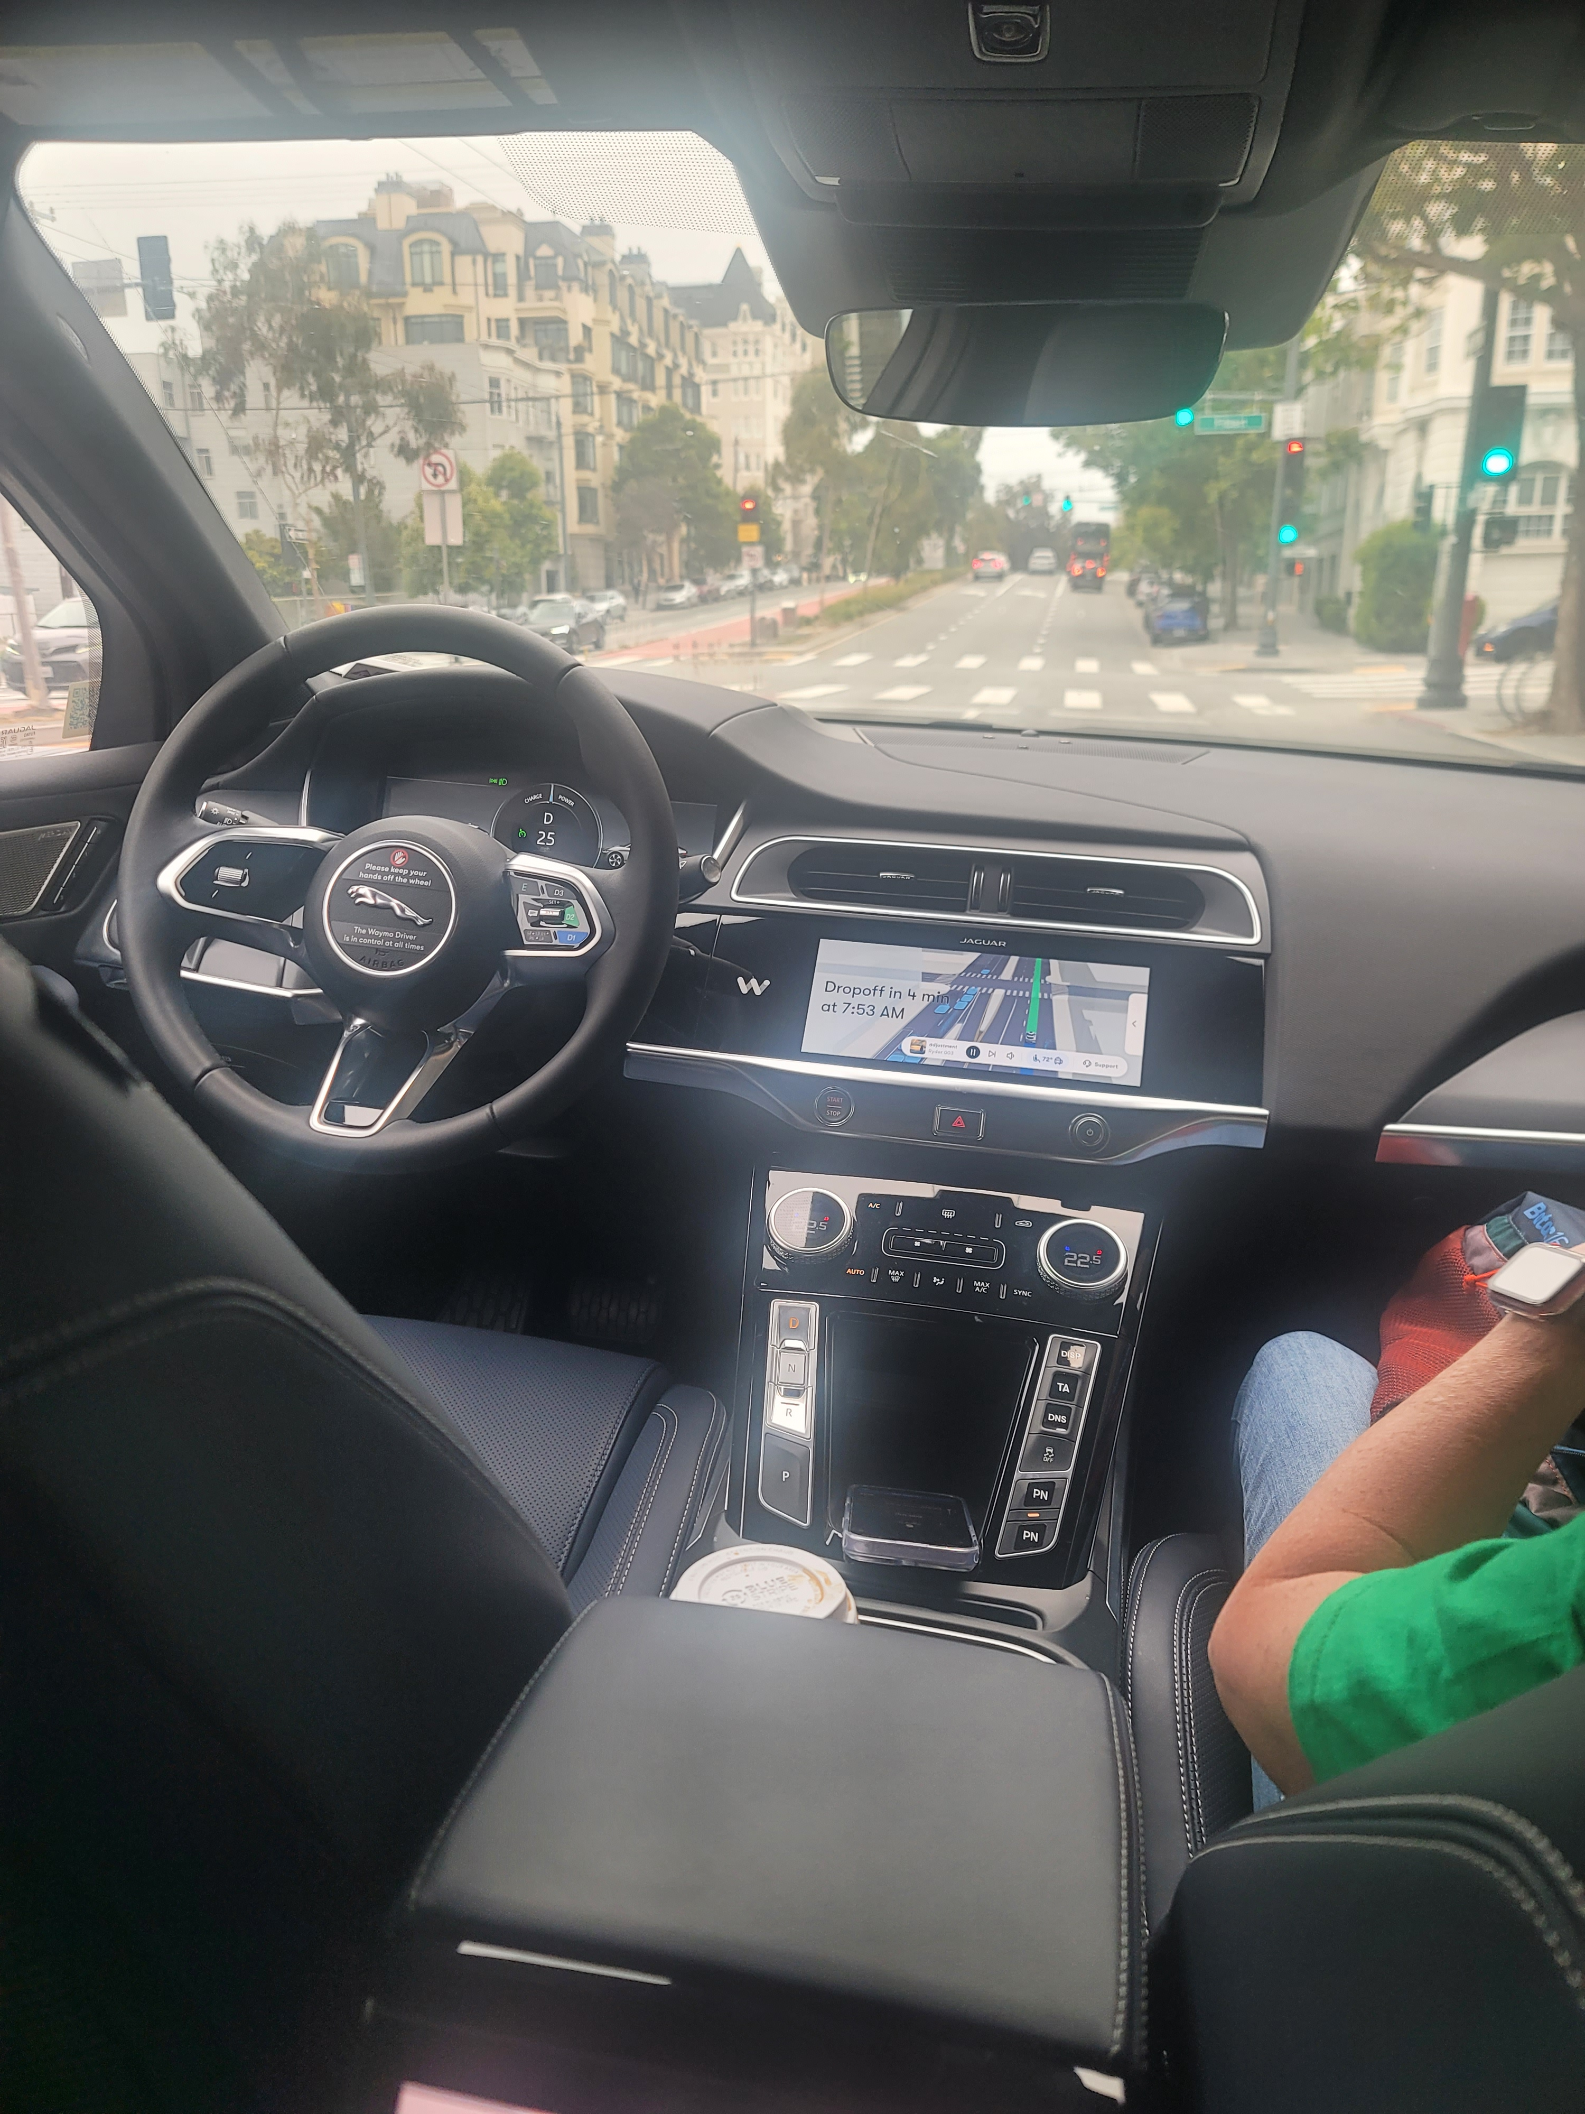

Slide 33
