Slide 1
CPS 499/564 Project 1
Team Members:
Benjamin Merrell, Elijah Rose, and Ashley Blankenship

Slide 2
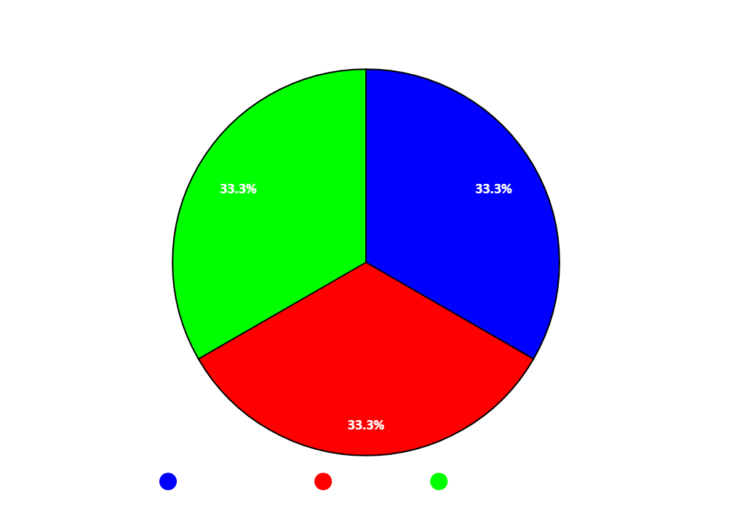
Team Contributions
Team Contribution Details
Benjamin Merrell:
Completed Problem 1a and helped with 1b.
Wrote the report details and slides for problem 1a.
Wrote the Readme.txt file.
Elijah Rose:
Completed Problem 1b and helped with 1a.
Wrote the report details and slides for problem 1b.
Compiled resulting images from problem 1 into the results folder.
Ashley Blankenship
Completed Problem 2
Wrote the report details and slides for problem 2
Compiled the resulting images from problem 2 into the test results folder
Teammate | Code: | Report: | Slides | Total
Benjamin Merrell | 33% | 33% | 33% | 33%
Elijah Rose | 33% | 33% | 33% | 33%
Ashley Blankenship | 33% | 33% | 33% | 33%

Slide 3
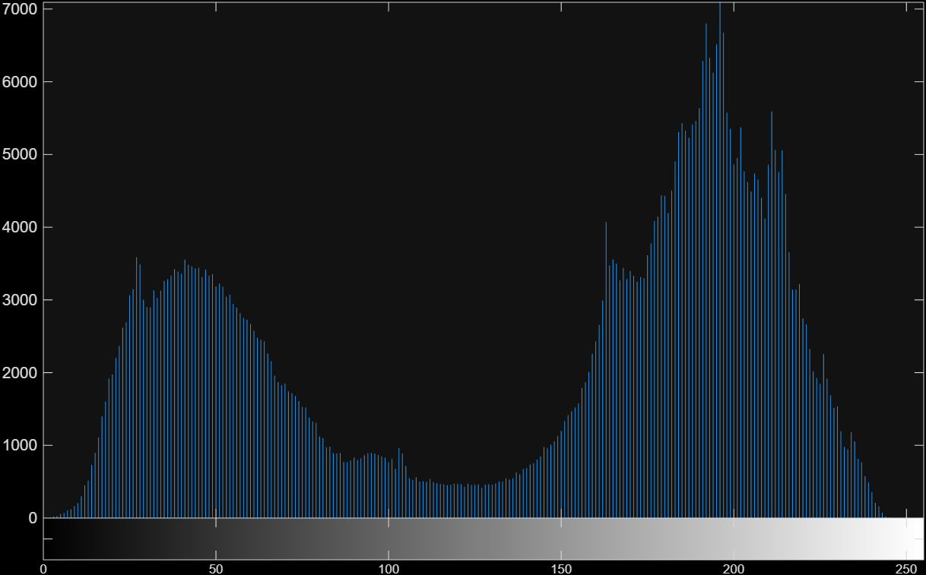
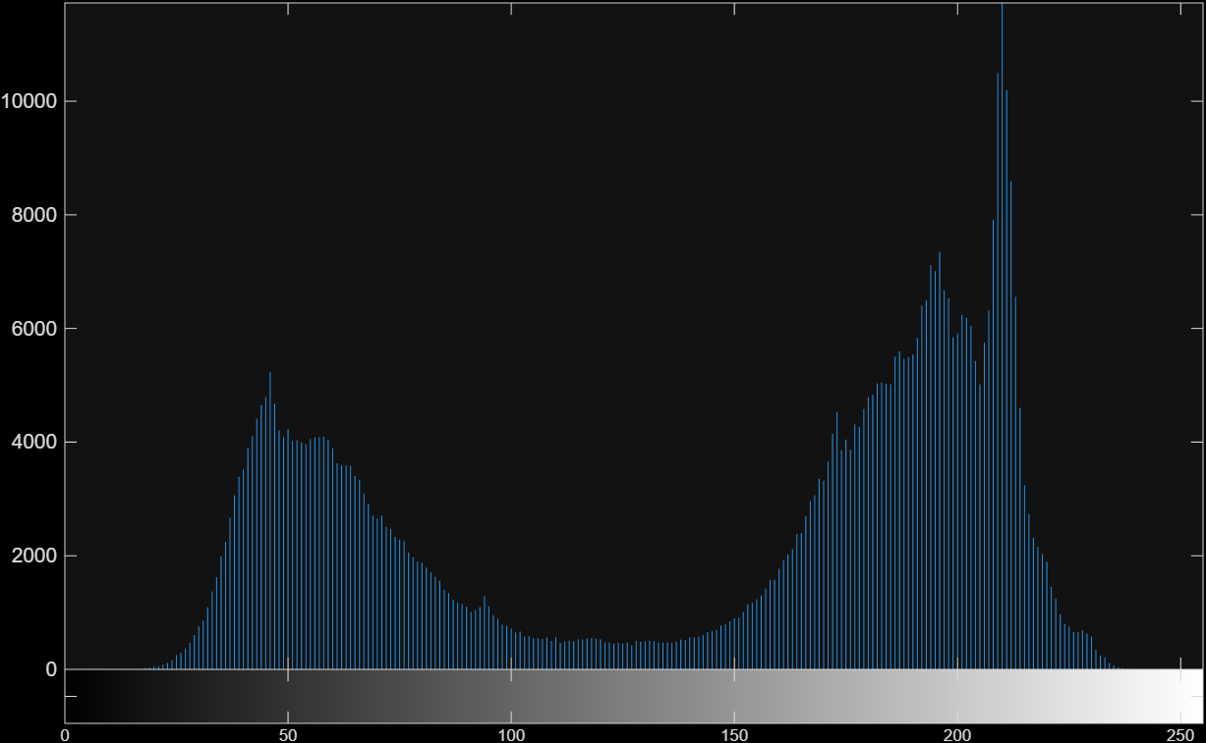
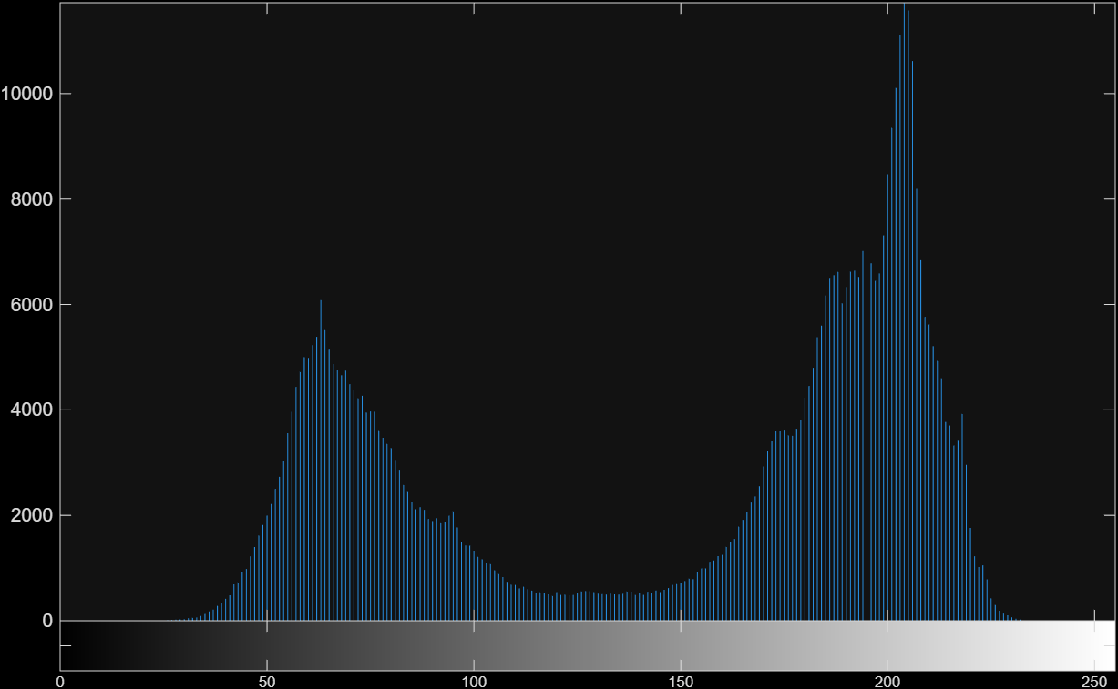
Problem 1a. Detecting Manipulated Channel
Common Histogram Patterns
Shape test:
Unedited Image
Red Channel
Tests used to calculate confidence score:
Histogram Shape Test(⅓ of final score)
Histogram peak Test(⅓ of final score)
Noise Estimation(⅓ of final score)
Unedited channels tend to share the overall shape(Here, two humps with a valley)
Peak locations and heights differ slightly, but shape is usually consistent.
A tampered channel should be the odd one out.
Green Channel
Blue Channel
For each pair of channels, sum the absolute histogram differences and divide by 2 (0 = identical, 1 = no overlap).

Slide 4
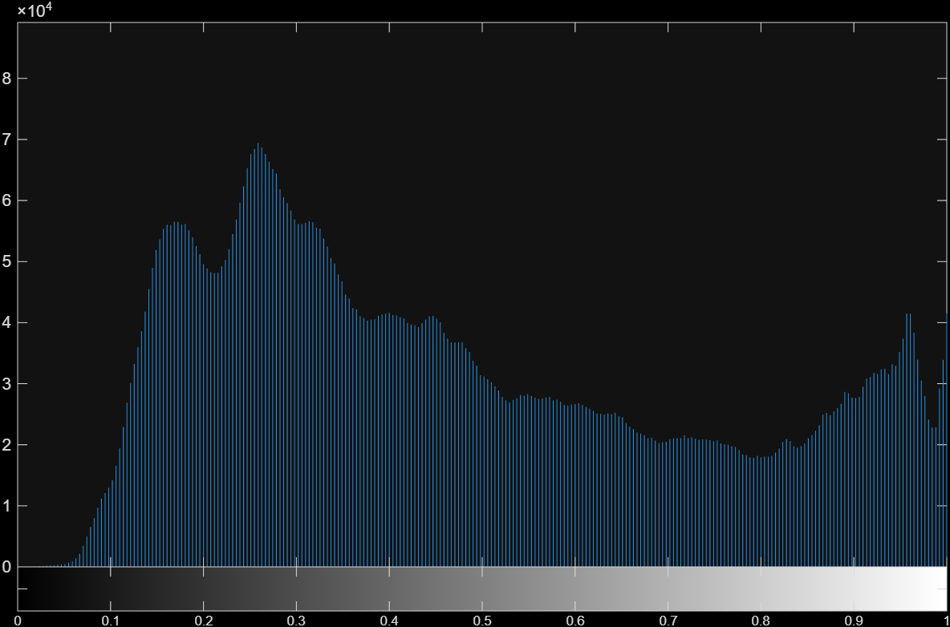
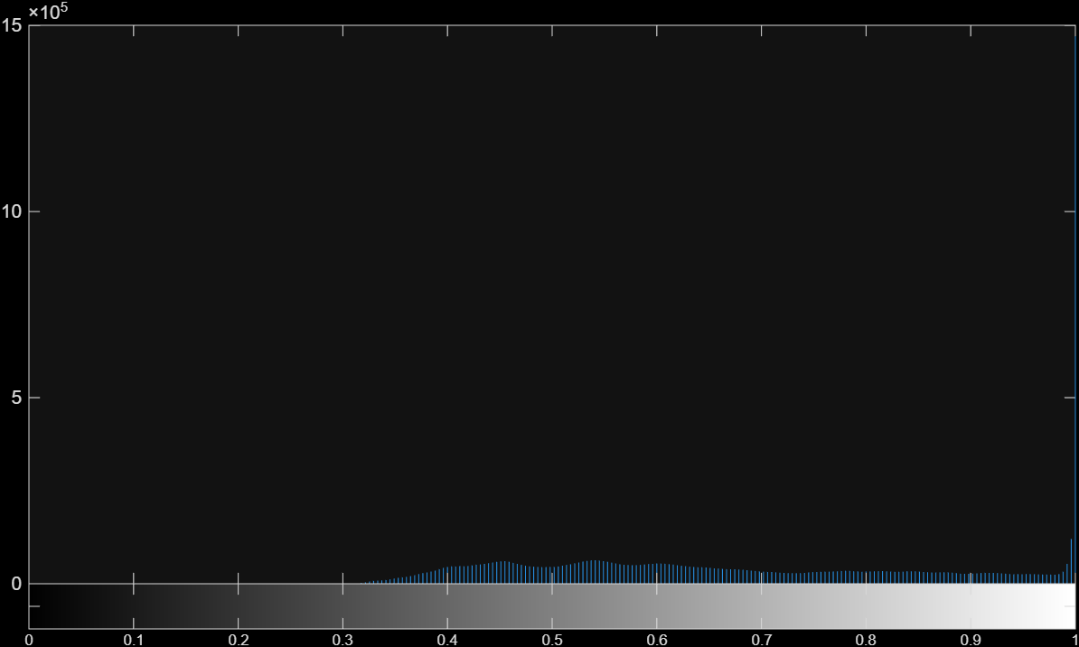

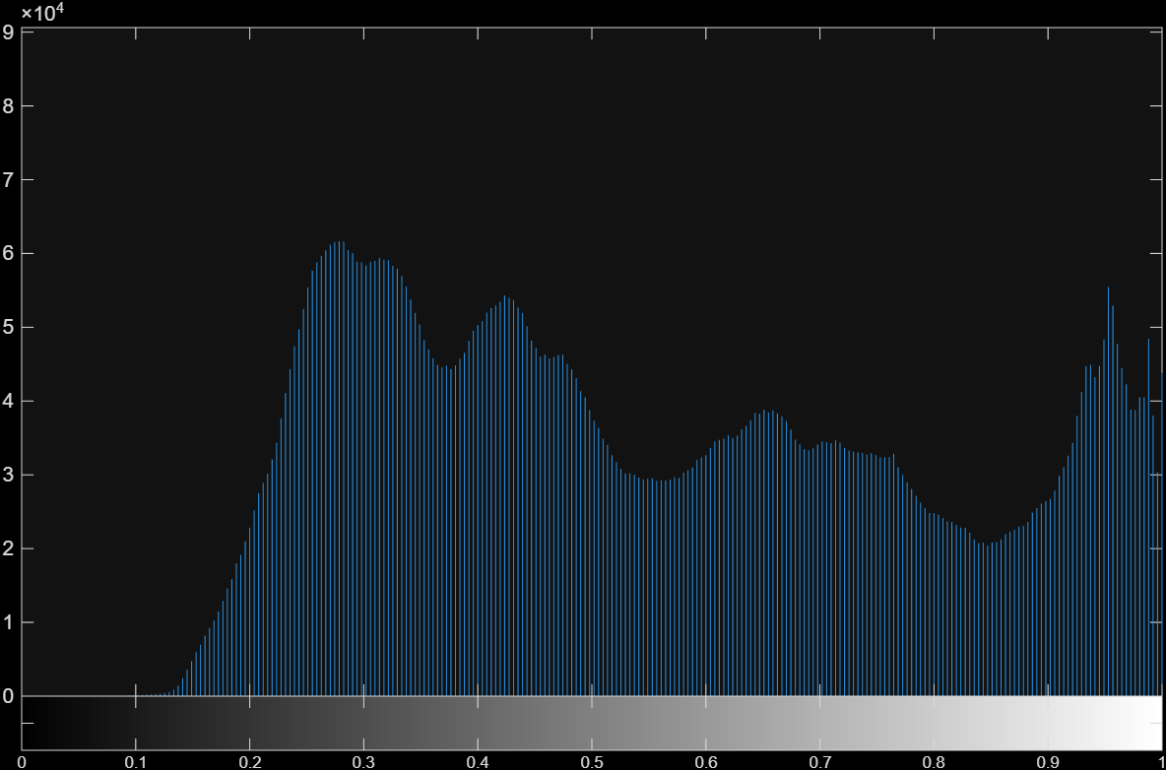
Green Channel Manipulated Image(image 3 of RGB Dataset):
Red Channel
Green Channel
Green Channel
The histogram has an unusually high peak compared to the rest of the graph
Blue Channel
Green’s histogram no longer resembles red and blue so it’s average distance is high.
Green channel is also scaled up to see all data which is why it looks more flat than other 2 channels.

Slide 5
Problem 1a. Detecting Manipulated Channel
Peak test:
Noise Estimation:
Brightness and contrast edits clip pixels to 0 or 255, piling them into one huge bin.
Score = pixel count at the mode divided by the average pixel count of the next 19 highest peaks.
A larger ratio means that channel is more likely tampered with.
Scores are normalized so R, G, and B sum to 1.
Blur each channel with a gaussian filter and subtract it from the original.
The standard deviation of what’s left is the channel’s noise score.
Unedited Channels should have similar noise levels.
Had little effect on this dataset, since the images weren’t very noisy.

Slide 6
Detection Results:
 | IMG 1 | IMG 2 | IMG 3 | IMG 4 | IMG 5 | IMG 6 | IMG 7 | IMG 8 | IMG 9 | IMG 10
R Score | 40.11% | 23.15% | 31.89% | 25.42% | 23.58% | 31.90% | 54.82% | 23.00% | 55.87% | 39.82%
G Score | 30.54% | 51.15% | 40.14% | 51.50% | 54.89% | 31.25% | 23.18% | 53.19% | 22.33% | 29.39%
B Score | 29.35% | 25.70% | 27.97% | 23.08% | 21.52% | 36.84% | 22.00% | 23.80% | 21.80% | 30.79%
Tampered Channel | R | G | G | G | G | B | R | G | R | R
Confidence score | 40.11% | 51.15% | 40.14% | 51.50% | 54.89% | 36.84% | 54.82% | 53.19% | 55.87% | 39.82%
Analysis:
Ways it could be improved:
10/10 channels correctly identified.
Confidence is each channel's share of the total score (R + G + B = 100%). An even split would be about 33% each, so higher means the channel stands out more.
Lowest scores (about 37-40%) came from inverted channels (images 1, 6, 10) and a right shift (image 3).
Add a test that detects inversion better.
Weight each test by how informative it is. For example, a test whose scores are all 33% should have little to no weight in the final confidence scores.

Slide 7
Problem 1b
d₁ = manipulated - reference₁
d₂ = manipulated - reference₂
d_{1,smooth} = gauss(d₁)
d_{2,smooth} = gauss(d₂)
sol₁ = d_{1,smooth} + reference₁
sol₂ = d_{2,smooth} + reference₂
restored = (⅙)sol₁ + (⅙)sol₂ + (⅓)reference₁ + (⅓)reference₂
Difference maps
Inter-Channel Difference Filtering
Difference maps are computed between the manipulated channel and each reference channel
Gaussian filter is applied to smooth out noise from both difference maps
Add the smoothed differences back to the reference channels to get primary estimates for the restored channel
Final output is blended with the reference channels to produce a distribution close to the good channels.
Smoothing the maps
Adding smoothed maps back to reference channels
Final result is a weighted average with the reference channels

Slide 8
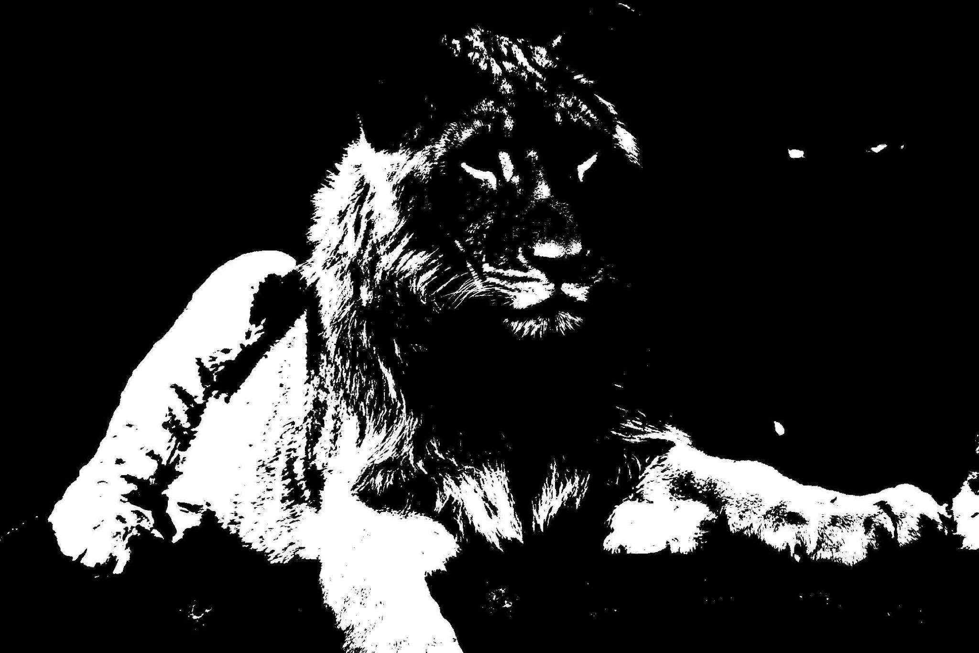
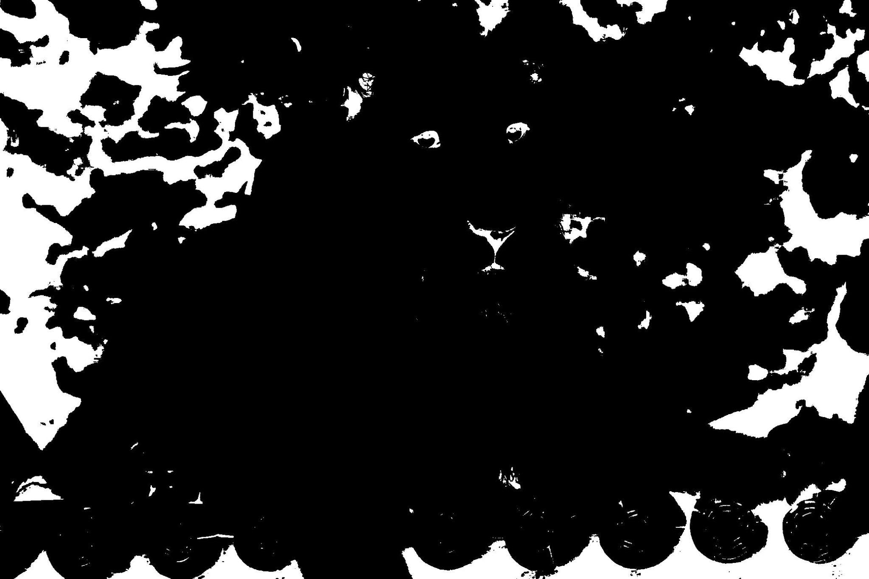
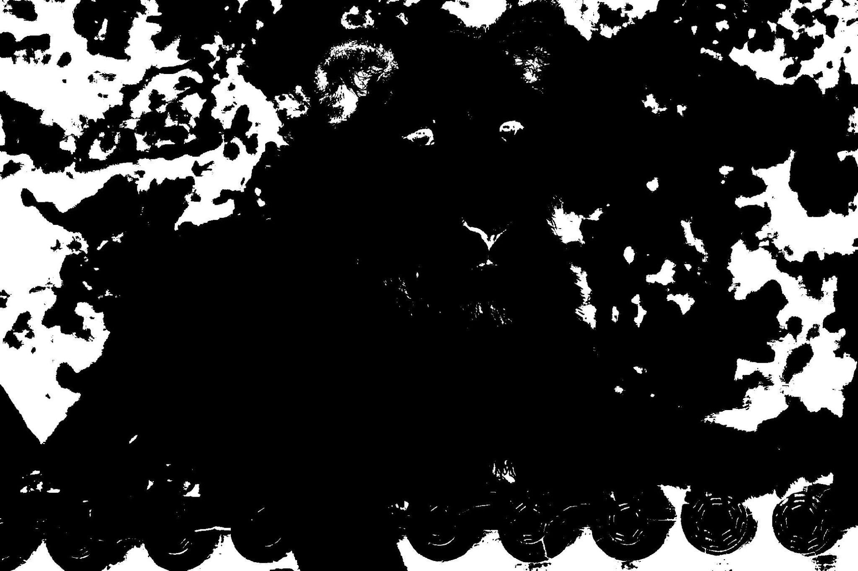
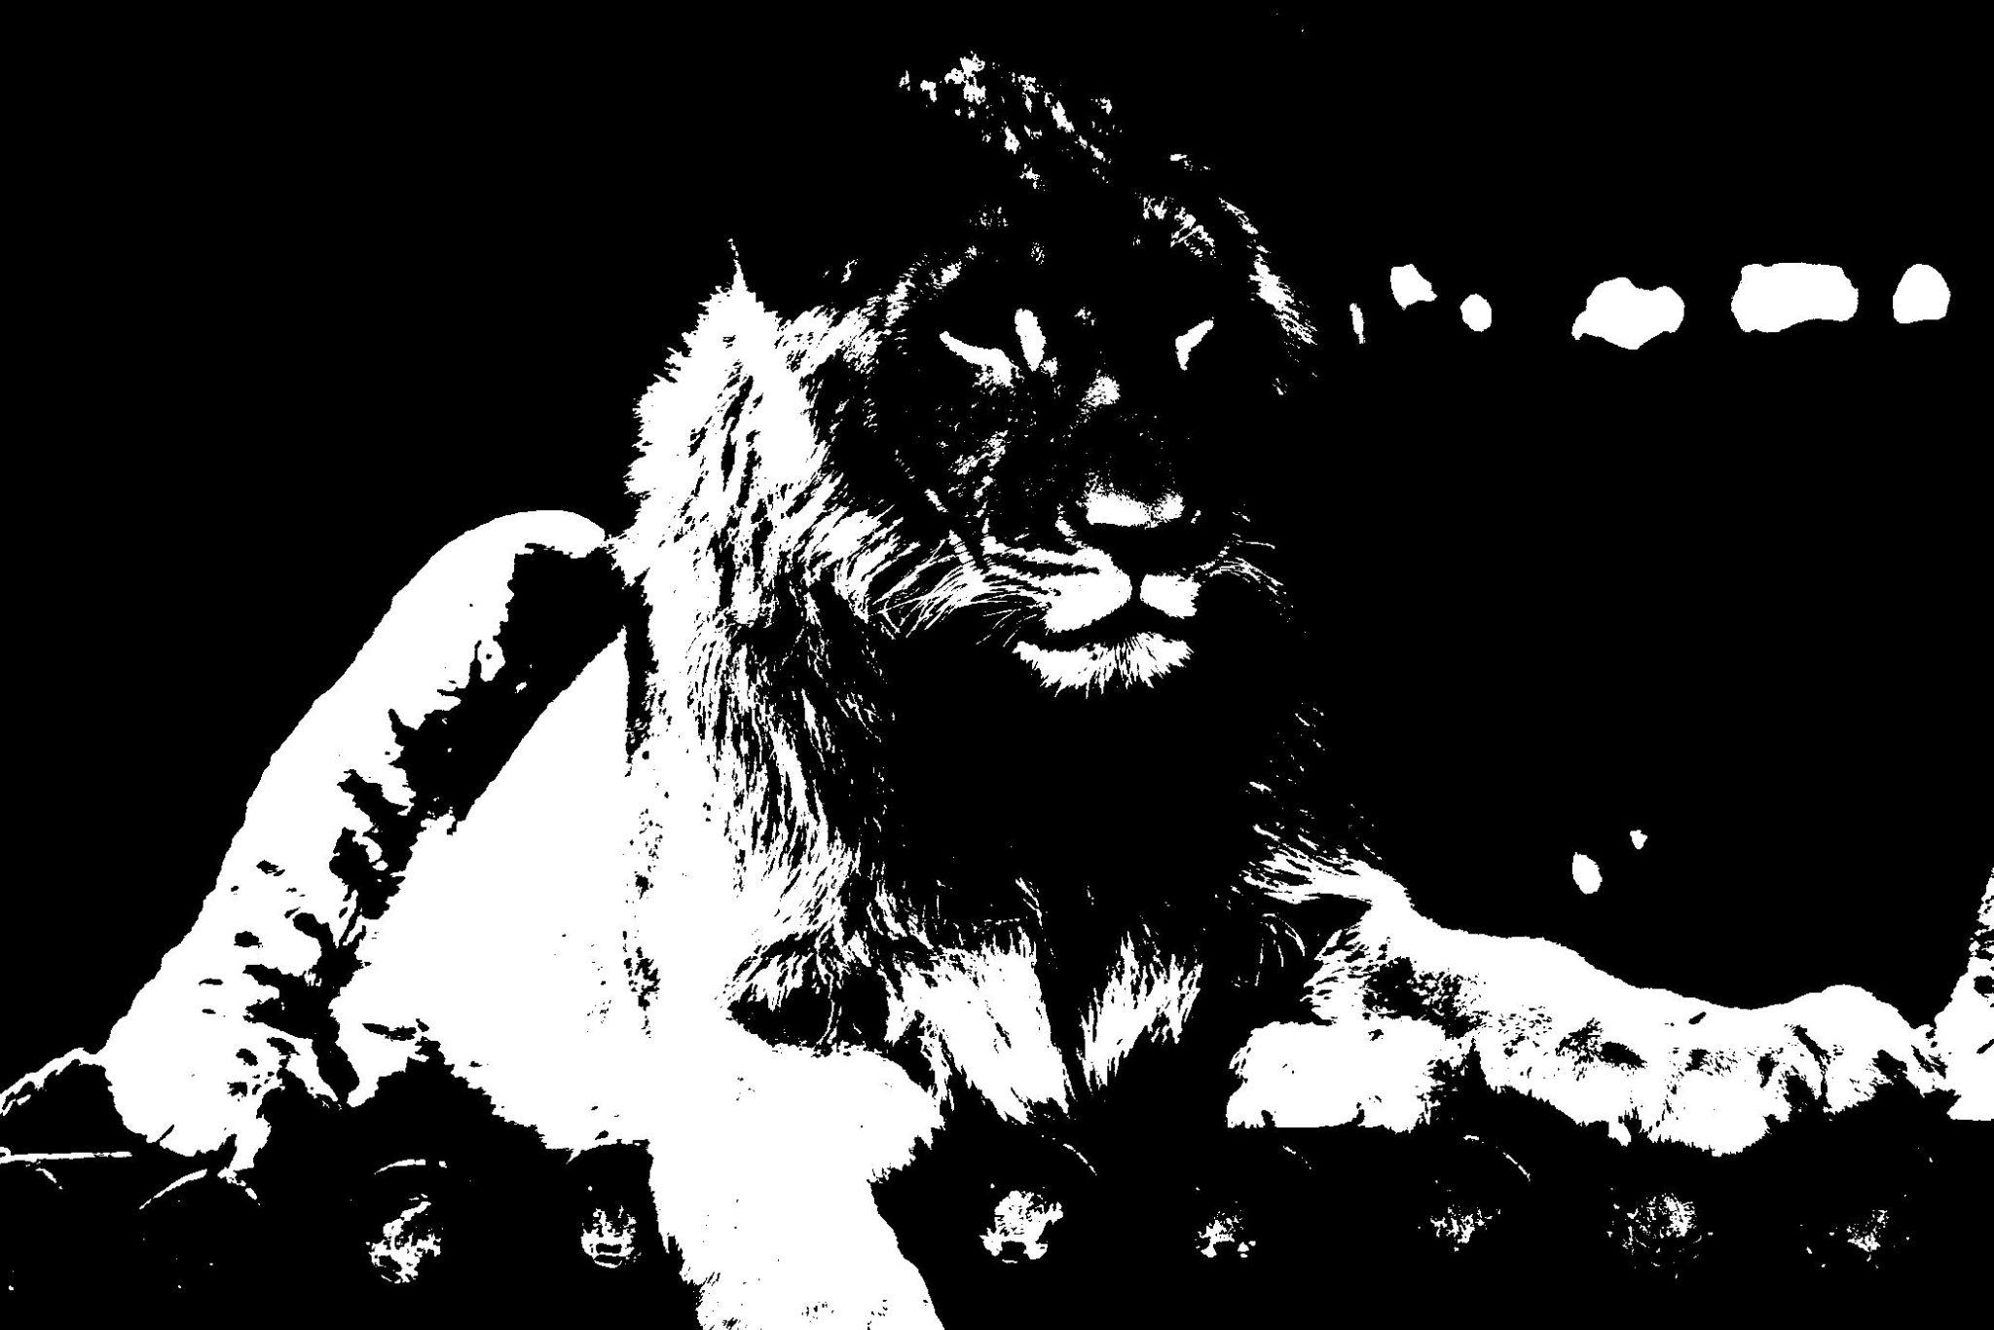
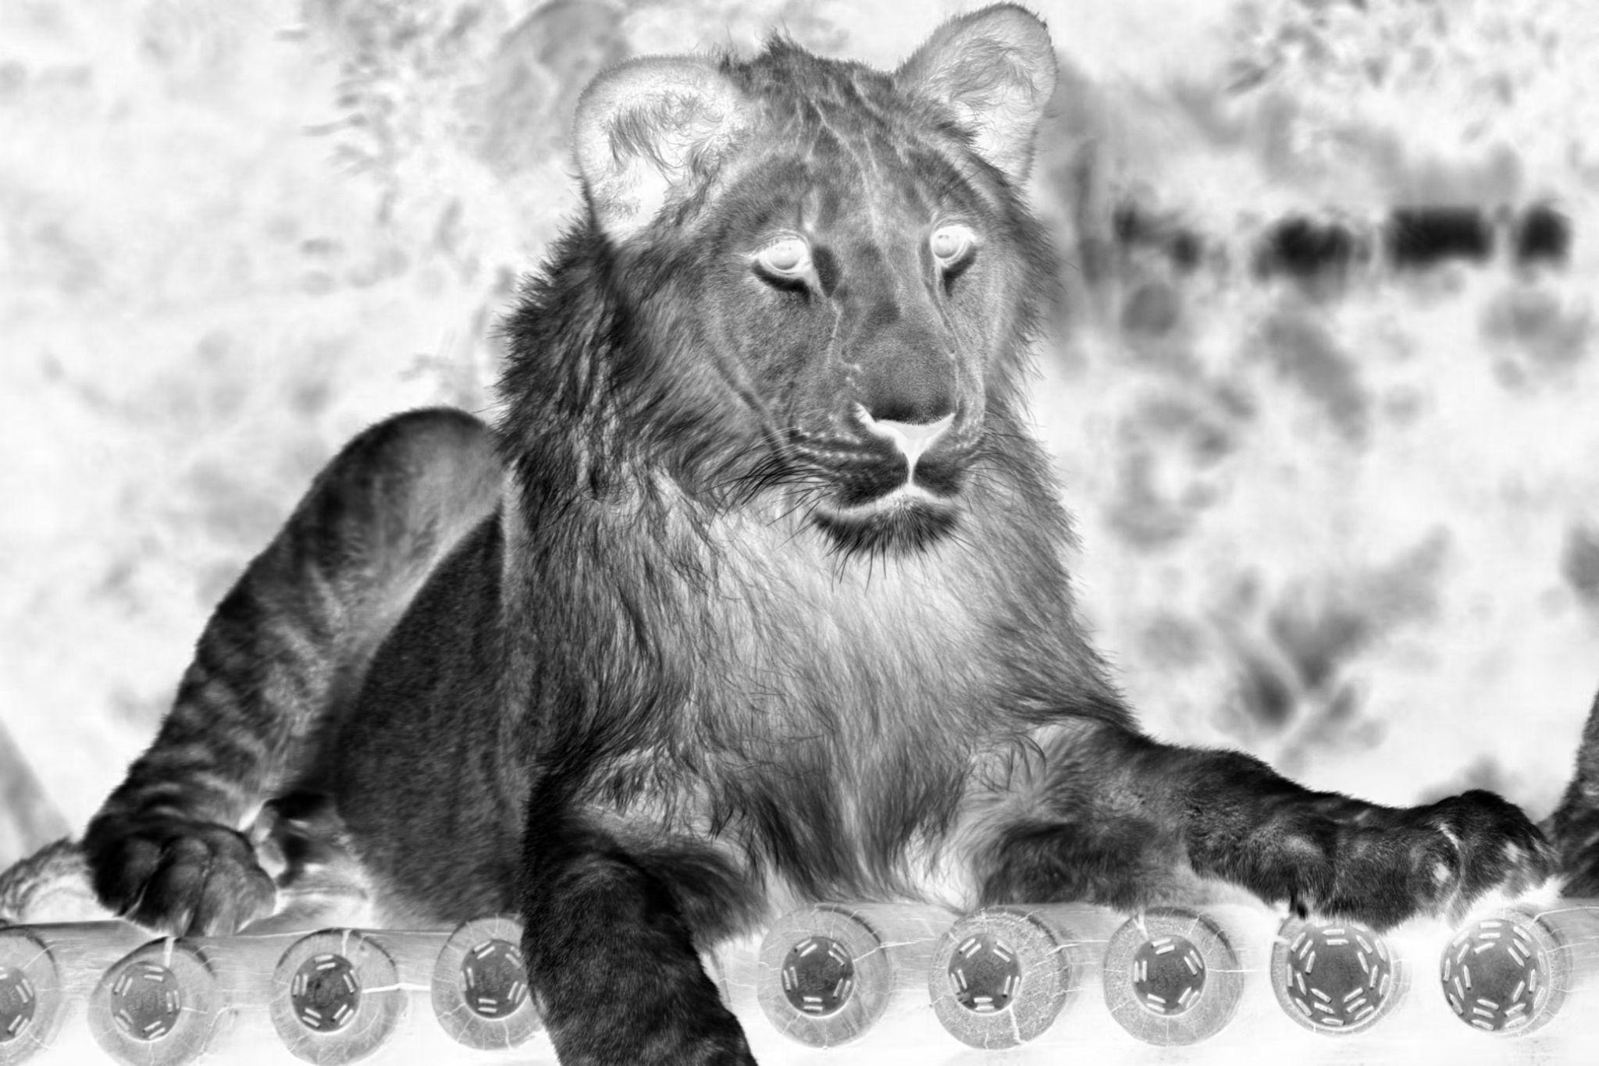
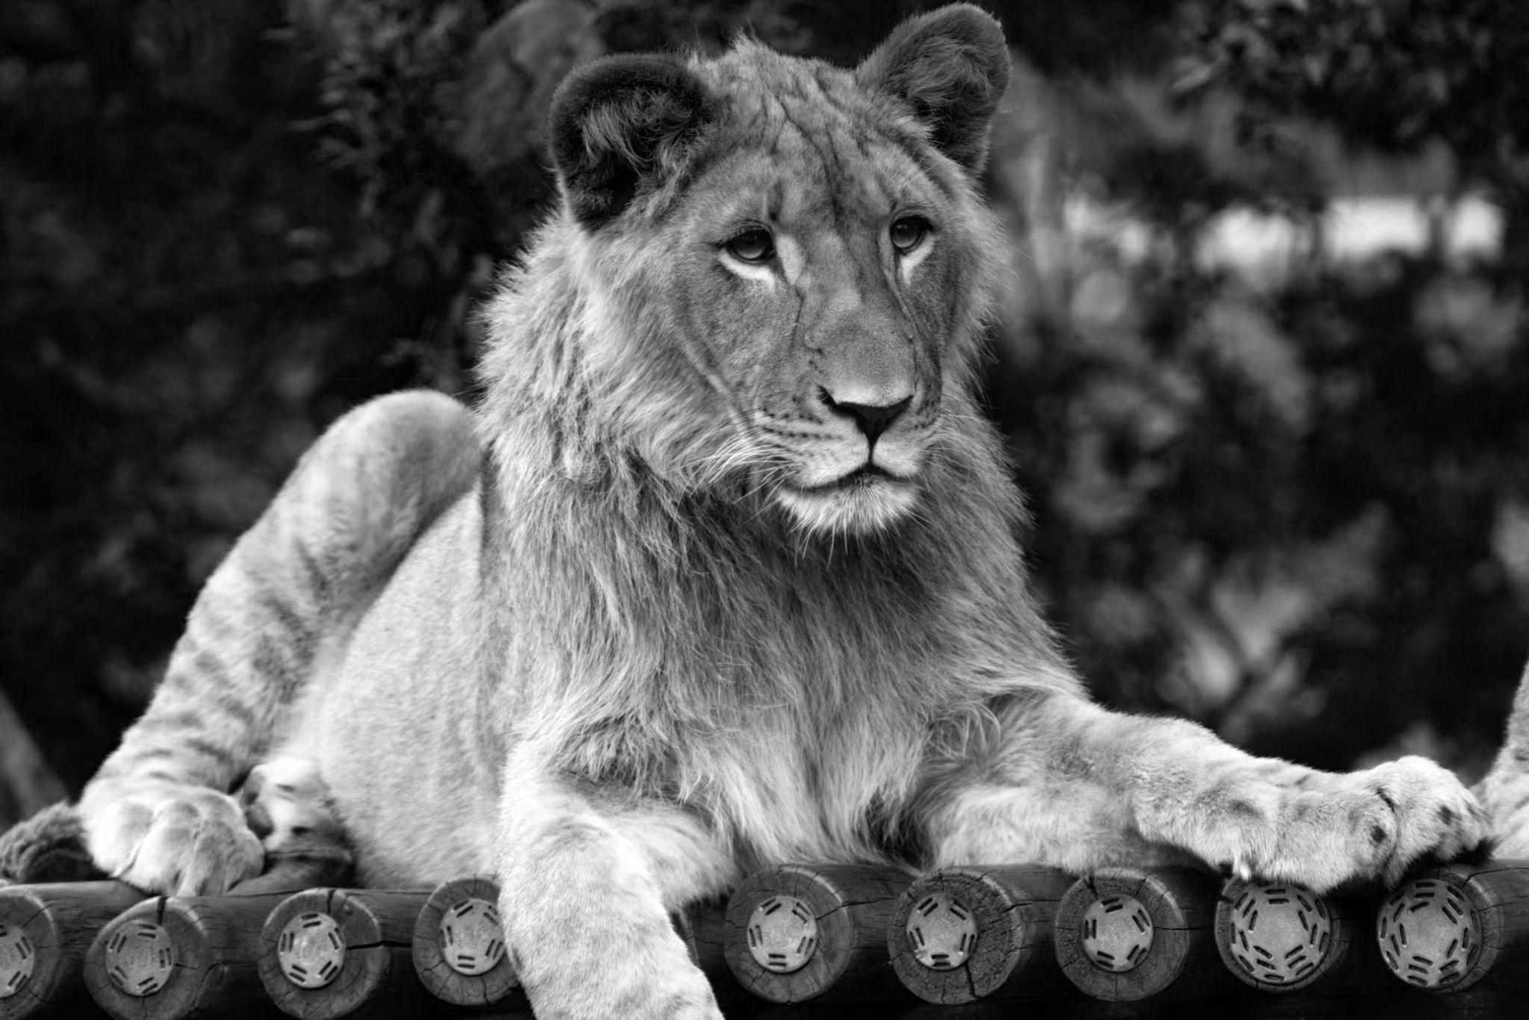
Problem 1b
Reference Masks
Channel Inversion Detection
If a channel has been inverted, difference smoothing is ineffective
Dynamic thresholds are calculated using μ and σ of the reference channels to make highlight and shadow masks
Corresponding masks are made for the manipulated channel using μ_{bad} and σ_{bad}
Flags inverted channels when dark areas in the good channels match bright areas in manipulated channels
Manipulated Channel Masks
Manipulated Channel & Corrected Channel
Once detected, simply flipping the values back restores the manipulated channel

Slide 9


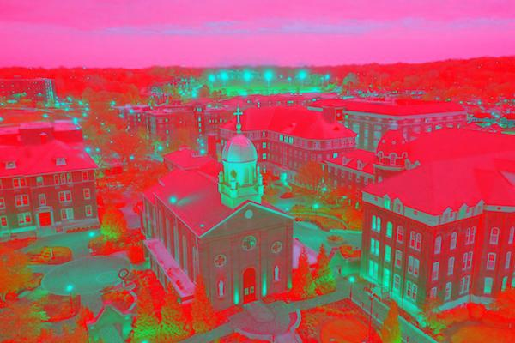

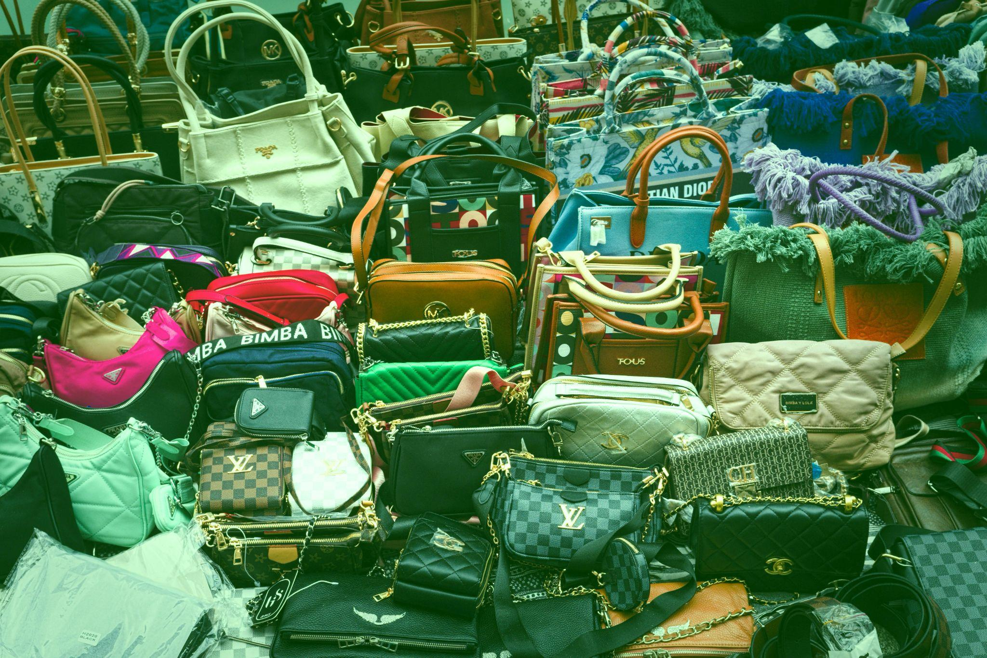
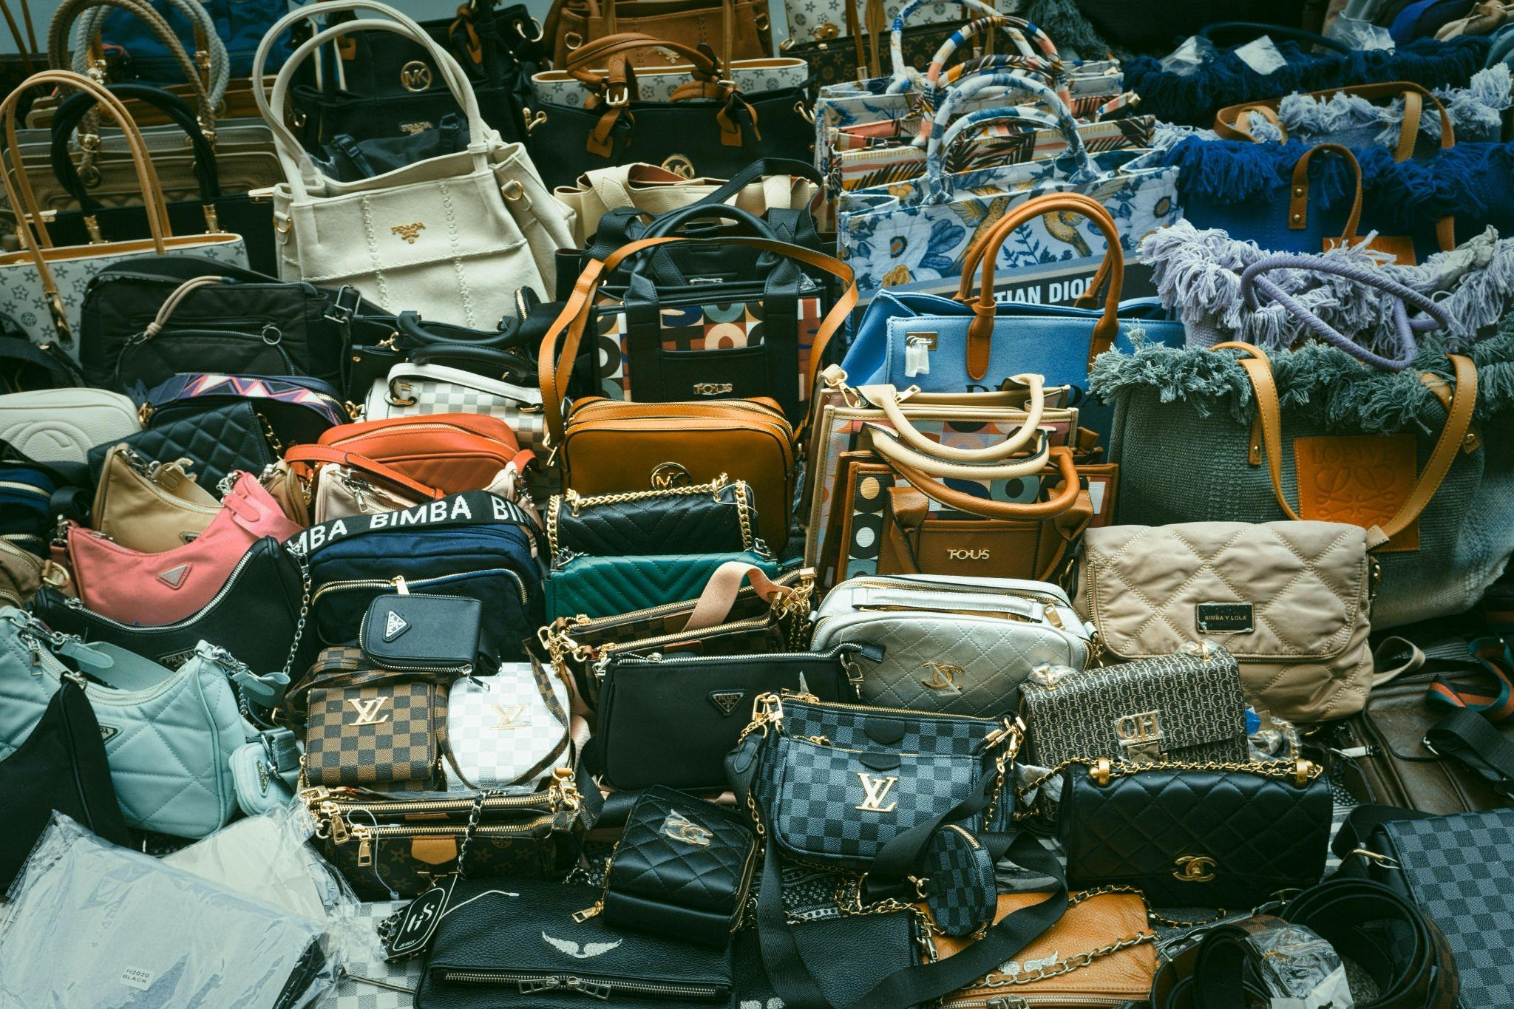
Restoration Results
Manipulated green channel of image 4, corrected channel
Image 1 constructed with manipulated (inverted) red channel, construction with corrected channel
Manipulated (inverted) blue channel of image 6, corrected channel
Image 3 constructed with manipulated green channel, construction with corrected channel

Slide 10
Problem 2
Reducing noise on depth maps using a bilateral filter and the associated RGB image - Challenges
Processing the RGB image in such a way that the program didn’t simply return it in varying shades of grayscale instead of the depth image
Ensuring that I appropriately applied the RGB kernels to the depth maps and not the other way around

Slide 11
Problem 2 Solutions
The solution to the first issue is to run each channel in the RGB image through the bilateral filter and use that to determine the kernel range for the depth maps
The solution for the second issue is to simply switch the RGD images and depth maps

Slide 12
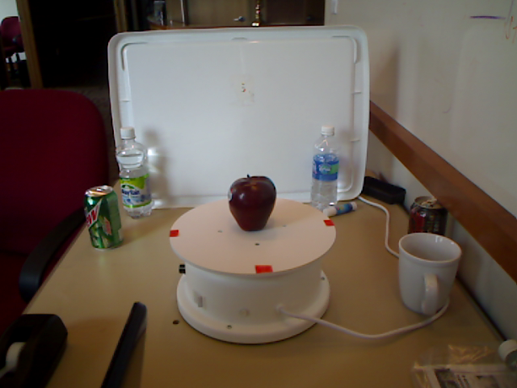

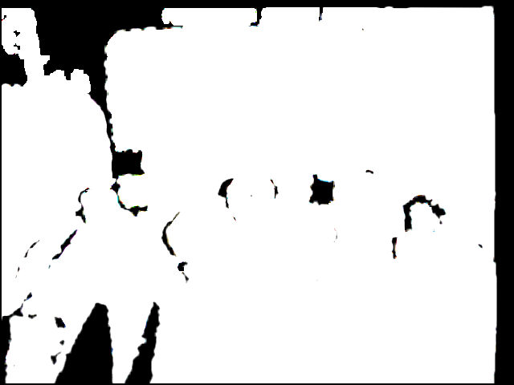
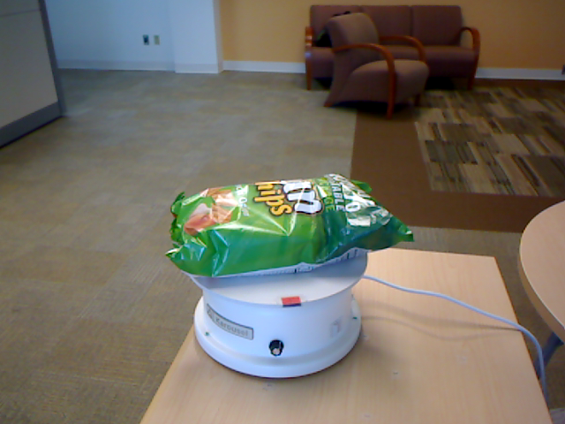

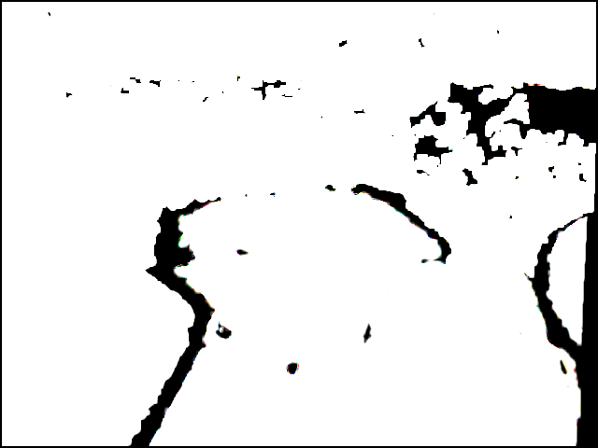
Problem 2 Results

