Slide 1
Super Awesome Processor A (SAPA) v1.0
TEAM 1A
Khaled Alfayez, Shaun Davis, Trinity Merrell, Logan Smith

Slide 2
Processor Specification
Architecture: Load-Store/Accumulator
Instruction Design:
C-Type – computation type
I-type – immediate type
L-type – leap type
Unique Features
Computation Register

Slide 3
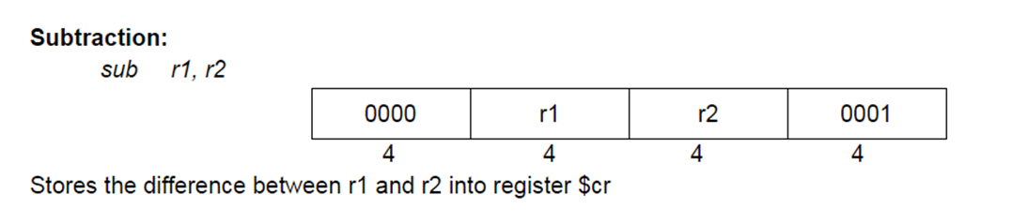
C-type Instructions
4-bit opcode
2 4-bit registers
4-bit function code

Slide 4
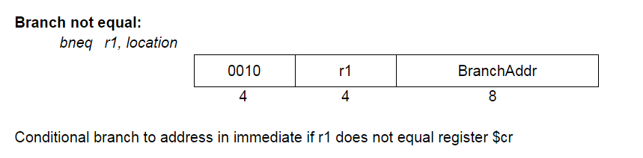
I-type Instructions
4-bit opcode
1 4-bit register
8-bit immediate

Slide 5
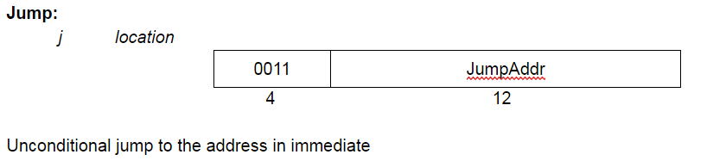
L-type Instructions
4-bit opcode
No registers
12-bit immediate

Slide 6
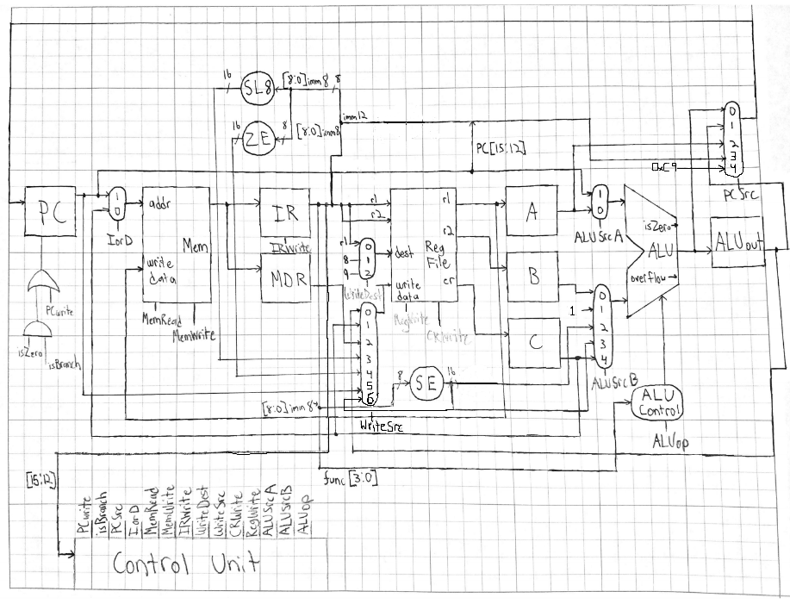
Datapath

