Slide 1
Super Awesome Processor A (SAPA) v1.0
TEAM 1A
Khaled Alfayez, Shaun Davis, Trinity Merrell, Logan Smith

Slide 2
Processor Specification
Architecture: Load-Store/Accumulator
Instruction Design:
C-Type – computation type
I-type – immediate type
L-type – leap type
Unique Features
A Computation Register that holds the last result from a C-type

Slide 3
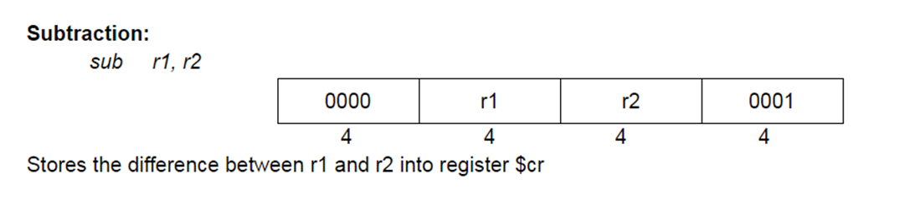
C-type Instructions
4-bit opcode
2 4-bit registers
4-bit function code
All results stored in computation
register
Example:

Slide 4
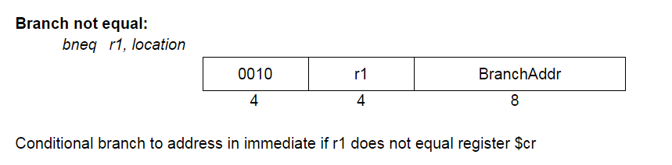
I-type Instructions
4-bit opcode
1 4-bit register
8-bit immediate
Branches use a previously computed
comparison value
Example:

Slide 5
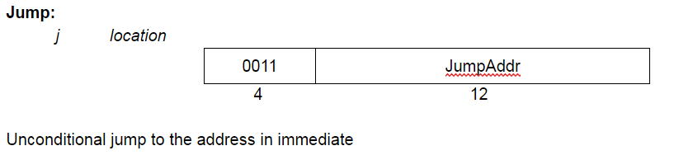
L-type Instructions
4-bit opcode
No registers
12-bit immediate
Example:

Slide 6
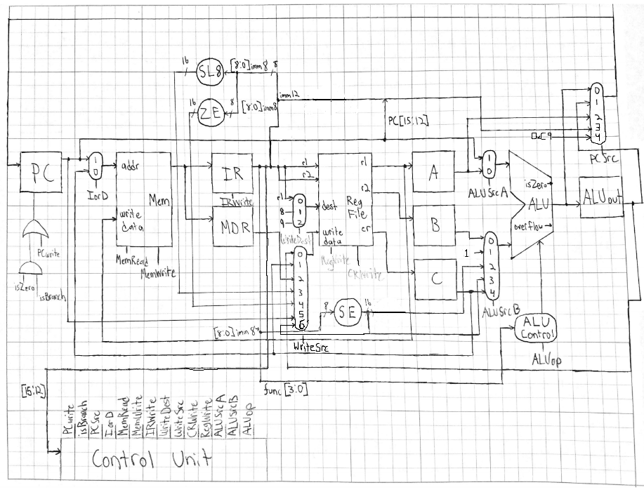
Datapath

Slide 7
Performance

Slide 8
Possible Changes to Our Design
Not all function codes are used and not all bits are used
Better utilize unused bits
Make it easier to manipulate numbers using the computation register
Add more pseudo-code to reduce code density

Slide 9
Design Challenges
Problems
Solutions
PC was being incremented one cycle late during branches and jumps
Working with a 10-bit memory unit provided some challenges to the integration step
Inserted a stall to align them
Edited the part for our needs after troubleshooting

Slide 10
Xilinx Challenges
Once the datapath was complete and working, it was diffulcult to find the data we needed for testing.
While developing the datapath, the files accidentally became corrupt and we had to start from scratch.
Updating schematics sometimes difficult and figuring out all the issues when starting to create the datapath took a little bit to solve

Slide 11
Interesting Aspects
The instructions are split up into numbers divisible by 4, so each instruction can easily be represented in hex
Branch comparisons are computed beforehand and accessed from the computation register during instructions that change PC
Load word/Store word memory addresses are computed beforehand and accessed from the computation register during memory access instructions

