Slide 1
home.ly
James Thompson
Nam Doan
Malcolm Gill
Merrick Heley
Chris Ponticello

Slide 2
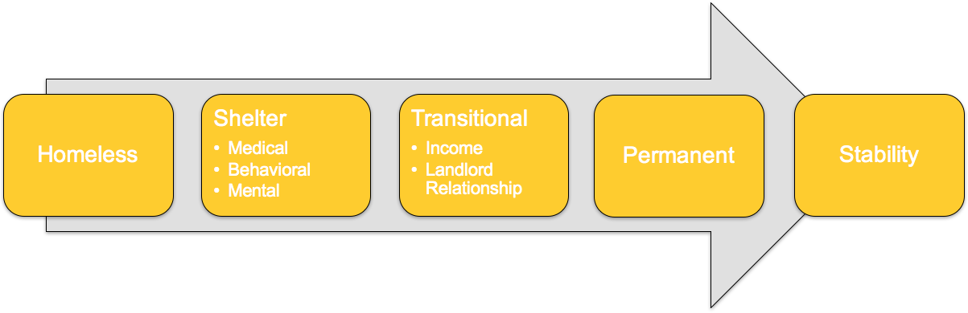
Problem
Homelessness
Strains public coffers with each homeless person costing ~$30,000 in support services (Zaretzky et al, 2013; ABC)
Limited access to support services due to transparency and service coordination issues (AHURI)
Negative reputation of social housing (Pindari)
Causes are broad
Zaretzky et al (2013) The cost of homelessness and the net benefit of homelessness programs: a national study p3
Australian Housing and Urban Research Institute (2011), Evidence for improving access to homelessness services p24

Slide 3
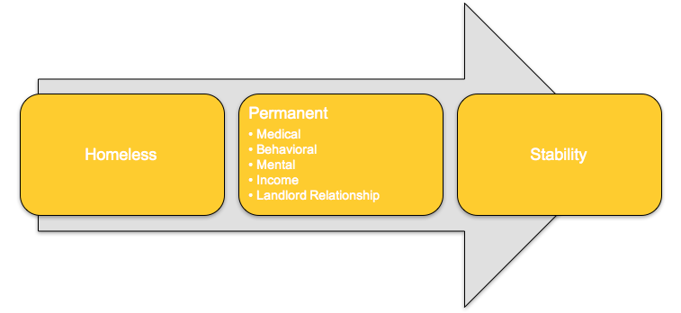
Opportunity
Housing First approach
Brisbane Negative Space
Vacancy rate approximately 3.3%

Slide 4
home.ly
Finding a homely solution to homelessness

Slide 5
Proposition
Provision of a rapid long-term housing first solution that disrupts traditional real estate models

Slide 6
Solution
Fast and efficient long-term housing
Social service integration
Emphasis on individual choice and agency

Slide 7
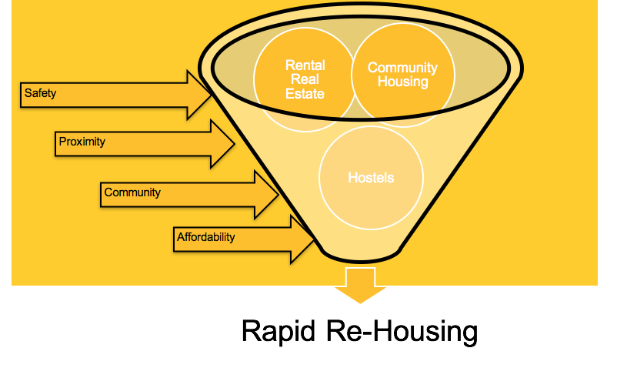
Medical - Behavioral -Mental - Income - Landlord Relationship
Support

Slide 8

WHAT WE’VE DONE SO FAR

Slide 9
The Outcome
People find permanent homes!
Save community money - 23k per year using shelters
Greater Housing Stability - 75% - 91% retention rate
Safety & dignity provided
http://www.endhomelessness.org/page/-/files/2016-04-26%20Housing%20First%20Fact%20Sheet.pdf

Slide 10
Target Market: Landlords
home.ly becomes the real estate agent
Saves money from fees $900 p/a ($165 Marketing, Lease Renewal 1 Week Rent, Releasing 2 Weeks Rent)
Trend towards taxing empty homes (AFR 2017)
Oversupply of dwellings predicted in near future
Case - Rapid Re-Housing Statewide: The Commonwealth of Virginia - 92% of families stayed in permanent housing
Notes:
http://www.afr.com/real-estate/residential/government-faces-tough-test-on-163m-property-vacancy-tax-plan-20170522-gwa7tv

Slide 11
Target Market: Homeless
Deliver on needs:
Homes are screened as safe
Information availability
Co-ordination of services
Agency
Dignity

Slide 12
We'll acquire customers by...
Word of mouth referral
Social services referral
Department for Housing Services
Targeted advertising on media platforms

Slide 13
Competition
HomeGround (VIC) real estate
Similar service provision catered to homelessness population
Difference: Does not possess or utilize technological platform
AskIzzy
Provision of a broad range of social services
Difference: Their focus is broad whilst our service will be tailored to rapid redeployment only

Slide 14
The Expert Team
Malcolm Gill
Chief whip cracker
Nam Doan
Legal consultant with healthcare expertise
James Thompson
Intern & Data Monkey
Merrick Heley
Lead Tech Intern
Chris Ponticello
Tech genius

Slide 15
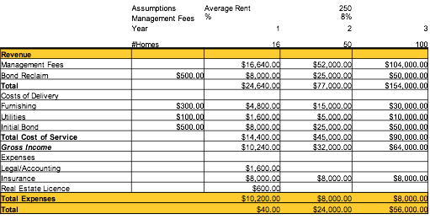
Financials
Assuming free manpower for ongoing development
Excludes philanthropy & Government Funds
Potential to engage PAFs/High net worth individuals if DGR 1 status
16 Homes rented to break even
Total Startup Cost for year one: approx $25,000 + developer cost

Slide 16
Next Steps
Further develop the platform
More questions & more choice
Build Landlord Network
16 Homes in 1st year
Develop Social Services/Charity Partner Networks

Slide 17
We are seeking
Capital - $25,000
Contacts
Legal
Acconting
Industry/Social Services
Real Estate

Slide 18
Thanks!
Any questions ?

