Slide 1

Introduction to R
1. Basics of R

Slide 2
What is R
R is a language and environment for statistical computing and graphics

Slide 3
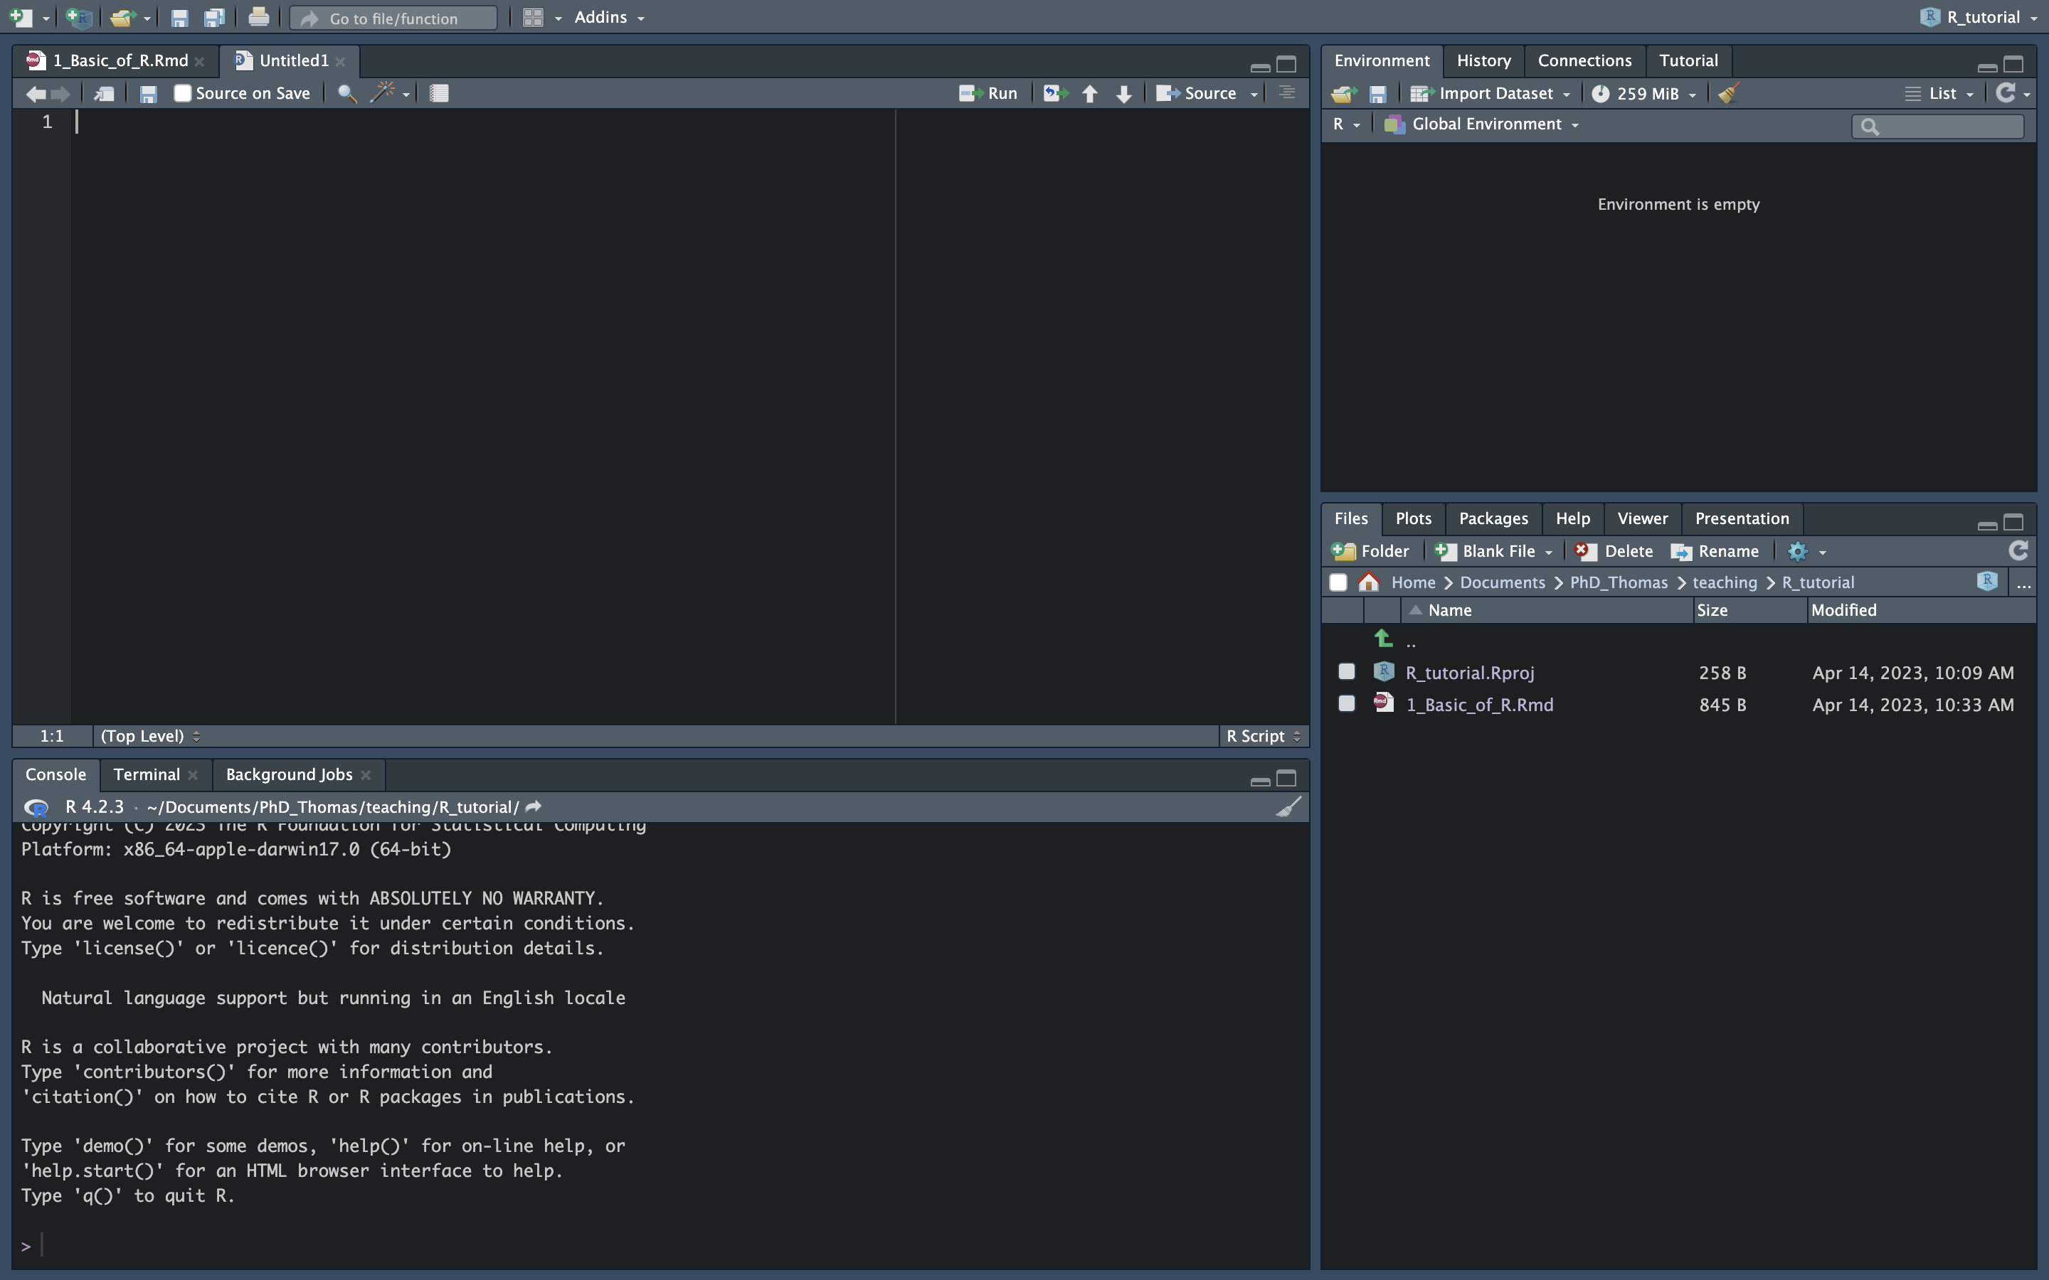
How does it looks like?
Environment
Script editor
Files’, plots’ and packages’ management pane
Consol and terminal

Slide 4
How does it looks like?

Slide 5
How does it looks like?

Slide 6
What is a package in R
It is a set of reusable functions.
It can also contain some data and a preset environment.

Slide 7
Let’s have a look at Rstudio

Slide 8
What are the data types in R
character (“a”, “hello”)
numeric (real or decimal) (“-2”, ”2”, “2.15”)
integer (“2”) → “2L” where the L tell R to store the number as an integer
logical (“TRUE”,”FALSE”)
complex (“1+4i”)

Slide 9
What are the different kinds of objects in R
atomic vector: vector of data → c(obj_1, … ,obj_n)
list: group together R objects → list(obj_1, … ,obj_n)
matrix: to store data in a 2-dimensional space → matrix(data, nrow = x, ncol = y)
array: to store data in n-dimensions –> array(data, dim = )
data frame: 2-dimensional version of lists → data.frame(name_obj1 = obj_1, … name_objn = obj_n)
factors: it is a vector where each values is a category and a hierarchy can exist between this categories → factor(data, level = [here you put a vector with your level in the order you wish])

Slide 10
How to create an object
Use “=“ or “<-” to assign a value to an object
Examples:
x <- 1
x = 1
Never use spaces in variable names!!! Better to use short meaningful names (but you can use long names)
Never use numbers only as variable names
a1 is ok
11 is not ok

Slide 11
Let’s have a look at Rstudio

Slide 12
How to explore your data
head(Your_data) #to see the first 5 rows of your data
tail(Your_data) #to see the last 5 rows of your data
summary(Your_data) #to get an overview of your data

Slide 13
How to do simple plots and histogram
plot(x = …, y = …) #to plot a graph with a x- and y-axis. You can specify use type = ”l” for plotting lines, type = ”p” for dots
hist(x=…, breaks =…) #To plot a simple histogram, in the x put the data you are interested in, for the breaks you can put the number of unit you want to see

Slide 14
Let’s have a look at Rstudio

Slide 15
How to do FOR and WHILE loops
If you want to iterate a calculation you can use loops
FOR loops if you want to do it a certain number of times
WHILE loops if you want to make it until a condition has been reached
for ([index] in [start]:[end]){
Do stg
}
while (condition){
Do stg
}

Slide 16
Example of FOR and WHILE loops
FOR loops if you want to do it a certain number of times
WHILE loops if you want to make it until a condition has been reached
for (i in 1:100){
a <- a+i
}
while (a+b < 100){
a <- a+1
b <- b+1
}

Slide 17
How to write a function
Function can be used to automate task. So, you don’t have to write everything again
To run it you then do:
sum <- function(a,b){ #a and b are your parameters that you will be able to change
return(a+b)
}
sum(a,b)

Slide 18
How to import data in R
Let say you want to open your data in R
read.delim(file = , #name and path to the file to open
header = , #does your file have header: TRUE or FALSE
sep = , #how are the different values separated: “,” or “;” etc.
dec = , #What symbol is used for decimals? “.” or “,”

Slide 19
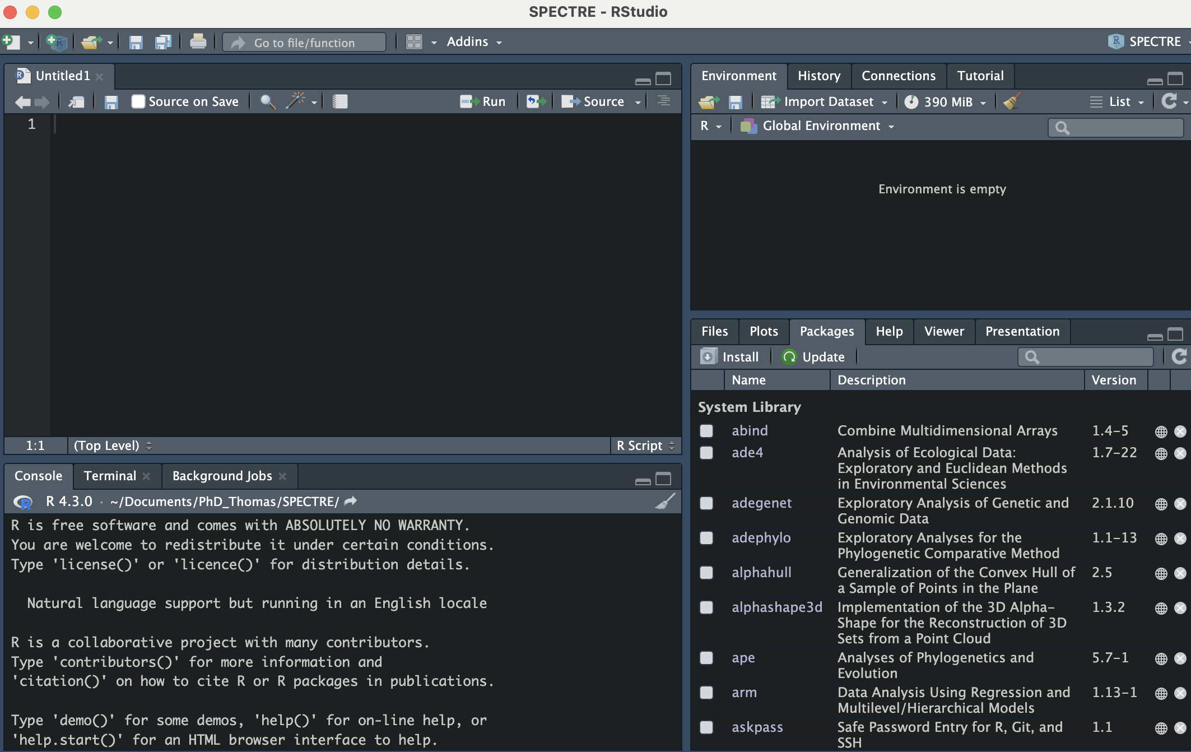
Installing R-Package

Slide 20
Installing R-packages
You can also do it directly from the console using this command
If you want to download from github:
install.packages(”package_name”)
devtools::install_github(”username/repo[/subdir]”)

Slide 21
Loading an R-package
You can import the whole package that way
Or just call the function you want in that package this way
library(”package_name”)
package_name::function()

Slide 22
Accessing the documentation
In the console you can type:
Or you can go directly in the help pannel and type the name of the function you want to check
?package_name::function()
?function()

Slide 23
Useful commands
setwd(dirname(rstudioapi::getActiveDocumentContext()$path))→ Set working directory to where your source file is located
getwd() → show your working directory
Sys.time() → to give you the time at the moment you execute this command. It helps to measure the time it takes for a function to run

