Slide 1


How important is it to account for spatial variation in growth for data-limited fisheries?
Merrill Rudd
FISH 507 Project
June 7, 2016

Slide 2
Need to make many assumptions about population processes when data and capacity are limited
90% of the world’s fisheries lack classical stock assessments, usually due to the fact that data and capacity are limited.
In capacity-limited situations, length measurements are often the easiest type of data to collect.
The assessment then involves making many assumptions about the spatial and time-varying population processes from which the length measurements arose to make inferences about stock status (e.g. proportion spawning stock biomass relative to an unfished state, fishing mortality rates, etc.).
Many stock assessments are assuming that fishing mortality and recruitment are relatively constant.

Slide 3
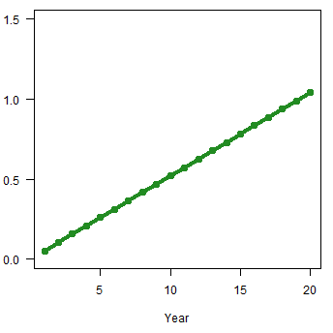
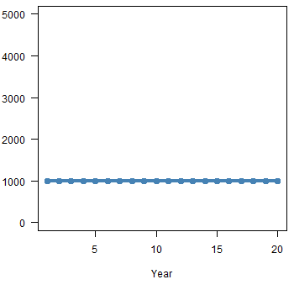
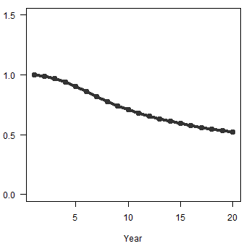
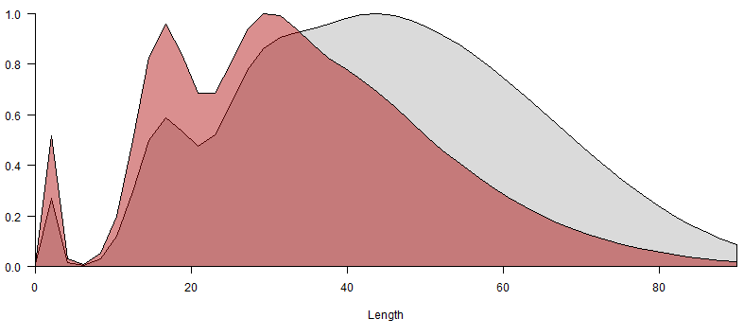
Time-variation More small fish relative to big fish: recruitment pulse or fishing mortality?
Fishing mortality
Recruitment
Mean Length
Length composition
Unfished length frequency
Fished length frequency
Year
Year
Year
Length bin
Notes:
But an issue with these equilibrium-based methods is that when you are only looking at mean length or length composition data, and you have more small fish relative to big fish, it is difficult to tease apart a recruitment pulse from increased fishing mortality.
This is just a toy example
As fishing mortality increases over time, and recruitment constant, mean length is expected to decrease as fishing mortality increases. The length composition as fishing mortality is increases is skewed left from the distribution in the unfished state.

Slide 4
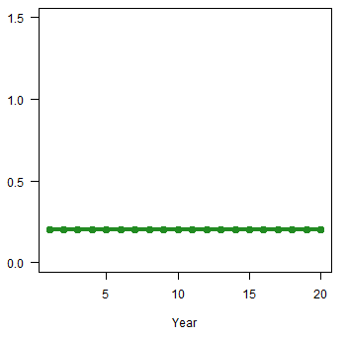
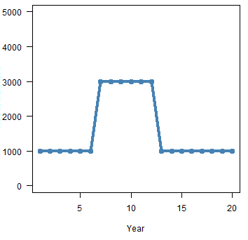
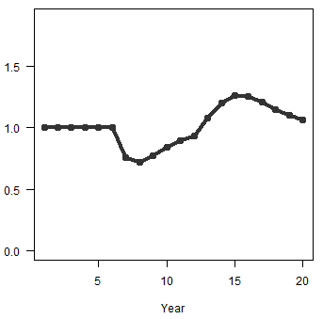
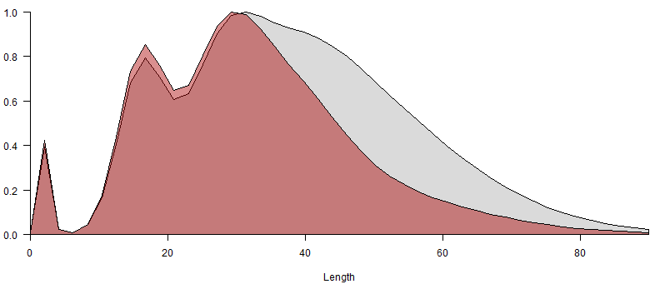
Time-variation More small fish relative to big fish: recruitment pulse or fishing mortality?
Fishing mortality
Recruitment
Mean Length
Length composition
Unfished length frequency
Fished length frequency
Similar effects on length frequency from recruitment pulse
Year
Year
Year
Length bin
Notes:
But when fishing mortality is constant and there is a recruitment pulse, mean length is expected to decrease (when there are many young individuals) and then increase (as they get older).
There are similar impacts to the length composition when there is a recruitment pulse as when there is increased fishing mortality.
So changing recruitment has its own impact on mean length and the length composition, independent of fishing mortality.

Slide 5
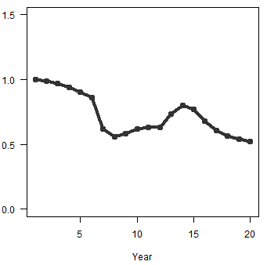
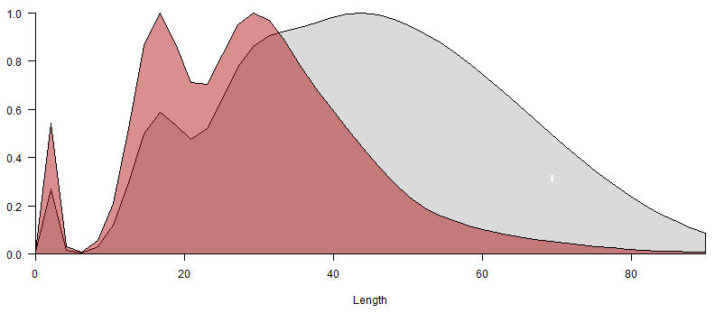
Time-variation More small fish relative to big fish: recruitment pulse or fishing mortality?
Fishing mortality
Recruitment
Mean Length
Length composition
Unfished length frequency
Fished length frequency
Similar effects on length frequency from recruitment pulse
Year
Year
Year
Length bin
Notes:
When there are both increases in fishing mortality and pulses in recruitment, they each impact the mean length and length composition.
Especially with variation in the system from environmental processes, these impacts can be very difficult to tease apart.

Slide 6
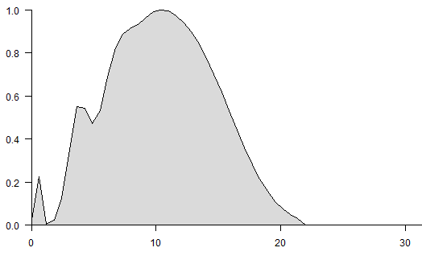
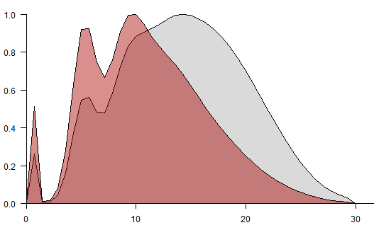
Space-variation Differences in growth between areas?
Unfished
Linf = 30 cm
All length-based assessment methods for data-limited fisheries assume that growth is constant across the harvested area
Coral reef fisheries – landings from one trip may come from many different reef areas
Proportion of lengths in vulnerable population
Fished
Linf = 35 cm
Length bin

Slide 7
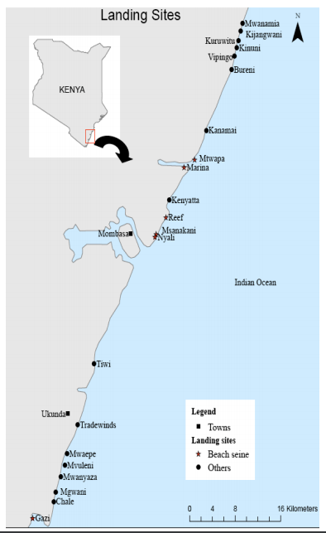
Kenyan coral reef fishery data
Wildlife Conservation Society
Length measurements at 23 landing sites
Approximately 21 data collection periods over 15 years
297 species in 77 taxonomic families
Plan: Estimate stock status for top 3 commercially valuable species (60% of catch)
But how important is it to account for spatial variation in growth for these species?
→ Test via simulation

Slide 8
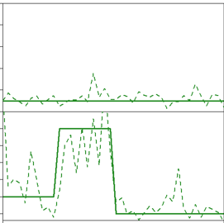
Operating model 1: No spatial process on asymptotic length
Create “true” population
Sample the “true” population
True fishing mortality
Age-structured dynamics
Length composition ~ growth (incl. variation), selectivity, abundance at age
True recruitment
Notes:
I then sample the true population to generate my data
From the underlying age-structured dynamics, I generate length composition data based on the assumed growth curve, which includes uncertainty in length-at-age,
The selectivity curve (the pattern at which fish are vulnerable to the gear),
And abundance at age that arises from the aforementioned processes and the true fishing mortality and recruitment

Slide 9
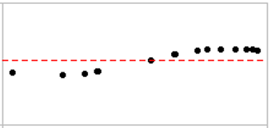
Operating model 2: Add 1D spatial process on asymptotic length
Create “true” population
Sample the “true” population
True fishing mortality
Age-structured dynamics by site
True recruitment
Length composition by site ~ growth by site, selectivity, abundance at age
Linf across sites
Pooled length composition across sites
Notes:
I then sample the true population to generate my data
From the underlying age-structured dynamics, I generate length composition data based on the assumed growth curve, which includes uncertainty in length-at-age,
The selectivity curve (the pattern at which fish are vulnerable to the gear),
And abundance at age that arises from the aforementioned processes and the true fishing mortality and recruitment

Slide 10
Estimation model: Assumes growth is constant across space & time
Create “true” population
Sample the “true” population
True fishing mortality
Age-structured dynamics
True recruitment
Length composition
Age-structured dynamics by site
Linf across sites
Pooled length composition
Estimation model – time-varying processes only
Inputs
Length composition
Assumed growth and maturity
Outputs
Average recruitment Annual fishing mortality
Recruitment variation Age at 50% selectivity
→ Derived reference point (SPR)
Notes:
I then apply the assessment method to those generated data
I want to emphasize these are the same data inputs as are required for the other equilibrium-based methods currently in use
The outputs of the estimation model are estimates of annual fishing mortality, age at 50% selectivity, and then the 2 parameters that describe the lognormal distribution from which recruitment could arise.
But the most important output of the estimation model is the derived reference point – spawning potential ratio (the ratio of lifetime egg production between the fished and unfished state)
This is derived from the underlying age-structured population dynamics
We then compare the estimated SPR with the true SPR in our known population to identify how accurate our assessment model is
And we iterate this process 200 times to identify whether the method would be accurate with lots of noise in the system
----------Integrating across possible values of the fixed effects to estimate the random effects – the variations in recruitment

Slide 11
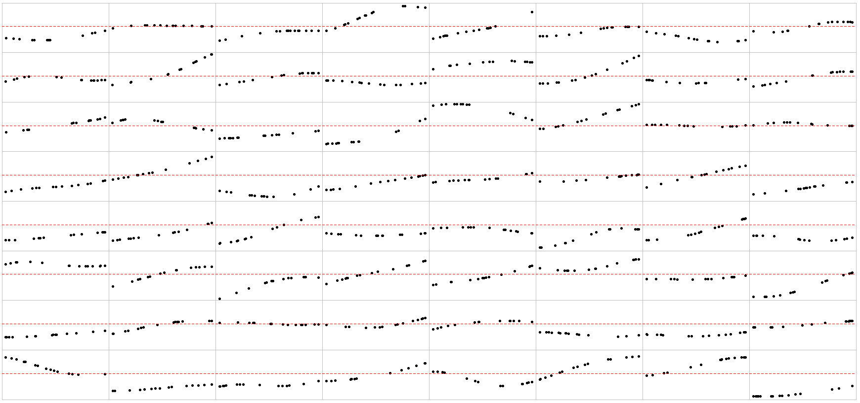
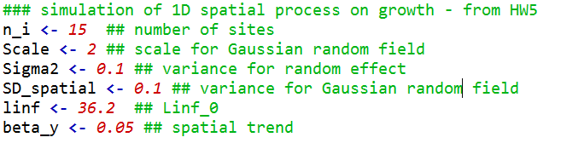
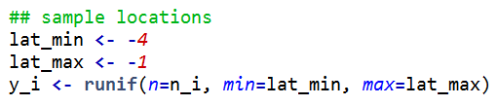
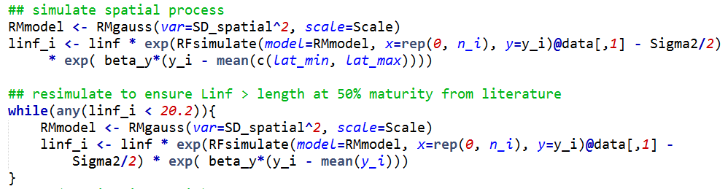
Simulated asymptotic length by site
Mimic Siganus sutor (FishBase)
Mimic Kenyan coastline
Check that no asymptotic length is less than length at maturity…

Slide 12
Simulated asymptotic length by site

Slide 13
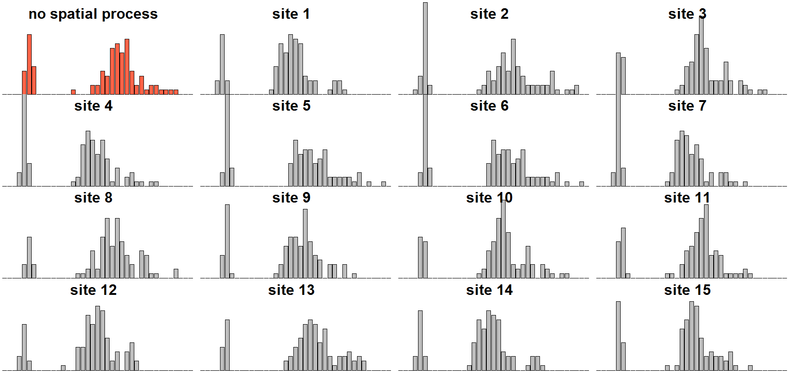
Example length composition by site

Slide 14
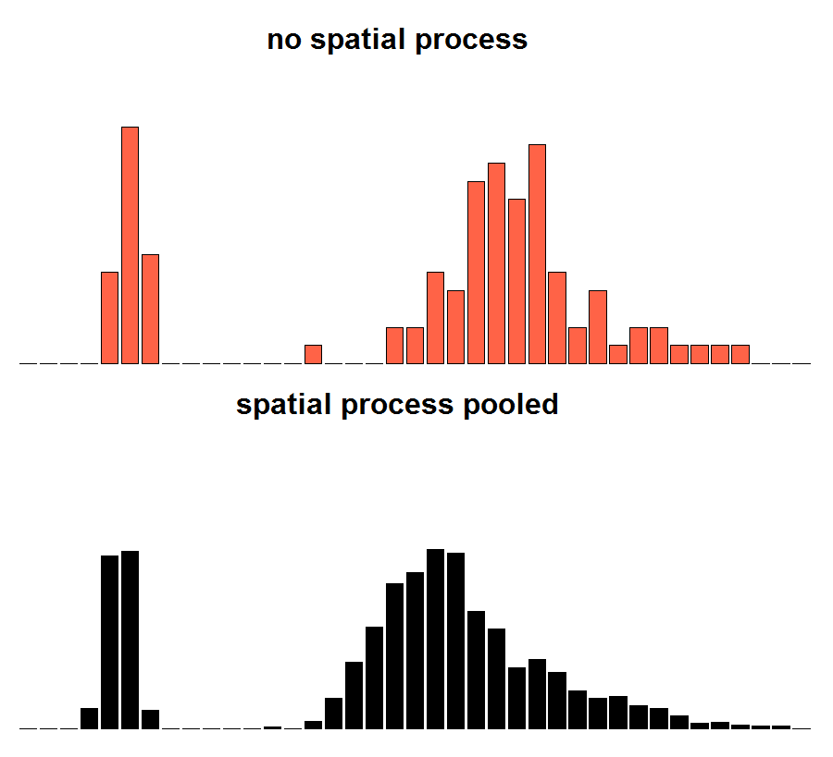

Slide 15
How important is it to account for spatial variation in growth for data-limited fisheries?
Failure to explicitly account for spatial variation in growth processes results in less certainty in our ability to accurately predict stock status with process error in the system.

Slide 16
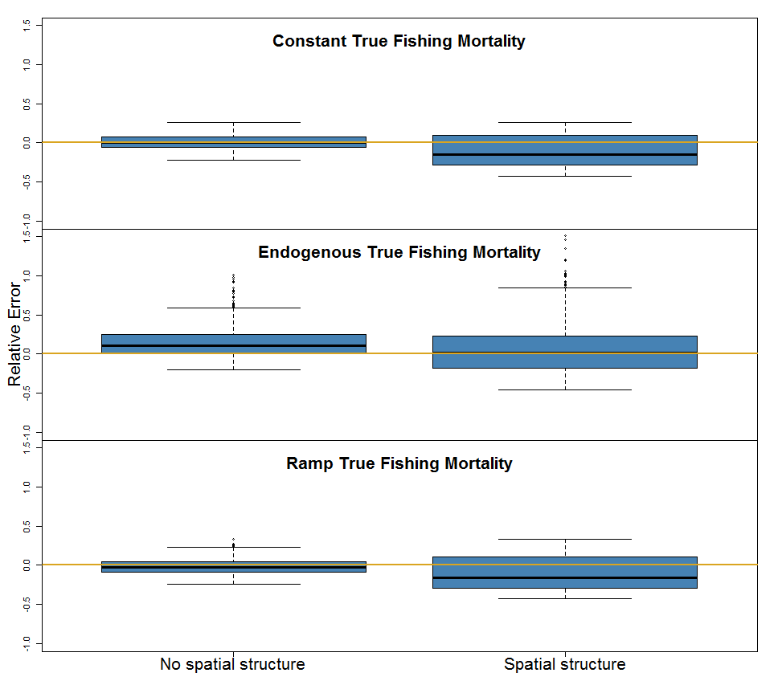
Relative error in spawning potential ratio reference point
SPR = ratio of total lifetime egg production given estimated fishing mortality in the most recent year to that in the unfished state
3 “true” fishing mortality patterns
1000 “true” populations (process error in recruitment, fishing mortality, and spatial asymptotic length)

Slide 17
How important is it to account for spatial variation in growth for data-limited fisheries?
Failure to explicitly account for spatial variation in growth processes results in less certainty in our ability to accurately predict stock status with process error in the system.
When asymptotic length is mis-specified and spatial variation is not accounted for, estimates of fishing mortality appear to be most impacted of any parameter.

Slide 18
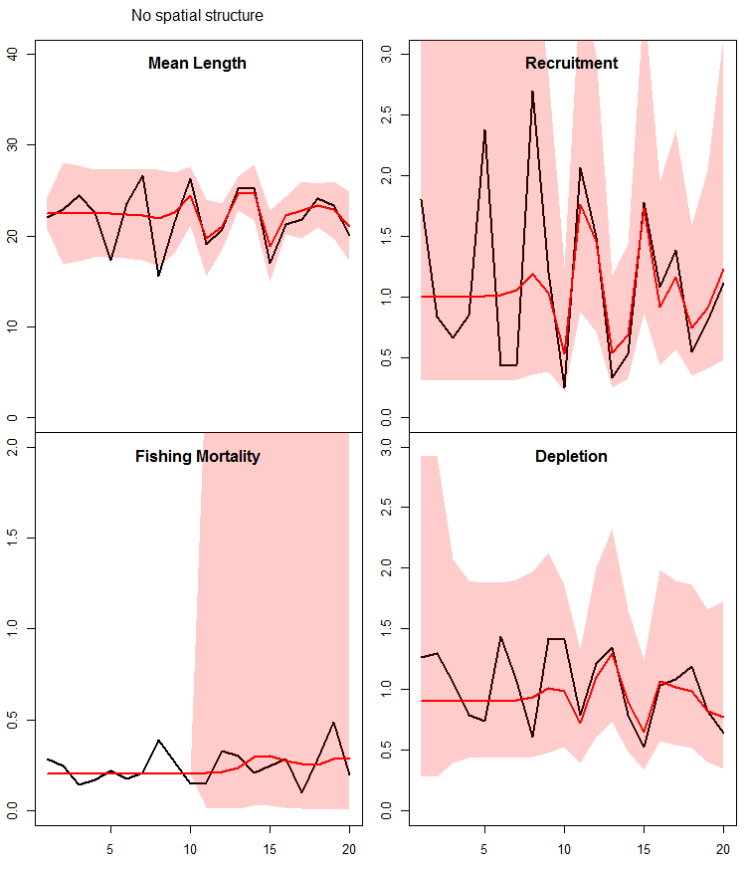
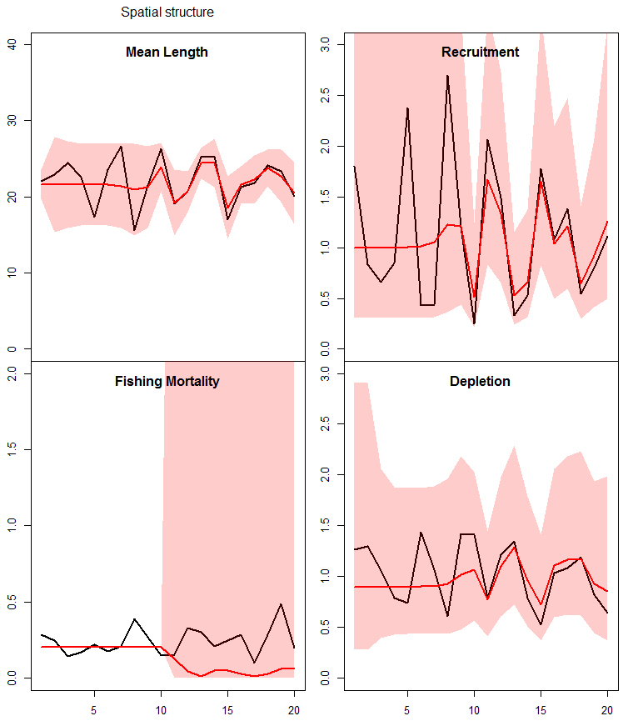
No spatial process
Spatial process pooled
Spatial Linf

Slide 19
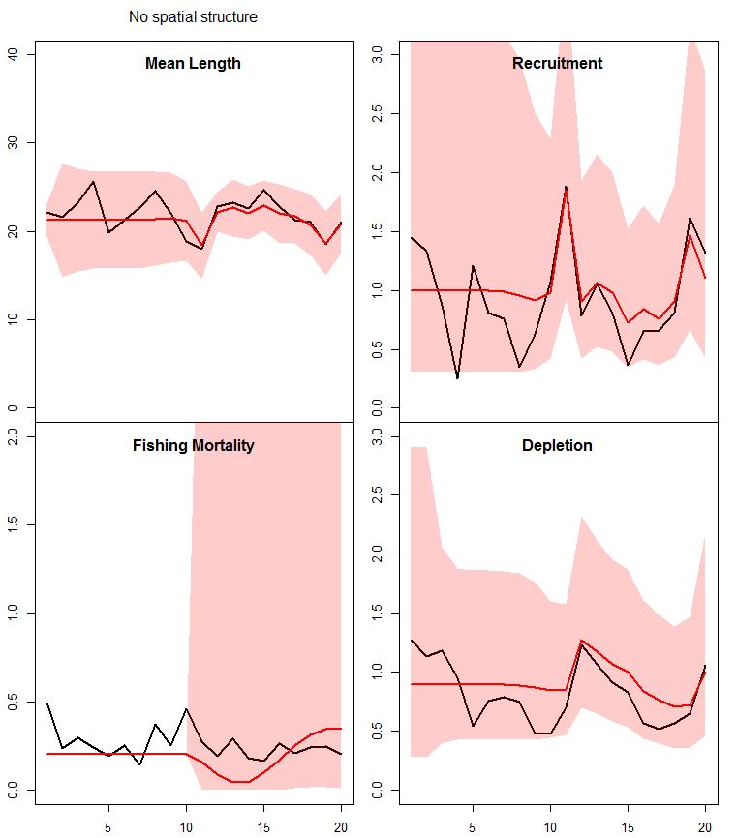
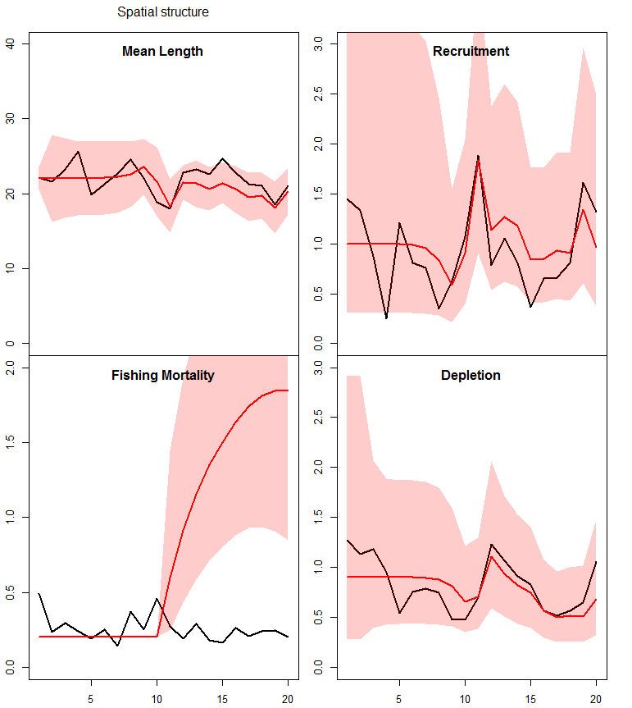
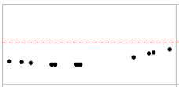
No spatial process
Spatial process pooled
Spatial Linf

Slide 20
Conclusions
I should consider the possibility of a variable growth process along the Kenyan coast when deciding how to pool the length composition data to have more certainty that stock status estimates are accurate.
BUT the ability to estimate the SPR reference point is still relatively unbiased (e.g. fishing mortality is only over-estimated drastically for some “true” populations, not all).
Added bonus of this project: Can now continue testing on length-based data-limited assessment methods with a more complex operating model.

Slide 21

Next steps
Is it more important to account for time-varying recruitment, time-varying fishing mortality, or space-varying growth when relying mostly on length composition data for stock assessment?
Add random effect on asymptotic length across sites to estimation model as an option
Options for estimation model:
Fishing mortality: estimate annual fishing mortality OR single value mean-length mortality estimator
Recruitment: estimate random effects across time OR assume static stock-recruit curve
Asymptotic length: fix asymptotic length OR estimate random effects across space
y$(i)\sim g(μ)$
$$μ=Xβ+ε_{s}$$
$$ε_{s}\sim Normal(0,σ_{ε}^{2})$$
(Would need to fix β)

Slide 22
Operating model Age-converted to length-structured population dynamics
Abundance
Maturity
Growth
Fast-growing:
k = 0.2
L∞ = 30 cm
M = 0.37
Amax = 13
(Williams and Shertzer 2003)
(Hordyk et al. 2015)
Mortality
Selectivity

Slide 23
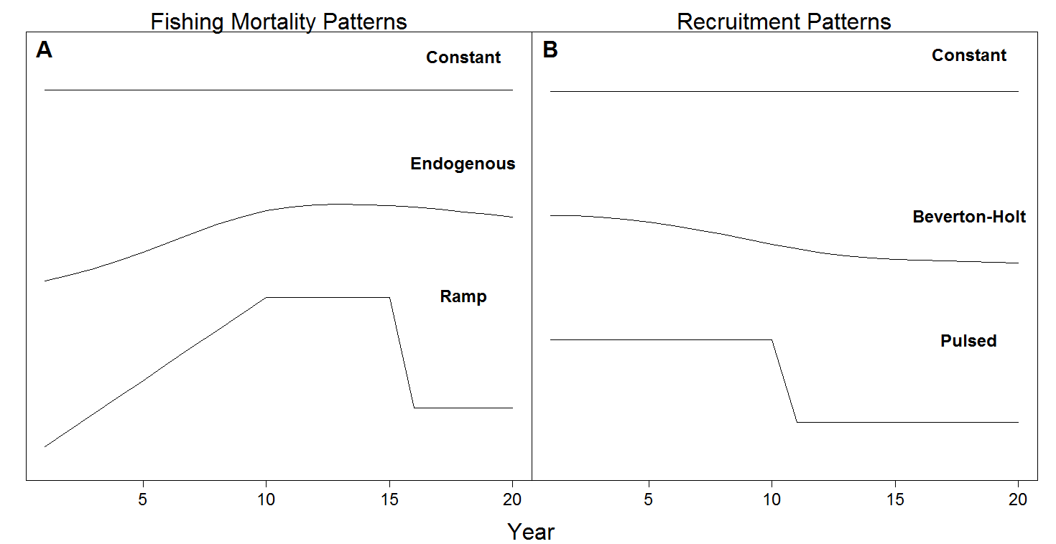
Operating model – fishing and recruitment dynamics
Notes:
Effort dynamics model from Thorson et al. 2013 that is based on biomass at equilibrium, acceleration rate, an initial fishing mortality – to generate stochastic realizations of fishery development with an equilibrium value around 25% of unfished biomass

Slide 24
Operating model – generating length composition
Probability of being in a length bin given age
Probability of harvesting in a given length bin
Probability of sampling a given length bin
Notes:
Check other notation

Slide 25
Estimation model – implemented using Template Model Builder
Inputs
Fixed parameters
Von Bertalanffy Linf and k
Maturity curve
Natural mortality
CV for length-at-age
CV for observed catch and index
Data inputs
Length composition
Catch time series
Abundance index time series
Outputs
Estimated
Annual fishing mortality (fixed effect)
Global mean recruitment
Random effects on annual recruitment
Recruitment variation (σ_{R})
Catchability coefficient
Logistic selectivity parameters
Performance measure
- SPR
Notes:
Options to estimate annual fishing mortality as a fixed effect – informed by catch data, length composition since it arises from the predicted catch
Recruitment as a random effect
Meaning it estimates global mean recruitment and then the random effects for the annual variability in recruitment
Also a standard deviation representing the recruitment variation
Gets information from length composition
Catchability coefficient when an index is available
And the parameters for a logistic selectivity curve
End goal – derive a value for spawning potential ratio
Looking for ability to detect depletion

Slide 26
Estimation model – age- converted to length-structured
Recruitment
Abundance
Mortality
Selectivity
(Methot and Taylor 2011)
Notes:
The selectivity parameters are set up to be estimated, and then the mortality is based on the estimated fishing mortality and derived catch

Slide 27
Estimation model – maximum penalized likelihood
TMB

Slide 28
Estimation model – maximum penalized likelihood
TMB
Penalty on fishing mortality
Notes:
Penalty on fishing mortality was useful in the very data poor scenarios to keep the estimated fishing mortality from dropping to 0

