Slide 1
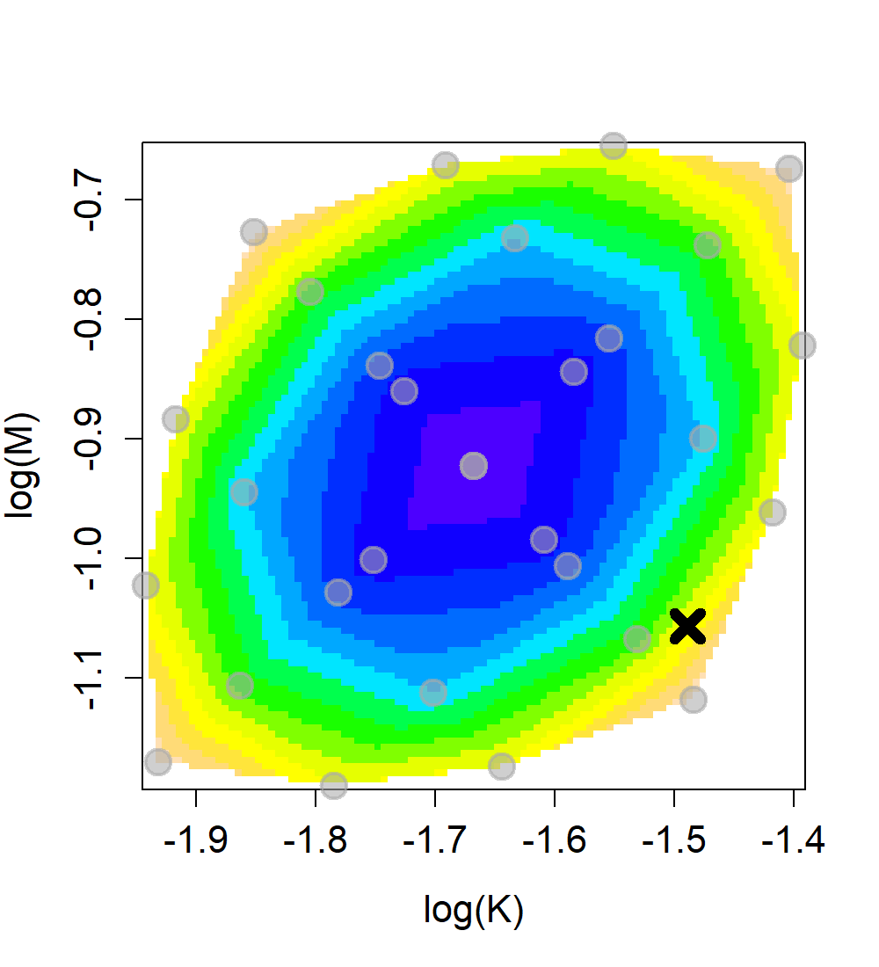
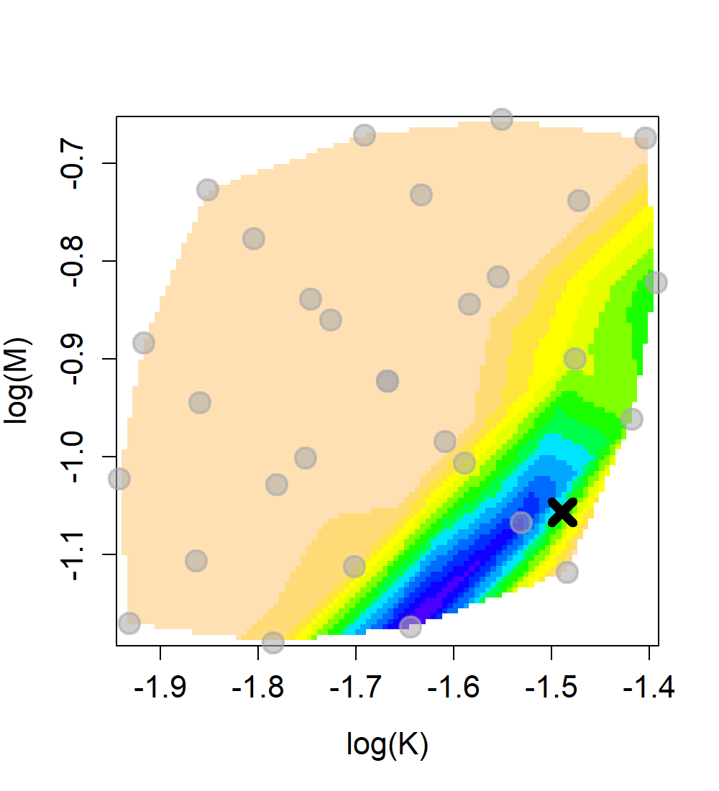
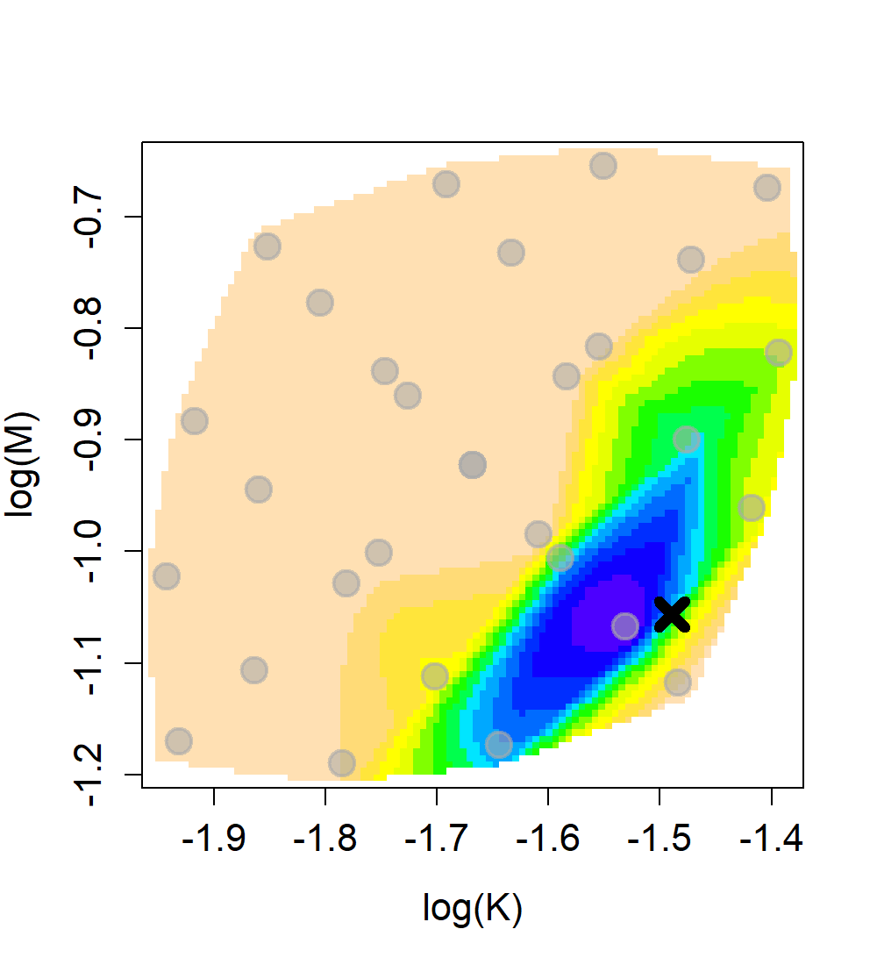
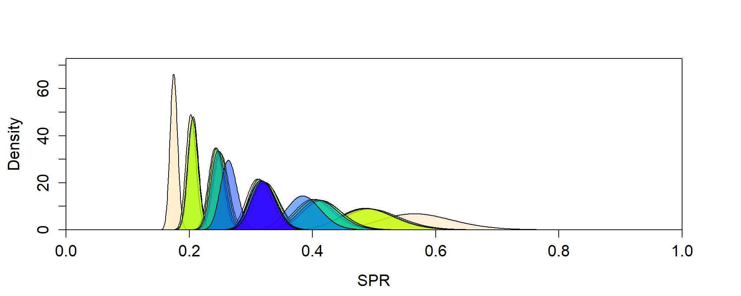
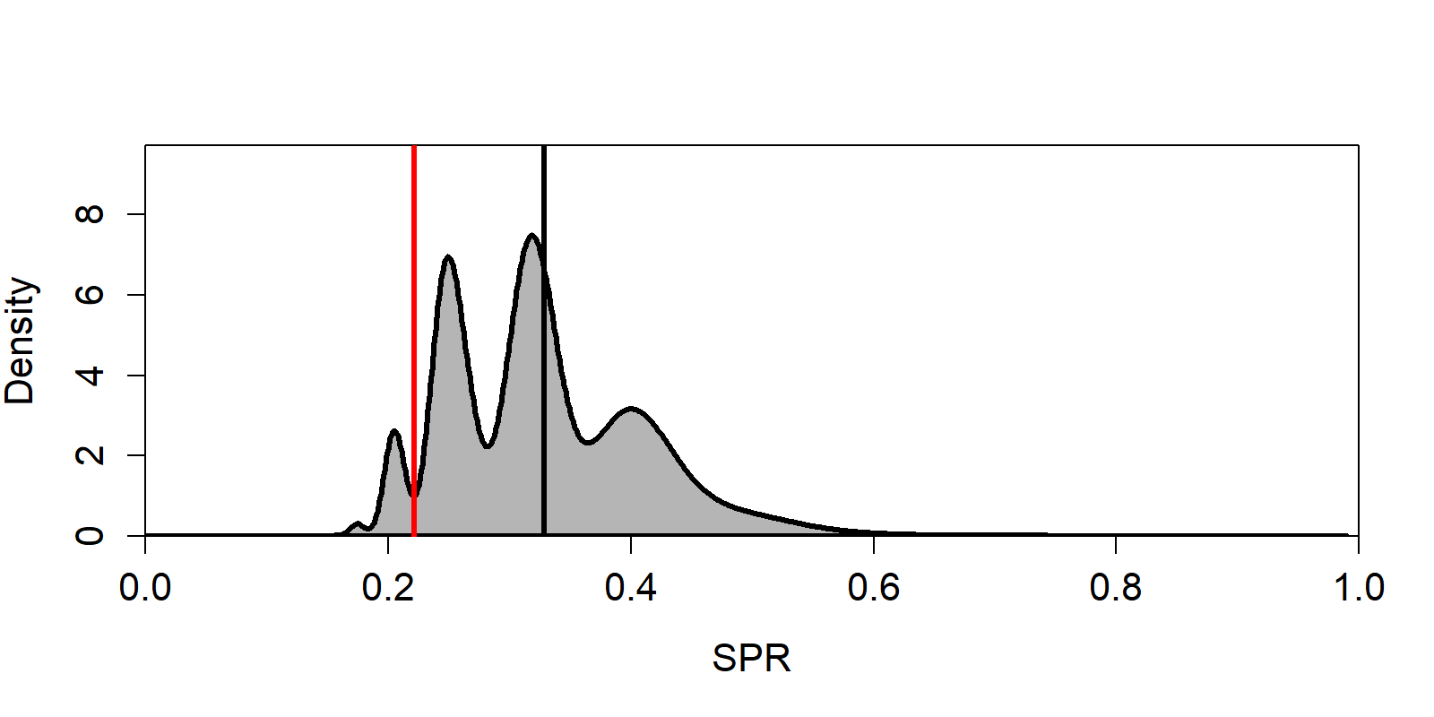




$$∗$$
$$≈$$
Multivariate normal PDF weights interpolated across nodes j
Density of assessment function (e.g. SPR @ True)
Weighted densities of assessment function (e.g. SPR @ True)
A
B
C
$$\sum_{j=1}^{J}{}$$
Results of predictive stacking: weighted nodal densities
Density_{j} * weight_{j}
D
E
$$=$$

