Slide 1
Updated natural mortality rate estimates using acoustic telemetry data – adults (>1250mm FL)
Potential figures and tables

Slide 2
Data exploration

Slide 3
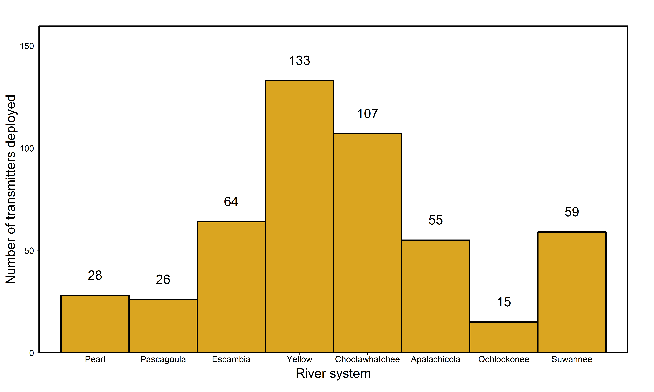
Total number of transmitters deployed in adults in each river

Slide 4
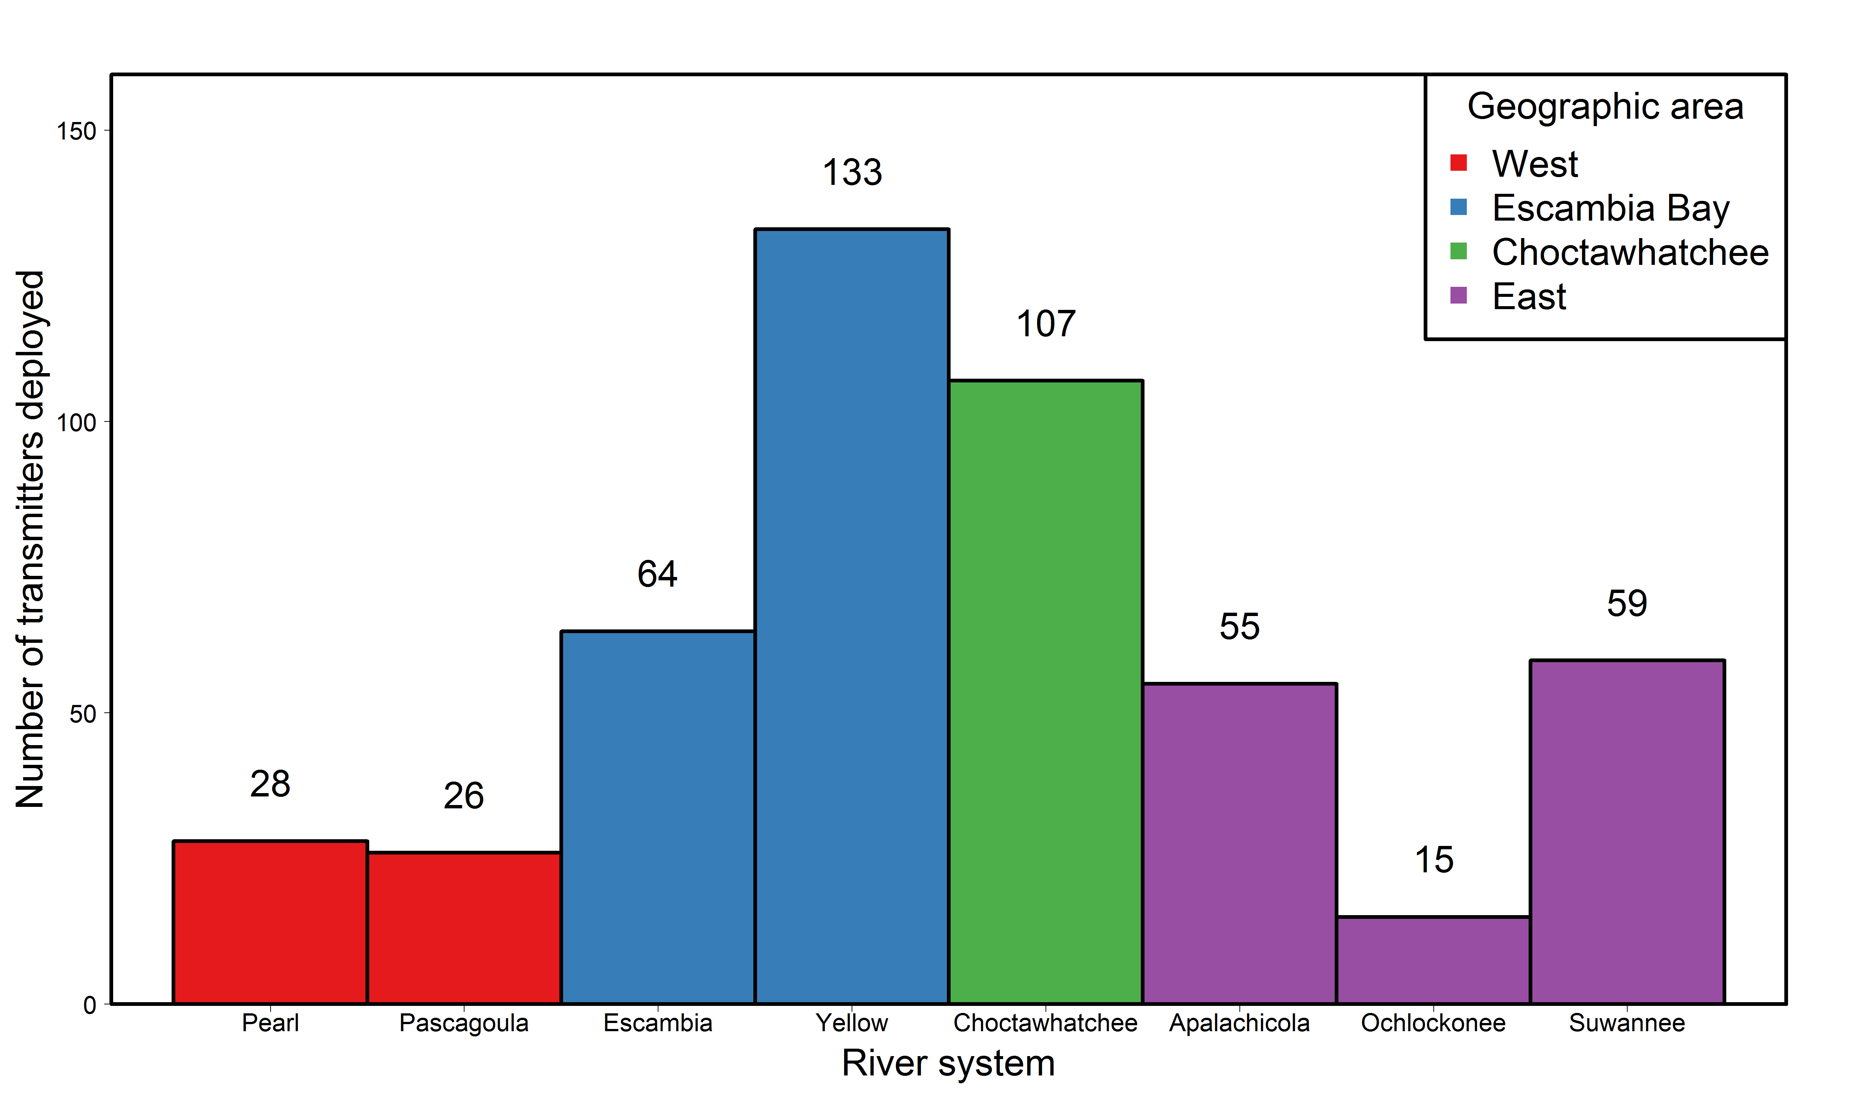
Total number of transmitters deployed in adults in each river,
categorized by geographic area

Slide 5
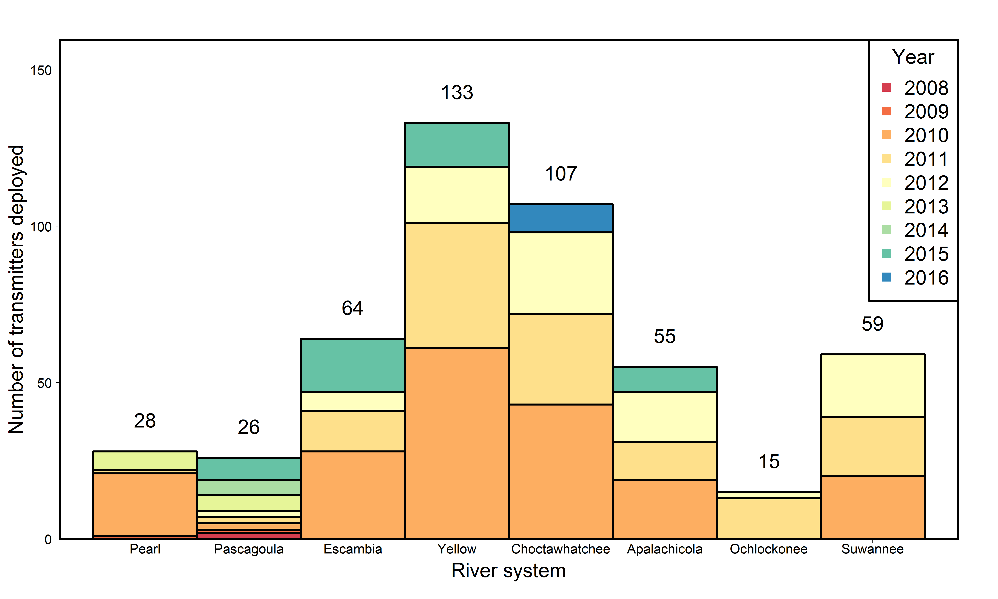
Total number of transmitters deployed in adults
in each river by year

Slide 6
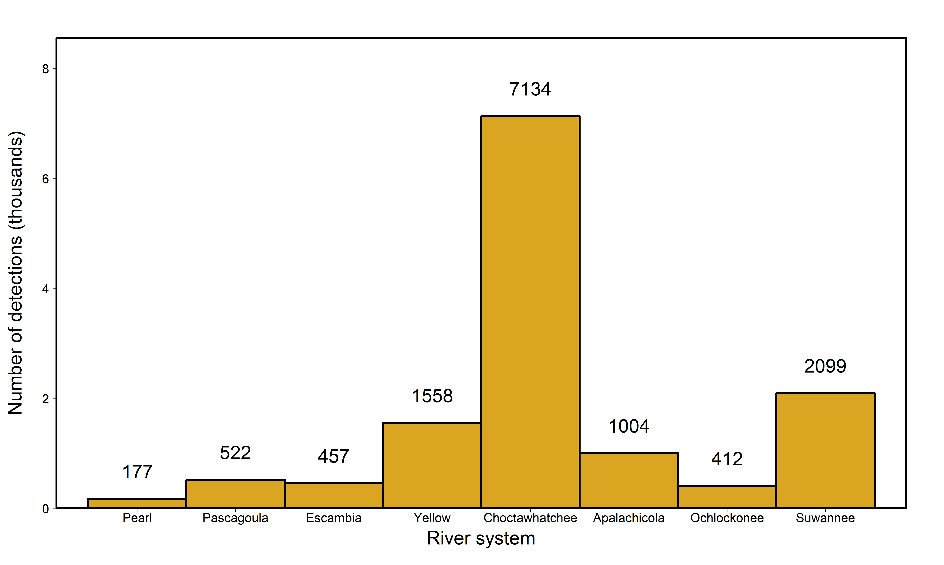
Total number of detections of adults in each river

Slide 7
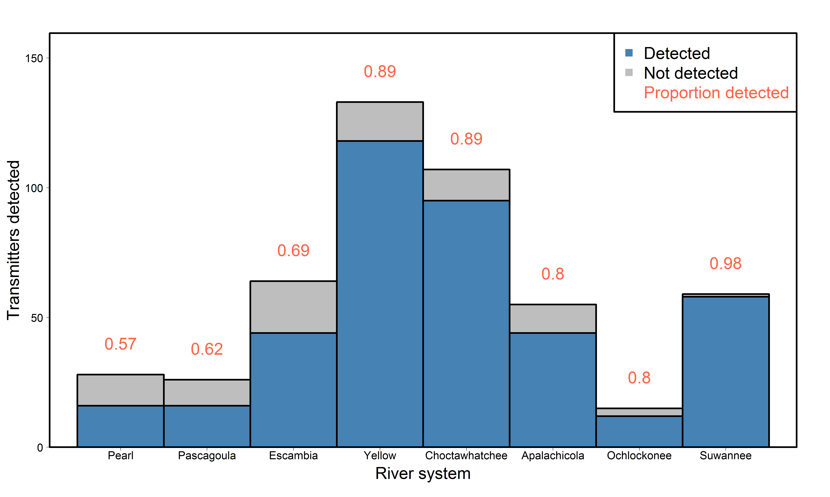
Proportion of transmitters deployed in adults in each river
detected somewhere

Slide 8
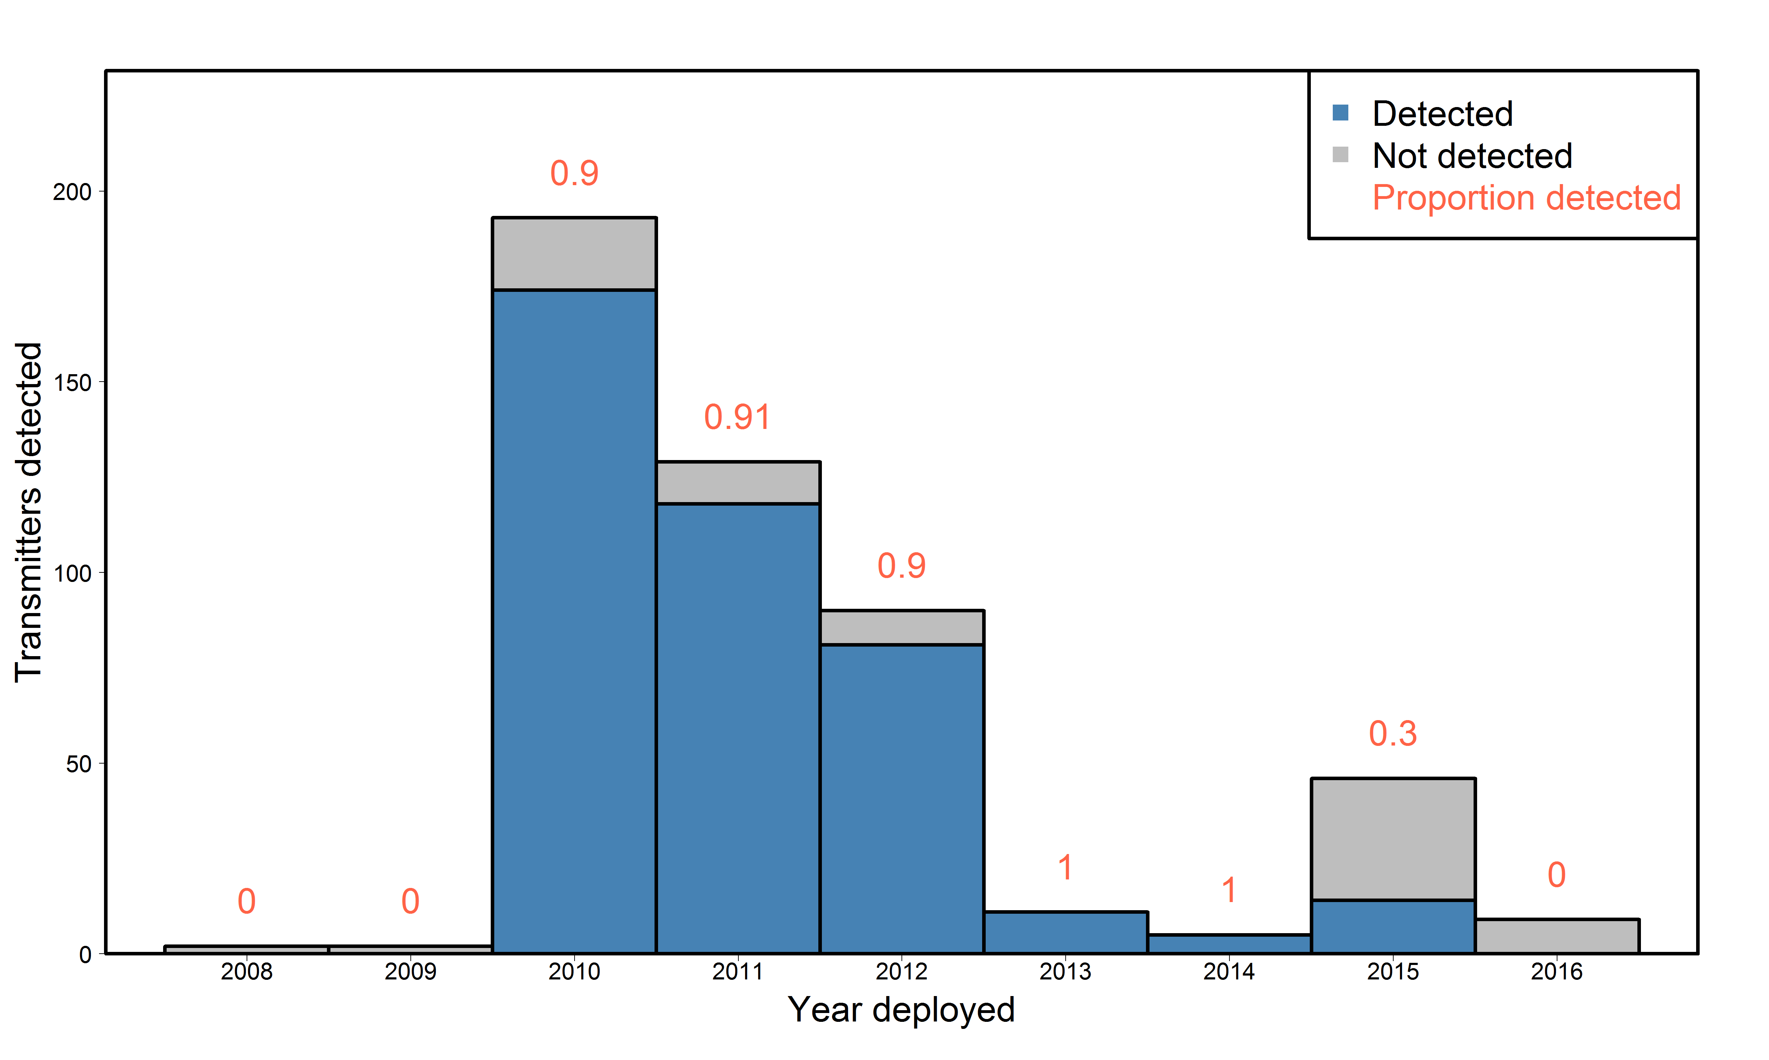
Proportion of transmitters deployed in adults each year
detected at some point

Slide 9
River-specific estimates: Survival, detection, and movement rates by tagging location

Slide 10
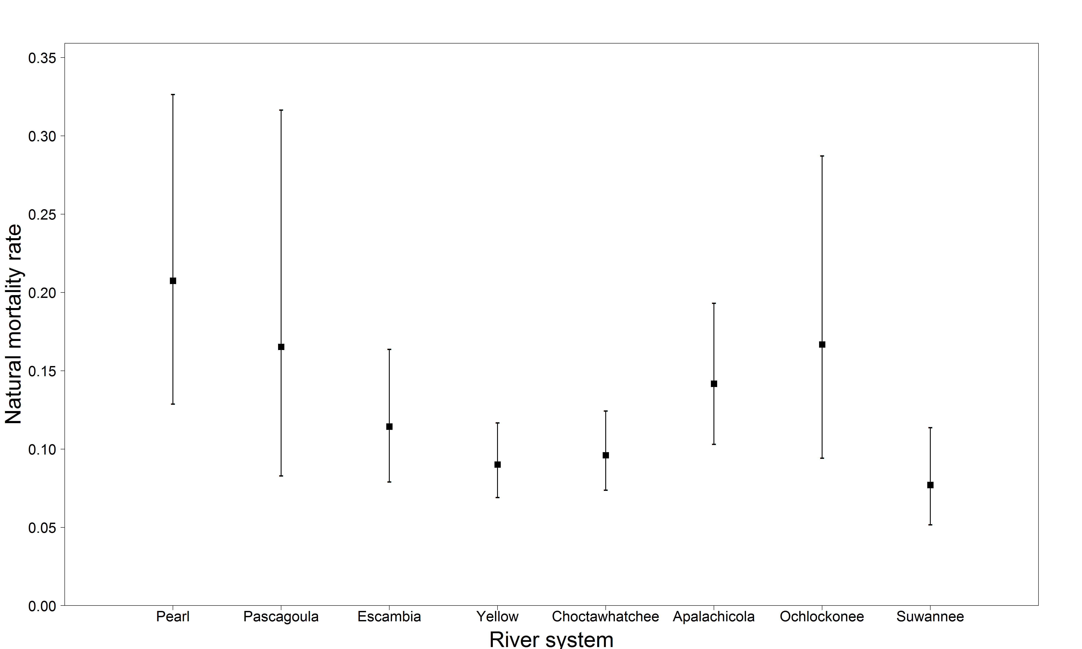
Adult natural mortality rate estimates by river
Natural mortality rate estimates are derived from estimates of survival
M = -log(S)

Slide 11
Adult natural mortality rate estimates by river
River | Estimate | Standard error | Lower 95% CI | Upper 95% CI
Pearl | 0.207 | 0.040 | 0.129 | 0.326
Pascagoula | 0.165 | 0.048 | 0.083 | 0.317
Escambia | 0.114 | 0.019 | 0.079 | 0.164
Yellow | 0.090 | 0.011 | 0.069 | 0.117
Choctawhatchee | 0.096 | 0.012 | 0.074 | 0.124
Apalachicola | 0.142 | 0.020 | 0.103 | 0.193
Ochlockonee | 0.167 | 0.040 | 0.094 | 0.287
Suwannee | 0.077 | 0.014 | 0.052 | 0.114

Slide 12
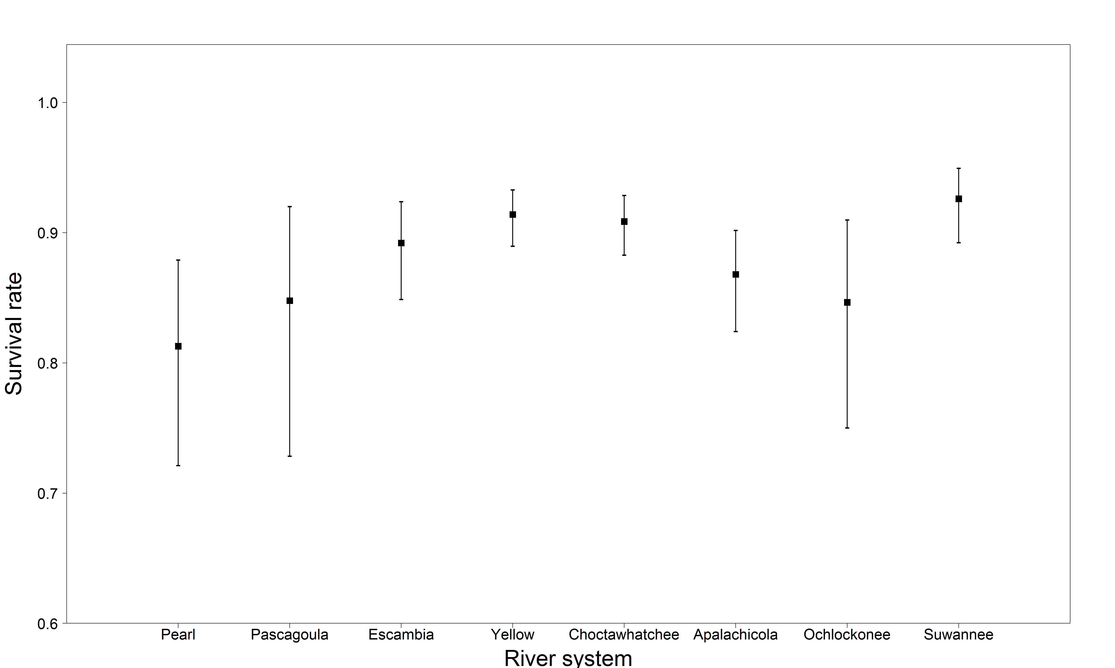
Adult survival rate estimates by river

Slide 13
Adult survival rate estimates by river
River | Estimate | Standard error | Lower 95% CI | Upper 95% CI
Pearl | 0.813 | 0.040 | 0.721 | 0.879
Pascagoula | 0.848 | 0.048 | 0.729 | 0.920
Escambia | 0.892 | 0.019 | 0.849 | 0.924
Yellow | 0.914 | 0.011 | 0.890 | 0.933
Choctawhatchee | 0.908 | 0.012 | 0.883 | 0.929
Apalachicola | 0.867 | 0.020 | 0.824 | 0.902
Ochlockonee | 0.846 | 0.040 | 0.750 | 0.910
Suwannee | 0.926 | 0.014 | 0.892 | 0.950

Slide 14
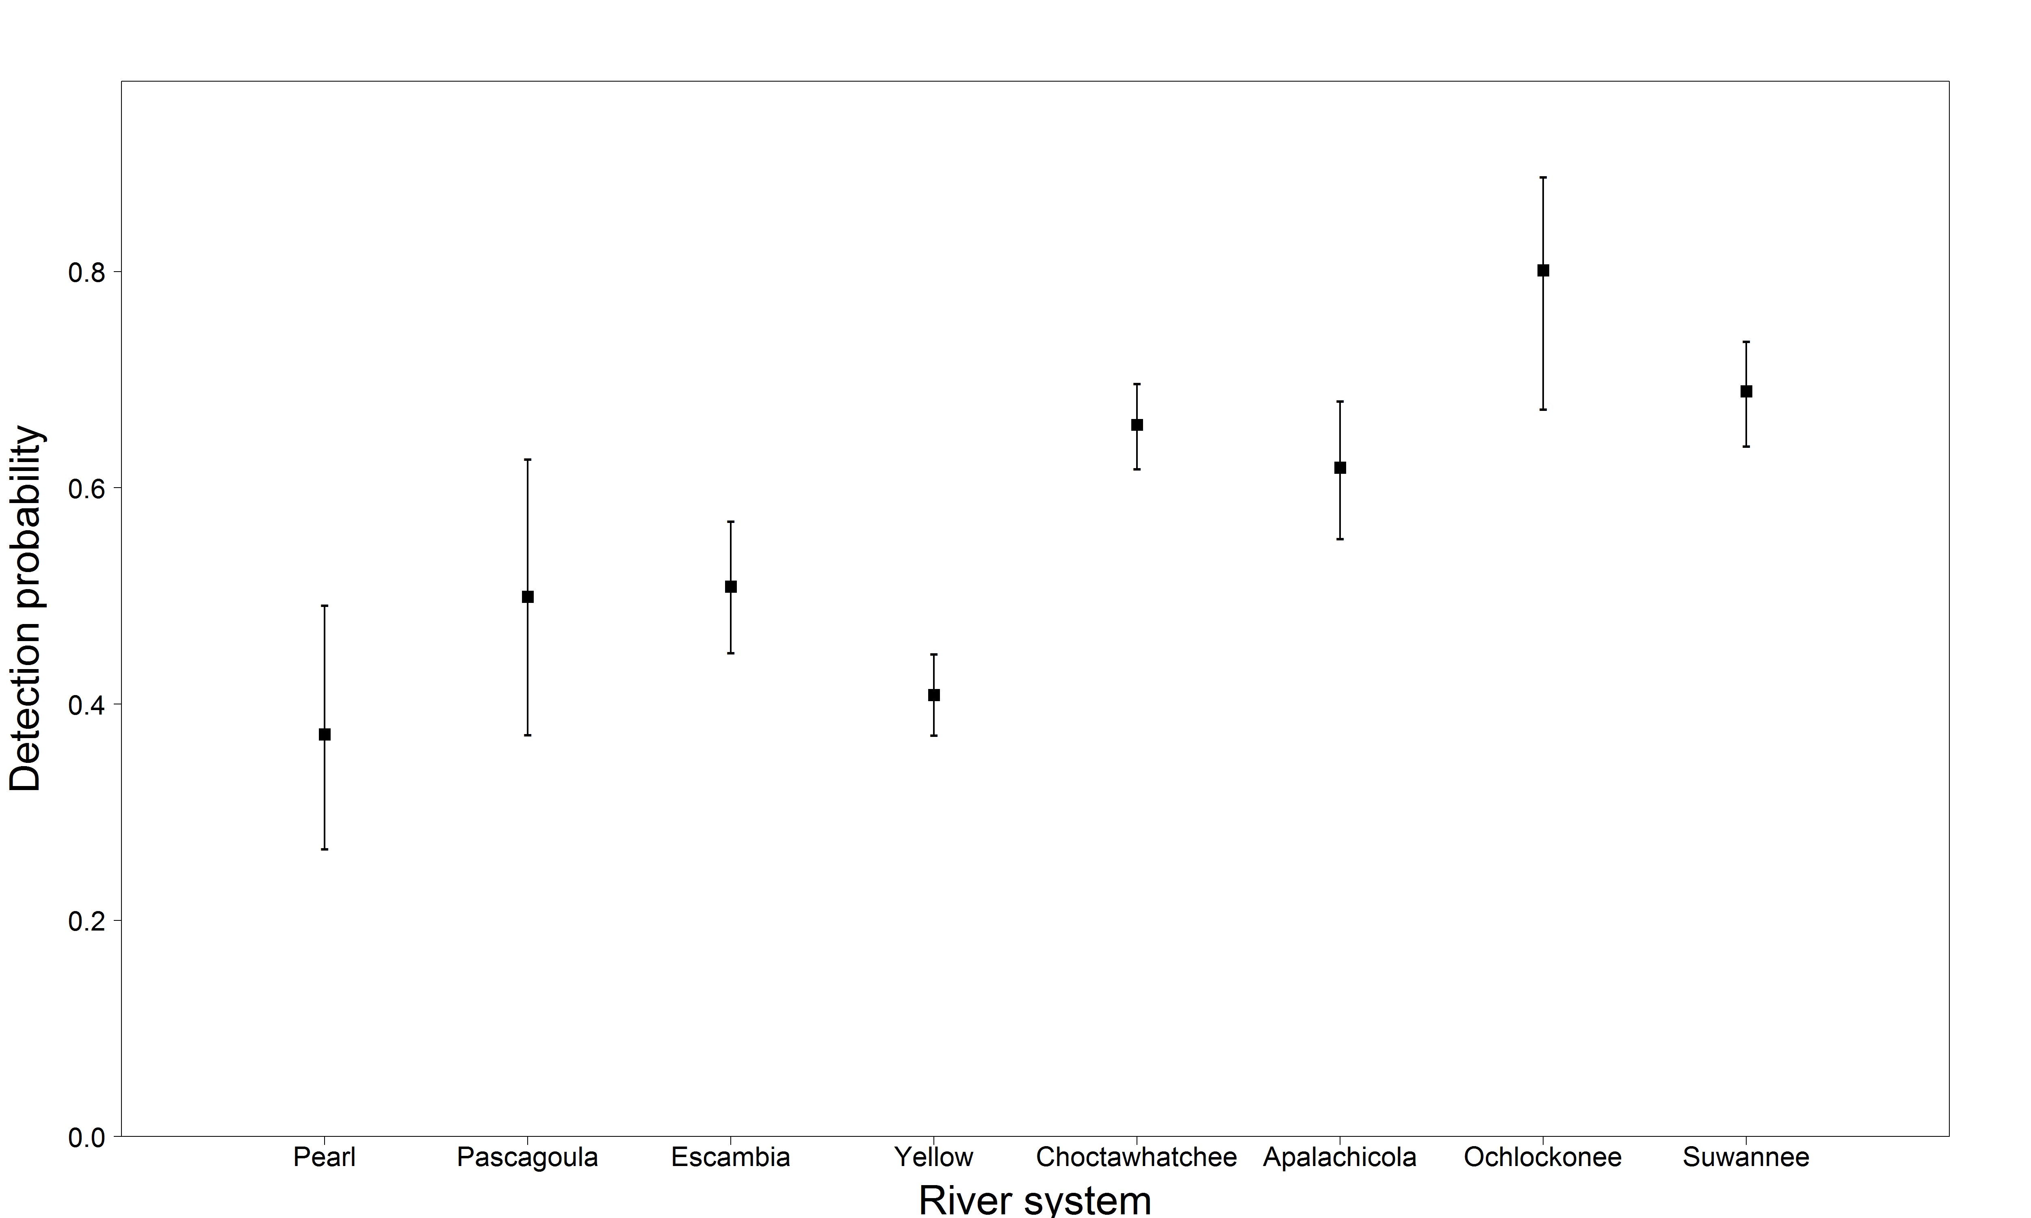
Adult detection probability estimates by river

Slide 15
Adult detection probability estimates by river
River | Estimate | Standard error | Lower 95% CI | Upper 95% CI
Pearl | 0.372 | 0.058 | 0.266 | 0.491
Pascagoula | 0.500 | 0.067 | 0.372 | 0.627
Escambia | 0.508 | 0.031 | 0.448 | 0.569
Yellow | 0.408 | 0.019 | 0.2371 | 0.446
Choctawhatchee | 0.658 | 0.020 | 0.618 | 0.696
Apalachicola | 0.619 | 0.033 | 0.553 | 0.680
Ochlockonee | 0.801 | 0.055 | 0.673 | 0.887
Suwannee | 0.689 | 0.025 | 0.638 | 0.736

Slide 16
Adult transition probability estimates by river
 |  | FROM
TO |  | Pearl | Pascagoula | Escambia | Yellow | Choctaw. | Apalach. | Ochlock. | Suwannee
 | Pearl | 1
 | Pascagoula |  | 1 | 0.009
 | Escambia |  |  | 0.505 | 0.129 | 0.044
 | Yellow |  |  | 0.330 | 0.737 | 0.029 | 0.009
 | Choctaw. |  |  | 0.128 | 0.121 | 0.920 | 0.078
 | Apalach. |  |  | 0.028 | 0.013 | 0.007 | 0.810 | 0.026 | 0.005
 | Ochlock. |  |  |  |  |  | 0.086 | 0.462
 | Suwannee |  |  |  |  |  | 0.017 | 0.513 | 0.995

Slide 17
Region-specific estimates: Survival and movement rates by tagging location, detection rates by state (single rate for moving into the marine environment, separate rates for moving into each river)

Slide 18
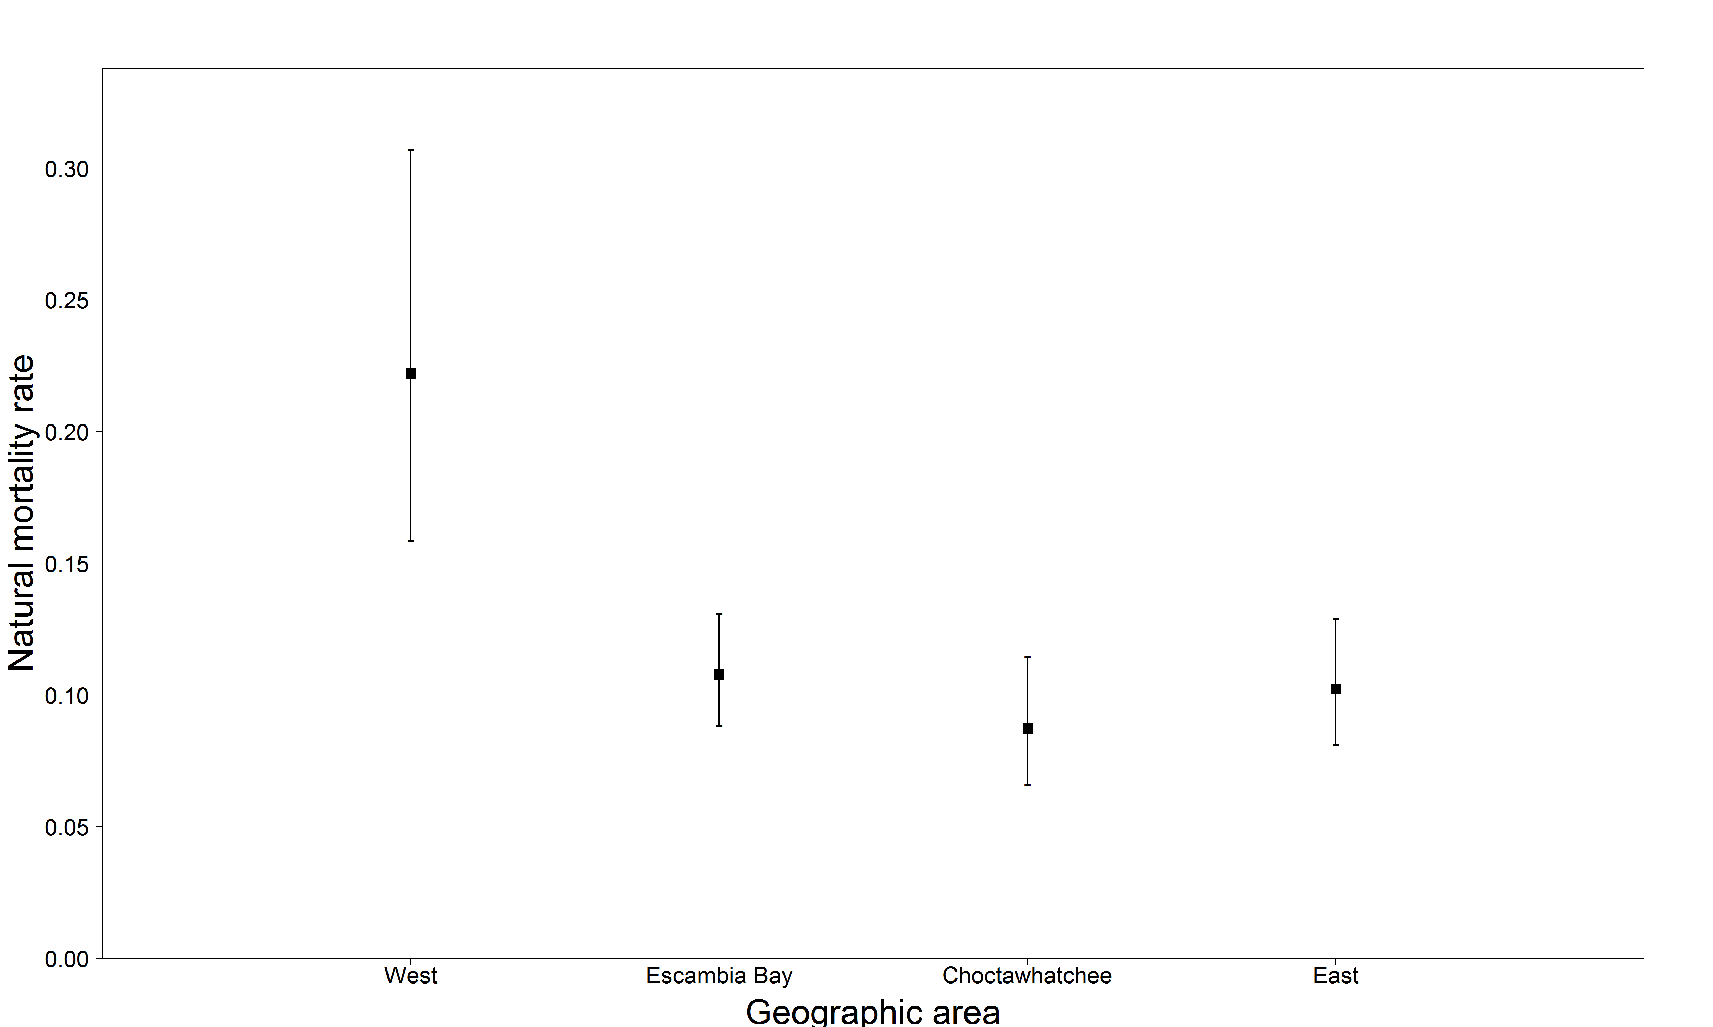
Adult natural mortality rate estimates by region
Natural mortality rate estimates are derived from estimates of survival
M = -log(S)

Slide 19
Adult natural mortality rate estimates by region
Region | Estimate | Standard error | Lower 95% CI | Upper 95% CI
West | 0.222 | 0.030 | 0.159 | 0.307
Escambia Bay | 0.108 | 0.010 | 0.089 | 0.131
Choctawhatchee | 0.087 | 0.011 | 0.066 | 0.115
East | 0.102 | 0.011 | 0.081 | 0.129

Slide 20
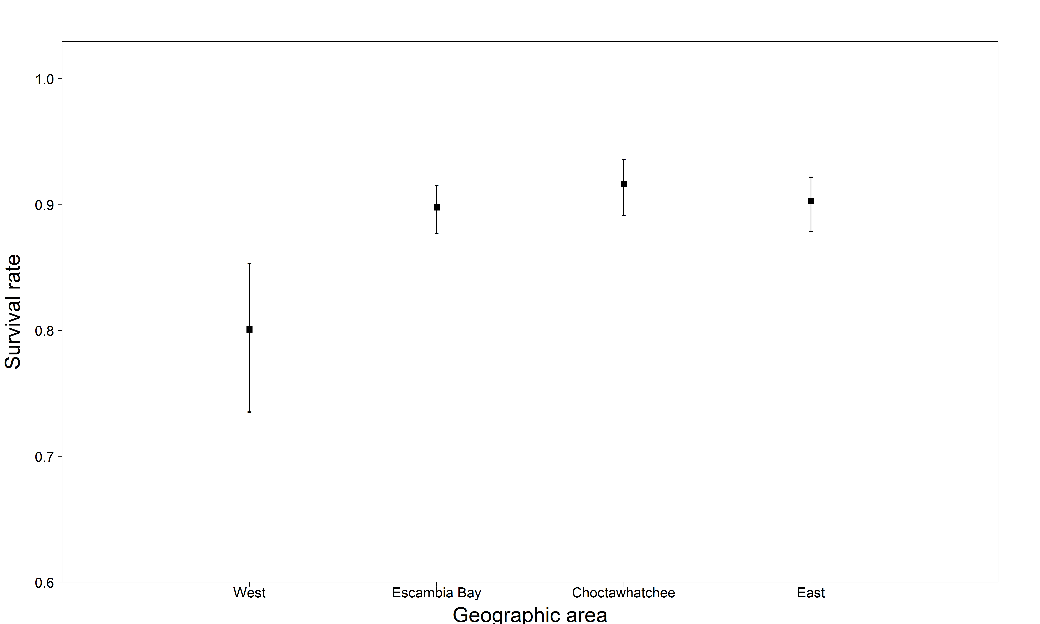
Adult survival rate estimates by region

Slide 21
Adult survival rate estimates by region
Region | Estimate | Standard error | Lower 95% CI | Upper 95% CI
West | 0.801 | 0.030 | 0.736 | 0.853
Escambia Bay | 0.898 | 0.010 | 0.877 | 0.915
Choctawhatchee | 0.916 | 0.011 | 0.892 | 0.936
East | 0.903 | 0.011 | 0.879 | 0.922

Slide 22
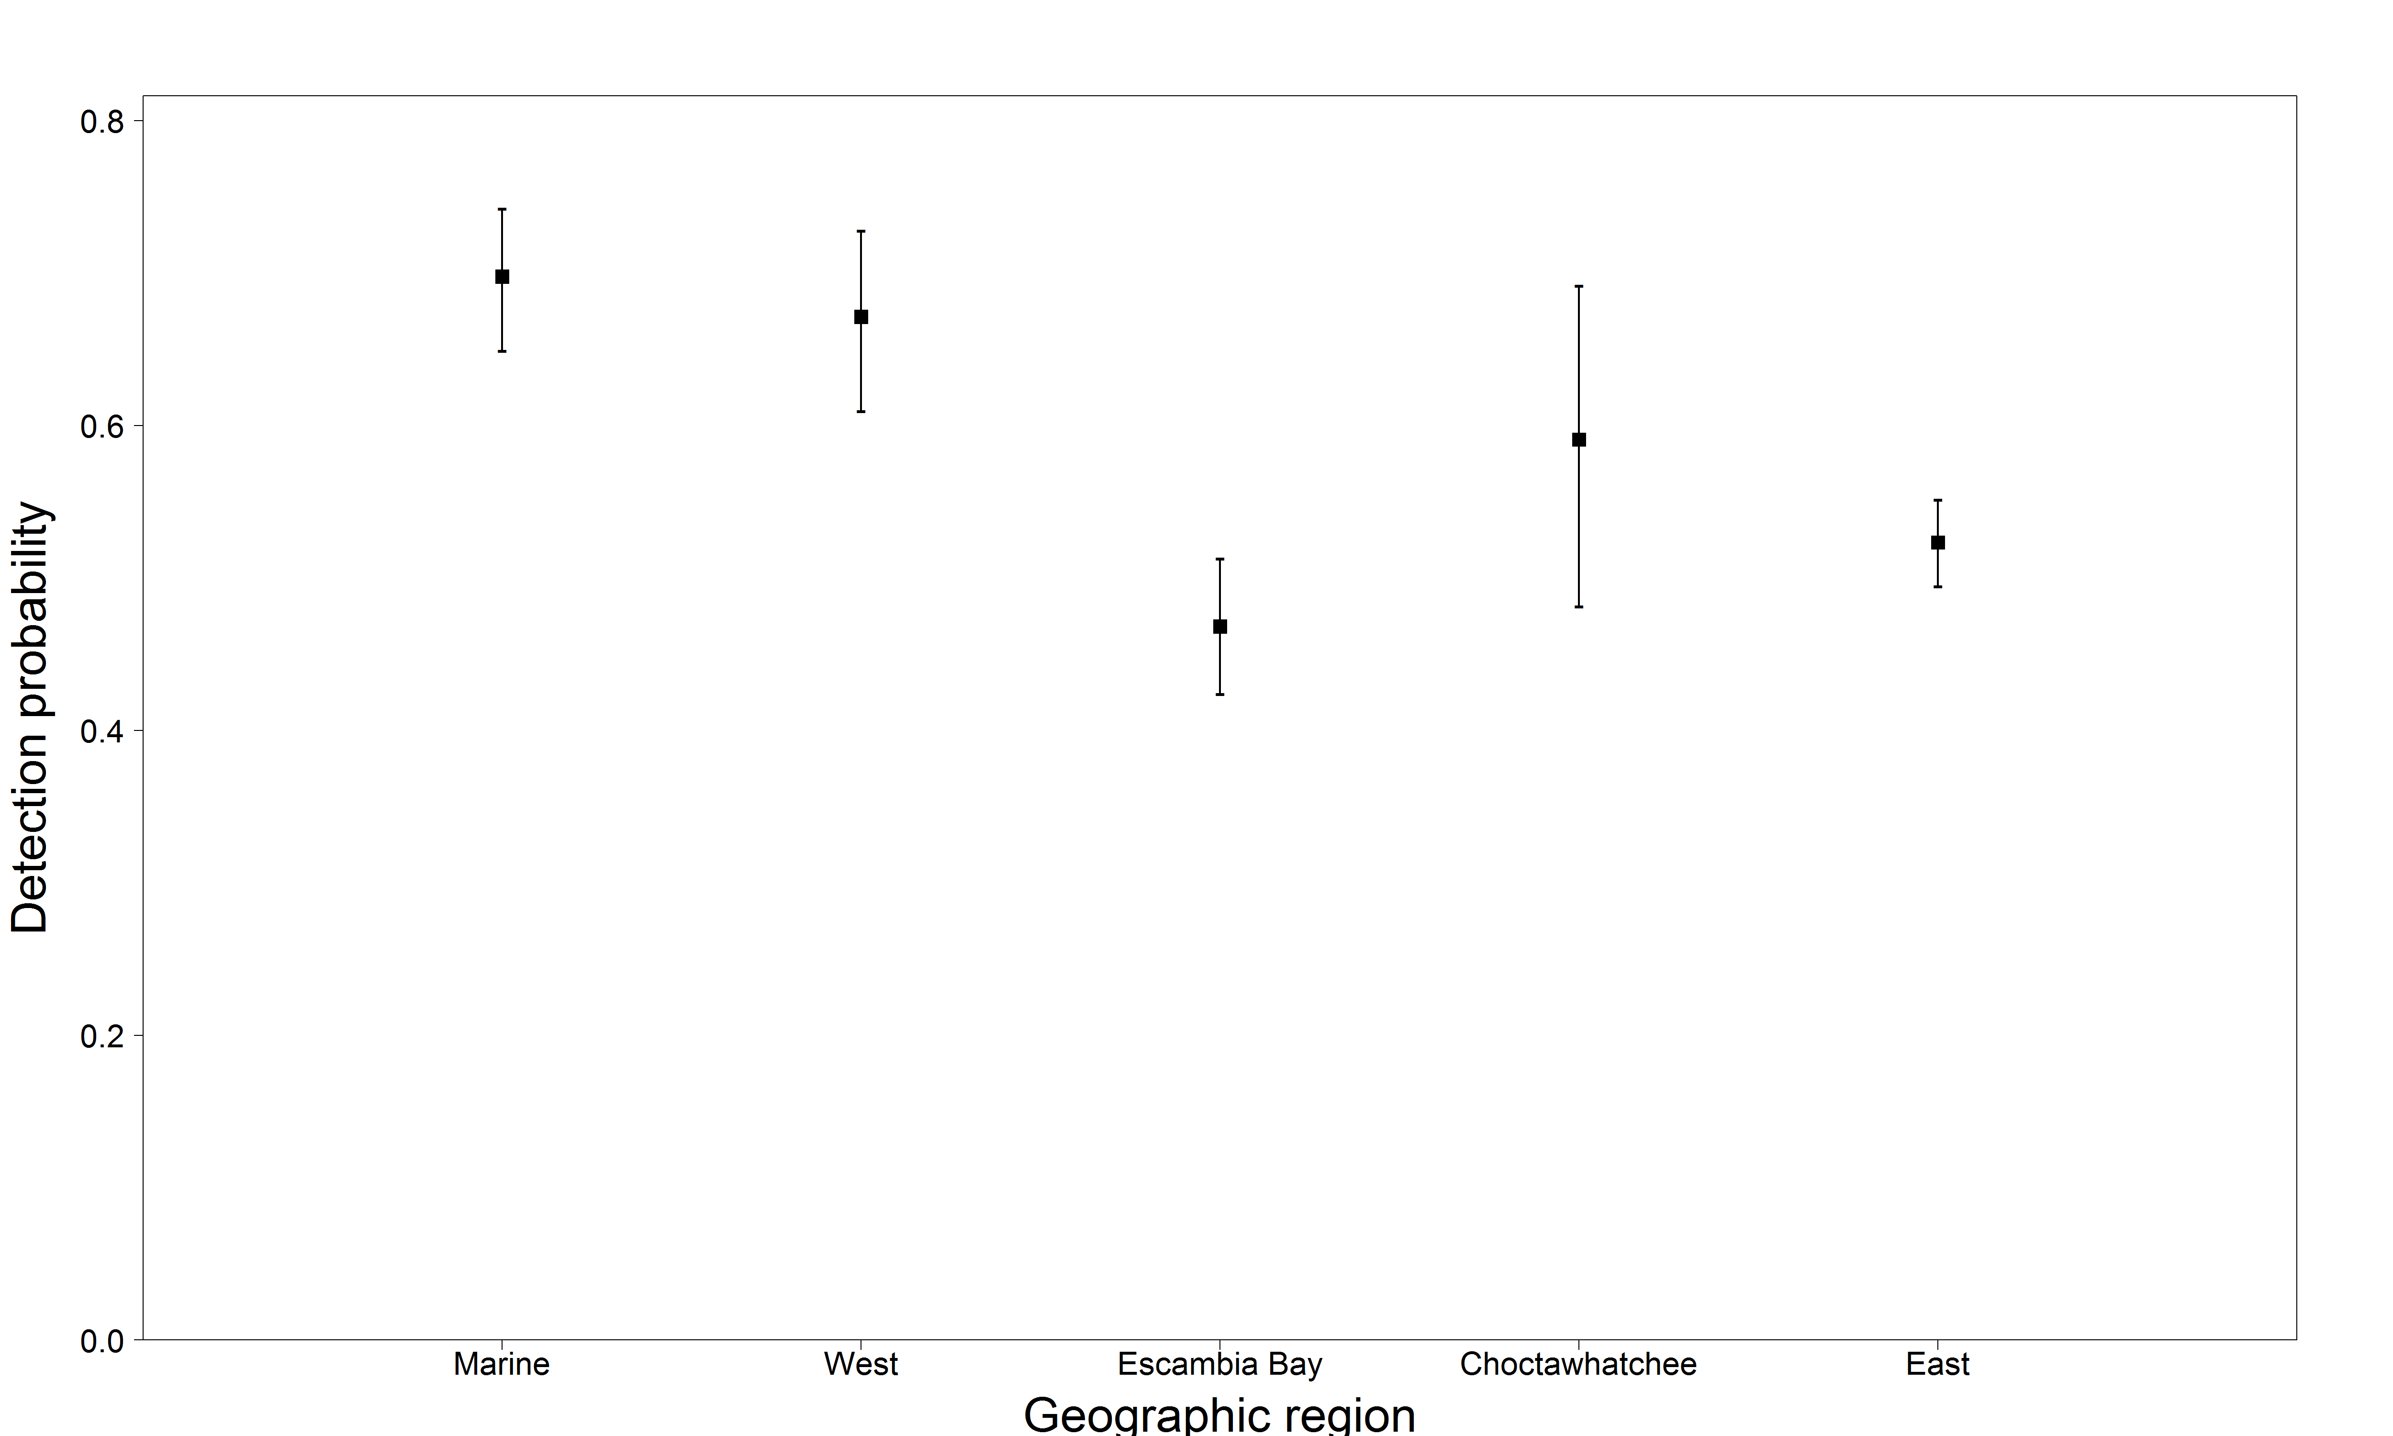
Adult detection probability estimates by region
(marine = leaving river)

Slide 23
Adult detection probability estimates by region
Region | Estimate | Standard error | Lower 95% CI | Upper 95% CI
West | 0.698 | 0.024 | 0.649 | 0.724
Escambia Bay | 0.671 | 0.030 | 0.609 | 0.728
Choctawhatchee | 0.468 | 0.023 | 0.424 | 0.513
East | 0.591 | 0.054 | 0.481 | 0.692
Marine (leaving river) | 0.523 | 0.014 | 0.495 | 0.551

Slide 24
Adult transition probability estimates by region
 |  | FROM
TO |  | West | Escambia Bay | Choctawhatchee | East
 | West | 1.00 | 5.4e-10 | 3.1e-11 | 4.5e-11
 | Escambia Bay | 0.002 | 0.895 | 0.090 | 0.013
 | Choctawhatchee | 3.8e-11 | 0.101 | 0.892 | 0.007
 | East | 3.19e-9 | 0.004 | 0.027 | 0.969

Slide 25
Survival and detection rates for all tagged fish, movement rates given tagging location

Slide 26
Overall survival and detection probabilities
Parameter | Estimate | Standard error | Lower 95% CI | Upper 95% CI
Survival | 0.898 | 0.006 | 0.885 | 0.901
Mortality | 0.108 | 0.006 | 0.095 | 0.122
Detection | 0.563 | 0.010 | 0.543 | 0.584
Natural mortality rate estimates are derived from estimates of survival
M = -log(S)

Slide 27
Transition probability estimates by region
 |  | FROM
TO |  | West | Escambia Bay | Choctawhatchee | East
 | West | 1.00 | 1.7e-8 | 8.6e-10 | 2.1e-8
 | Escambia Bay | 0.003 | 0.856 | 0.123 | 0.018
 | Choctawhatchee | 9.9e-5 | 0.073 | 0.920 | 0.007
 | East | 2.9e-8 | 0.003 | 0.026 | 0.971

Slide 28
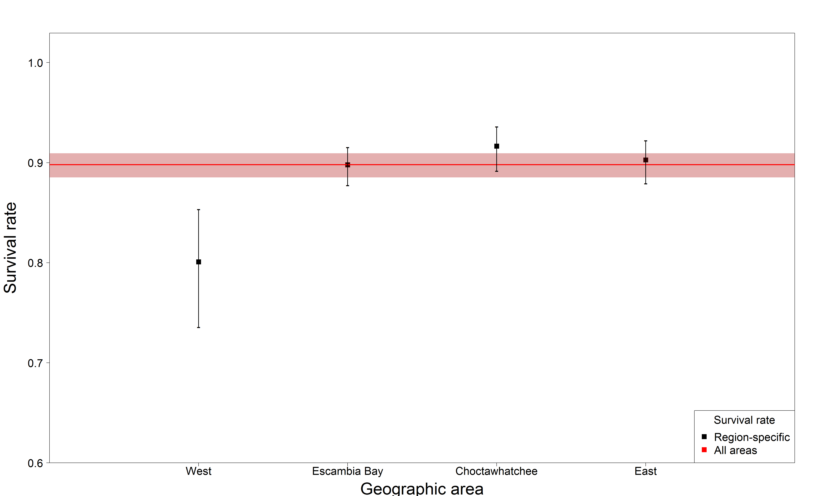
Adult survival rate estimate compared to region-specific

Slide 29
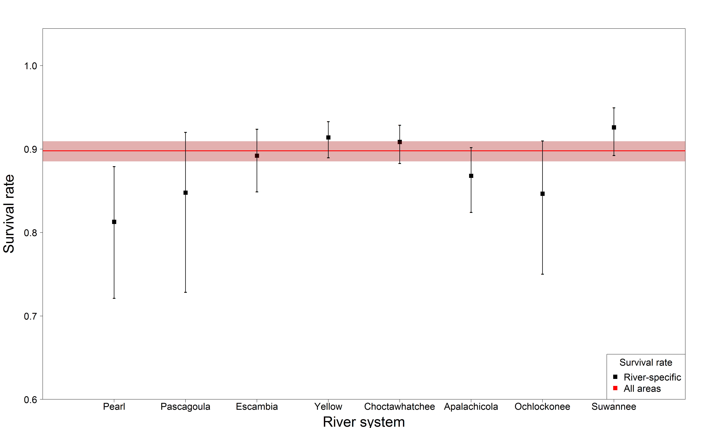
Adult survival rate estimate compared to river-specific

Slide 30
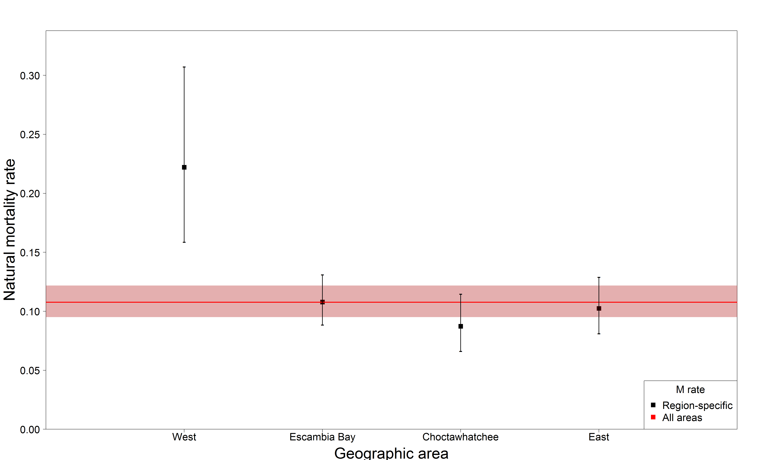
Adult natural mortality rate estimate compared to region-specific

Slide 31
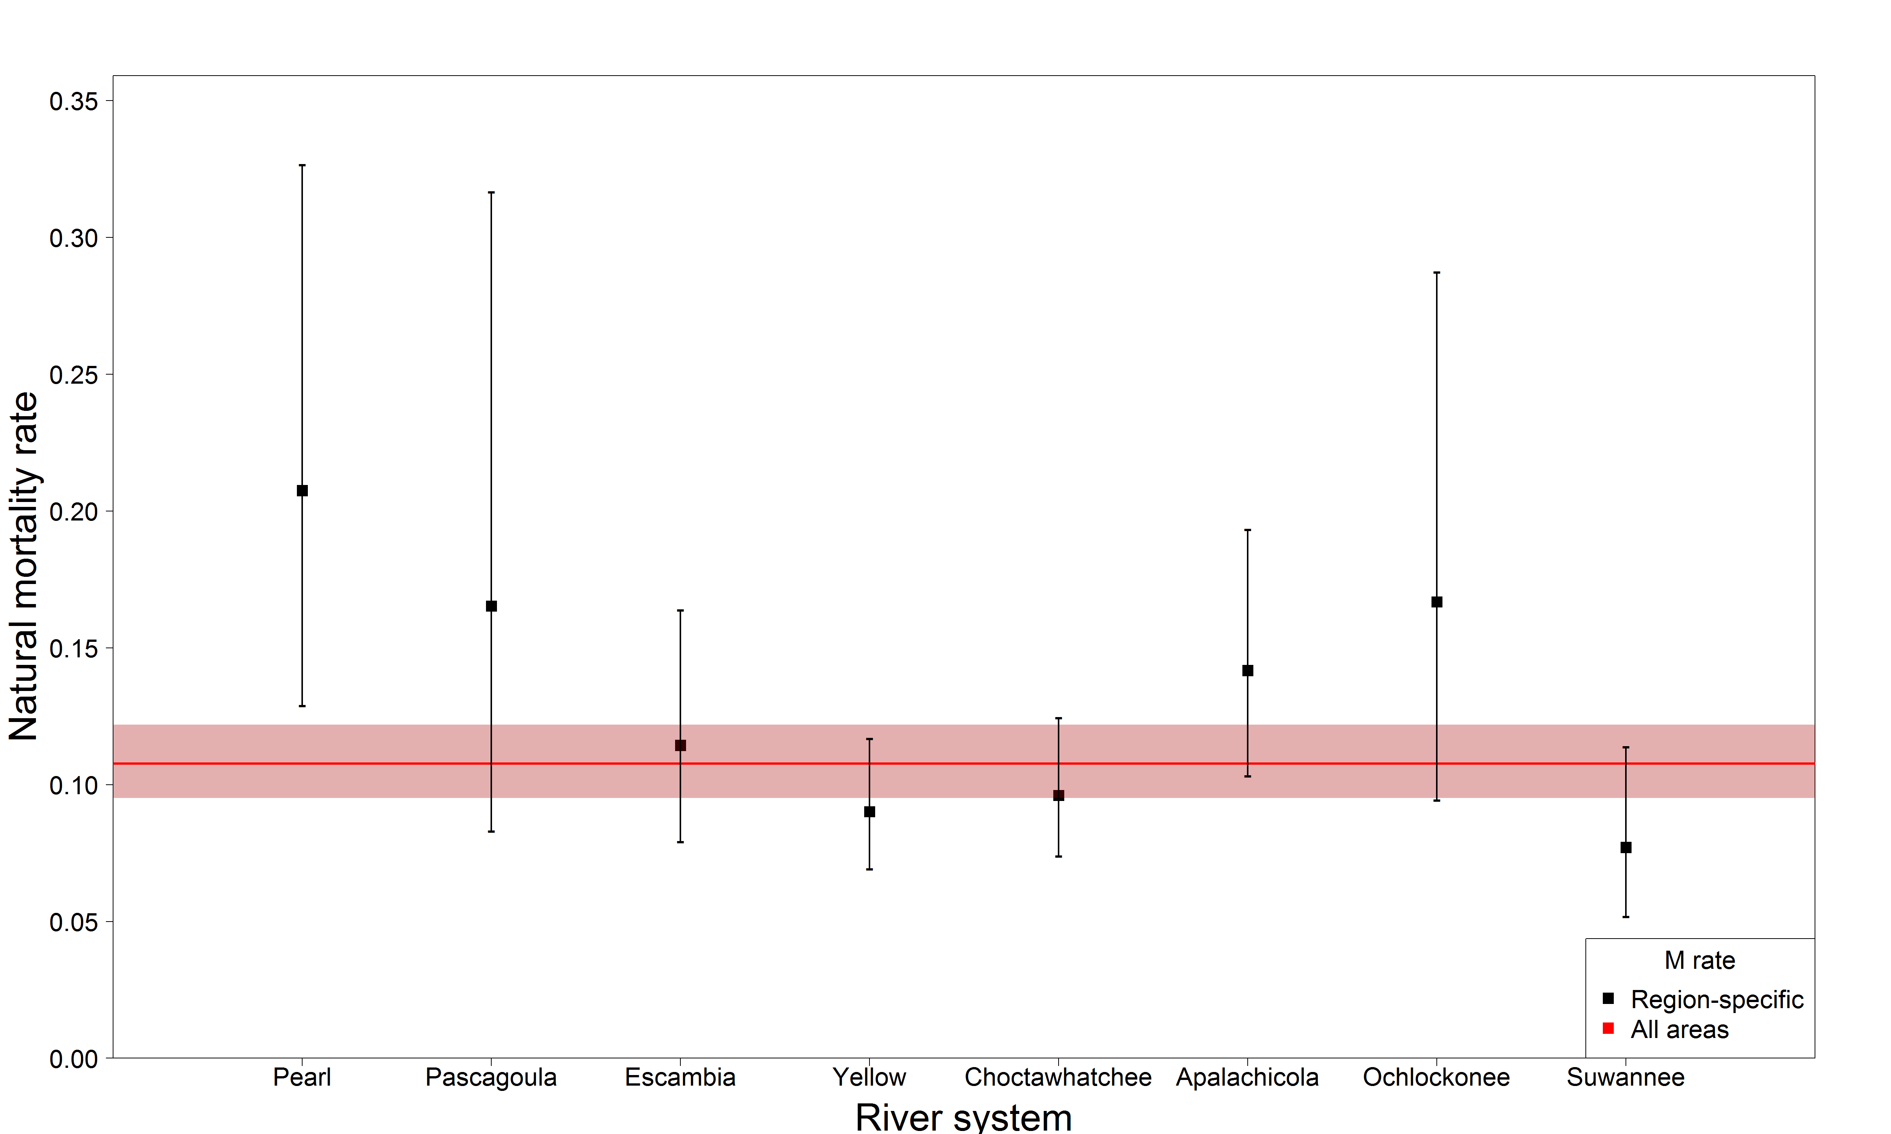
Adult natural mortality rate estimate compared to river-specific

Slide 32
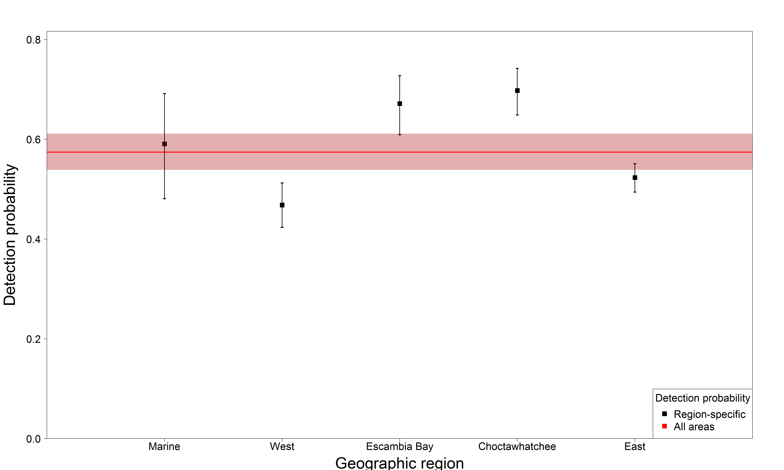
Adult detection probability estimate compared to region-specific

Slide 33
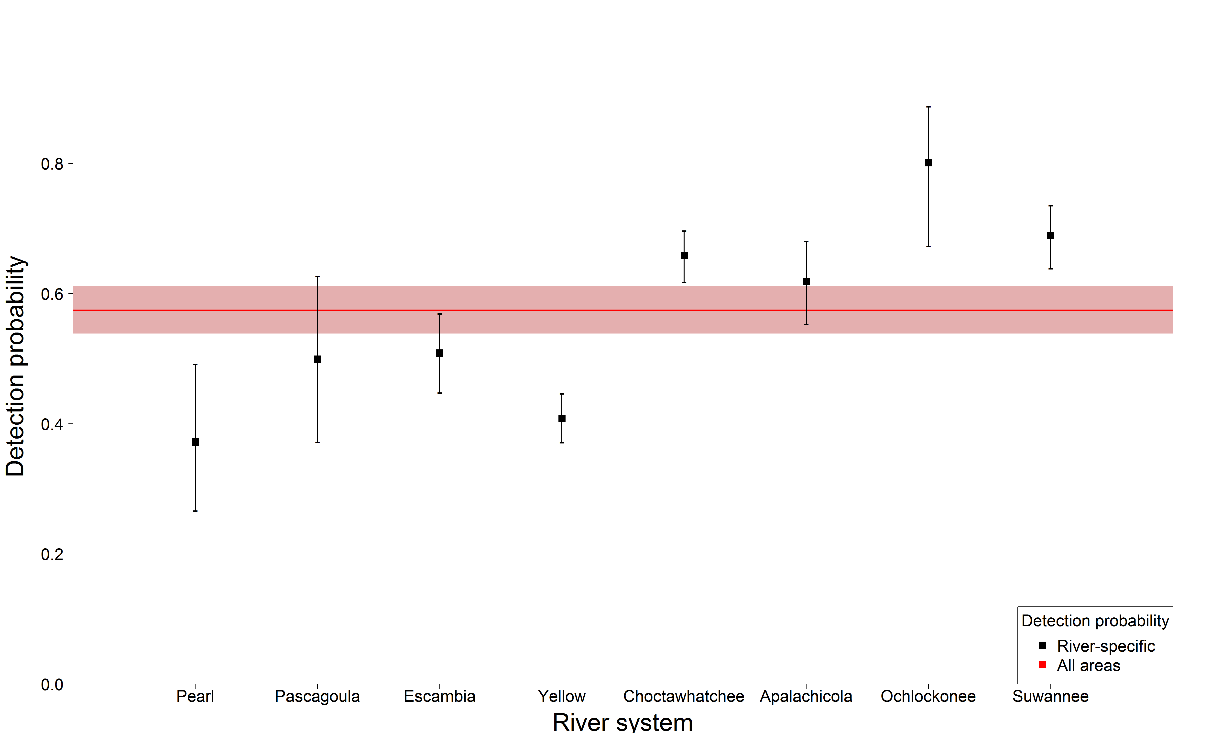
Adult detection probability estimate compared to river-specific

