Slide 1
Updated natural mortality rate estimates using acoustic telemetry data – juveniles (<1250mm FL)
Potential figures and tables

Slide 2
Data exploration

Slide 3
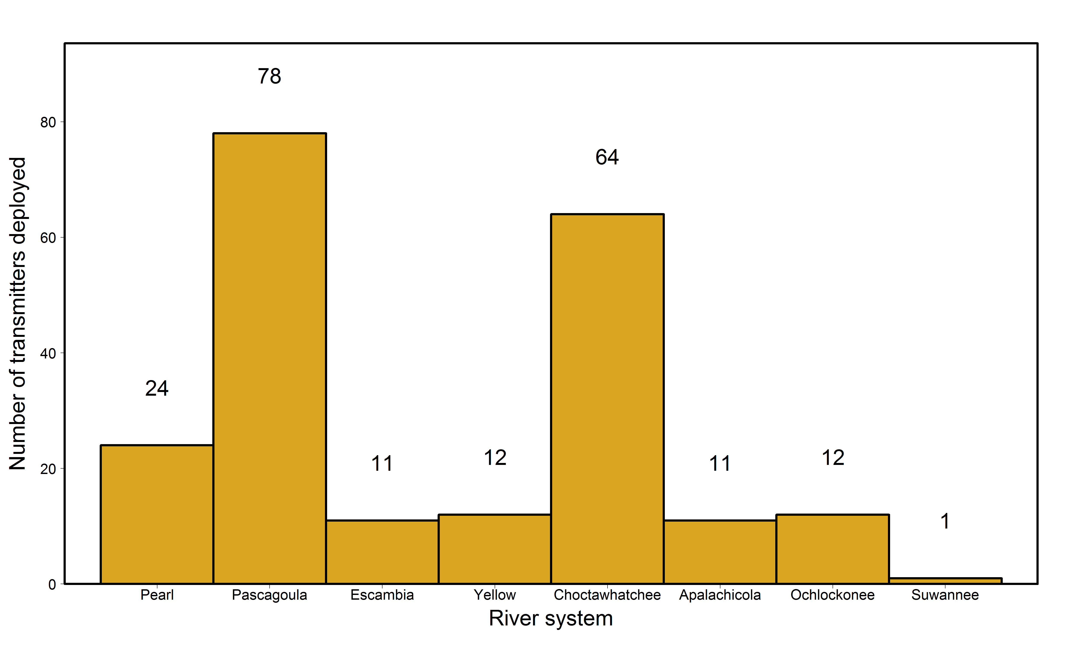
Total number of transmitters deployed in juveniles in each river

Slide 4
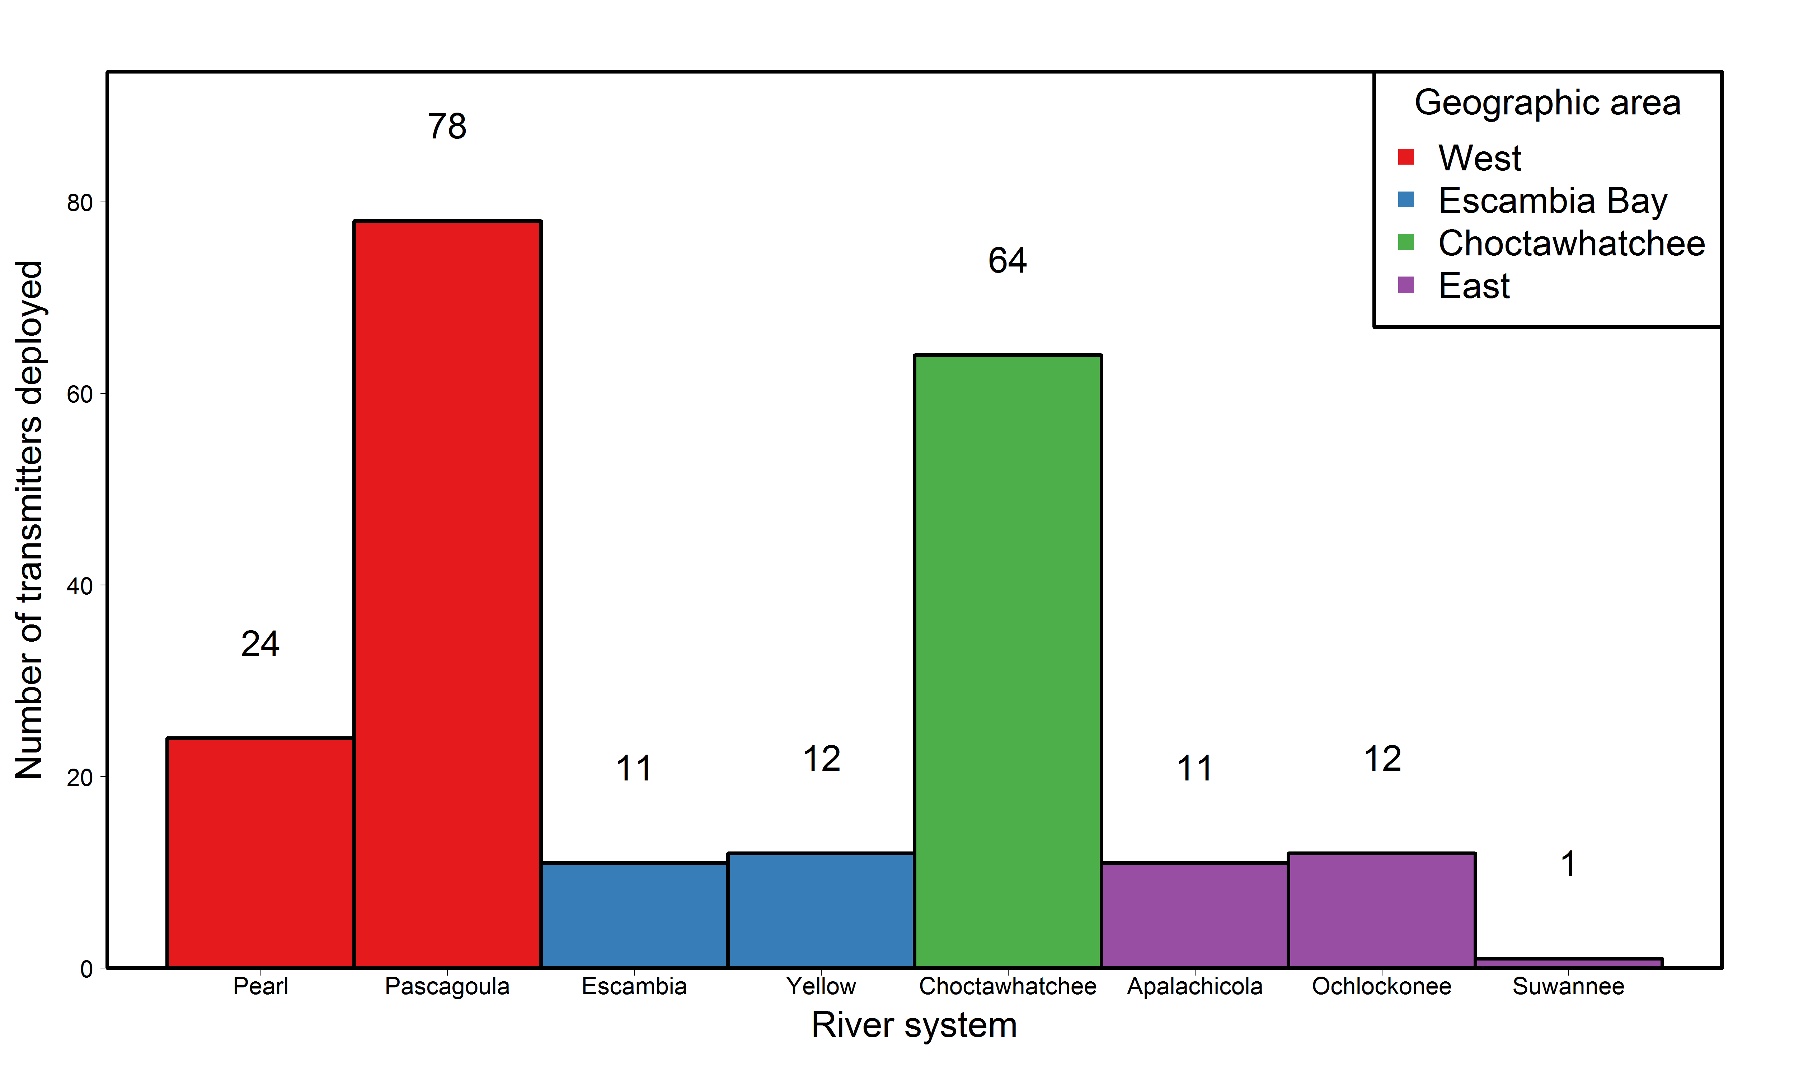
Total number of transmitters deployed in juveniles in each river,
categorized by geographic area

Slide 5
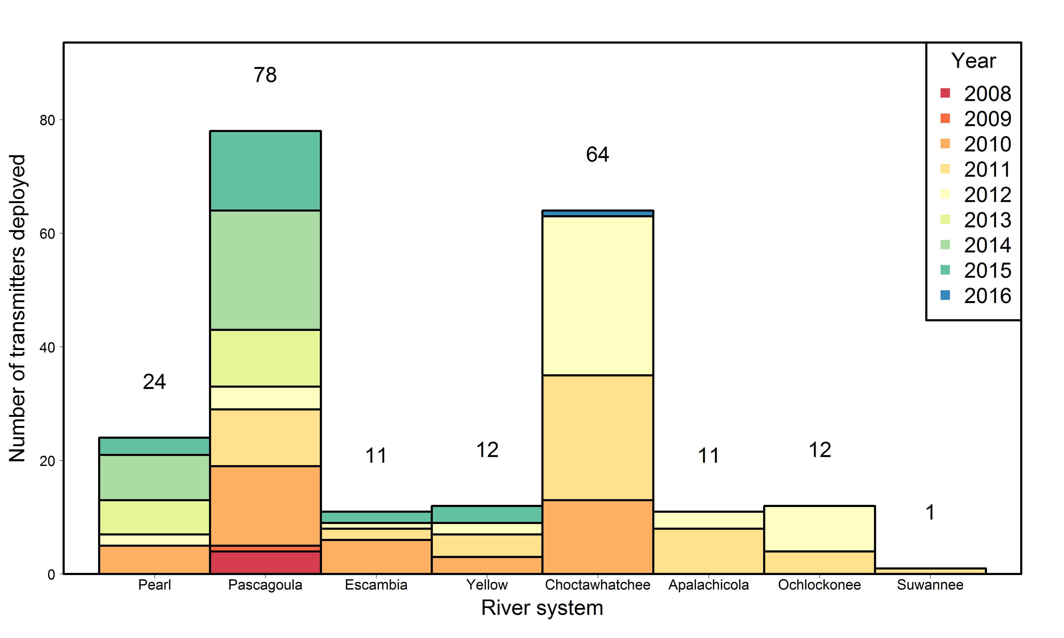
Total number of transmitters deployed in juveniles
in each river by year

Slide 6
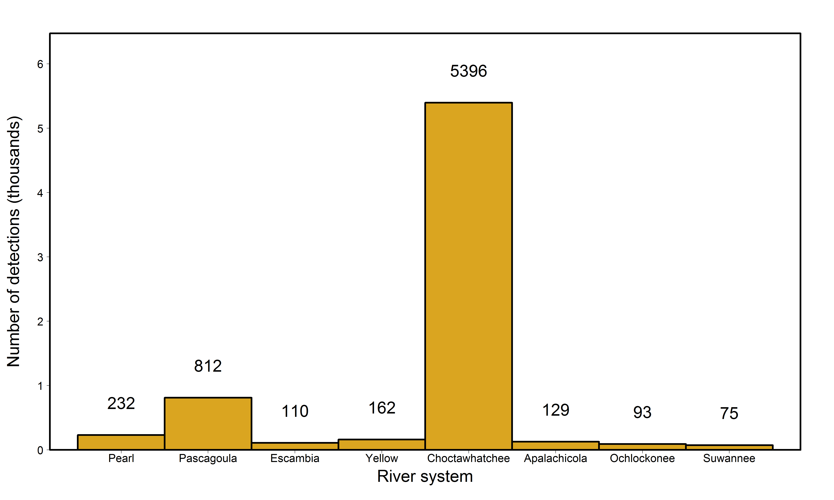
Total number of detections of juveniles in each river

Slide 7
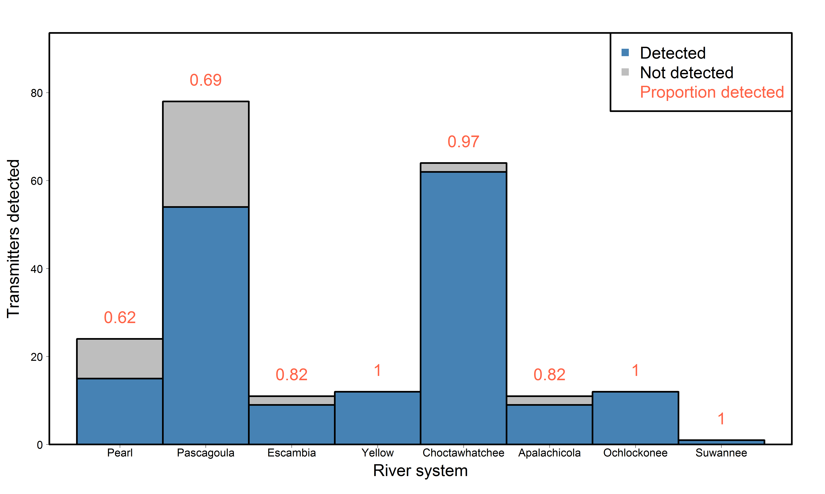
Proportion of transmitters deployed in juveniles in each river
detected somewhere

Slide 8
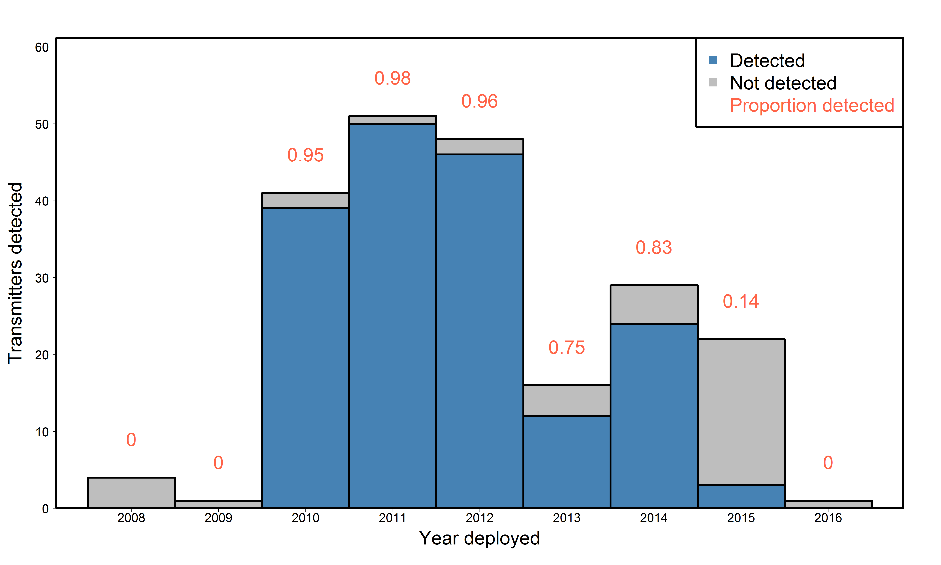
Proportion of transmitters deployed in juveniles each year
detected at some point

Slide 9
River-specific estimates: Survival, detection, and movement rates by tagging location

Slide 10
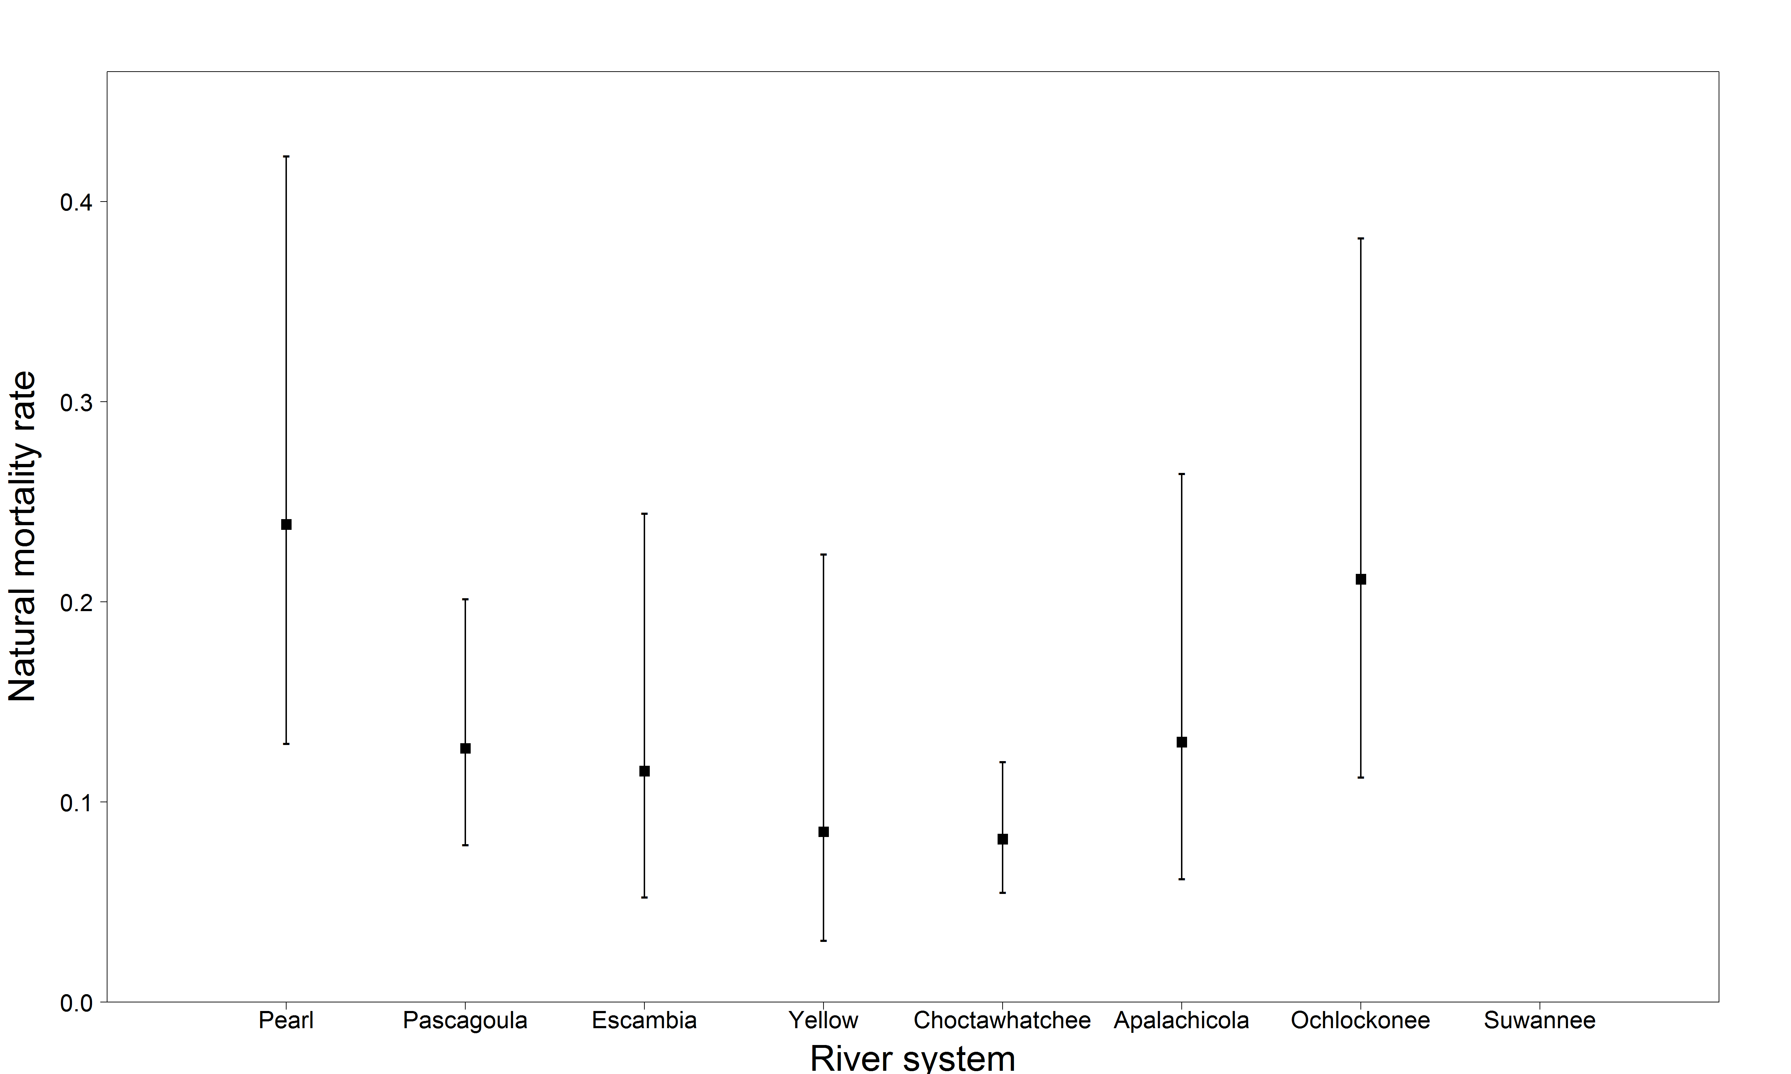
Juvenile natural mortality rate estimates by river
Natural mortality rate estimates are derived from estimates of survival
M = -log(S)
Cannot run model with only one transmitter deployed in a juvenile in the Suwannee River

Slide 11
Juvenile natural mortality rate estimates by river
River | Estimate | Standard error | Lower 95% CI | Upper 95% CI
Pearl | 0.239 | 0.057 | 0.129 | 0.423
Pascagoula | 0.127 | 0.027 | 0.079 | 0.202
Escambia | 0.115 | 0.040 | 0.053 | 0.244
Yellow | 0.085 | 0.040 | 0.031 | 0.224
Choctawhatchee | 0.081 | 0.015 | 0.055 | 0.120
Apalachicola | 0.130 | 0.043 | 0.062 | 0.264
Ochlockonee | 0.211 | 0.054 | 0.112 | 0.382
Suwannee | NA | NA | NA | NA

Slide 12
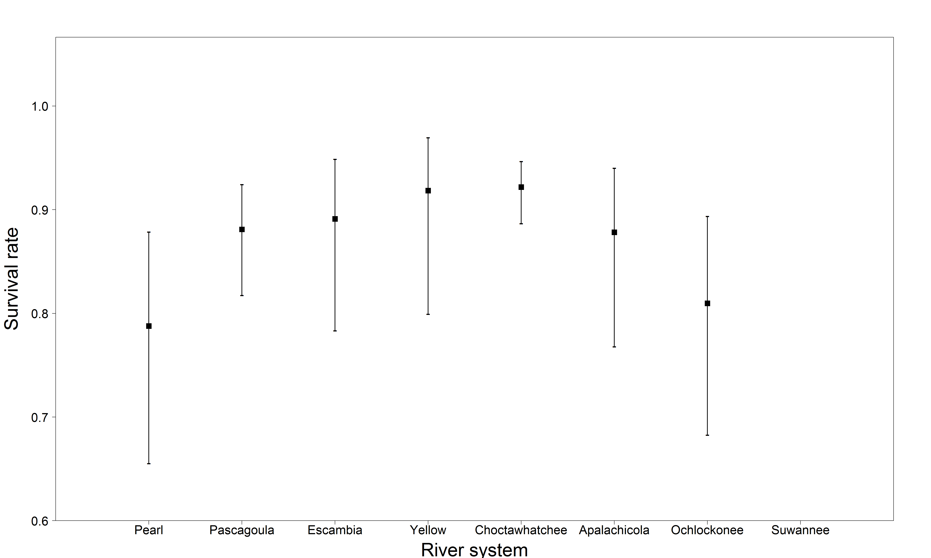
Juvenile survival rate estimates by river
Cannot run model with only one transmitter deployed in a juvenile in the Suwannee River

Slide 13
Juvenile survival rate estimates by river
River | Estimate | Standard error | Lower 95% CI | Upper 95% CI
Pearl | 0.788 | 0.057 | 0.655 | 0.879
Pascagoula | 0.881 | 0.027 | 0.817 | 0.924
Escambia | 0.891 | 0.040 | 0.783 | 0.949
Yellow | 0.918 | 0.040 | 0.799 | 0.969
Choctawhatchee | 0.922 | 0.015 | 0.887 | 0.947
Apalachicola | 0.878 | 0.043 | 0.768 | 0.940
Ochlockonee | 0.810 | 0.054 | 0.683 | 0.894
Suwannee | NA | NA | NA | NA

Slide 14
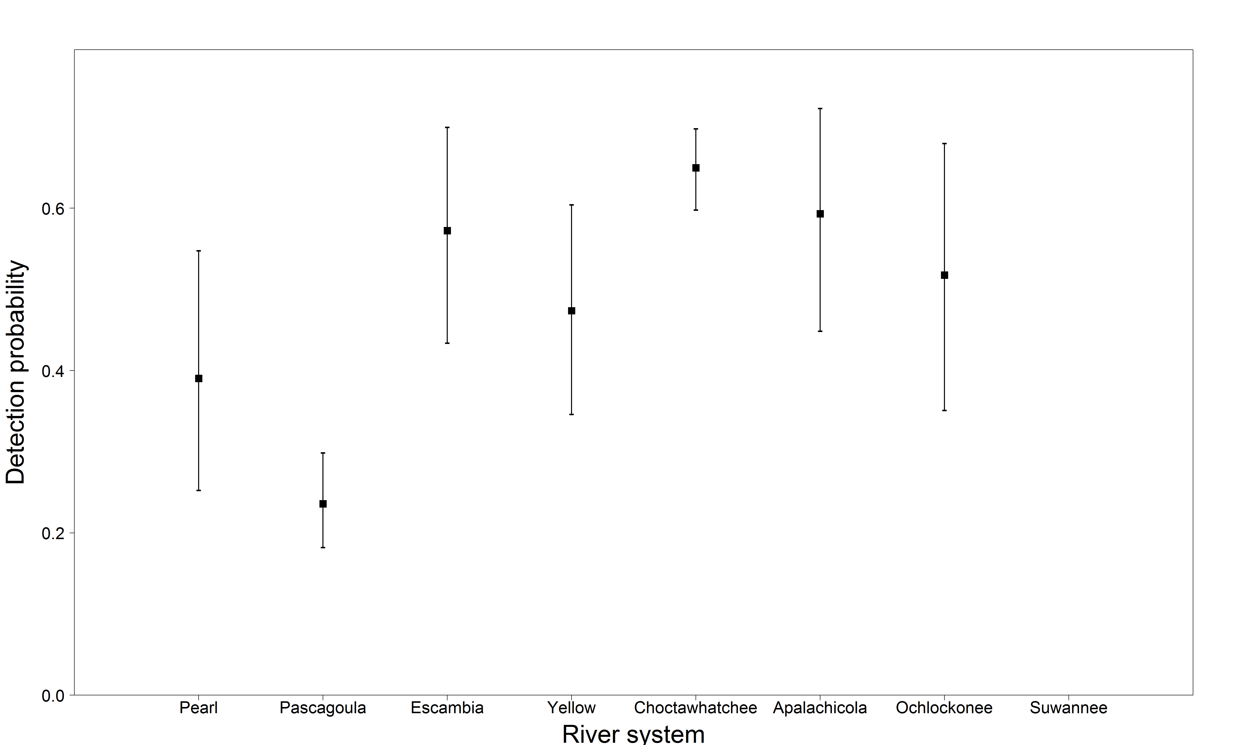
Juvenile detection probability estimates by river
Cannot run model with only one transmitter deployed in a juvenile in the Suwannee River

Slide 15
Juvenile detection probability estimates by river
River | Estimate | Standard error | Lower 95% CI | Upper 95% CI
Pearl | 0.390 | 0.078 | 0.253 | 0.548
Pascagoula | 0.236 | 0.030 | 0.182 | 0.299
Escambia | 0.572 | 0.069 | 0.434 | 0.700
Yellow | 0.474 | 0.067 | 0.346 | 0.605
Choctawhatchee | 0.650 | 0.026 | 0.598 | 0.698
Apalachicola | 0.593 | 0.072 | 0.449 | 0.723
Ochlockonee | 0.518 | 0.087 | 0.351 | 0.680
Suwannee | NA | NA | NA | NA

Slide 16
Juvenile transition probability estimates by river
 |  | FROM
TO |  | Pearl | Pascagoula | Escambia | Yellow | Choctaw. | Apalach. | Ochlock. | Suwannee
 | Pearl | 1 | 0.038
 | Pascagoula |  | 0.962
 | Escambia |  |  | 0.423 | 0.304 | 0.017
 | Yellow |  |  | 0.0154 | 0.696 | 0.017
 | Choctaw. |  |  | 0.423 |  | 0.966
 | Apalach. |  |  |  |  |  | 0.696 | 0.118
 | Ochlock. |  |  |  |  |  | 0.043 | 0.765
 | Suwannee |  |  |  |  |  | 0.261 | 0.118

Slide 17
Region-specific estimates: Survival and movement rates by tagging location, detection rates by state (single rate for moving into the marine environment, separate rates for moving into each river)

Slide 18
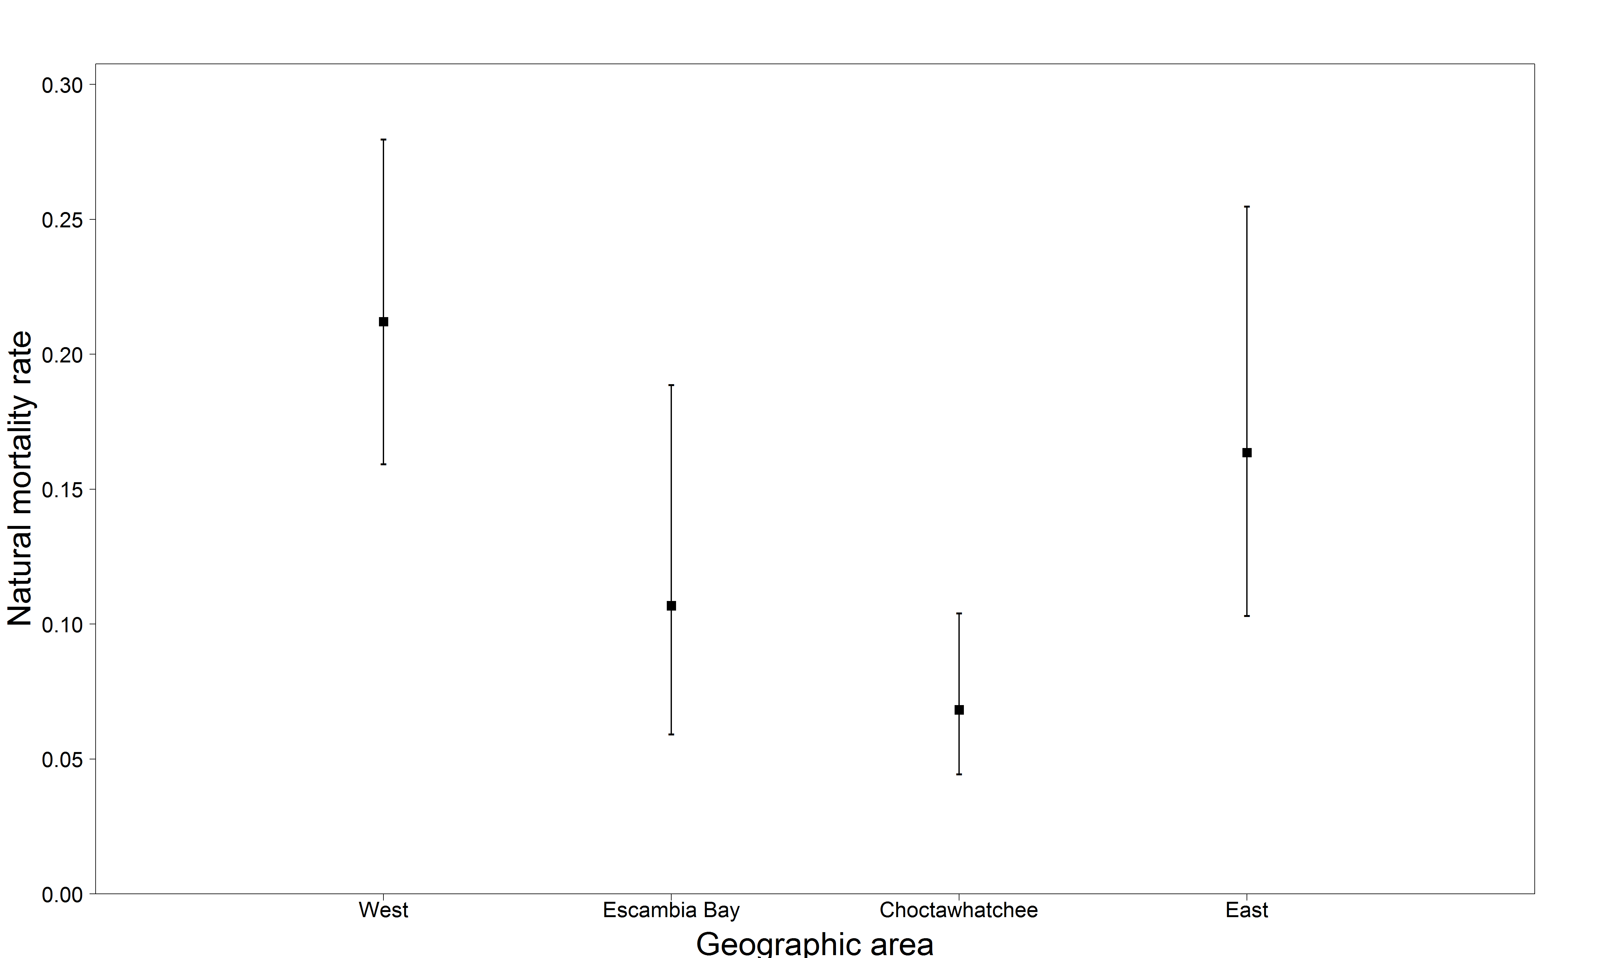
Juvenile natural mortality rate estimates by region
Natural mortality rate estimates are derived from estimates of survival
M = -log(S)

Slide 19
Juvenile natural mortality rate estimates by region
Region | Estimate | Standard error | Lower 95% CI | Upper 95% CI
West | 0.212 | 0.025 | 0.159 | 0.280
Escambia Bay | 0.107 | 0.028 | 0.059 | 0.189
Choctawhatchee | 0.068 | 0.014 | 0.044 | 0.104
East | 0.164 | 0.032 | 0.103 | 0.255

Slide 20
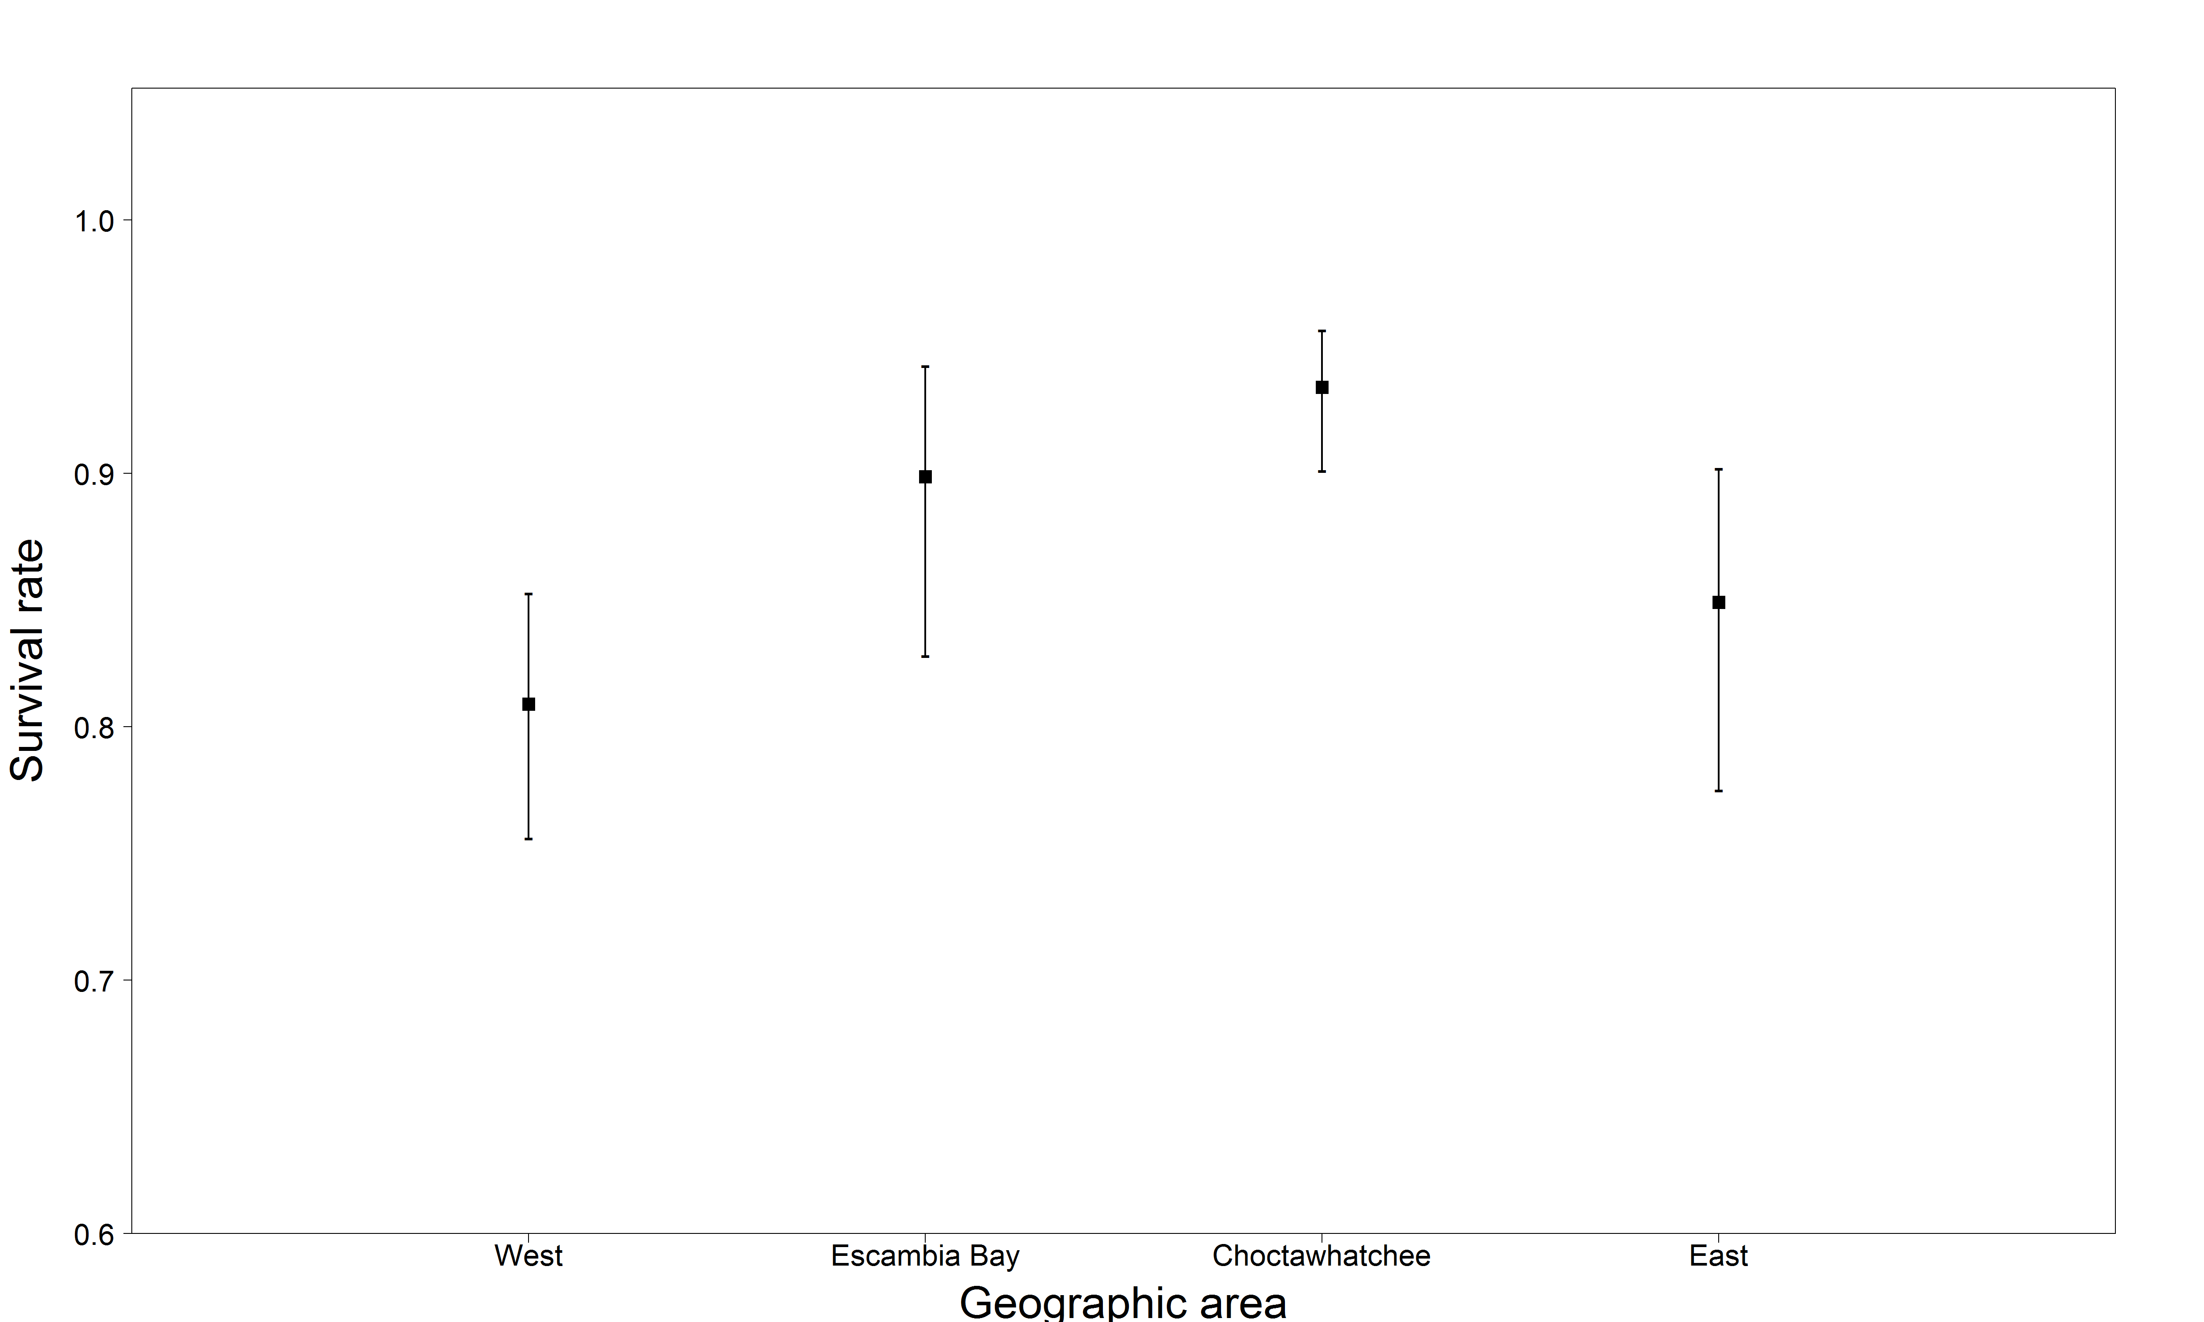
Juvenile survival rate estimates by region

Slide 21
Juvenile survival rate estimates by region
Region | Estimate | Standard error | Lower 95% CI | Upper 95% CI
West | 0.809 | 0.025 | 0.756 | 0.853
Escambia Bay | 0.899 | 0.028 | 0.828 | 0.942
Choctawhatchee | 0.934 | 0.014 | 0.901 | 0.957
East | 0.849 | 0.032 | 0.775 | 0.902

Slide 22
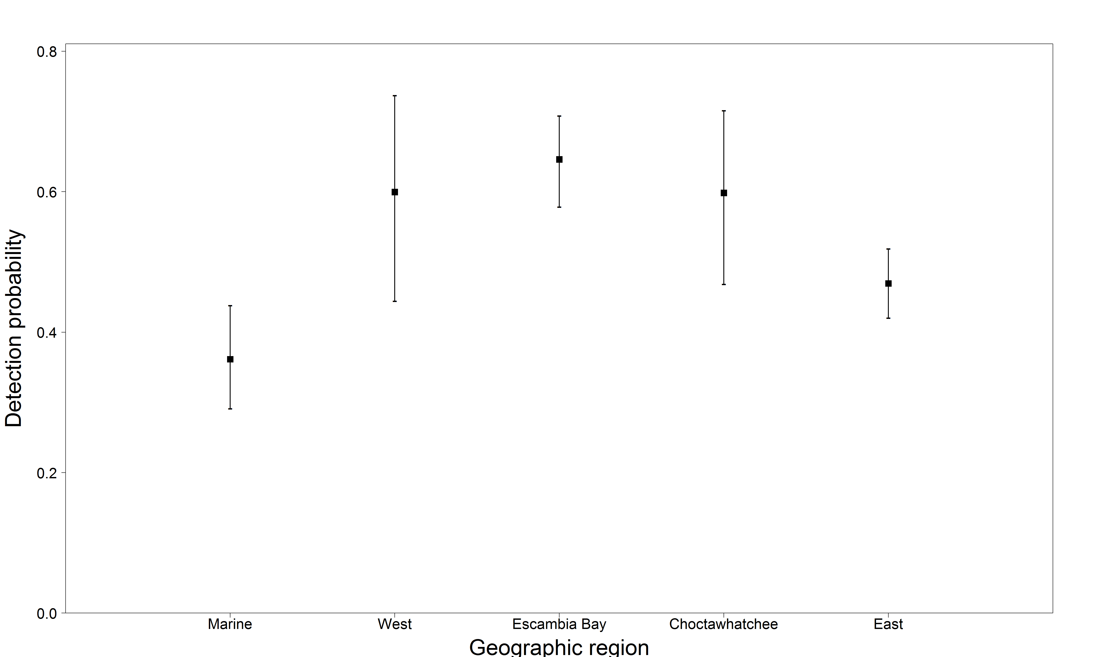
Juvenile detection probability estimates by region
(marine = leaving river)

Slide 23
Juvenile detection probability estimates by region
Region | Estimate | Standard error | Lower 95% CI | Upper 95% CI
West | 0.361 | 0.038 | 0.291 | 0.438
Escambia Bay | 0.599 | 0.077 | 0.444 | 0.737
Choctawhatchee | 0.646 | 0.033 | 0.578 | 0.708
East | 0.598 | 0.064 | 0.468 | 0.715
Marine (leaving river) | 0.469 | 0.025 | 0.420 | 0.519

Slide 24
Juvenile transition probability estimates by region
 |  | FROM
TO |  | West | Escambia Bay | Choctawhatchee | East
 | West | 1 | 1e-26 | 2.8e-40 | 1.7e-32
 | Escambia Bay | 3.2e-7 | 0.788 | 0.212 | 4.6e-28
 | Choctawhatchee | 0 | 0.036 | 0.964 | 1.1e-29
 | East | 1e-14 | 2.3e-28 | 5.8e-30 | 1

Slide 25
Survival and detection rates for all tagged fish, movement rates given tagging location

Slide 26
Overall survival and detection probabilities
Parameter | Estimate | Standard error | Lower 95% CI | Upper 95% CI
Survival | 0.874 | 0.012 | 0.849 | 0.895
Mortality | 0.135 | 0.012 | 0.111 | 0.163
Detection | 0.517 | 0.018 | 0.481 | 0.553
Natural mortality rate estimates are derived from estimates of survival
M = -log(S)

Slide 27
Transition probability estimates by region
 |  | FROM
TO |  | West | Escambia Bay | Choctawhatchee | East
 | West | 1 | 2.2e-24 | 4.1e-15 | 7.1e-21
 | Escambia Bay | 8.1e-15 | 0.776 | 0.224 | 3.6e-16
 | Choctawhatchee | 0 | 0.034 | 0.966 | 3.4e-22
 | East | 7.9e-12 | 1.5e-29 | 1.0e-7 | 0.999

Slide 28
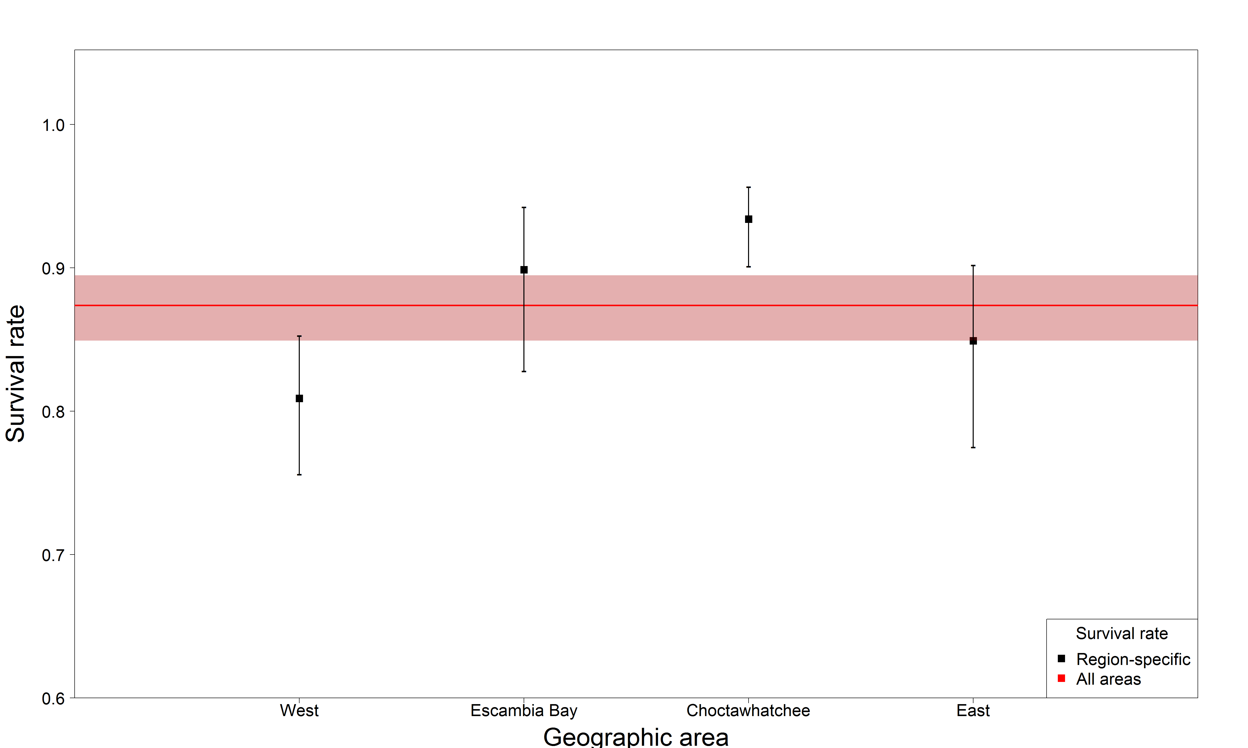
Juvenile survival rate estimate compared to region-specific

Slide 29
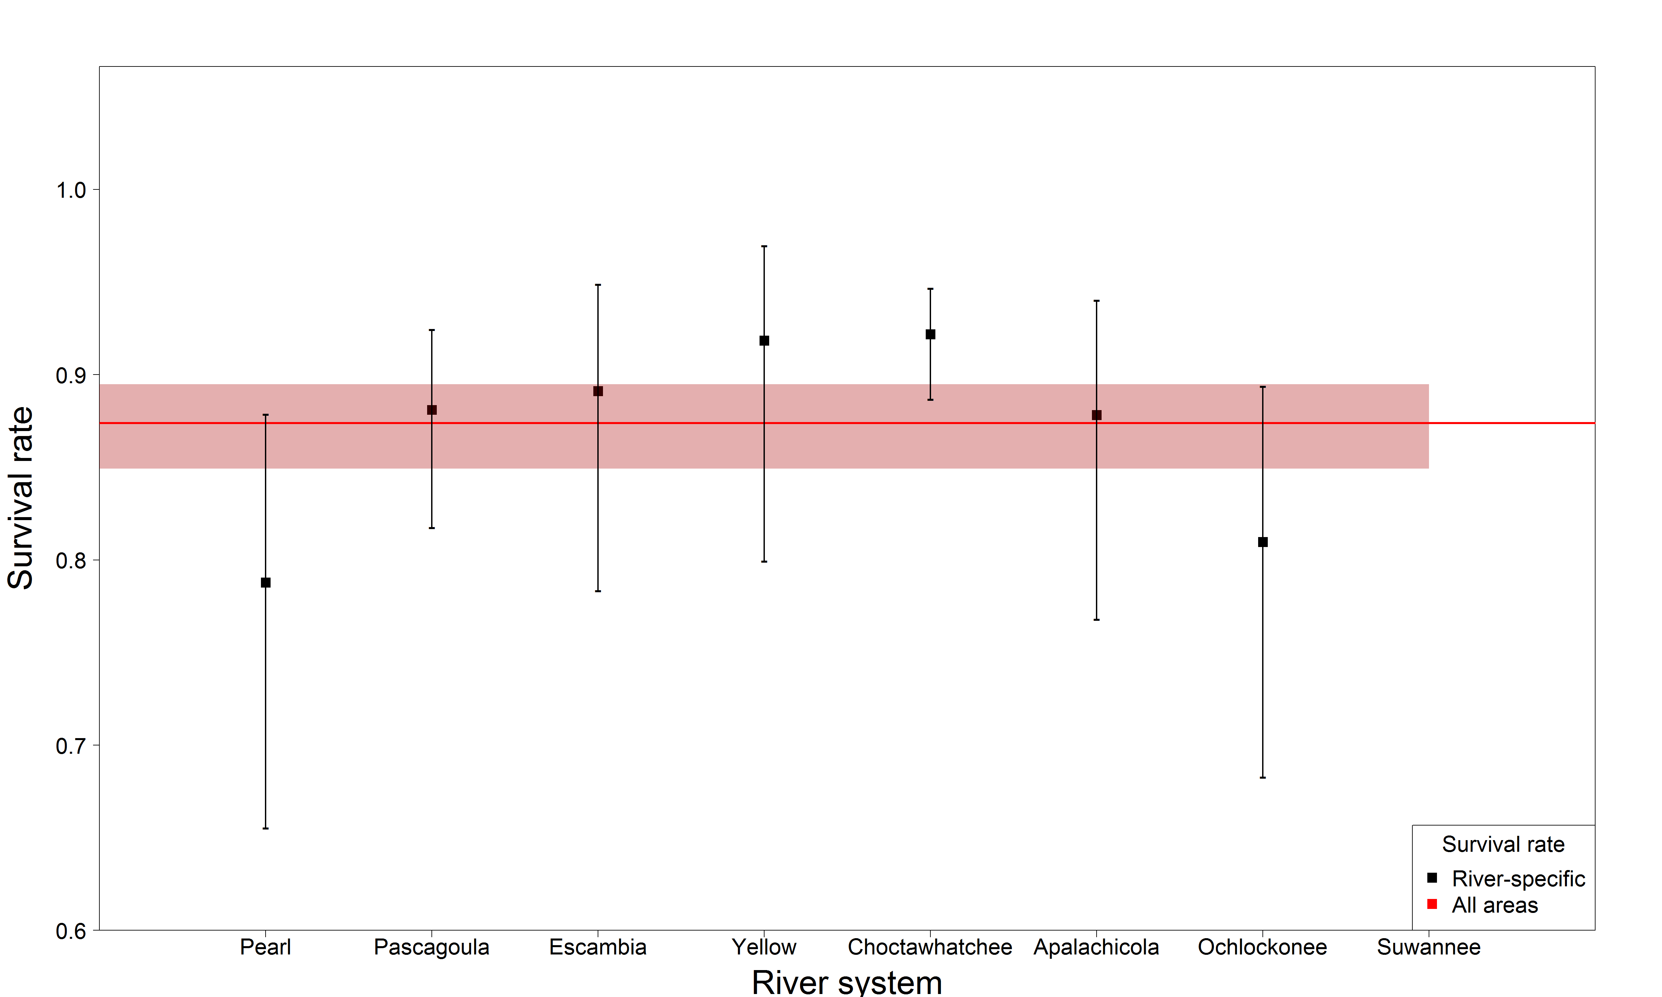
Juvenile survival rate estimate compared to river-specific

Slide 30
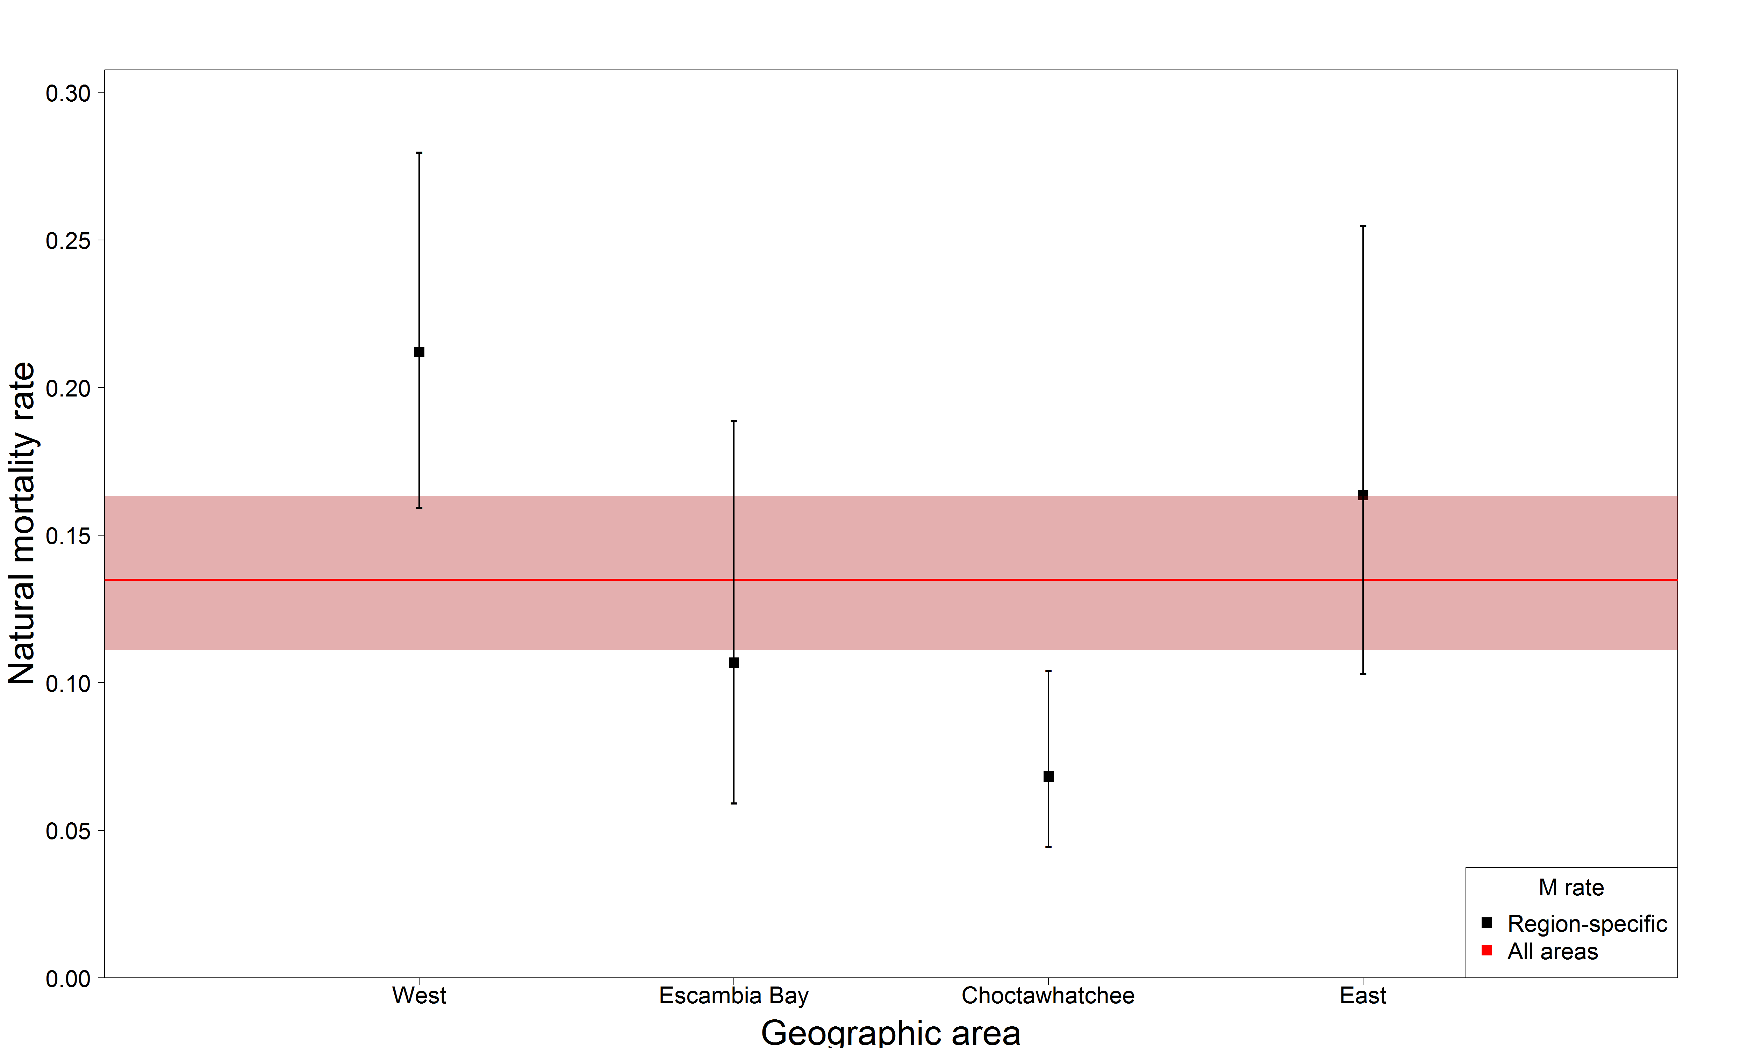
Juvenile natural mortality rate estimate compared to region-specific

Slide 31
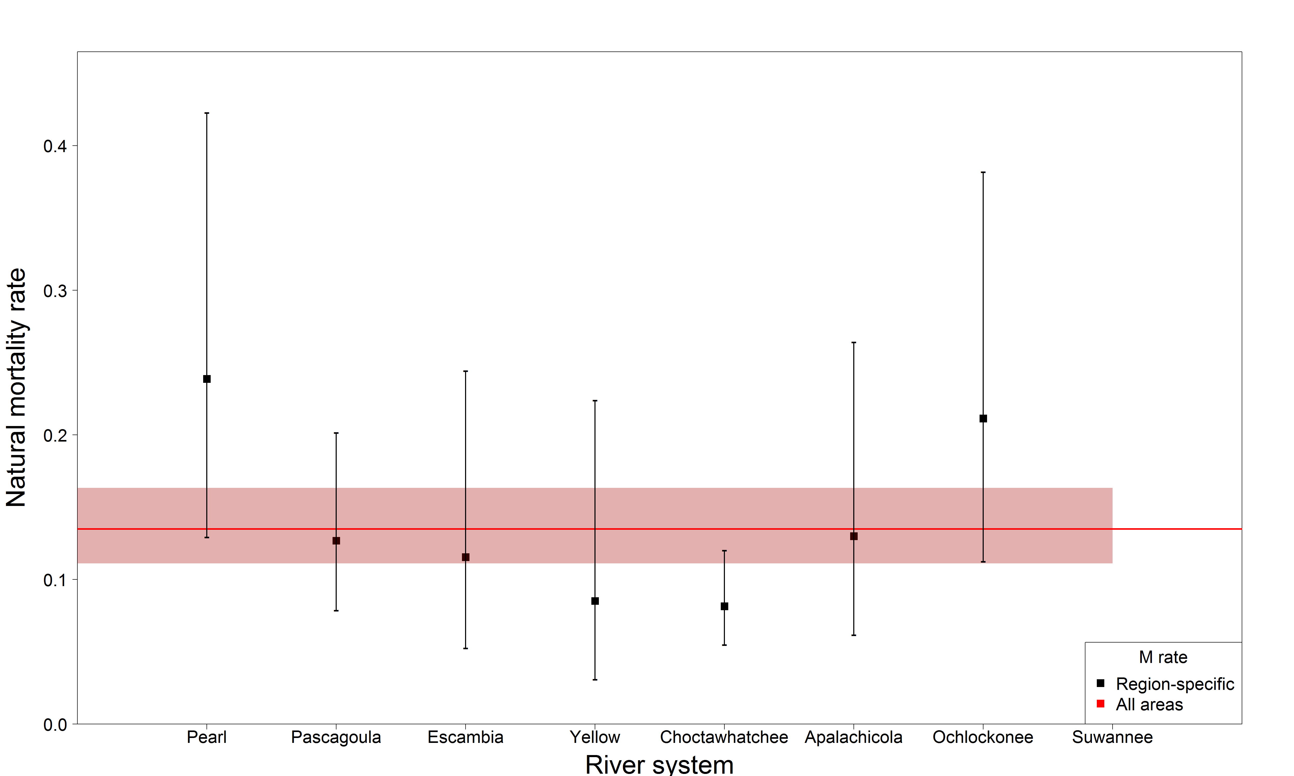
Juvenile natural mortality rate estimate compared to river-specific

Slide 32
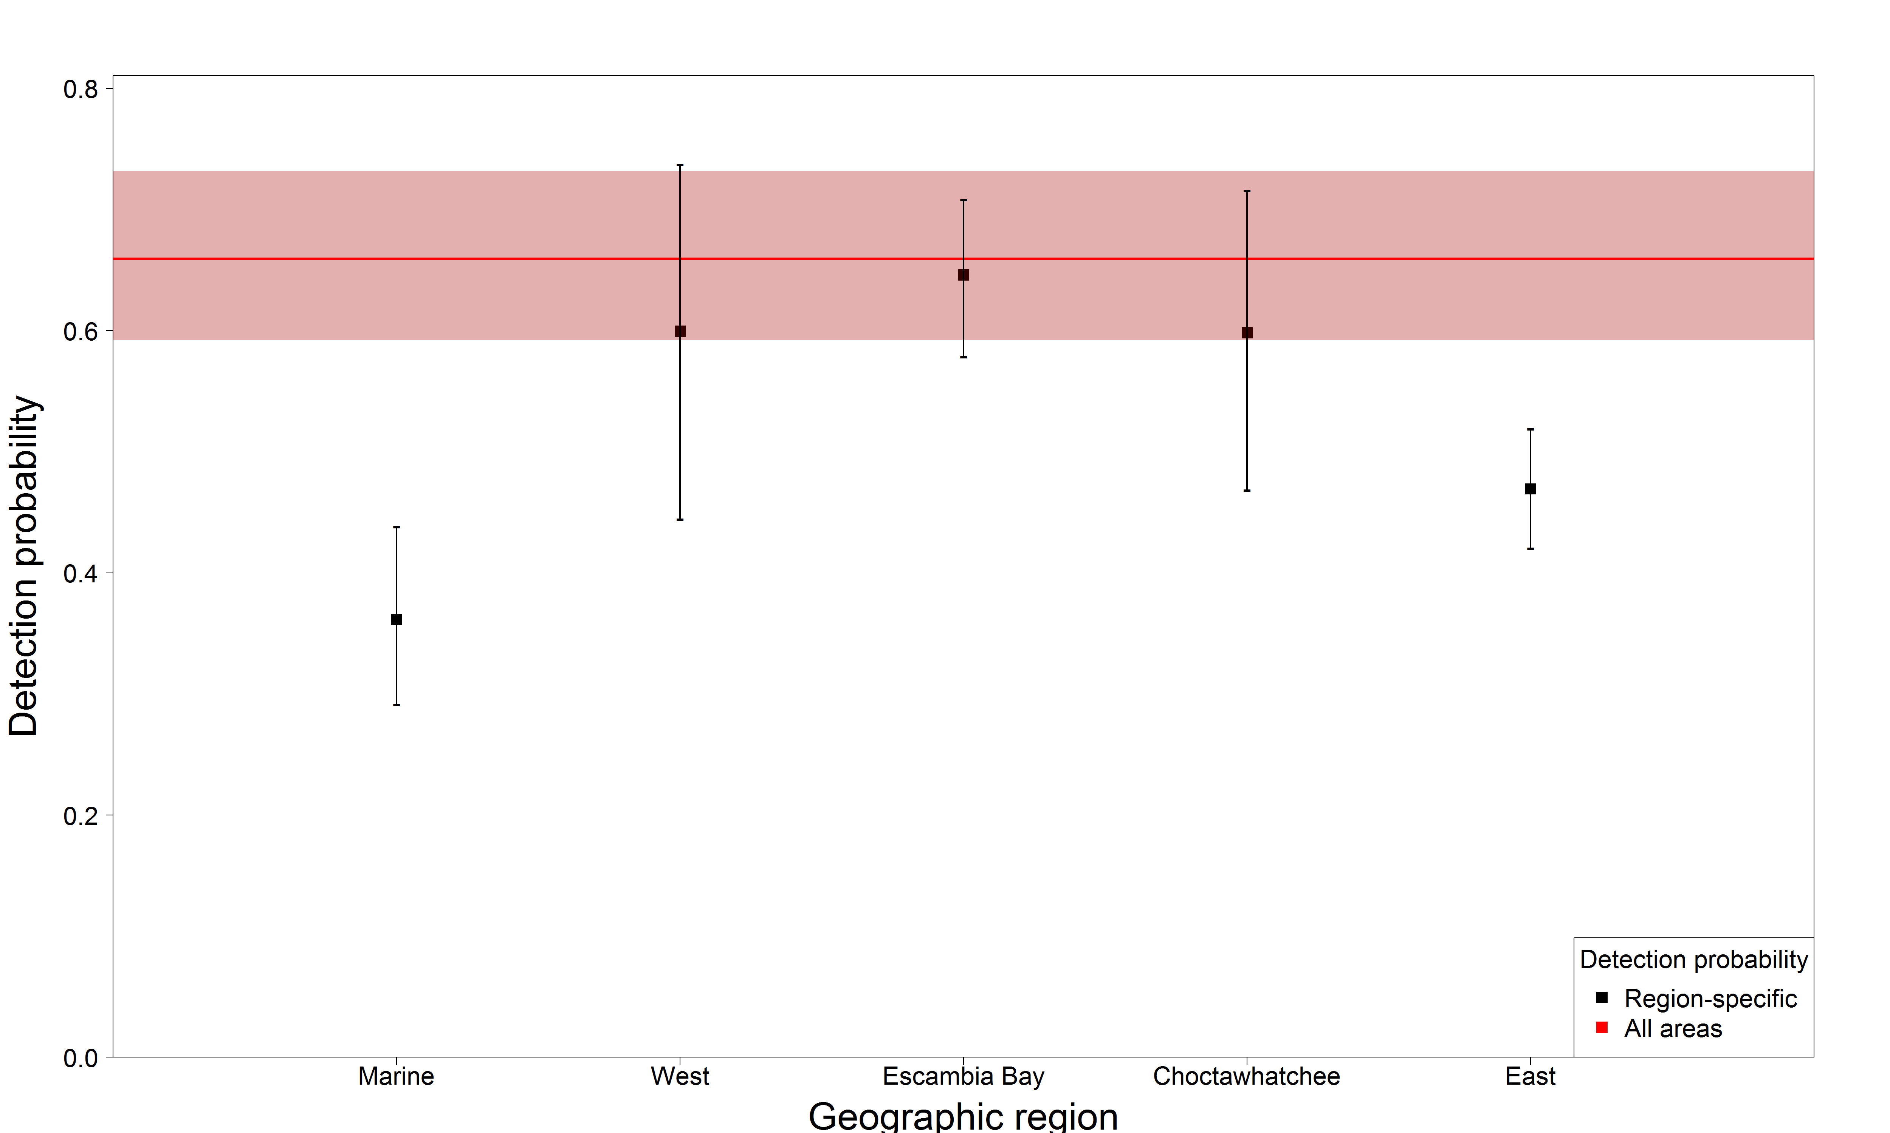
Juvenile detection probability estimate compared to region-specific

Slide 33
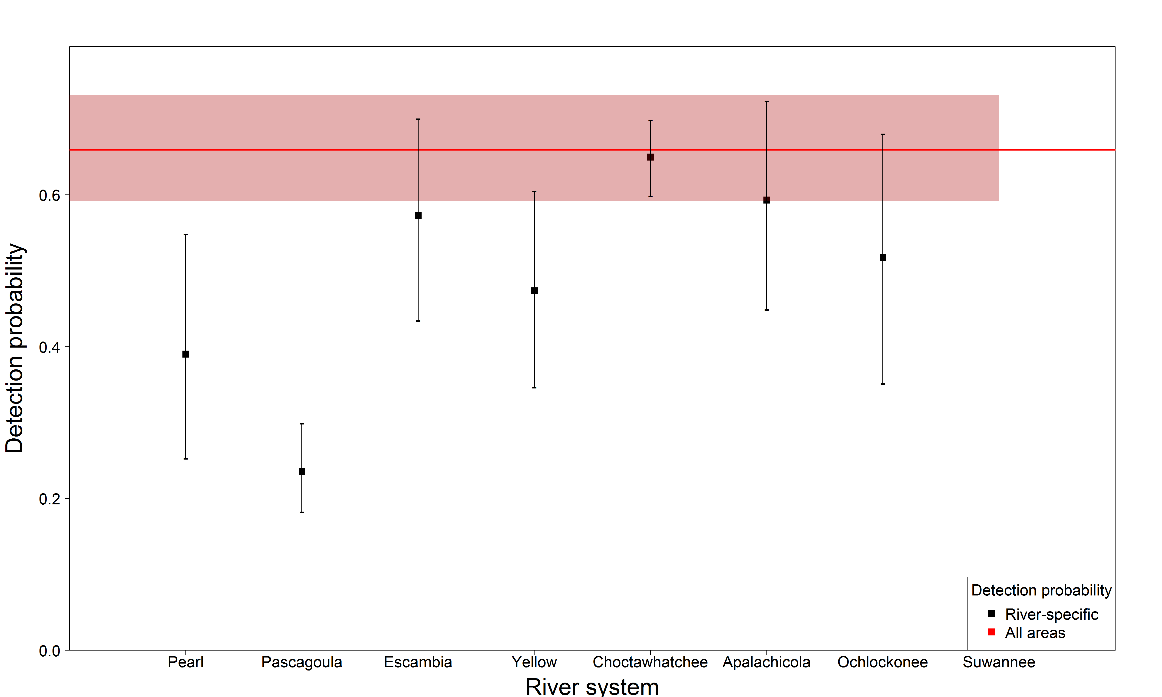
Juvenile detection probability estimate compared to river-specific

