Slide 1
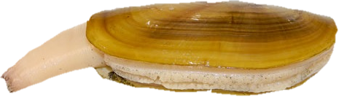
Values used in model
Transitions
*Staying pre-recruit
T_{PP} = 0.05
*Pre-recruit to recruit
T_{PR} = 0.95
Survival
*Pre-recruits
S_{P} = 0.11
*Recruits
S_{R} = 0.70
*Eggs
S_{E} = 0.000056
◊Harvest rate
H = 0.3
Reproduction
◊Proportion female
P_{F} = 0.5
◊Number of Eggs
E = 300,000
Produce eggs that survive to be pre-recruits
Expected number: P_{F}ES_{E}
Survive pre-recruit stage and transition to recruit stage
Probability: S_{p}T_{PR}
Pre-recruits
Recruits
Survive pre-recruit stage and stay pre-recruit
Probability: S_{p}T_{PP}
Survive as a recruit
Probability: S_{R}(1-H)

Slide 2
Transitions
Staying pre-recruit◊
T_{PP} = 0.05
Pre-recruit to recruit◊
T_{PR} = 0.95
Survival
Pre-recruits (Nickerson 1975)
S_{P} = 0.089
Recruits (Nickerson 1975)
S_{R} = 0.40
Eggs*
S_{E} = 2.9e-6
Harvest rate (WDFW)
H = 0.3
Years as adult◊
y = 3
Reproduction
Proportion female◊
P_{F} = 0.5
Fecundity (McMillin 1925)
E = 8e6
Density dependence
Shape parameter*
D = -1.19
Number of recruits
R = calculated
Beach capacity
C = 1
Produce eggs that survive to be pre-recruits
Expected number: P_{F}ES_{E}
Survive pre-recruit stage and transition to recruit stage
Probability: S_{p}T_{PR}
Pre-recruits
Recruits
Survive pre-recruit stage and stay pre-recruit
Probability: S_{p}T_{PP}
Survive as a recruit
Probability: (S_{R}(1-H) ^{y-1})/(1-S_{R}(1-H)) ^{DR/C}
* Tuned to obtain reasonable dynamics.
◊ Based on communication with razor clam scientists and managers.

Slide 3
Pre-recruits
Recruits
Recruits
Pre-recruits
Pre-recruits
Recruits

Slide 4
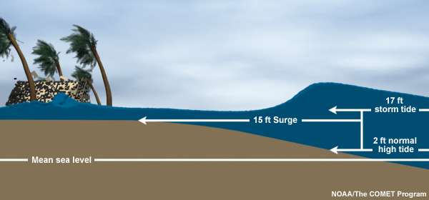
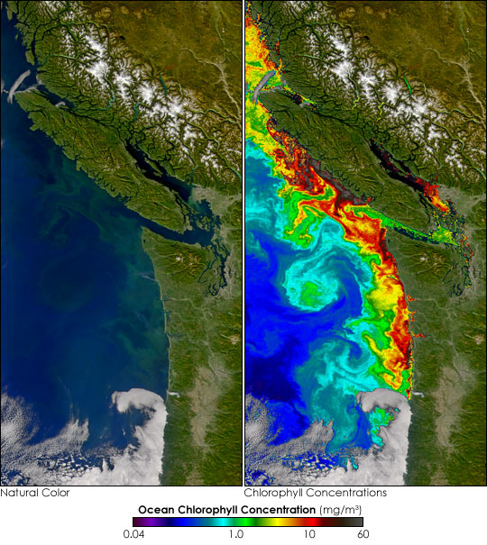
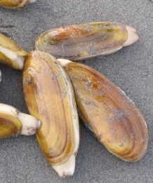

Slide 5
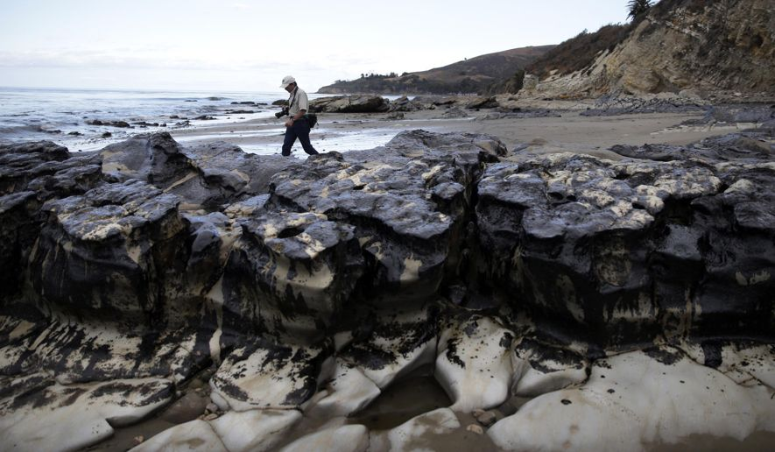

Slide 6
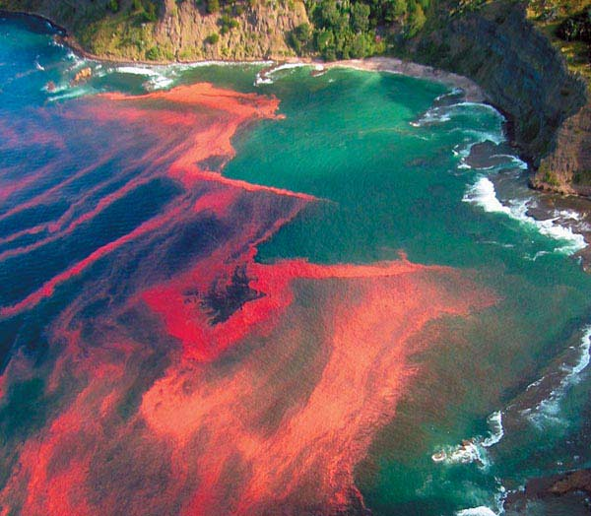

Slide 7
