Slide 1
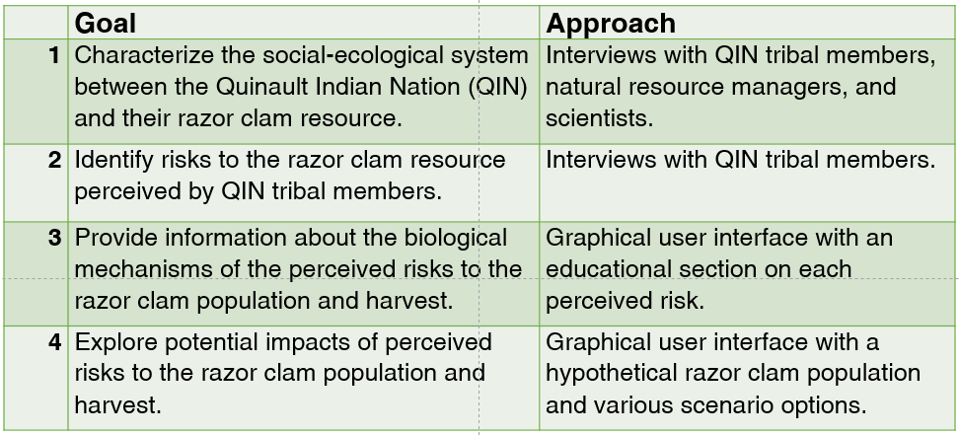
 | Goal | Approach
1 | Characterize the social-ecological system between the Quinault Indian Nation (QIN) and their razor clam resource. | Interviews with QIN tribal members, natural resource managers, and scientists.
2 | Identify risks to the razor clam resource perceived by QIN tribal members. | Interviews with QIN tribal members.
3 | Provide information about the biological mechanisms of the perceived risks to the razor clam population and harvest. | Graphical user interface with an educational section on each perceived risk.
4 | Explore potential impacts of perceived risks to the razor clam population and harvest. | Graphical user interface with a hypothetical razor clam population and various scenario options.

