Slide 1
Merritt Burch
Lab Meeting
2019-07-10

Slide 2
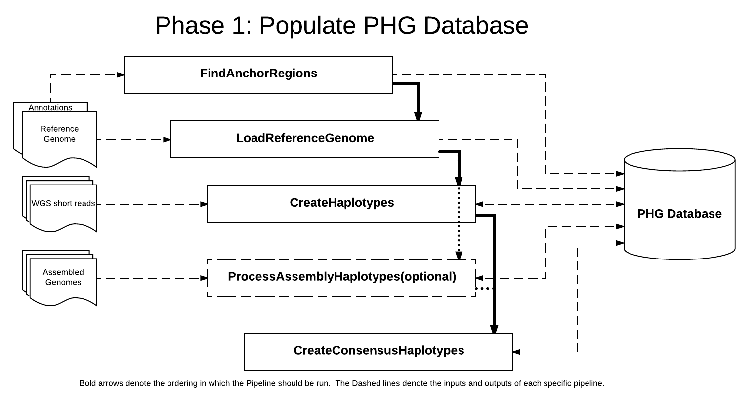
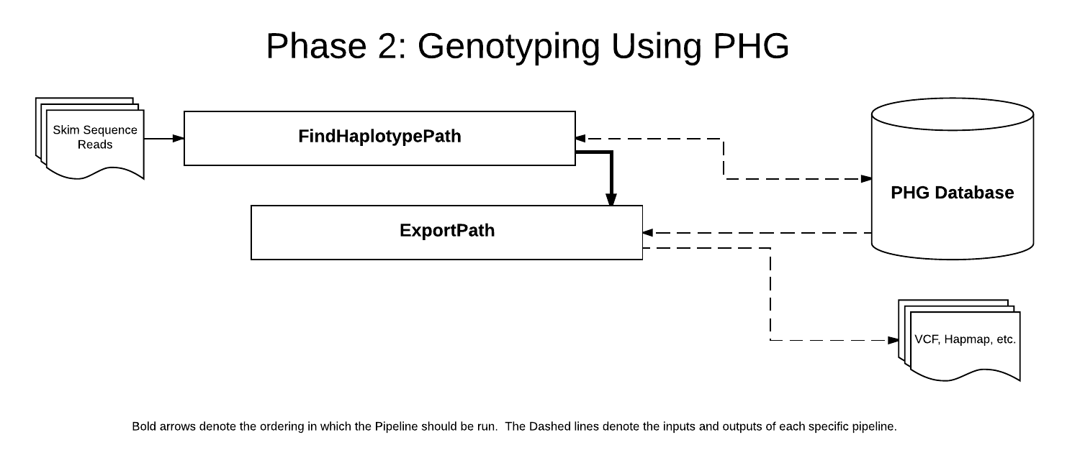
Ran PHG Pipeline
Populated database and genotyped test data

Slide 3
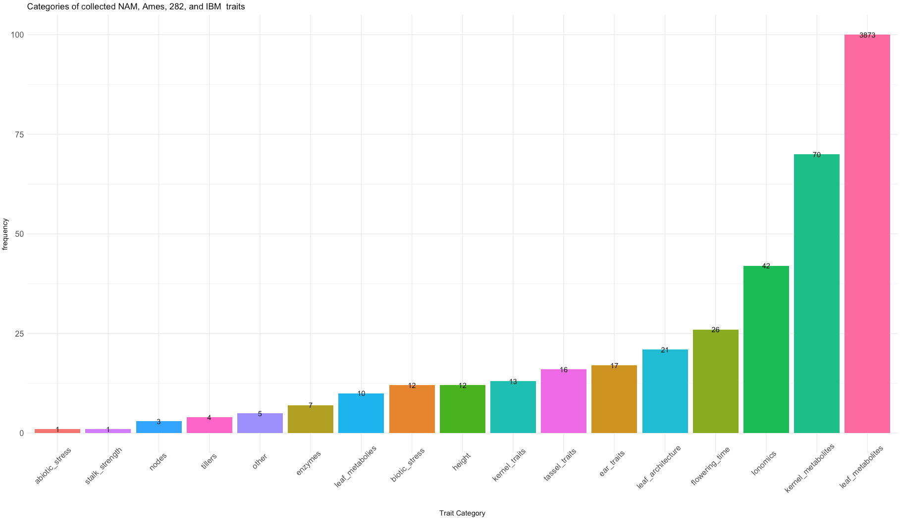
Phenotype collection

