Slide 1
SNP-GWAS/Haplotype-GWAS in Maize
Merritt Burch
Buckler Lab Presentation
2019-06-06

Slide 2
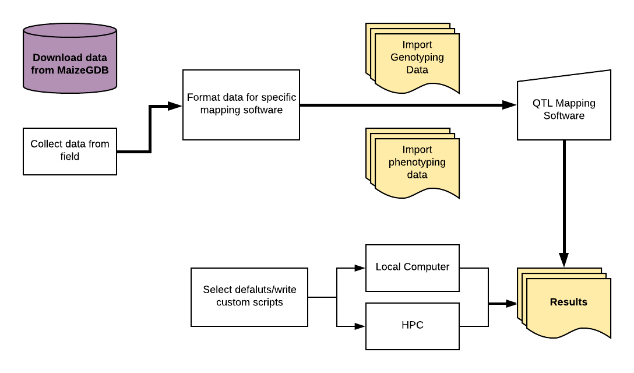
R-Shiny (or similar) based web-based GWAS tool
IBM, Ames, 282, NAM
Panzea/Cyverse
Compare results with past GWAS experiments

Slide 3
Maize-GWAS mapping tool
R/Shiny (or similar) web-based mapping interface
Perform SNP-GWAS and test haplotype-GWAS using PHG
  Collect phenotypes from past experiments
Hypotheses
Haplotype GWAS will still produce similar significant loci/haplotypes associated with traits as compared to the 80M SNP-GWAS but:
  “New” haplotypes will be uncovered as being associated with complex phenotypes that previously in SNP-GWAS, were masked due to: surrounding SNP effects (synthetic associations, rare-alleles, etc)
  Significant haplotypes will be highly conserved as inferred by GERP
  Haplotypes will be associated with changes in expression as inferred from 282 expression data, NAM parents, and B73 data

Slide 4
Collecting past phenotypes
QTL/GWAS data for IBM, NAM, 282, and Ames populations spanning 30+ years
Prior data collection efforts: MaizeGDB, Wallace 2014, Hung 2011, Panzea/Cinta
Currently have: 5481 individuals, ~<60 phenotypes
Phenos: flowering time, chlorophyll a&b, leaf length, glucose, metabolites, total AA, total protein, disease resistance

Slide 5
Ongoing questions
Should we collect data on other populations?
  Landrace and teosinte common garden (n=4000 teos; n=4000 LRs)
  Zea synthetics & DHs (n=1000s)
  European and Chinese NAM (n=?)
  Magic population, NAM and Ames hybrids, Genomes to Fields data?
How far back should we go?
  IBM phenotypes date back to 1990’s

