Slide 1
Merritt Burch
Lab Meeting Presentation
2019-07-25

Slide 2
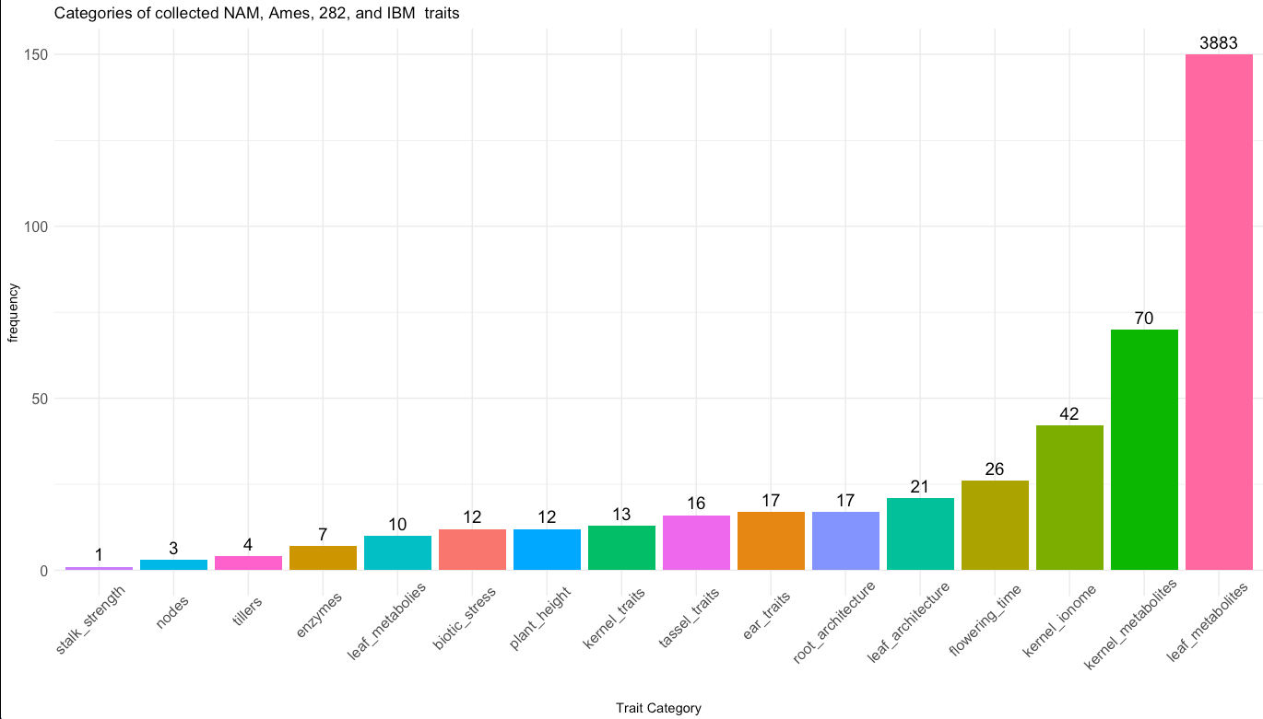
(Still) merging phenotypes
Population | N | # Phenotypes
NAM | 5182 | 463
282 Association Panel | 282 | 4301
Ames Diversity Panel | 2648 | 22
IBM | 302 | TBD

Slide 3
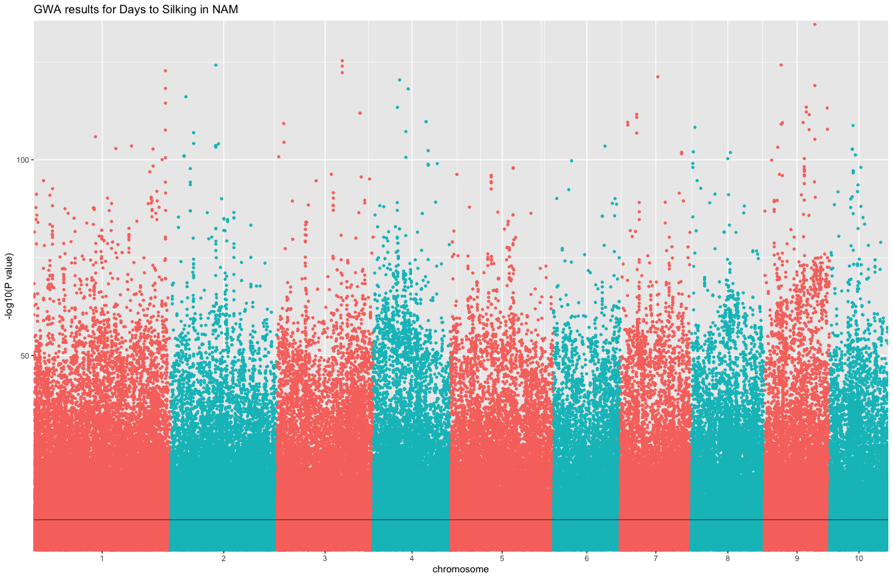
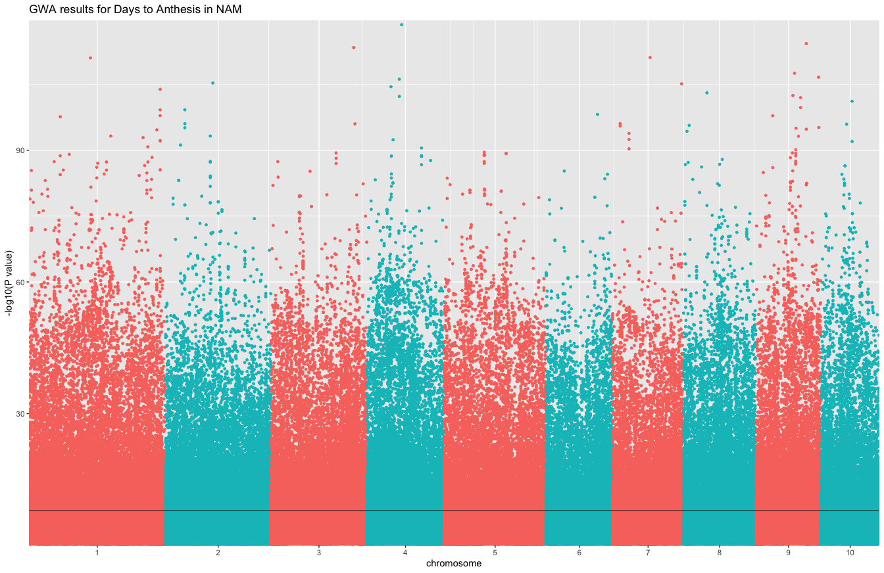
GLM on NAM flowering time traits
Site Min Count = 2000
Min Allele Freq = 0.02
Class Size = 10
MDS PCs = 5
Taxa = 4763
Sites = 441,264
Too much population structure still!
Testing with family as a covariate (no PCs)

Slide 4
GLM on NAM flowering time traits
Modifying parameters - rerunning
Site Min Count = 2000
Min Allele Freq = 0.01
Class Size = 10
MDS PCs = 5
Families as factors
Taxa = 4763
Sites = 441,264
Too much population structure still!
Testing with family as a covariate (no PCs)

